Slide 1
Branch and Bound
Huỳnh Phạm Đức Lâm Nguyễn Trường Thịnh

Slide 2


Backtracking
Evaluate promising node in state-space tree until solution.

Slide 3
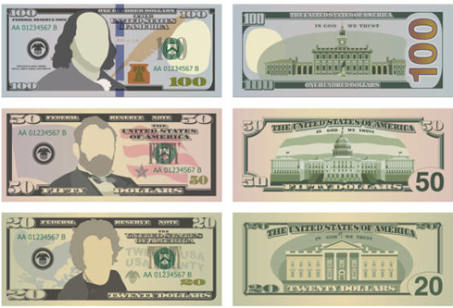
Optimization Problem
To maximize (minimize) objective functions.
10 money bills on table
Choose 4 random bills.
Maximize your earning?

Slide 4
Backtracking
downside
Evaluate the whole tree
01.
Because backtracking only find feasible, not optimal solution
Next step is not guarantee optimal
02.
Traverse the tree by depth-first (DFS)

Slide 5
Branch and bound
Requires:
A bound on objective function when extending current node
Best solution so far

Slide 6
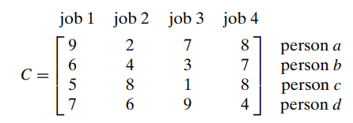
Assignment Problem
Permutation of N elements.
Choose n element in matrix C sum up the smallest with no 2 elements being in the same row or column.
Lower bound: Sum of each person’s minimum. (row minimum)
Bound = 10
What is the lower bound if person 1 choose job 1?
17

Slide 7
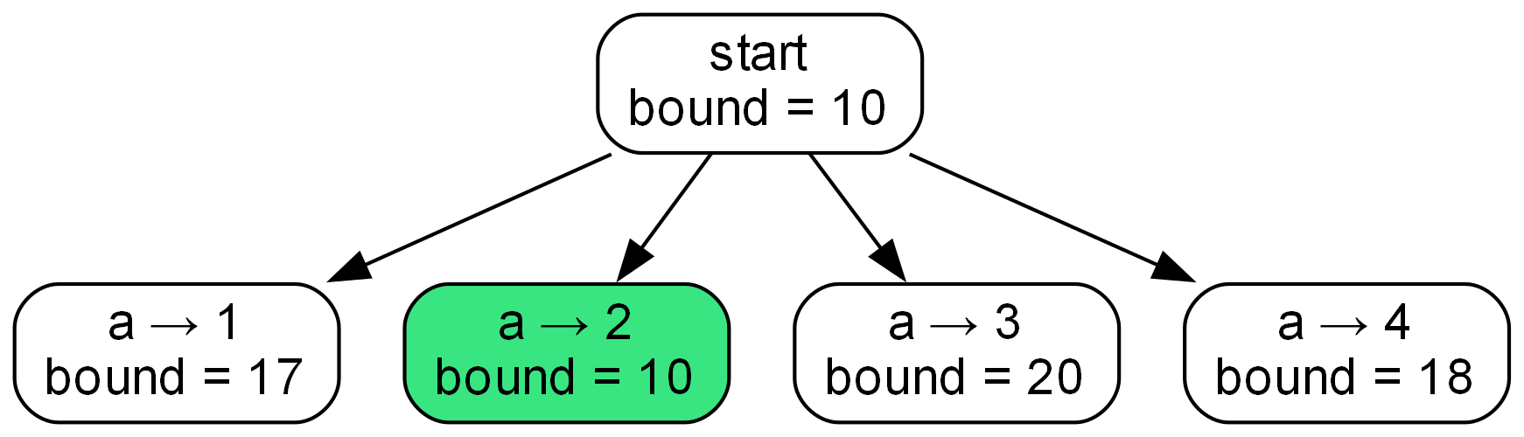
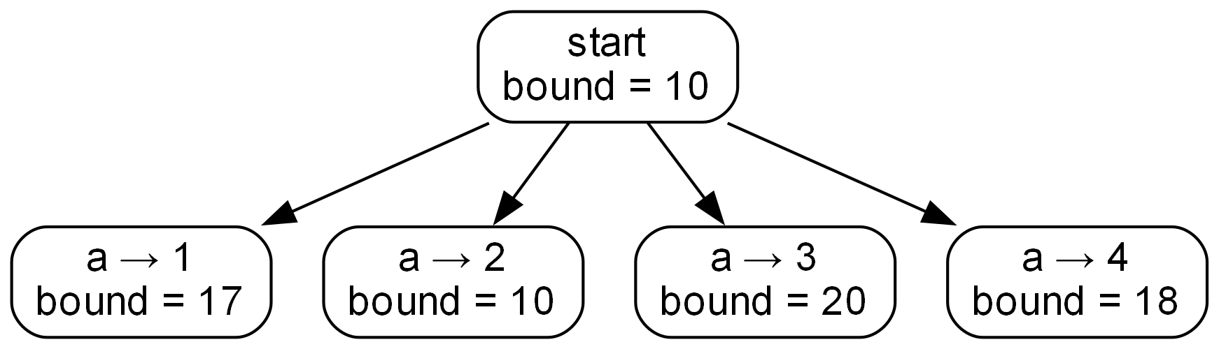
Best-first branch-and-bound

Slide 8
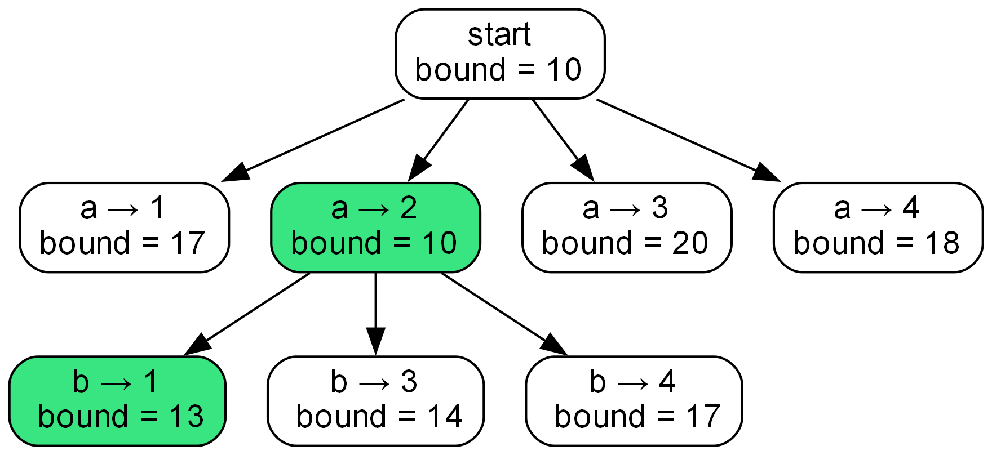

Slide 9
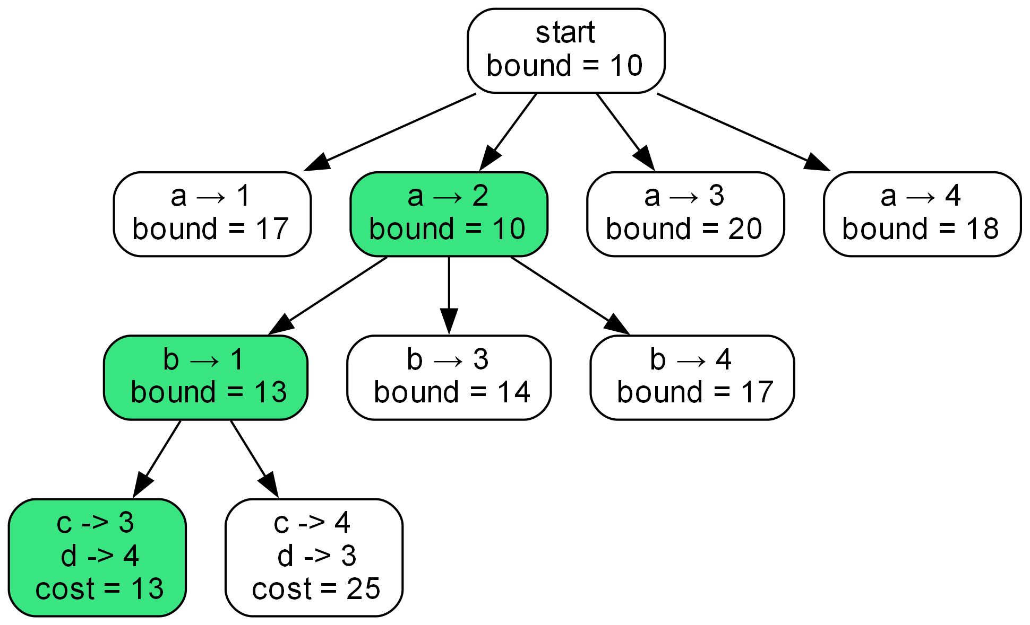

Slide 10
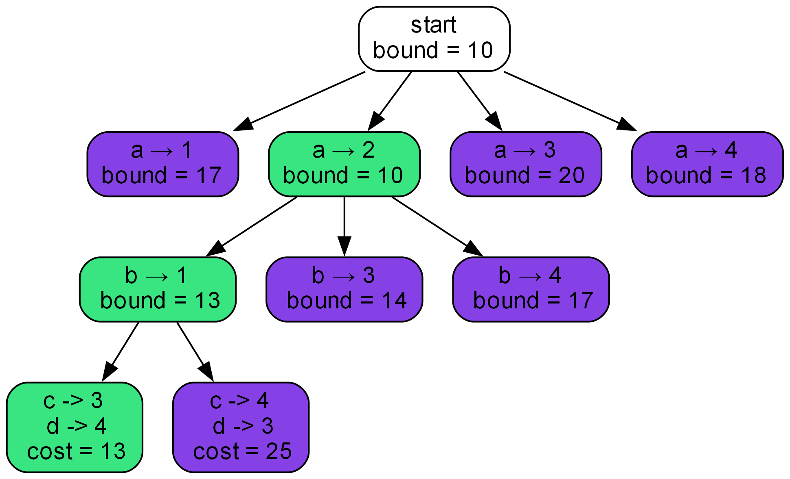

Slide 11
Complexity
Time
Auxiliary
O(2^{n-1})
O(2^{n-1}) for tree
O(n) for min

Slide 12
Exercises
What is the state-space tree when the lower bound is the sum of each job’s minimum? (column minimum)
Bound of start node: 5+2+1+4 = 12

Slide 13


Slide 14
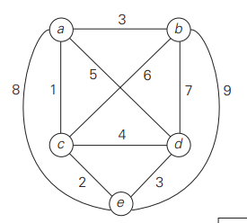
Travelling salesman problem
Find the shortest Hamilton circuit in the graph.
Lower bound: Smallest distance times n.
Any stricter bound?

Slide 15
Travelling salesman problem
We have to come in and come out from a city
So the lower bound is the average of 2 smallest edge across n cities.
Lower bound: [1+3] + [3+6] + [1+2] + [3+4] + [2+3] = 28/2 = 14
The tour include (a,d)? LB = [1+5] + [3+6] + [1+2] + [2+5] + [2+3] = 32/2 = 16

Slide 16
Complexity
Time
Auxiliary
O(2^{n-1})
O(2^{n-1}) for tree
O(n) for min edges

Slide 17
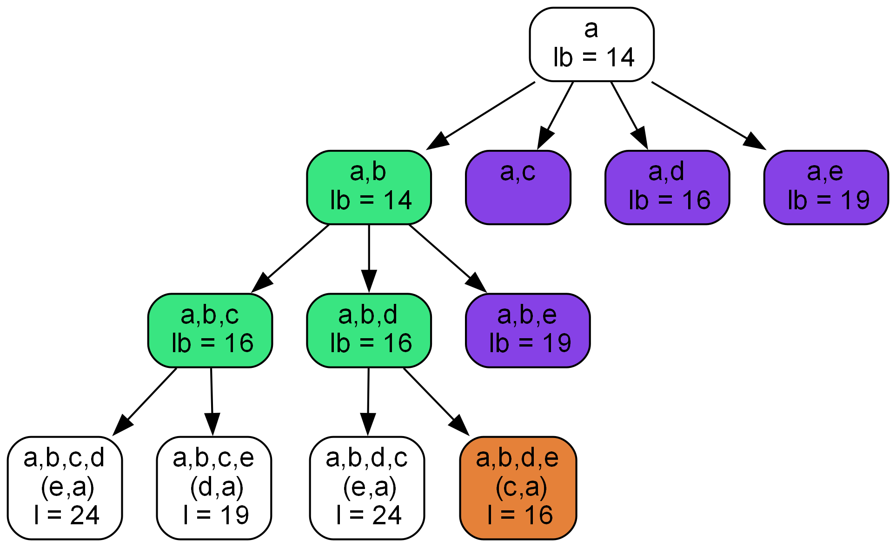

Slide 18
Linear programming
Who thought linear=easy?

Slide 19
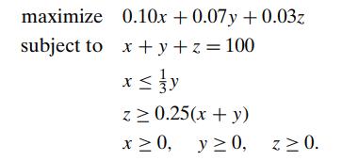
Linear programming
Invest $100m on stocks(10%), bonds(7%) and cash(3%). Stocks are risky so less than 1/3 bonds. 25% sum(stocks, bonds) must be converted in cash.
Let x, y, z be the amount invested in stocks, bonds and cash.
Simplex Method (George Dantzig) [Section 10.1, Page 346]

Slide 20
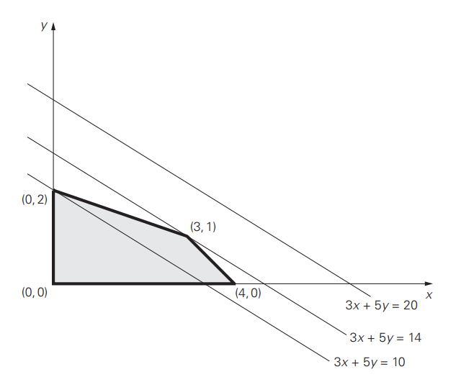
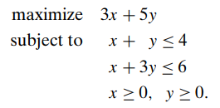
Linear programming
Extreme point theorem: Optimal solution can be found on extreme point on the feasible region

Slide 21
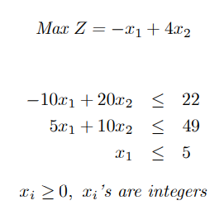
Integer linear programming
No known polynomial-time algorithm.
Branch and bound method.

Slide 22
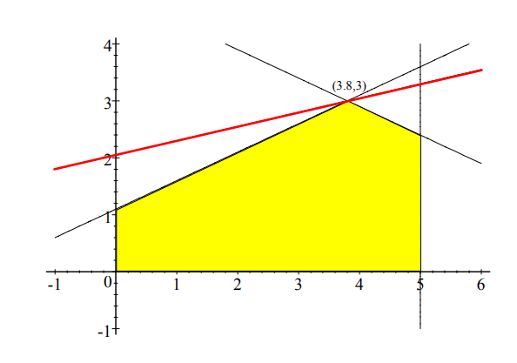
Integer linear programming
Optimal solution in (3.8, 3)

Slide 23
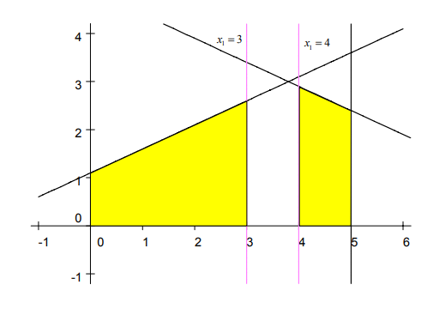
Integer linear programming
Divide into 2 region: x₁≥4 and x₁≤3

Slide 24
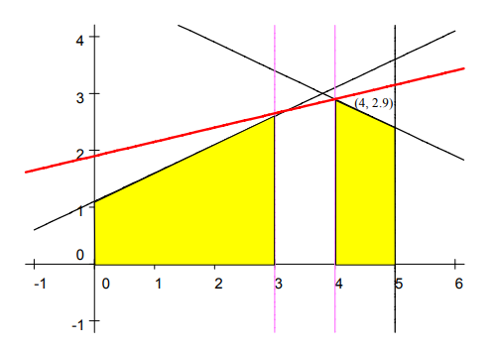
Integer linear programming
x₁≥4
x₂≥3 is not feasible, consider x₂≤2

Slide 25
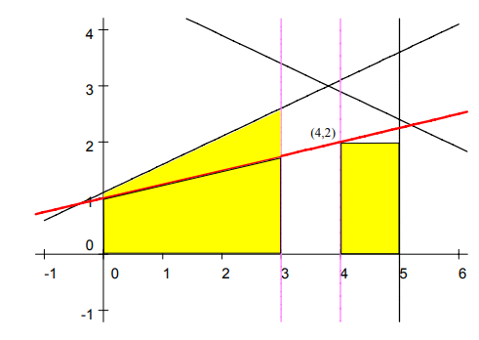
Integer linear programming
x₁≥4, x₂≤2
Optimal solution at (4,2): Z=4. Stop

Slide 26
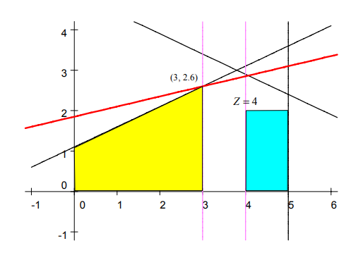
Integer linear programming
x₁≤3

Slide 27
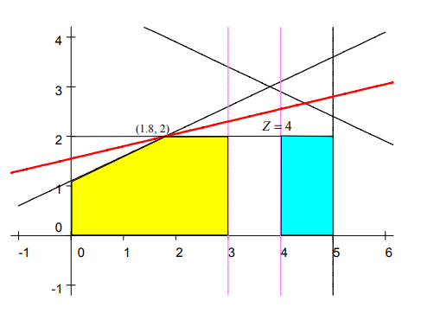
Integer linear programming
x₁≤3, x₂≤2

Slide 28
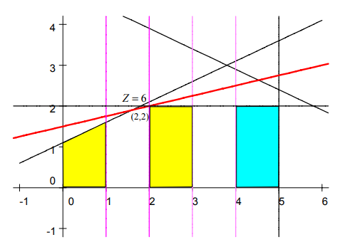
Integer linear programming
2≤x₁≤3, x₂≤2

Slide 29
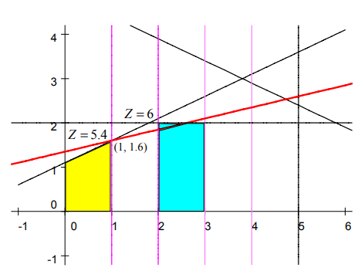
Integer linear programming
x₁≤2, x₂≤2

Slide 30
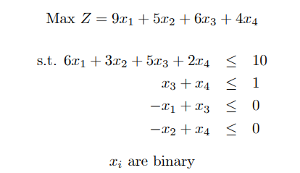
Integer linear programming
Example 2

Slide 31
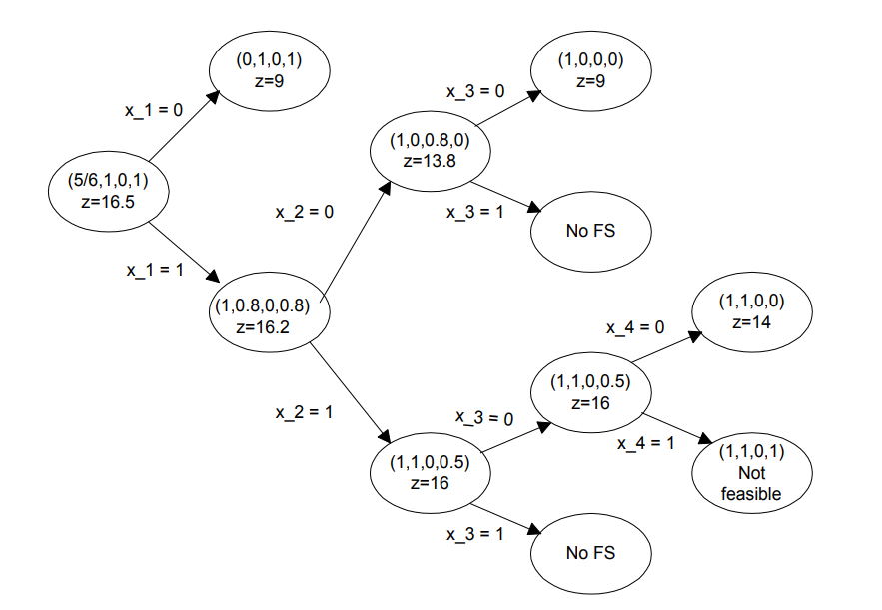
Integer linear programming

Slide 32
Integer linear programming
Pruning subproblem:
Has optimal solution z < z* (z* is the current best solution).
No feasible solution.
Optimal solution with integer value.
https://www.ie.bilkent.edu.tr/~mustafap/courses/bb.pdf

Slide 33
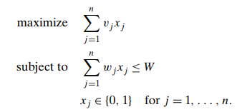

Knapsack problem
Given n items of weights w₁, w₂, …, w_{n} and values v₁, v₂, …, v_{n} and a knapsack capacity W.
Find the most valuable subset of items fitting in W.

Slide 34
Any question?

Slide 35
Thanks for listening

