Slide 1
Window 7 Memory Forensics

Slide 2
Windows Volatile Memory (RAM)

Slide 3
storage media vs RAM
RAM stores information
running process, incognito browsing sessions, clipboard data , information stored in plain text files and much more.
Essential for malware analysis
running process information, services, system service behavior, registry updates, network traffic
Other artifacts
browsing sessions (Incognito Sessions) , passwords, accessed files and multimedia, Chats/Running Application stored data

Slide 4
Pre- Acquisition Process
Host machine should not be connected to any external network
Disconnect LAN/WIFI/Bluetooth connections by putting the device in airplane mode
Ensure the device is unlocked without installing any password bypassing module
Remove any external connected devices
Host machine should be connected to a stable power source

Slide 5
steps for acquisition
Determine the state of the machine
Identify the operating system
Check for authentic device access
Insert acquisition media
Perform Volatile Memory Dump
Collect SWAP, PAGEFILE.sys and system protected files
Hash and verify the acquired files
Create Investigator copies

Slide 6
Memory acquisition

Slide 7
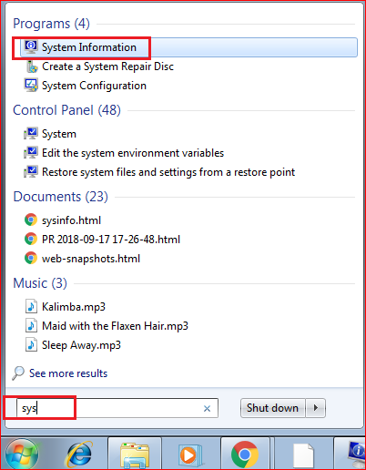
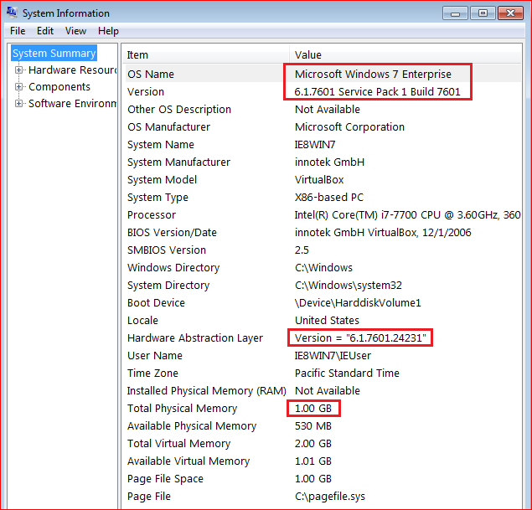
VM Windows 7 SP 1 system information

Slide 8
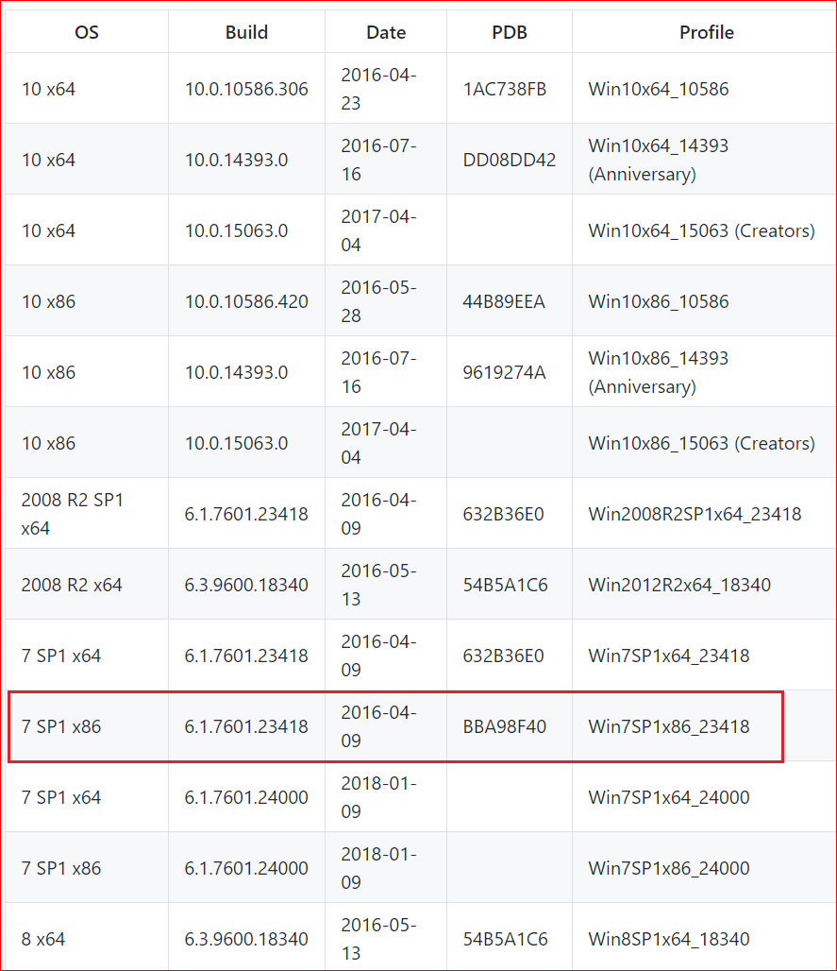
Win Profiles supported by software

Slide 9
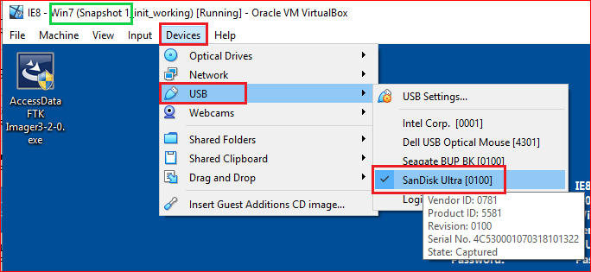
Prepare a USB to save memory information

Slide 10
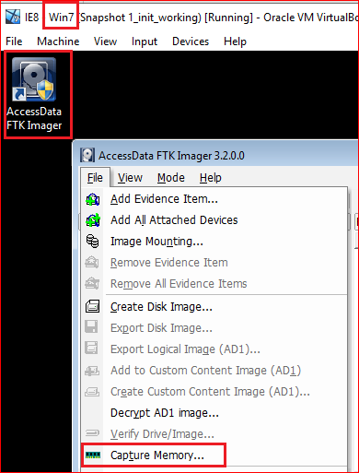
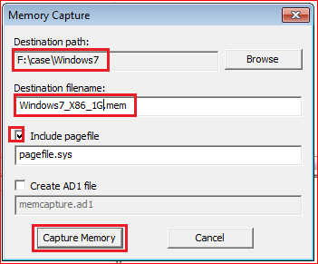

Slide 11
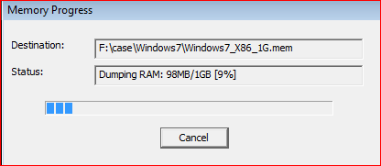
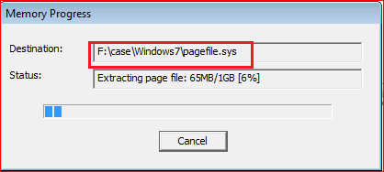
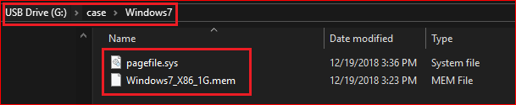

Slide 12
Move captured memory from a USB to Kali

Slide 13
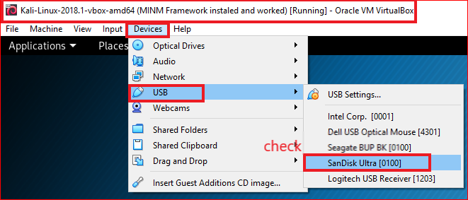

Slide 14
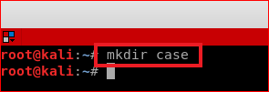
Prepare a working directory in Kali

Slide 15
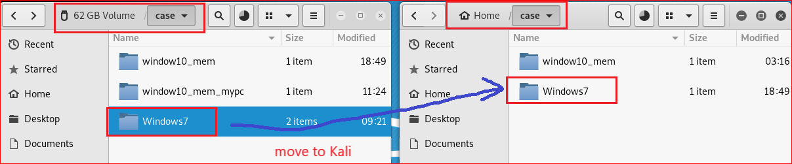
Move memory information from USB to Kali

Slide 16
Memory Analysis

Slide 17
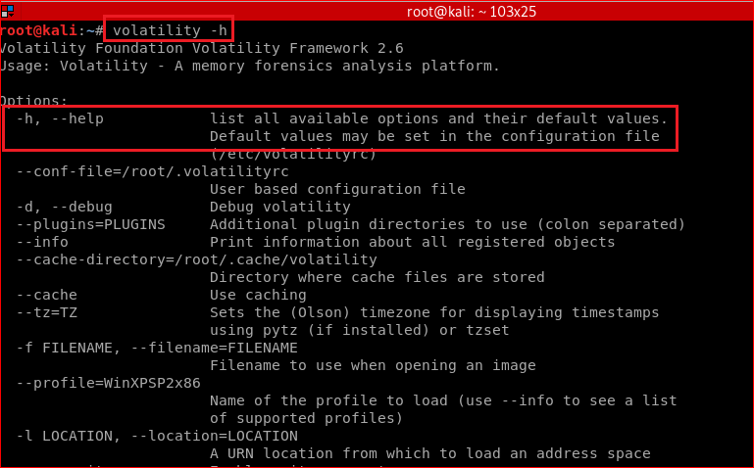
Display global command line options

Slide 18
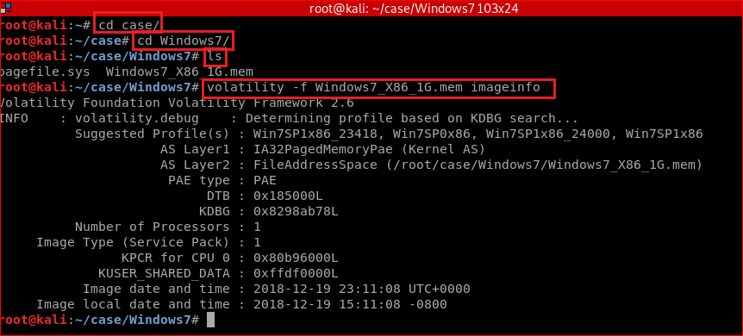
Identify information for the image using imageinfo plugin

Slide 19
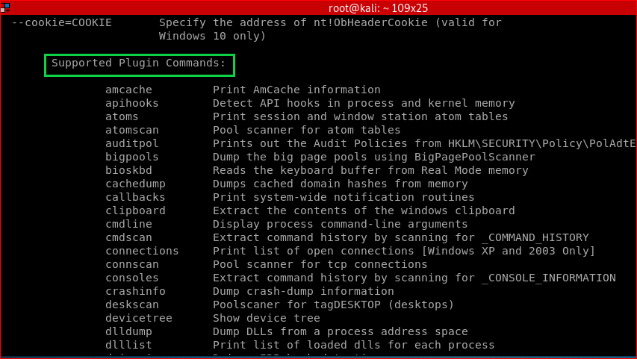
Other plugins

Slide 20
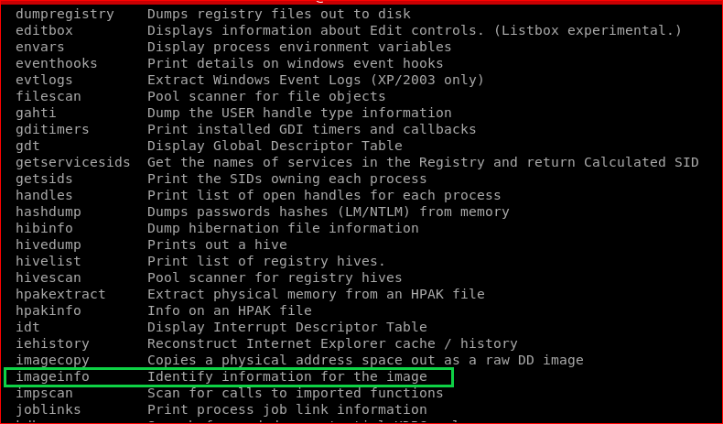

Slide 21
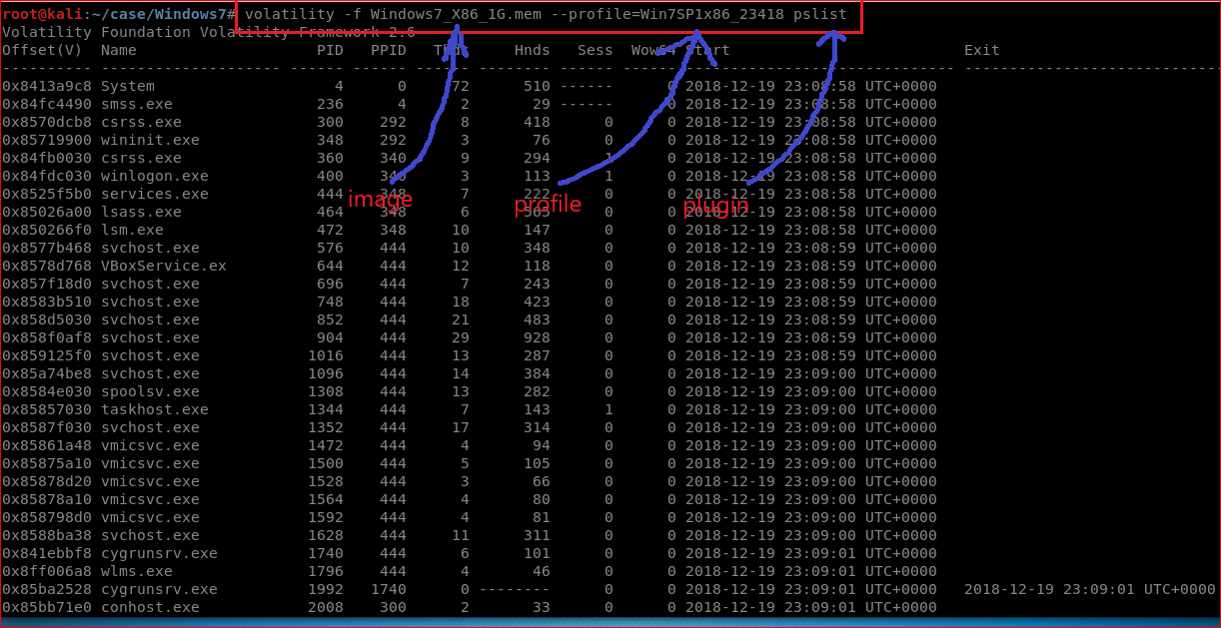
Print all running processes

Slide 22
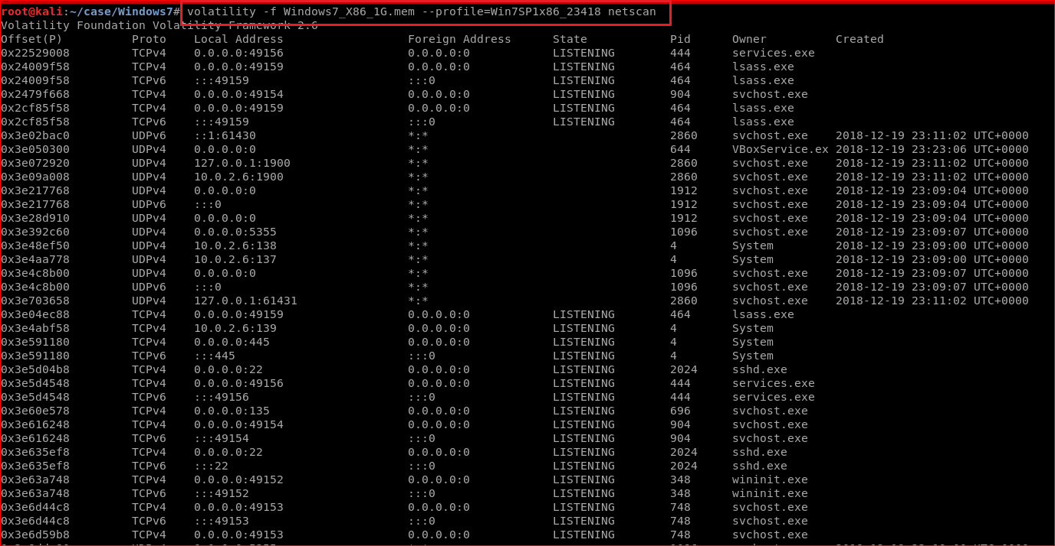
scan for network artifacts

Slide 23
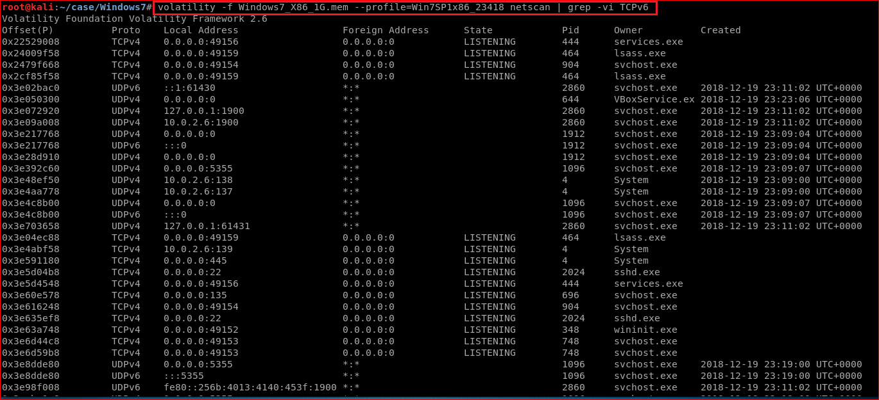
Fillet out TCPv6: grep –vi TCPv6

Slide 24
Listing Hidden or terminated process

Slide 25
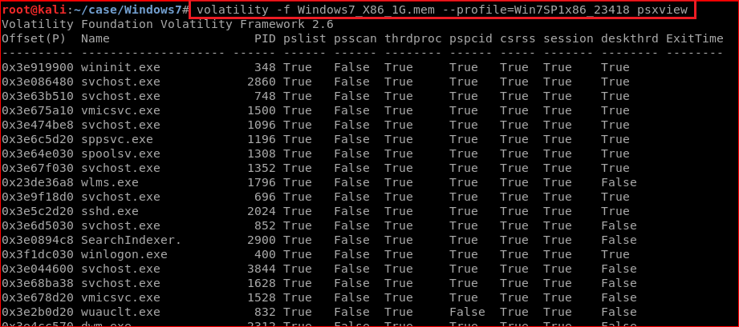
Cross reference processes with various lists (clues for malware)

Slide 26
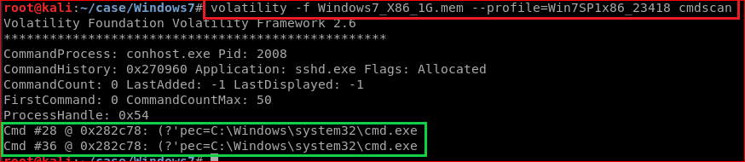
Recover command history
Notes:
https://www.andreafortuna.org/cybersecurity/volatility-my-own-cheatsheet-part-2-processes-and-dlls/

Slide 27
Other interesting functions
volatility -f memdumpWin7.mem --profile=Win7SP1x86_23418 consoles
Not only show cmd history, but screen information
volatility -f memdumpWin7.mem --profile=Win7SP1x86_23418 evtlogs
Not support this profile
There is also an option (--save-evt) to dump raw event logs for parsing with external tools:
--profile=WinXPSP2x64 evtlogs --save-evt -D output
volatility -f memdumpWin7.mem --profile=Win7SP1x86_23418 iehistory > output.txt
iehistory

Slide 28
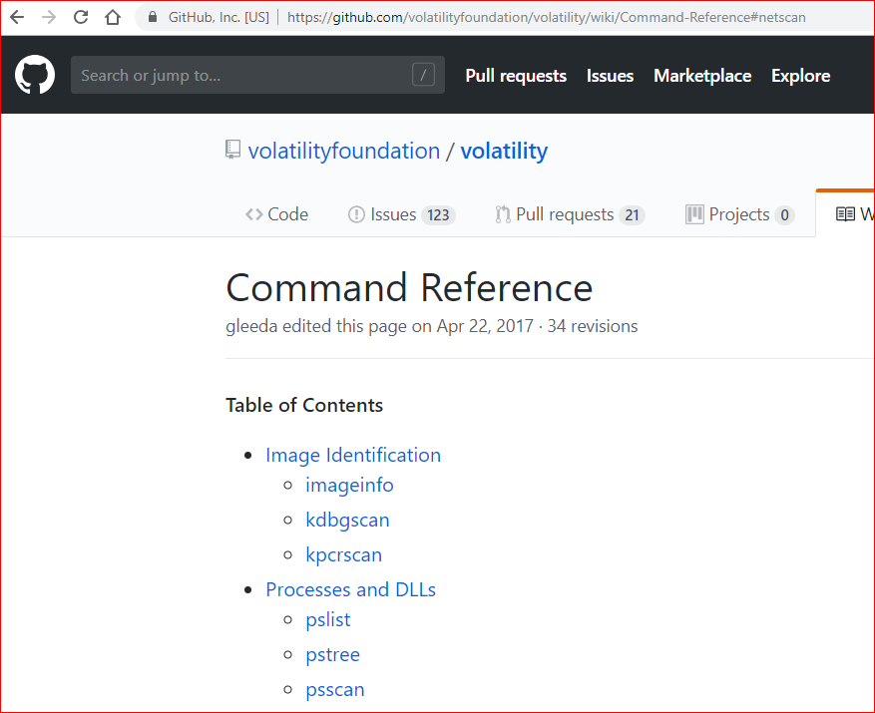
Command Reference

Slide 29
Process Limitations

Slide 30
Limitation
A locked machine with limited access cannot be utilized for volatile memory analysis .
The unlocking procedure will create changes to the system data and can cause system instability.

Slide 31
mobile device platforms
Memory dump is available only for the devices having administrative access or privileges in simple terms, device has to be rooted or jailbroken.
Memory dump is specific to the user account it has been accessed with, the RAM contents are available for only the logged in user.

Slide 32
Reference
https://lucideustech.blogspot.com/2018/01/windows-volatile-memory-acquisition.html
https://www.youtube.com/watch?v=1OxR4KLj-4I
https://github.com/volatilityfoundation/volatility
https://github.com/volatilityfoundation/volatility/wiki/Volatility-Usage
https://github.com/volatilityfoundation/volatility/wiki
https://lucideustech.blogspot.com/2018/01/windows-volatile-memory-acquisition.html
https://eforensicsmag.com/finding-advanced-malware-using-volatility/
https://resources.infosecinstitute.com/memory-forensics-and-analysis-using-volatility/#gref
https://www.andreafortuna.org/cybersecurity/volatility-my-own-cheatsheet-part-2-processes-and-dlls/

