Slide 1
Windows Forensics New Technology File System(NTFS)

Slide 2
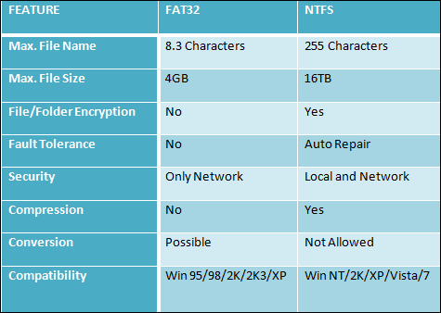

Slide 3
NTFS Boot Sector

Slide 4
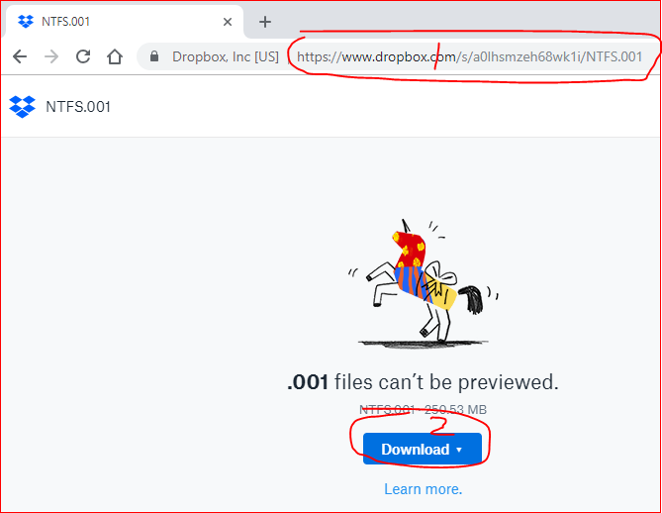
https://www.dropbox.com/s/lhcizqpe15g8833/fat16_250m.001

Slide 5
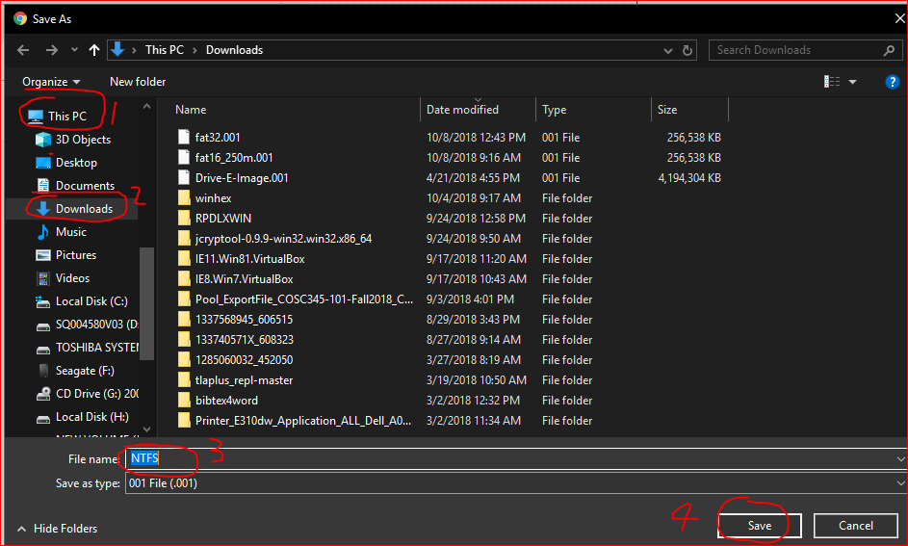

Slide 6

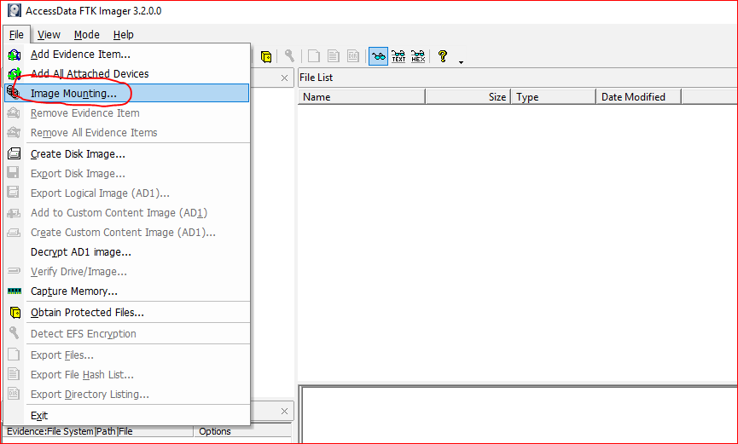

Slide 7
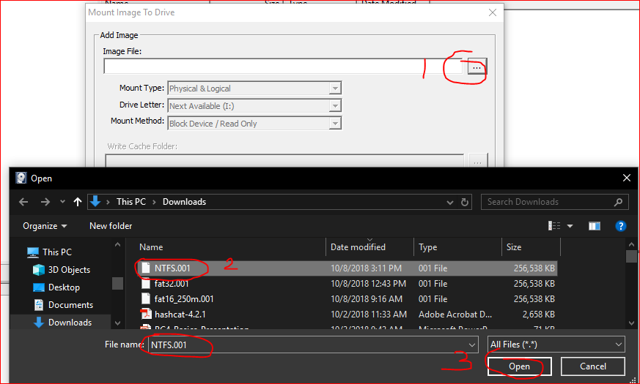

Slide 8
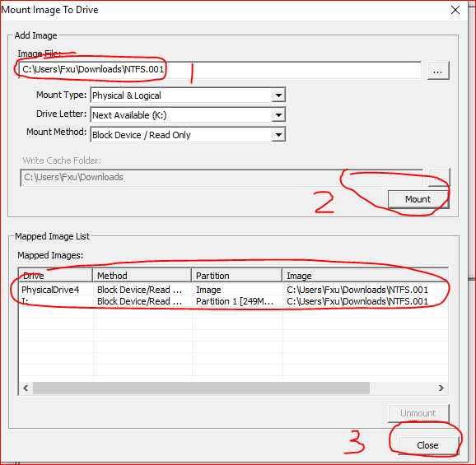
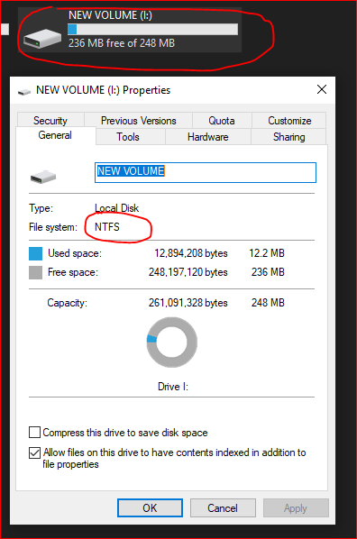

Slide 9
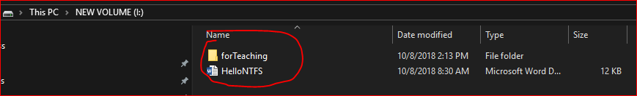

Slide 10
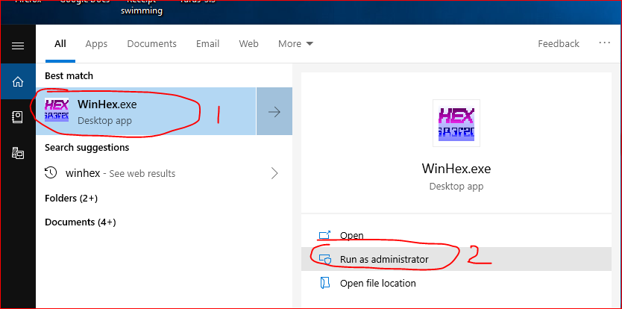
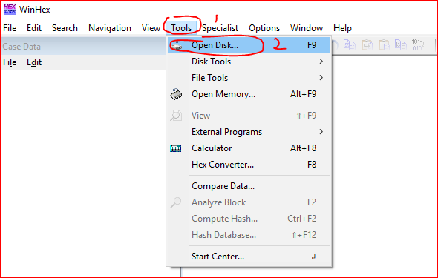

Slide 11
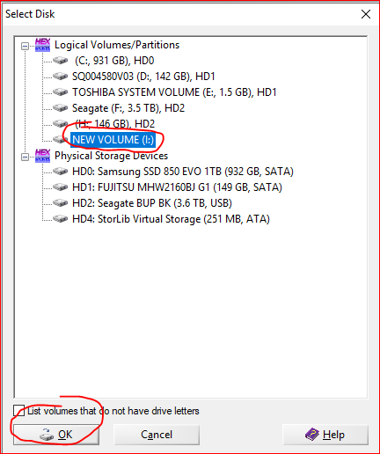

Slide 12
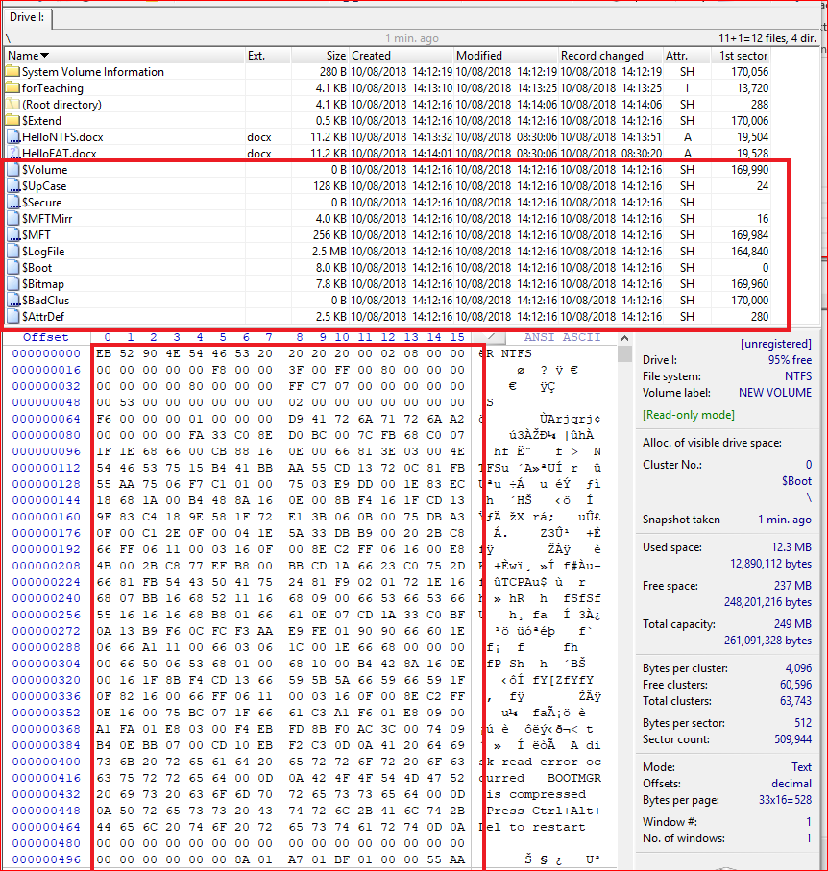
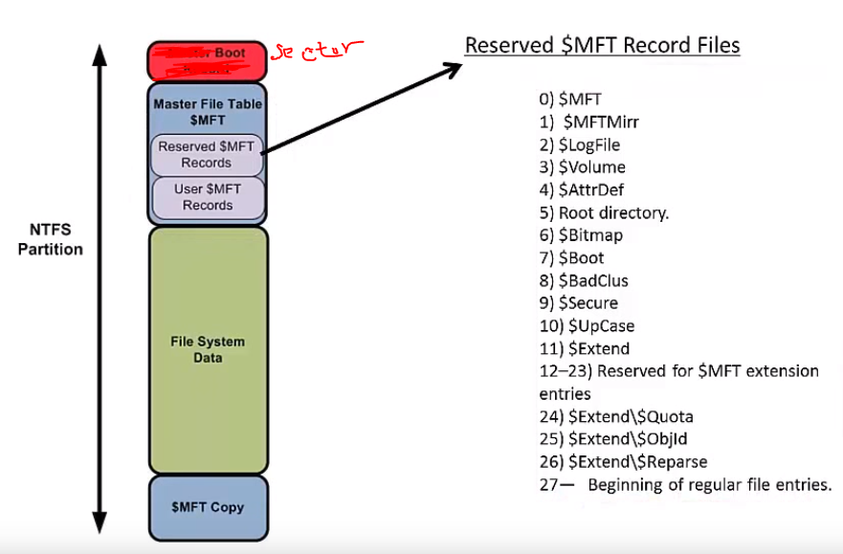
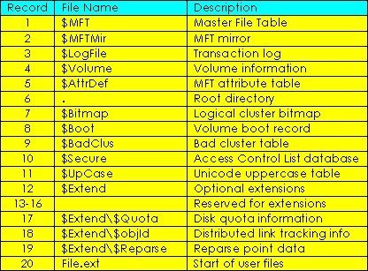

Slide 13
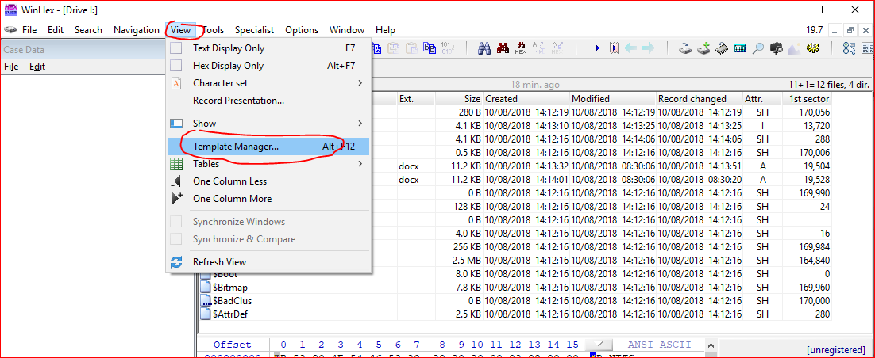
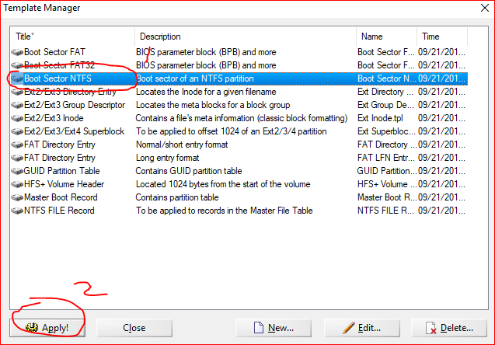

Slide 14
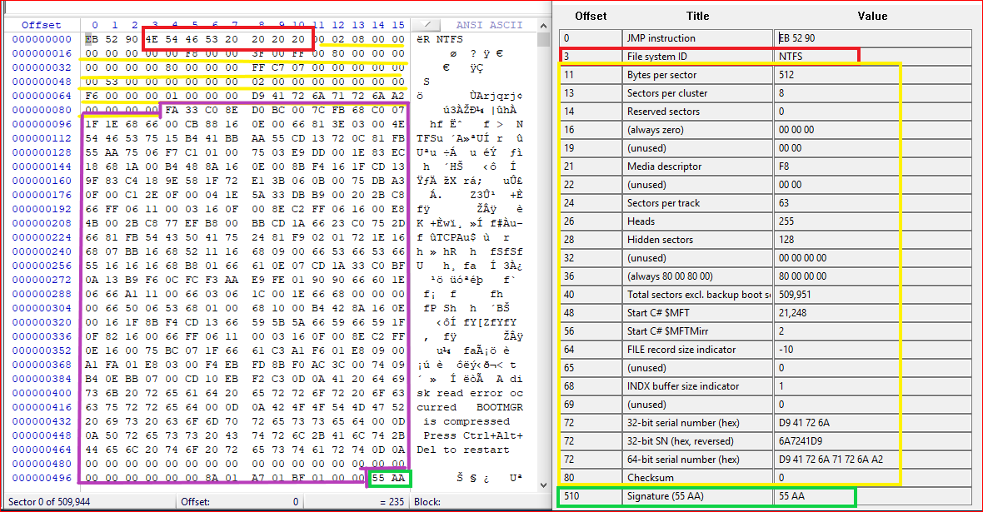
BPB: BIOS parameter block:
--describe the physical information/layout of a data storage

Slide 15
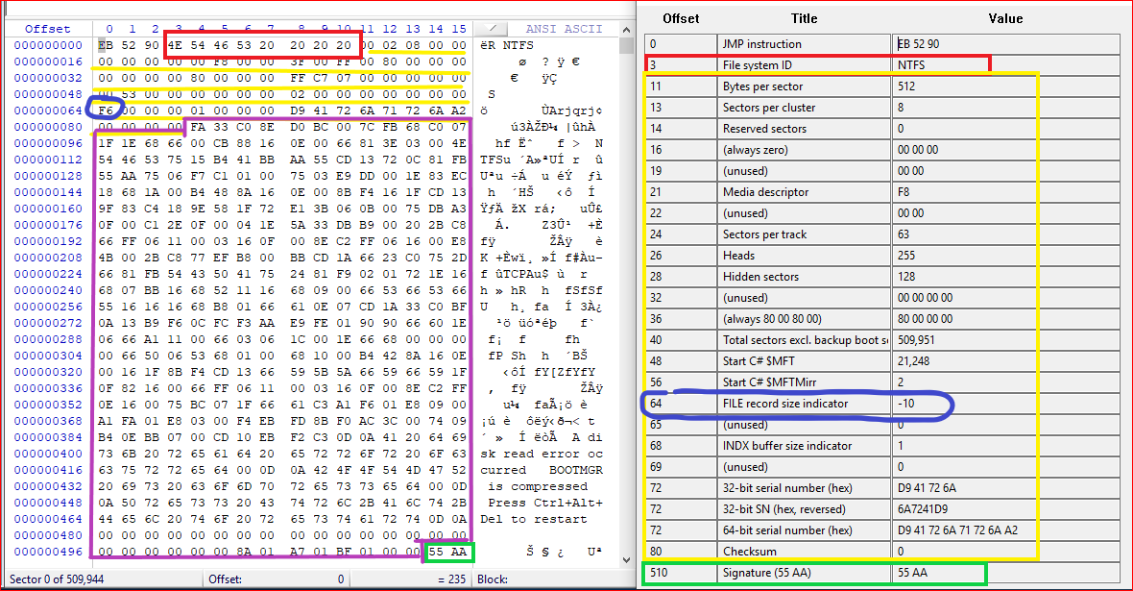
File record size indicator: 2 ^10 = 1024.

Slide 16
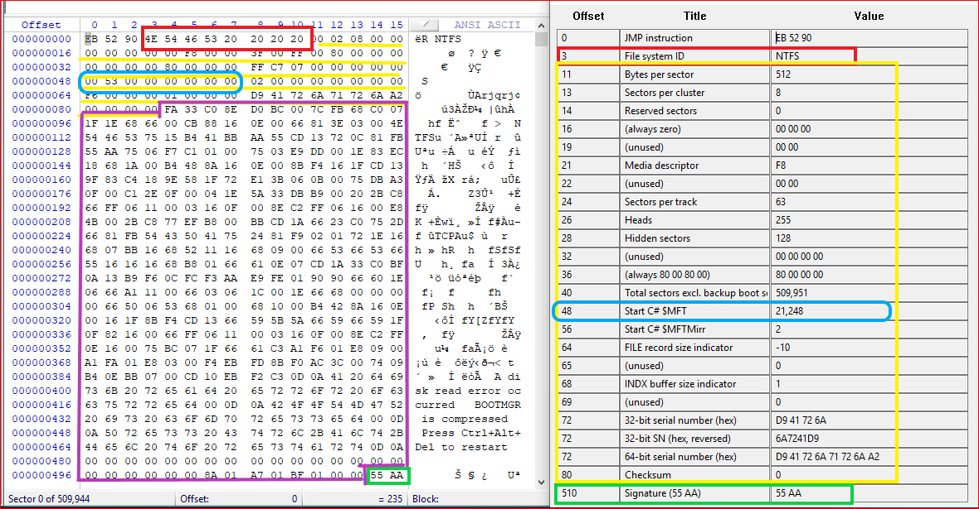
Start cluster $MFT: (53)hex=(21248)dec

Slide 17
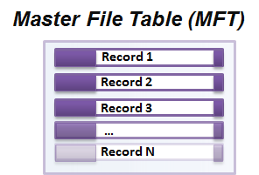
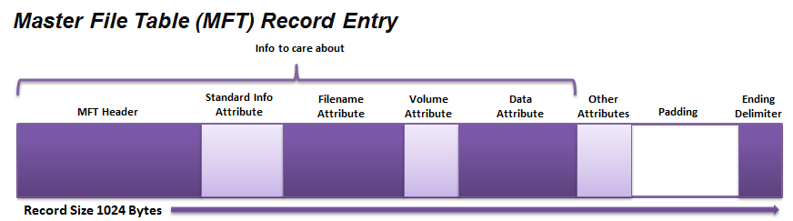

Slide 18
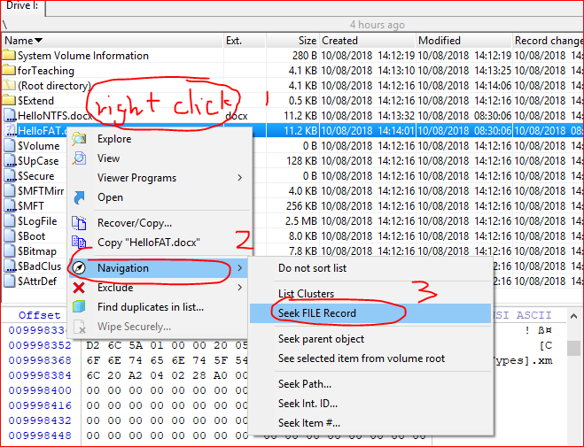

Slide 19
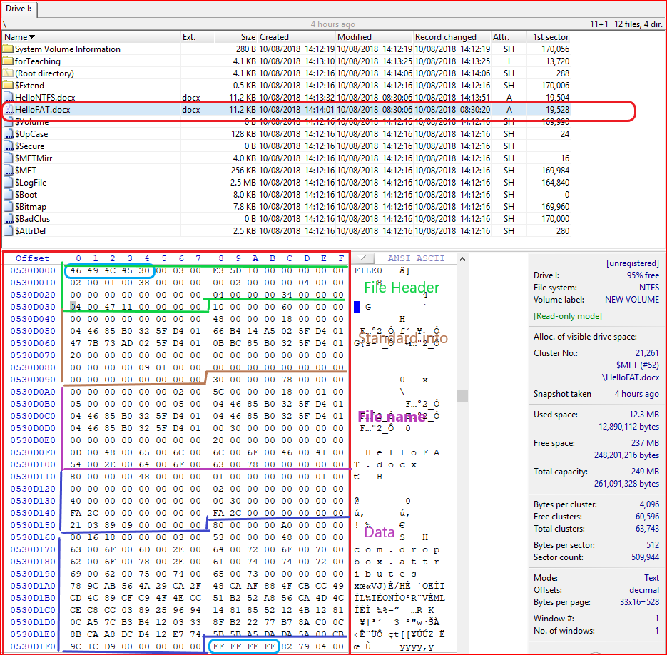

Slide 20
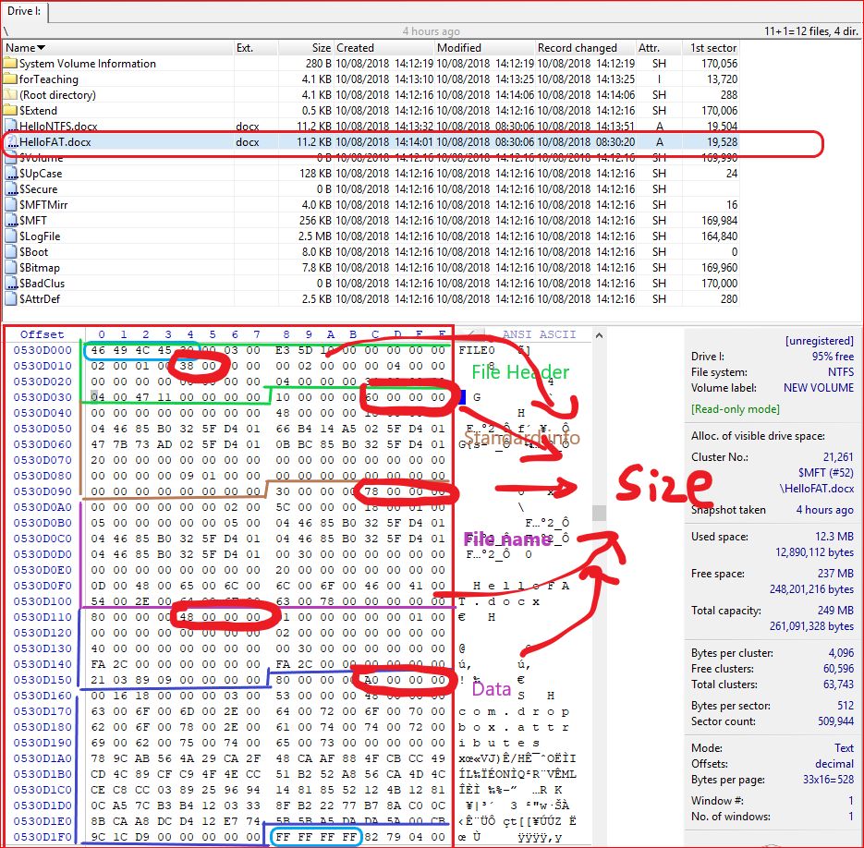

Slide 21
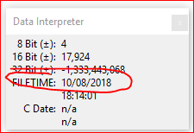
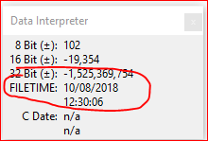
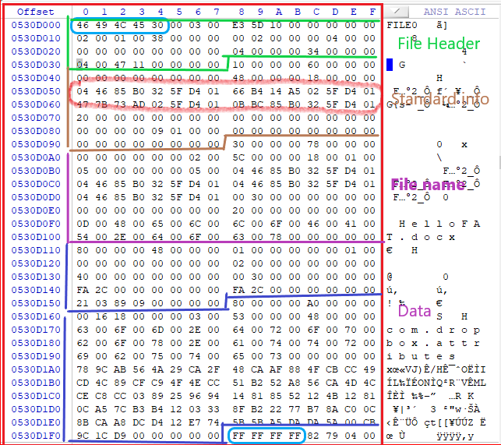
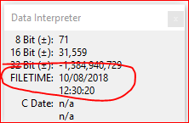
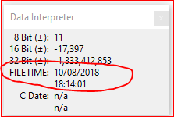

Slide 22
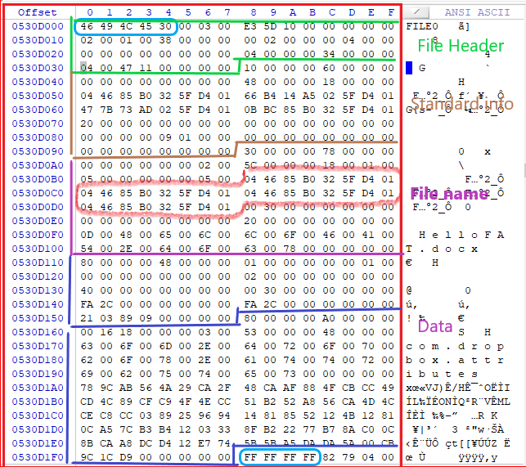
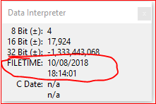
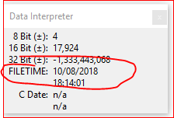
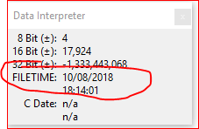
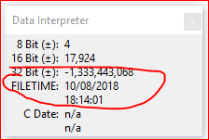

Slide 23
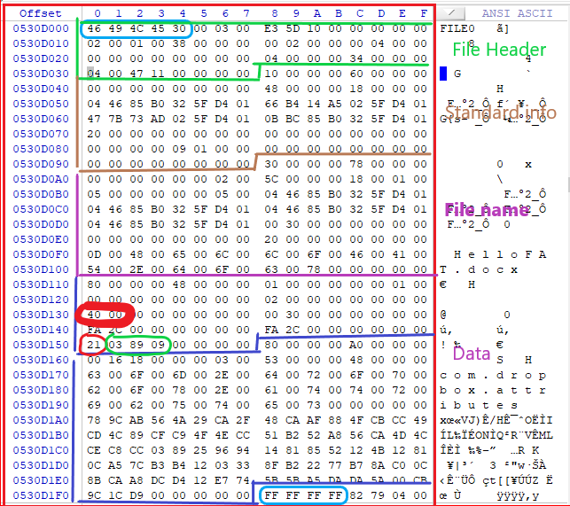
At offset 0x20, the offset to the runlist is 0x40, leads to the first datarun 0x0321
A datarun has three components
a length/offset byte (2 Bytes) 0x21
length of the cluster run number (1 Bytes) 0x1
the length of the cluster start number (1 Bytes) 0x2
a cluster run size 0x1 byte
a cluster start number (offset to previous datarun) 0x2 byte (0x0989)

Slide 24
Question:
Follow the screenshot and capture your screen (5 points).
Create a file “my_file.docx” under the root of your PC. Find the “date created” information using WinHex (5 points).

Slide 25
Reference
http://www.cse.scu.edu/~tschwarz/COEN252_09/Lectures/NTFS.html
https://www.youtube.com/watch?v=xW5UwDztkX4
https://docs.microsoft.com/en-us/windows-server/storage/disk-management/change-an-mbr-disk-into-a-gpt-disk
http://thestarman.pcministry.com/asm/mbr/NTFSBR.htm
http://www.kes.talktalk.net/ntfs/
http://amanda.secured.org/ntfs-mft-record-parsing-parser/
https://pdfs.semanticscholar.org/presentation/0209/570d0f395dd3da03d55ab5ea56214764269e.pdf
https://www.kazamiya.net/en/fte/MFT
https://www.writeblocked.org/resources/NTFS_CHEAT_SHEETS.pdf

