Slide 1
Windows Command Prompt

Slide 2
File structure

Slide 3
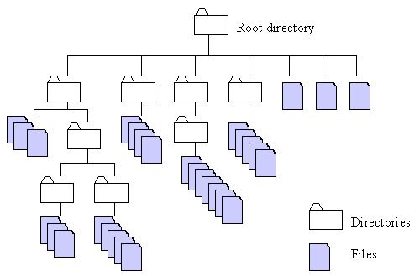
http://home.easy-key.info/images/stories/file_structure.gif

Slide 4
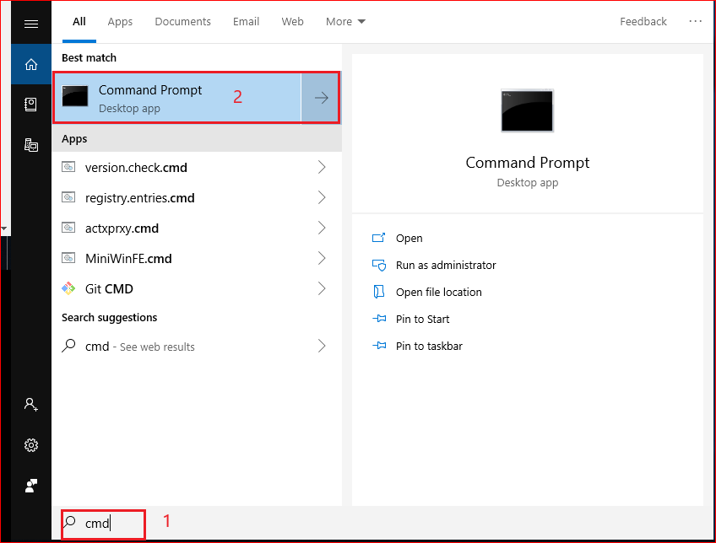
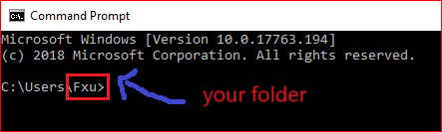

Root directory
C:
\Users
\Fxu

Slide 5

C:
C:
Change to an upper directory
\Users
\Users
\Fxu

Slide 6

C:
C:
Change to an upper directory/root
\Users

Slide 7
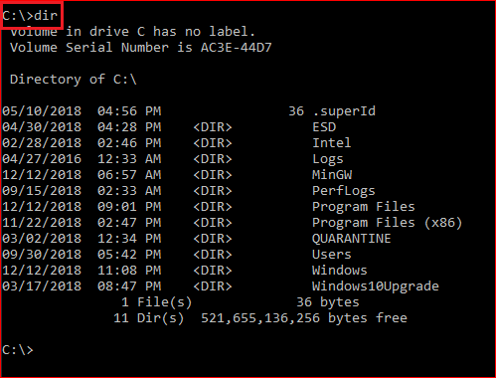
Display root

Slide 8
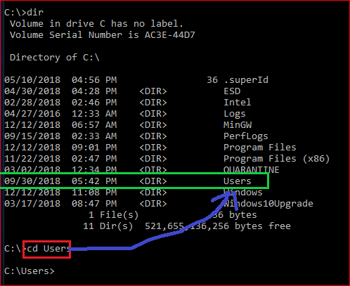
Change to \users directory

Slide 9
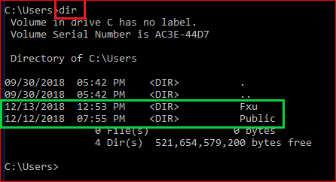
Show all files under the \Users

Slide 10
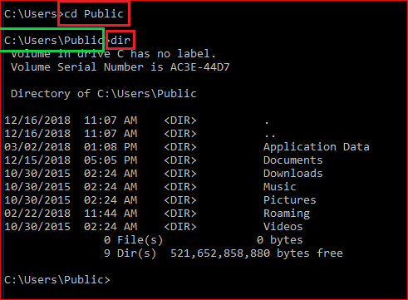
Change directory to \Public and display the content of the folder

Slide 11
Create folders and files

Slide 12
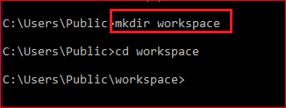
C:
C:
\Users
\Users
Create a folder
\Public
\Public
\workspace

Slide 13
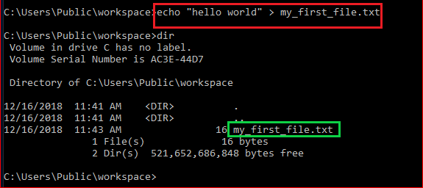
Create a new text file
C:
\Users
\Public
\workspace
hello world
my_first_file.txt

Slide 14
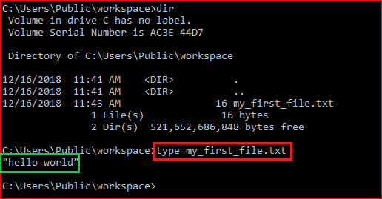
Show the content of the file: type

Slide 15
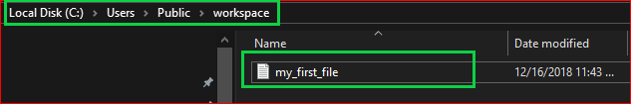

Show the content of the file: Explore

Slide 16
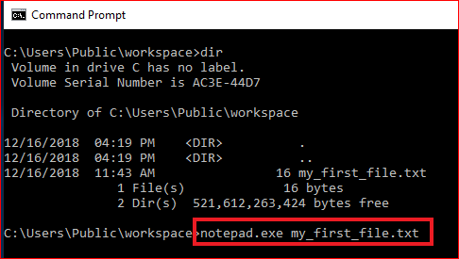
Show the content of the file: exe command

Slide 17
File operations

Slide 18
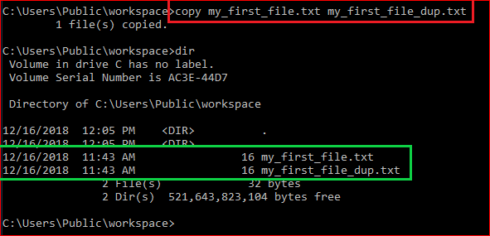
Duplicate files

Slide 19
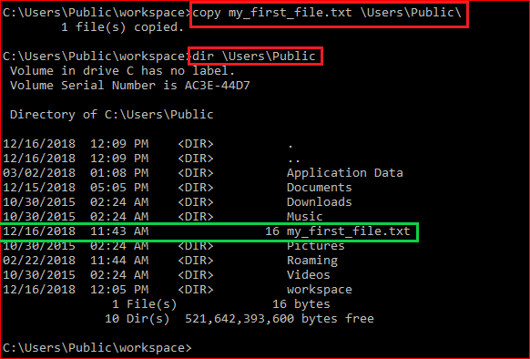
Copy a file to a different location

Slide 20
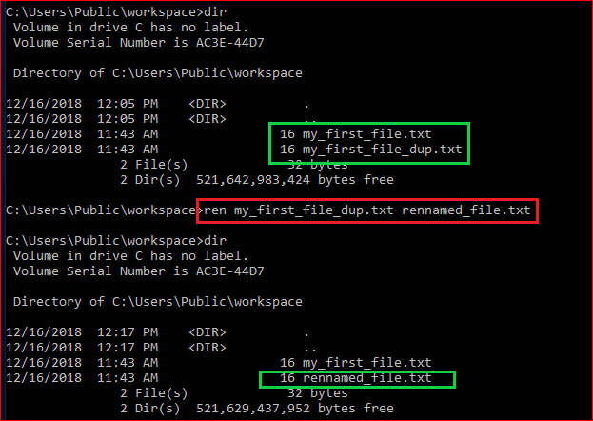
Rename a file

Slide 21
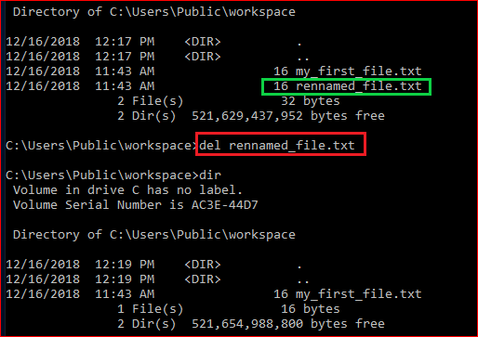
Delete a file

Slide 22
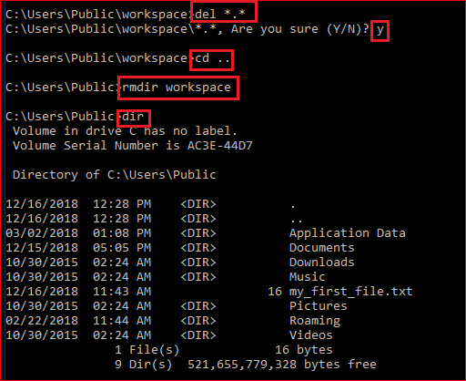
Delete a folder

Slide 23
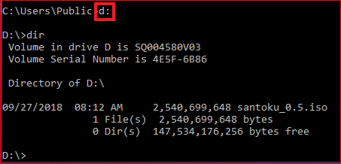
Change to a different drive

Slide 24
Networking

Slide 25
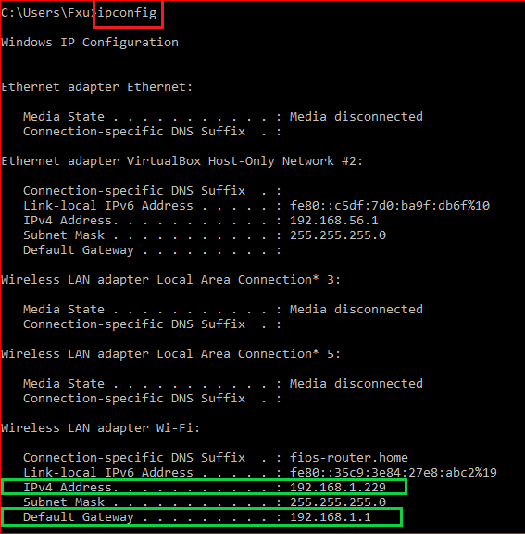
IP and default gateway

Slide 26
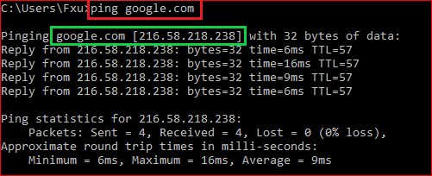
Test network connection

Slide 27
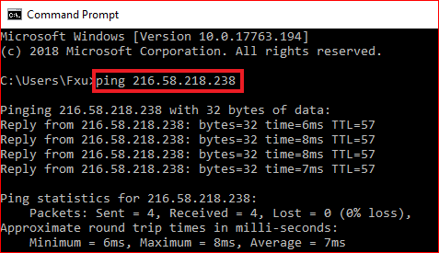
Test network connection

Slide 28
Download files

Slide 29
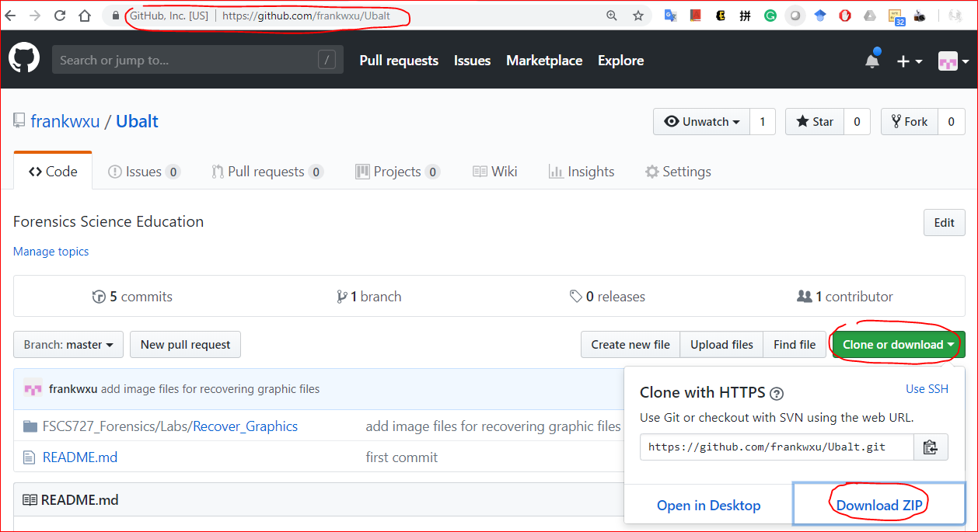
https://github.com/frankwxu/Ubalt

Slide 30
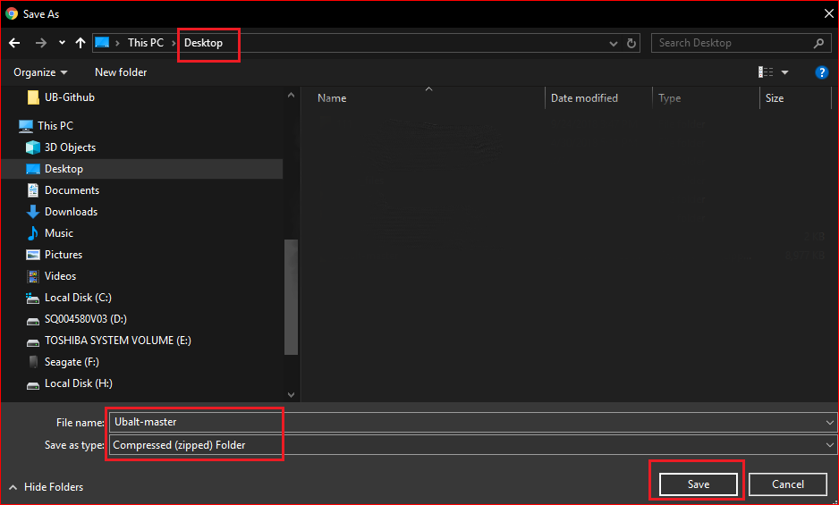

Slide 31
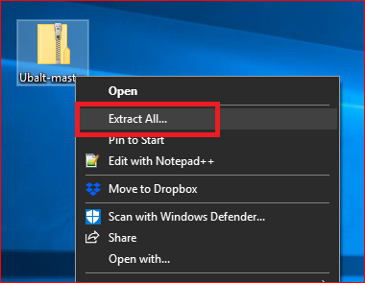
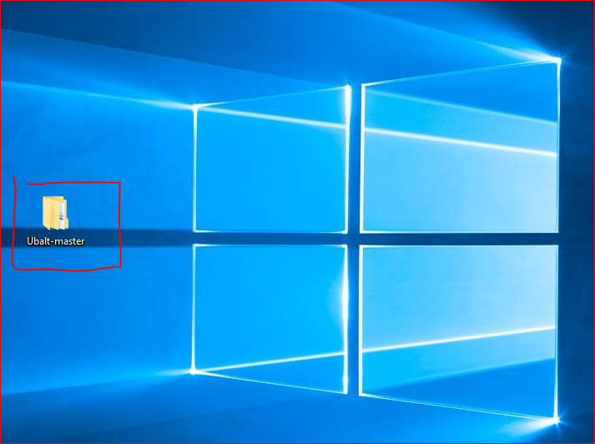

Slide 32
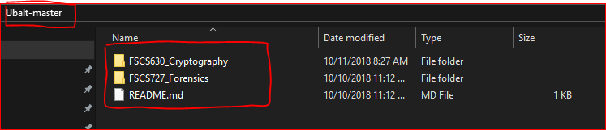

Slide 33
Create a working space

Slide 34
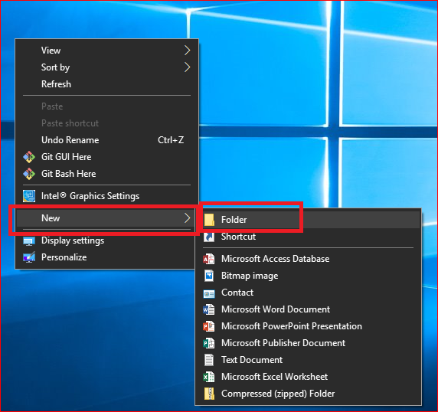
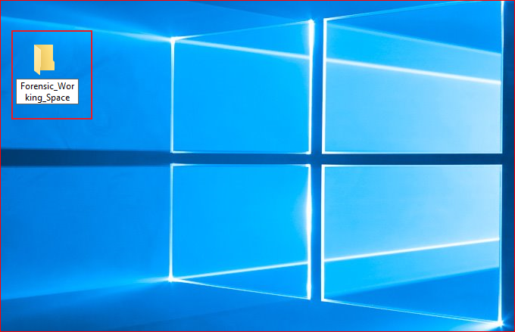

Slide 35
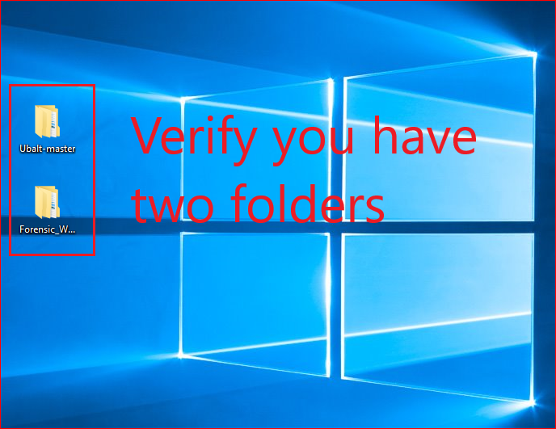

Slide 36
View large icon of files

Slide 37
