Slide 1
The Enigma machine

Slide 2
Background
http://stanford.edu/class/archive/cs/cs106a/cs106a.1164/handouts/29A-CryptographyChapter.pdf
http://enigma.louisedade.co.uk/howitworks.html

Slide 3
Watch
https://www.youtube.com/watch?v=aLj8WCO-2QI
https://www.khanacademy.org/computing/computer-science/cryptography/crypt/v/case-study-ww2-encryption-machines
https://www.youtube.com/watch?v=mcX7iO_XCFA

Slide 4
Modern computing
Modern computing got its start during World War II
German High Command used to communicate with the army, navy, and air force.
In the early 1930s, the German military adopted a new encryption protocol called Enigma.
letter substitution

Slide 5
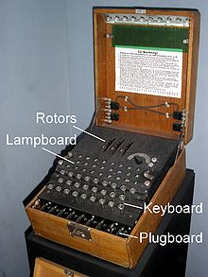
Three rotors
rotor setting: JLY
Lampboard (Output)
Keyboard (Input)
Plugboard

Slide 6
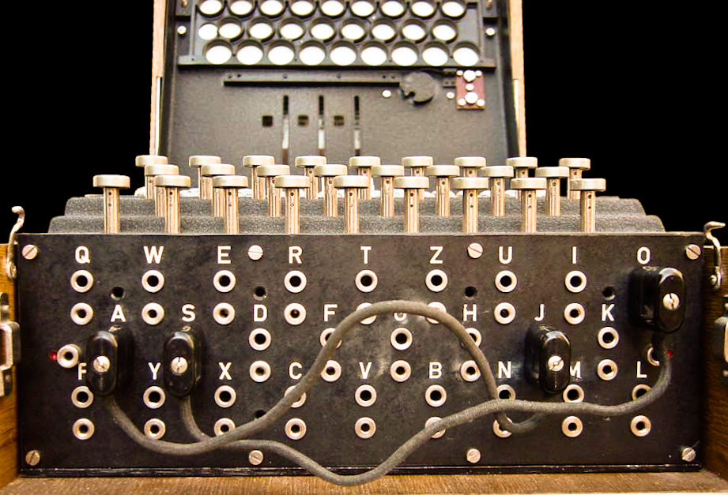
Plugboard

Slide 7
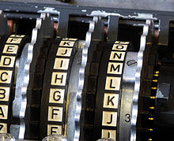
Rotors

Slide 8
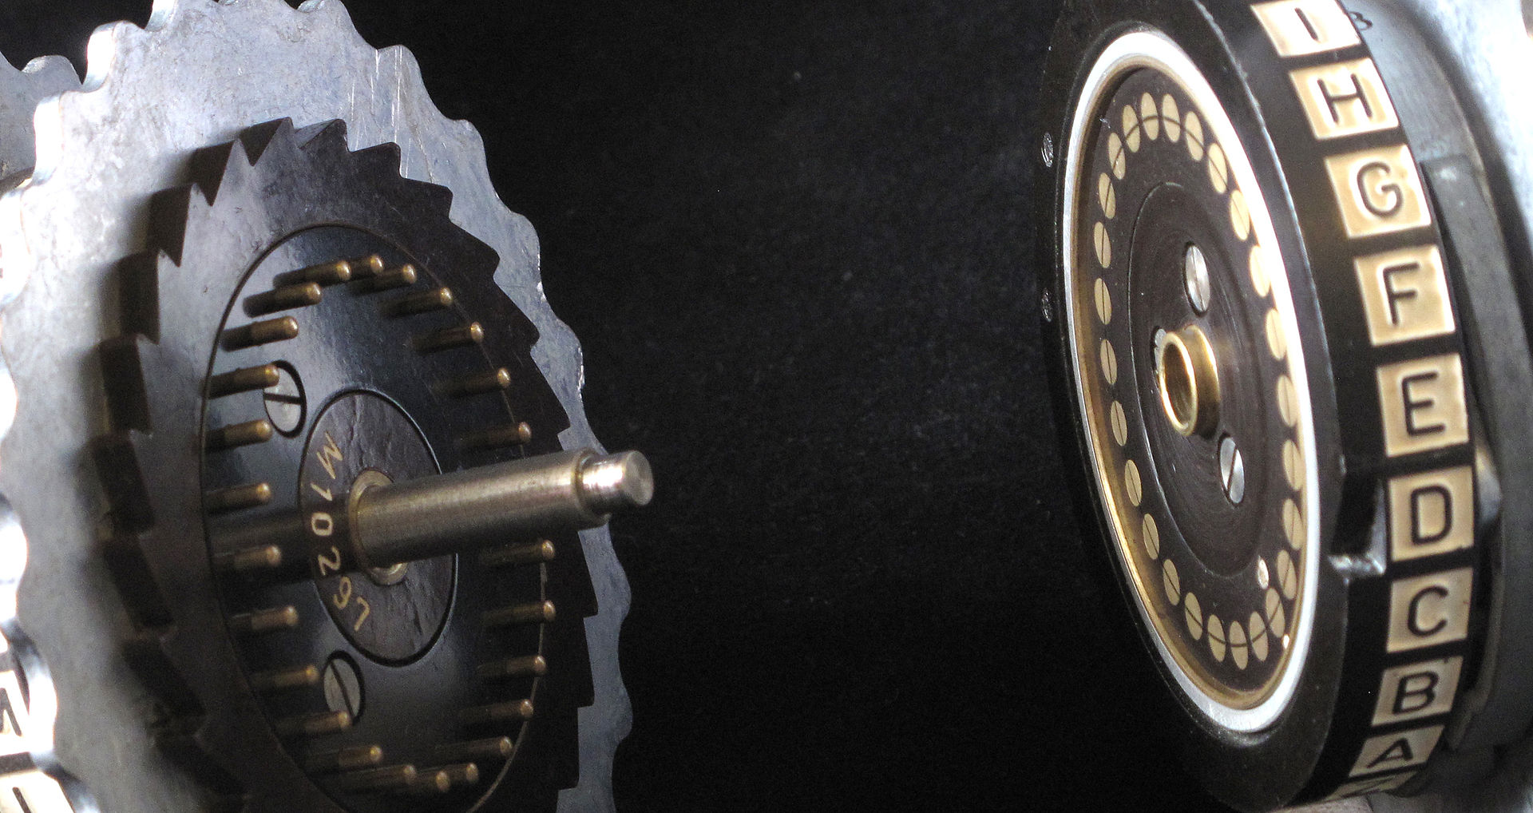
notch
Two Enigma rotors showing electrical contacts, stepping ratchet (on the left) and notch (on the right-hand rotor opposite D).

Slide 10
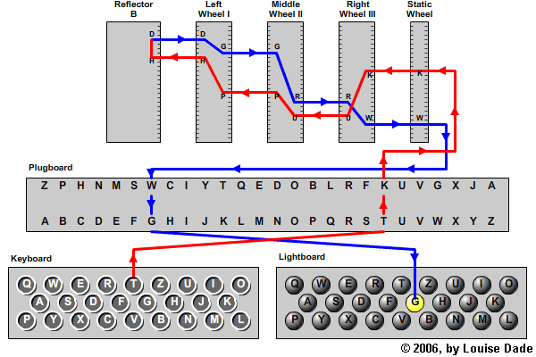

Slide 11
Hands-on

Slide 12
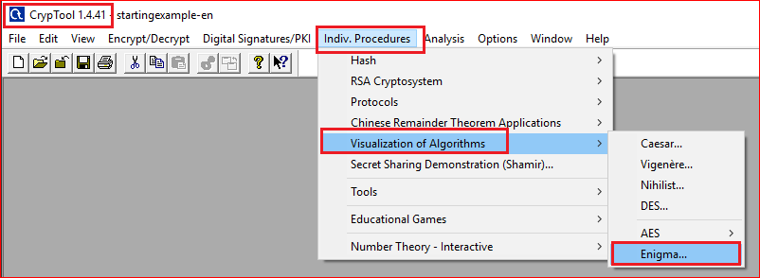

Slide 13
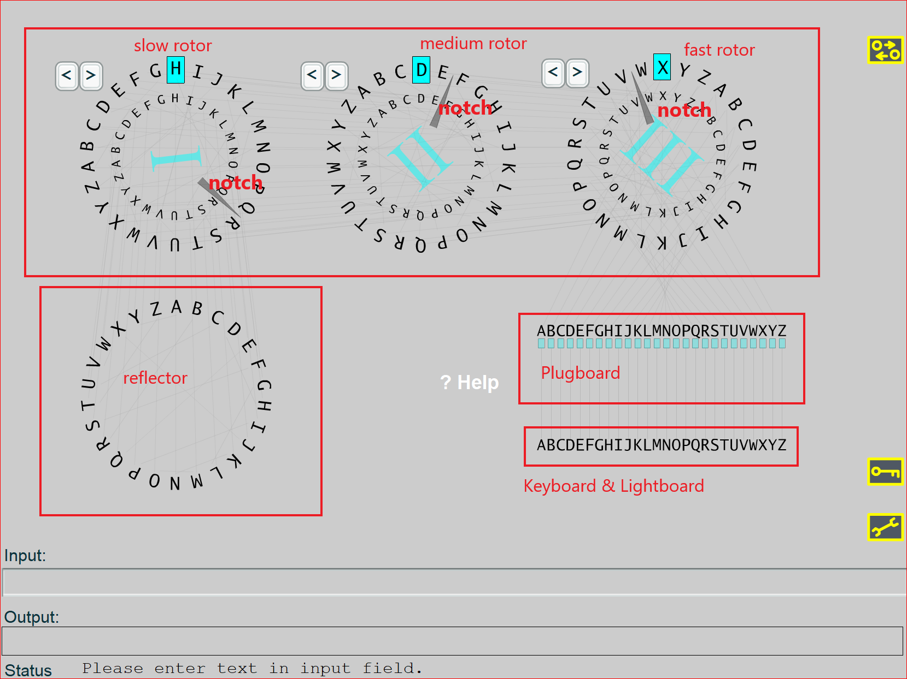

Slide 14
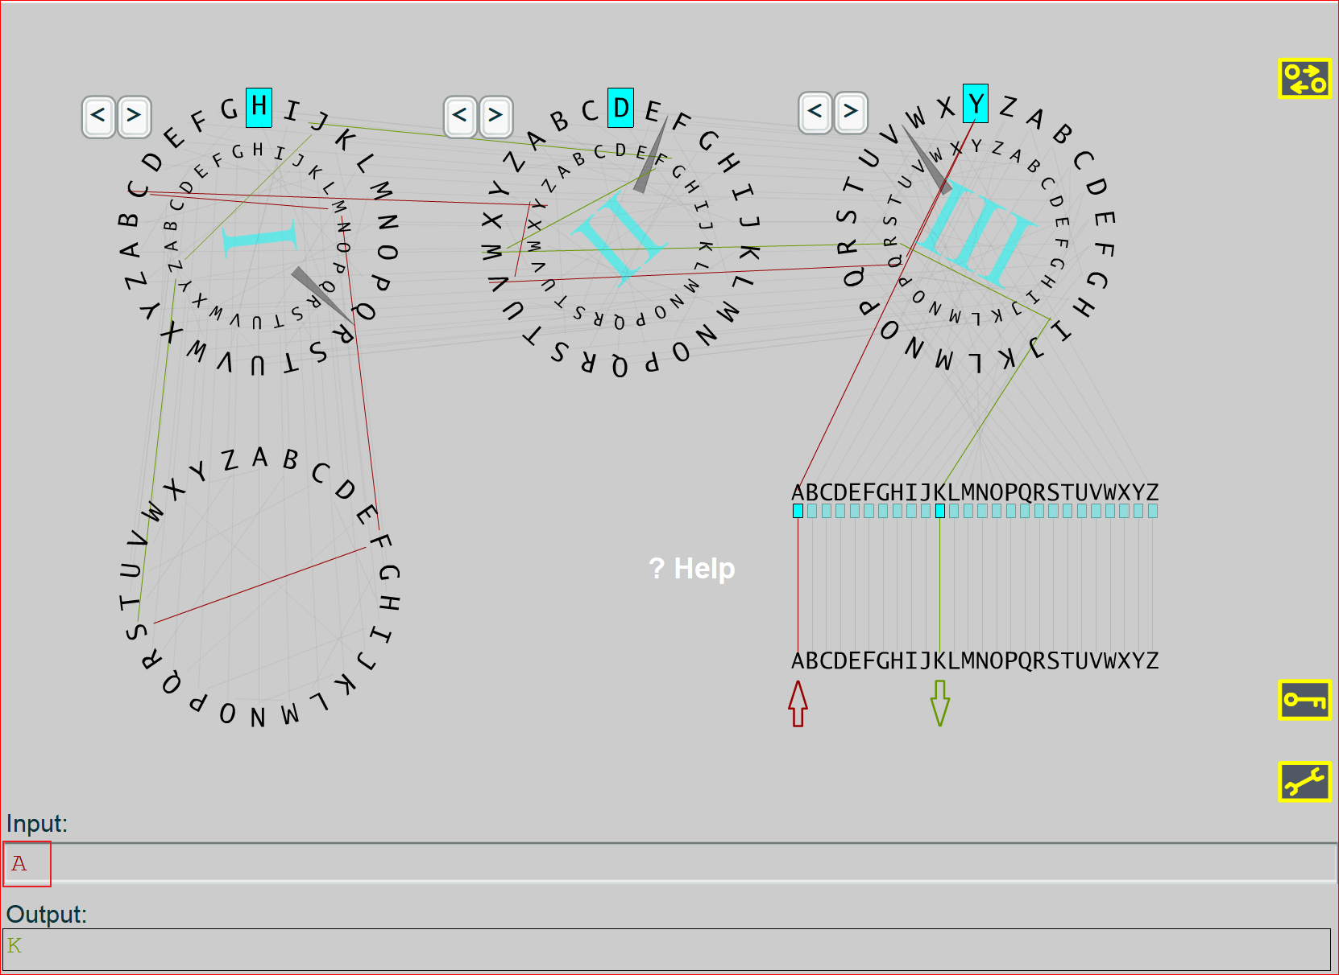

Slide 15
Questions
How many notches does the Enigma have?
For the rotor setting (HDX), how many characters do you have to type to change the fast rotor’s notch position?
For the rotor setting (HDX), how many characters do you have to type to change the medium rotor’s notch position?
For the rotor setting (HDX), how many characters do you have to type to change the slow rotor’s notch position?

Slide 16
Questions
Type “AAAAA” for the input. Why doesn't the output produce the same characters?
What is the purpose of notches?

Slide 17
Extra credits
https://www.youtube.com/watch?v=cVdjxMjSQNo
http://wiki.franklinheath.co.uk/index.php/Enigma/Paper_Enigma#The_Plug_Board
http://enigmaco.de/enigma/enigma.html
try this message: A E F A E J X X B N X Y J T Y

