Slide 1
How to Crack MS-Word Password

Slide 2
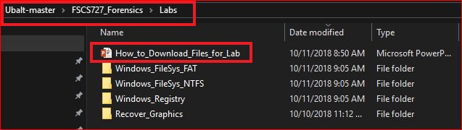
Following the PPTs to download required files for the lab

Slide 3
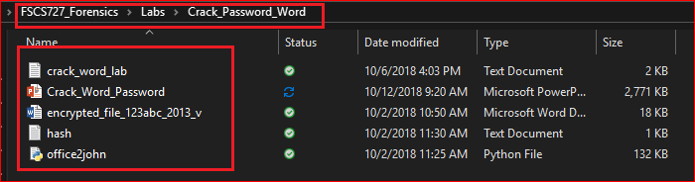
Verify the required files

Slide 4
Download files from Github repository

Slide 5
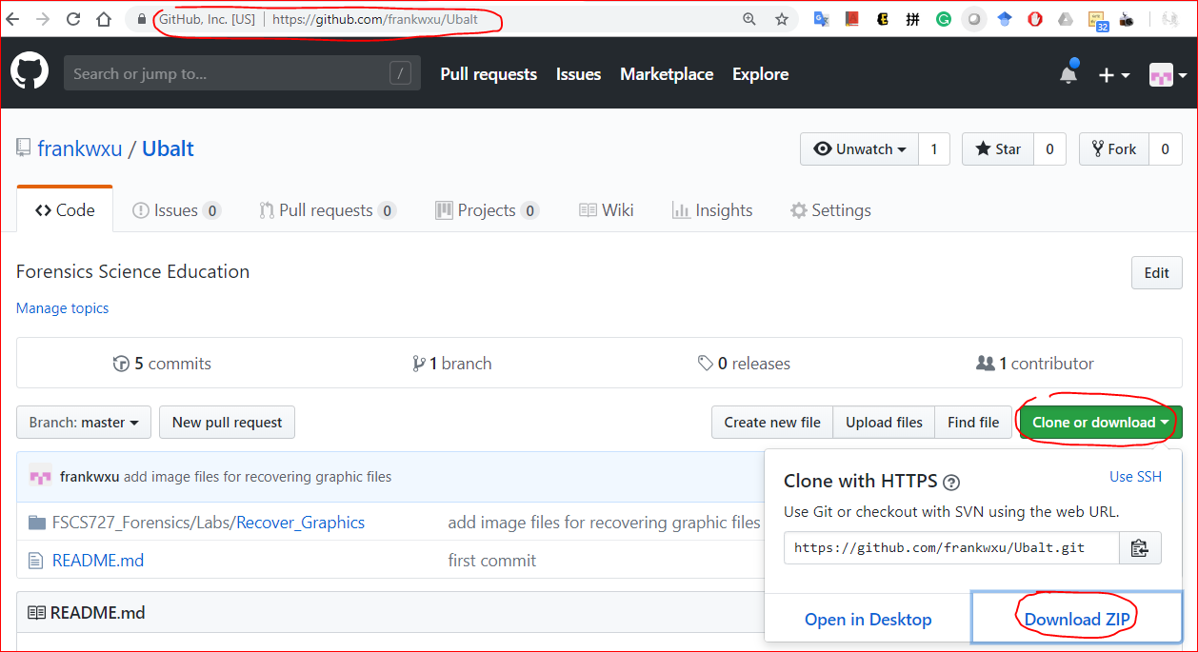
https://github.com/frankwxu/Ubalt

Slide 6
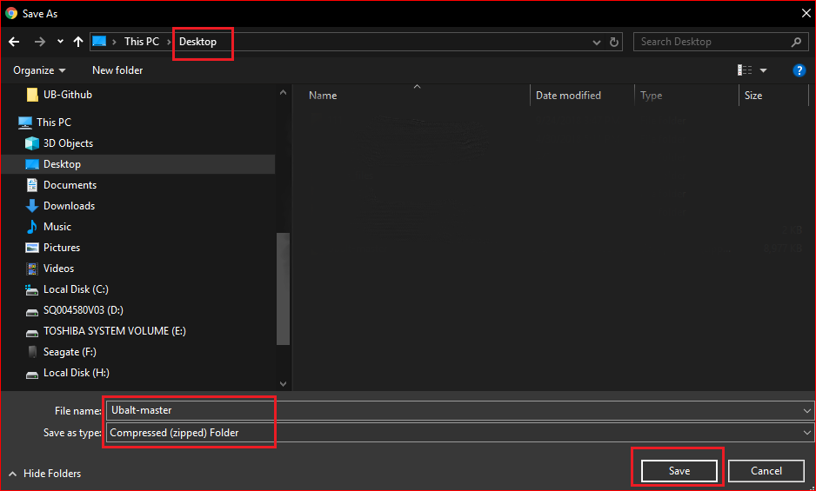

Slide 7
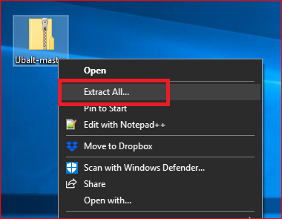
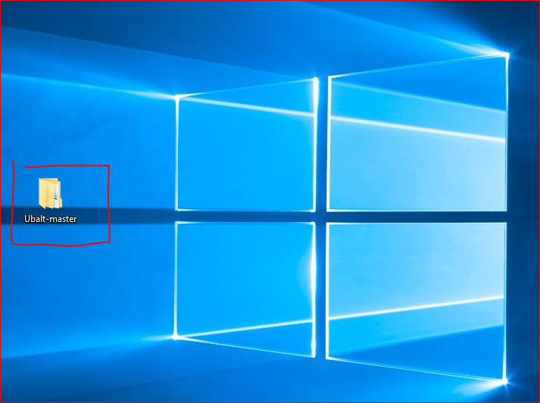

Slide 8
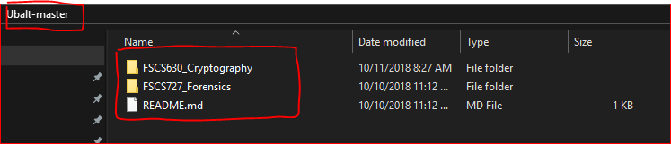

Slide 9
Create a working space

Slide 10
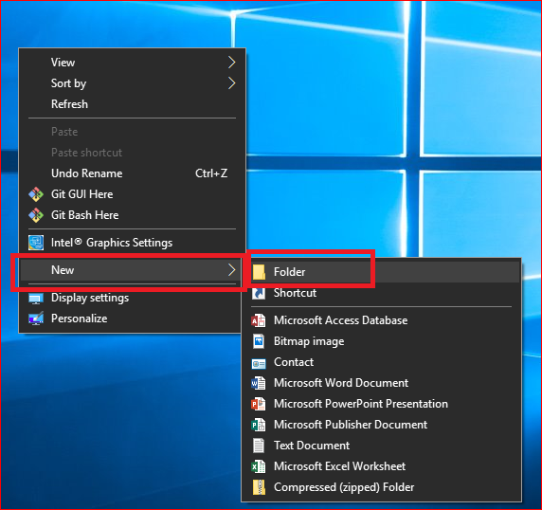
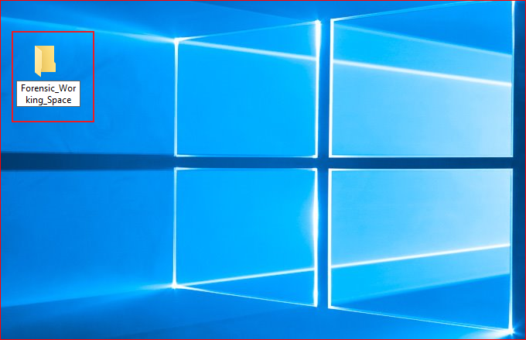

Slide 11
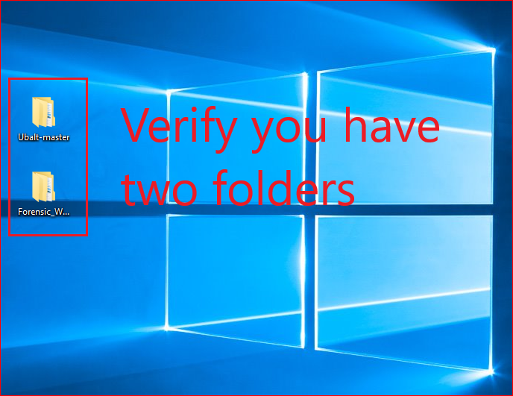

Slide 12
You need to repeat these steps before each lab to get updated files

