Slide 1
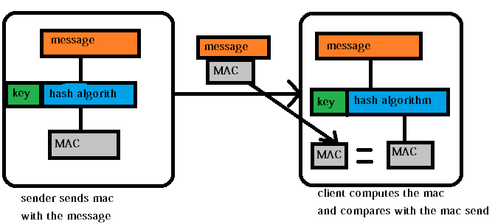
Hash-based Message Authentication Code (HMAC)
https://i.stack.imgur.com/FpSuH.png

Slide 2
Overview

Slide 3
Motivation
Digital signatures using asymmetric techniques are slow
Can we using symmetric techniques to provide security service, including message integrity and message authentication?
Used in many practical protocols such as Transport Layer Security(TLS)

Slide 4
Basic idea
Concatenate the key and the message, and hash them together.
Since it is impossible, given a cryptographic hash, to find out what it is the hash of, knowing the hash (or even a collection of such hashes) does not make it possible to find the key.

Slide 5
How HMAC works?

Slide 6
Requirement
Both parties share a secret key
Message can be encrypted or unencrypted.

Slide 7




Hash code (MAC)
Re-compute the MAC’
Verify MAC=MAC’?

Slide 8
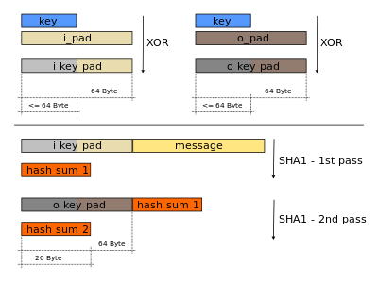
HMAC uses two passes of hash computation
The secret key is first used to derive two keys
inner and outer.
The first pass
produces an internal hash derived
from the message and the inner key.
The second pass
produces the final HMAC code
derived from the inner hash result and the outer key.

Slide 9
Crypt Tool

Slide 10
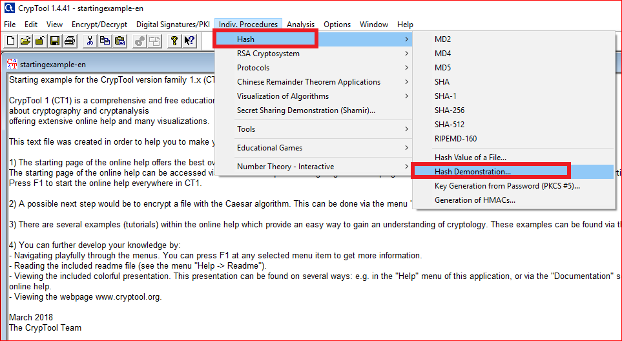

Slide 11
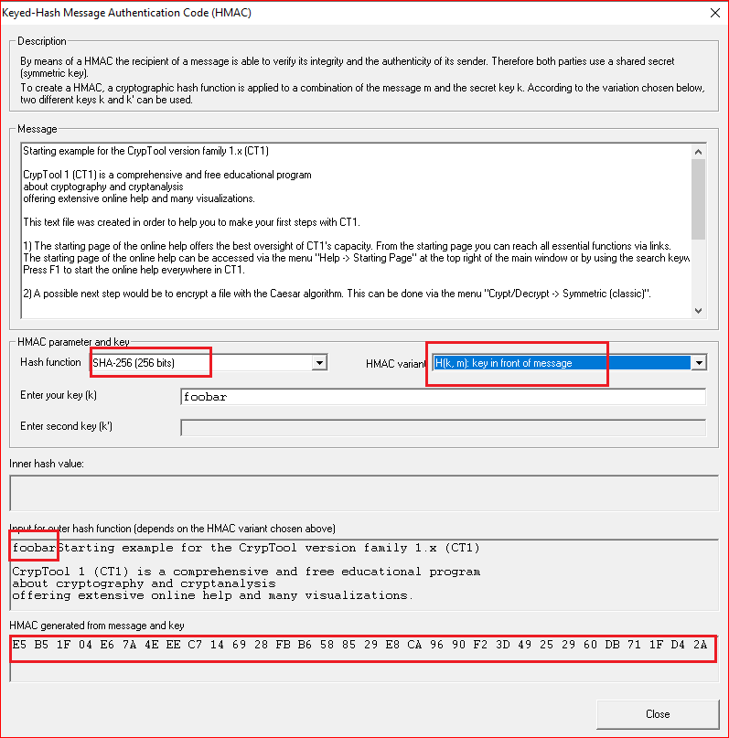

Slide 12
Properties of MAC -1
Cryptographic checksum
A MAC generates a cryptographically secure authentication tag for a given message.
Symmetric
MACs are based on secret symmetric keys. The signing and verifying parties must share a secret key.
Arbitrary message size
MACs accept messages of arbitrary length.
Fixed output length
MACs generate fixed-size authentication tags.

Slide 13
Properties of MAC-2
Message integrity
MACs provide message integrity: Any manipulations of a message during transit will be detected by the receiver.
Message authentication
The receiving party is assured of the origin of the message.
No nonrepudiation
Since MACs are based on symmetric principles, they do not provide nonrepudiation.

Slide 14
HMAC and Wi-Fi Protected Access (WPA/WPA2)

Slide 15
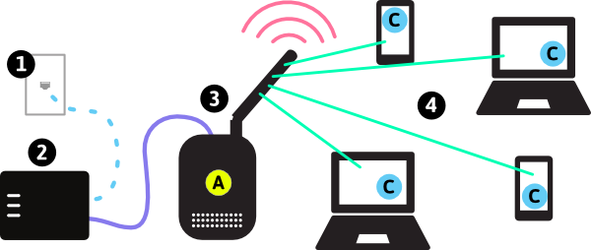
Home office setting
Pairwise Master Key (PWK)
Pairwise Master Key (PWK)

Slide 16
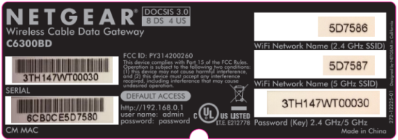
service set identifier (SSID)
Pre-shared key (PSK)
SHA-1
Pairwise Master Key (PWK/256bit)

Slide 17
Wireless cracking

Slide 18
How to crack wireless passwords? (old approach, still work)
WPA/WPA2 crackers required an attacker to patiently wait while listening in on a wireless network until a user successfully logged in.
They could then capture the four-way handshake in order to crack the key.
Handshake contains PMK

Slide 19
How to crack wireless passwords? (new approach)
https://www.bleepingcomputer.com/news/security/new-method-simplifies-cracking-wpa-wpa2-passwords-on-80211-networks/
https://medium.com/@SwiftSafe/hacking-wifi-password-in-a-few-steps-using-a-new-attack-on-wpa-wpa2-cec2856e044c
Pairwise Master Key Identifier (PMKID)
PMKID generated by a router when a user tries to authenticate.
PMKID = HMAC-SHA1-128(PMK, "PMK Name" | MAC_AP | MAC_STA)
Key: PMK
the data part: the concatenation of
a fixed string label "PMK Name",
the access point's MAC address and
the station's MAC address

Slide 20
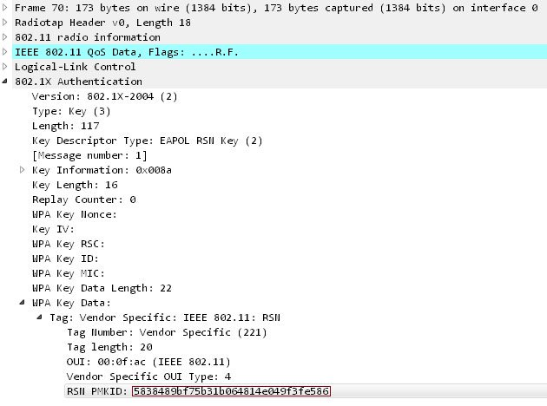

Slide 21
Idea for cracking wireless password
New crack method found a few months ago
Retrieve a single frame in order to get access to the PMKID,
PMKID can be cracked to retrieve the Pre-Shared Key (PSK) of the wireless network.

Slide 22
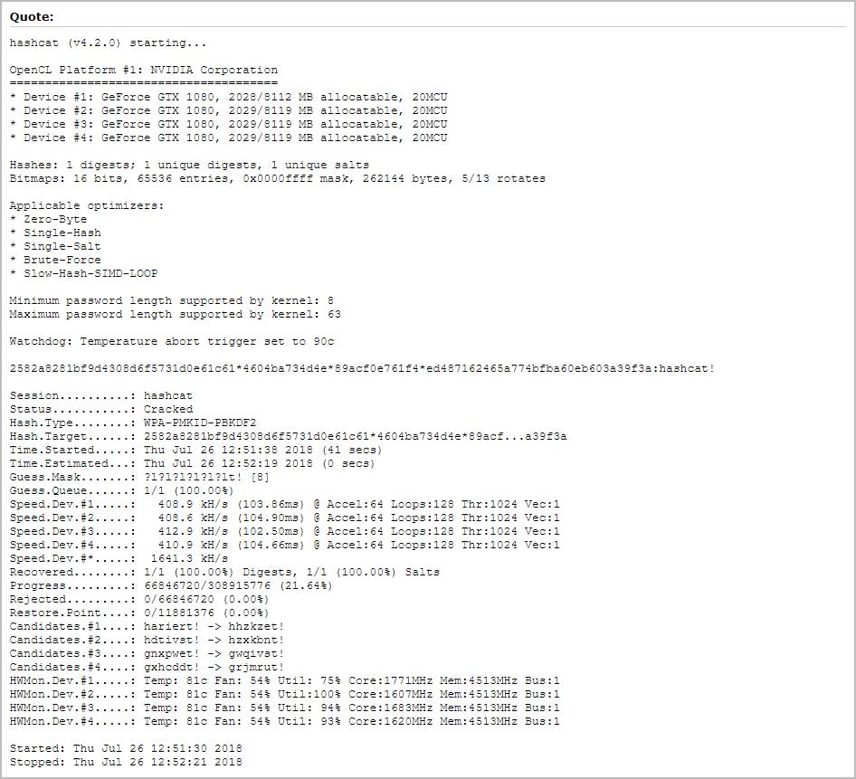

Slide 23
Tutorial
https://www.youtube.com/watch?v=DarsUXcHTSU

