Slide 1
Shifting Cipher (Caesar)

Slide 2
Background

Slide 3
Shift (Caesar) Cipher
Ancient cipher
named after Julius Caesar
It is a type of substitution cipher
One of the simplest and most widely known encryption techniques
each letter in the plaintext is replaced by a letter some fixed number of positions down the alphabet

Slide 4

Example: Left shift of three (k=3)
https://en.wikipedia.org/wiki/Caesar_cipher
E in the plaintext becomes B in the ciphertext.

Slide 5
Animation

Slide 6
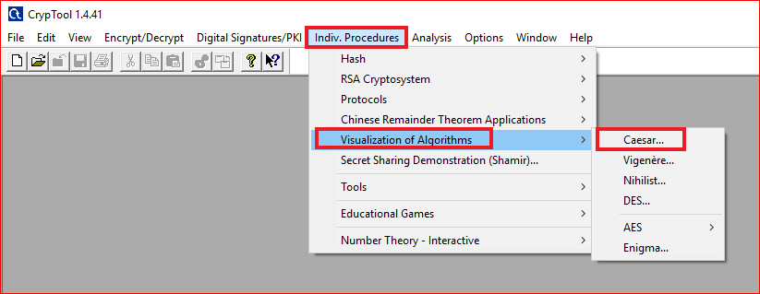

Slide 7
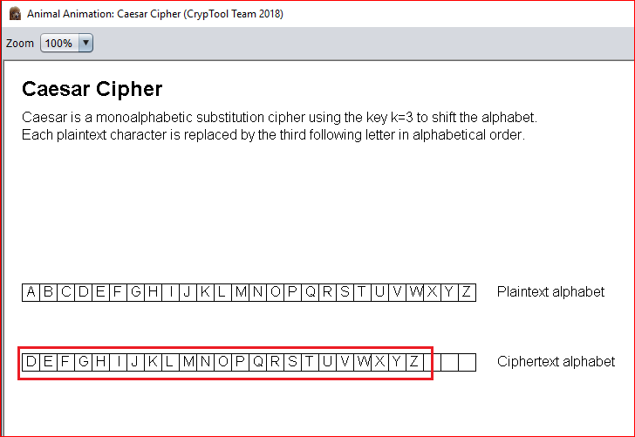

Slide 8
Using Tool

Slide 9
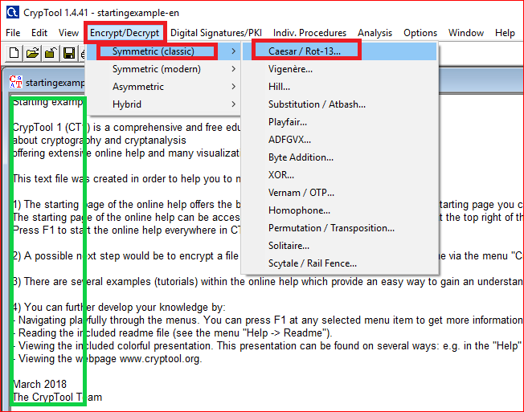

Slide 10
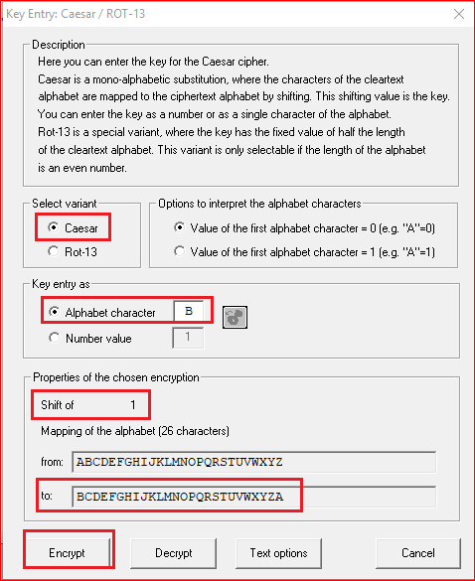
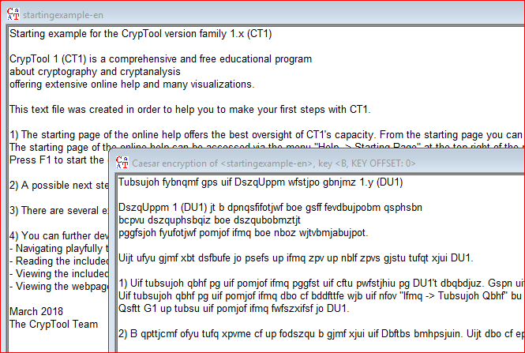

Slide 11
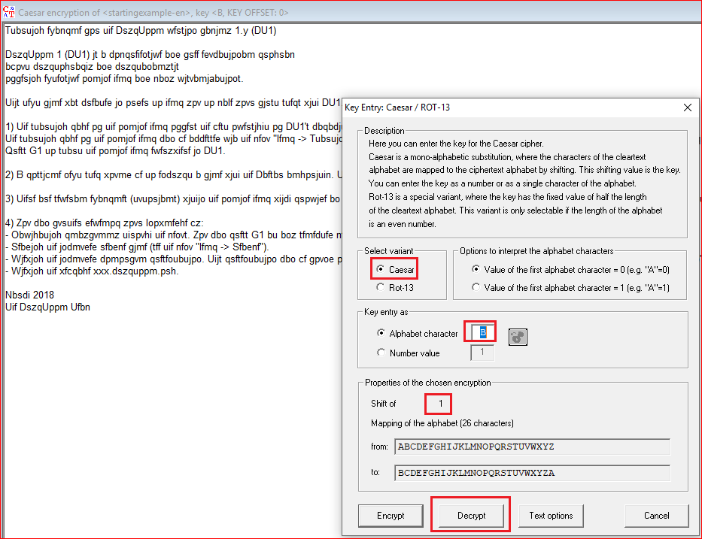
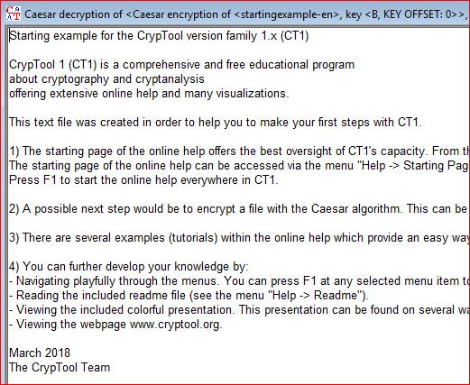

Slide 12
Question
Encrypt and decrypt “hello shifting”
Pick up your own key

Slide 13
Math and Shift Cipher
Modular arithmetic

Slide 14
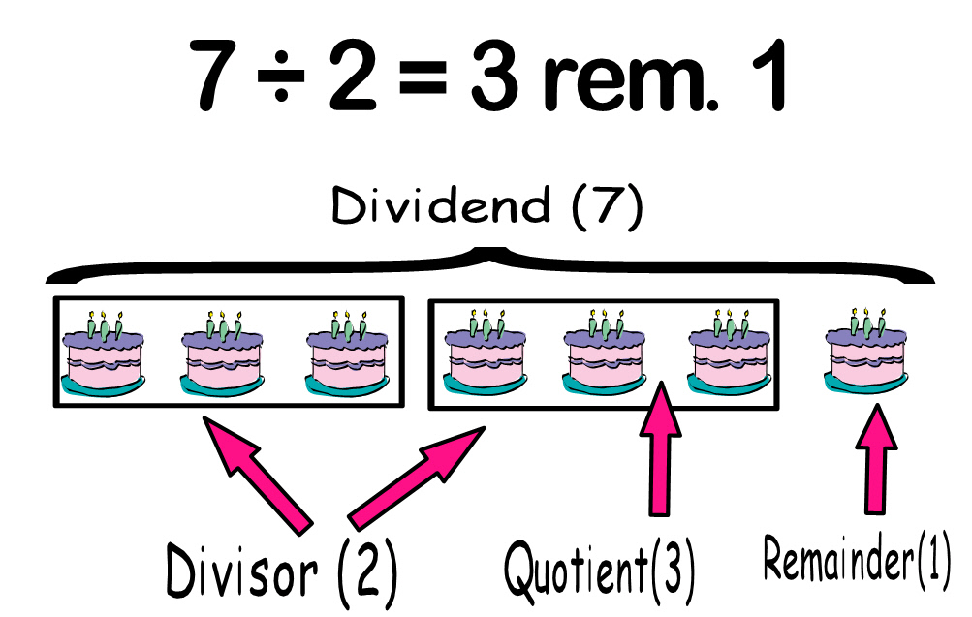
Remainder and Modulo operation
7 mod 2 = 1
modulo
modulus
remainder
7 ≡ 1 mod 2

Slide 15
Examples
12 ≡ 3 mod 9
12-3 divisible by 9
34 ≡ 7 mod 9
34-7 divisible by 9
11 ≡ 2 mod 9
11-2 divisible by 9

Slide 16
Attack

Slide 17
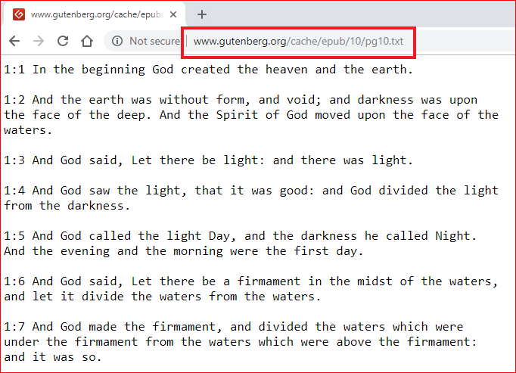
http://www.gutenberg.org/cache/epub/10/pg10.txt

Slide 18
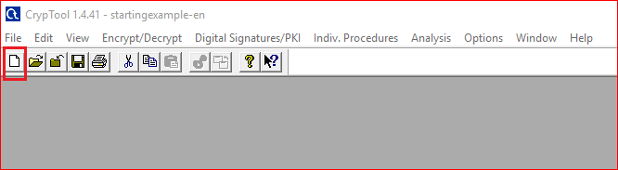
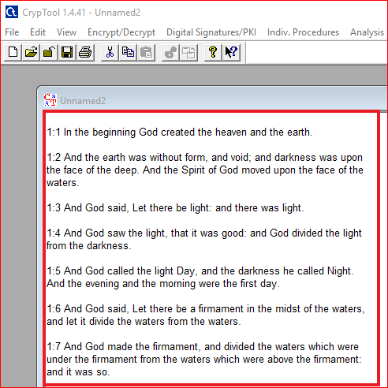

Slide 19
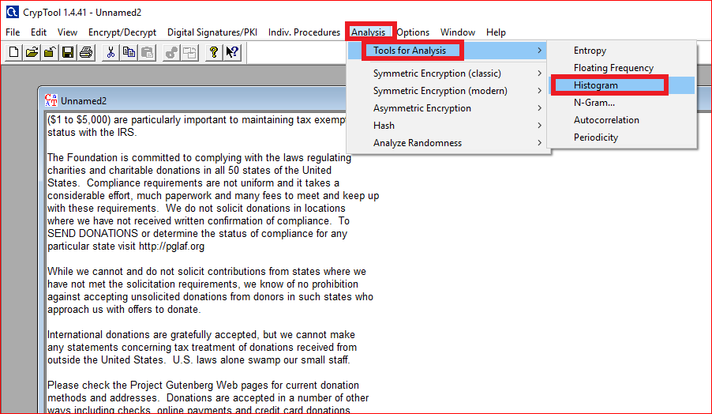
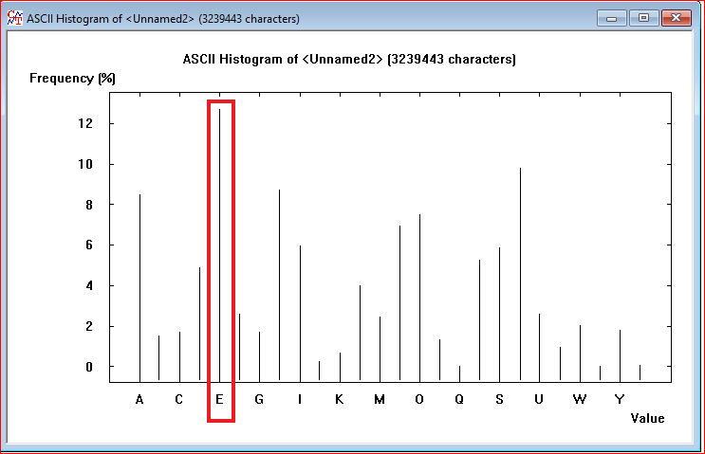

Slide 20
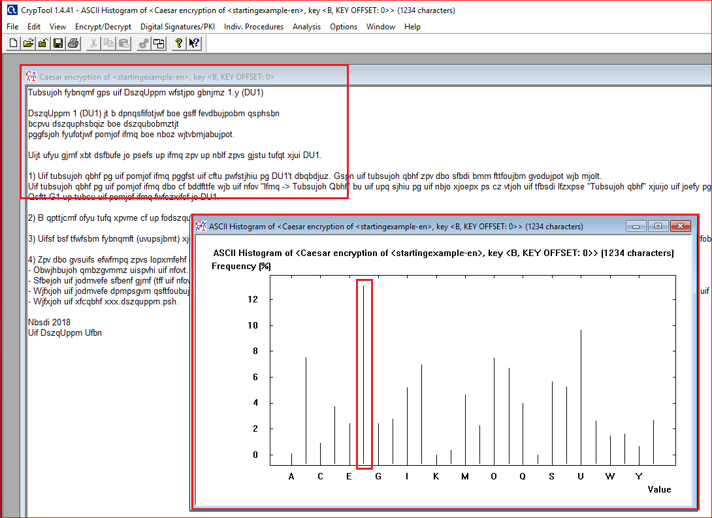

Slide 21
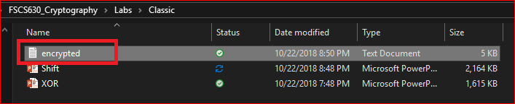
Question: how to decrypt the file?

