Slide 1
Introduction to Cryptography

Slide 2
Field of Cryptology

Slide 3
Cryptology
Cryptography
Symmetric Ciphers
Asymmetric Ciphers
Cryptanalysis
Protocols

Slide 4
Symmetric Cryptography Example
secret-key

Slide 5




Problem of Internet: Unsecure
Unsecure
Bad guy

Slide 6
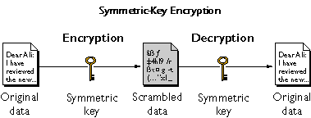

https://www.ibm.com/support/knowledgecenter/en/SSB23S_1.1.0.14/gtps7/s7symm.html

Slide 7
x=plaintext
K
y=ciphertext
K
key space = Set of all keys {K1, K2, ...,Kn}
https://www.ibm.com/support/knowledgecenter/en/SSB23S_1.1.0.14/gtps7/s7symm.html

Slide 8
Math Formula for symmetric cryptography
Encryption equation y = e (x, k)
Decryption equation x = d (y, k)
The key transmission
Must via a secure channel between Alice and Bob.
Methods
Manually installing the key for the Wi-Fi Protected Access (WPA) protocol
Post office

Slide 9
The idea of secure communication
The system is only secure if an attacker does not learn the key K
The problem of secure communication is reduced to secure transmission the key K

Slide 10
Cryptanalysis

Slide 11
Motivation: Why do we need Cryptanalysis
There is no mathematical proof of security for any practical cipher
The only way to have assurance that a cipher is secure is to try to break it (and fail) !

Slide 12
Cryptanalysis
Classical Cryptanalysis
Mathematical Analysis
Brute-Force Attack
implementation Attack
Social Engineering

Slide 13
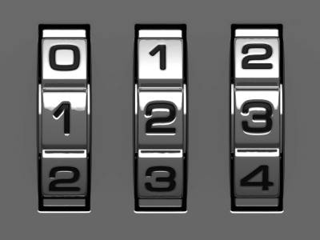
Brute-Force Attack
Repetitive successive attempts of trying various keys (password) combinations to break into any systems
How many keys to we need ?
10*10*10=1000

Slide 14
Key space and key length
Key length (size) in bits
Key space
10*10*10=1000= 2 ¹⁰
x=0 or 1
=
x | x | x | x | x | x | x | x | x | x

Slide 15
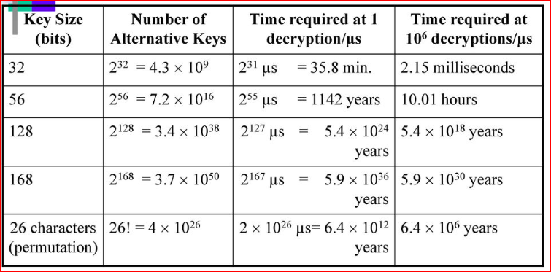
Key strength
https://slideplayer.com/slide/12031562/69/images/53/Average+time+required+for+exhaustive+key+search.jpg

Slide 16
Substitution Cipher

Slide 17
Substitution Cipher
Historical cipher
Great tool for understanding brute-force vs. analytical attacks
Encrypts letters rather than bits

Slide 18
Example
Plain alphabet
a | b | c | d | e | f | g | h | i | j | a | l | m | n | o | p | q | r | s | t | u | v | w | x | y | z
g | w | e | r | h | j | y | o | l | i | a | n | c | m | z | q | f | u | t | p | k | f | s | x | v | b
Cipher alphabet
HELLO=>OHNNZ
GWERHJYOLIANCMZQFUTPKDSXVB

Slide 19
Crypt Tool

Slide 20
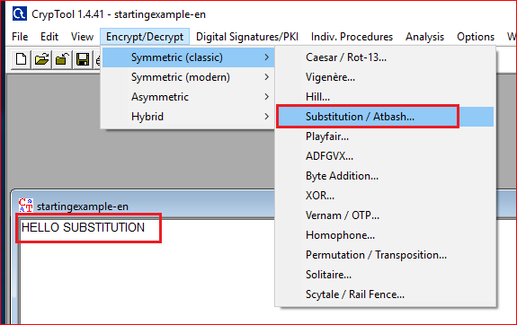

Slide 21
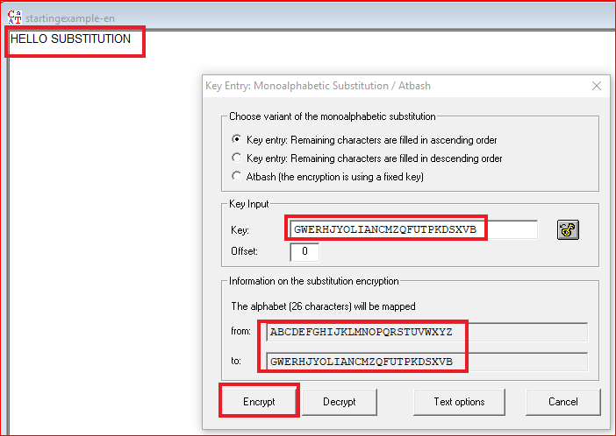

Encryption

Slide 22
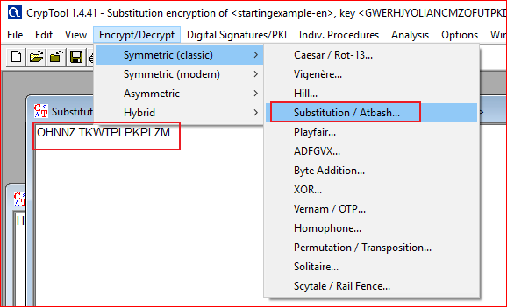
Decryption

Slide 23
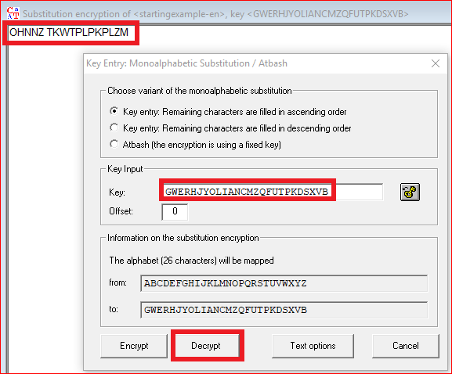

Set up key and decrypt

Slide 24
Cryptanalysis
Attacks against the Substitution Cipher

Slide 25
Brute-Force Attack
How many substitution keys are there?
26 x 25 x … x 3 x 2 x 1 = 26! ≈ 2⁸⁸
Infeasible with today‘s computers
hs the substitution cipher secure?
No! We have to protect against all possible attacks
Letter frequency Analysis can break the substitution cipher

Slide 26
Letter frequency Analysis
A mathematical analysis attack

Slide 27
Problem
GFS WMY OG LGDVS MF SFNKYHOSU ESLLMRS, PC WS BFGW POL DMFRQMRS, PL OG CPFU M UPCCSKSFO HDMPFOSXO GC OIS LMES DMFRQMRS DGFR SFGQRI OG CPDD GFS LISSO GK LG, MFU OISF WS NGQFO OIS GNNQKKSFNSL GC SMNI DSOOSK. WS NMDD OIS EGLO CKSJQSFODY GNNQKKPFR DSOOSK OIS 'CPKLO', OIS FSXO EGLO GNNQKKPFR DSOOSK OIS 'LSNGFU' OIS CGDDGWPFR EGLO GNNQKKPFR DSOOSK OIS 'OIPKU', MFU LG GF, QFOPD WS MNNGQFO CGK MDD OIS UPCCSKSFO DSOOSKL PF OIS HDMPFOSXO LMEHDS. OISF WS DGGB MO OIS NPHISK OSXO WS WMFO OG LGDVS MFU WS MDLG NDMLLPCY POL LYEAGDL. WS CPFU OIS EGLO GNNQKKPFR LYEAGD MFU NIMFRS PO OG OIS CGKE GC OIS 'CPKLO' DSOOSK GC OIS HDMPFOSXO LMEHDS, OIS FSXO EGLO NGEEGF LYEAGD PL NIMFRSU OG OIS CGKE GC OIS 'LSNGFU' DSOOSK, MFU OIS CGDDGWPFR EGLO NGEEGF LYEAGD PL NIMFRSU OG OIS CGKE GC OIS 'OIPKU' DSOOSK, MFU LG GF, QFOPD WS MNNGQFO CGK MDD LYEAGDL GC OIS NKYHOGRKME WS WMFO OG LGDVS.
http://crypto.interactive-maths.com/frequency-analysis-breaking-the-code.html

Slide 28
Letter frequency

Slide 29
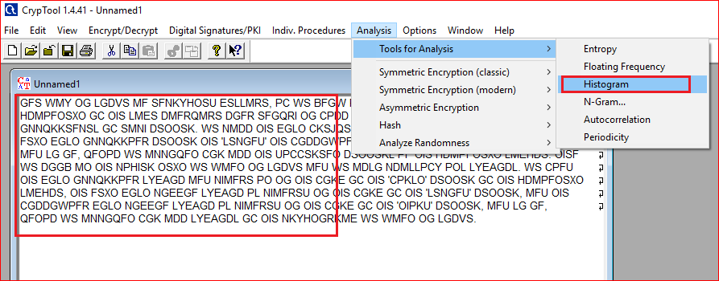
Use tool to generate frequency table

Slide 30
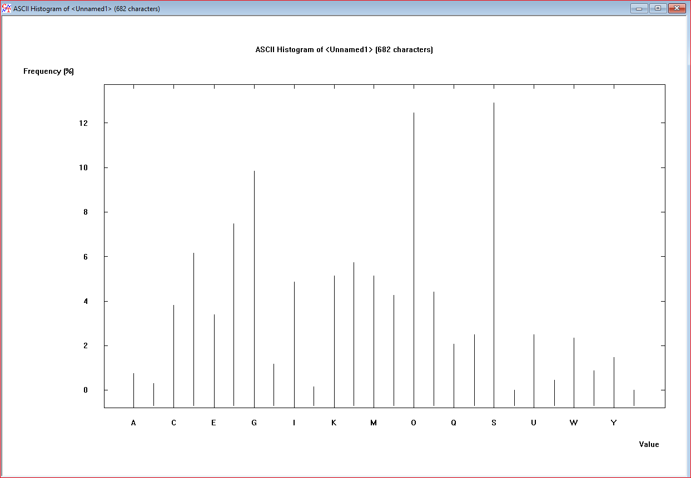

Slide 31
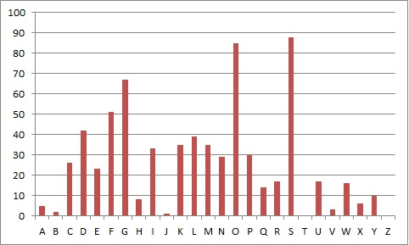
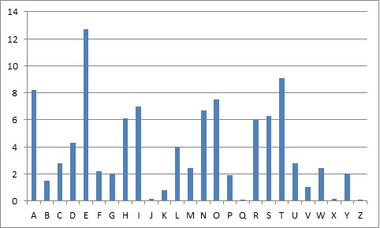
Ciphertext vs. Standard frequency
The letter frequencies of the letters in the ciphertext.
The Standard English Letter Frequencies.

Slide 32
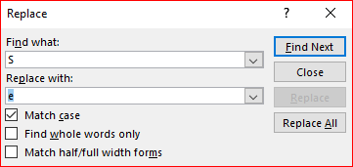
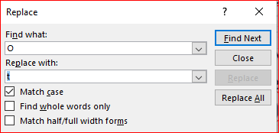
After replacing “S” with “e” and “O” with “t”
GFe WMY tG LGDVe MF eFNKYHteU EeLLMRe, PC We BFGW PtL DMFRQMRe, PL tG CPFU M UPCCeKeFt HDMPFteXt GC tIe LMEe DMFRQMRe DGFR eFGQRI tG CPDD GFe LIeet GK LG, MFU tIeF We NGQFt tIe GNNQKKeFNeL GC eMNI DetteK. We NMDD tIe EGLt CKeJQeFtDY GNNQKKPFR DetteK tIe 'CPKLt', tIe FeXt EGLt GNNQKKPFR DetteK tIe 'LeNGFU' tIe CGDDGWPFR EGLt GNNQKKPFR DetteK tIe 'tIPKU', MFU LG GF, QFtPD We MNNGQFt CGK MDD tIe UPCCeKeFt DetteKL PF tIe HDMPFteXt LMEHDe. tIeF We DGGB Mt tIe NPHIeK teXt We WMFt tG LGDVe MFU We MDLG NDMLLPCY PtL LYEAGDL. We CPFU tIe EGLt GNNQKKPFR LYEAGD MFU NIMFRe Pt tG tIe CGKE GC tIe 'CPKLt' DetteK GC tIe HDMPFteXt LMEHDe, tIe FeXt EGLt NGEEGF LYEAGD PL NIMFReU tG tIe CGKE GC tIe 'LeNGFU' DetteK, MFU tIe CGDDGWPFR EGLt NGEEGF LYEAGD PL NIMFReU tG tIe CGKE GC tIe 'tIPKU' DetteK, MFU LG GF, QFtPD We MNNGQFt CGK MDD LYEAGDL GC tIe NKYHtGRKME We WMFt tG LGDVe.

Slide 33
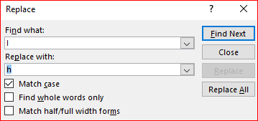
After replacing “I” with “h”
GFe WMY tG LGDVe MF eFNKYHteU EeLLMRe, PC We BFGW PtL DMFRQMRe, PL tG CPFU M UPCCeKeFt HDMPFteXt GC the LMEe DMFRQMRe DGFR eFGQRh tG CPDD GFe Lheet GK LG, MFU theF We NGQFt the GNNQKKeFNeL GC eMNh DetteK. We NMDD the EGLt CKeJQeFtDY GNNQKKPFR DetteK the 'CPKLt', the FeXt EGLt GNNQKKPFR DetteK the 'LeNGFU' the CGDDGWPFR EGLt GNNQKKPFR DetteK the 'thPKU', MFU LG GF, QFtPD We MNNGQFt CGK MDD the UPCCeKeFt DetteKL PF the HDMPFteXt LMEHDe. theF We DGGB Mt the NPHheK teXt We WMFt tG LGDVe MFU We MDLG NDMLLPCY PtL LYEAGDL. We CPFU the EGLt GNNQKKPFR LYEAGD MFU NhMFRe Pt tG the CGKE GC the 'CPKLt' DetteK GC the HDMPFteXt LMEHDe, the FeXt EGLt NGEEGF LYEAGD PL NhMFReU tG the CGKE GC the 'LeNGFU' DetteK, MFU the CGDDGWPFR EGLt NGEEGF LYEAGD PL NhMFReU tG the CGKE GC the 'thPKU' DetteK, MFU LG GF, QFtPD We MNNGQFt CGK MDD LYEAGDL GC the NKYHtGRKME We WMFt tG LGDVe

Slide 34
Ciphertext vs. Standard frequency (G=>{A,I,O})
The letter frequencies of the letters in the ciphertext.
The Standard English Letter Frequencies.

Slide 35
G=>{A,I,O})?
GFe WMY tG LGDVe MF eFNKYHteU EeLLMRe, PC We BFGW PtL DMFRQMRe, PL tG CPFU M UPCCeKeFt HDMPFteXt GC the LMEe DMFRQMRe DGFR eFGQRh tG CPDD GFe Lheet GK LG, MFU theF We NGQFt the GNNQKKeFNeL GC eMNh DetteK. We NMDD the EGLt CKeJQeFtDY GNNQKKPFR DetteK the 'CPKLt', the FeXt EGLt GNNQKKPFR DetteK the 'LeNGFU' the CGDDGWPFR EGLt GNNQKKPFR DetteK the 'thPKU', MFU LG GF, QFtPD We MNNGQFt CGK MDD the UPCCeKeFt DetteKL PF the HDMPFteXt LMEHDe. theF We DGGB Mt the NPHheK teXt We WMFt tG LGDVe MFU We MDLG NDMLLPCY PtL LYEAGDL. We CPFU the EGLt GNNQKKPFR LYEAGD MFU NhMFRe Pt tG the CGKE GC the 'CPKLt' DetteK GC the HDMPFteXt LMEHDe, the FeXt EGLt NGEEGF LYEAGD PL NhMFReU tG the CGKE GC the 'LeNGFU' DetteK, MFU the CGDDGWPFR EGLt NGEEGF LYEAGD PL NhMFReU tG the CGKE GC the 'thPKU' DetteK, MFU LG GF, QFtPD We MNNGQFt CGK MDD LYEAGDL GC the NKYHtGRKME We WMFt tG LGDVe
tG=tO?

Slide 36
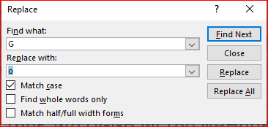
After replacing “G” with “o”
oFe WMY to LoDVe MF eFNKYHteU EeLLMRe, PC We BFoW PtL DMFRQMRe, PL to CPFU M UPCCeKeFt HDMPFteXt oC the LMEe DMFRQMRe DoFR eFoQRh to CPDD oFe Lheet oK Lo, MFU theF We NoQFt the oNNQKKeFNeL oC eMNh DetteK. We NMDD the EoLt CKeJQeFtDY oNNQKKPFR DetteK the 'CPKLt', the FeXt EoLt oNNQKKPFR DetteK the 'LeNoFU' the CoDDoWPFR EoLt oNNQKKPFR DetteK the 'thPKU', MFU Lo oF, QFtPD We MNNoQFt CoK MDD the UPCCeKeFt DetteKL PF the HDMPFteXt LMEHDe. theF We DooB Mt the NPHheK teXt We WMFt to LoDVe MFU We MDLo NDMLLPCY PtL LYEAoDL. We CPFU the EoLt oNNQKKPFR LYEAoD MFU NhMFRe Pt to the CoKE oC the 'CPKLt' DetteK oC the HDMPFteXt LMEHDe, the FeXt EoLt NoEEoF LYEAoD PL NhMFReU to the CoKE oC the 'LeNoFU' DetteK, MFU the CoDDoWPFR EoLt NoEEoF LYEAoD PL NhMFReU to the CoKE oC the 'thPKU' DetteK, MFU Lo oF, QFtPD We MNNoQFt CoK MDD LYEAoDL oC the NKYHtoRKME We WMFt to LoDVe

Slide 37
After replacing “F” with “n”
one WMY to LoDVe Mn enNKYHteU EeLLMRe, PC We BnoW PtL DMnRQMRe, PL to CPnU M UPCCeKent HDMPnteXt oC the LMEe DMnRQMRe DonR enoQRh to CPDD one Lheet oK Lo, MnU then We NoQnt the oNNQKKenNeL oC eMNh DetteK. We NMDD the EoLt CKeJQentDY oNNQKKPnR DetteK the 'CPKLt', the neXt EoLt oNNQKKPnR DetteK the 'LeNonU' the CoDDoWPnR EoLt oNNQKKPnR DetteK the 'thPKU', MnU Lo on, QntPD We MNNoQnt CoK MDD the UPCCeKent DetteKL Pn the HDMPnteXt LMEHDe. then We DooB Mt the NPHheK teXt We WMnt to LoDVe MnU We MDLo NDMLLPCY PtL LYEAoDL. We CPnU the EoLt oNNQKKPnR LYEAoD MnU NhMnRe Pt to the CoKE oC the 'CPKLt' DetteK oC the HDMPnteXt LMEHDe, the neXt EoLt NoEEon LYEAoD PL NhMnReU to the CoKE oC the 'LeNonU' DetteK, MnU the CoDDoWPnR EoLt NoEEon LYEAoD PL NhMnReU to the CoKE oC the 'thPKU' DetteK, MnU Lo on, QntPD We MNNoQnt CoK MDD LYEAoDL oC the NKYHtoRKME We WMnt to LoDVe
Lheet =sheet?

Slide 38
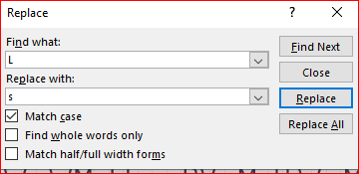
After replacing “L” with “s”
one WMY to soDVe Mn enNKYHteU EessMRe, PC We BnoW Pts DMnRQMRe, Ps to CPnU M UPCCeKent HDMPnteXt oC the sMEe DMnRQMRe DonR enoQRh to CPDD one sheet oK so, MnU then We NoQnt the oNNQKKenNes oC eMNh DetteK. We NMDD the Eost CKeJQentDY oNNQKKPnR DetteK the 'CPKst', the neXt Eost oNNQKKPnR DetteK the 'seNonU' the CoDDoWPnR Eost oNNQKKPnR DetteK the 'thPKU', MnU so on, QntPD We MNNoQnt CoK MDD the UPCCeKent DetteKs Pn the HDMPnteXt sMEHDe. then We DooB Mt the NPHheK teXt We WMnt to soDVe MnU We MDso NDMssPCY Pts sYEAoDs. We CPnU the Eost oNNQKKPnR sYEAoD MnU NhMnRe Pt to the CoKE oC the 'CPKst' DetteK oC the HDMPnteXt sMEHDe, the neXt Eost NoEEon sYEAoD Ps NhMnReU to the CoKE oC the 'seNonU' DetteK, MnU the CoDDoWPnR Eost NoEEon sYEAoD Ps NhMnReU to the CoKE oC the 'thPKU' DetteK, MnU so on, QntPD We MNNoQnt CoK MDD sYEAoDs oC the NKYHtoRKME We WMnt to soDVe
soDVe=solve

Slide 39
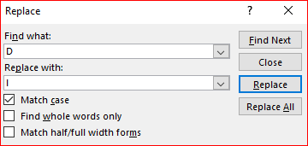
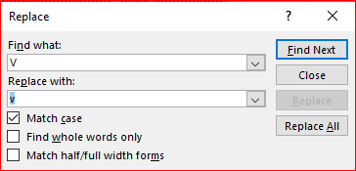
After replacing “D” with “l”
one WMY to solve Mn enNKYHteU EessMRe, PC We BnoW Pts lMnRQMRe, Ps to CPnU M UPCCeKent HlMPnteXt oC the sMEe lMnRQMRe lonR enoQRh to CPll one sheet oK so, MnU then We NoQnt the oNNQKKenNes oC eMNh letteK. We NMll the Eost CKeJQentlY oNNQKKPnR letteK the 'CPKst', the neXt Eost oNNQKKPnR letteK the 'seNonU' the ColloWPnR Eost oNNQKKPnR letteK the 'thPKU', MnU so on, QntPl We MNNoQnt CoK Mll the UPCCeKent letteKs Pn the HlMPnteXt sMEHle. then We looB Mt the NPHheK teXt We WMnt to solve MnU We Mlso NlMssPCY Pts sYEAols. We CPnU the Eost oNNQKKPnR sYEAol MnU NhMnRe Pt to the CoKE oC the 'CPKst' letteK oC the HlMPnteXt sMEHle, the neXt Eost NoEEon sYEAol Ps NhMnReU to the CoKE oC the 'seNonU' letteK, MnU the ColloWPnR Eost NoEEon sYEAol Ps NhMnReU to the CoKE oC the 'thPKU' letteK, MnU so on, QntPl We MNNoQnt CoK Mll sYEAols oC the NKYHtoRKME We WMnt to solve
oK=or

Slide 40
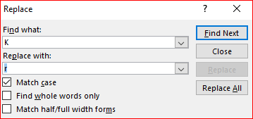
After replacing “K” with “r”
one WMY to solve Mn enNrYHteU EessMRe, PC We BnoW Pts lMnRQMRe, Ps to CPnU M UPCCerent HlMPnteXt oC the sMEe lMnRQMRe lonR enoQRh to CPll one sheet or so, MnU then We NoQnt the oNNQrrenNes oC eMNh letter. We NMll the Eost CreJQentlY oNNQrrPnR letter the 'CPrst', the neXt Eost oNNQrrPnR letter the 'seNonU' the ColloWPnR Eost oNNQrrPnR letter the 'thPrU', MnU so on, QntPl We MNNoQnt Cor Mll the UPCCerent letters Pn the HlMPnteXt sMEHle. then We looB Mt the NPHher teXt We WMnt to solve MnU We Mlso NlMssPCY Pts sYEAols. We CPnU the Eost oNNQrrPnR sYEAol MnU NhMnRe Pt to the CorE oC the 'CPrst' letter oC the HlMPnteXt sMEHle, the neXt Eost NoEEon sYEAol Ps NhMnReU to the CorE oC the 'seNonU' letter, MnU the ColloWPnR Eost NoEEon sYEAol Ps NhMnReU to the CorE oC the 'thPrU' letter, MnU so on, QntPl We MNNoQnt Cor Mll sYEAols oC the NrYHtoRrME We WMnt to solve
lonR =long?
enoQRh=enough?

Slide 41
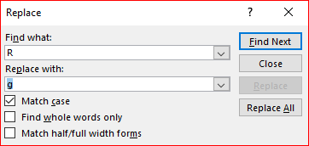
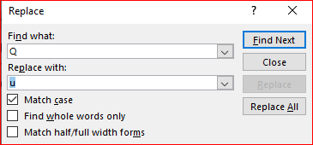
After replacing “R” with “g”, “Q” with “u”
one WMY to solve Mn enNrYHteU EessMge, PC We BnoW Pts lMnguMge, Ps to CPnU M UPCCerent HlMPnteXt oC the sMEe lMnguMge long enough to CPll one sheet or so, MnU then We Nount the oNNurrenNes oC eMNh letter. We NMll the Eost CreJuentlY oNNurrPng letter the 'CPrst', the neXt Eost oNNurrPng letter the 'seNonU' the ColloWPng Eost oNNurrPng letter the 'thPrU', MnU so on, untPl We MNNount Cor Mll the UPCCerent letters Pn the HlMPnteXt sMEHle. then We looB Mt the NPHher teXt We WMnt to solve MnU We Mlso NlMssPCY Pts sYEAols. We CPnU the Eost oNNurrPng sYEAol MnU NhMnge Pt to the CorE oC the 'CPrst' letter oC the HlMPnteXt sMEHle, the neXt Eost NoEEon sYEAol Ps NhMngeU to the CorE oC the 'seNonU' letter, MnU the ColloWPng Eost NoEEon sYEAol Ps NhMngeU to the CorE oC the 'thPrU' letter, MnU so on, untPl We MNNount Cor Mll sYEAols oC the NrYHtogrME We WMnt to solve
EssMge=message
Nount=count

Slide 42
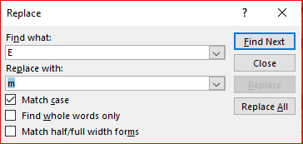
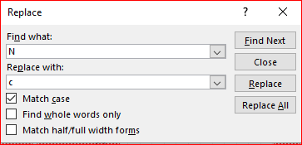
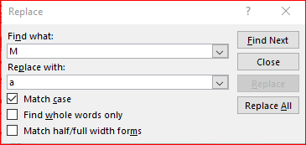
After replacing “E” with “m”, “N” with “c”, “M” with “a”
one WaY to solve an encrYHteU message, PC We BnoW Pts language, Ps to CPnU a UPCCerent HlaPnteXt oC the same language long enough to CPll one sheet or so, anU then We count the occurrences oC each letter. We call the most CreJuentlY occurrPng letter the 'CPrst', the neXt most occurrPng letter the 'seconU' the ColloWPng most occurrPng letter the 'thPrU', anU so on, untPl We account Cor all the UPCCerent letters Pn the HlaPnteXt samHle. then We looB at the cPHher teXt We Want to solve anU We also classPCY Pts sYmAols. We CPnU the most occurrPng sYmAol anU change Pt to the Corm oC the 'CPrst' letter oC the HlaPnteXt samHle, the neXt most common sYmAol Ps changeU to the Corm oC the 'seconU' letter, anU the ColloWPng most common sYmAol Ps changeU to the Corm oC the 'thPrU' letter, anU so on, untPl We account Cor all sYmAols oC the crYHtogram We Want to solve

Slide 43
“W” => “w”, “Y” => “y”, “X” => “x” , “U”=> “d”
one way to solve an encryHted message, PC we Bnow Pts language, Ps to CPnd a dPCCerent HlaPntext oC the same language long enough to CPll one sheet or so, and then we count the occurrences oC each letter. we call the most CreJuently occurrPng letter the 'CPrst', the next most occurrPng letter the 'second' the CollowPng most occurrPng letter the 'thPrd', and so on, untPl we account Cor all the dPCCerent letters Pn the HlaPntext samHle. then we looB at the cPHher text we want to solve and we also classPCy Pts symAols. we CPnd the most occurrPng symAol and change Pt to the Corm oC the 'CPrst' letter oC the HlaPntext samHle, the next most common symAol Ps changed to the Corm oC the 'second' letter, and the CollowPng most common symAol Ps changed to the Corm oC the 'thPrd' letter, and so on, untPl we account Cor all symAols oC the cryHtogram we want to solve

Slide 44
“H” => “p”, “B” => “k”, “P” => “i”
one way to solve an encrypted message, iC we know its language, is to Cind a diCCerent plaintext oC the same language long enough to Cill one sheet or so, and then we count the occurrences oC each letter. we call the most CreJuently occurring letter the 'Cirst', the next most occurring letter the 'second' the Collowing most occurring letter the 'third', and so on, until we account Cor all the diCCerent letters in the plaintext sample. then we look at the cipher text we want to solve and we also classiCy its symAols. we Cind the most occurring symAol and change it to the Corm oC the 'Cirst' letter oC the plaintext sample, the next most common symAol is changed to the Corm oC the 'second' letter, and the Collowing most common symAol is changed to the Corm oC the 'third' letter, and so on, until we account Cor all symAols oC the cryptogram we want to solve

Slide 45
“C” => “f”, “A” => “b”
one way to solve an encrypted message, if we know its language, is to find a different plaintext of the same language long enough to fill one sheet or so, and then we count the occurrences of each letter. we call the most freJuently occurring letter the 'first', the next most occurring letter the 'second' the following most occurring letter the 'third', and so on, until we account for all the different letters in the plaintext sample. then we look at the cipher text we want to solve and we also classify its symbols. we find the most occurring symbol and change it to the form of the 'first' letter of the plaintext sample, the next most common symbol is changed to the form of the 'second' letter, and the following most common symbol is changed to the form of the 'third' letter, and so on, until we account for all symbols of the cryptogram we want to solve

Slide 46
“J” => “q”
one way to solve an encrypted message, if we know its language, is to find a different plaintext of the same language long enough to fill one sheet or so, and then we count the occurrences of each letter. we call the most frequently occurring letter the 'first', the next most occurring letter the 'second' the following most occurring letter the 'third', and so on, until we account for all the different letters in the plaintext sample. then we look at the cipher text we want to solve and we also classify its symbols. we find the most occurring symbol and change it to the form of the 'first' letter of the plaintext sample, the next most common symbol is changed to the form of the 'second' letter, and the following most common symbol is changed to the form of the 'third' letter, and so on, until we account for all symbols of the cryptogram we want to solve

Slide 47
Your work
ZL HAMDIKJAUDBM, U QYRQIZIYIZKL HZDBGA ZQ U XGIBKE KW GLHAMDIZLJ RM OBZHB YLZIQ KW DNUZLIGPI UAG AGDNUHGE OZIB HZDBGAIGPI, UHHKAEZLJ IK U WZPGE QMQIGX; IBG "YLZIQ" XUM RG QZLJNG NGIIGAQ (IBG XKQI HKXXKL), DUZAQ KW NGIIGAQ, IAZDNGIQ KW NGIIGAQ, XZPIYAGQ KW IBG URKTG, ULE QK WKAIB. IBG AGHGZTGA EGHZDBGAQ IBG IGPI RM DGAWKAXZLJ IBG ZLTGAQG QYRQIZIYIZKL. QYRQIZIYIZKL HZDBGAQ HUL RG HKXDUAGE OZIB IAULQDKQZIZKL HZDBGAQ. ZL U IAULQDKQZIZKL HZDBGA, IBG YLZIQ KW IBG DNUZLIGPI UAG AGUAAULJGE ZL U EZWWGAGLI ULE YQYUNNM FYZIG HKXDNGP KAEGA, RYI IBG YLZIQ IBGXQGNTGQ UAG NGWI YLHBULJGE. RM HKLIAUQI, ZL U QYRQIZIYIZKL HZDBGA, IBG YLZIQ KW IBG DNUZLIGPI UAG AGIUZLGE ZL IBG QUXG QGFYGLHG ZL IBG HZDBGAIGPI, RYI IBG YLZIQ IBGXQGNTGQ UAG UNIGAGE. IBGAG UAG U LYXRGA KW EZWWGAGLI IMDGQ KW QYRQIZIYIZKL HZDBGA. ZW IBG HZDBGA KDGAUIGQ KL QZLJNG NGIIGAQ, ZI ZQ IGAXGE U QZXDNG QYRQIZIYIZKL HZDBGA; U HZDBGA IBUI KDGAUIGQ KL NUAJGA JAKYDQ KW NGIIGAQ ZQ IGAXGE DKNMJAUDBZH. U XKLKUNDBURGIZH HZDBGA YQGQ WZPGE QYRQIZIYIZKL KTGA IBG GLIZAG XGQQUJG, OBGAGUQ U DKNMUNDBURGIZH HZDBGA YQGQ U LYXRGA KW QYRQIZIYIZKLQ UI EZWWGAGLI DKQZIZKLQ ZL IBG XGQQUJG, OBGAG U YLZI WAKX IBG DNUZLIGPI ZQ XUDDGE IK KLG KW QGTGAUN DKQQZRZNZIZGQ ZL IBG HZDBGAIGPI ULE TZHG TGAQU.
Notes:
URHEGWJBZCVNXLKDFAQIYTOP

Slide 48
Reference
https://en.wikipedia.org/wiki/Substitution_cipher

