Slide 1
Wireless Packets Sniffing

Slide 2
Update Kali (optional)
apt-get update
apt-get upgrade
apt-get dist-upgrade

Slide 3

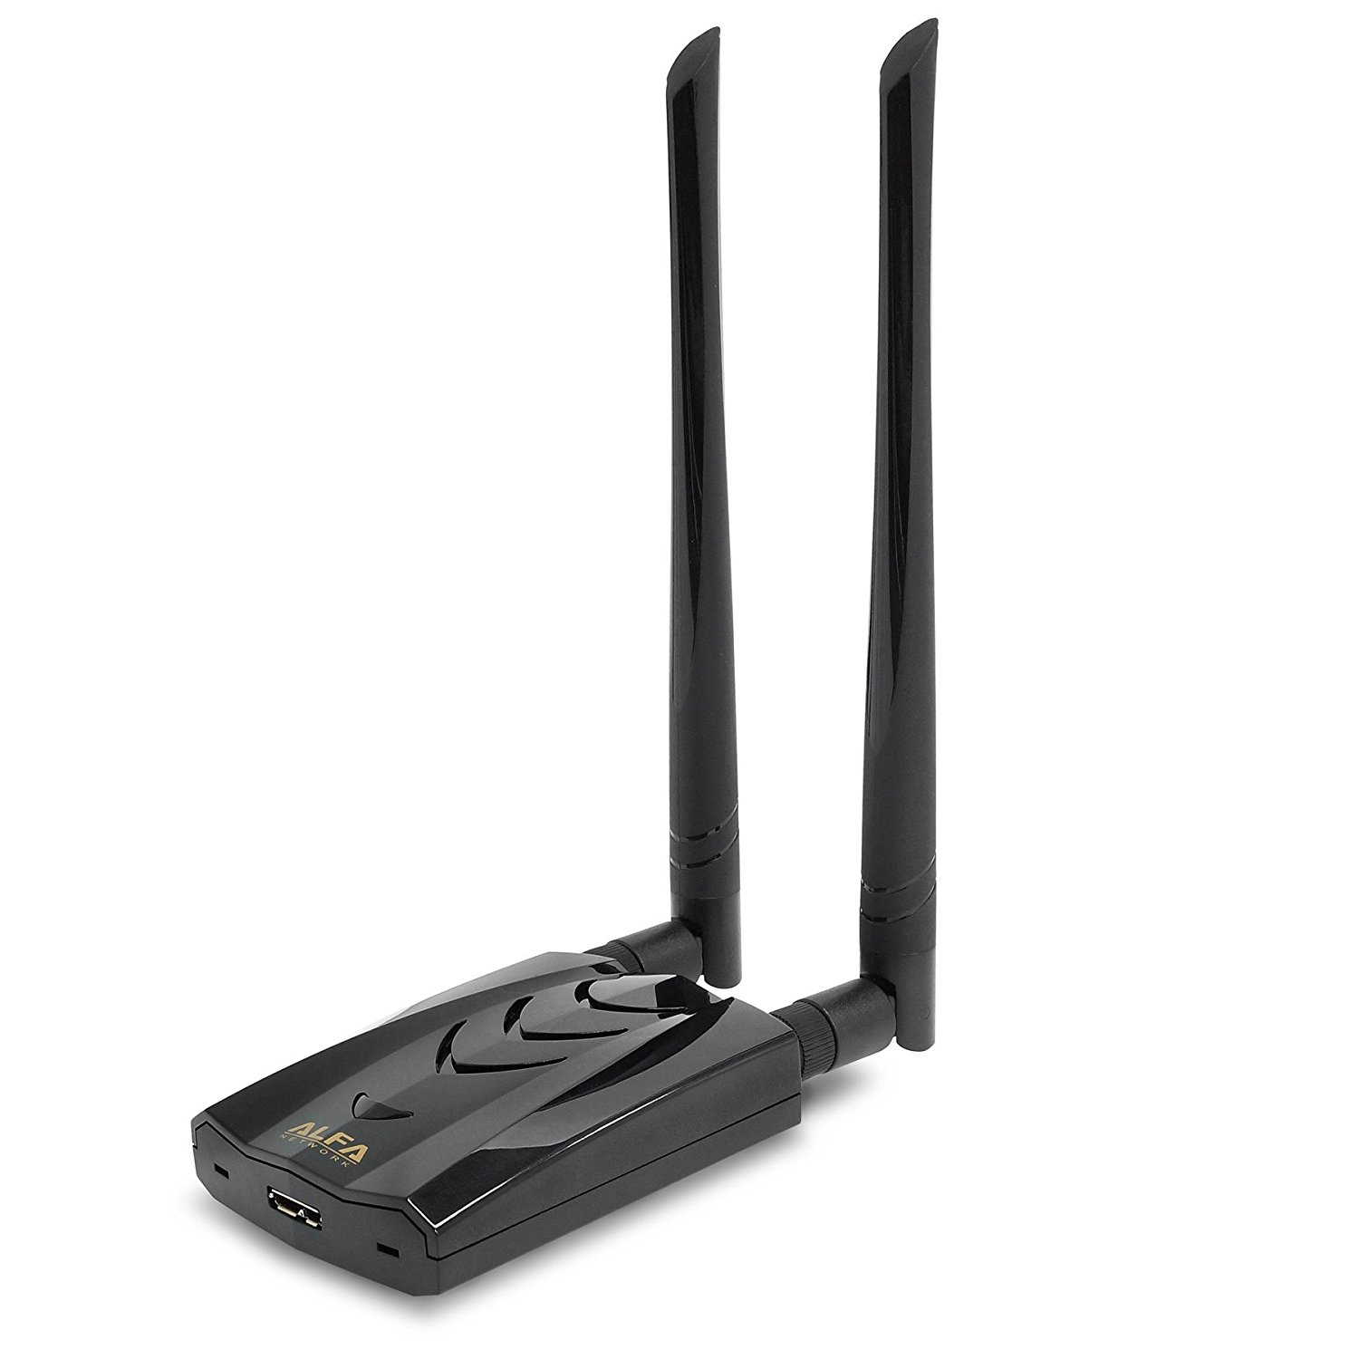
USB wireless adaptors
https://www.amazon.com/Alfa-AWUS036NHA-Wireless-USB-Adaptor/dp/B004Y6MIXS
https://www.amazon.com/Long-Range-Dual-Band-Wireless-External-Antennas/dp/B00VEEBOPG

Slide 4
Method 1

Slide 5
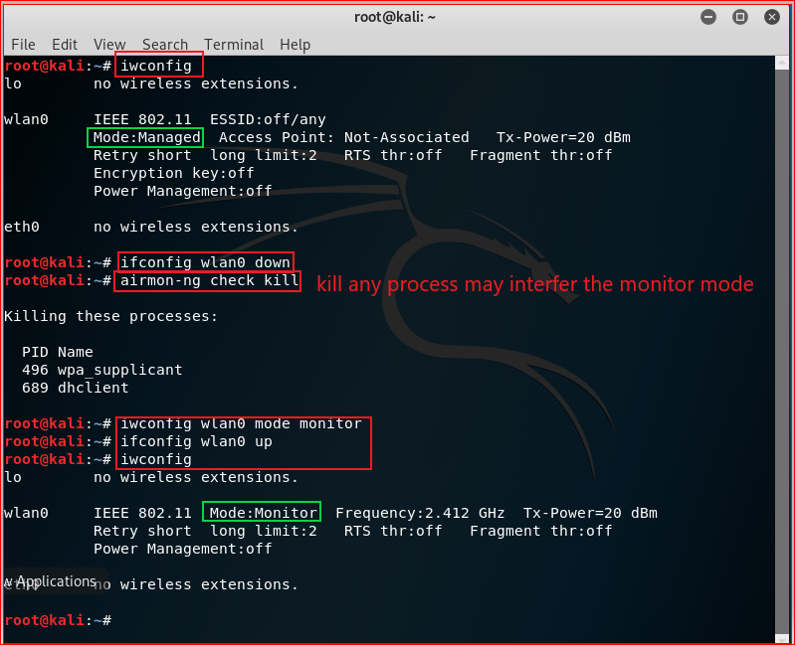

Slide 6


Slide 7
Method 2

Slide 8
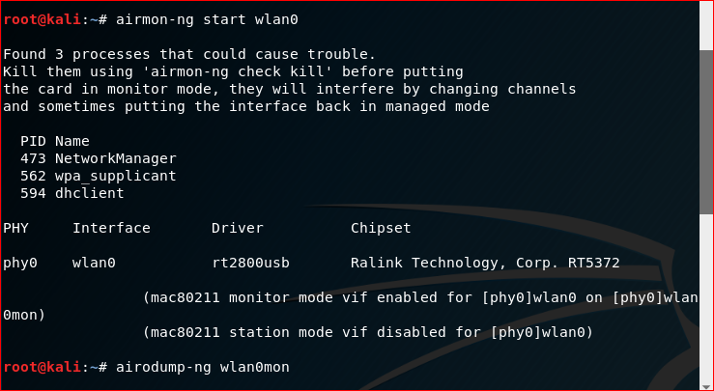

Slide 9
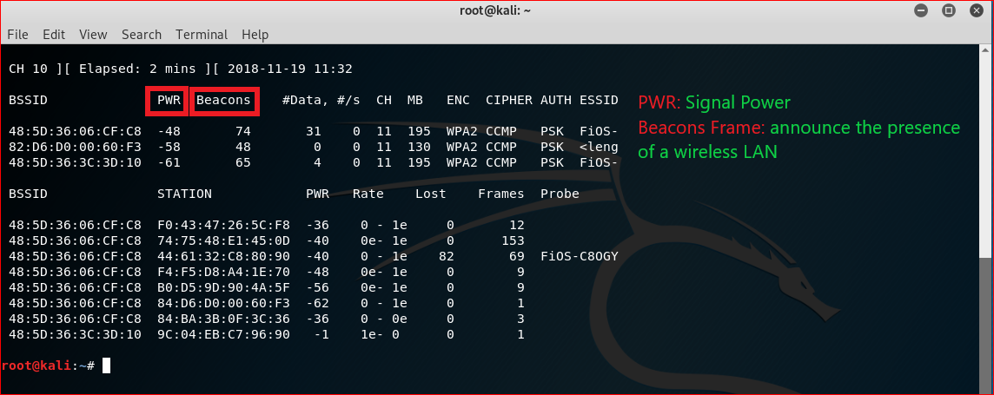
Ctrl-C to stop

Slide 10
Wireless packets sniffing

Slide 11
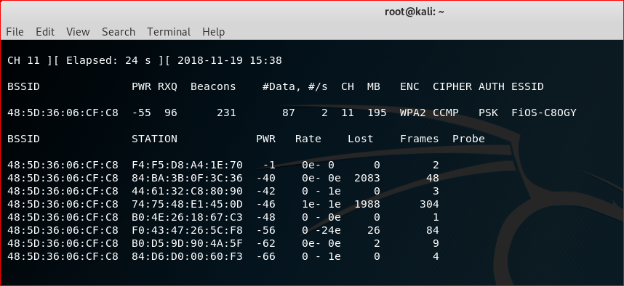

Slide 12
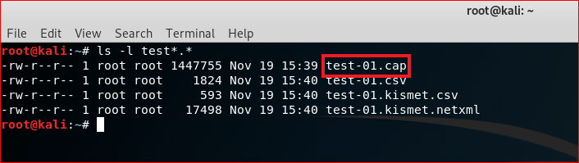

Slide 13
Command Summary
iwconfig
airmon-ng start wlan0
airodump-ng wlan0mon
airmon-ng stop wlan0mon //optional command to disable monitor mode
airodump-ng –channel [channel] –bssid [] –write [file name] wlan0mon

