Slide 1
How to Crack MS-Word Password

Slide 2

Following the PPTs to download required files for the lab

Slide 3

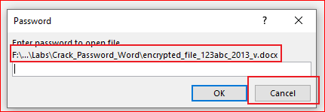
Verify the required files
Try to open the Word file

Slide 4
We are going to find the password!

Slide 5
Extract Hash code of an encrypted Word file

Slide 6
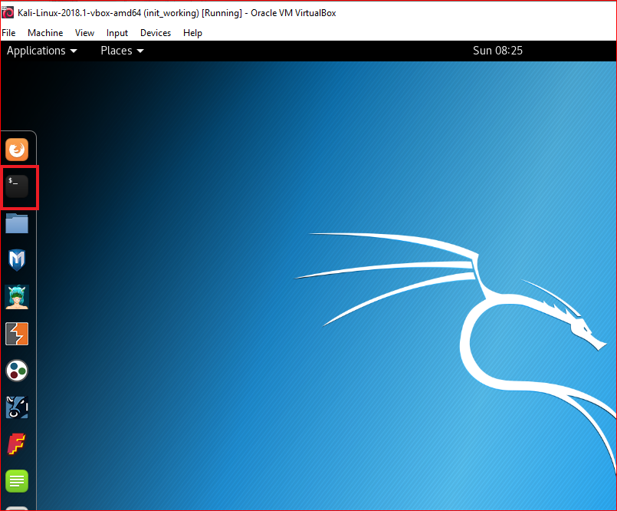
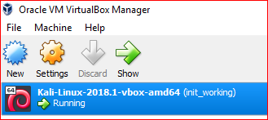

Slide 7
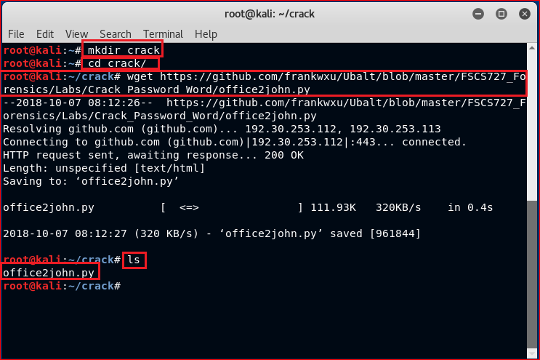

Slide 8

Make office2John runnable

Slide 9


Slide 11
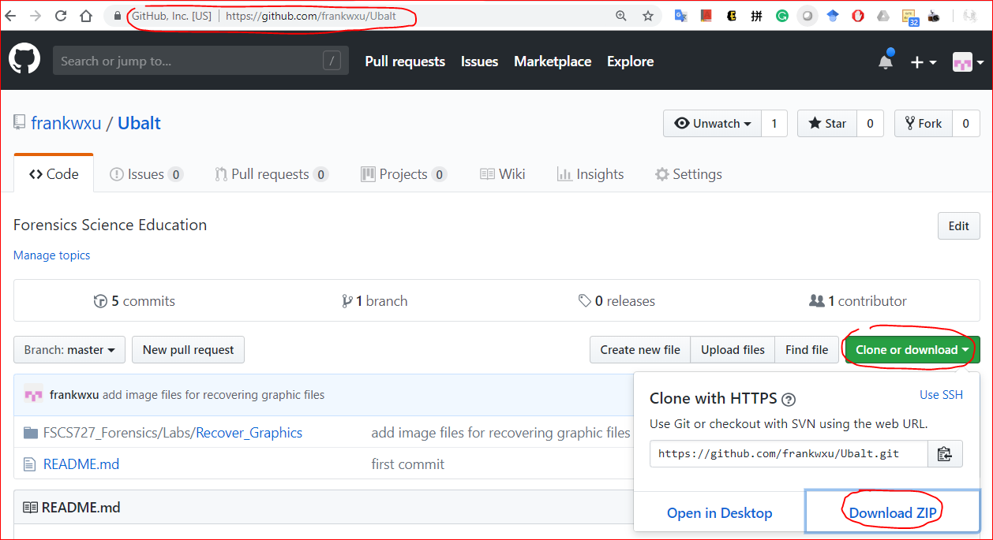
https://github.com/frankwxu/Ubalt

Slide 12
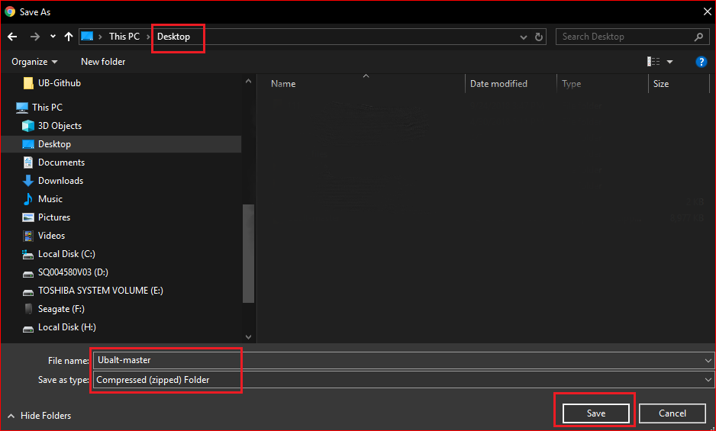

Slide 13
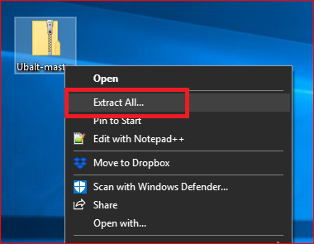
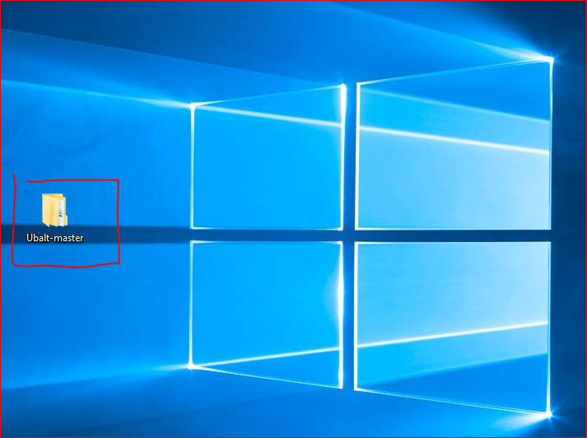

Slide 14


Slide 15
Create a working space

Slide 16
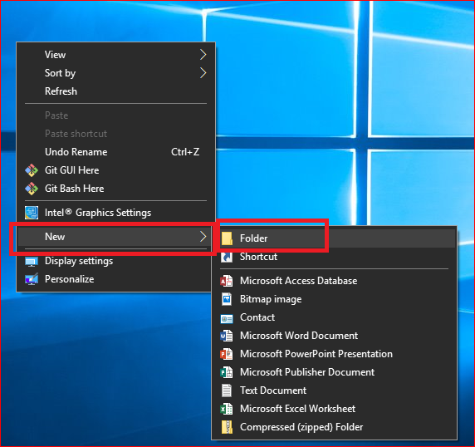
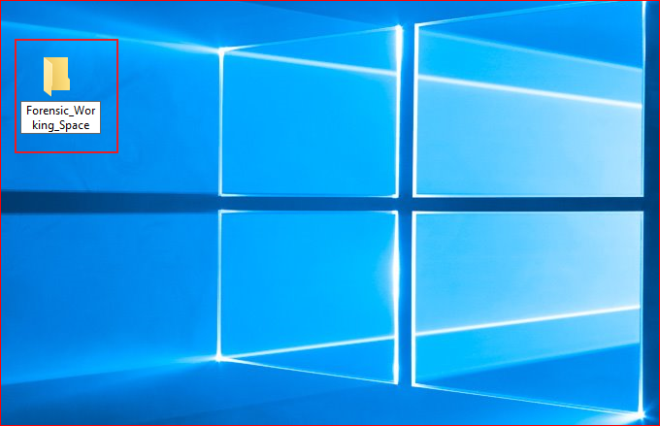

Slide 17
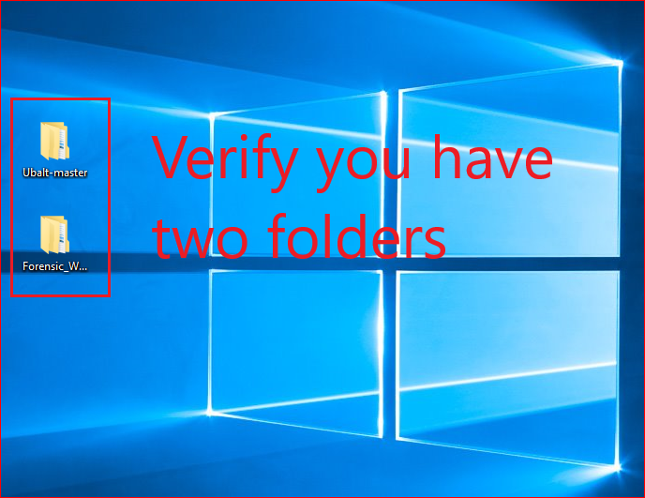

Slide 18
You need to repeat these steps before each lab to get updated files

