Slide 1
Set Wireless USB to Monitor Mode

Slide 3
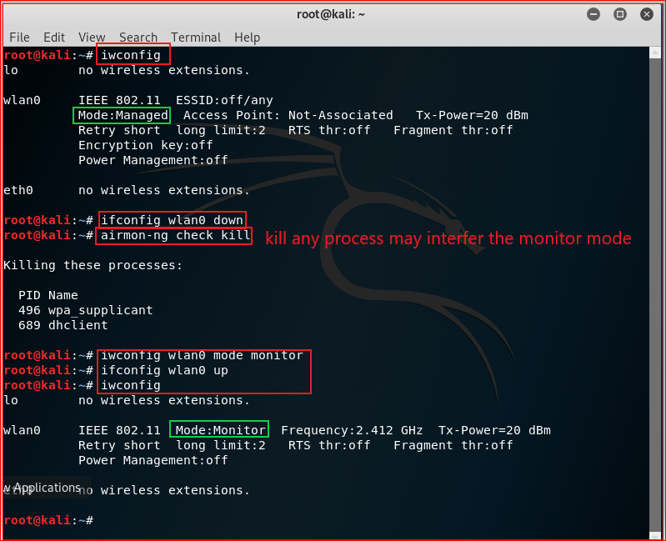

Slide 4


Slide 9
FAT File System Layout on disk

Slide 10
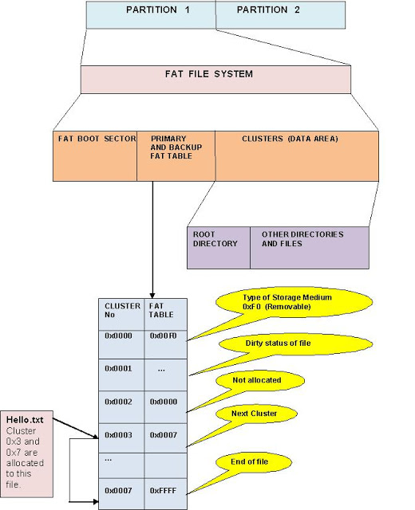
Boot section
Partition Parameters that describe the rest of the file system
It holds a special program (the bootstrap program)
bootstrap program: is used for loading the operating system into memory.
One sector
FAT
a method of keeping track of the contents of a hard drive
used by early Microsoft operating systems
was first introduced in 1977.
Root Directory
contains an entry for each file whose name appears at the root (the top level) of the file system.

Slide 11
FAT 16 Root Sector

Slide 12
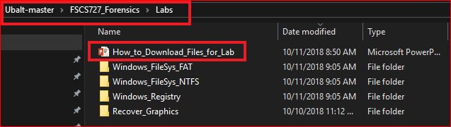
Following the PPTs to download required files for the lab

Slide 13
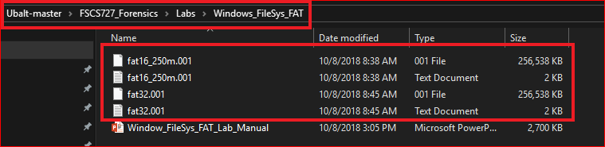
Verify all the files

Slide 14

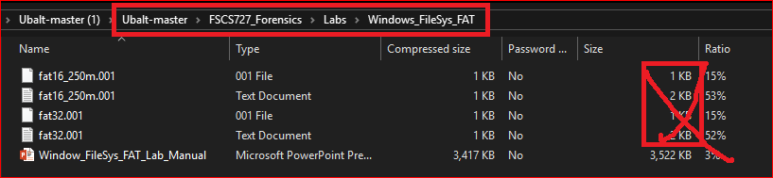
Warning: if you see this (Problem with Github large size files)
Follow next 3 slides to download four fat files again from Github

Slide 15
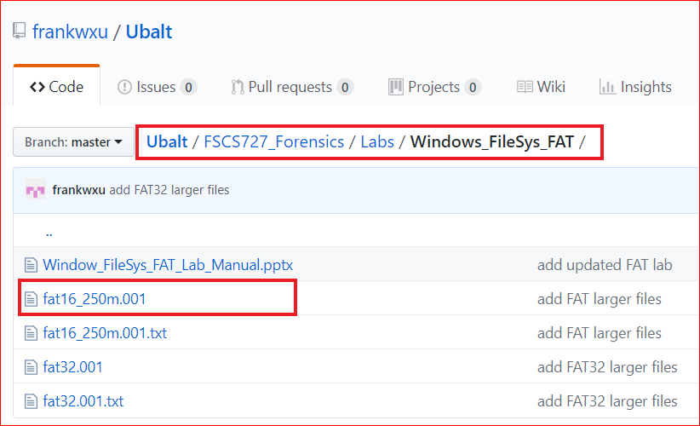
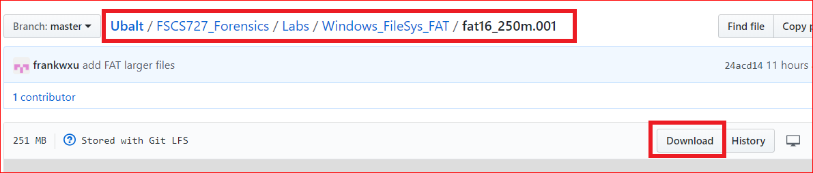

Slide 16
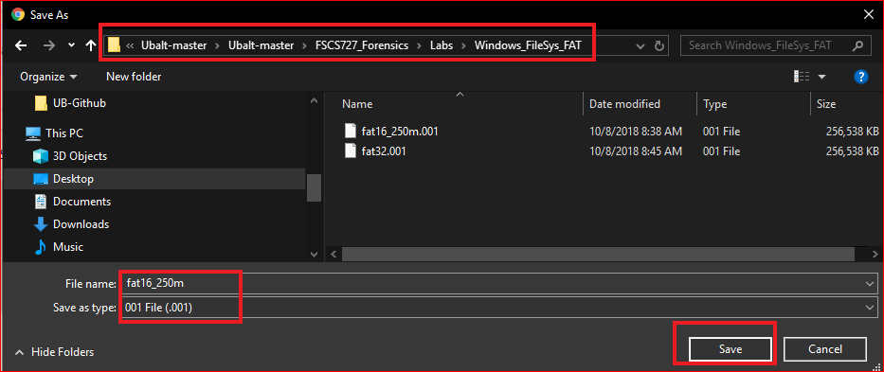

Slide 17

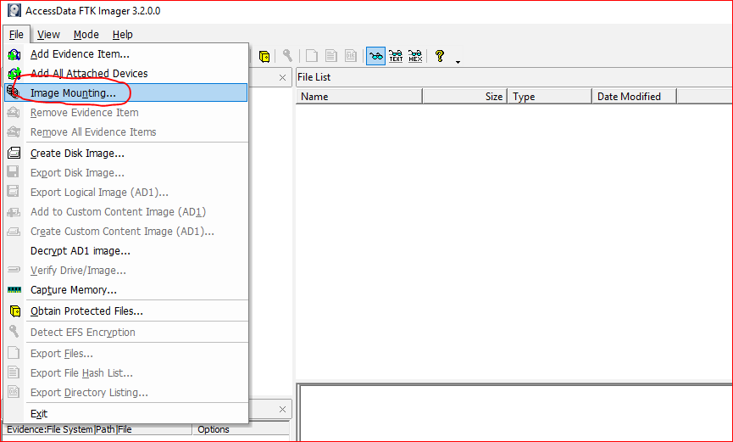

Slide 18
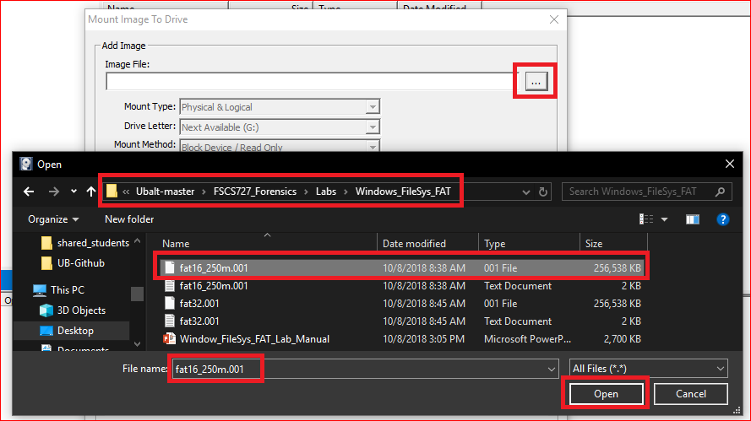

Slide 19
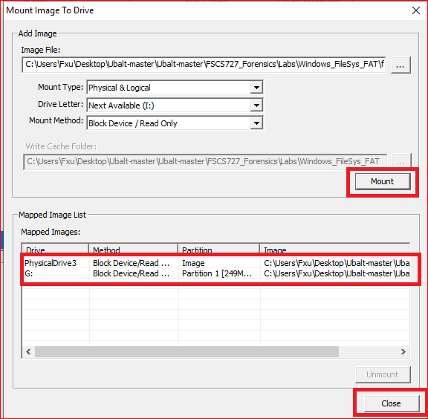
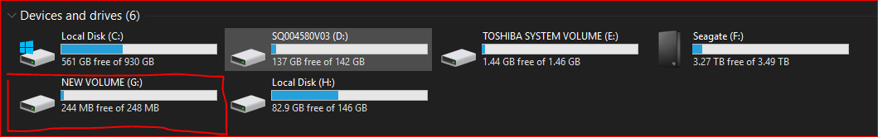

Slide 20
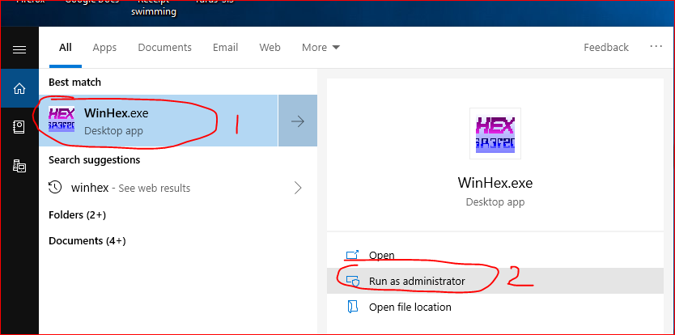
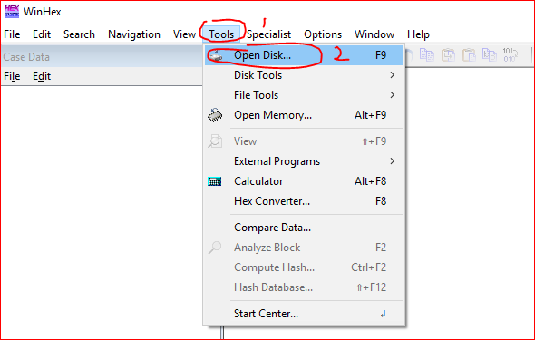

Slide 21
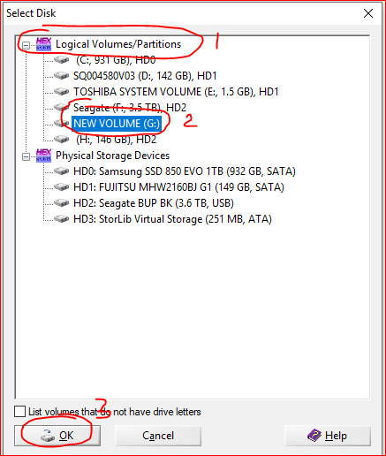

Slide 22
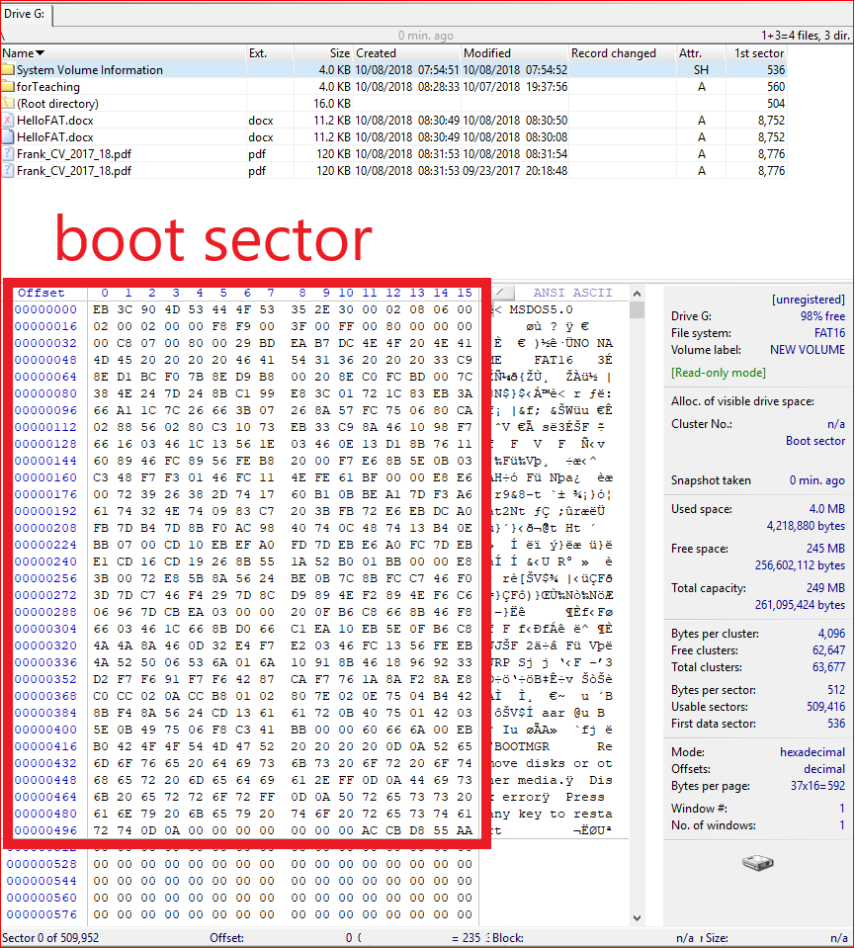

Slide 23
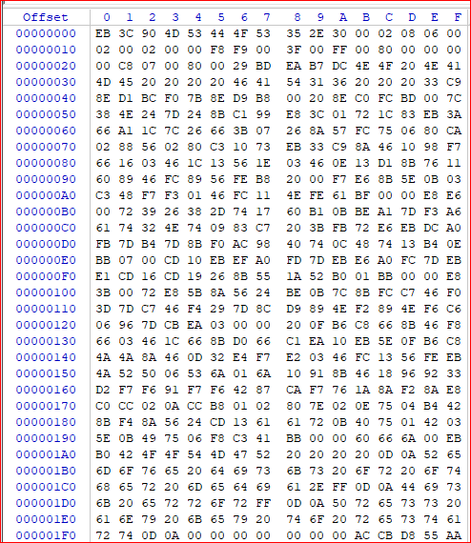

Slide 24
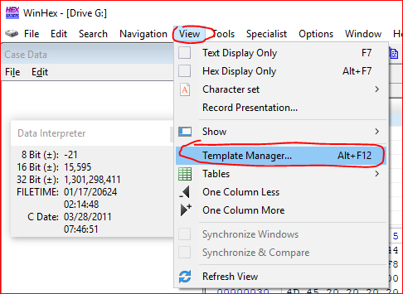
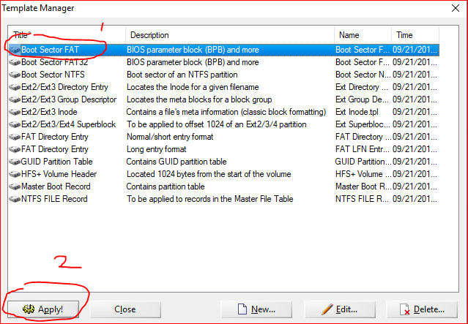

Slide 25
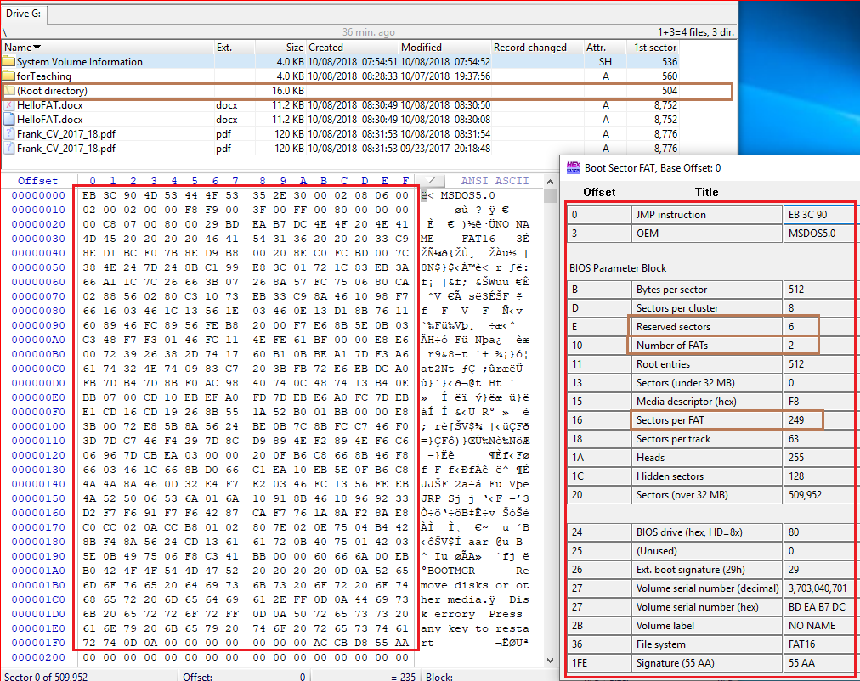
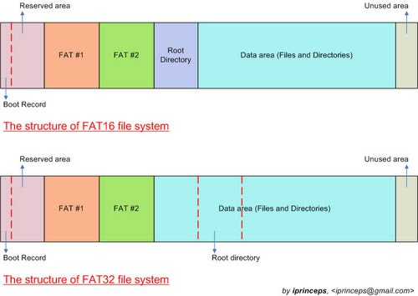
How to calculate the 1st sector of root directory?
1+6+249+249=505
We need minus 1 because of sector starts from 0

Slide 26
Root Directory

Slide 27
The Root Directory
The root directory contains an entry for each file whose name appears at the root (the top level) of the file system.
Each entry is 32 bytes (0x20) in size
a single block can contain 16 of them (=512/32).

Slide 28
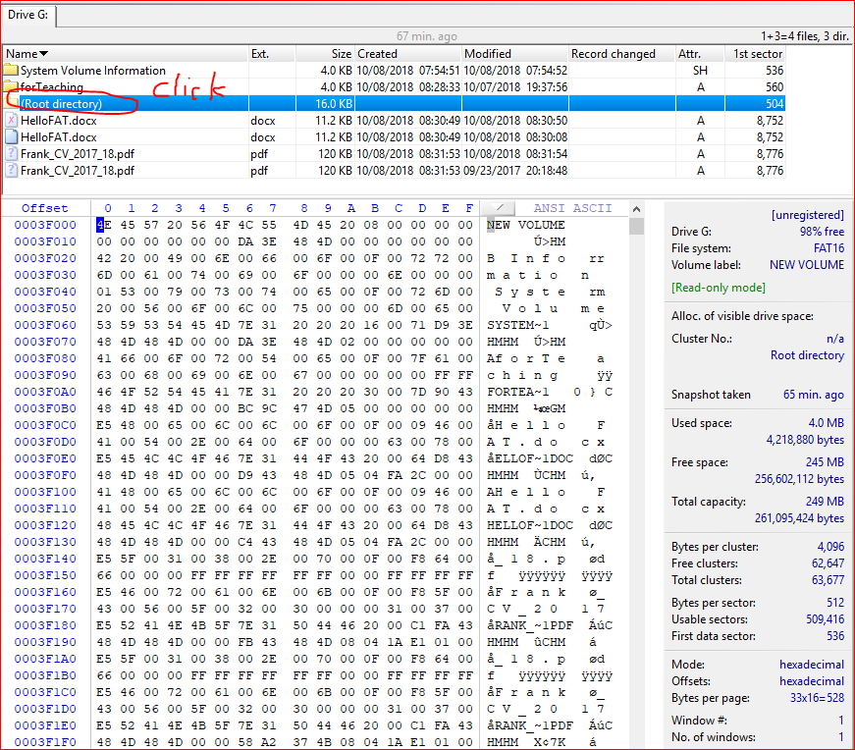

Slide 29
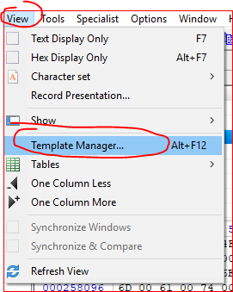
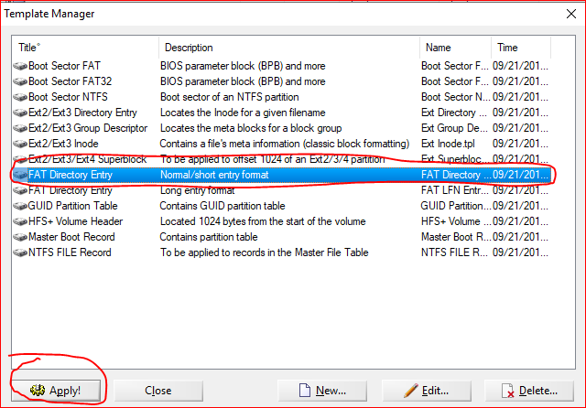

Slide 30
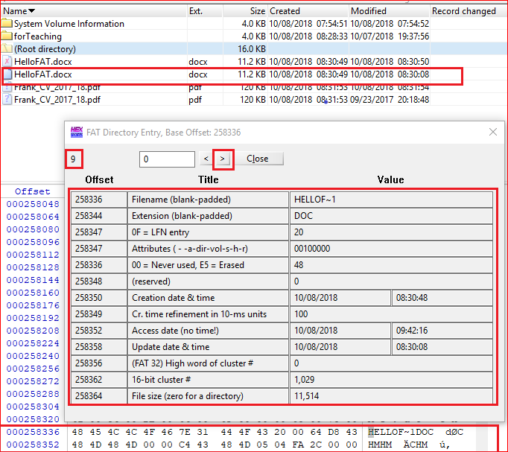
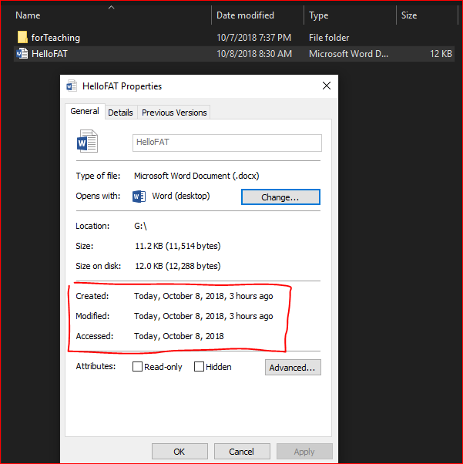

Slide 31
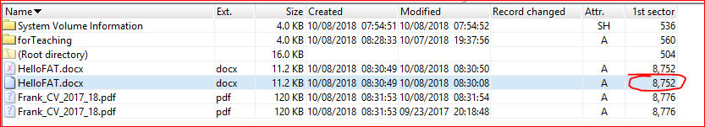
Why 8752

Slide 32
Boot sector (1) + Reserved sections (6) + FAT 1 (249) + FAT (249) + Root (32) + Cluster (1029 -2) *8

Slide 33
FAT 32

Slide 35
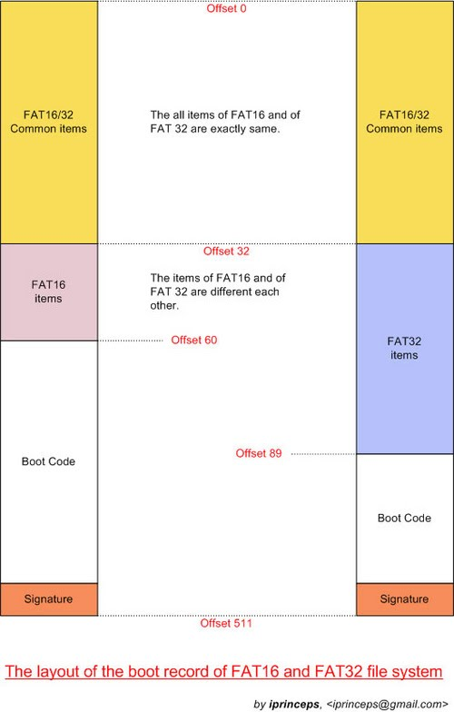

Slide 36
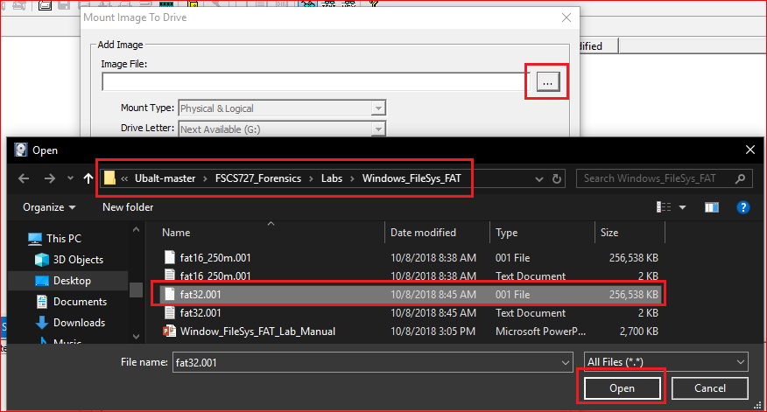

Slide 37
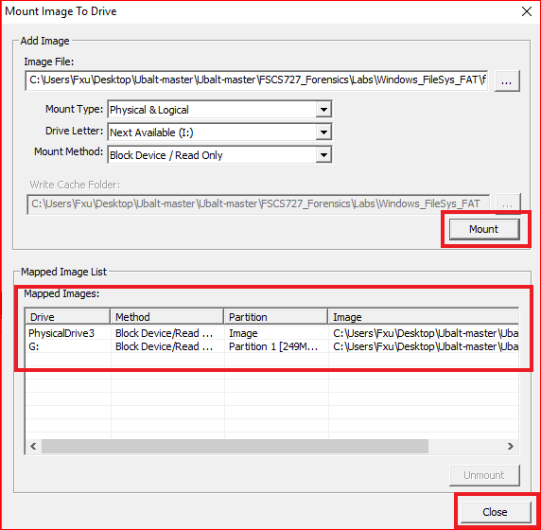
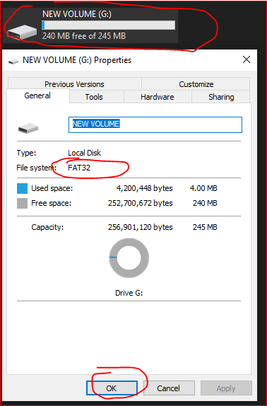

Slide 38
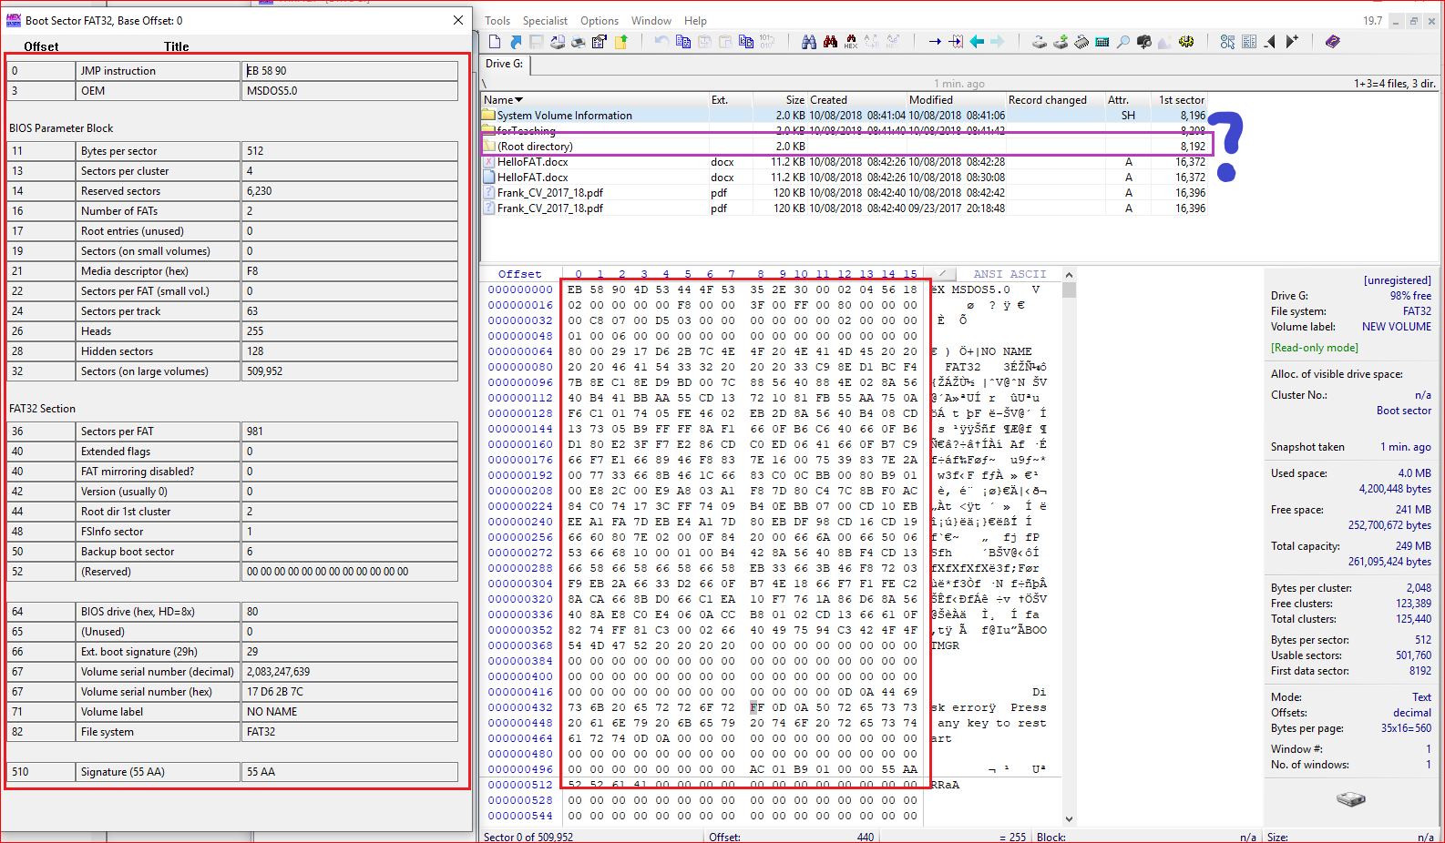
Boot sector (1) + Reserved sections (6230) + FAT 1 (981) + FAT2 (981)

Slide 39
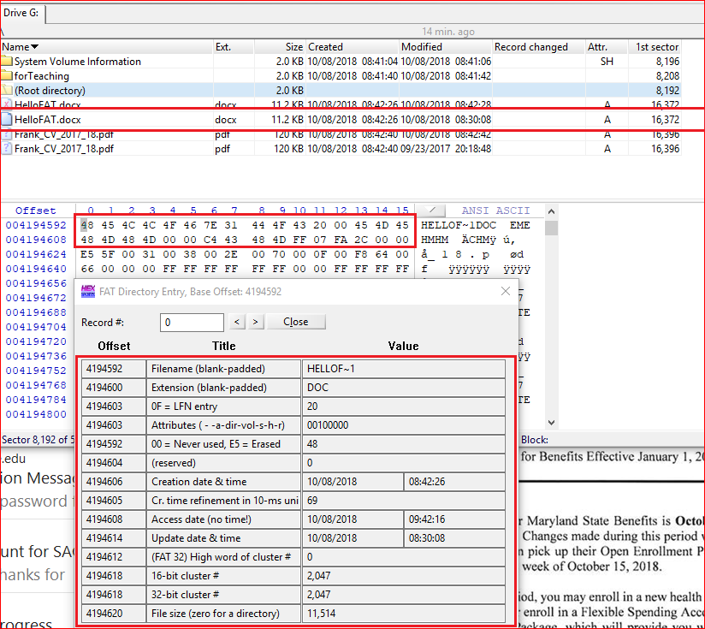

Slide 40
Reference
https://sites.google.com/site/iprinceps/Home/embedded-system-and-operating-systems/understanding-file-system
http://www.dewassoc.com/kbase/hard_drives/boot_sector.htm
http://www.tavi.co.uk/phobos/fat.html
https://www.compuphase.com/mbr_fat.htm
http://www.cse.scu.edu/~tschwarz/COEN252_09/Lectures/FatExample.html
http://havefunwhileulearn.blogspot.com/2010/05/dissecting-fat-16-file-system.html

