Slide 1
Windows Forensics Fat16 and Fat32

Slide 2
FAT 16 Root Sector

Slide 3
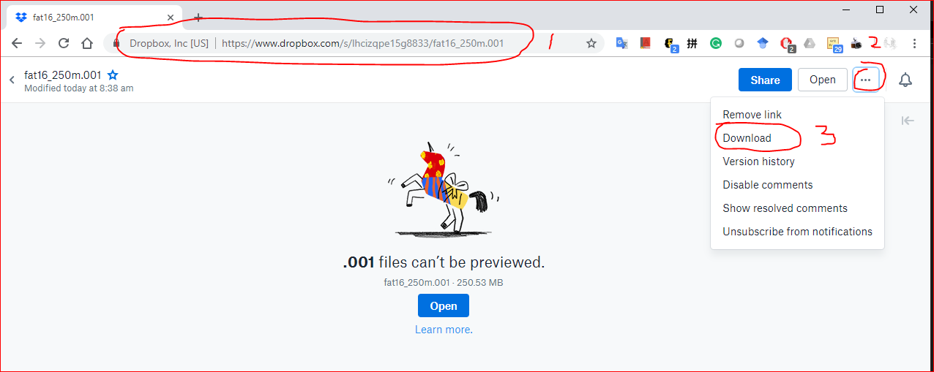
https://www.dropbox.com/s/a0lhsmzeh68wk1i/NTFS.001

Slide 4
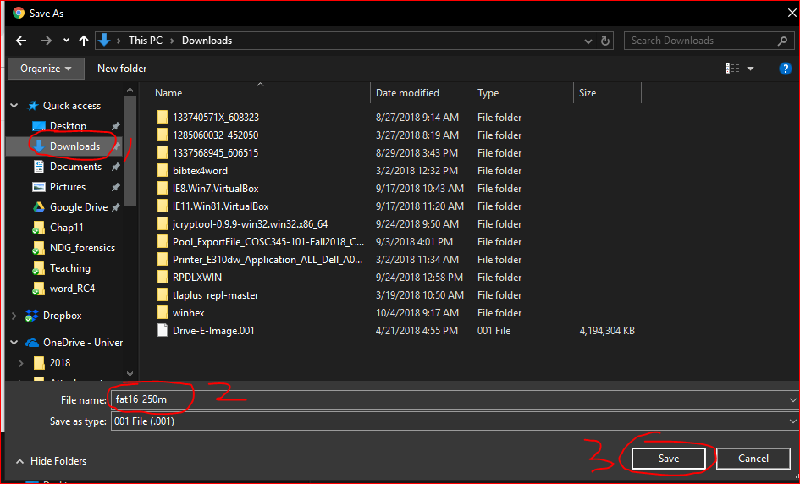

Slide 5

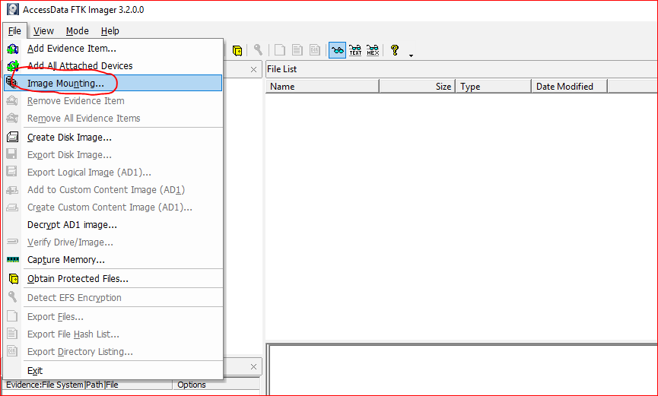

Slide 6
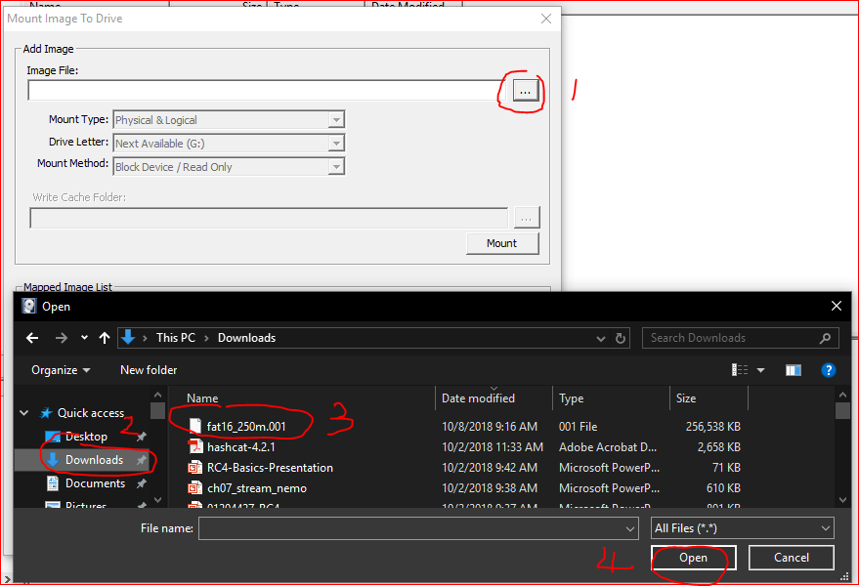

Slide 7
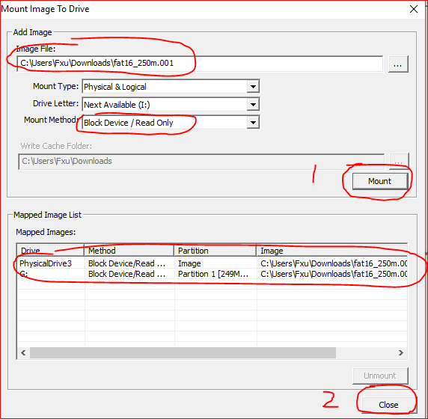
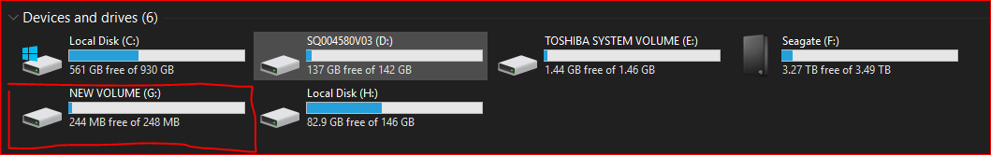

Slide 8
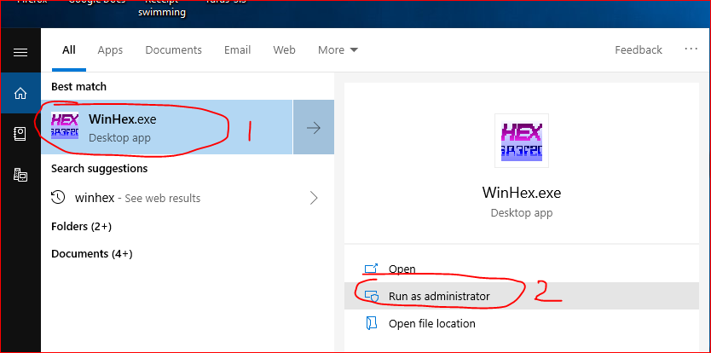
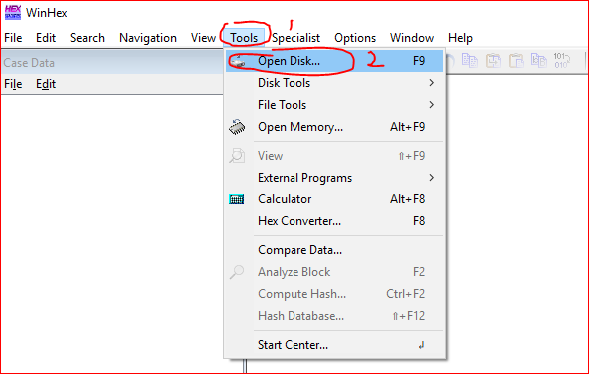

Slide 9
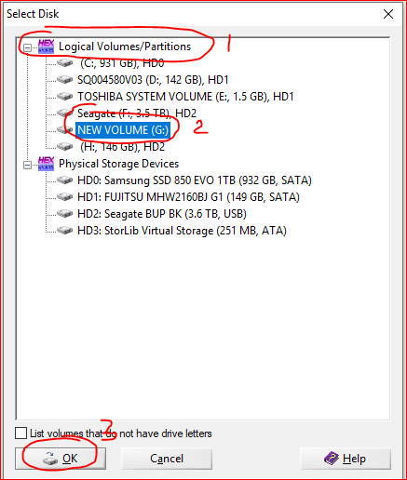

Slide 10
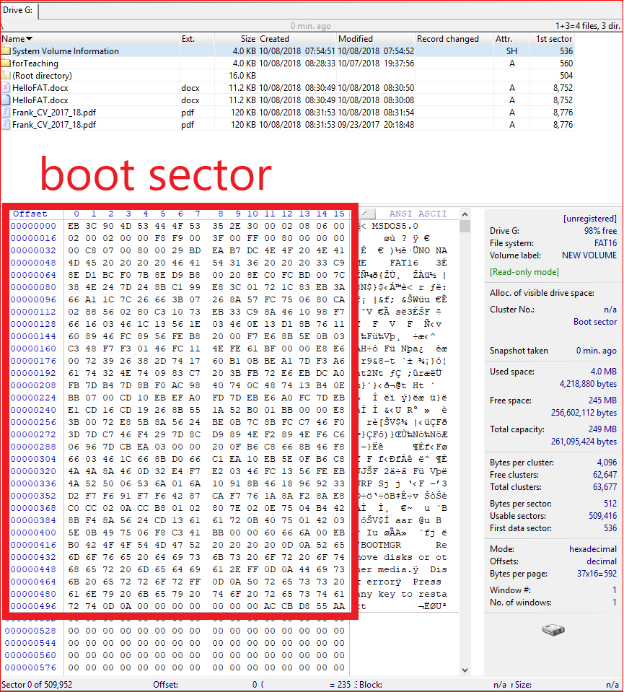

Slide 11
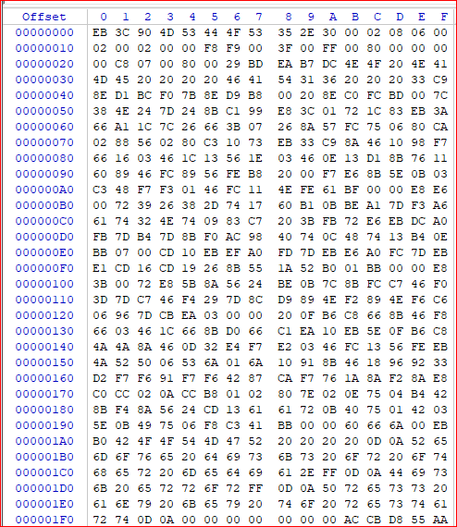

Slide 12
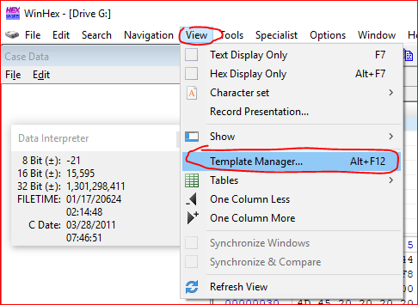
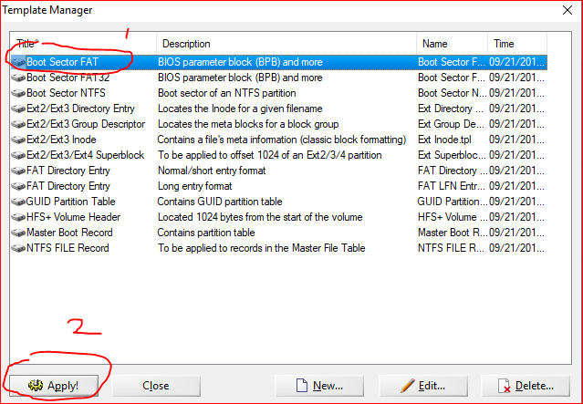

Slide 13
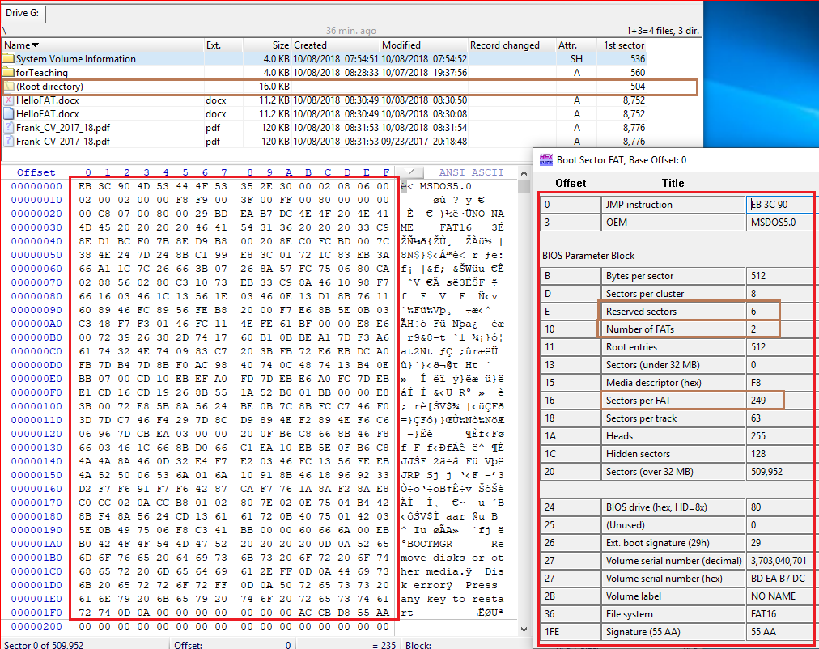
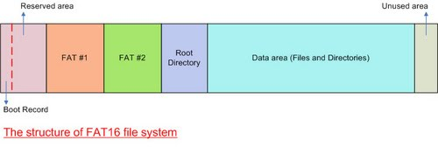
How to calculate the 1st sector of root directory?
1+6+249+249=505
We need minus 1 because of sector starts from 0

Slide 14
Root Directory

Slide 15
The Root Directory
The root directory contains an entry for each file whose name appears at the root (the top level) of the file system.
Each entry is 32 bytes (0x20) in size
a single block can contain 16 of them (=512/32).

Slide 16
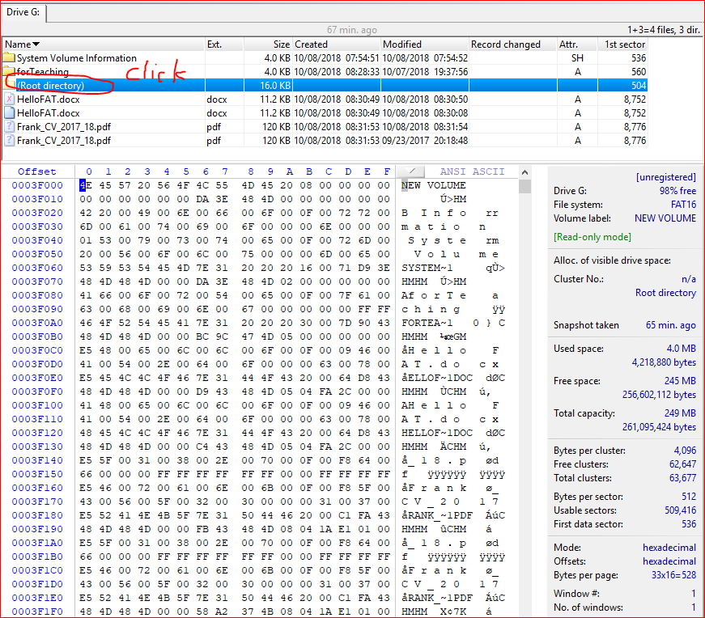

Slide 17
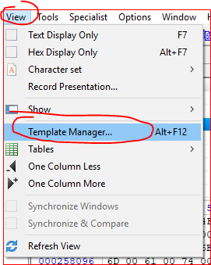
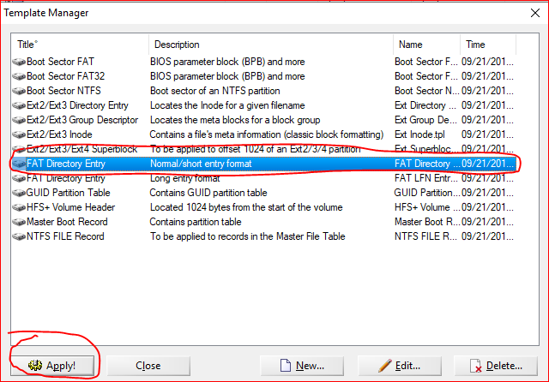

Slide 18
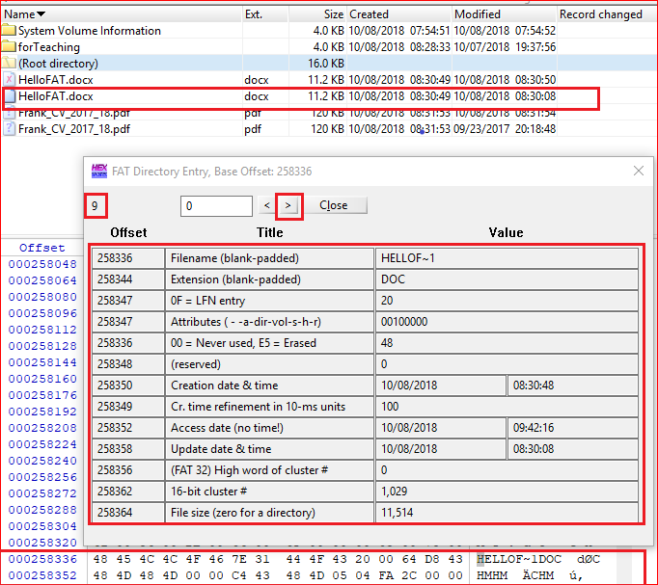
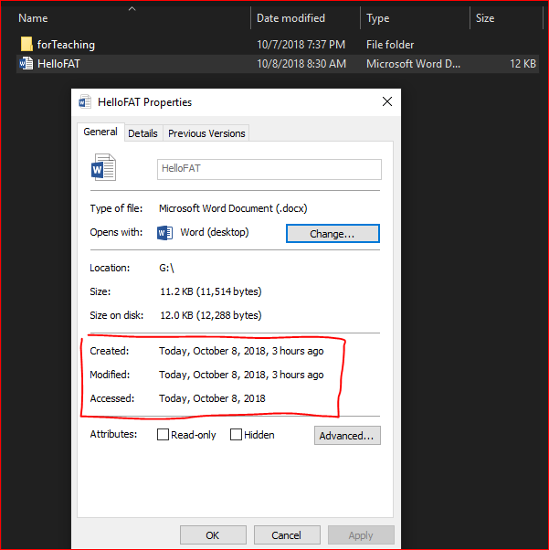

Slide 19
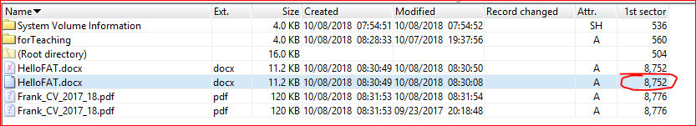
Why 8752

Slide 20
Boot sector (1) + Reserved sections (6) + FAT 1 (249) + FAT (249) + Root (32) + Cluster (1029 -2) *8

Slide 21
FAT 32

Slide 22
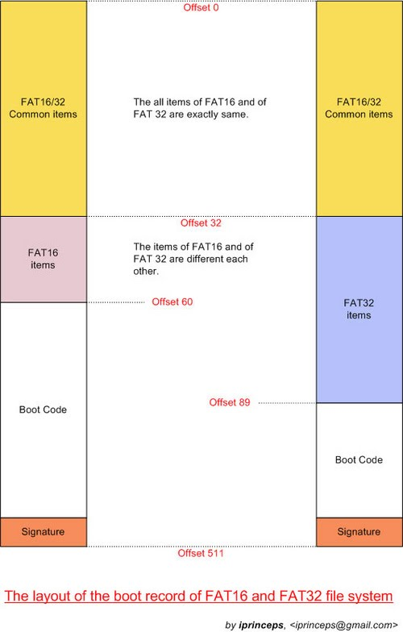

Slide 23
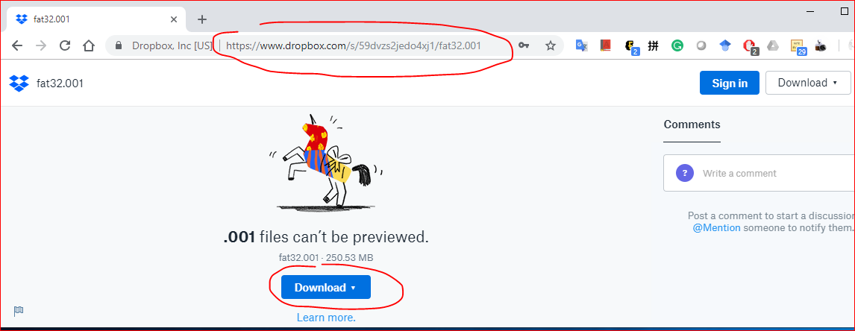
https://www.dropbox.com/s/59dvzs2jedo4xj1/fat32.001

Slide 24
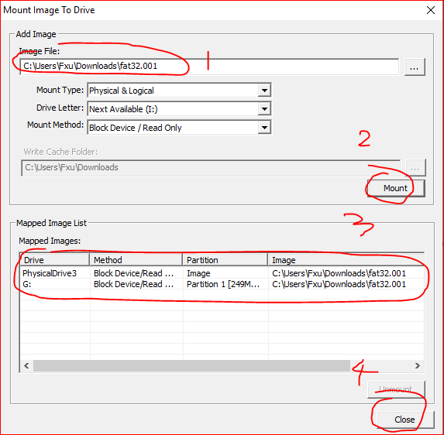
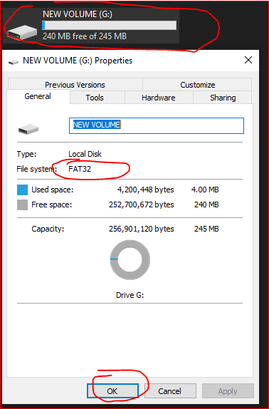

Slide 25
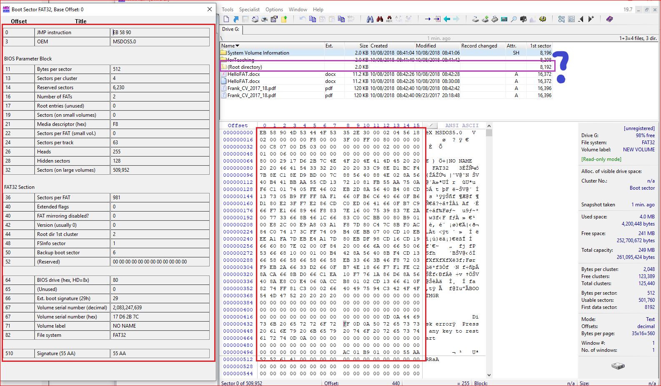
Boot sector (1) + Reserved sections (6230) + FAT 1 (981) + FAT2 (981)

Slide 26
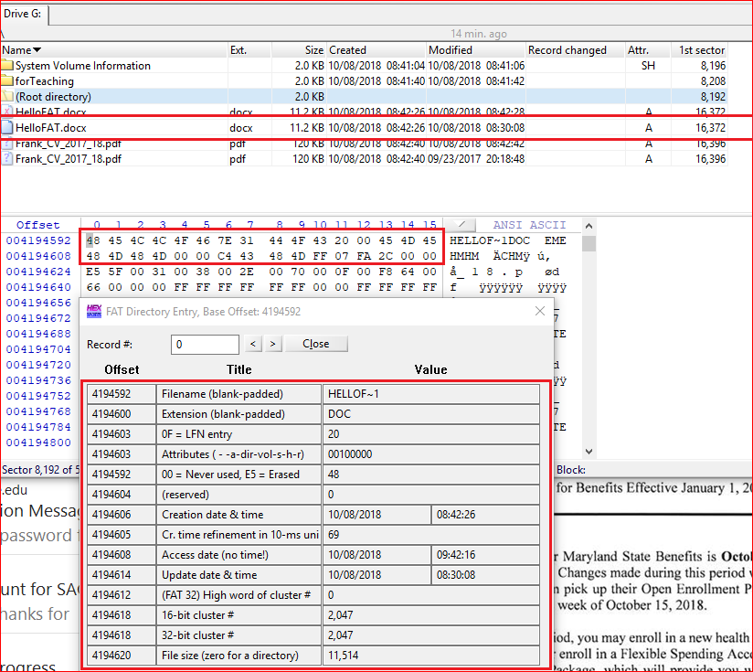

Slide 27
Reference
https://sites.google.com/site/iprinceps/Home/embedded-system-and-operating-systems/understanding-file-system

