Slide 1
XOR Cipher

Slide 2
Cryptology
Cryptography
Symmetric Ciphers
Asymmetric Ciphers
Cryptanalysis
Protocols
Block Ciphers
Stream Ciphers
Integer Factoring Problem
Discrete Logarithm problem
XOR

Slide 3
Stream cipher

Slide 4
Definition
A stream cipher is a symmetric key cipher where plaintext digits (Binary) are combined with a keystream (pseudorandom cipher digit stream)

Slide 5


k
k
Stream generator
Stream generator
s₀, s₁s₂ …,s_{n}
s₀, s₁s₂ …,s_{n}
x₀, x₁ , x₂ …,x_{n}
y₀, y₁ , y₂ …,y_{n}
y₀, y₁ , y₂ …,y_{n}
x₀, x₁ , x₂ …,x_{n}
transmission
encryption
decryption

Slide 6
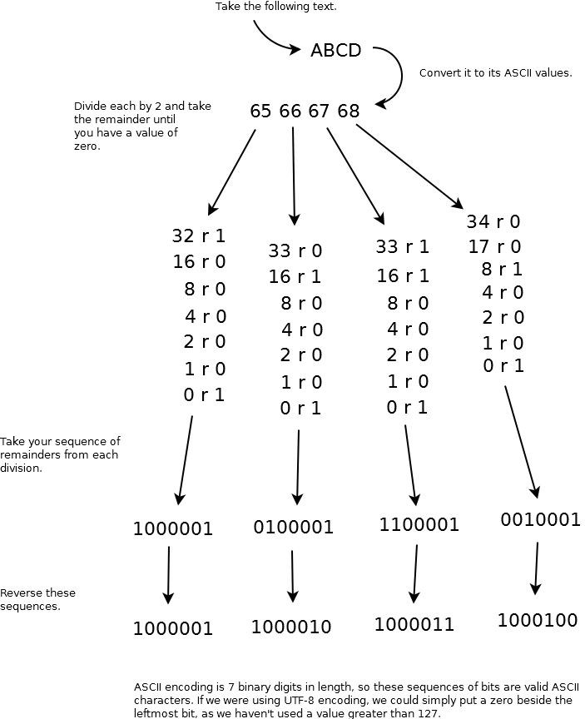
Input
Letter
ASCII
Binary
A
65
1000001
https://blogs.msdn.microsoft.com/smallbasic/2013/02/05/how-to-convert-text-into-binary/

Slide 7
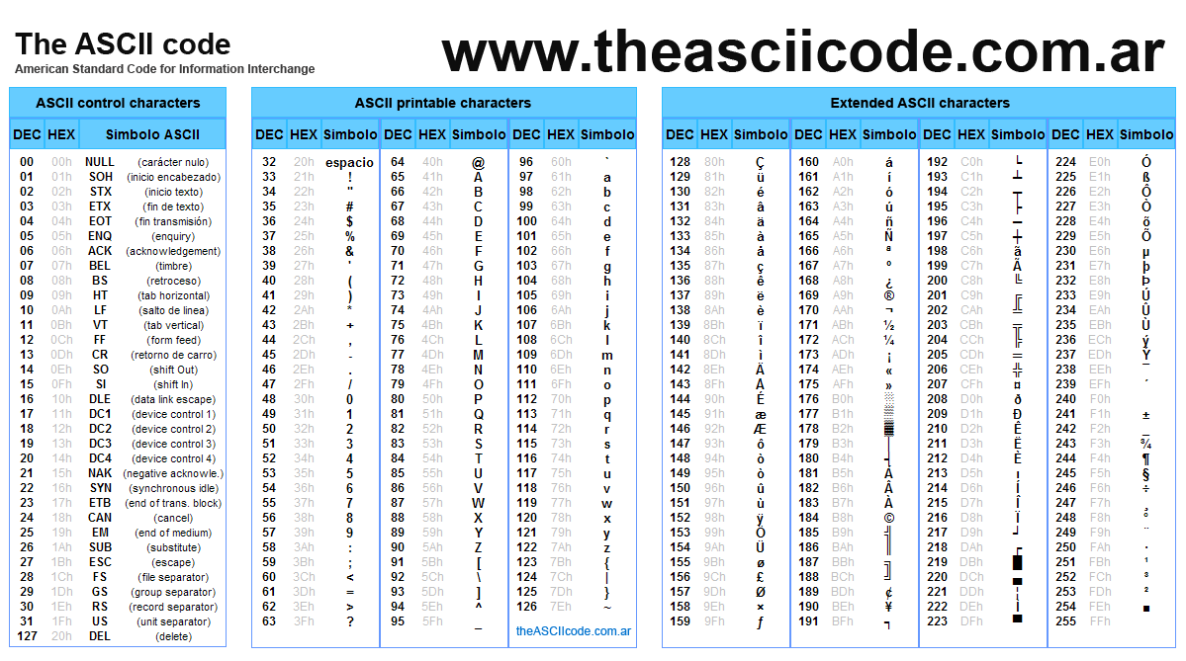

Slide 8

Exclusive OR
Symbol | Truth Table
2-input Ex-OR Gate | B | A | Q
 | 0 | 0 | 0
 | 0 | 1 | 1
 | 1 | 0 | 1
 | 1 | 1 | 0
Boolean Expression Q = A ⊕ B | A OR B but NOT BOTH gives Q
https://www.electronics-tutorials.ws/logic/logic_7.html

Slide 9
Example encryption
Convert each character to ASCII (Binary)
“A”= 65= (0100 0001)b
Pick up a key stream
S=(0001 0001)b
A xor S=?
(0100 0001)
xor (0001 0001)
------------------
(0101 0000)=80=P

Slide 10
Idea for decryption
Convert the ciphertext to ASCII (Binary)
“P” = 0101 0000
Xor with the same key
S=0001 0001
“P” xor S=?
(0101 0000)
xor (0001 0001)
------------------
(0100 0001)=65=“A”

Slide 11
Math and XOR
Encryption and decryption are simple additions modulo 2
For each bit, x_{i} , y_{i} , s_{i} ∈ {0,1}, of input, output and key stream,
Encryption (bit): y_{i} = x_{i} + s_{i} mod 2
Decryption (bit): x_{i} = y_{i} + s_{i} mod 2
(0100 0001)
+ (0001 0001)
------------------
(0101 0000)=80=P

Slide 12
How to pick a key stream?
Ture random Number
Based on physical random processes
coin flipping, dice rolling
Impractical

Slide 13
Pseudorandom Number Generator
Generate sequences from initial seed value
Output stream has good statistical properties
Output can be reproduced and can be predicted
Linear Congruential Generator

Slide 14

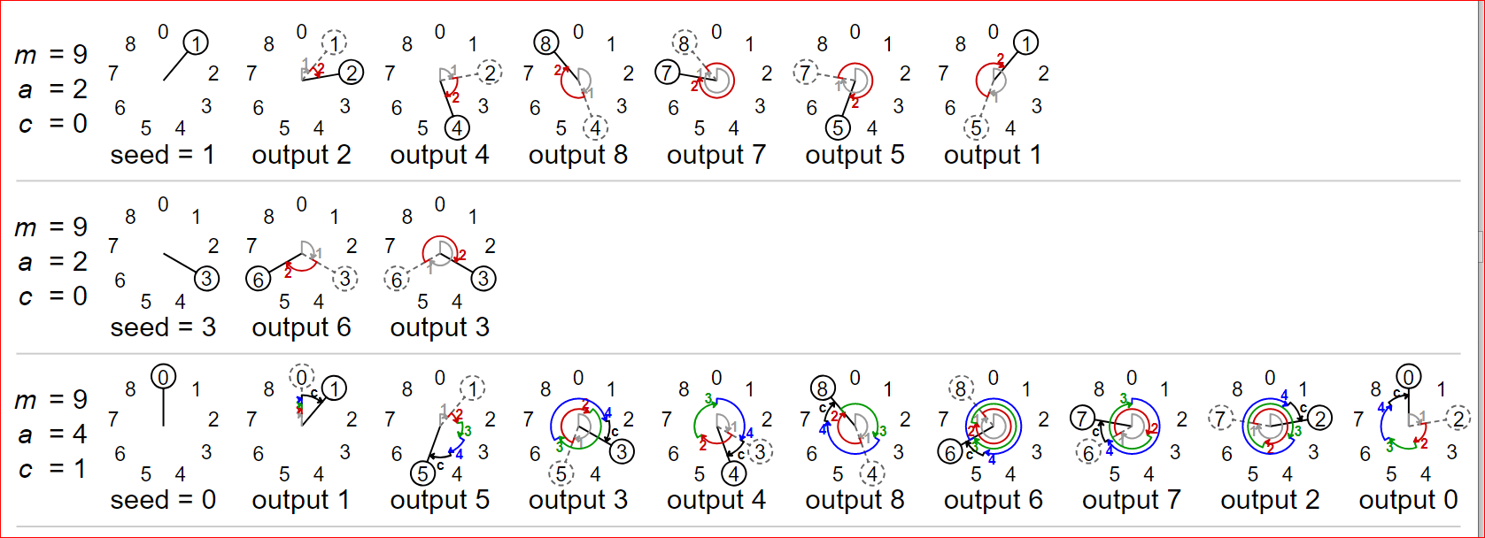
Linear Congruential Generator
Bad cryptographic properties due to the linearity of most PRNGs
X₀: Seed

Slide 15
Random number generators summary
RNG
True RNG
Pseudorandom NG
Cryptographically Secure RNG

Slide 16
XOR Using Crypto Tool

Slide 17
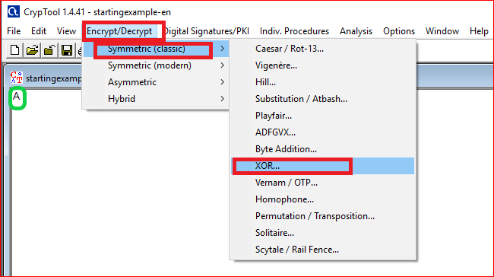
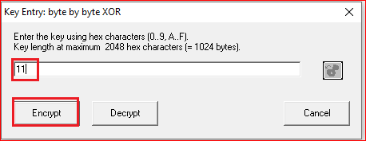
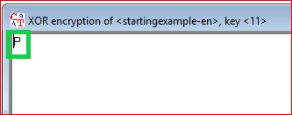

Slide 18
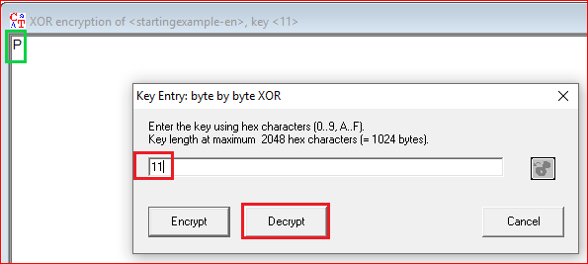
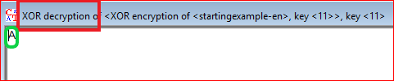

Slide 19
Question
Encrypt and decrypt “hello” using pencil and paper. You need to pick up a key
Verify it using the tool. You can capture screenshots.

