Slide 1
Email Forensics

Slide 2
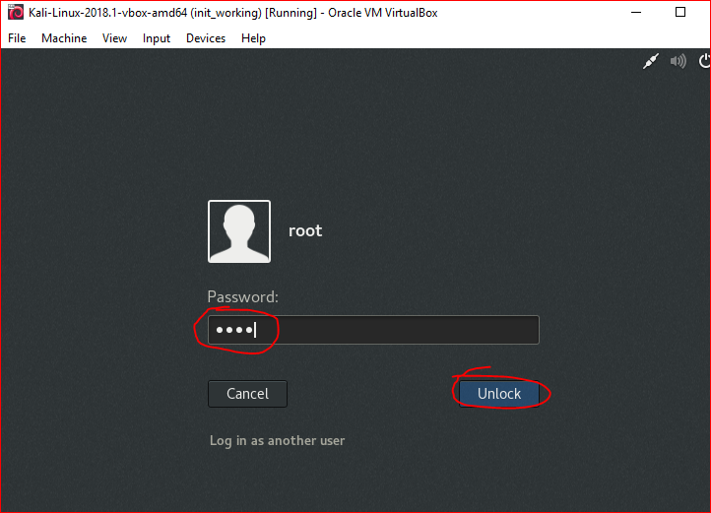

Slide 3


Slide 4


Slide 5



Slide 6
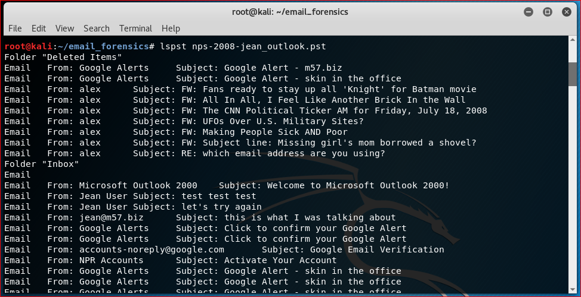

Slide 7
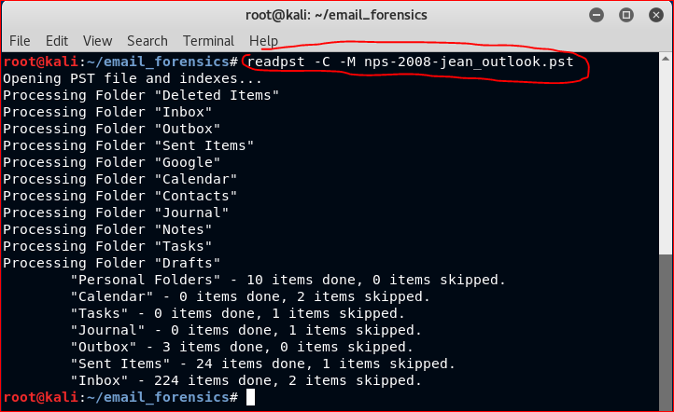
-C = standard character set
-M = output messages RFC 822 format (test messages) as separate files

Slide 8


Slide 9
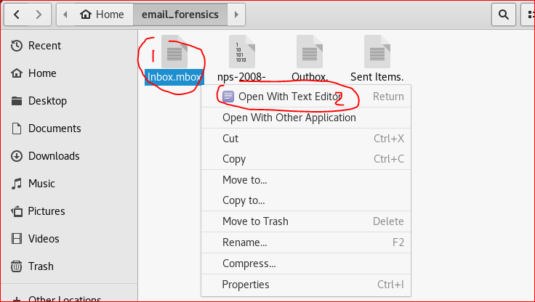
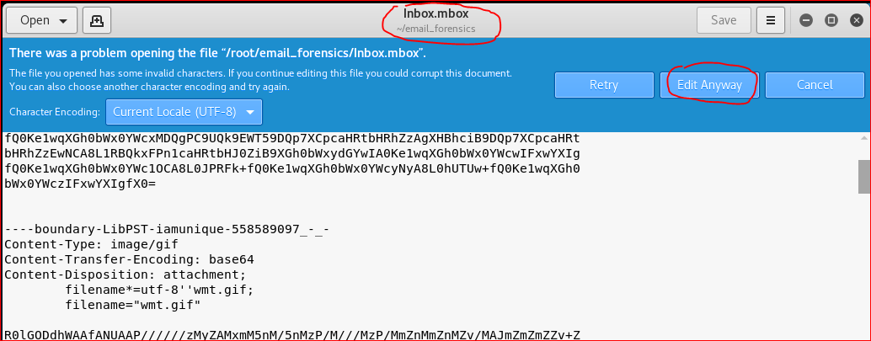

Slide 10
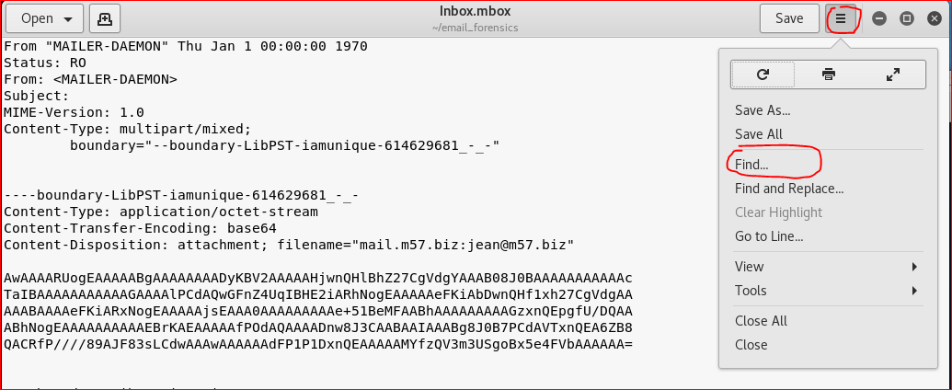

Slide 11
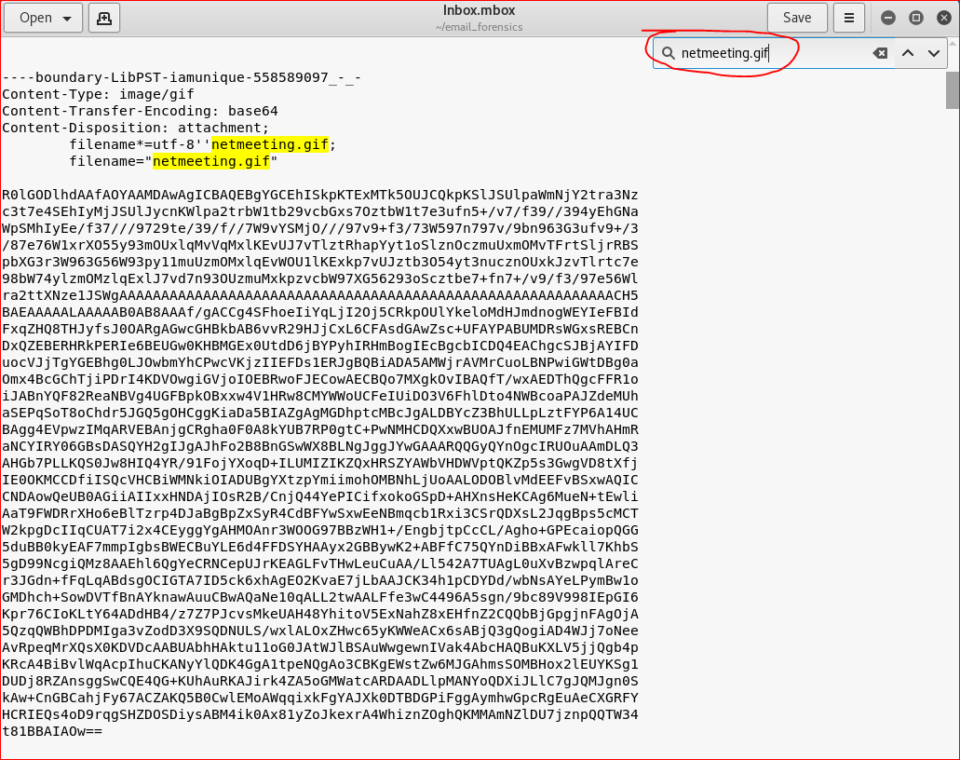
SMTP can’t transmit anything other than ASCII characters therefore attachments are encoded with Base64 encoding to translate non-ascii into ASCII for transmission.

Slide 12
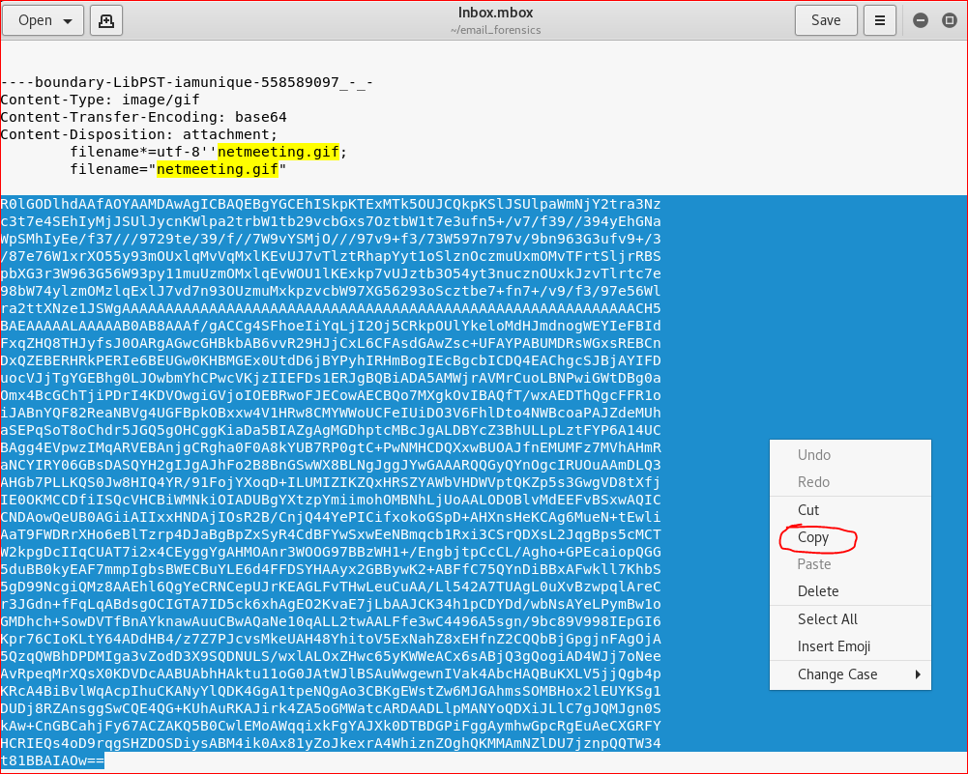

Slide 13
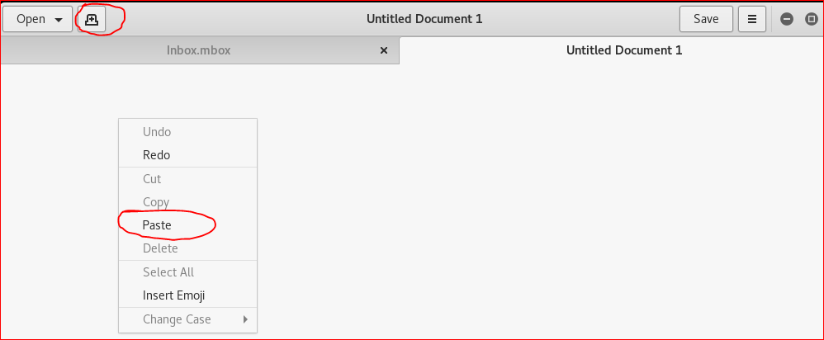

Slide 14
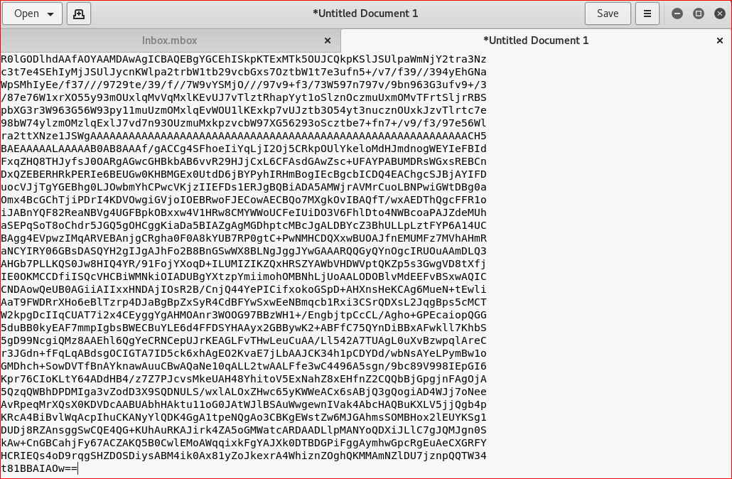

Slide 15
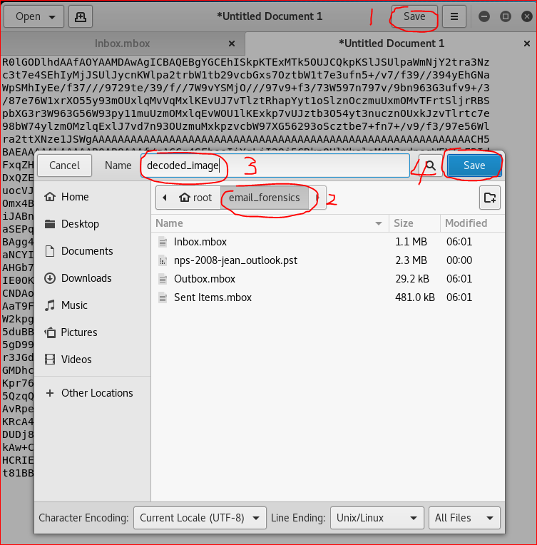

Slide 16


Slide 17
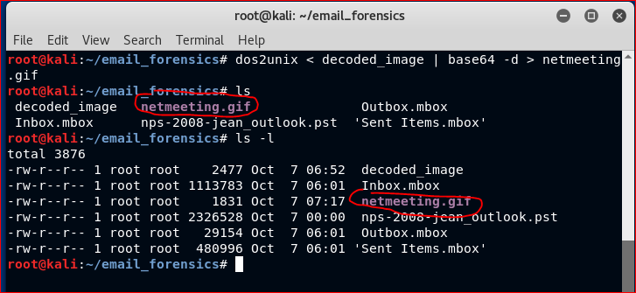

Slide 18
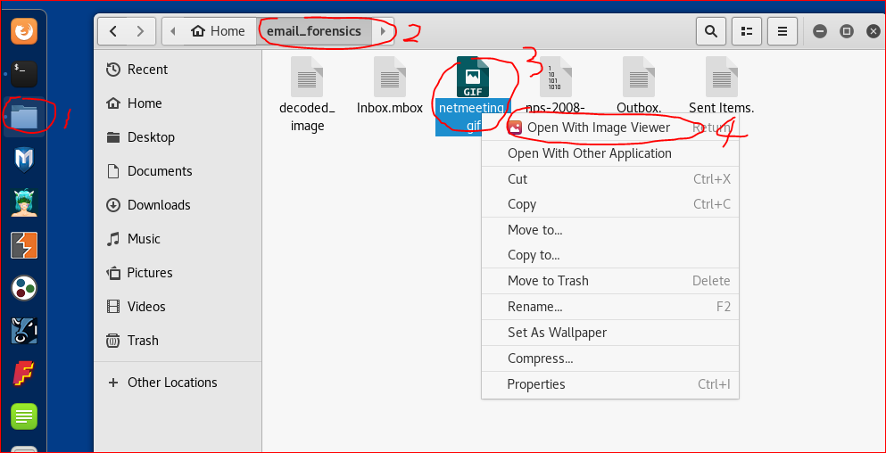

Slide 19
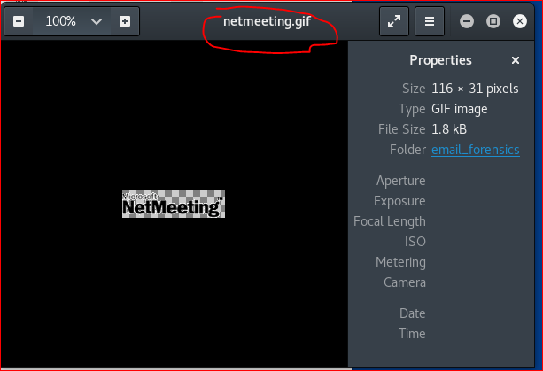

Slide 21
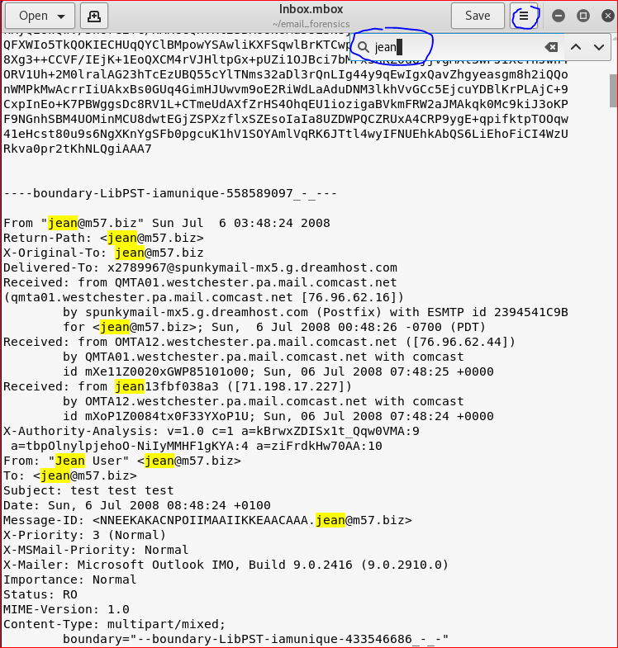

Slide 22
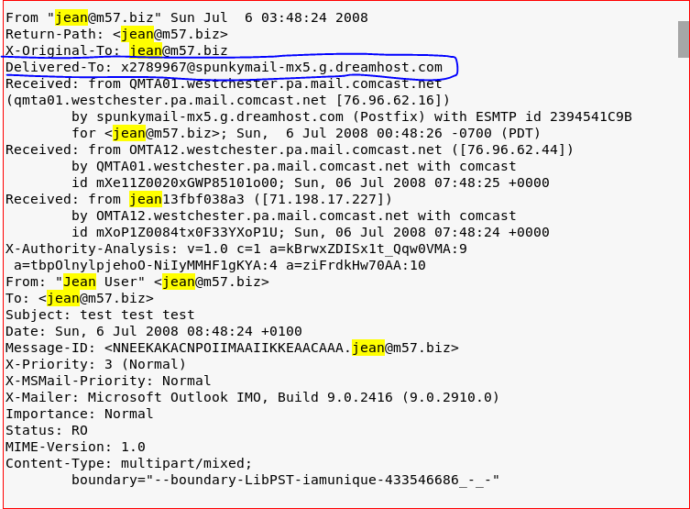
the incoming SMTP server of the message that it was delivered

Slide 23
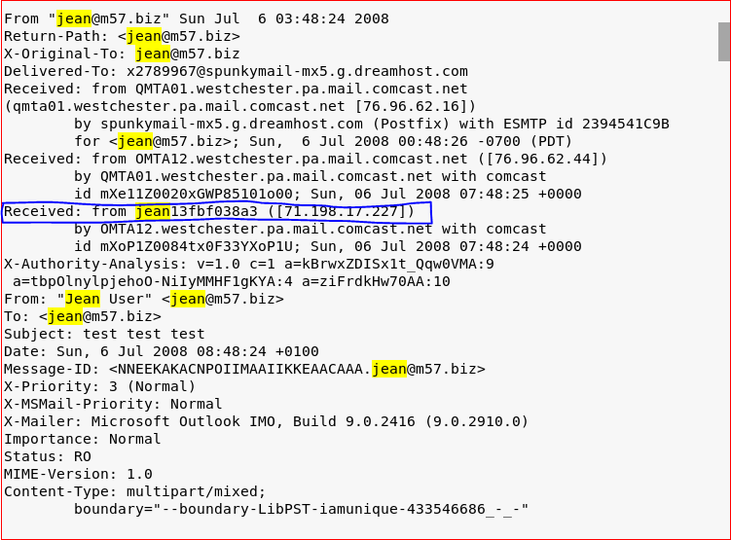
the originator of the message as well as the SMTP server

Slide 24
Your Work

Slide 25
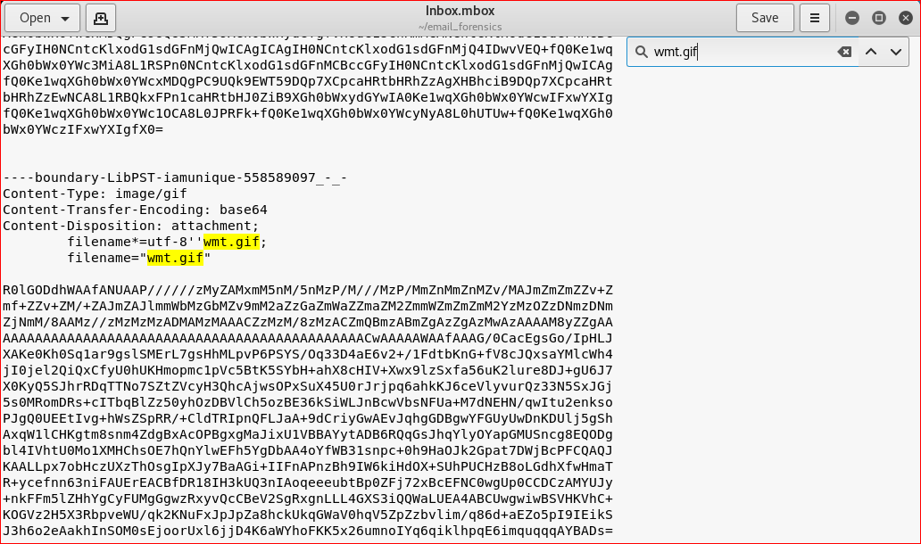

Slide 26
