Slide 1
HoneyPot

Slide 2
Introduction

Slide 3
What is honeypot?
In computer terminology, a honeypot is a computer security mechanism set to detect, deflect, or, in some manner, counteract attempts at unauthorized use of information systems

Slide 4
Lab

Slide 5
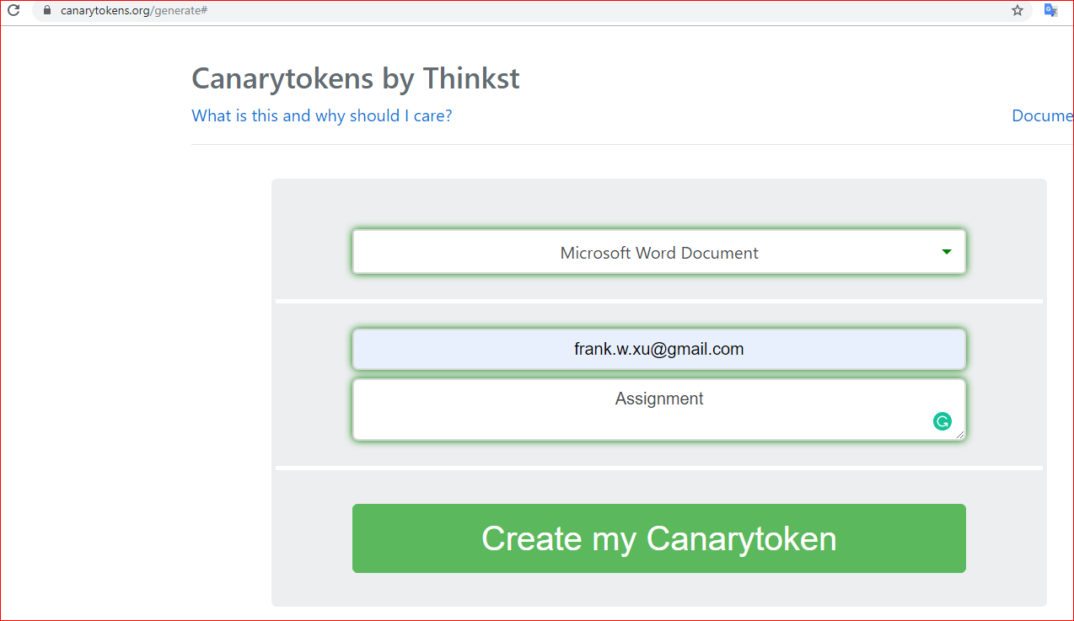
https://canarytokens.org/generate#

Slide 6


Slide 7

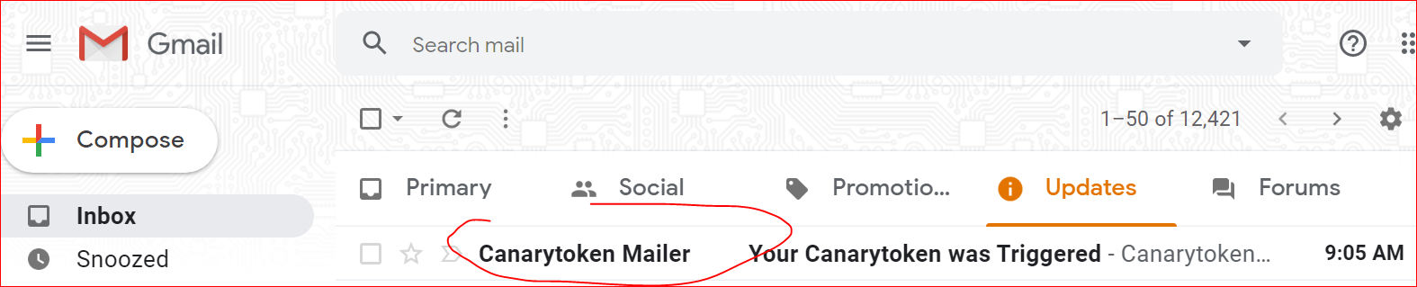

Slide 8
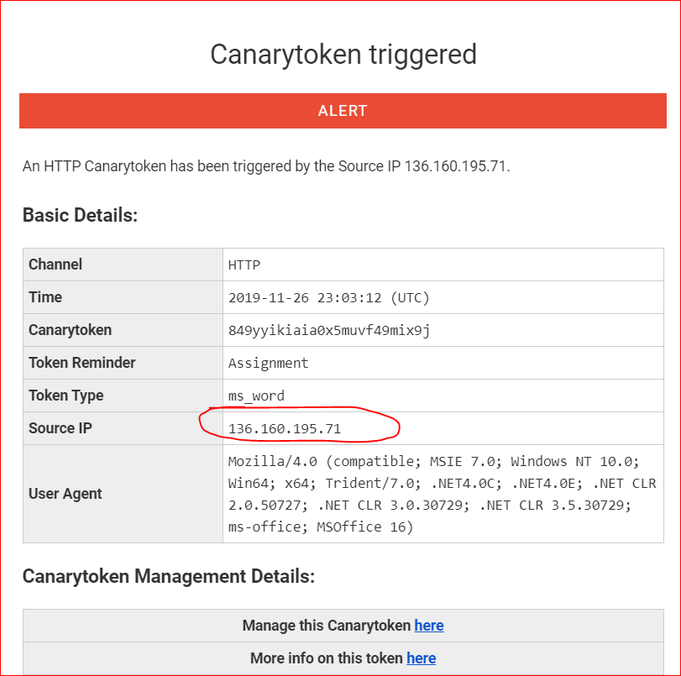

Slide 9
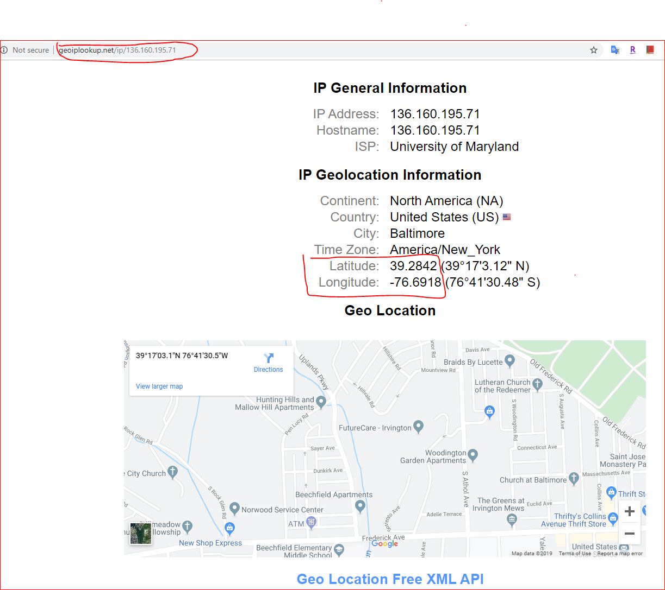

Slide 10
