Slide 1
Poison Ivy: Hiding Trojan

Slide 2
Introduction
Combining two piece of executable software
7zip
Trojan
One software
Two processes

Slide 3
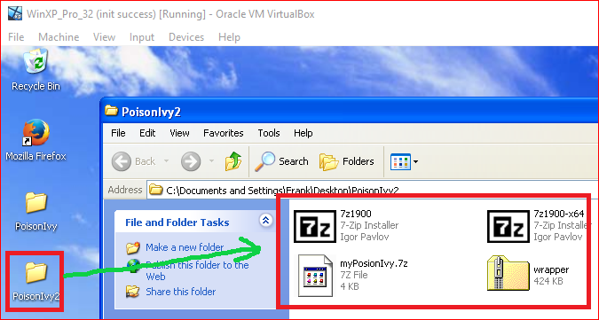
Copy folder to WinXP

Slide 4
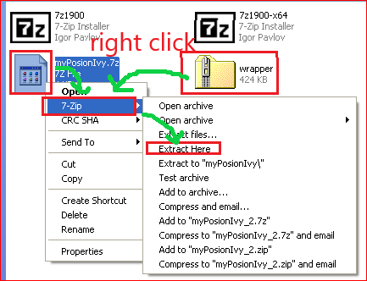
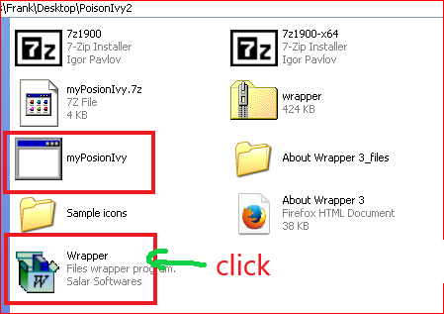
Unzip

Slide 5
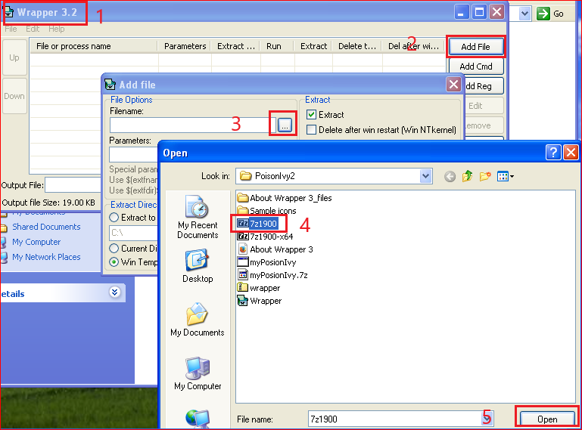
Add 7z1900.exe

Slide 6
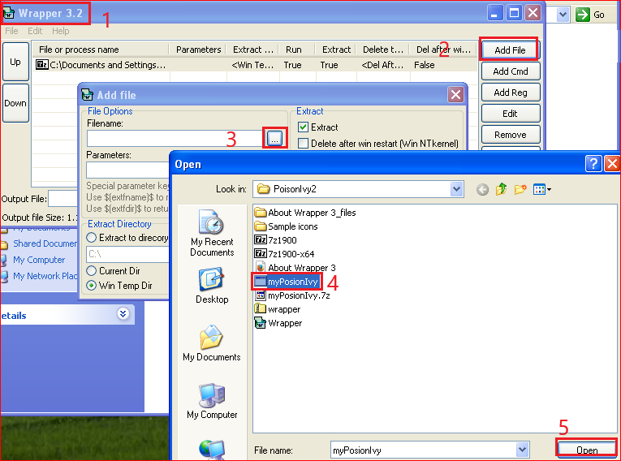
Add myPoisonIvy.exe

Slide 7
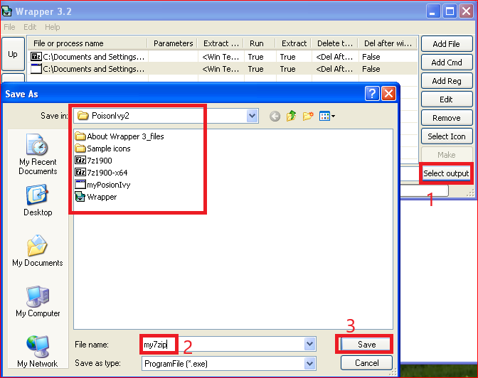
Set combined exe file parameters

Slide 8
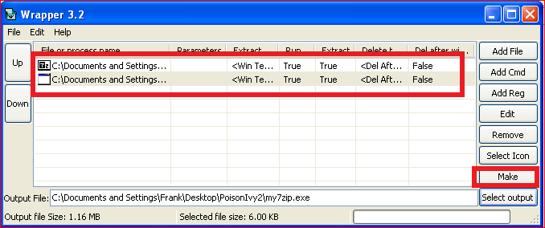
Combining two files

Slide 9
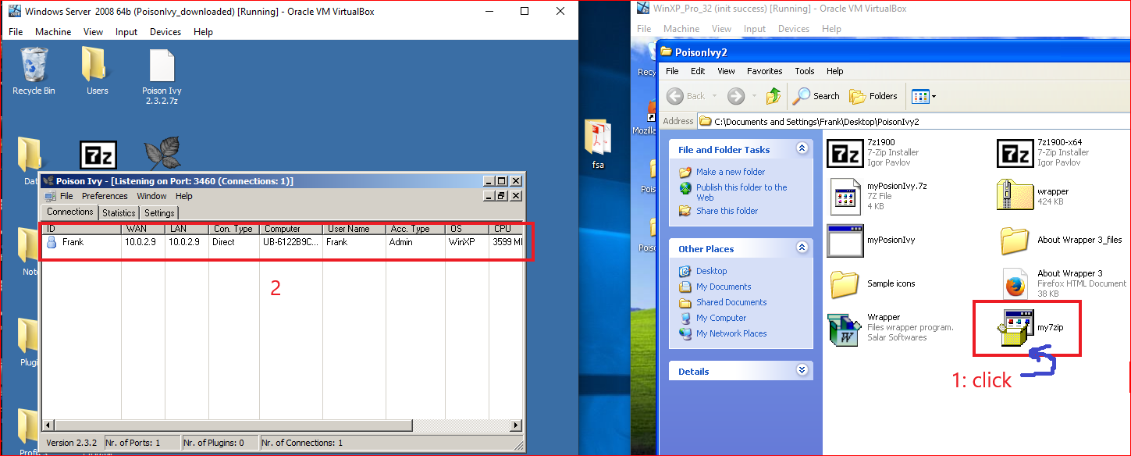
Victim runs myZip.exe

Slide 10
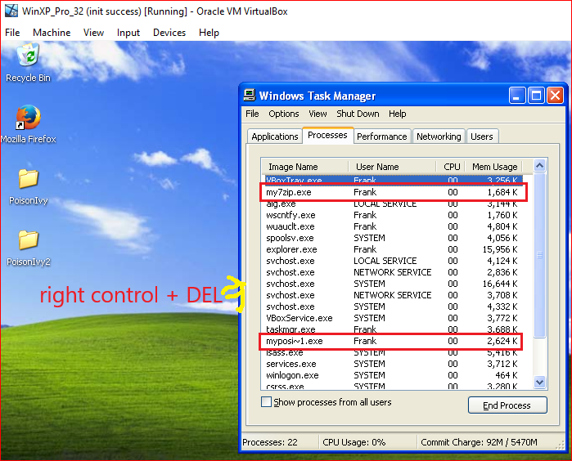
Show two process
Kill two processes for stopping trojan

