Slide 1
Poison Ivy

Slide 2
Poison Ivy Background
User-friendly malware programs Remote Access Trojan to perform a variety of post exploitation tasks
Capture screen, audio, and webcam
List active ports
Log keystrokes
Manage passwords
Manage registry, processes, services, devices, and installed applications
Perform remote shell
Update, restart, terminates itself

Slide 3
Poison Ivy
An extremely dangerous malware that will allow attackers to
maintain a persistent connection on a victim’s machine through an encrypted connection.
Used by many Advanced Persistent Threat (APT)
RSA’s network in 2011.

Slide 4
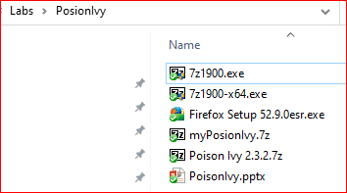
Lab Folder Structure
7zip 32bits
7zip 64 bits
Firefox for WinXP
Poison Ivy Server
Poison Ivy
Generate poison Ivy server
Act as poison Ivy client

Slide 5
Methods for Downloading Files
Method 1
USB
Method 2
Shared folder

Slide 6


Poison Ivy Components
Poison Ivy Client (listen)
is configured on the machine that will accept client connections.
Poison Ivy Server (sent)
A server executable, or payload, is created and then distributed to one or more victims.
Once the victim executes the payload, the malware will infect their machine and they will connect to the computer running the Poison Ivy Client.

Slide 7
Notes for the lab
Client MUST be Win XP
Server can be Win XP, Win 7, and Win Server 2008
Win Server 2008/
Poison Ivy Client
Win XP/
Poison Ivy Client

Slide 8
Generate poison Ivy server
Win Server 2008/
Poison Ivy Client

Slide 9
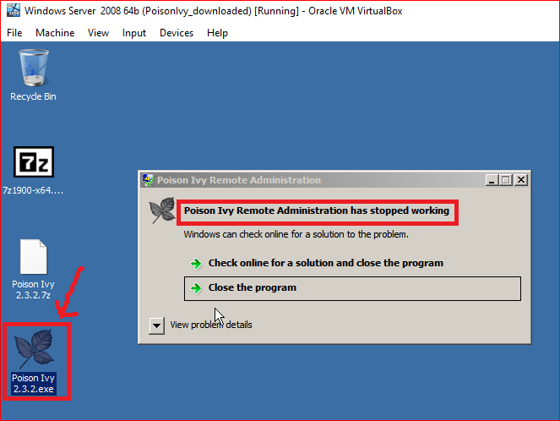
Generate Poison Ivy Server/Payload
1. install
2. unzip

Slide 10
Disable Data Execution Prevention (Windows 2008)
“…can help protect your computer by monitoring your programs to make sure that they use system memory safely.” - Dell
Open a Command Prompt using Run as Administrator or disable UAC.
Execute the following command:
bcdedit.exe /set nx AlwaysOff
Restart the Windows system.

Slide 11
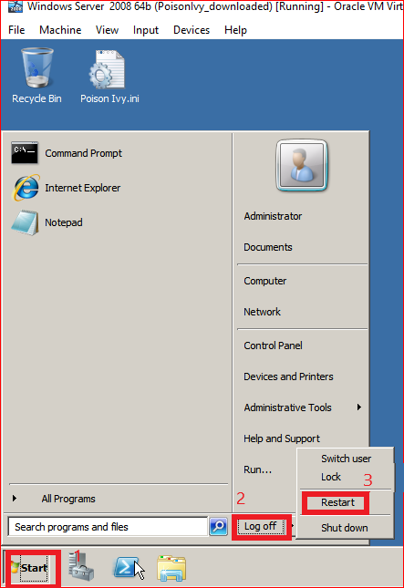
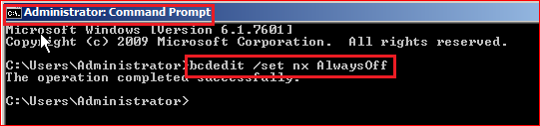
Disable Data Execution Prevention

Slide 12
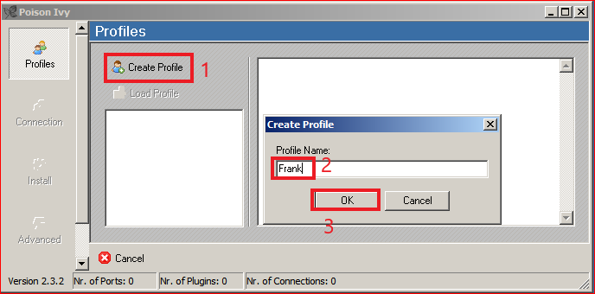
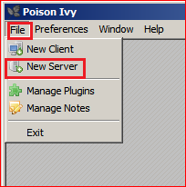
Create Profile

Slide 13
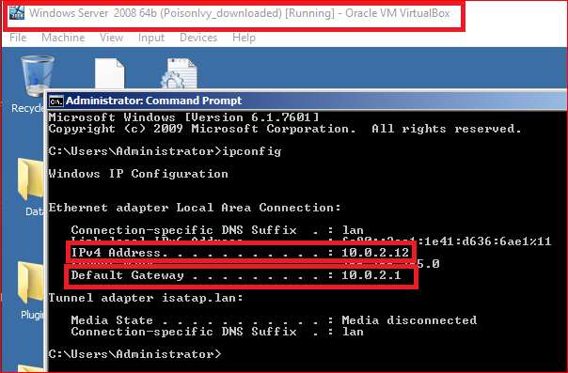
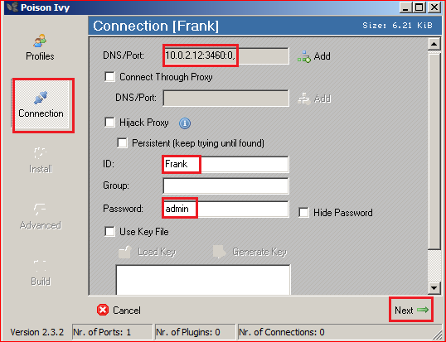
Connection Setting

Slide 14
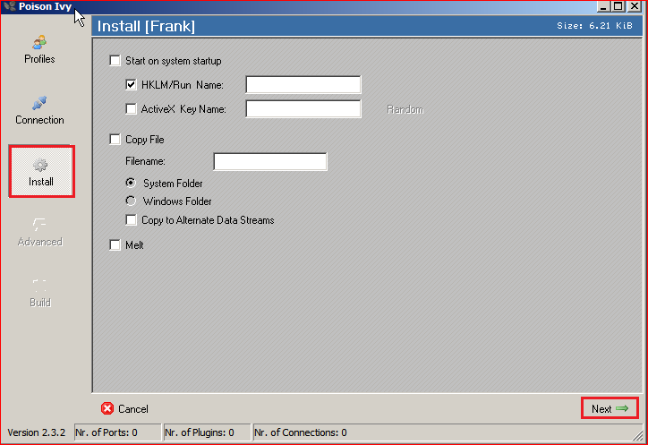
Install

Slide 15
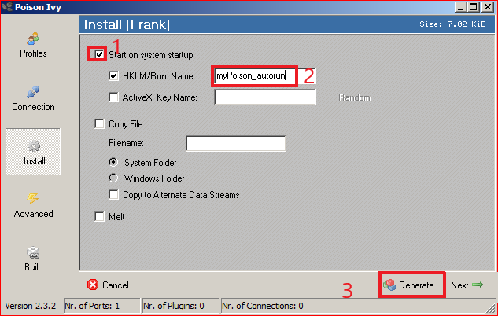

Install (Optional)

Slide 16
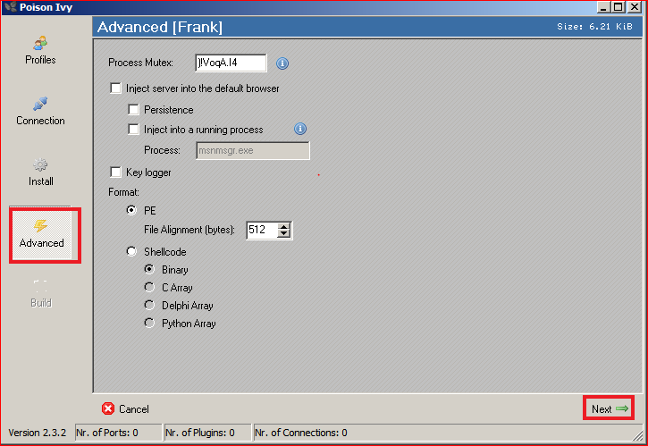
Advanced option: no change

Slide 17
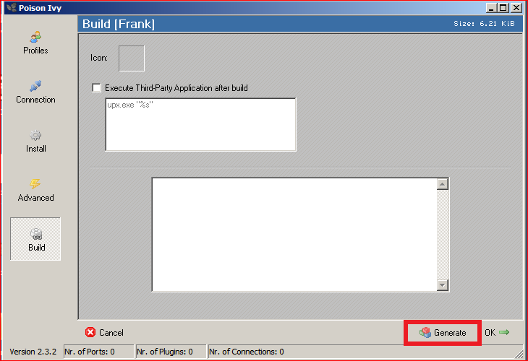
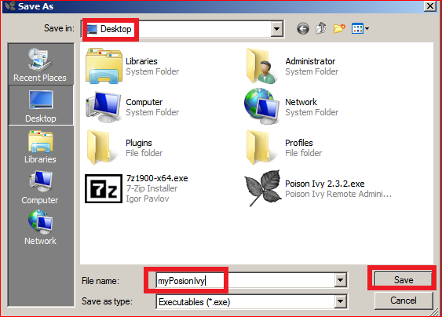
Generate Trajan/Server

Slide 18
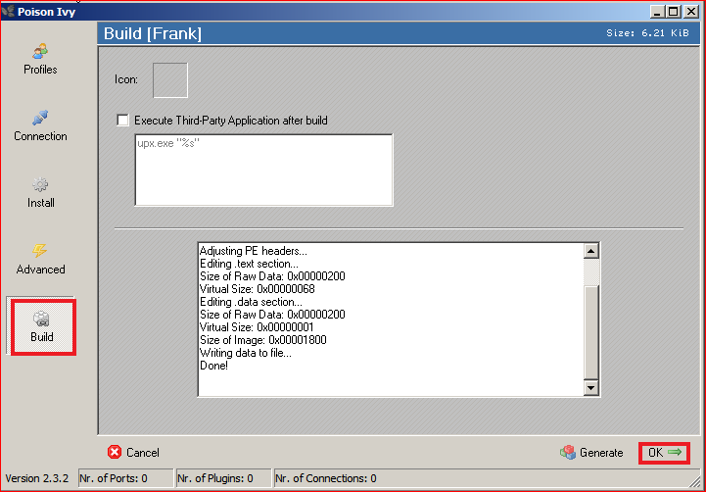
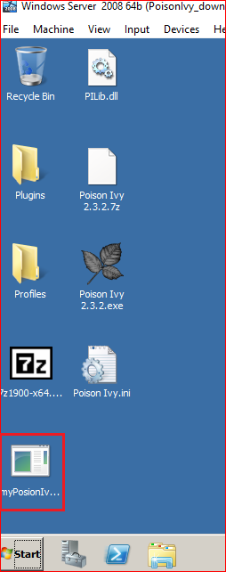
Generate Trajan/Server

Slide 19
Launch Poison Ivy Client
Win Server 2008/
Poison Ivy Client

Slide 20
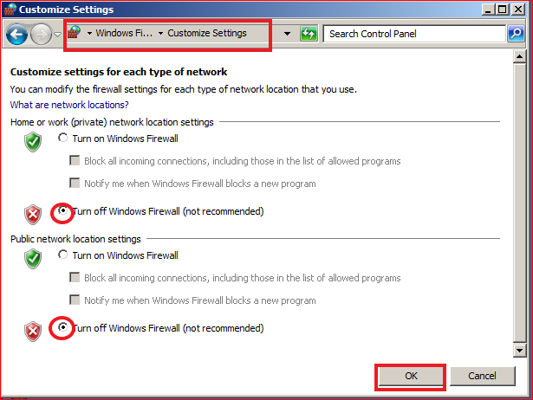
Prepare: disable firewall at Windows 2008 VM

Slide 21
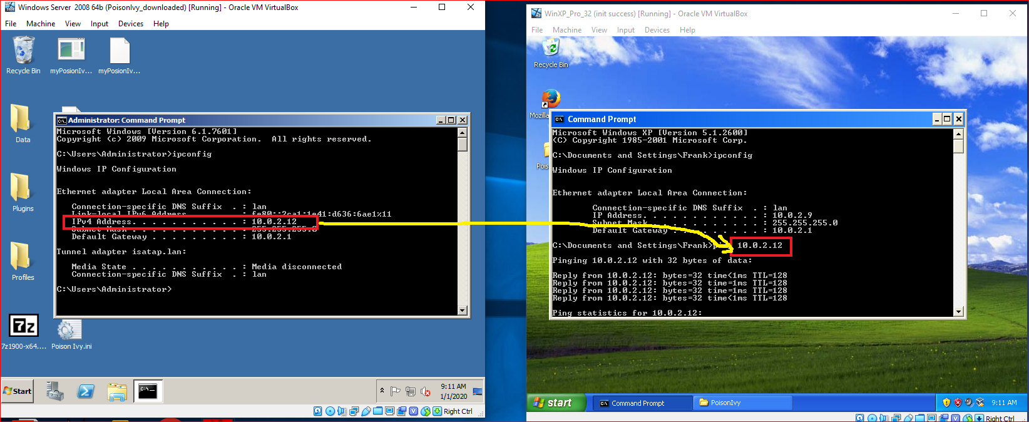
Prepare : Check network connection

Slide 22
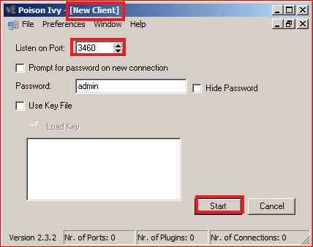
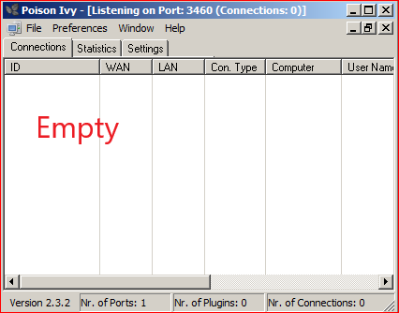
Start Poison Ivy Client at Attacker’s VM

Slide 23
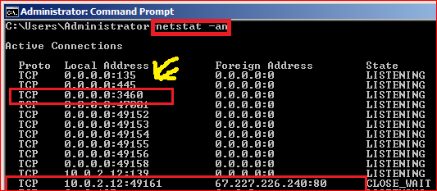
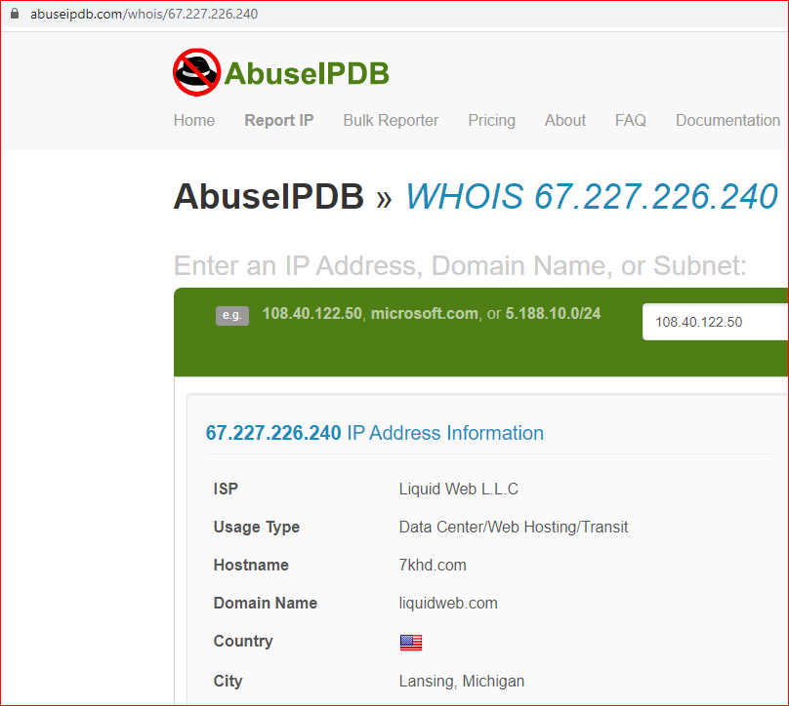
Verify that the attack machine is listening on port 3460
Potential backdoor

Slide 24
Victim
Win XP/
Poison Ivy Client

Slide 25
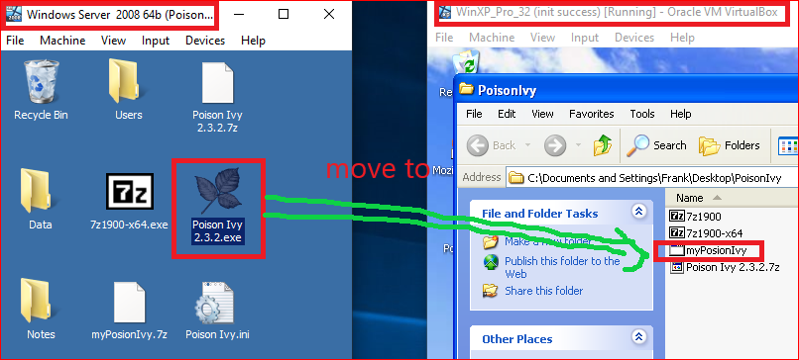
Move Trajan from Attacker to Victim (USB)

Slide 26
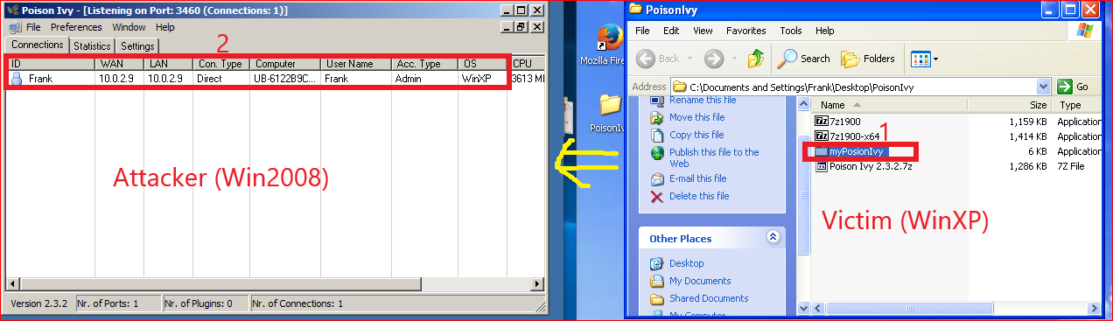
Attack Success!

Slide 27
Exploiting the Victim Machine with Poison Ivy

Slide 28
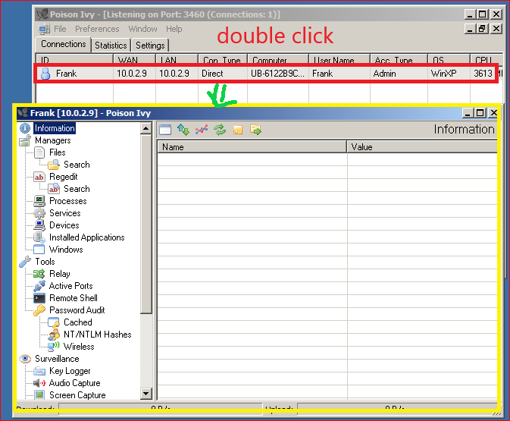
Show Attacker Exploitation Interface

Slide 29
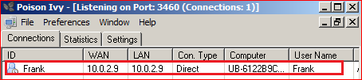
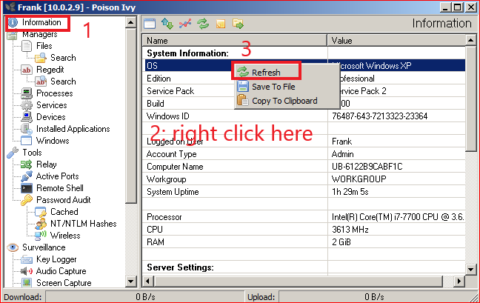
Show System Information

Slide 30
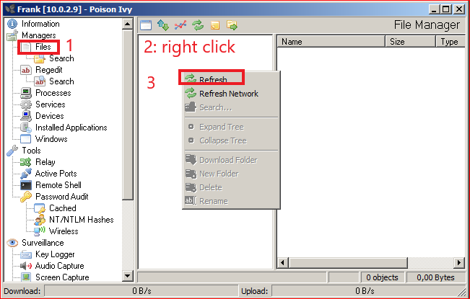
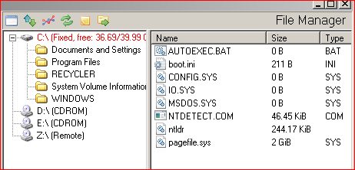
Show all files

Slide 31
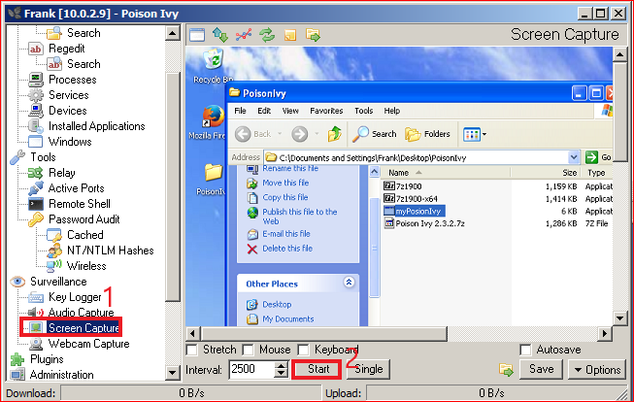

Slide 32
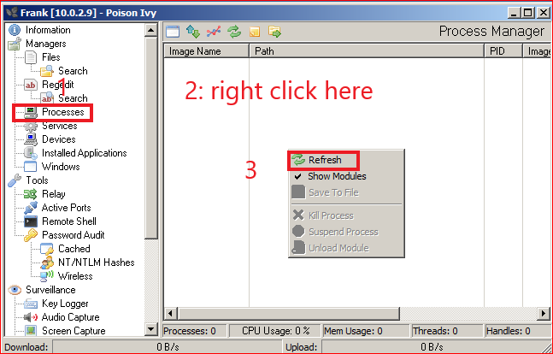
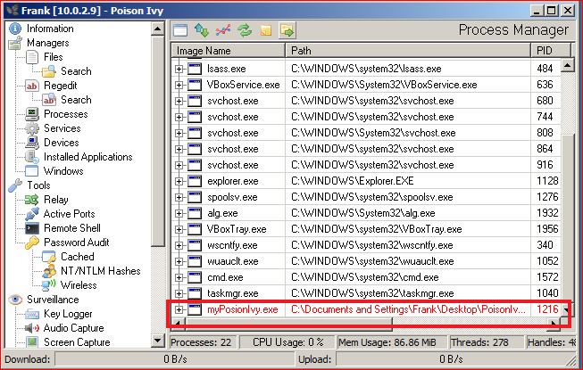
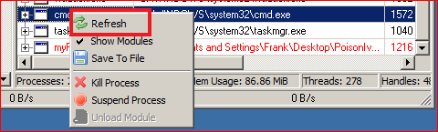
Display Victim’s Processes
Process can be killed

Slide 33
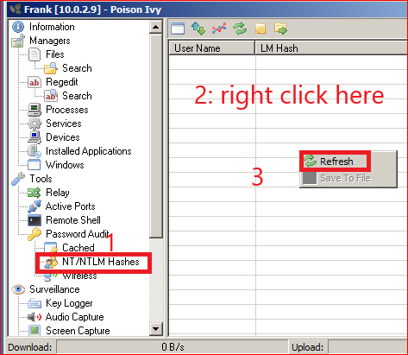
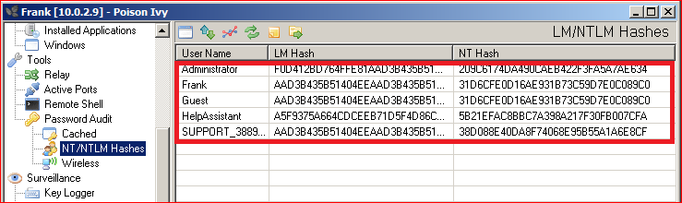
Dump the hashes on the remote machine

Slide 34
Conclusion
Poison Ivy provides a Graphical User Interface
through which users may perform
Malicious tasks against a victim machine over an encrypted connection.
The attacker can perform tasks
uploading and downloading files,
dumping hashes
killing processes and stopping services.

