Slide 1
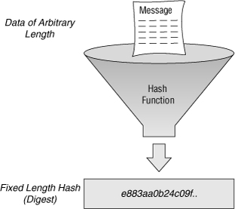
Hash Function

Slide 2
Overview

Slide 3
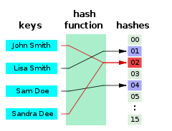
Definition
A hash function is any function that can be used to map data of arbitrary size to data of a fixed size.
The values returned by a hash function are called
hash values, hash codes, digests, or simply hashes
https://en.wikipedia.org/wiki/Hash_function

Slide 4
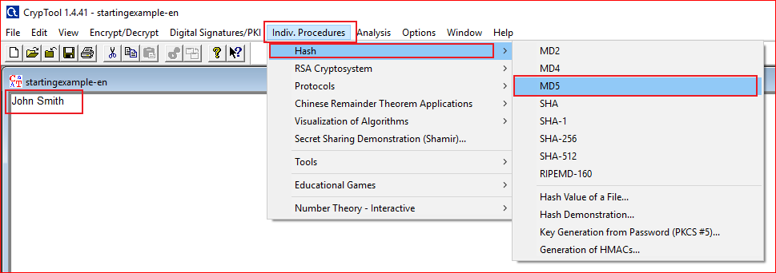

Slide 5
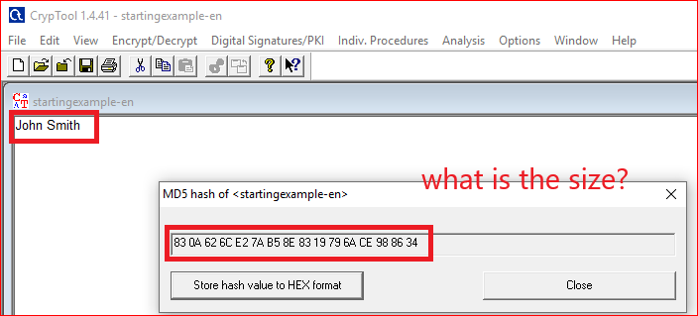
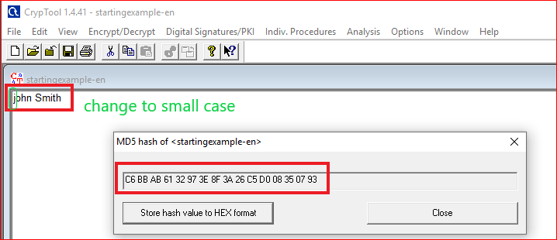

Slide 6
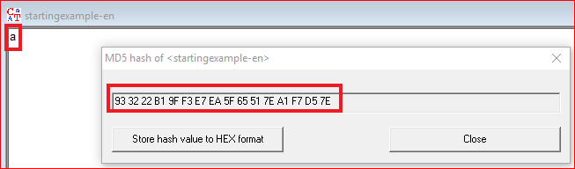
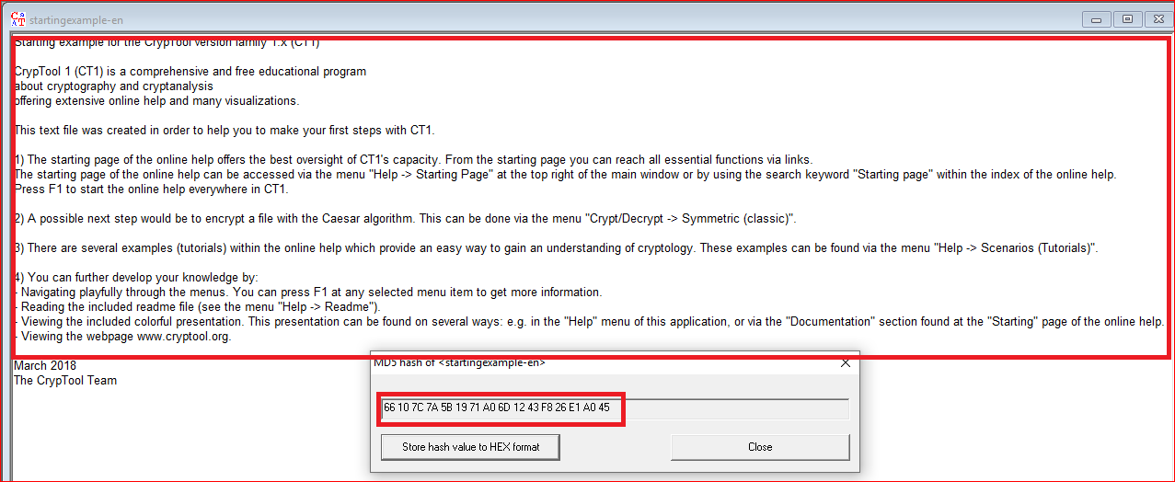

Slide 7
Question: You need to answer
Copy and paste different texts to the tool
What is the size of MD5 hash value?
Does the length of the MD5 hash value change when inputs change?

Slide 8
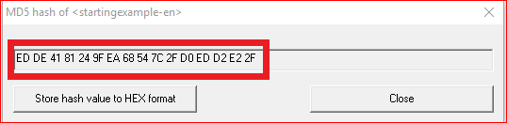
Questions: Can you produce the follow MD5 hash value?
If you can, show your results.
If you can’t, how difficult to produce the hash value? Or how many time you have to try to produce the same hash value.

Slide 9
Hash Demo

Slide 10
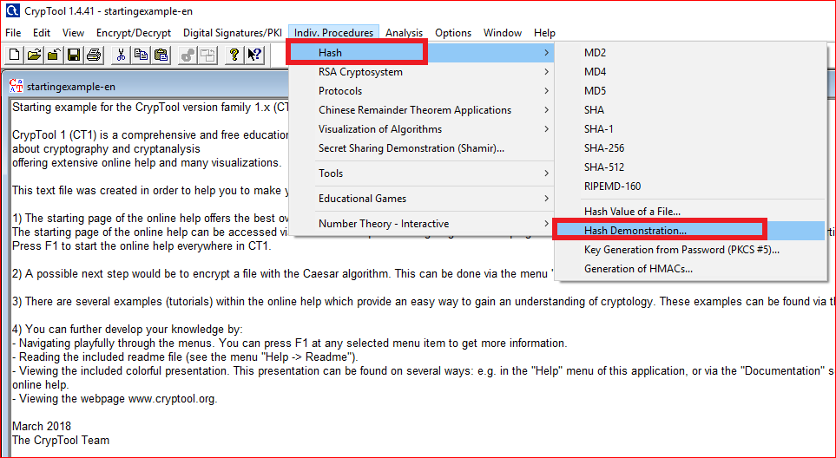

Slide 11
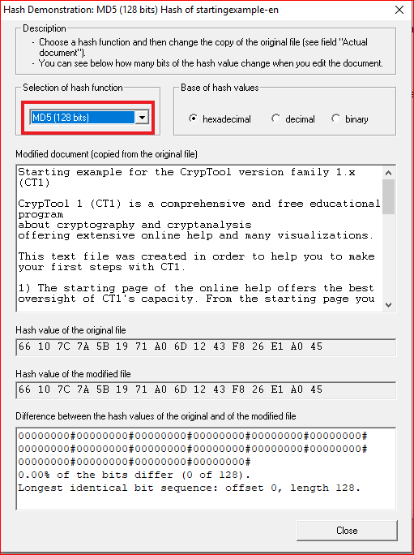
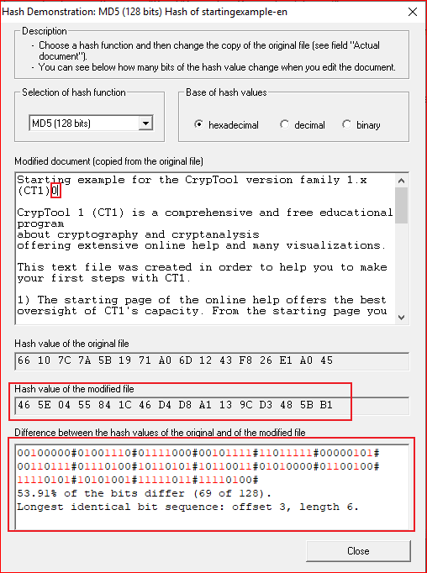

Slide 12
Question
Change the document and record your observation
Change to a different hash algorithm, i.e., SHA-256. What is the size of hash code?

Slide 13
An evil pair of files have the same MD5 hash
http://web.archive.org/web/20071226014140/http://www.cits.rub.de/MD5Collisions/

Slide 14
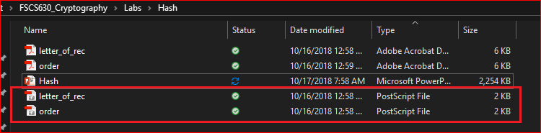
Two PostScript files
Note: You can view PostScript file by double clicking them. Adobe will convert PostScript to pdf
http://web.archive.org/web/20071226014140/http://www.cits.rub.de/MD5Collisions/

Slide 15
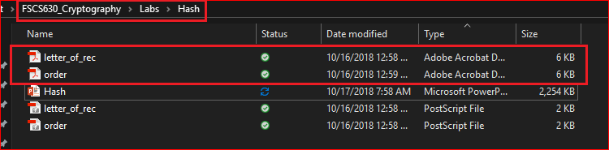

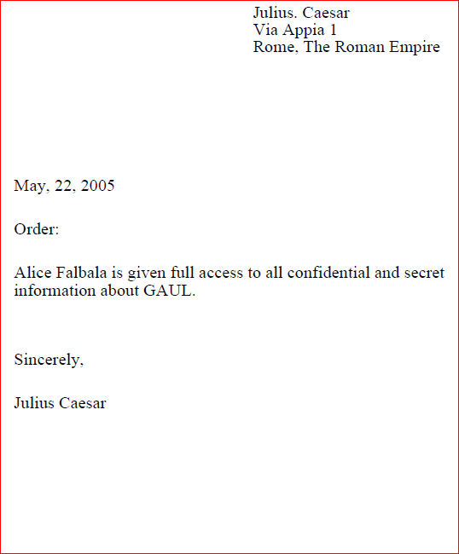
View the corresponding Pdf files

Slide 16
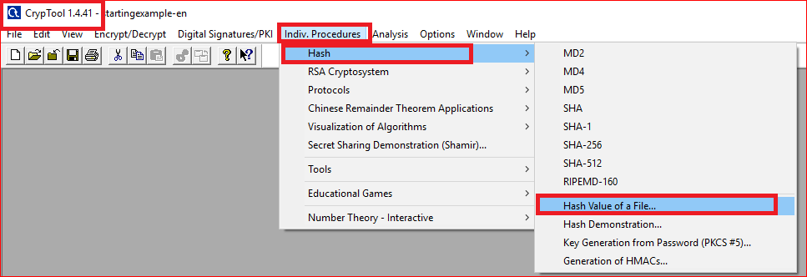
Computing MD5 hash values of two Postscript files (method 1)

Slide 17
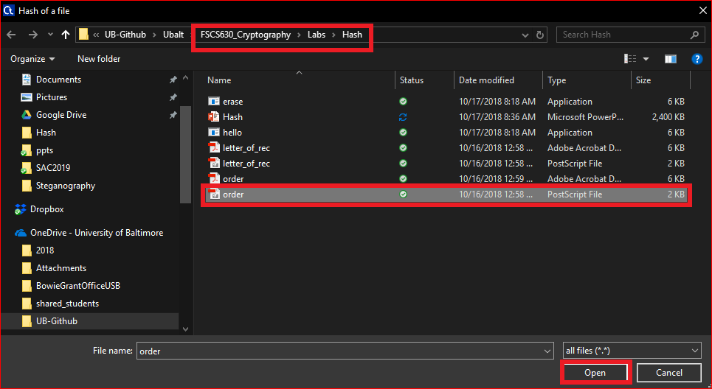
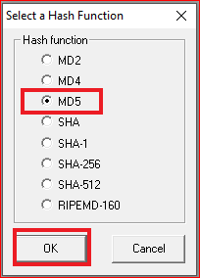
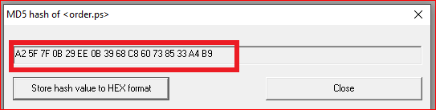

Slide 18
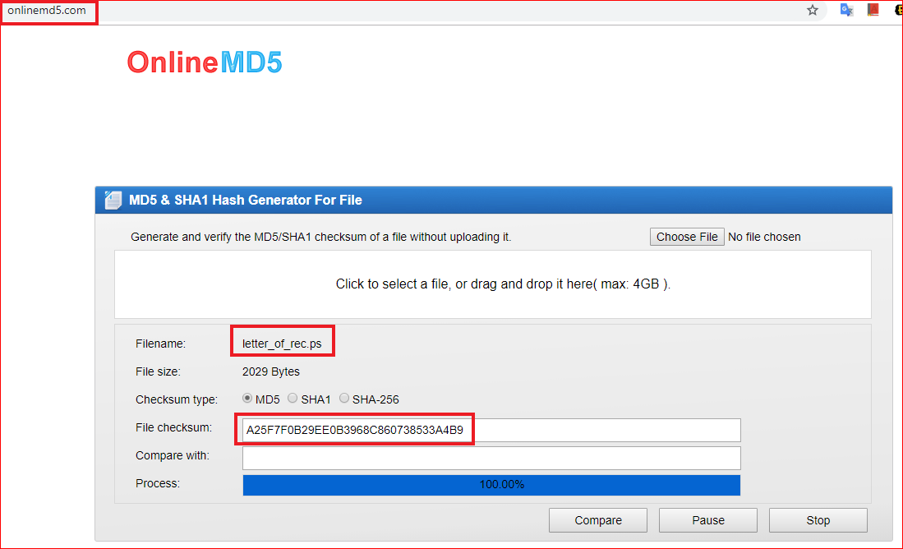
Computing the MD5 hash values of two Postscript files (method 2)

Slide 19
Question
Record both MD5 hash values
Are the two hash values same?

Slide 20
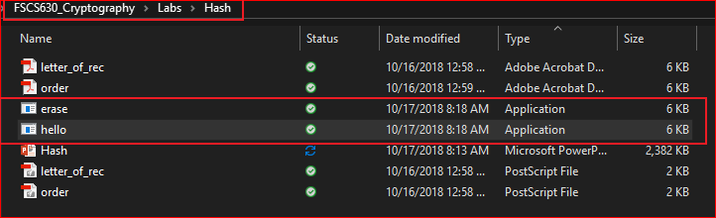
An evil pair of executable programs
https://www.mscs.dal.ca/~selinger/md5collision/

Slide 21
Question
Record both MD5 hash values of executable files
Are the two hash values same?

Slide 22
Attack on digital signature
Generate a malicious file with the same hash of another file

Slide 23
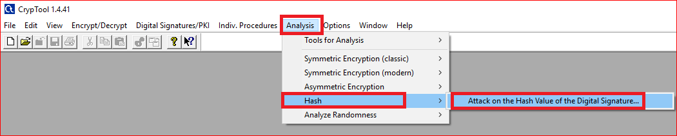

Slide 24
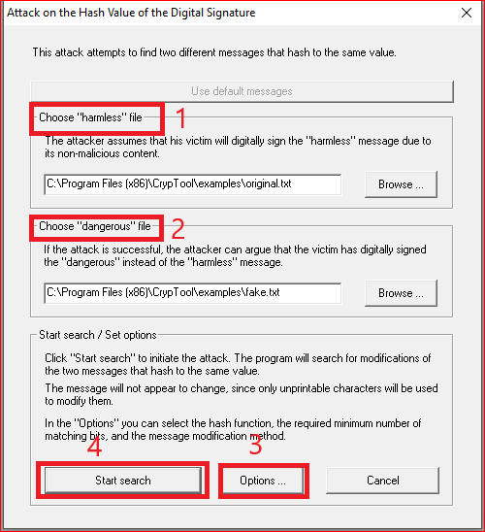
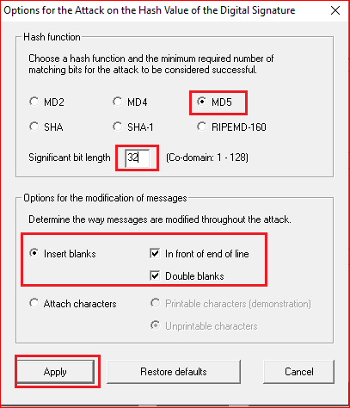

Slide 25
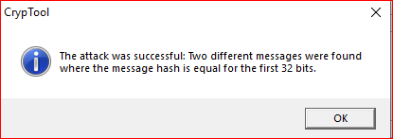
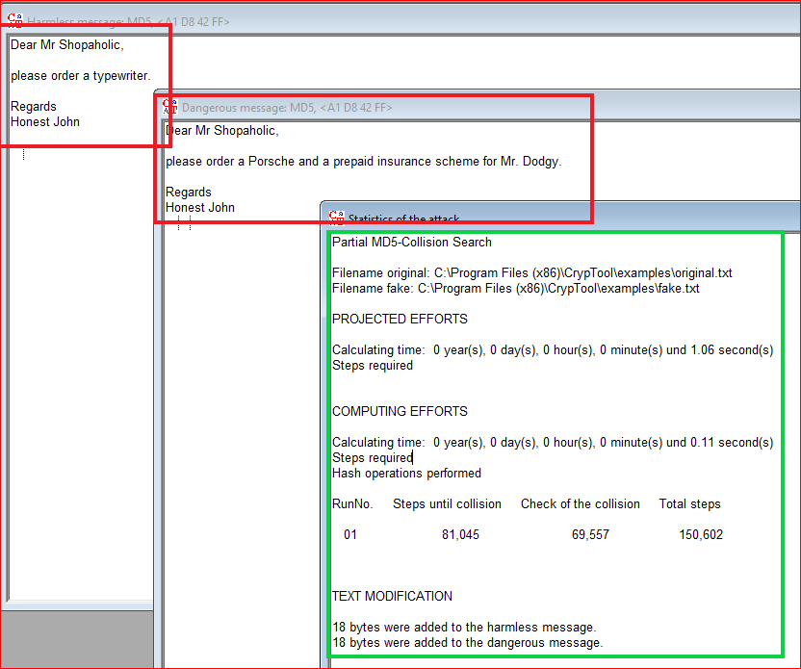
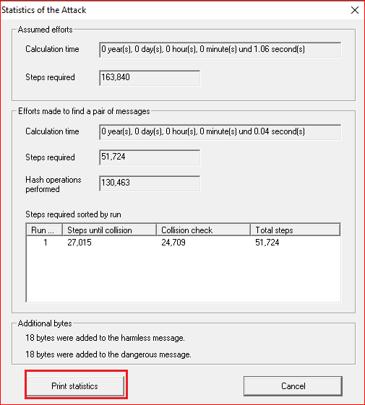

Slide 26
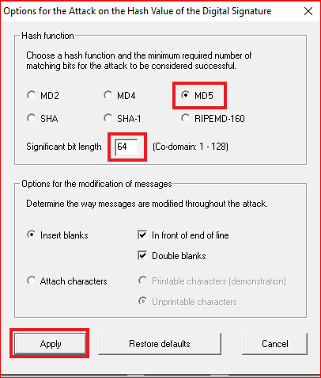
Question
Change the significate bit length to 64 and 128 bits.
Record the results and describe your observation.

Slide 27
Question
Design two files, the harmless and dangerous files.
Can you generate the same hash values using the tool? Why or why not?
Record the results and describe your observation.

