Slide 1
The Advanced Encryption Standard (AES)

Slide 2
Cryptology
Cryptography
Symmetric Ciphers
Asymmetric Ciphers
Cryptanalysis
Protocols
Block Ciphers
Stream Ciphers
Integer Factoring Problem
Discrete Logarithm problem
AES
DES

Slide 3
AES Facts
The most widely used symmetric cipher today
Chosen by the US National Institute of Standards and Technology (NIST) in Oct 2000
Approved as a US federal standard in November 2001

Slide 4
How AES was selected by AES?
The need for a new block cipher announced by NIST in January, 1997
15 candidates algorithms accepted in August, 1998
5 finalists announced in August, 1999:
MARS, submitted by a large team from IBM Research
RC6, submitted by RSA Security
Rijndael, submitted by two Belgian cryptographers, Joan Daemen and Vincent Rijmen
Serpent, submitted by Ross Anderson, Eli Biham and Lars Knudsen
Twofish, submitted by a large team of researchers from Counterpane Internet Security, including noted cryptographer Bruce Schneier

Slide 5
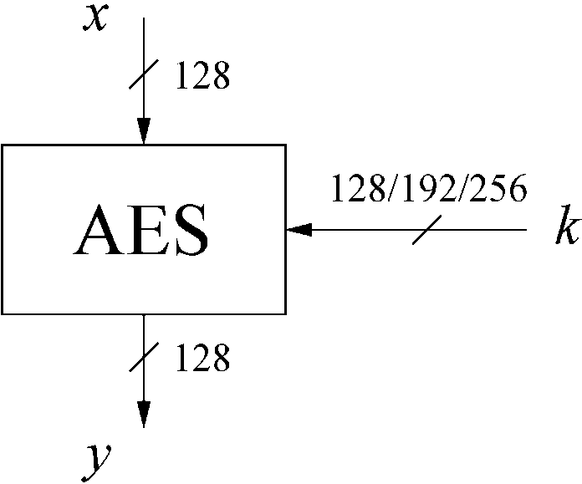
AES: Overview

Slide 6
AES hands-on

Slide 7
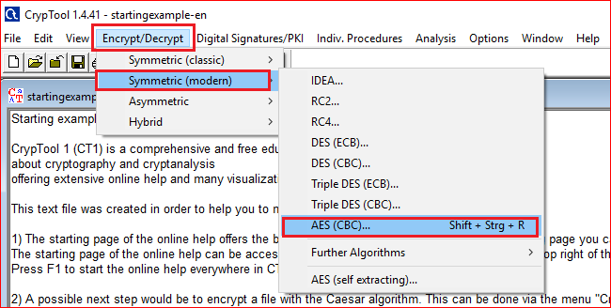

Slide 8
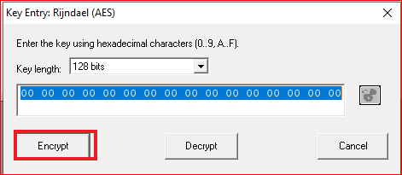
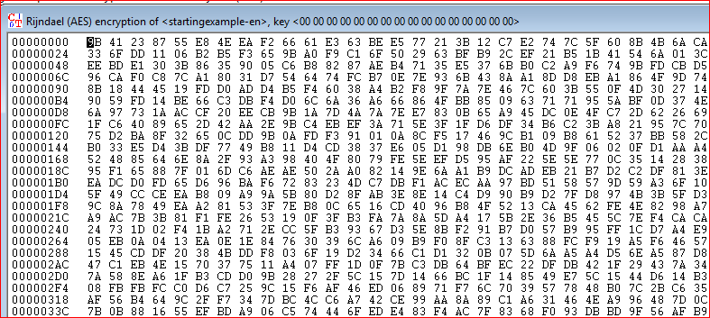

Slide 9
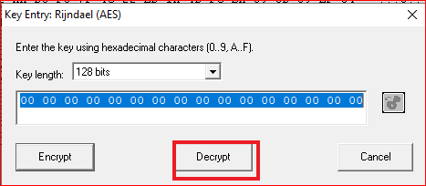
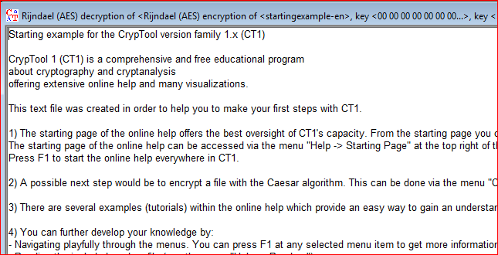

Slide 10
Brute-Force Analysis

Slide 11
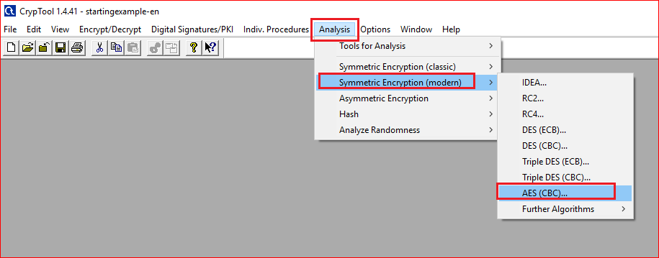

Slide 12
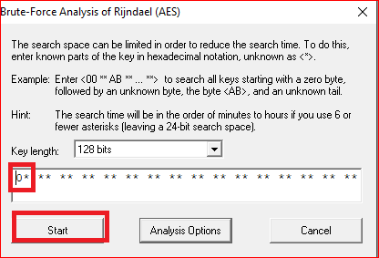
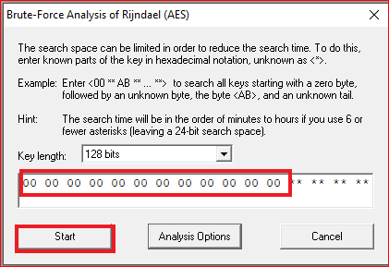
Question
Add one “0”, two “0”s, .. Twelve “0”s. Describe the time you need to guess the keys

Slide 13
Encryption Animation

Slide 14
AES: Overview
Key length (bits) | Number of rounds
128 | 10
192 | 12
256 | 14

Slide 15
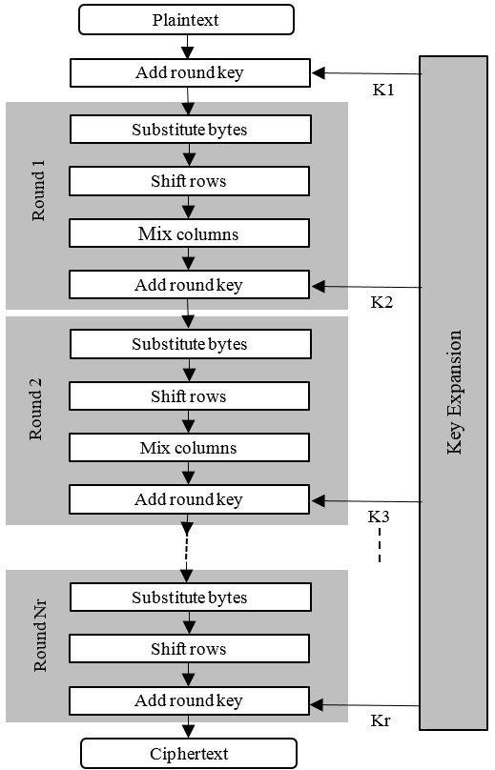
Diffusion
ShiftRows Sublayer: Permutation of the data on a byte level
MixColumn Sublayer: Matrix operation which combines (“mixes”) blocks of four bytes

Slide 16
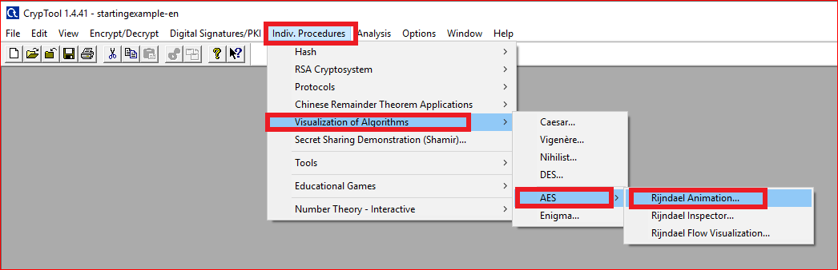

Slide 17
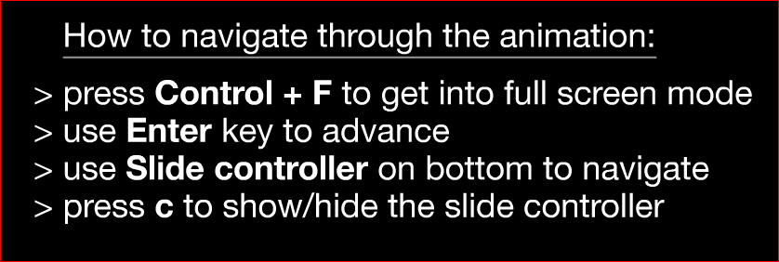
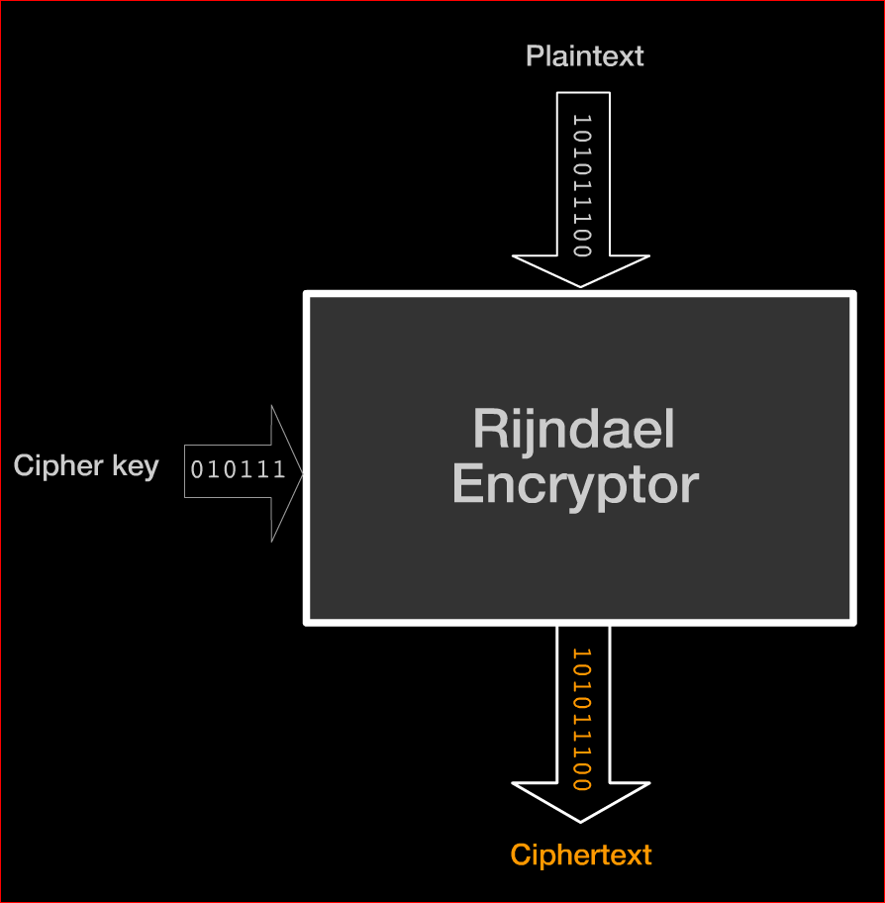

Slide 18
Questions: in round 1
SubBytes: what is the output for a0?
ShiftRows: record the last row results.
MixColums: record the last column results.
AddRoundKey: show how the last column is calculated.
Notes:
e0

Slide 19
Questions
What is the difference between the fist around and the last round?
Notes:
e0

Slide 20
Key schedule Animation

Slide 21
Question
Watch the animation and describe how the first and the second keys are generated.

