Slide 1
Acquiring a USB Image

Slide 2
Prepare a USB with files

Slide 3
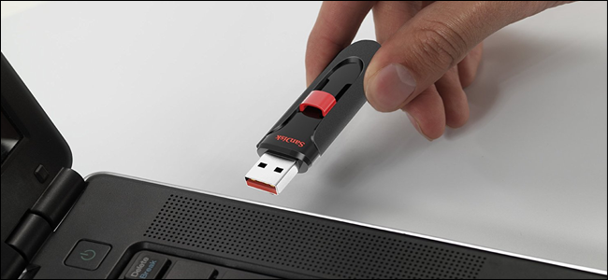
Plug in a Flash Drive to Your Computer
https://www.howtogeek.com/wp-content/uploads/2017/09/ximg_59b9b8dfbb300.png.pagespeed.gp+jp+jw+pj+ws+js+rj+rp+rw+ri+cp+md.ic.2DjSUAOnqK.jpg

Slide 4
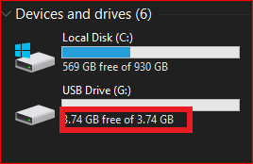
Verify your PC can read the USB drive

Slide 5

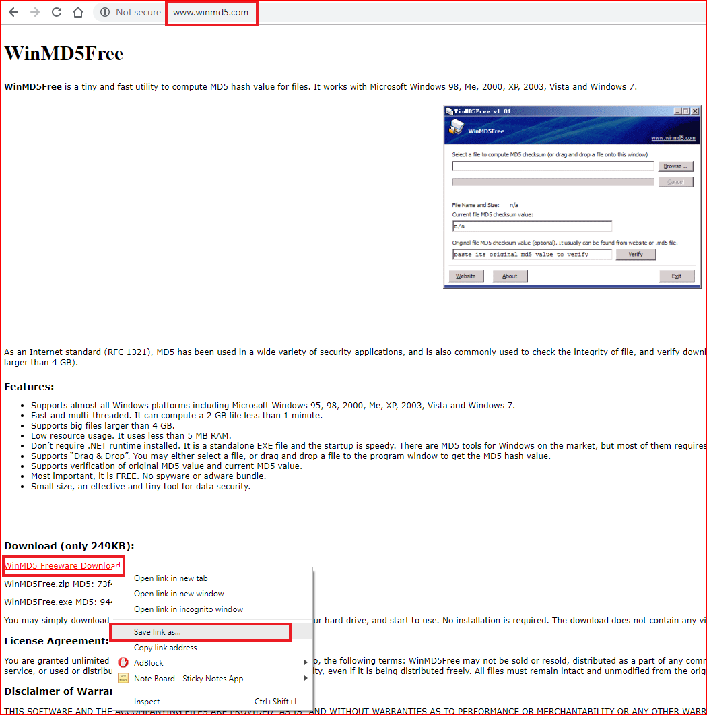
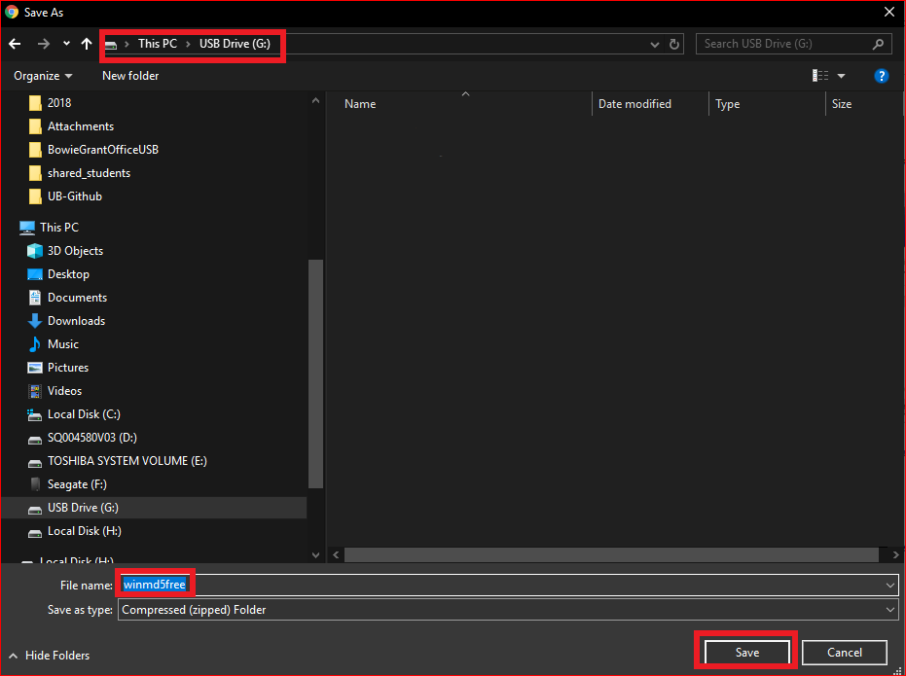
Download a free software to the USB using Chrome

Slide 6
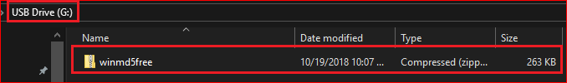
The USB we want to clone

Slide 7
Enable write protection for the USB
(optional)

Slide 8
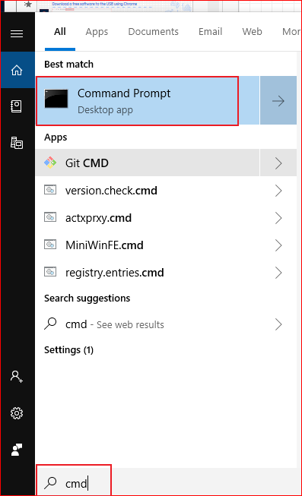
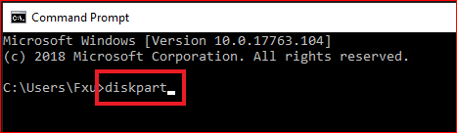

Slide 9
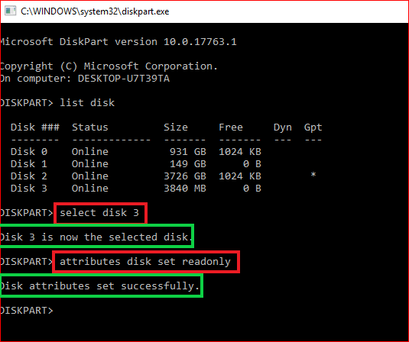
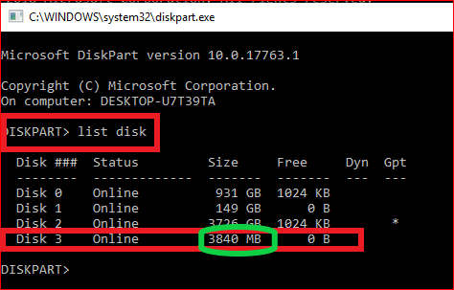

Slide 10
Question
Copy any files to the USB. Capture your screen.
Are you able to copy files to USB?

Slide 11
Acquiring the USB image

Slide 12

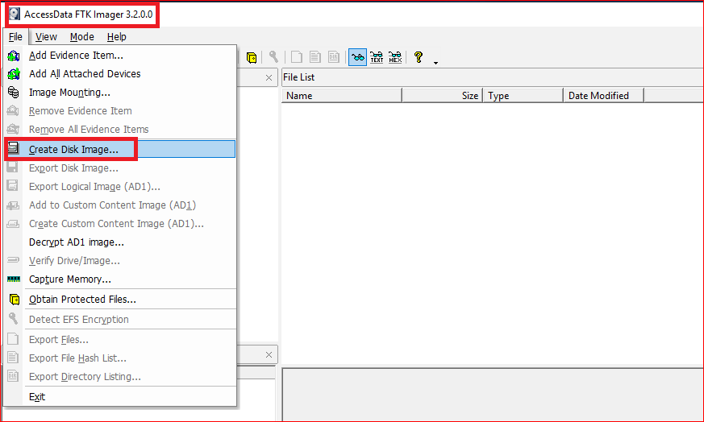
Acquiring a USB using FTK

Slide 13
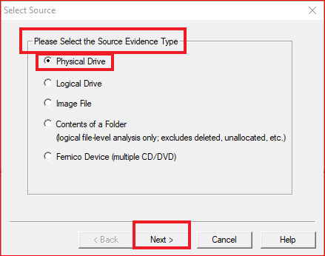
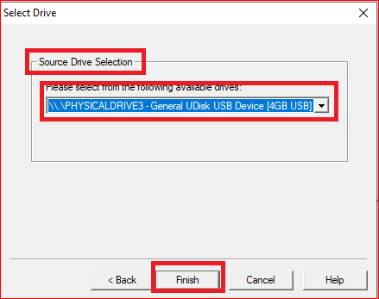

Slide 14
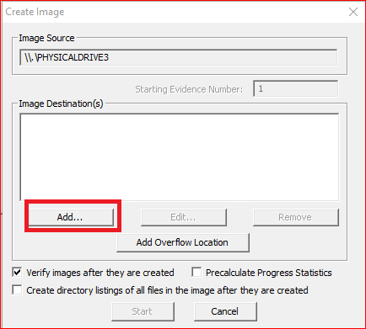
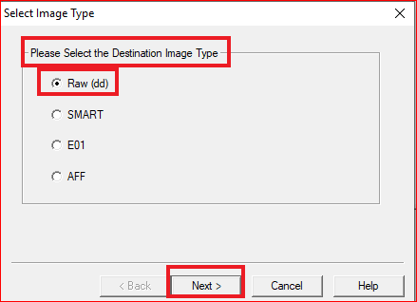

Slide 15
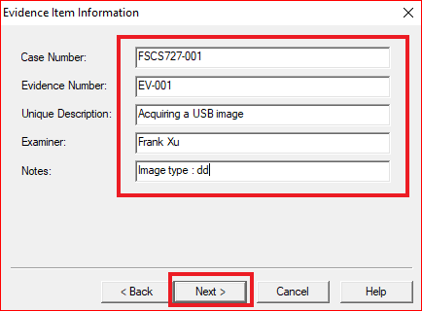

Slide 16
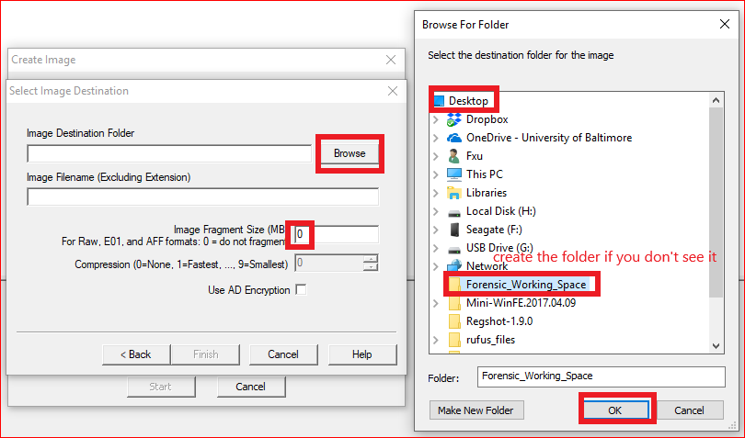

Slide 17
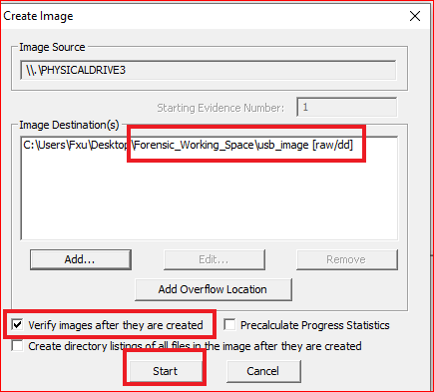
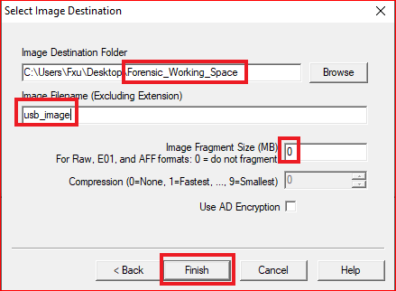

Slide 18
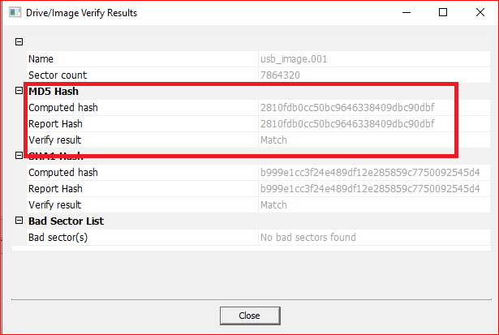
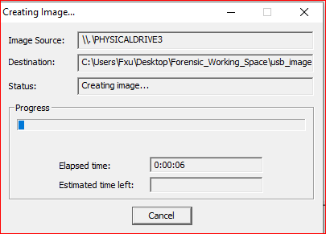

Slide 19
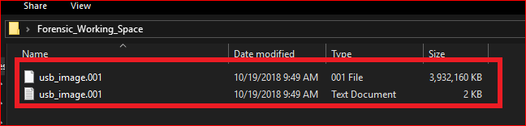

Slide 20
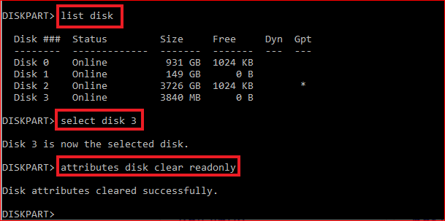
To Disable Write Protection for the Disk (Clean up)

Slide 21
Acquiring a USB image using Linux command lines

Slide 22
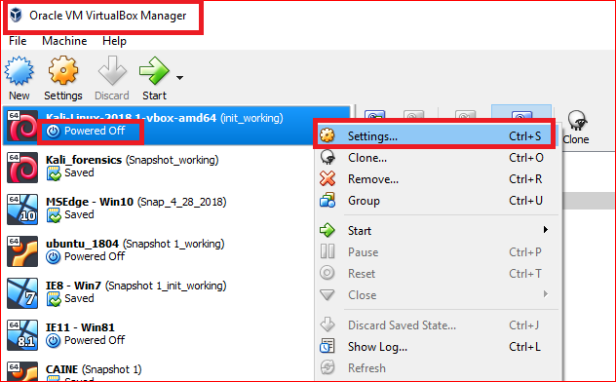

Slide 23
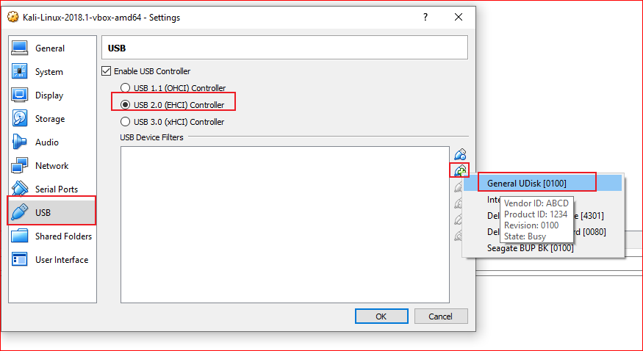

Slide 24
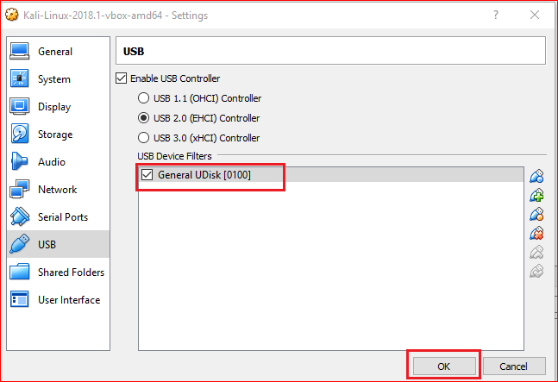

Slide 25
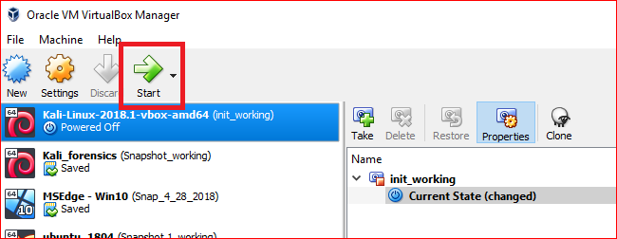

Slide 26
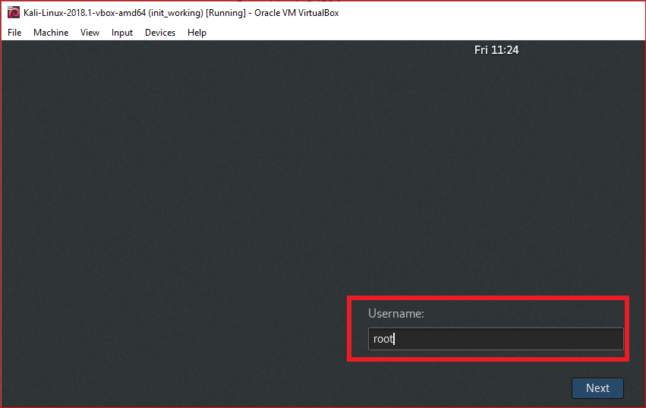
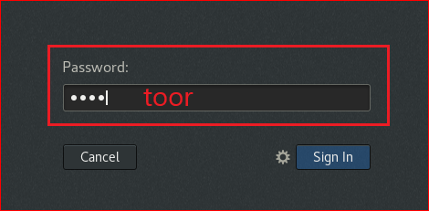

Slide 27
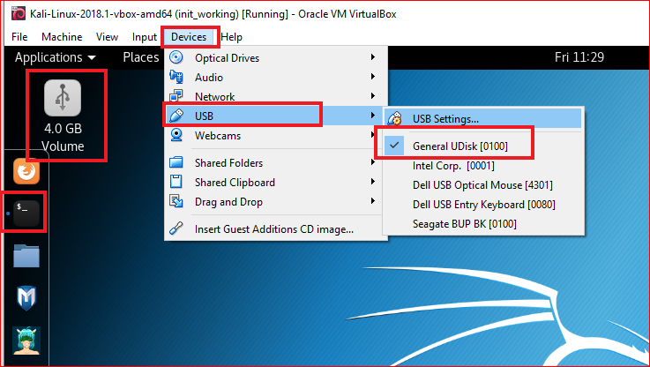

Slide 28
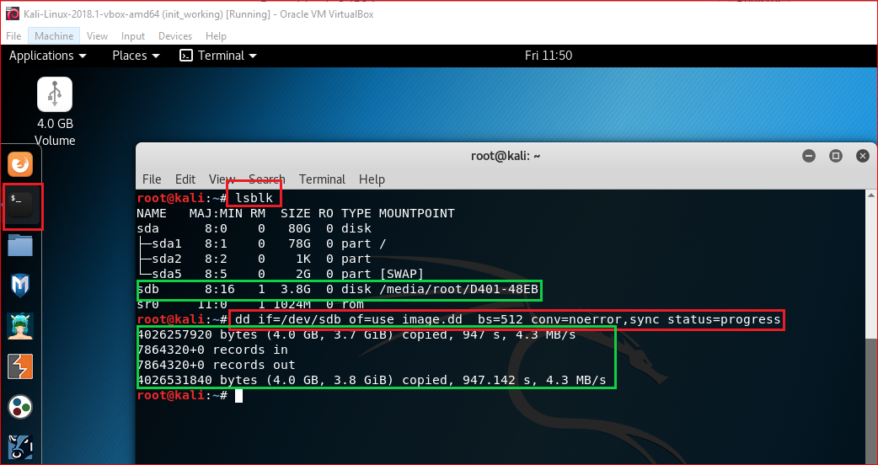
dd command to clone a USB
Notes:
If there are any errors, the above command will fail. If you give the parameter “conv=noerror” then it will continue to copy if there are read errors.

Slide 29
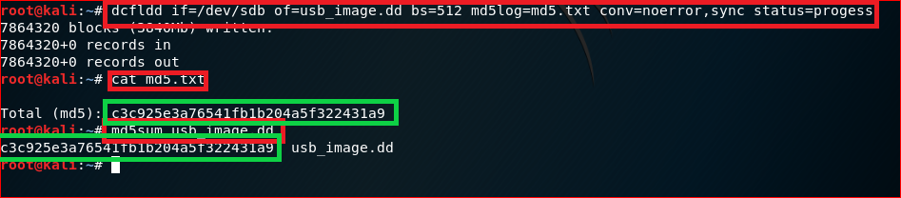
Use dcfldd

Slide 30
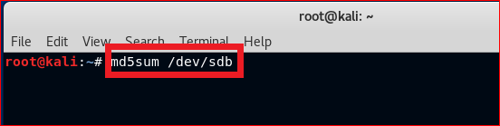
What is the MD5 hash value of the USB?

Slide 31
Questions
Add a file to USB and delete it.
Can you recover the file?

Slide 32
Questions
Should the MD5 hash values of USB and its image be the same?
Report your results and explain why your hash values (USB and its image) are the same or different.

