Slide 1
How to download required files for forensic labs

Slide 2
Download files from Github repository

Slide 3
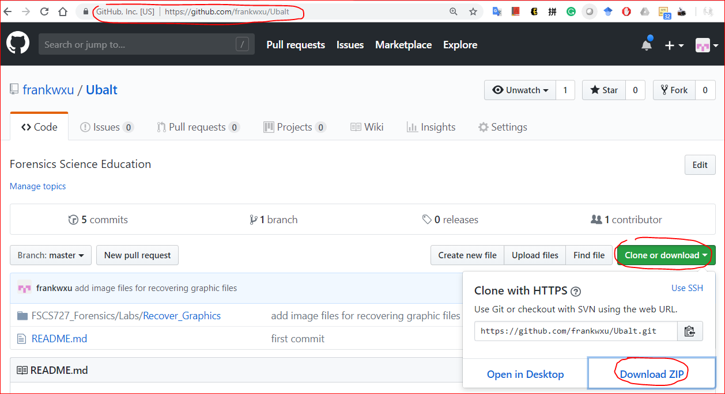
https://github.com/frankwxu/Ubalt

Slide 4
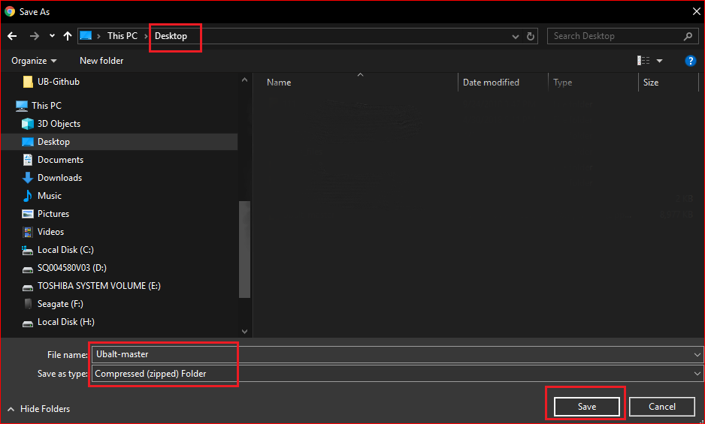

Slide 5
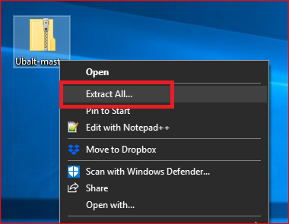
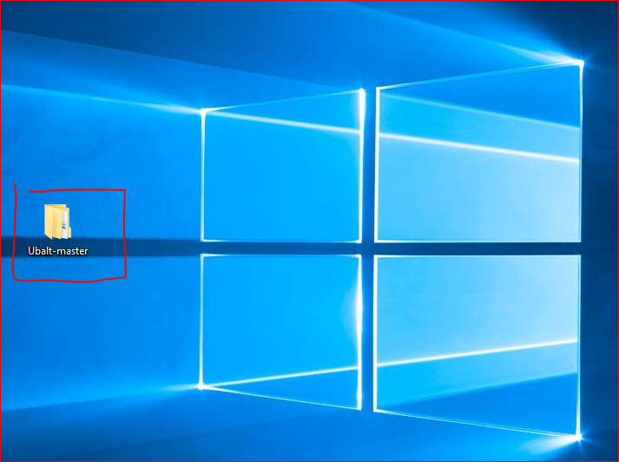

Slide 6


Slide 7
Create a working space

Slide 8
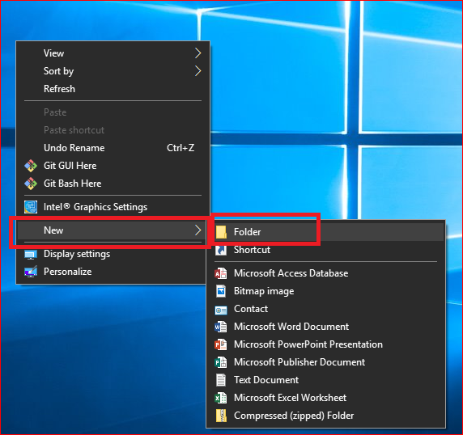
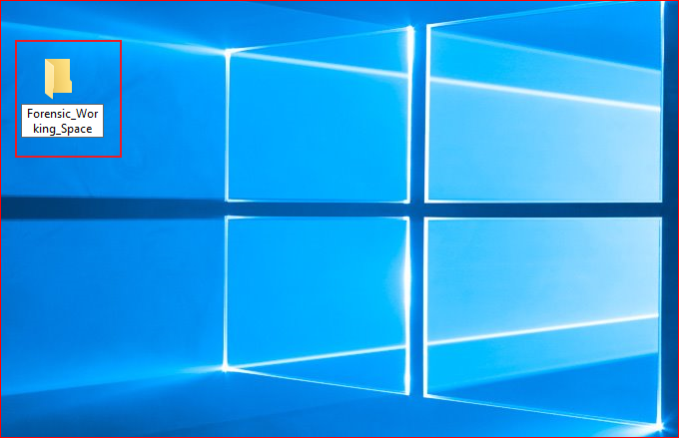

Slide 9
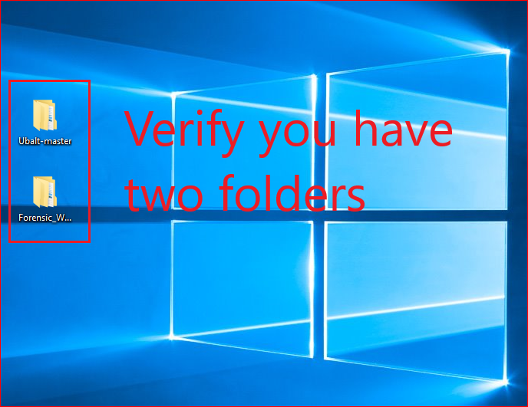

Slide 10
View large icon of files

Slide 11

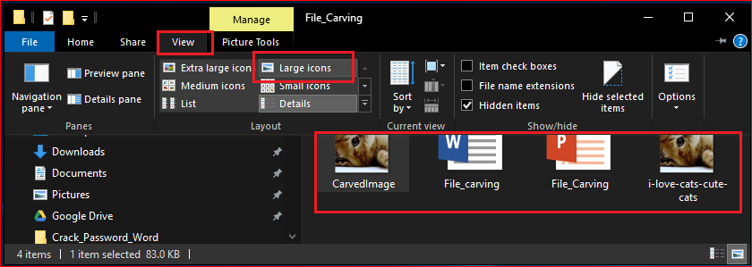

Slide 12
You need to repeat these steps before each lab to get updated files

