Slide 1
APR Spoofing using arpspoof commands

Slide 2
What is ARP spoof

Slide 3
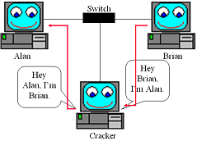
Address Resolution Protocol (ARP)

Slide 4
Information gathering

Slide 5
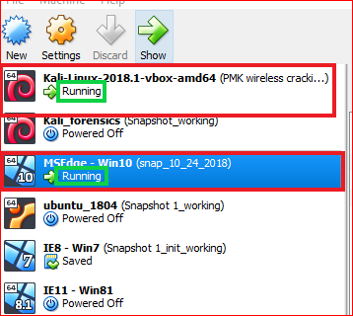

Slide 6
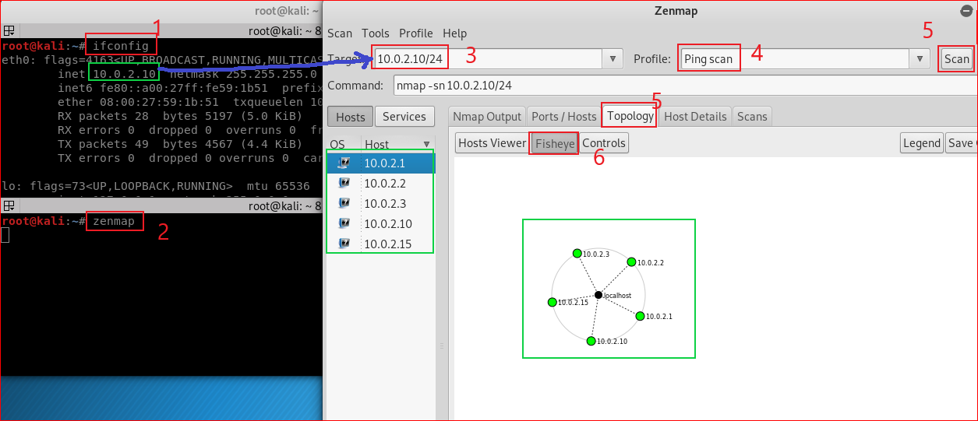

Slide 7
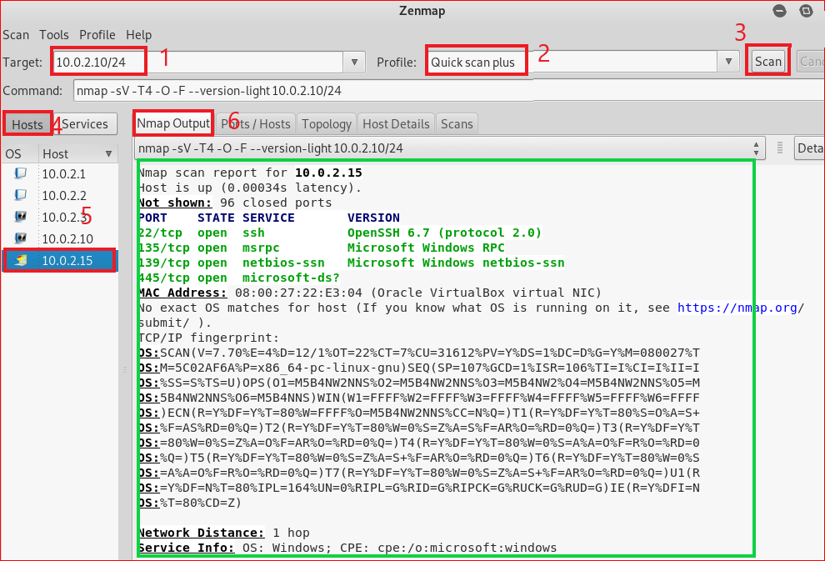

Slide 8
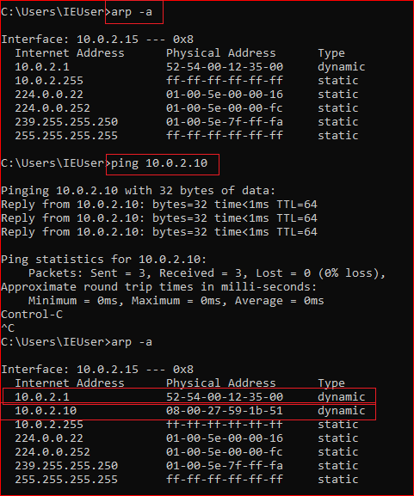
Windows 10 ARP table

Slide 9
ARP MITM attack

Slide 10
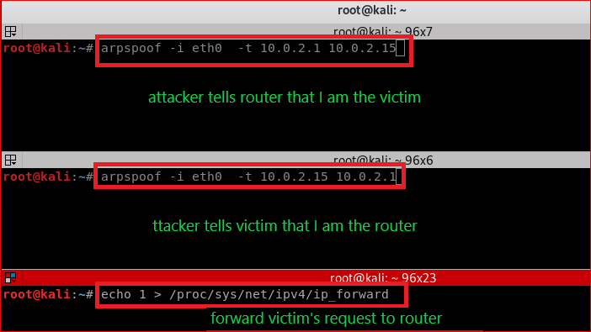

Slide 11
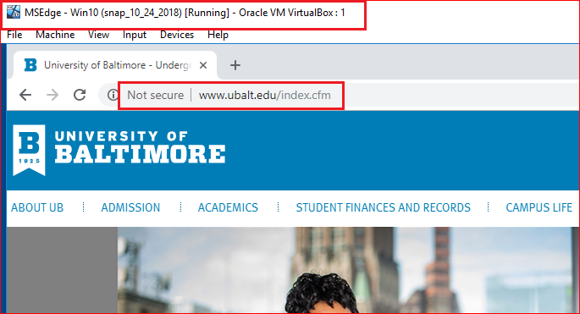

Slide 12
