Slide 1
APR Spoofing using mitm Framework

Slide 2
What is ARP spoof

Slide 3
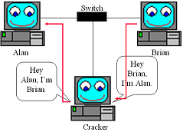
Address Resolution Protocol (ARP)

Slide 4
Information gathering

Slide 5
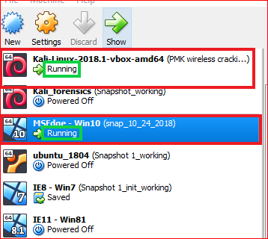

Slide 6
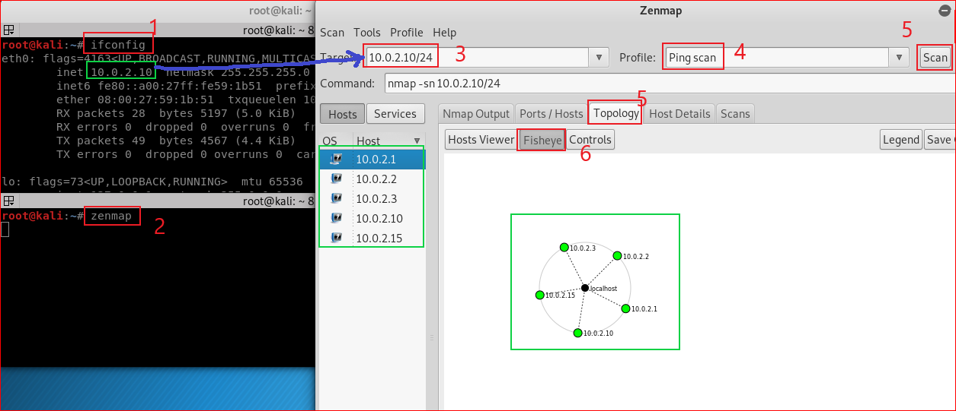

Slide 7
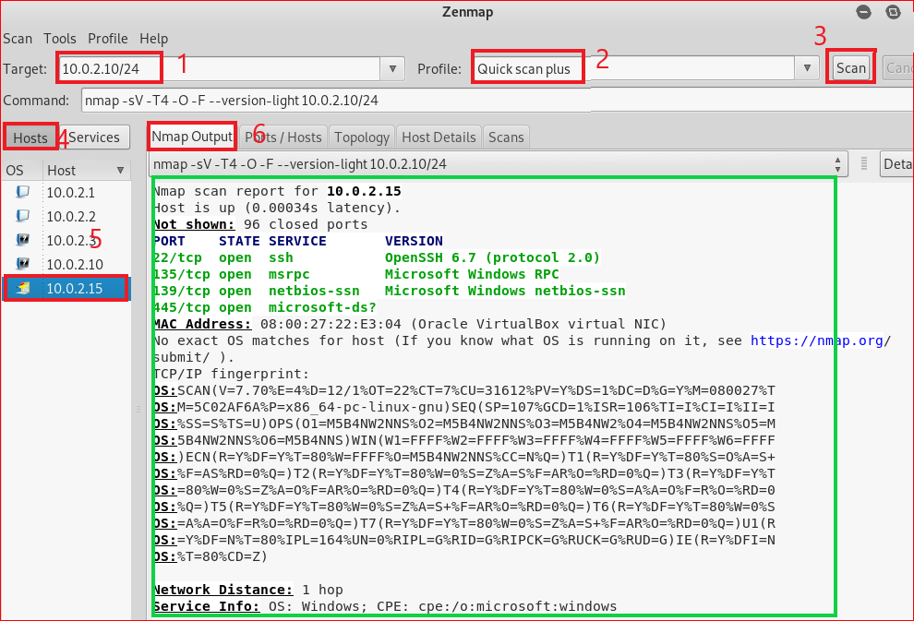

Slide 8
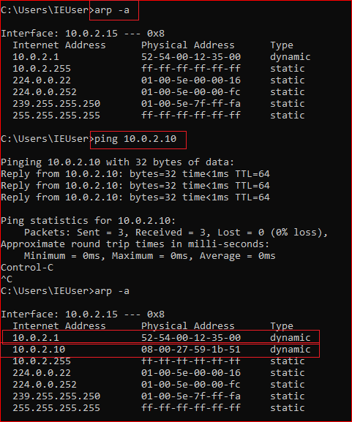
Windows 10 ARP table
Before the attack

Slide 9
ARP MITM attack

Slide 10
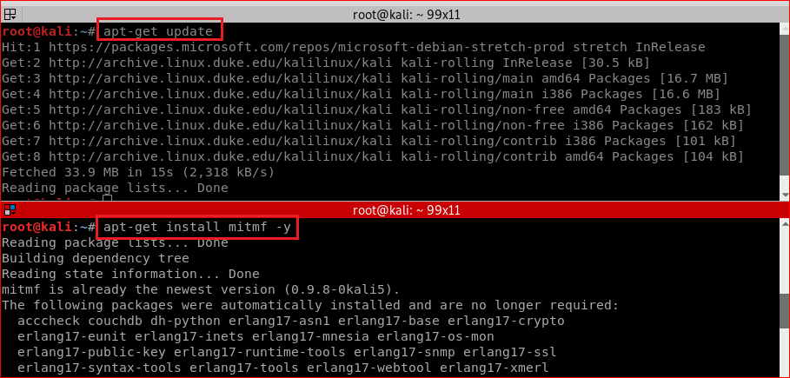
mitm framework installation

Slide 11
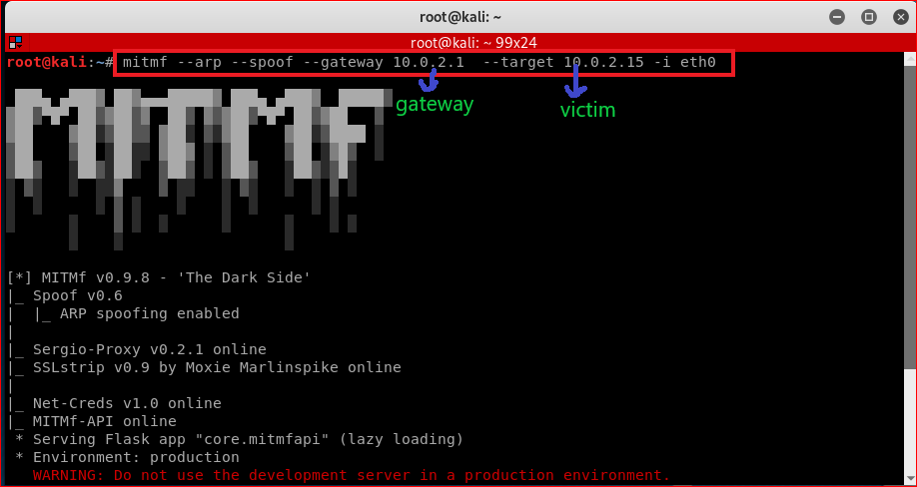
Attacking

Slide 12
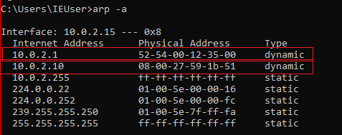
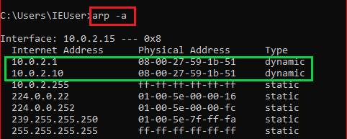
MAC address use Victim’s PC (Before and after attack)

Slide 13
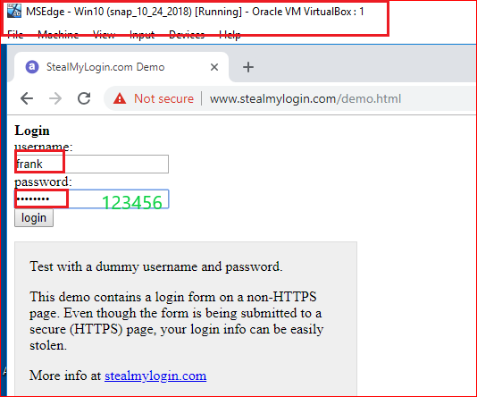

Slide 14
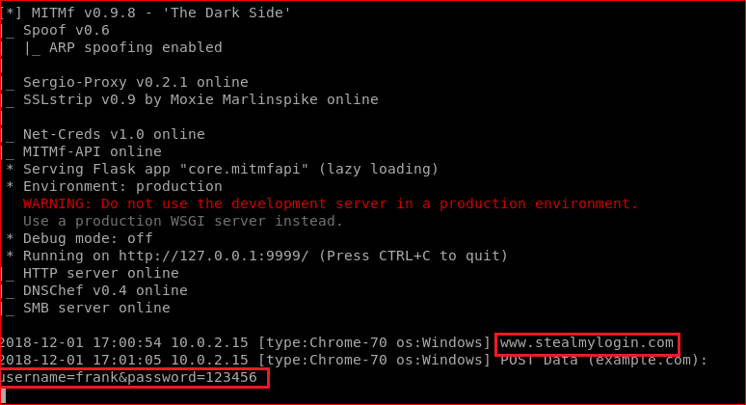

Slide 15
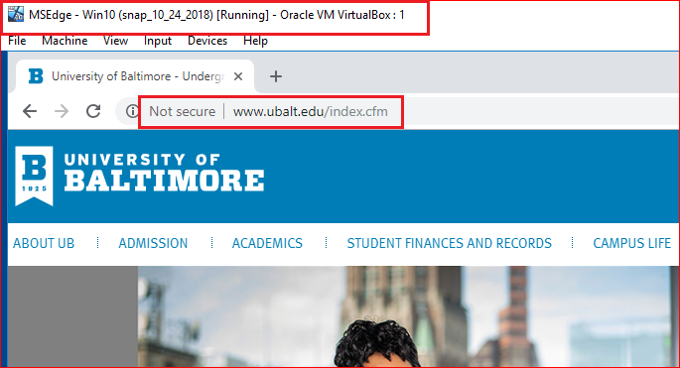

Slide 16
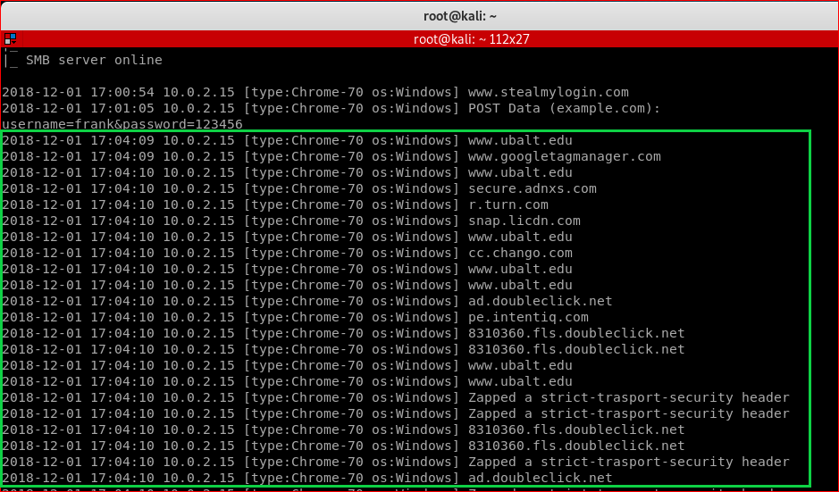

Slide 17
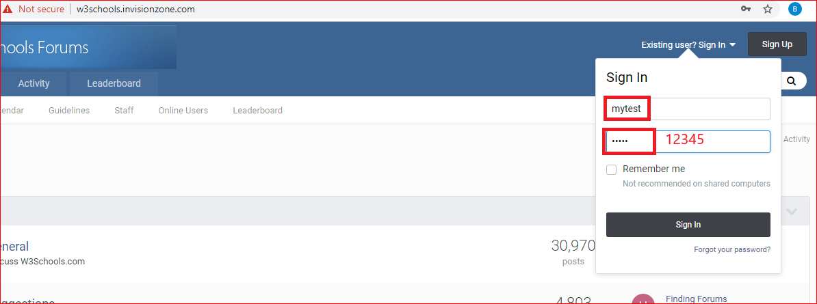
Try http://w3schools.invisionzone.com/

Slide 18


Slide 19
HTTPS downgrade to HTTP

Slide 20
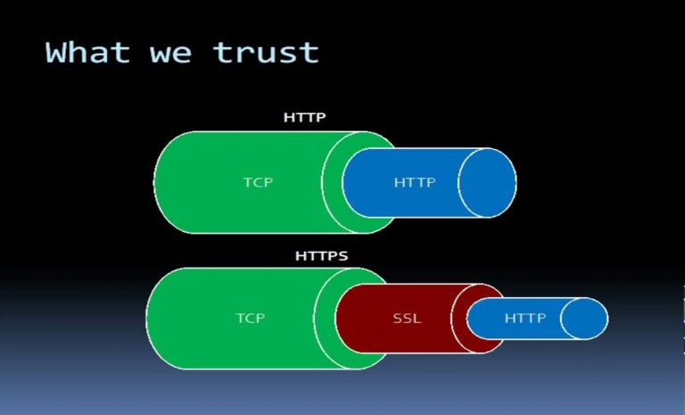

Slide 21
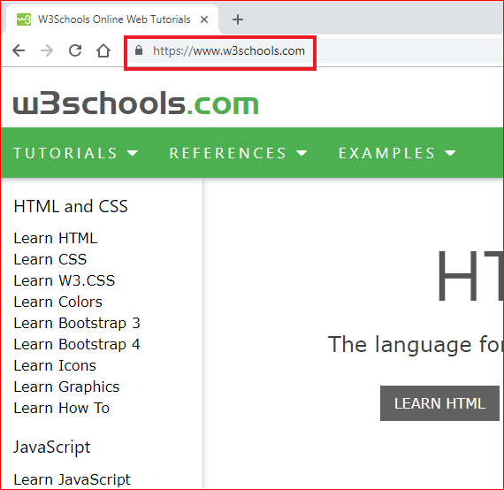
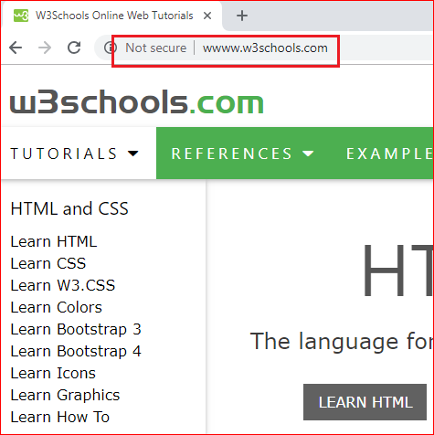
Before and after strip HTTPS

Slide 22
