Slide 1
The Advanced Encryption Standard (AES)

Slide 2
Cryptology
Cryptography
Symmetric Ciphers
Asymmetric Ciphers
Cryptanalysis
Protocols
Block Ciphers
Stream Ciphers
Integer Factoring Problem
Discrete Logarithm problem
AES
DES

Slide 3

Why abandon DES?
DES was officially withdrawn in 2005
DES I contest, 84 days, 1997
DES II contest, one month, 1998
DES III contest, 23 hours, 1999, $250K PC
NIST has approved Triple DES (3DES) through 2030 for sensitive government information.
Key size probelm

Slide 4
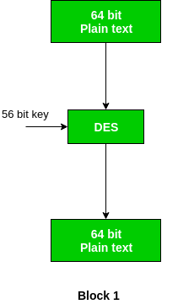
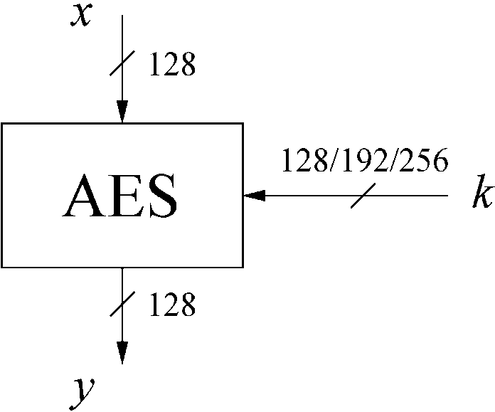
AES: Overview

Slide 5

AES Facts
The most widely used symmetric cipher today
Chosen by the US National Institute of Standards and Technology (NIST) in Oct 2000
Approved as a US federal standard in November 2001

Slide 6
How AES was selected by NIST?
The need for a new block cipher announced by NIST in January, 1997
15 candidates algorithms accepted in August, 1998
5 finalists announced in August, 1999:
MARS, submitted by a large team from IBM Research
RC6, submitted by RSA Security
Rijndael, submitted by two Belgian cryptographers, Joan Daemen and Vincent Rijmen
Serpent, submitted by Ross Anderson, Eli Biham and Lars Knudsen
Twofish, submitted by a large team of researchers from Counterpane Internet Security, including noted cryptographer Bruce Schneier

Slide 7
AES hands-on

Slide 8
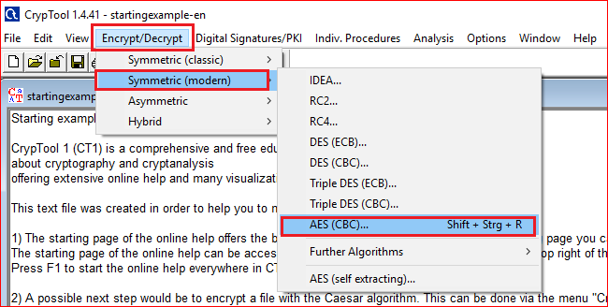

Slide 9
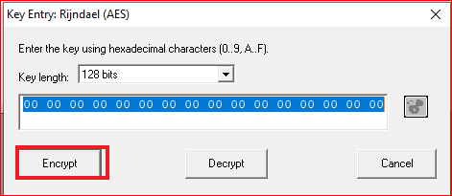
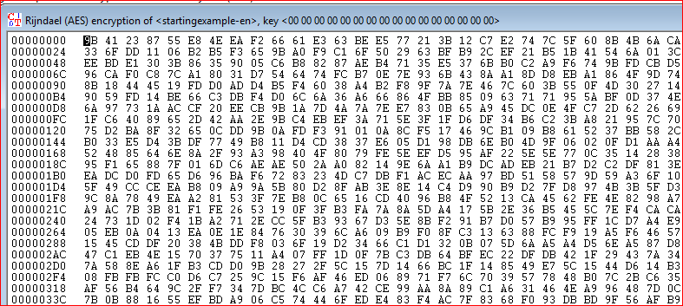

Slide 10
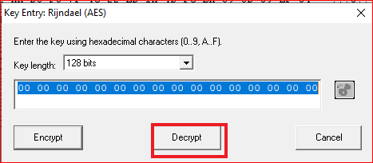
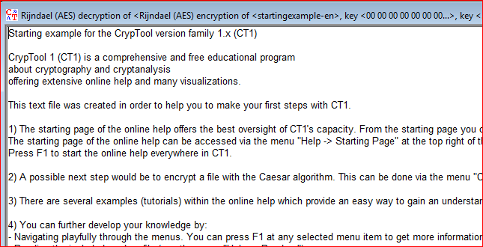

Slide 11
Brute-Force Analysis

Slide 12
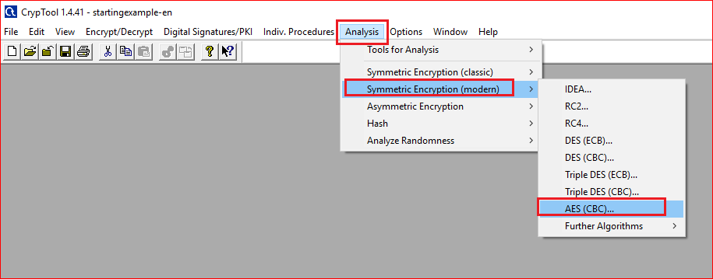

Slide 13
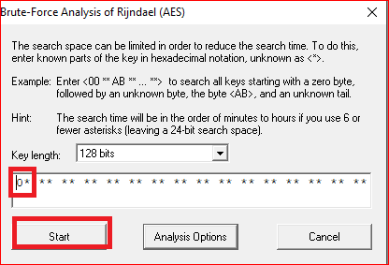
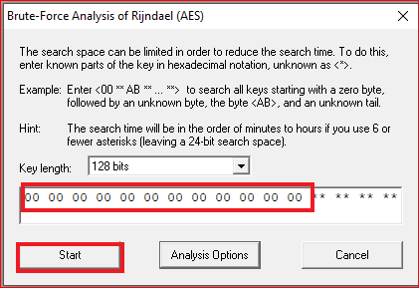
Question
Add one “0”, two “0”s, .. Twelve “0”s. Describe the time you need to guess the keys

Slide 14
Fill out the table
# | key | Number of known bits | Time need to decryption
1 | ******************************** | 0 | 1.2*10 ²⁵ year
2 | 0000**************************** | 16 | 1.8*10 ²⁰ year
3 | 000000************************** | 24
4 |  | 32
5 |  | 40
? | ? | ? | 5 minutes

Slide 15
Encryption Animation

Slide 16
AES: Overview
Key length (bits) | Number of rounds
128 | 10
192 | 12
256 | 14

Slide 17
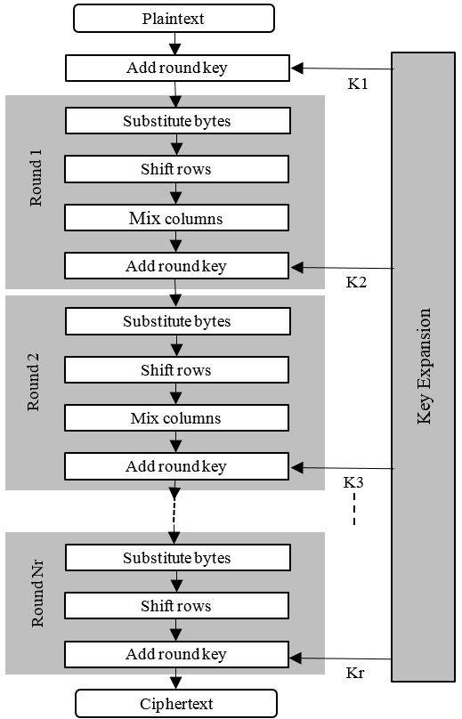
Diffusion
ShiftRows Sublayer: Permutation of the data on a byte level
MixColumn Sublayer: Matrix operation which combines (“mixes”) blocks of four bytes

Slide 18
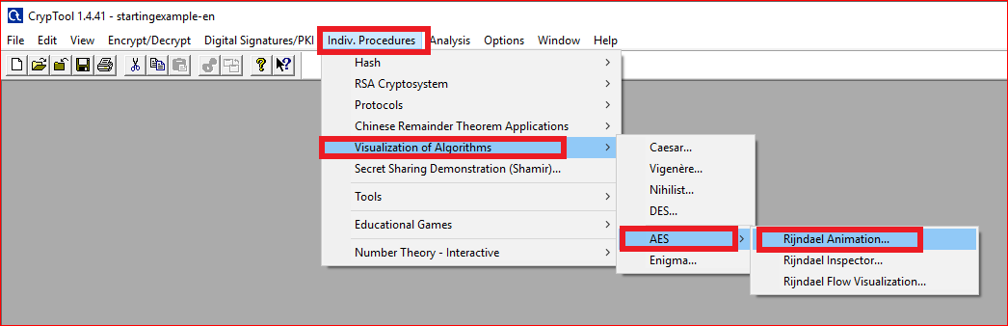

Slide 19
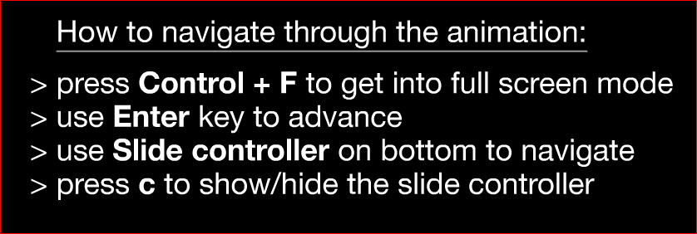
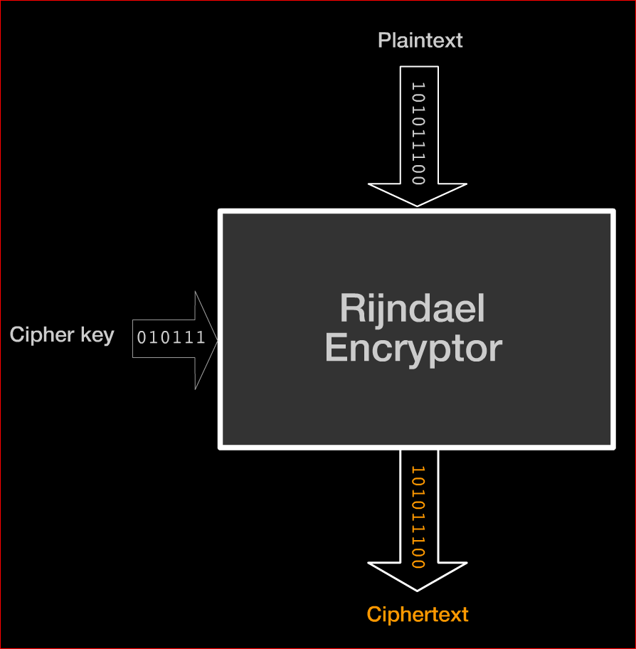

Slide 20
Questions: in round 1
SubBytes: what is the output for a0?
ShiftRows: record the last row results.
MixColums: record the last column results.
AddRoundKey: show how the last column is calculated.
Notes:
e0

Slide 21
Questions
What is the difference between the fist around and the last round?
Notes:
e0

Slide 22
Key schedule Animation

Slide 23
Question
Watch the animation and describe how the first and the second keys are generated.

