Slide 1
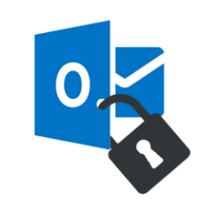
Secure Email with S/MIME

Slide 2
Introduction

Slide 3
S/MIME: Secure/Multipurpose Internet Mail Extensions
Sign your emails (we focus on this lab)
verify you as the legitimate sender of the message,
making it an effective weapon against many phishing attacks out there.
Encrypt your emails.
protect your emails from unwanted access.
based on asymmetric cryptography

Slide 4
PSE: Personal Security Environment
Is a secure location to store a user or component information
private and the certified public-key
located in a protected directory in the file system or on a smart card.
Only the owner of the information should be able to access his or her PSE.
An user must enter the personal identification number (PIN) or passphrase to access the PSE.

Slide 5
Encode/Decode
Why not using ASCII?
People typically want to communicate with more rich forms data such as text, images, other linages.
Two encoding
Base64
Quoted-printed: is an alternative encoding to Base64

Slide 6
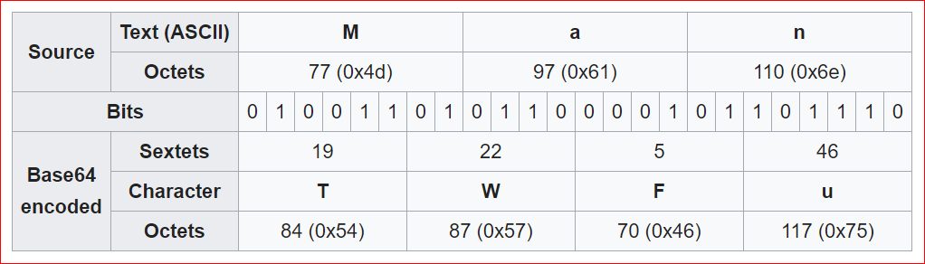
Base64
https://en.wikipedia.org/wiki/Base64

Slide 7
MIME type: multipart/signed
A multipart/signed message is used to attach a digital signature to a message.
Has exactly two body parts
a body part and a signature part.
the whole of the body part, including mime headers, is used to create the signature part.

Slide 8
Crypto Tool

Slide 9
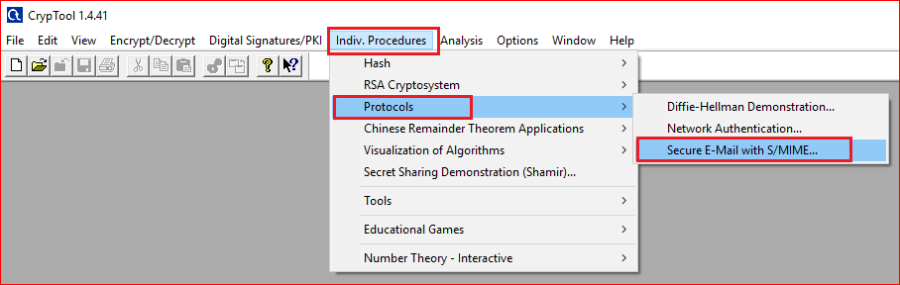

Slide 10
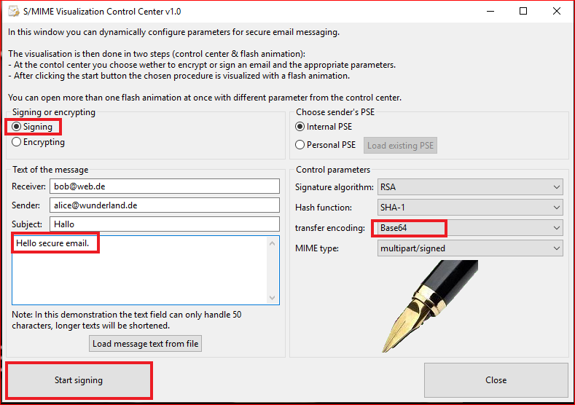

Slide 11
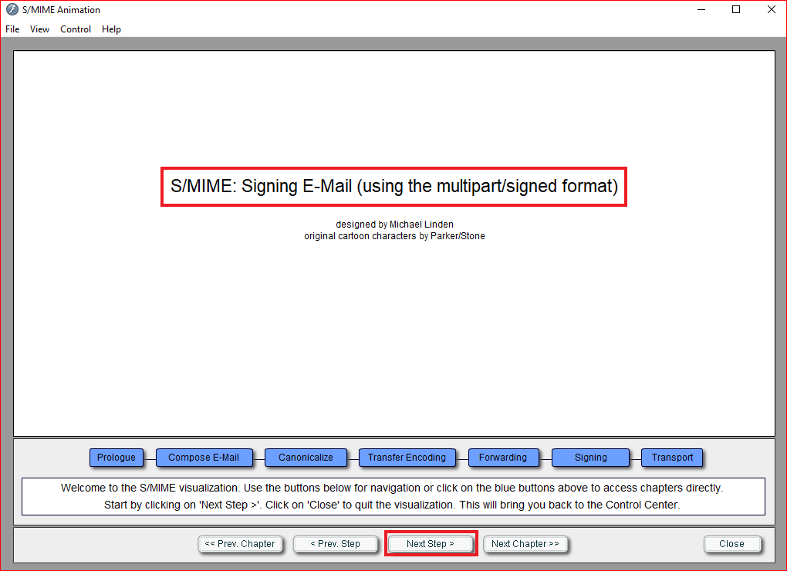

Slide 12
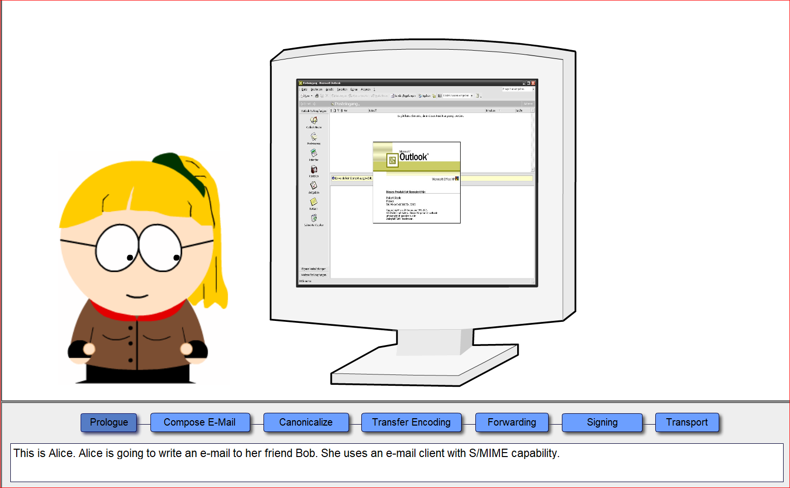

Slide 13
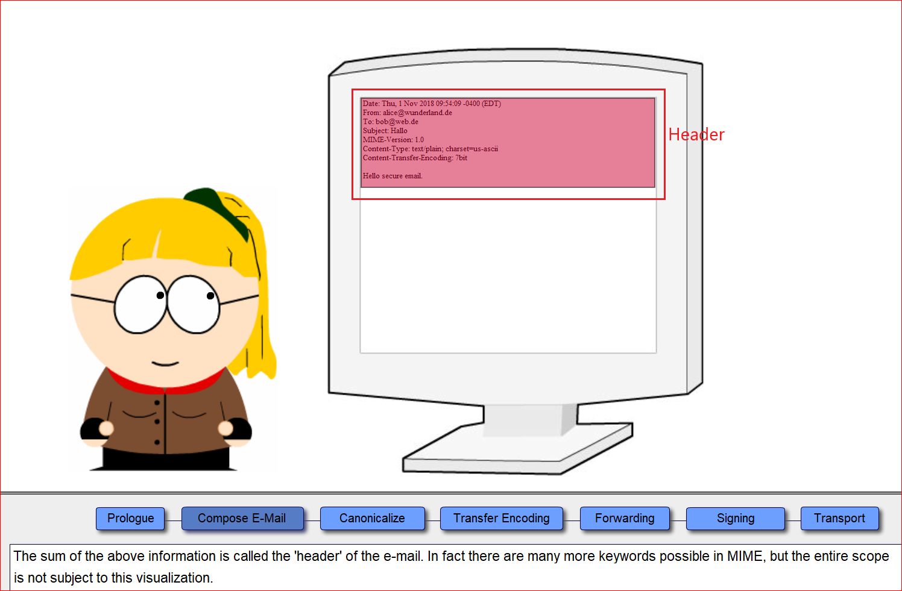
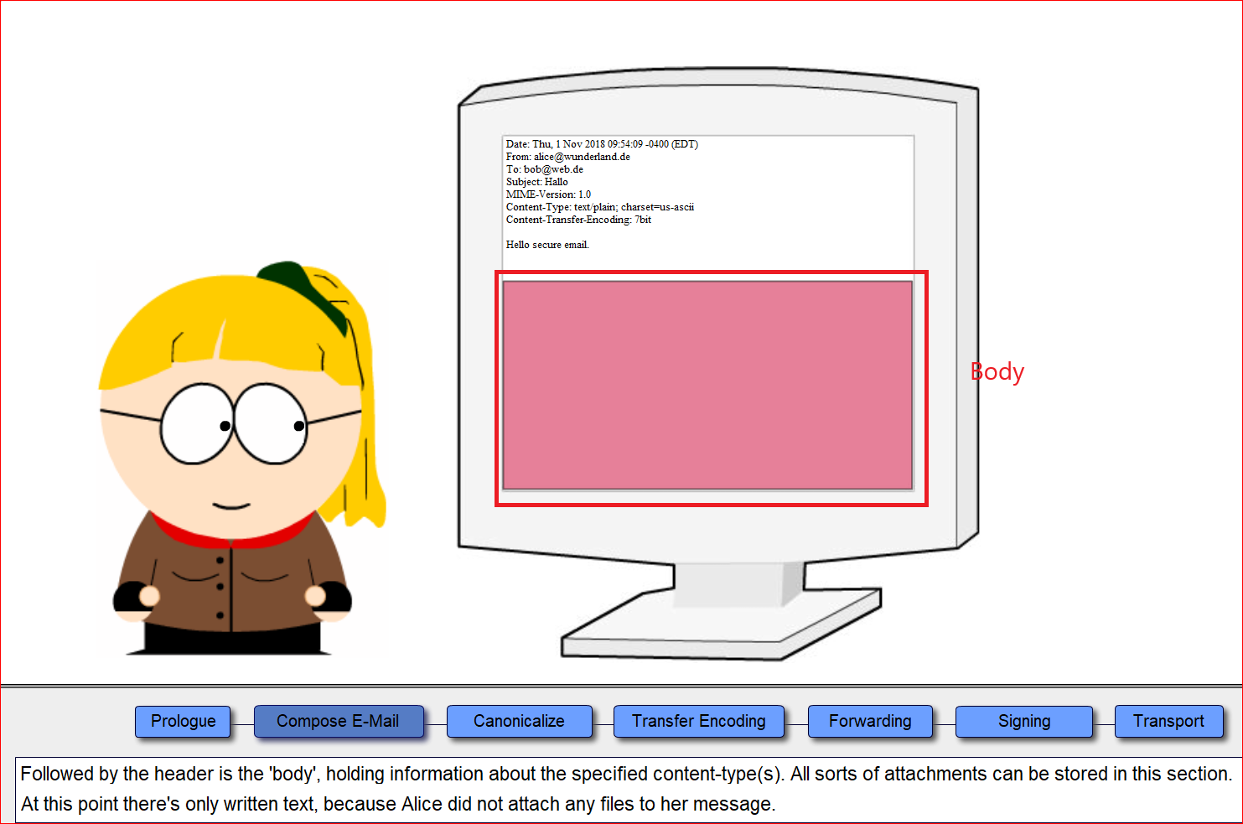
Header and Body

Slide 14
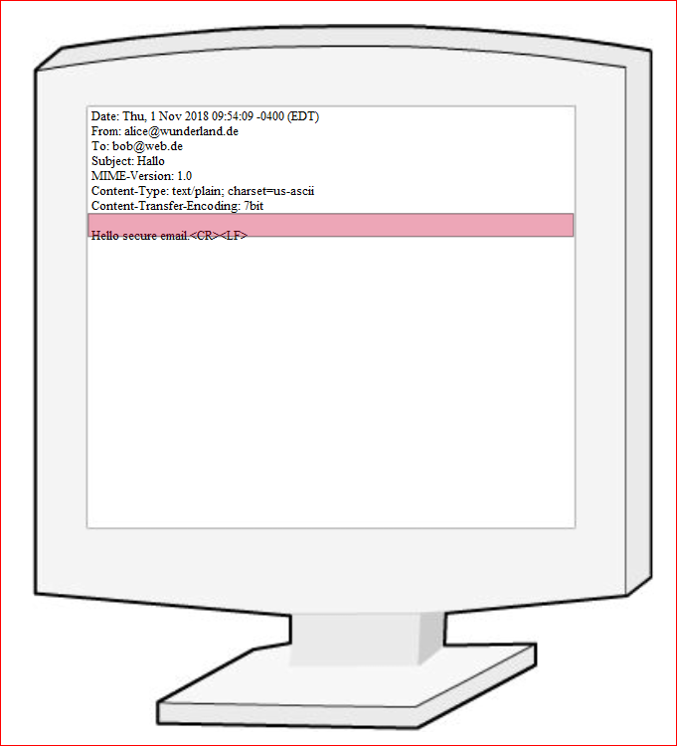
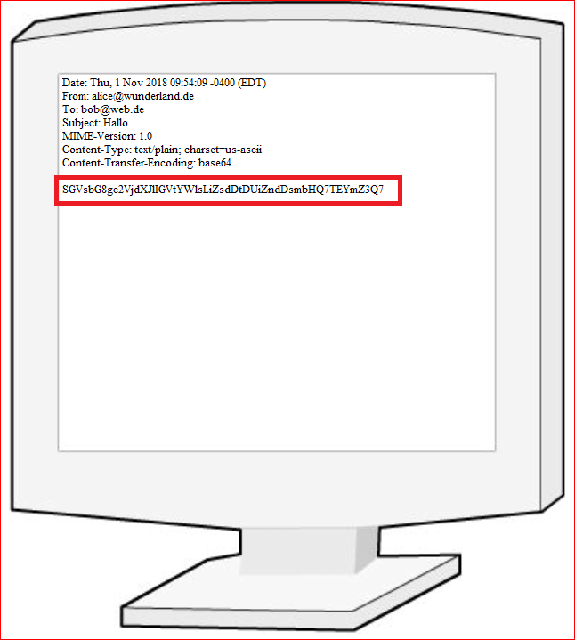
Encoding

Slide 15
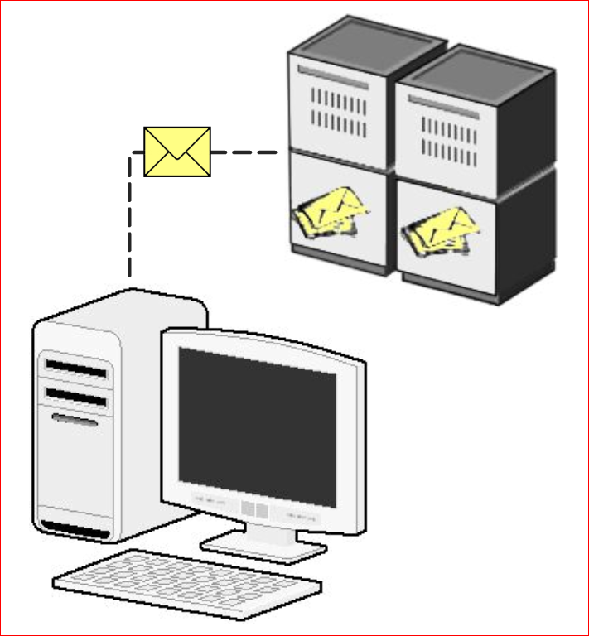
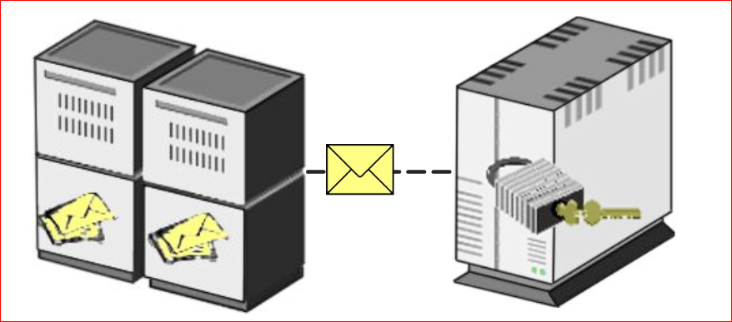
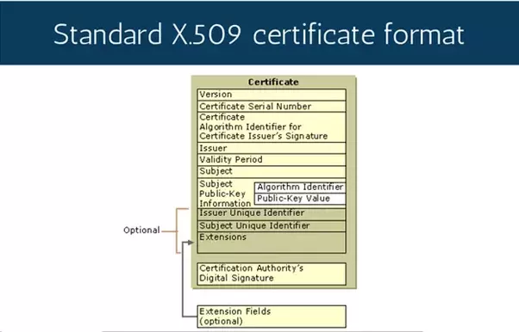
Email Forwarding and Signing
PSE on the server contains all employee’s private keys and certificate.
The server looks for Alice’s certificate in its database

Slide 16
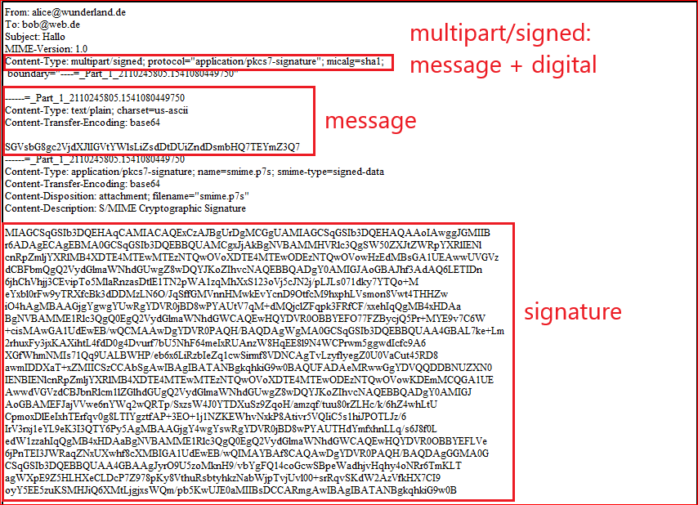

Slide 17
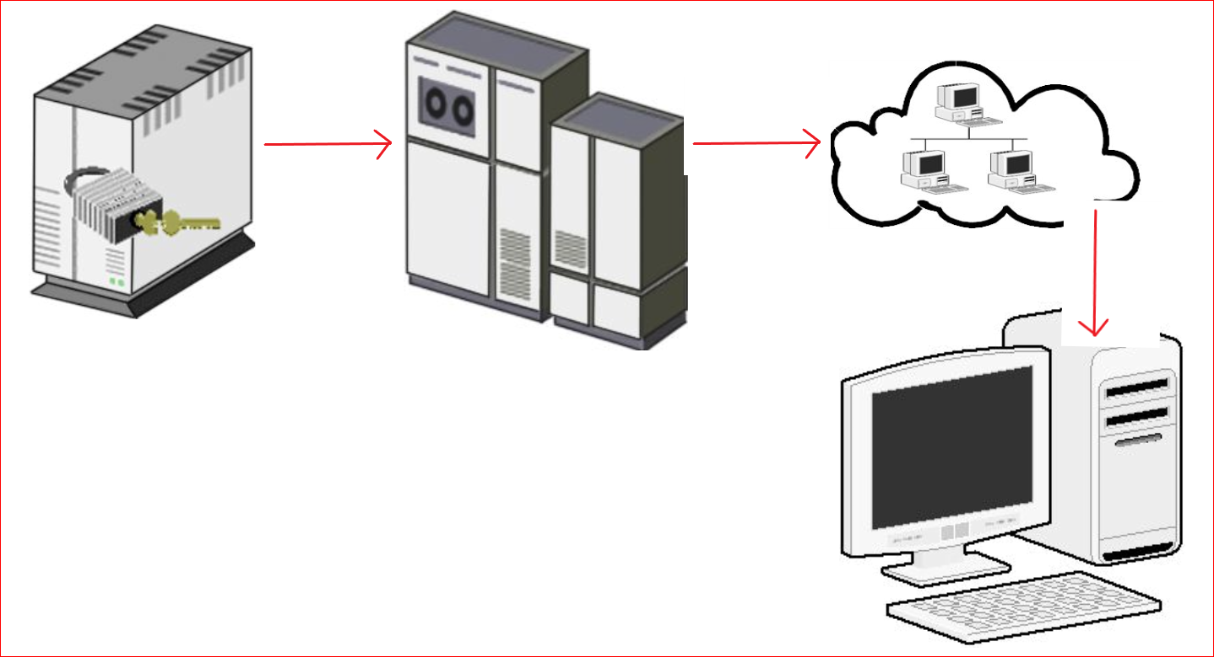

Slide 18
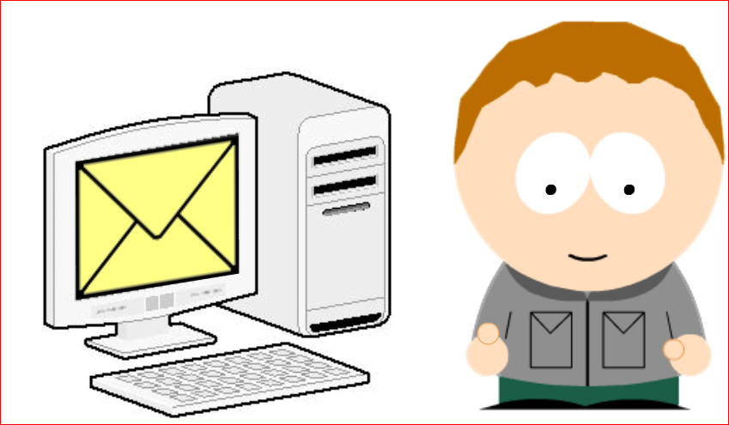
Validation

Slide 19
Question
How your PIN or password is associated with your public and private keys?
Who does your email?
How does Bob verify your signature?

