Slide 1
Hash Function

Slide 2
Overview
“digest” function

Slide 3
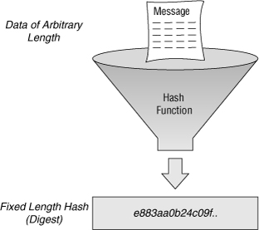
Definition
A hash function is any function that can be used to map data of arbitrary size to data of a fixed size.
The values returned by a hash function are called
hash values, hash codes, digests, or simply hashes
https://en.wikipedia.org/wiki/Hash_function

Slide 4
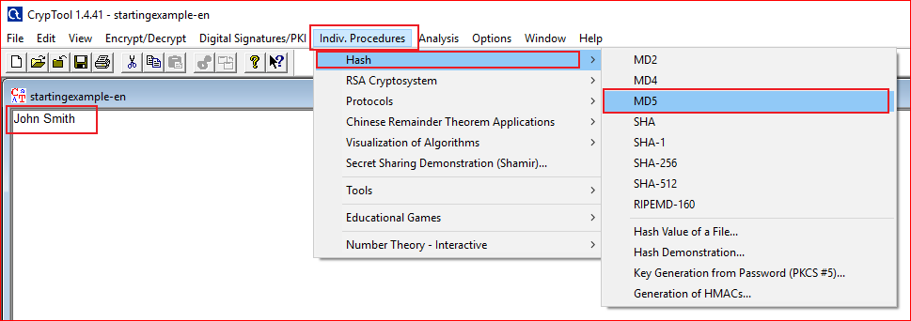

Slide 5
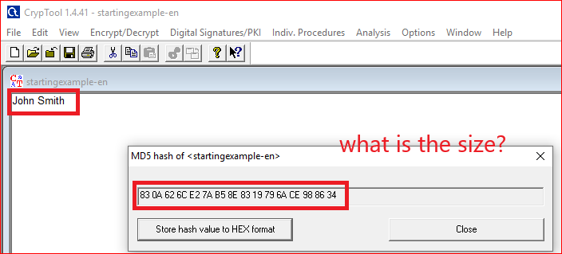
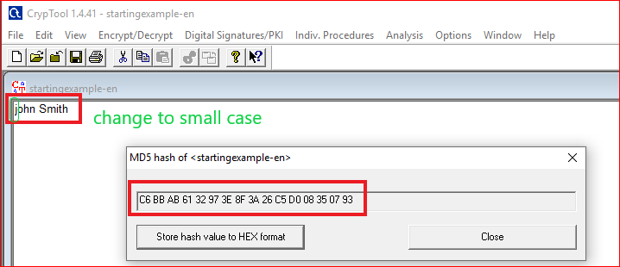

Slide 6
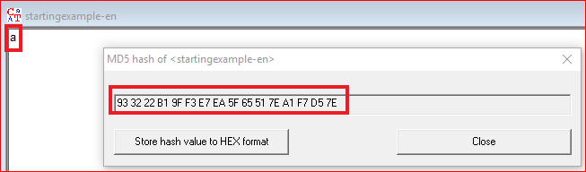
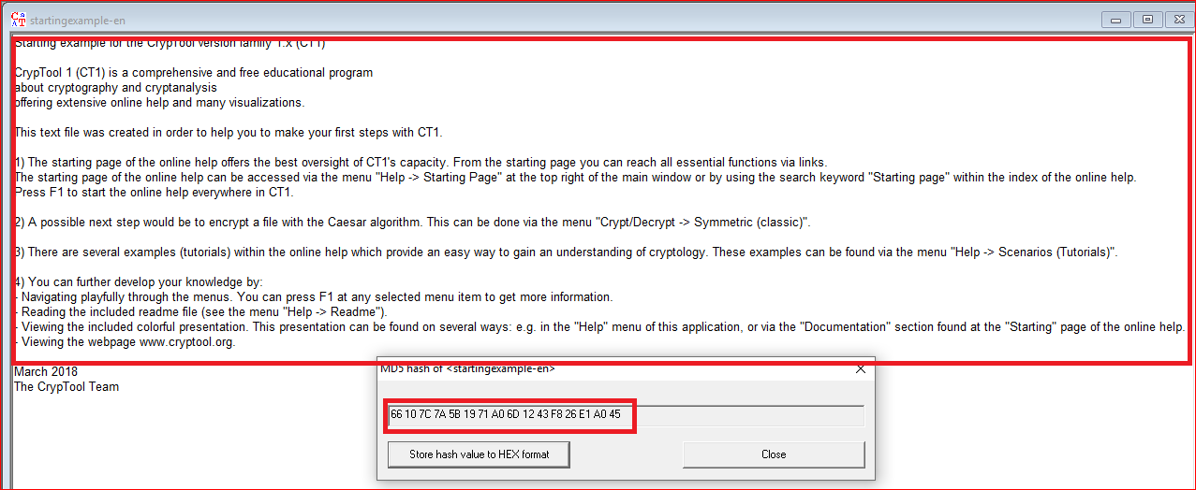

Slide 7
Question: You need to answer
Hash texts with different size using the tool
What is the size (in bits) of MD5 hash value?
Does the length of the MD5 hash value change when inputs change?

Slide 8
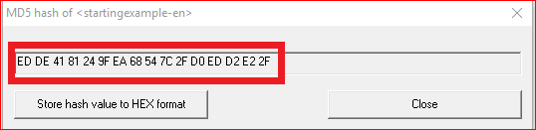
Question: Can you produce the follow MD5 hash value?
If you can, show the text and its MD5 hash value.
If you can’t, how difficult to produce the hash value? Or estimate how many time you have to try to produce the same hash value.

Slide 9
Hash Demo

Slide 10
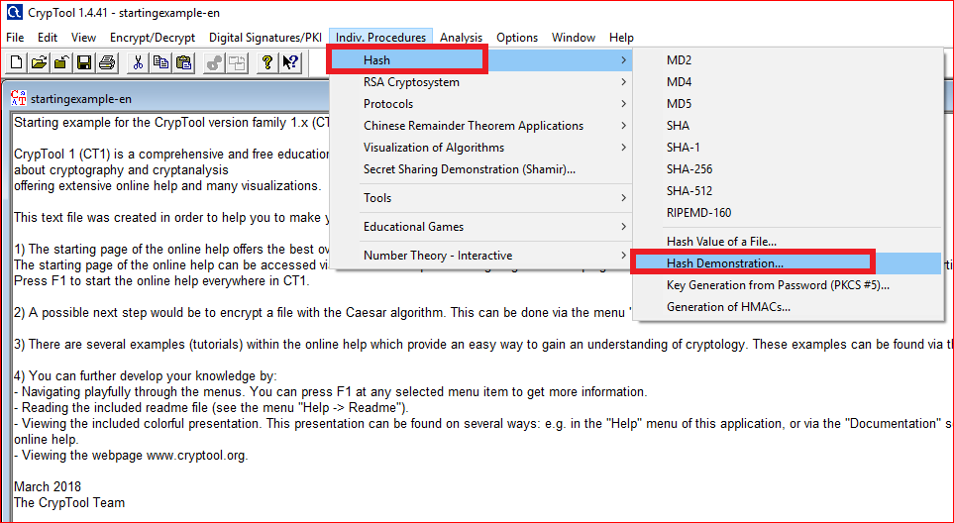

Slide 11
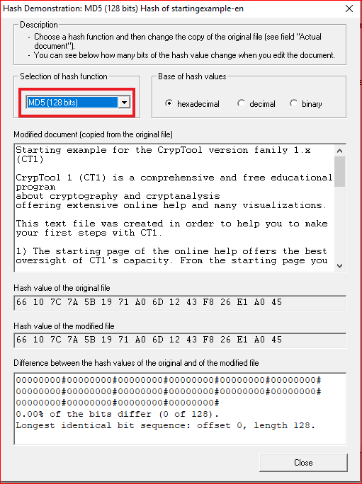
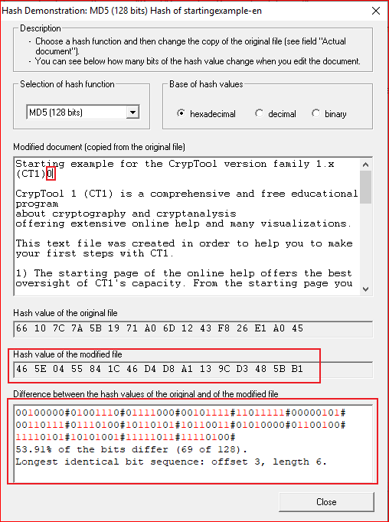

Slide 12
Questions
Change the document and record your observation a few times. Pay attention to the percentage of bits differ.
Are the percentages close to 50%?
Why the percentages close to 50%?
Change to a different hash algorithm, i.e., SHA-256. What is the size of hash code?

Slide 13
An evil pair of files have the same MD5 hash
http://web.archive.org/web/20071226014140/http://www.cits.rub.de/MD5Collisions/

Slide 14
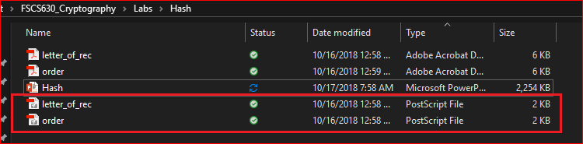
Two PostScript files
Note: You can view PostScript file by double clicking them. Adobe will convert PostScript to pdf
http://web.archive.org/web/20071226014140/http://www.cits.rub.de/MD5Collisions/

Slide 15
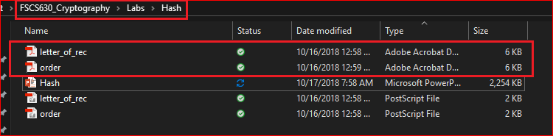
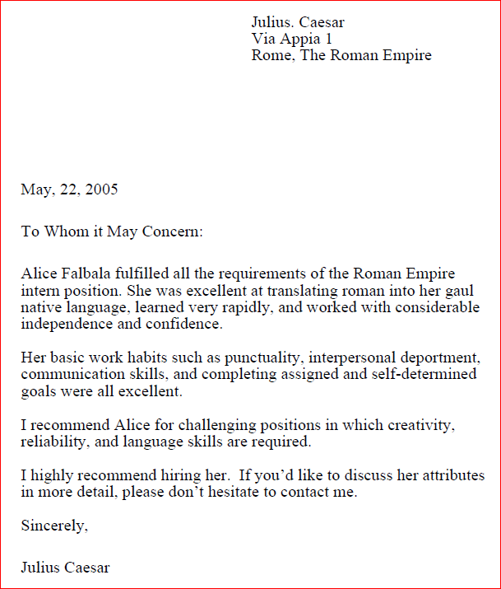
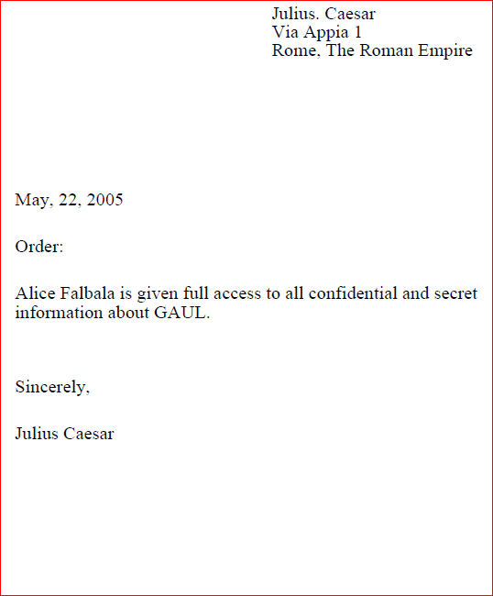
View the corresponding Pdf files

Slide 16
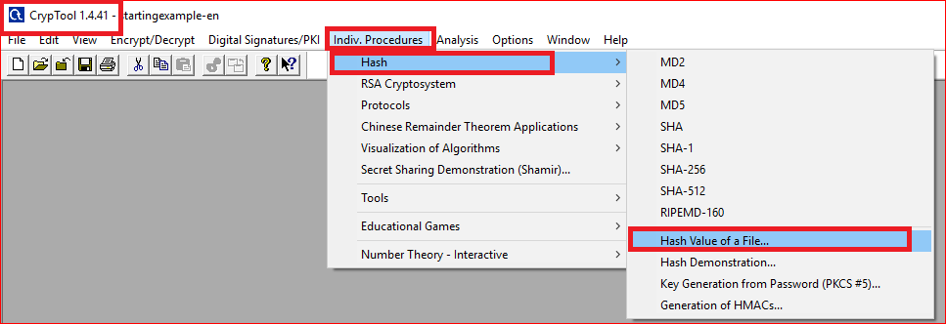
Computing MD5 hash values of two Postscript files (method 1)

Slide 17
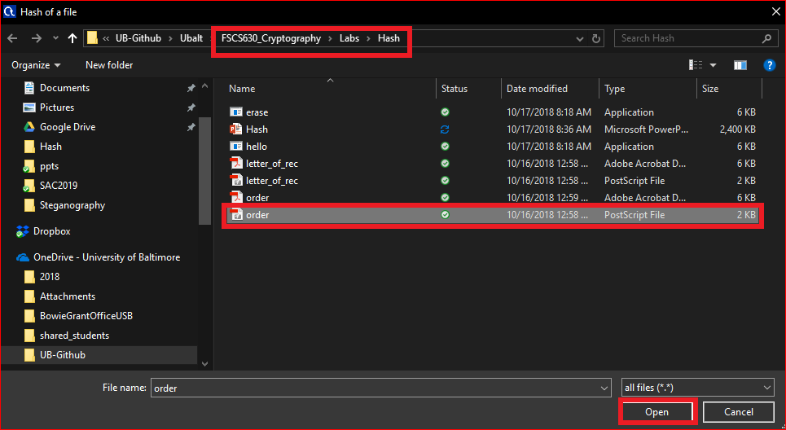
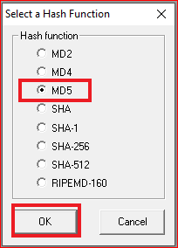
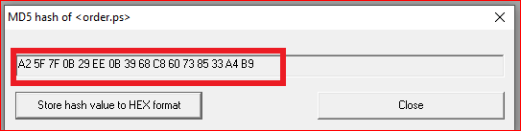

Slide 18
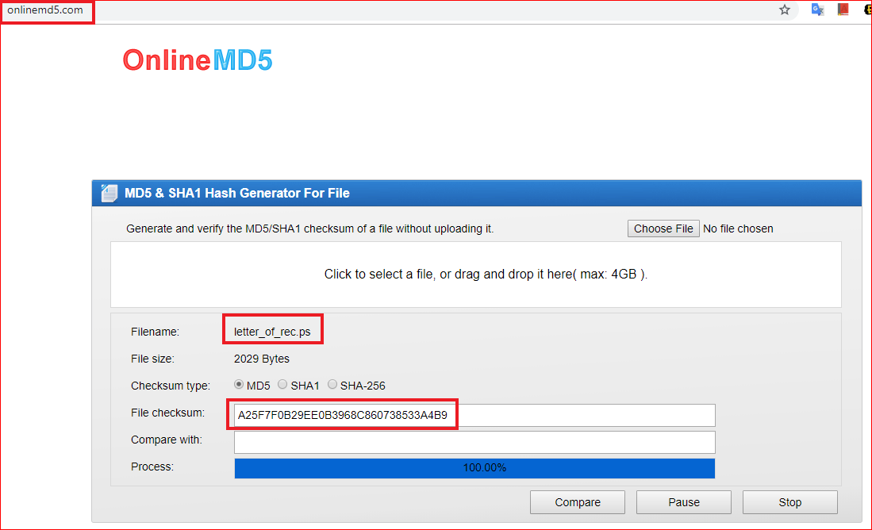
Computing the MD5 hash values of two Postscript files (method 2)

Slide 19
Question
Record both MD5 hash values
Are the two hash values same?

Slide 20
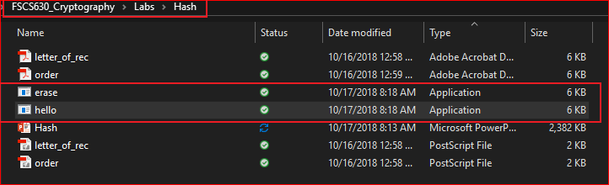
An evil pair of executable programs
https://www.mscs.dal.ca/~selinger/md5collision/

Slide 21
Question
Record both MD5 hash values of executable files
Are the two hash values same?

Slide 22
Attack on digital signature
Generate a malicious file with the same hash (some digits) of another file

Slide 23
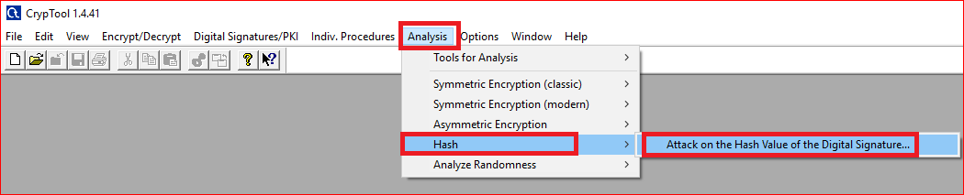

Slide 24
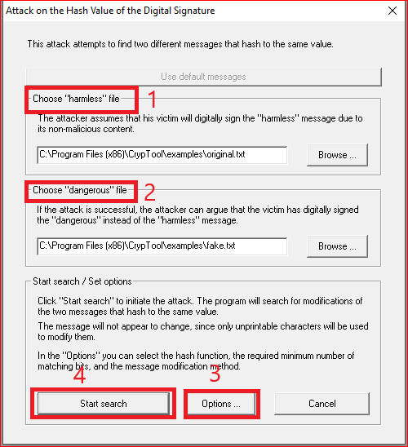
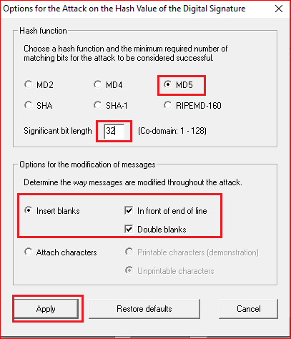

Slide 25
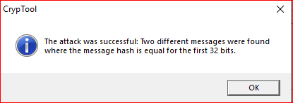
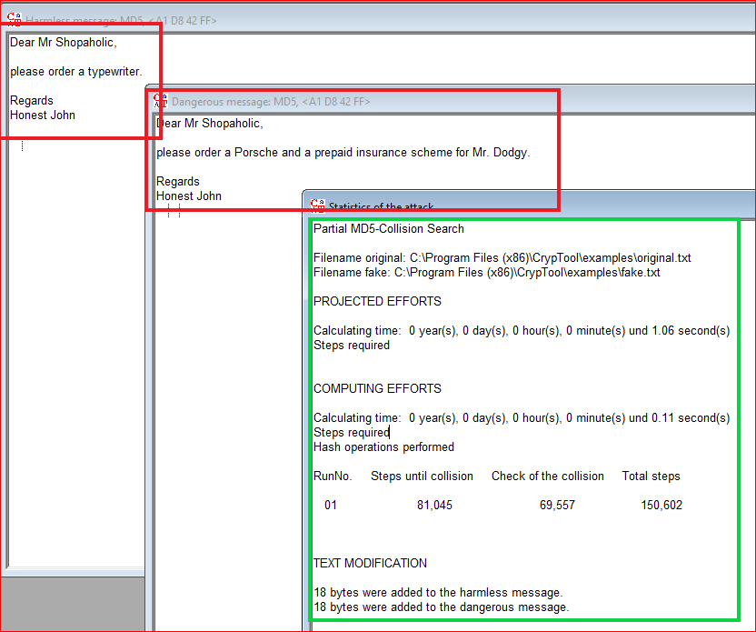
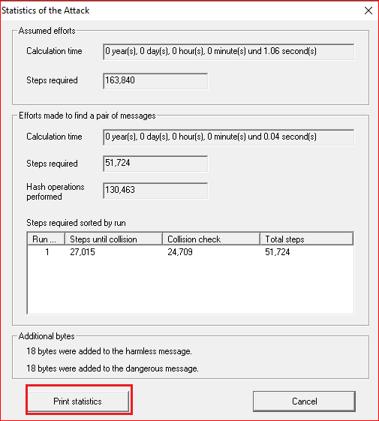

Slide 26
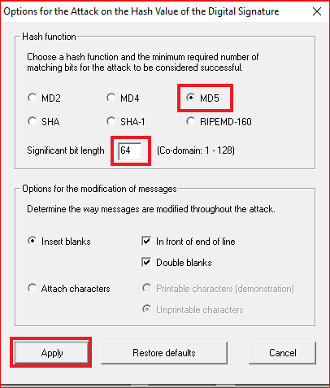
Questions
Change the significate bit length to 64 and 128 bits.
How much time do you need to generate the significant bit length of 64 and 128 bits?

Slide 27
Internal structure of MD5
https://www.slideshare.net/HarryPotter40/hash-crypto?from_action=save

Slide 28
Merkle-Damgard Scheme

Slide 29
MD5

Slide 30
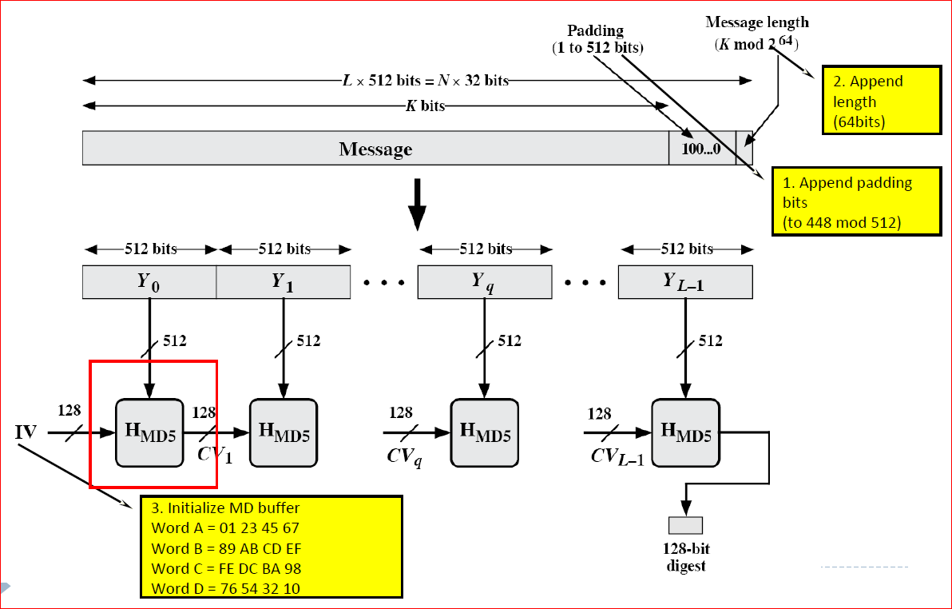

Slide 31
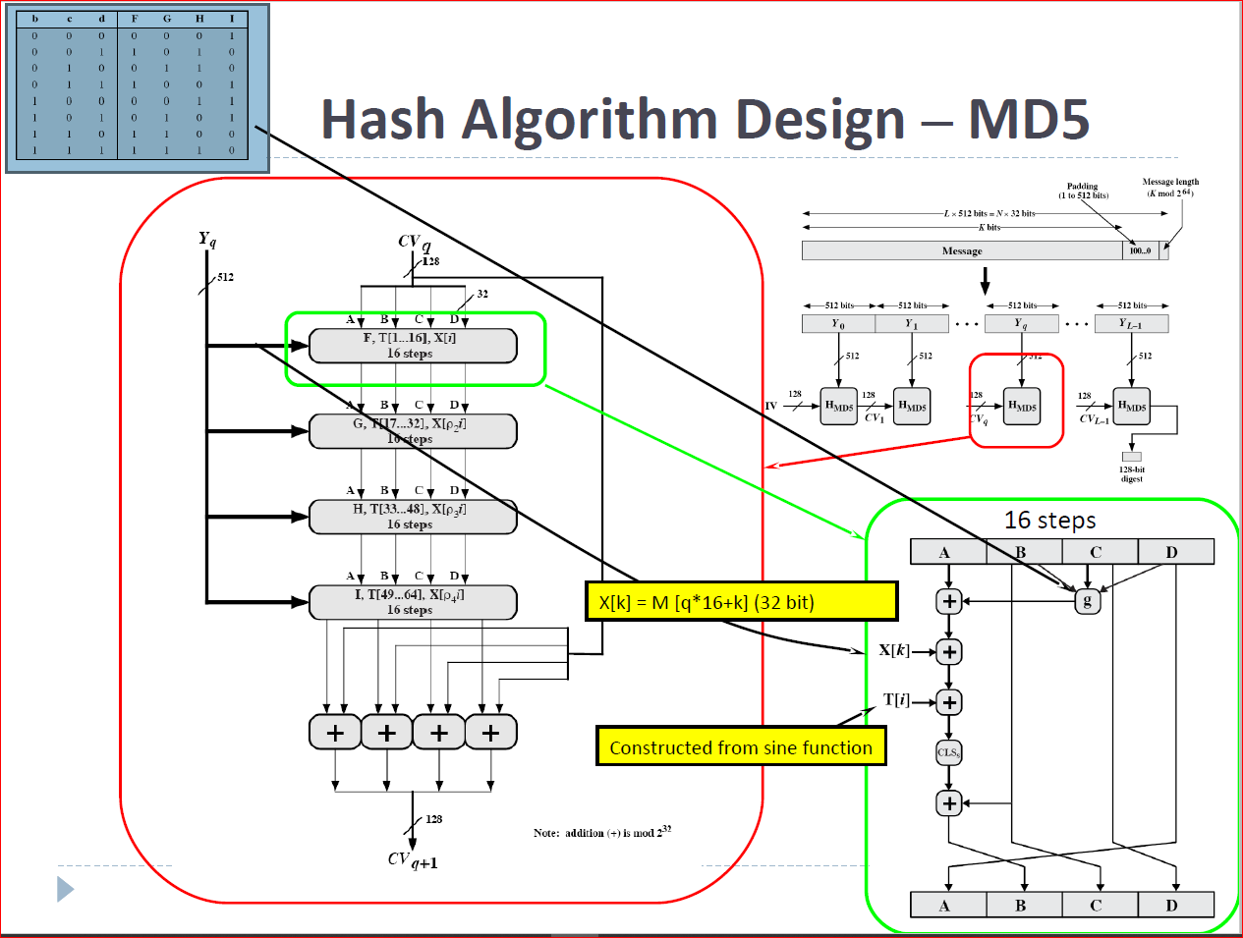

Slide 32
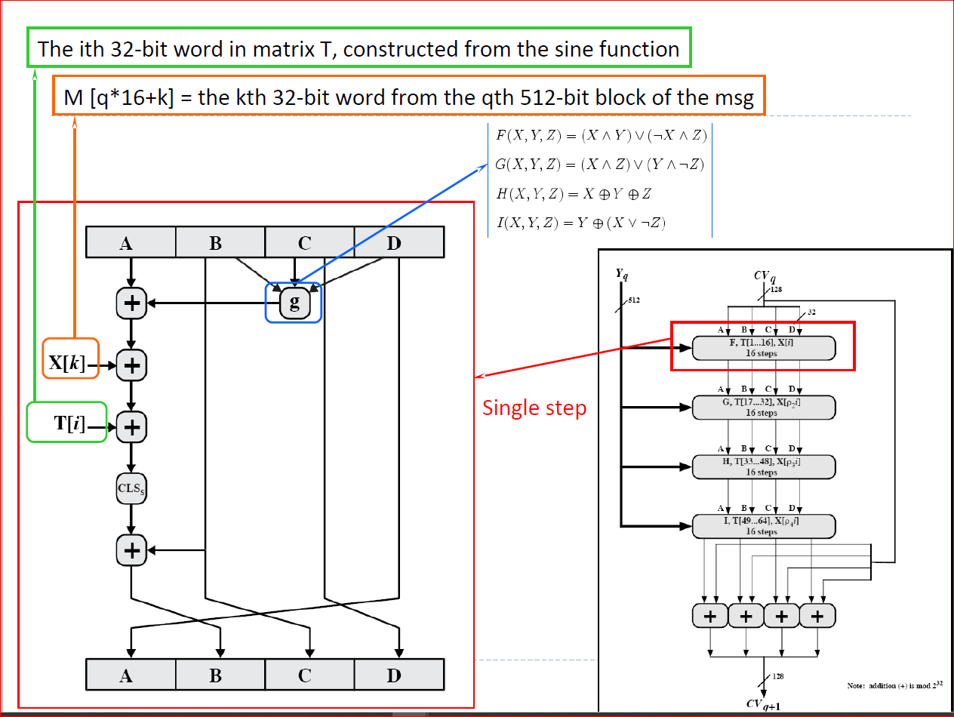

Slide 33
Hash passwords
http://www.unixwiz.net/techtips/iguide-crypto-hashes.html

Slide 34
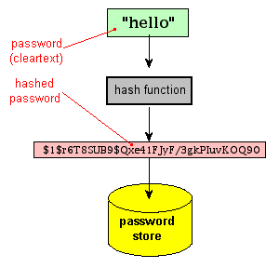
Storing a hash instead of a password (cleartext)

Slide 35
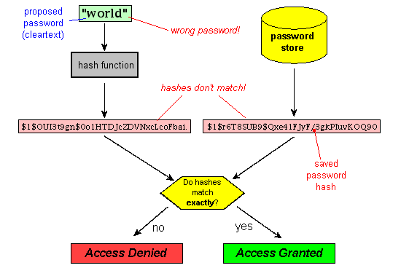
Testing a proposed password against the stored hash

Slide 36
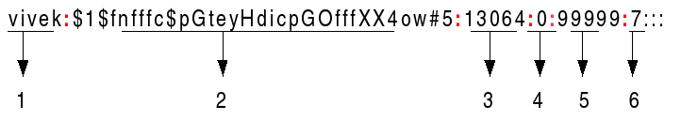
Linux passwords: cat etc/shadow
Username : It is your login name.
Password : It is your encrypted password. The password should be minimum 8-12 characters long including special characters, digits, lower case alphabetic and more. Usually password format is set to $id$salt$hashed, The $id is the algorithm used On GNU/Linux as follows:
$1$ is MD5
$2a$ is Blowfish
$2y$ is Blowfish
$5$ is SHA-256
$6$ is SHA-512

Slide 37
Last password change (lastchanged) : Days since Jan 1, 1970 that password was last changed
Minimum : The minimum number of days required between password changes i.e. the number of days left before the user is allowed to change his/her password
Maximum : The maximum number of days the password is valid (after that user is forced to change his/her password)
Warn : The number of days before password is to expire that user is warned that his/her password must be changed
Inactive : The number of days after password expires that account is disabled
Expire : days since Jan 1, 1970 that account is disabled i.e. an absolute date specifying when the login may no longer be used.

