Slide 1
Shifting Cipher (Caesar) and Modular Arithmetic

Slide 2
Shift background

Slide 3
Shift (Caesar) Cipher
Ancient cipher
named after Julius Caesar
It is a type of substitution cipher
One of the simplest and most widely known encryption techniques
each letter in the plaintext is replaced by a letter some fixed number of positions down the alphabet

Slide 4

Example: Left shift of three (k=3)
https://en.wikipedia.org/wiki/Caesar_cipher
E in the plaintext becomes B in the ciphertext.

Slide 5
Animation

Slide 6
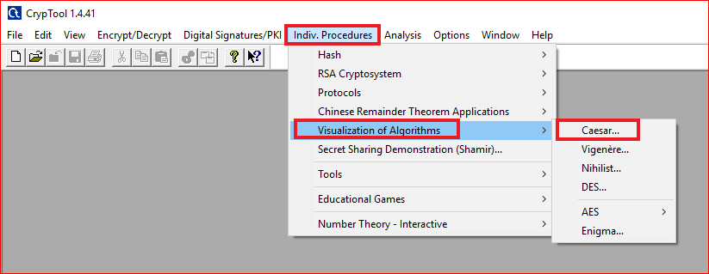

Slide 7
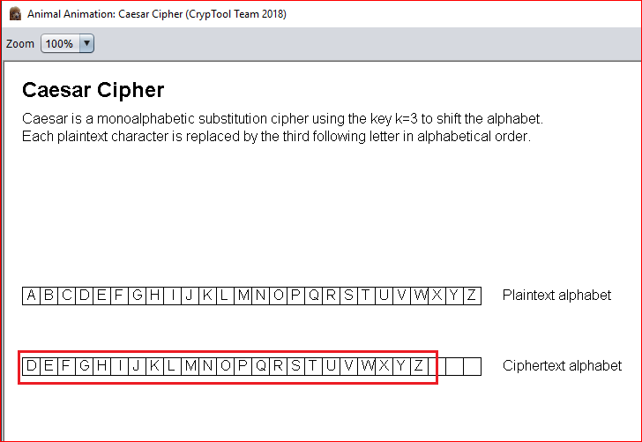

Slide 8
Using Tool

Slide 9
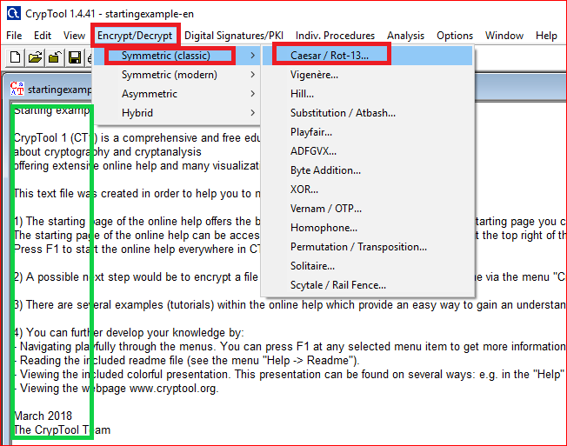

Slide 10
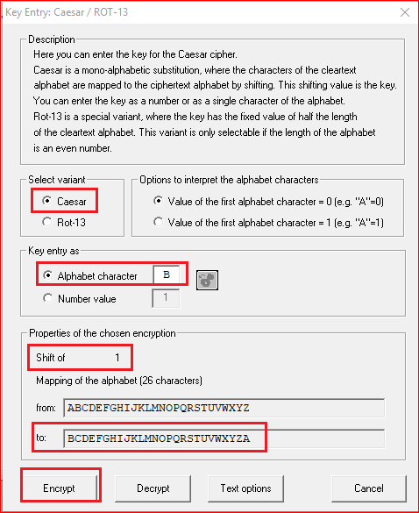
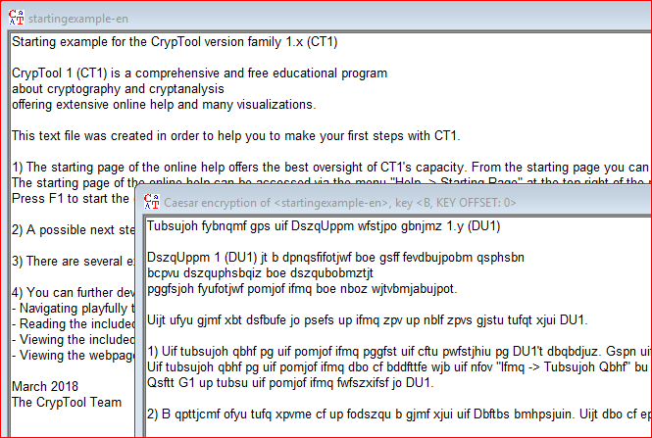

Slide 11
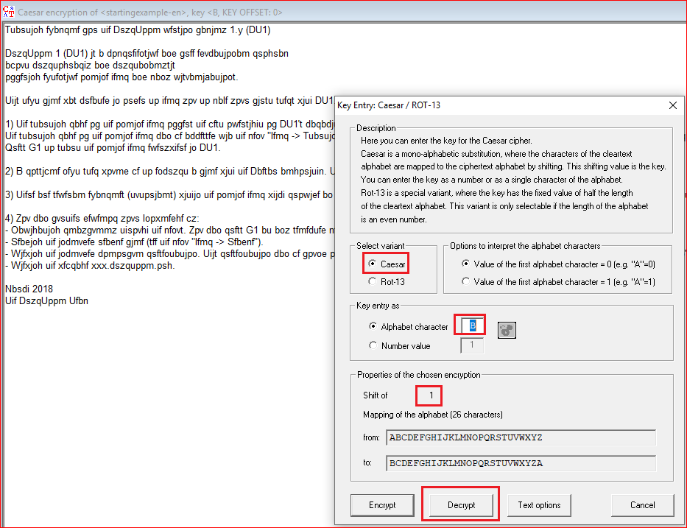
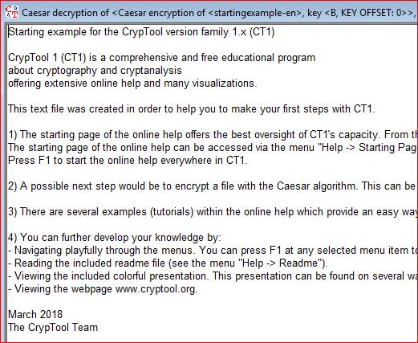

Slide 12
Question
Encrypt and decrypt “hello shifting”
Pick up your own key

Slide 13
Modular Arithmetic and Shift Cipher

Slide 14
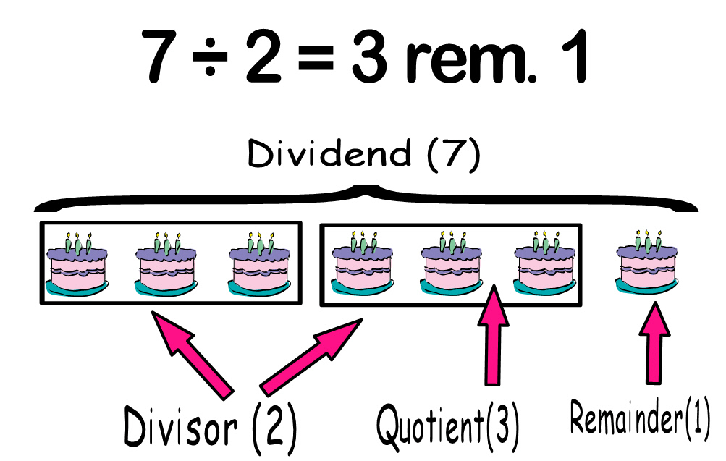
Remainder and Modulo operation
7 mod 2 = 1
modulo
modulus
remainder
7 ≡ 1 mod 2
1 mod 2 = 7 mod 2

Slide 15
Examples
12 ≡ 3 mod 9
12-3 divisible by 9
34 ≡ 7 mod 9
34-7 divisible by 9
11 ≡ 2 mod 9
11-2 divisible by 9

Slide 16
Convert Shift cipher to modular operations
Step 1: encode letters
Step 2: pick a key
Step 3: find modular operations for encryption and decryption

Slide 17
Encryption/decryption steps
A | B | C | D | E | F | G | H | I | J | K | L | M
0 | 1 | 2 | 3 | 4 | 5 | 6 | 7 | 8 | 9 | 10 | 11 | 12
N | O | P | Q | R | S | T | U | V | W | X | Y | Z
13 | 14 | 15 | 16 | 17 | 18 | 19 | 20 | 21 | 22 | 23 | 24 | 25
H,E,L,L,O=>7,4,11,11,14
K=3
Encryption: y= x+k mod 26
10, 7, 14, 14, 16 => K, H, O,O, Q
Decryption: x= y-k mod 26
7, 4, 11, 11, 14 => H,E,L,L,O

Slide 18
Questions
Why does the following formular need to modulo 26? y= x+k mod 26
What is size of the key space?

Slide 19
A little bit more math

Slide 20

Modular inverse
Multiplicative Inverse
What number (including fraction) can we multiply to 8 to get 1 ?
Modular inverse
What number (integer) can we multiply to 8 to get 1 under modulo 3?
-
mod 3

Slide 21
Question
Compute a for 2 × a ≡ 1 mod 9

Slide 22
Attack
Letter frequency analysis

Slide 23
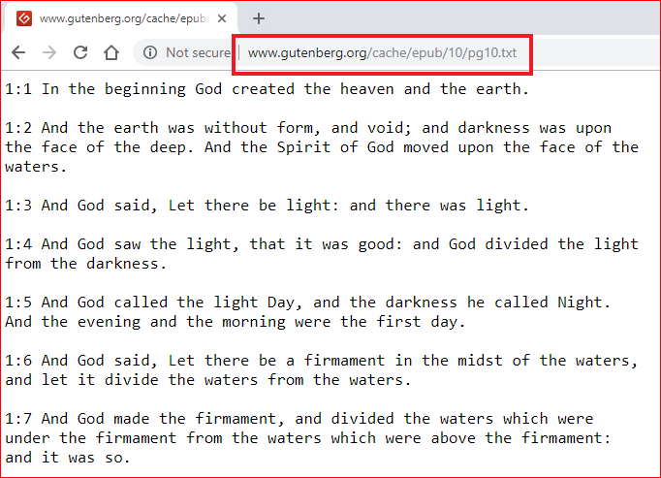
Frequency histogram generated from Bible
http://www.gutenberg.org/cache/epub/10/pg10.txt

Slide 24
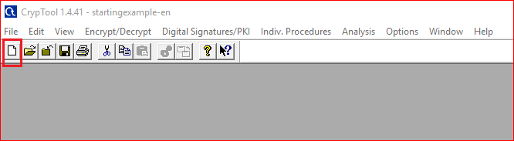
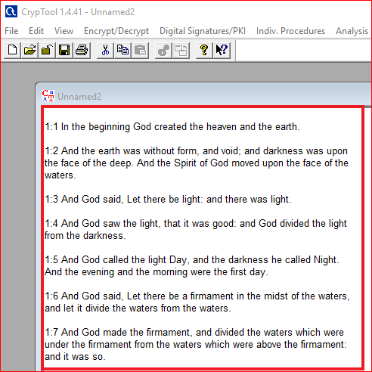

Slide 25
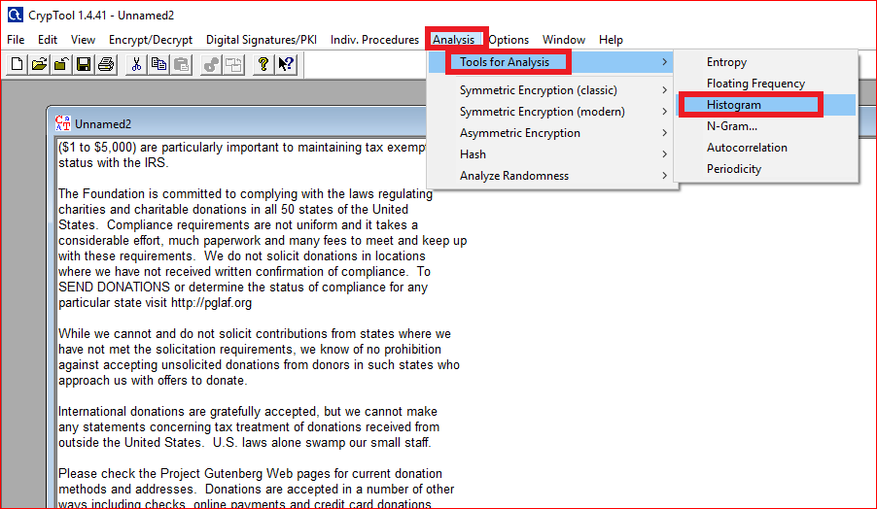
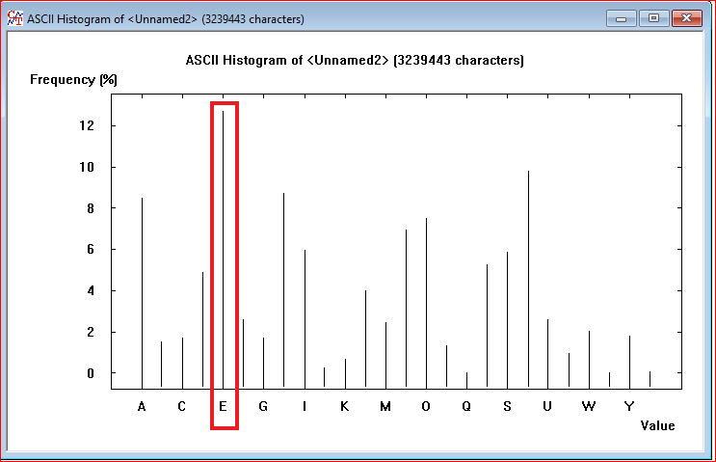

Slide 26
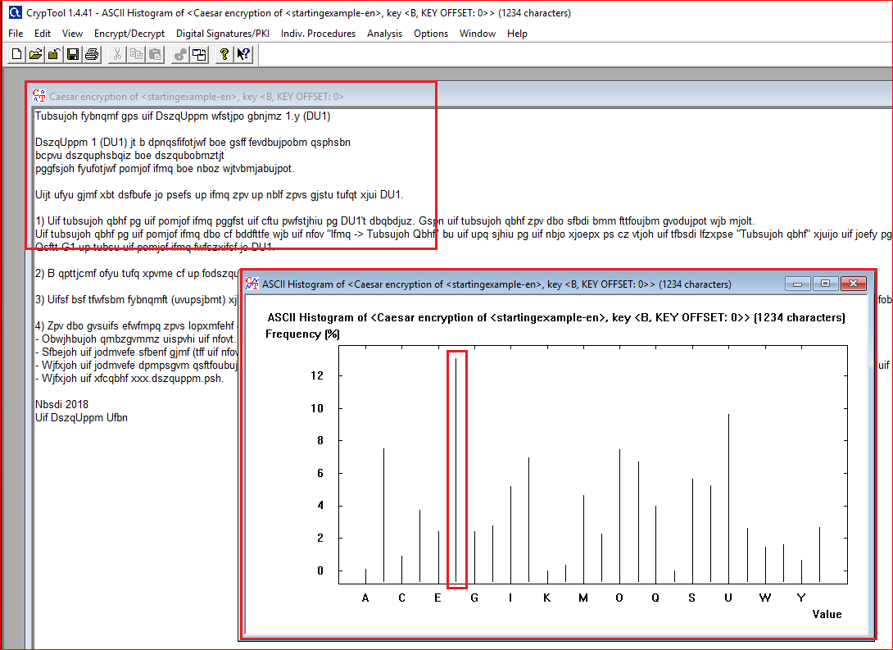
Frequency histogram generated from an encrypted file

Slide 27
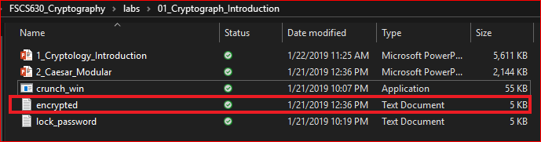
Question: how to decrypt the file?
Use frequency histograms

