Slide 1
AES

Slide 2
Encryption and Decryption Overview

Slide 3
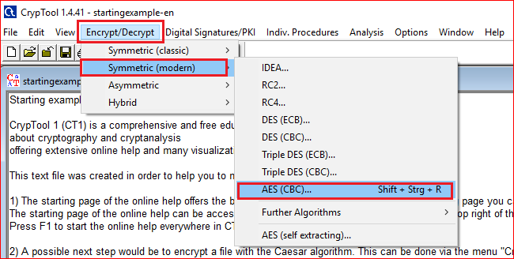

Slide 4
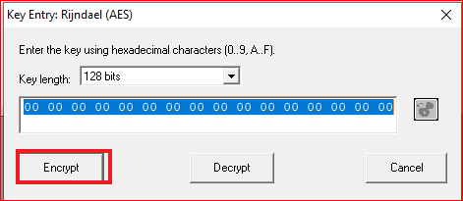
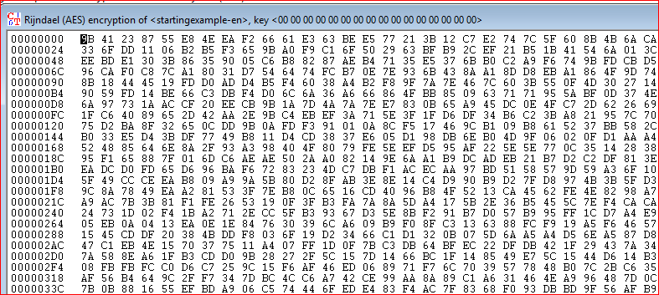

Slide 5
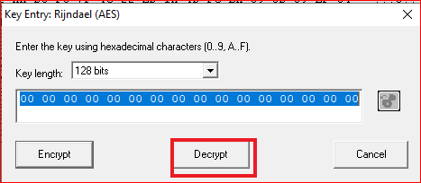
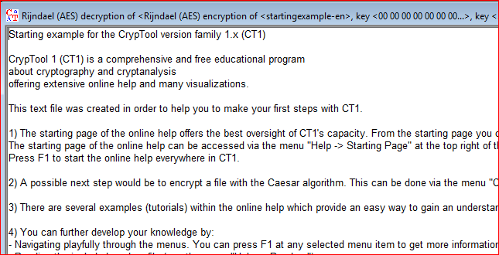

Slide 6
Encryption Animation

Slide 7
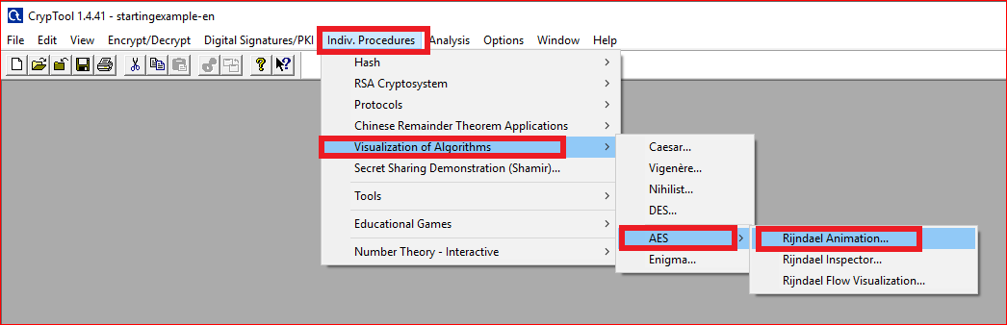

Slide 8
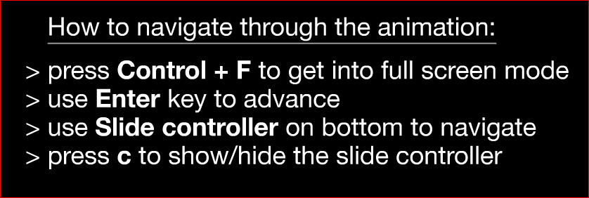
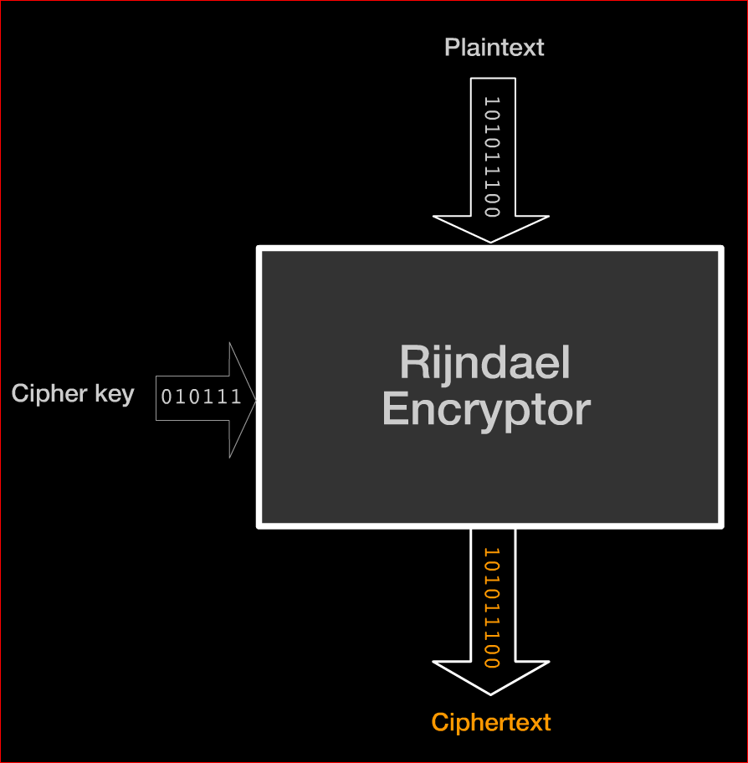

Slide 9
Questions: in round 1
SubBytes: what is the output for a0?
ShiftRows: record the last row results.
MixColums: record the last column results.
AddRoundKey: show how the last column is calculated.
Notes:
e0

Slide 10
Questions
What is the difference between the fist around and the last round?
Notes:
e0

Slide 11
Key schedule Animation

Slide 12
Question
Watch the animation and describe how the first and the second keys are generated.

Slide 13
Brute-Force Analysis

Slide 14
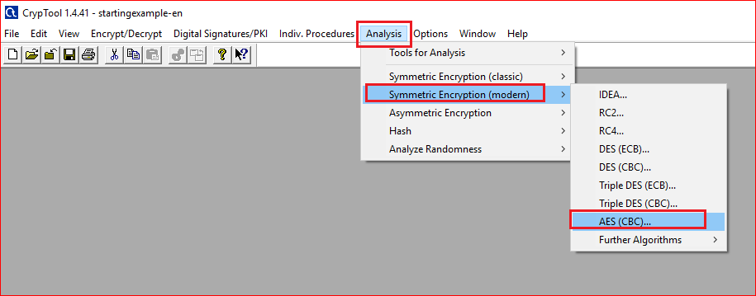

Slide 15
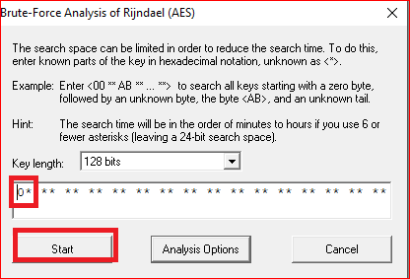
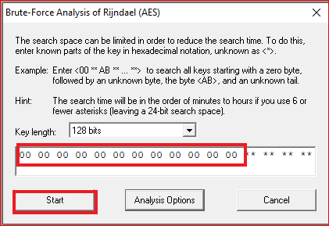
Question
Add one “0”, two “0”s, .. Twelve “0”s. Describe the time you need to guess the keys

