Slide 1
Shifting Cipher (Caesar)

Slide 2
Animation

Slide 3
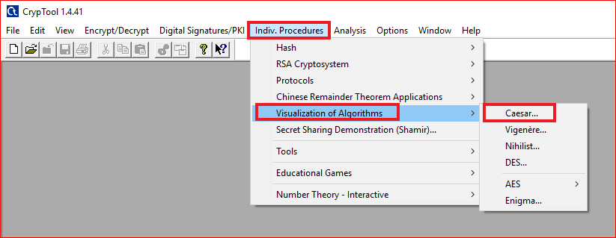

Slide 4
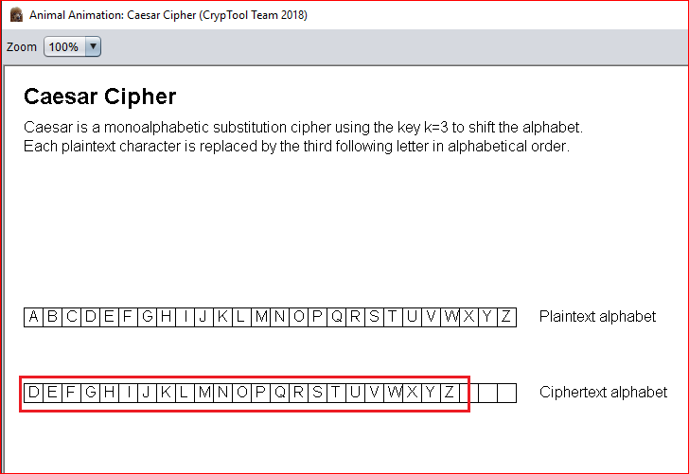

Slide 5
Using Tool

Slide 6
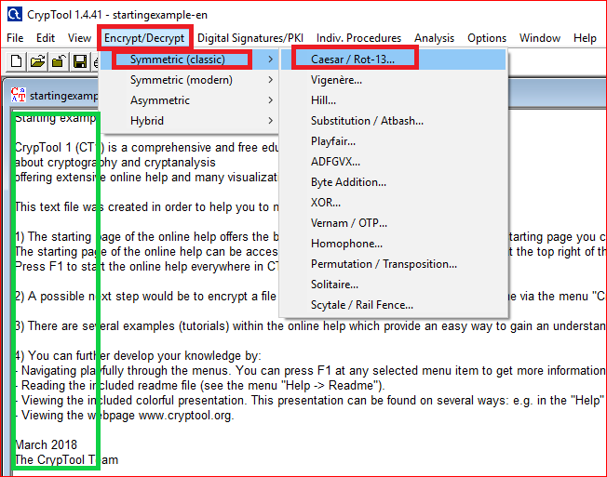

Slide 7
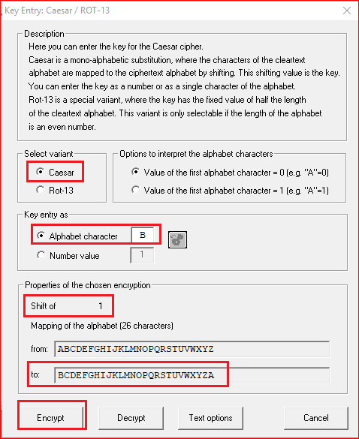
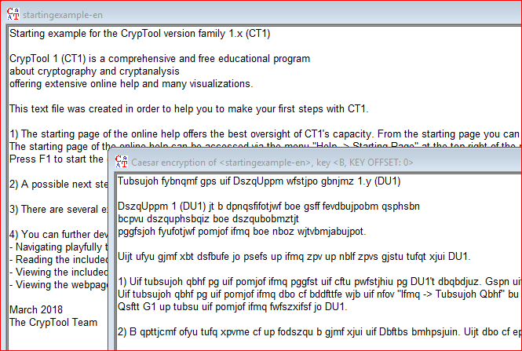

Slide 8
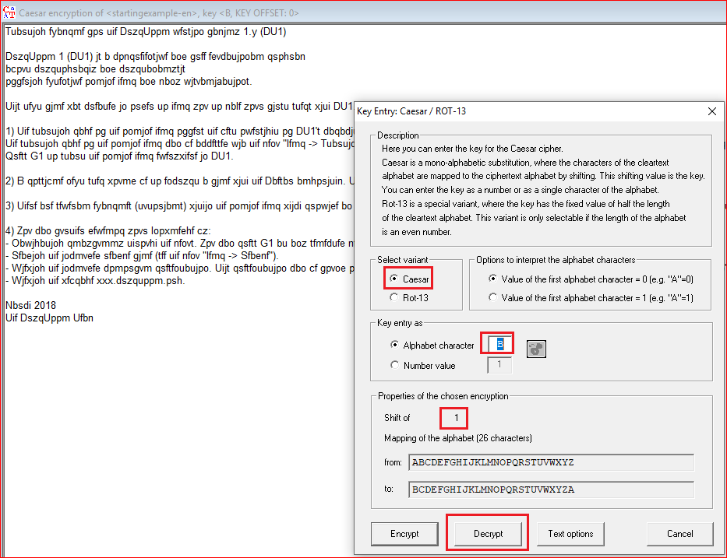
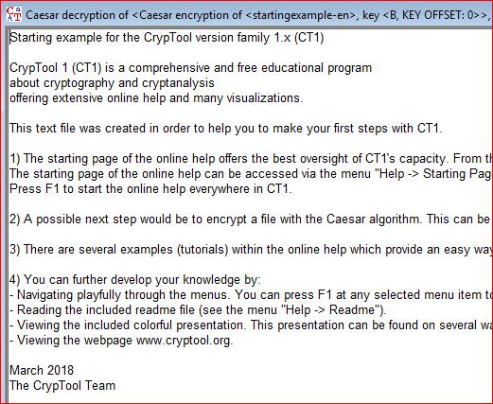

Slide 9
Question
Encrypt and decrypt “hello shifting”
Pick up your own key

Slide 10
Attack

Slide 11
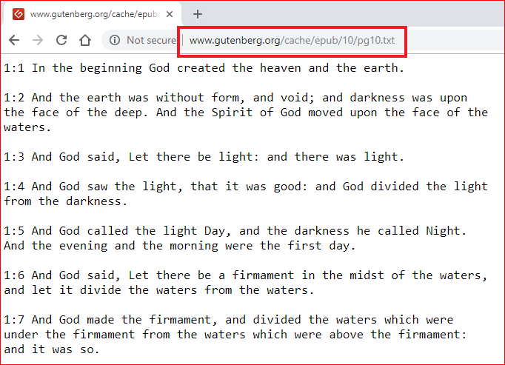
http://www.gutenberg.org/cache/epub/10/pg10.txt

Slide 12

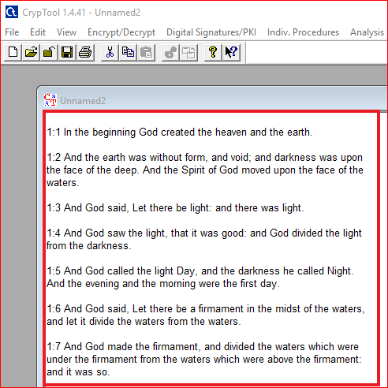

Slide 13
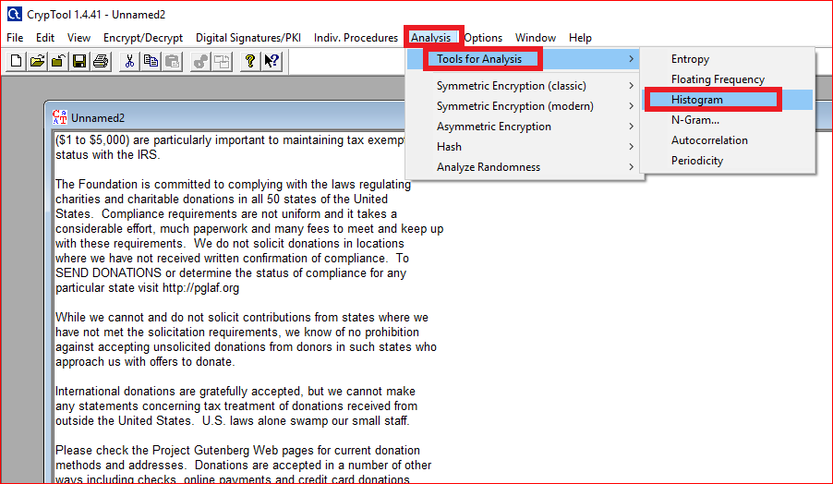
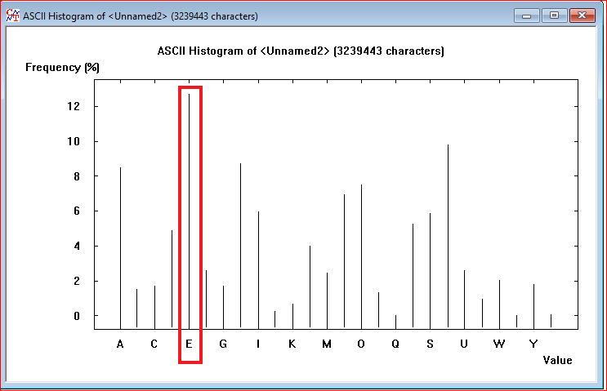

Slide 14
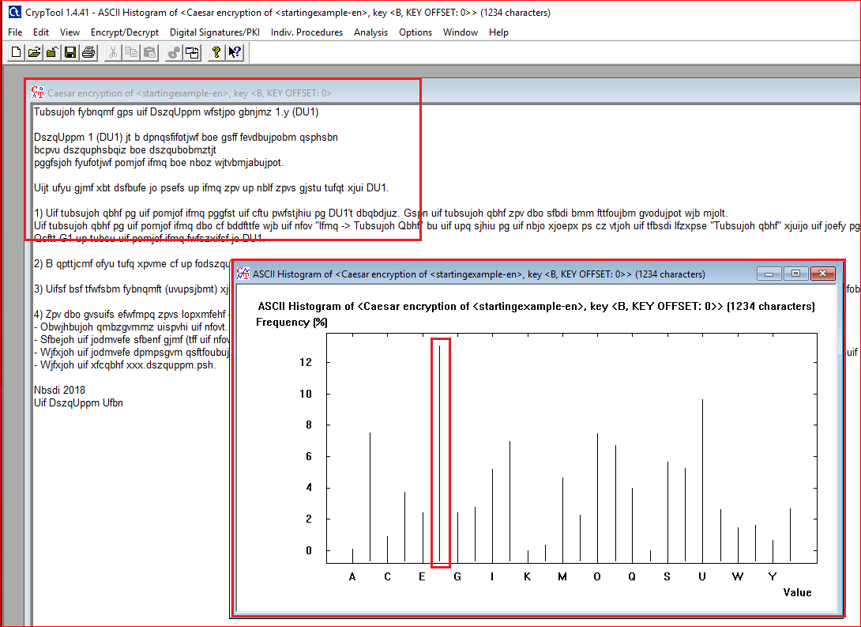

Slide 15

Question: how to decrypt the file?

