Slide 1
How to Crack MS-Word Password

Slide 2

Following the PPTs to download required files for the lab

Slide 3

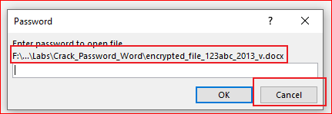
Verify the required files
Try to open the Word file

Slide 4
We are going to find the password!

Slide 5
Extract Hash code of an encrypted Word file

Slide 6
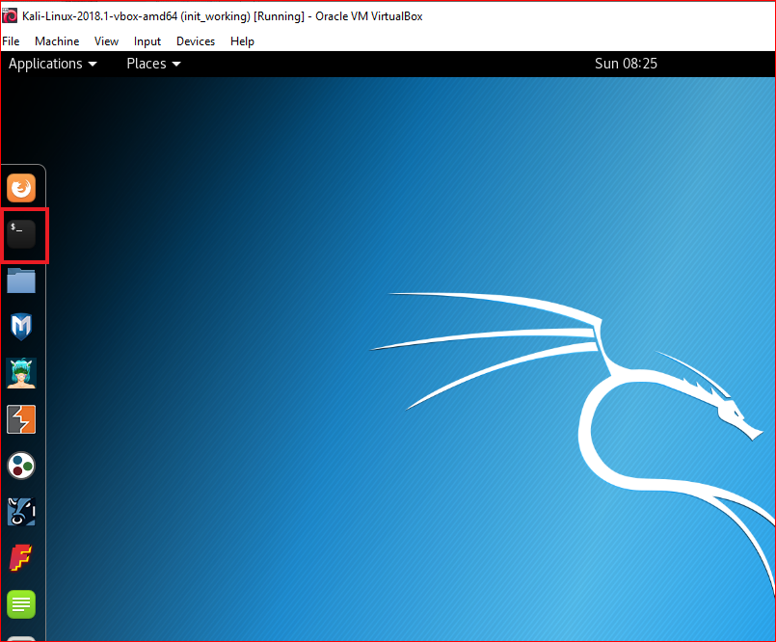
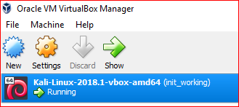

Slide 7
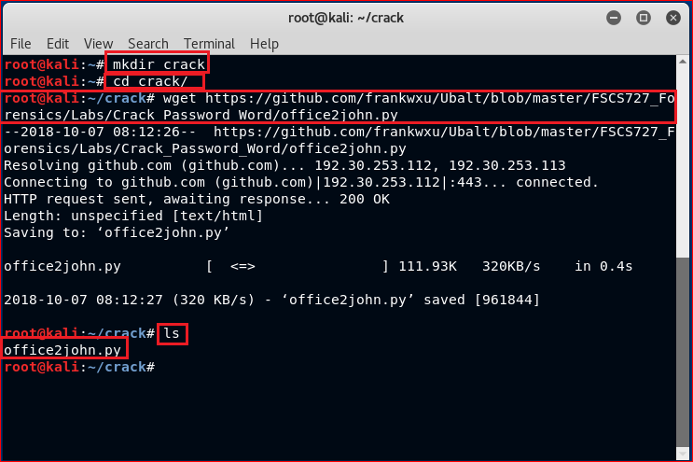

Slide 8

Make office2John runnable

Slide 10
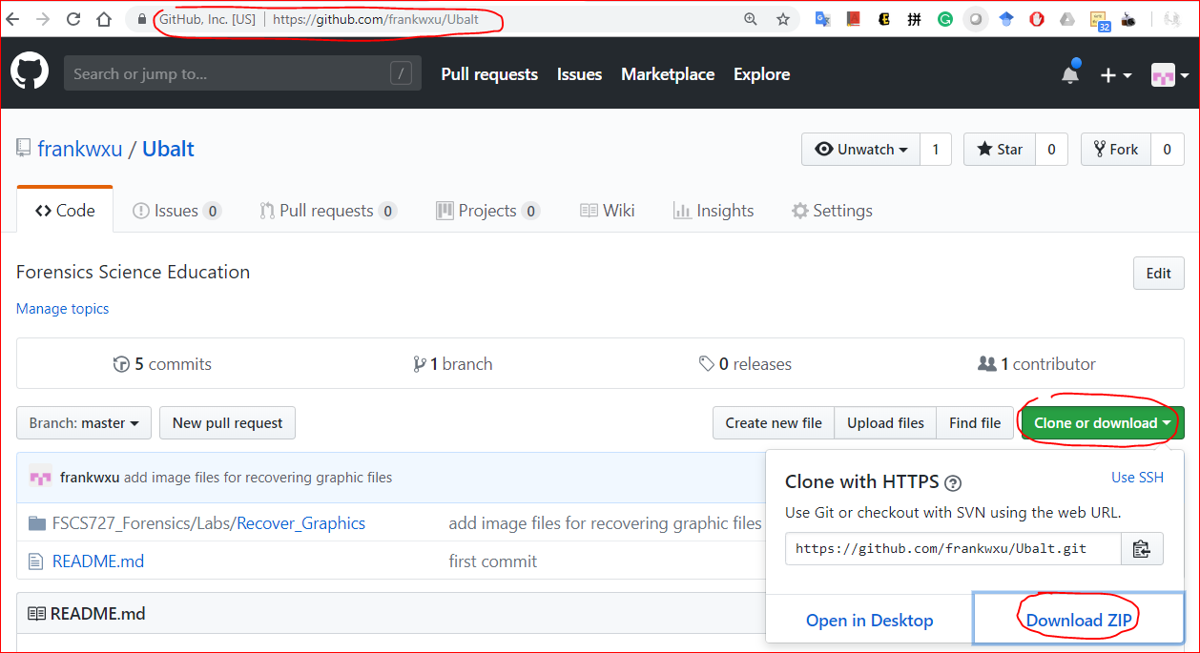
https://github.com/frankwxu/Ubalt

Slide 11
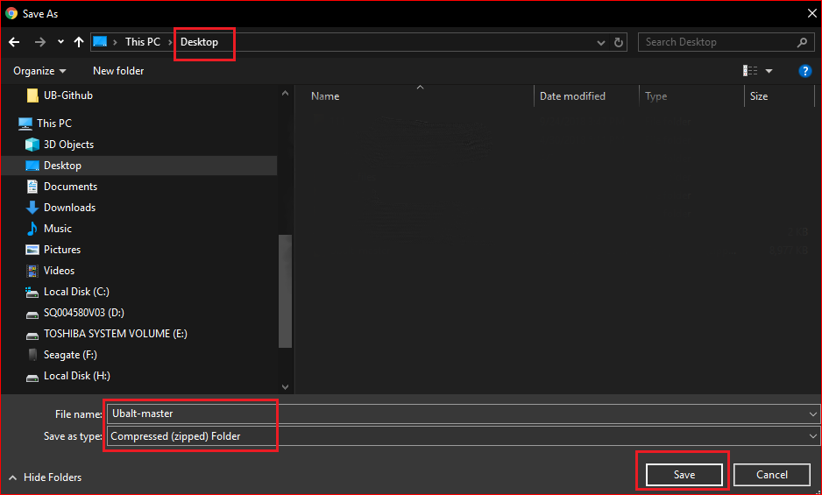

Slide 12
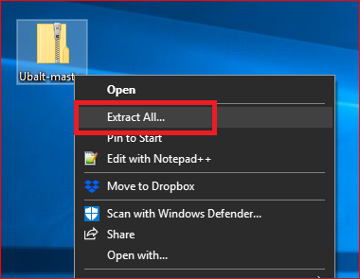
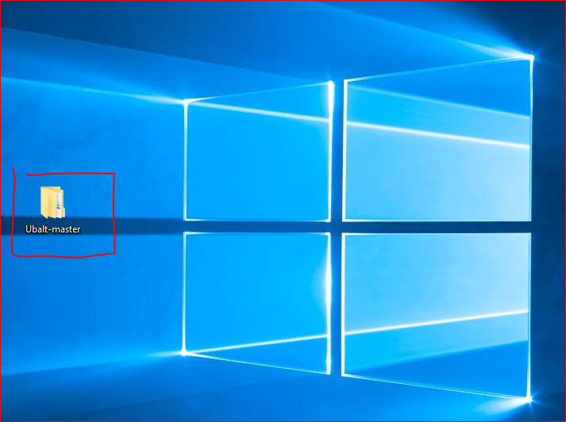

Slide 13


Slide 14
Create a working space

Slide 15
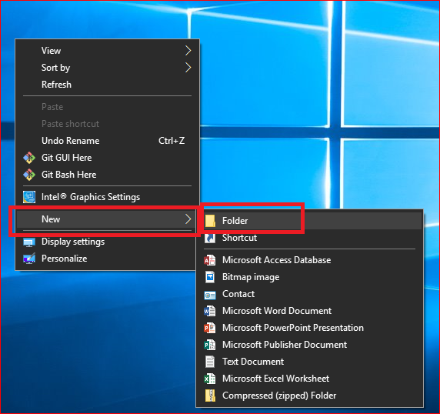
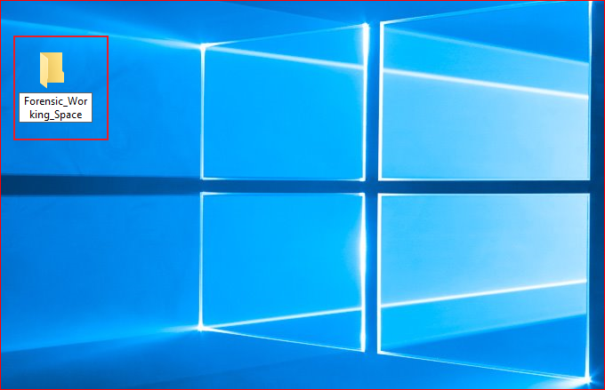

Slide 16
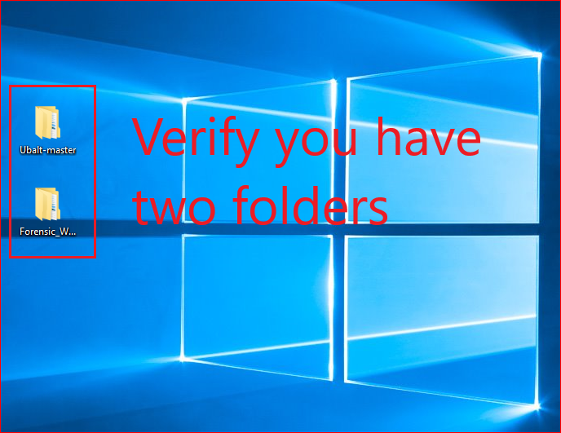

Slide 17
You need to repeat these steps before each lab to get updated files

