Slide 1
Window Registry
Frank Xu

Slide 2
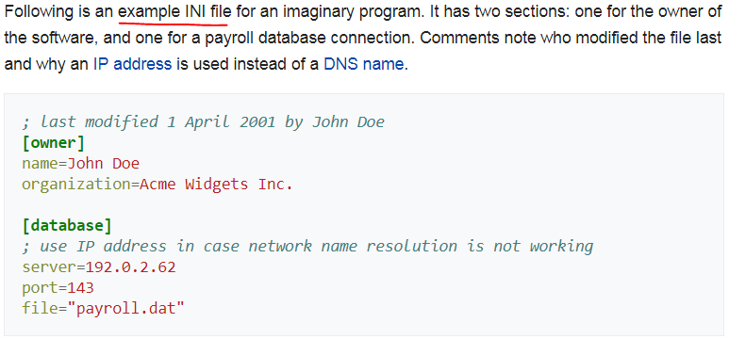
History: Why need it?
Prior to the Windows Registry, .INI files
stored each program's settings as a text file,
often located in a shared location

Slide 3
History: Why need it?
Problem with .INI
did not provide user-specific settings in a multi-user scenario
Not standardized format
Not centralized
One application, one .INI file

Slide 4
History: Why need it?
Windows Registry stores all application settings
binary file
in one logical repository (but a number of discrete files)
in a standardized form
Additional advantages over .INI files.
parsing a binary format is more efficiently
provide backup and restoration service

Slide 5
What is the Registry?
Is a hierarchical database
Stores low-level settings for Window OS and for App
Software and hardware info
settings, options, and other values
Which component uses registry?
The kernel, device drivers, services, Security Accounts Manager (SAM), and user interface

Slide 6
Example: Application
When a program is installed, a new subkey added to the Registry
settings such as a program's location,
its version, and
how to start the program

Slide 7
Examples Of Cool Registry Hacks
Prevent Windows Update from automatically restarting your computer:
Single-click to activate the last active window for a program on Windows 7’s taskbar:
Disable the Aero Shake feature that automatically minimizes other windows when you shake a window:
Click & hold title bar window and shake it to see what happens
Disable system tray notification balloon pop-ups:

Slide 8
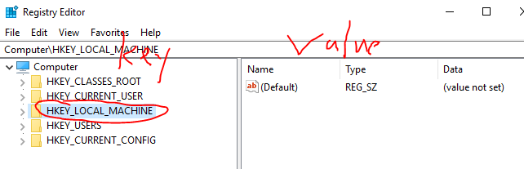

Structure
The registry has two basic concepts
Keys and Values.
Keys
are objects that are basically folders, and in the interface even look exactly like folders.
Values
are a bit like the files in the folders, and they contain the actual settings.

Slide 9
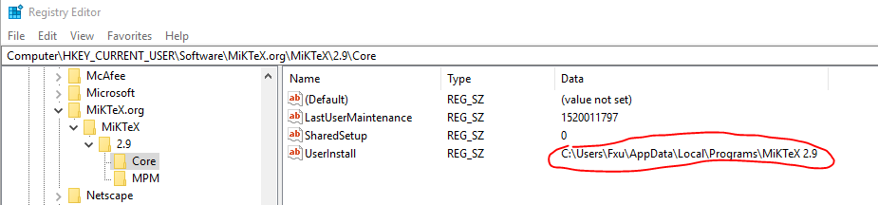
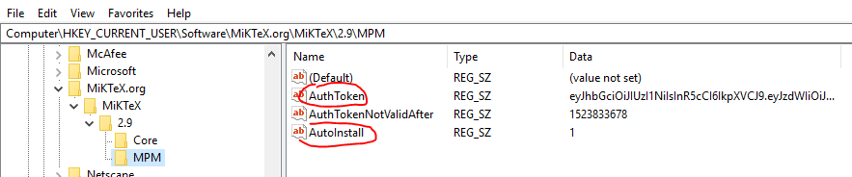
Structure Example

Slide 10
Hives
Is a logical group of keys/subkeys and values in the registry
their supporting files in %SystemRoot%\System32\Config directory
Each hive contains a Registry tree,
has a key that serves as the root (i.e., starting point) of the tree.
Subkeys and their values reside beneath the root.
In other words
On disk, the Registry isn't simply one large file but a set of discrete files called hives.

Slide 11
Table 1 Regedit Root Keys
Key | Description
HKEY_CLASSES_ROOT | Symbolic link to HKEY_LOCAL_MACHINE \SOFTWARE \Classes. file extension association information, as well as a programmatic identifier (ProgID), Class ID (CLSID), and Interface ID (IID) data contains the necessary information for Windows to know what to do when you ask it to do something, like to view the contents of a drive, or open a certain type of file, etc.
HKEY_CURRENT_USER | Symbolic link to a key under HKEY_USERS representing a user's profile hive.
HKEY_LOCAL_MACHINE | Placeholder with no corresponding physical hive. This key contains other keys that are hives.
HKEY_USERS | Placeholder that contains the user-profile hives of logged-on accounts.
HKEY_CURRENT_CONFIG | Symbolic link to the key of the current hardware profile under HKEY_LOCAL_MACHINE \SYSTEM CurrentControlSet\ Control\IDConfigDB\Hardware Profiles.
HKEY_DYN_DATA | Placeholder for performance data lookups. This key has no corresponding physical hive.

Slide 12
Standard Hives/Support Files
Registry hive | Supporting files
HKEY_CURRENT_CONFIG | System, System.alt, System.log, System.sav
HKEY_CURRENT_USER | Ntuser.dat, Ntuser.dat.log
HKEY_LOCAL_MACHINE\SAM | Sam, Sam.log, Sam.sav
HKEY_LOCAL_MACHINE\Security | Security, Security.log, Security.sav
HKEY_LOCAL_MACHINE\Software | Software, Software.log, Software.sav
HKEY_LOCAL_MACHINE\System | System, System.alt, System.log, System.sav
HKEY_USERS\.DEFAULT | Default, Default.log, Default.sav
.sav: A backup copy of a hive.
.log: A transaction log of changes to the keys and value entries in the hive.

Slide 13
Registry Hives and Corresponding Files
Registry Path | File Path
HKEY_LOCAL_MACHINE\System | %WINDIR%\system32\conf ig\System
HKEY_LOCAL_MACHINE\SAM | %WINDIR%\system32\config\Sam
HKEY_LOCAL_MACHINE\Security | %WINDIR%\system32\config\Security
HKEY_LOCAL_MACHINE\Software | %WINDIR%\system32\config\Software
HKEY_LOCAL_MACHINE\Hardware | Volatile hive
HKEY_LOCAL_MACHINE\System\Clone | Volatile hive
HKEY_USERS\User SID | User profile (NTUSER.DAT); "Documents and Settings\User (changed to "Users\User" on Vista)
HKEY_USERS\Default | %WINDIR%\system32\config\default
Volatile hive: created during system startup and are not available when the system shuts down.

Slide 14
Note for Volatile hive
This is important to remember when you’re performing postmortem forensic analysis as well as live response on a running system.
If data in volatile hives is important to troubleshooting a system or conducting incident response activities, you should consider either
exporting the entire volatile hive to a .reg file via regedit.exe, or
employing some other mechanism to collect specific data from the volatile hive before shutting the system down.

Slide 15
Tables observation: Most important hive: HKEY_LOCAL_MACHINE \SYSTEM
It’s subkey
\CurrentControlSet\Control
contains settings for initializing the Registry.
Configuration Manager
Using the settings to initialize hives
HKEY_LOCAL_MACHINE \SYSTEM \CurrentControlSet \Control \hivelist.

Slide 16
Tables observation: symbolic link
redirects the Configuration Manager to another key.
the key HKEY_LOCAL_MACHINE \SAM is a symbolic link to the key at the root of the SAM hive.
Configuration Manager uses it
to link hives to organize the Registry.

Slide 17
HKEY_USERS (HKU)
A User profile hive
each time a new user logs on to a computer, a new hive is created for that user with a separate file for the user profile.
contains specific registry information pertaining to the user's application settings, desktop, environment, network connections, and printers.
located under the HKEY_USERS key.

Slide 18
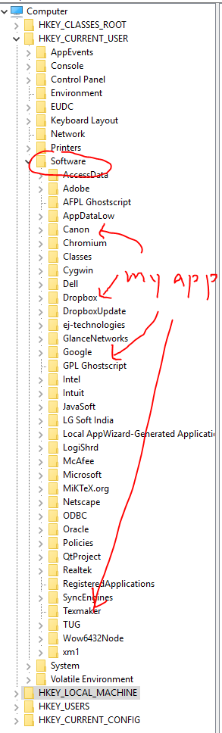
HKEY_CURRENT_USER
Holds the user settings for the currently logged in user
Abbreviation HKCU
Just a link to HKEY_USERS\<SID-FOR-CURRENT-USER>.
The most important sub-key in here is HKCU\Software,
contains user-level settings for most of your software.

Slide 19
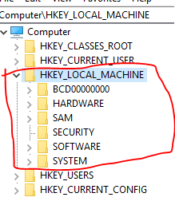
HKEY_LOCAL_MACHINE
All of the system-wide settings
HKLM
Not stored on disk, but maintained in memory by the system kernel in order to map all the other subkeys.

Slide 20
HKEY_LOCAL_MACHINE
HKLM\SAM:
"Security Accounts Manager" (SAM)
empty for most users
unless they are granted access by administrators
HKLM\SECURITY
kernel will access it to read and enforce the security policy applicable to the current user and all applications or operations executed by this user.
HKLM\SYSTEM
Windows system setup,
data for the secure random number generator (RNG)
HKLM\SOFTWARE

Slide 21
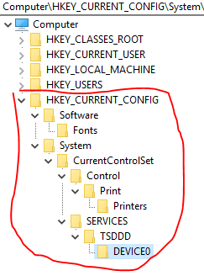
HKEY_CURRENT_CONFIG
Abbreviated HKCC
Contains (hardware) information gathered at runtime;
Information stored in this key is not permanently stored on disk,
but rather regenerated at boot time.
It is a handle to the key "HKEY_LOCAL_MACHINE\System\CurrentControlSet\Hardware Profiles\Current",
which is initially empty but populated at boot time by loading one of the other subkeys stored in "HKEY_LOCAL_MACHINE\System\CurrentControlSet\Hardware Profiles".

Slide 22
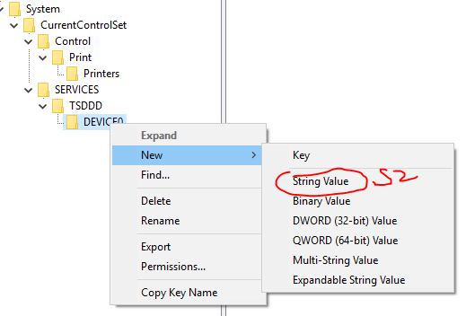
Creating New Keys and Values
String Value (REG_SZ)
Binary Value (REG_BINARY)
DWORD (32-bit) Value (REG_DWORD)
QWORD (64-bit) Value (REG_QWORD)
Multi-String Value (REG_MULTI_SZ)
Expandable String Value (REG_EXPAND_SZ)

Slide 23
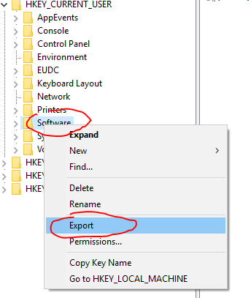
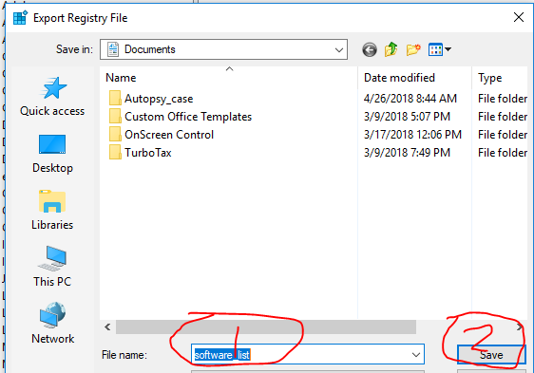
Exporting Registry Files

Slide 24
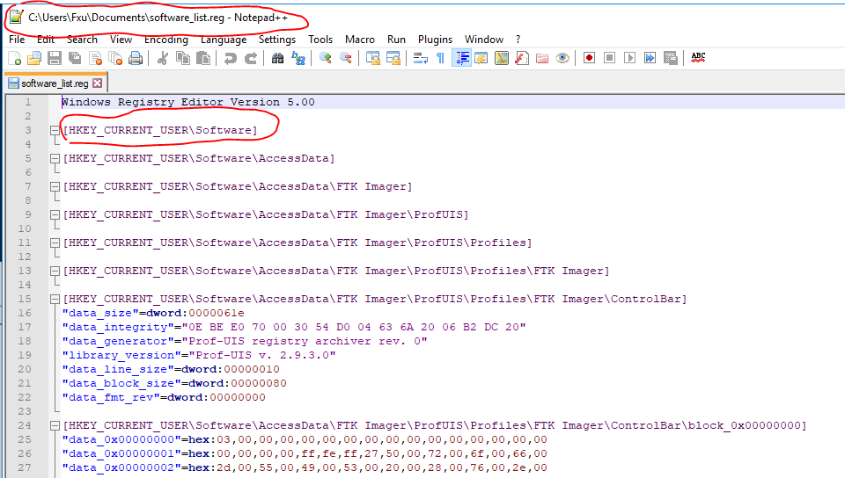
View .reg Exported Registry File

Slide 25
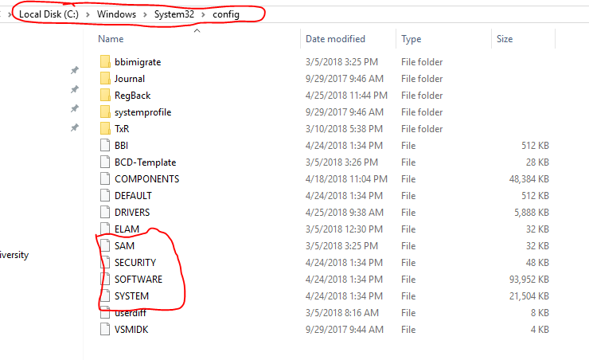
Where are these registry files stored?

Slide 26
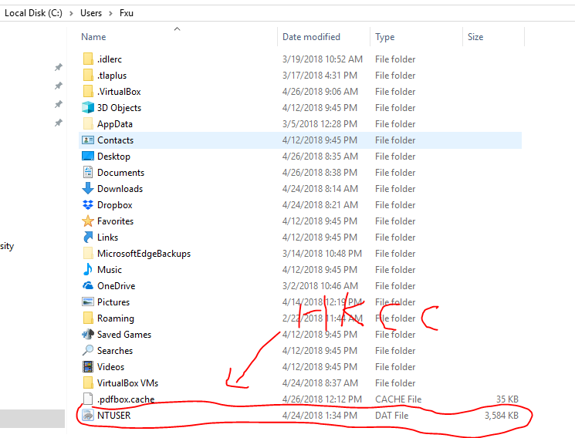
Where is HKCC registry file stored?

Slide 27
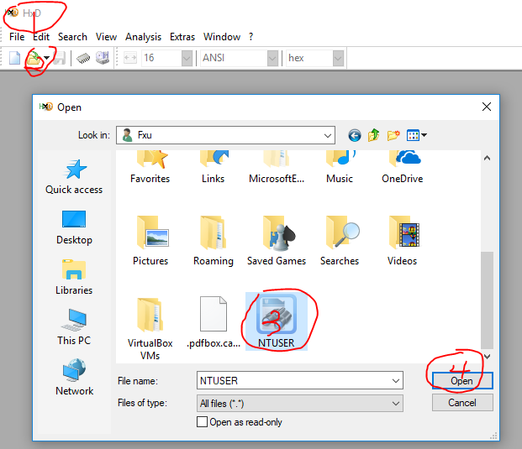
Try to Open NTUSER Using HxD

Slide 28
Can you open Reg Files?
No. You can’t open Registry files in your PC
They are being using by your PC
Need get a hard disk to test it
Get a hard disk image
Get Reg files
Use tool to read Reg files

Slide 29
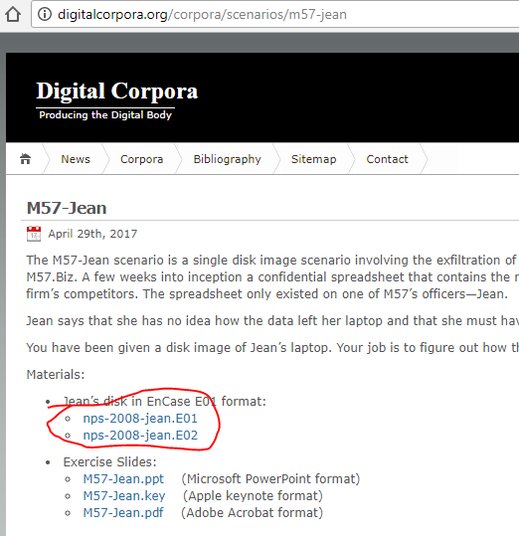
Use Reg Ripper to Read Reg Files
Where to get Registry?
get a Hard disk from here. http://digitalcorpora.org/corpora/scenarios/m57-jean
https://www.youtube.com/watch?v=eB211nF-Big

Slide 30
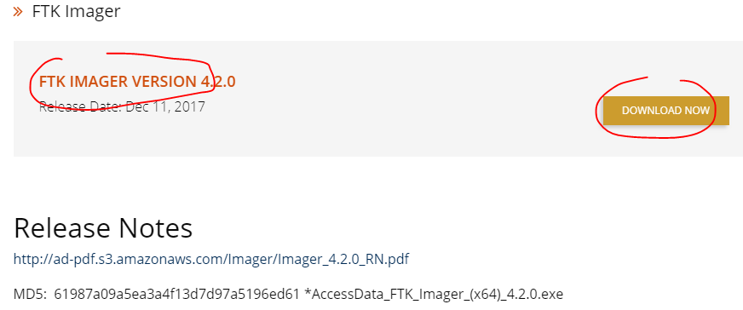
Install FTK for mounting Hard Disk

Slide 31
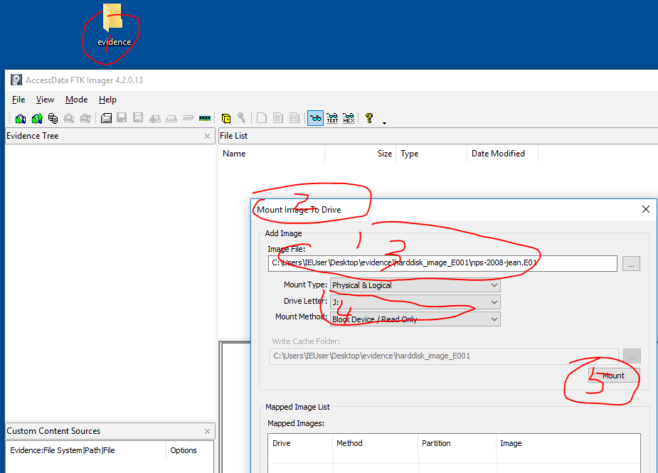
Mount Hard Disk Image

Slide 32
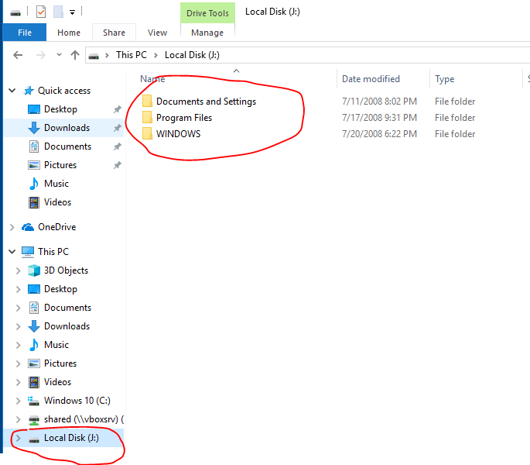
Mounted to J:

Slide 33
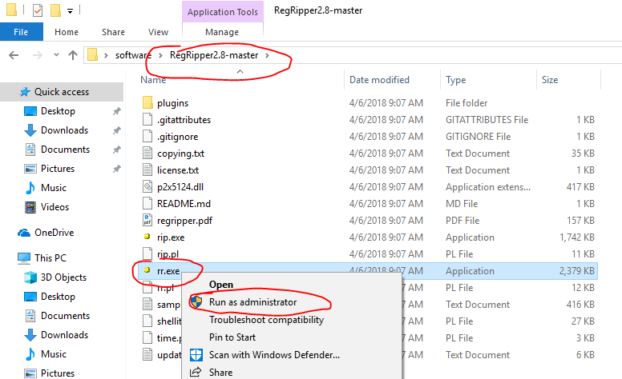
Open RegRipper

Slide 34
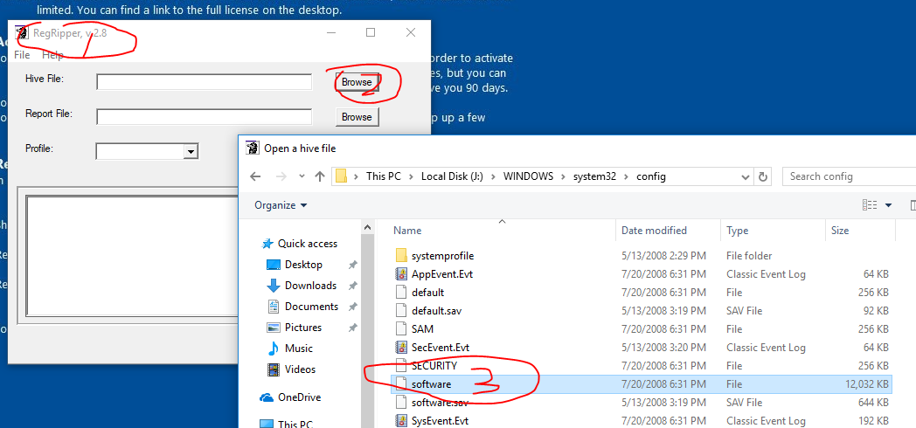
Read Software Hive

Slide 35
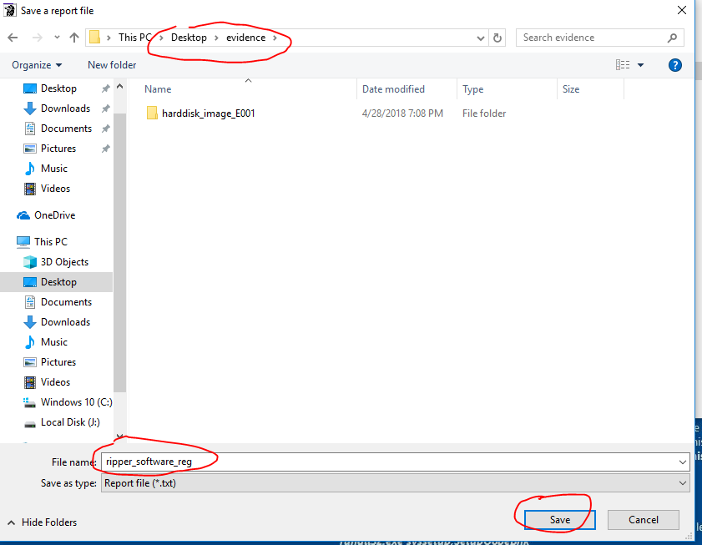
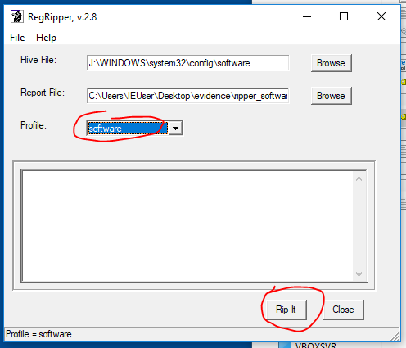

Slide 36
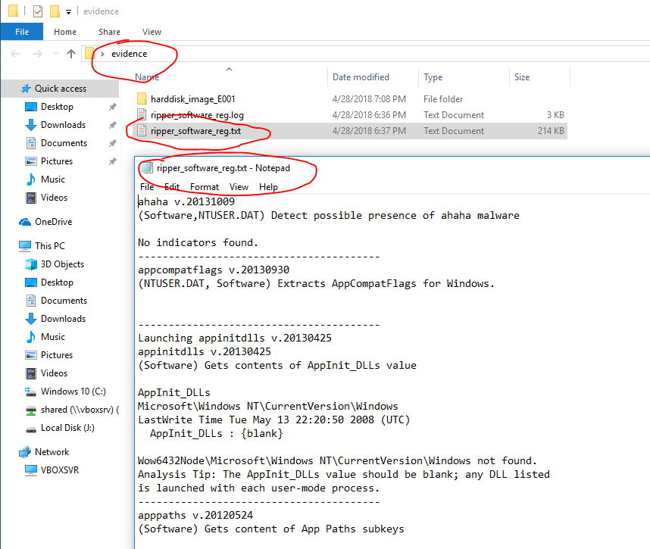
Show Results

Slide 37
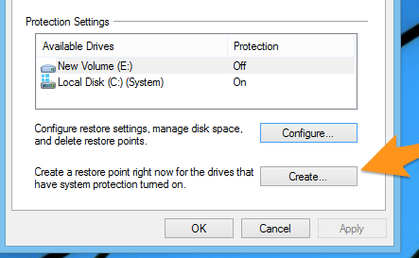
Backing Up Your Registry
You can’t export the entire registry to a file, and
it wouldn’t work very well to import it again either.
You also can’t easily access the files themselves on the hard drive,
because they are completely locked. So that’s not going to work.
The best option to backup your registry
We won’t cover here

Slide 38
Examples Of Cool Registry Hacks
Prevent Windows Update from automatically restarting your computer: Navigate to the HKEY_LOCAL_MACHINE\SOFTWARE\Policies\Microsoft\Windows\WindowsUpdate\AU key, creating the subkeys if they don’t exist. Right-click in the right pane and create a new 32-bit DWORD value named NoAutoRebootWithLoggedOnUsers. Set its value to 1.
Single-click to activate the last active window for a program on Windows 7’s taskbar: Navigate to the HKEY_CURRENT_USER\Software\Microsoft\Windows\CurrentVersion\Explorer\Advancedkey, create a new DWORD value, name it LastActiveClick, and change its value to 1.
Disable the Aero Shake feature that automatically minimizes other windows when you shake a window: Navigate to HKEY_CURRENT_USER\Software\Policies\Microsoft\Windows\Explorer, create a new DWORD value, name it NoWindowMinimizingShortcuts, and set its value to 1.
Disable system tray notification balloon pop-ups: Navigate to HKEY_CURRENT_USER\Software\Microsoft\Windows\CurrentVersion\Explorer\Advanced, create a new DWORD value, name it EnableBalloonTips, and set its value to 0.

Slide 39
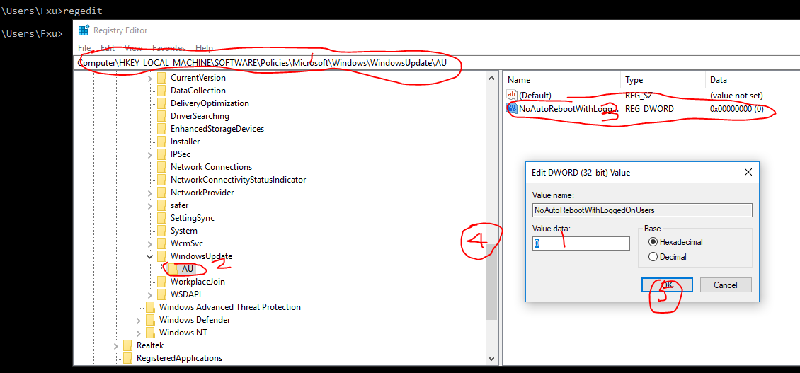
DEMO 1: Prevent Windows Update from automatically restarting your computer

Slide 40
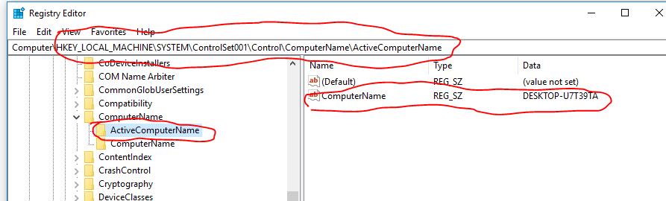
Demo 2: find the computer’s name

Slide 41
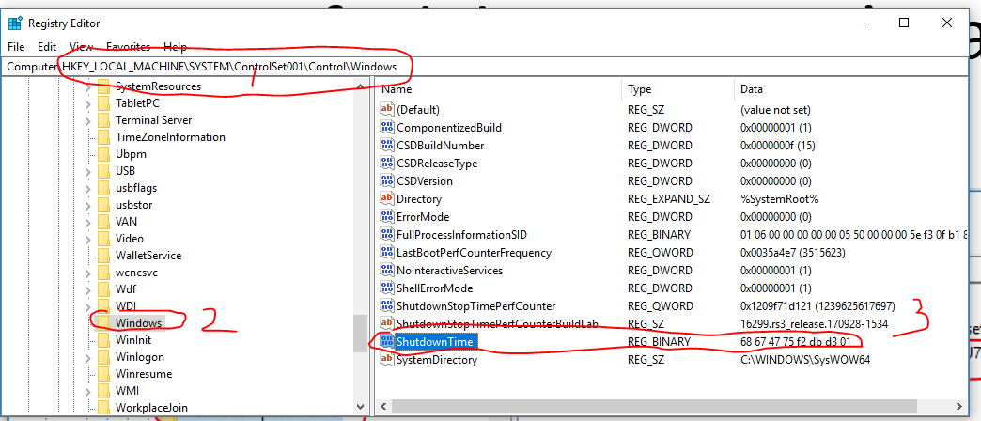
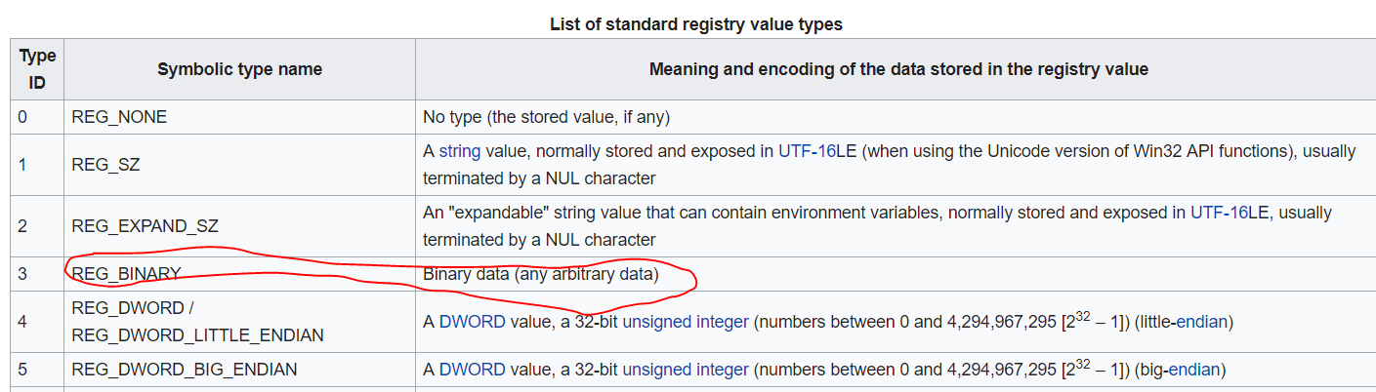
Demo 3: find the time at which the system was last shut down
68674775f2dbd301

Slide 42
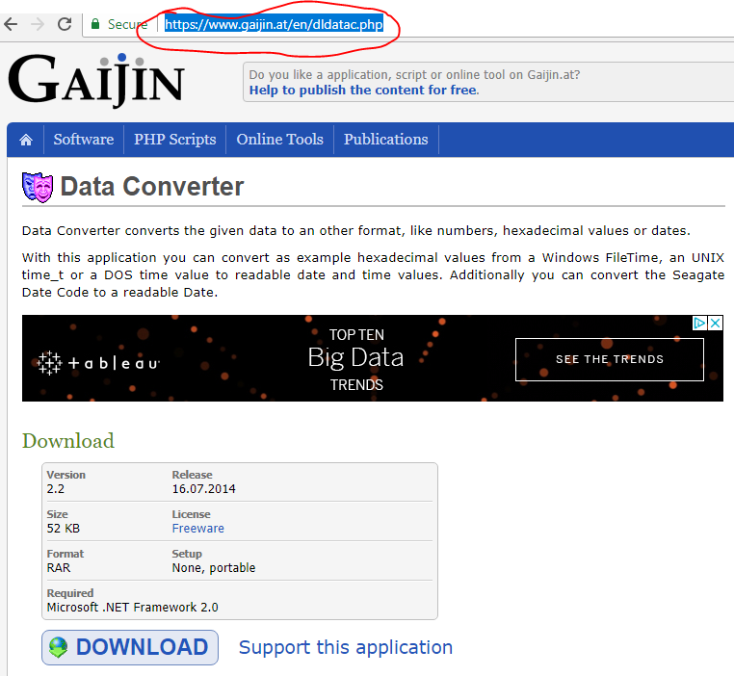
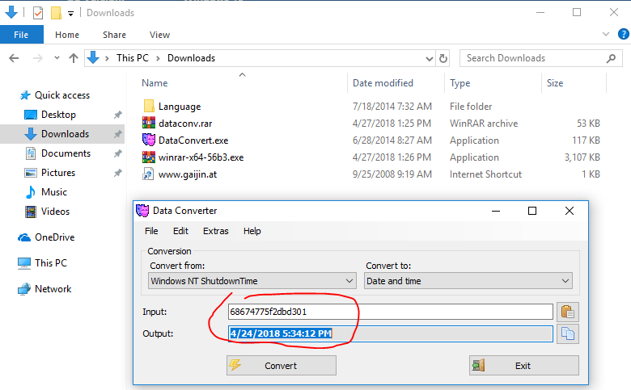
data conversion: Hex-> Date

Slide 43
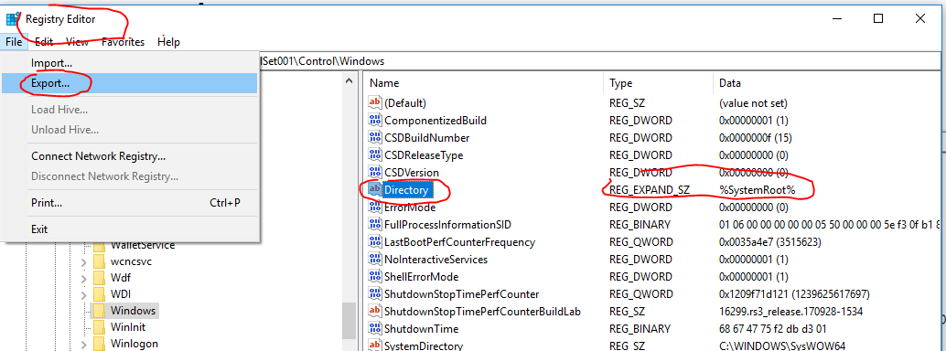
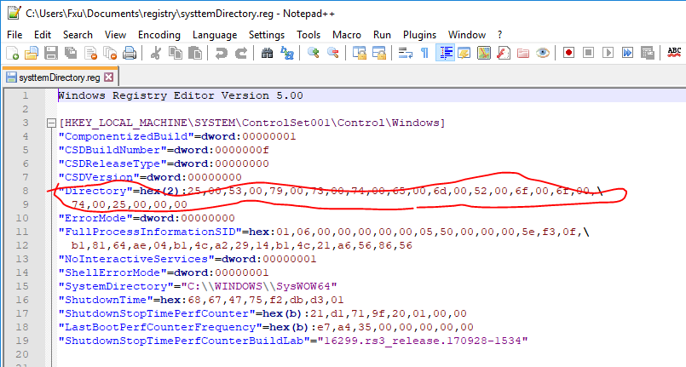
data conversion: Reg_expand_sz->string

Slide 44
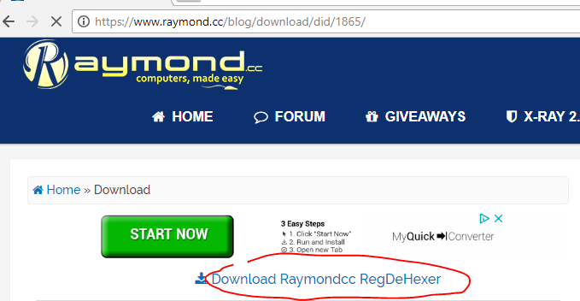
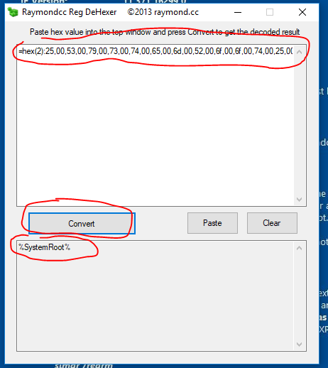
"Directory"=hex(2):25,00,53,00,79,00,73,00,74,00,65,00,6d,00,52,00,6f,00,6f,00,74,00,25,00,00,00
https://www.raymond.cc/blog/convert-windows-registry-hex-to-text/

Slide 45
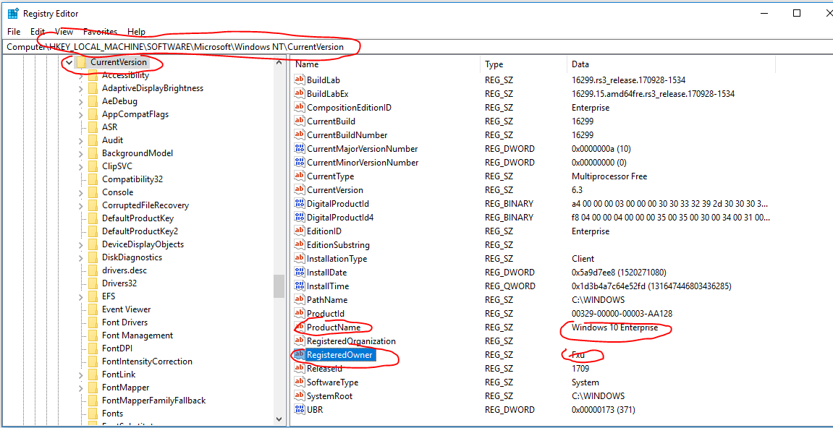
Demo 4: Current Version: provide information about the system

Slide 46
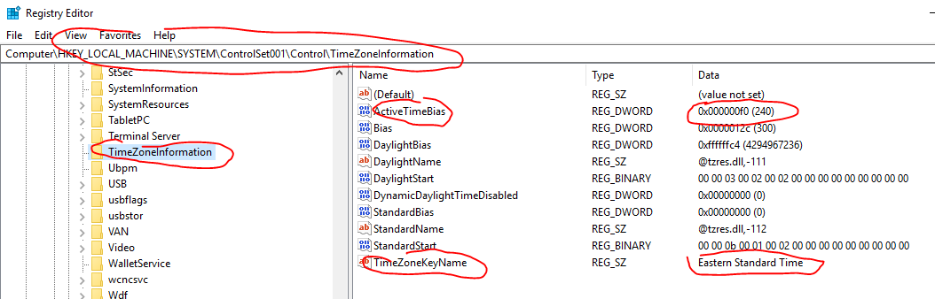
Demo 5: TimeZoneInformation
This information can be extremely important
for establishing a timeline of activity on the system.
ActiveTimeBias
is the current time difference from UTC in minutes, regardless of whether daylight saving is in effect or not. It is this value that helps establish the current time zone settings

Slide 47
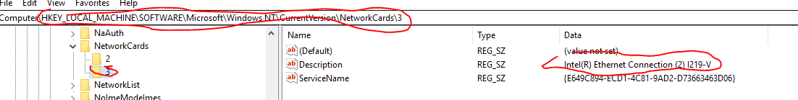
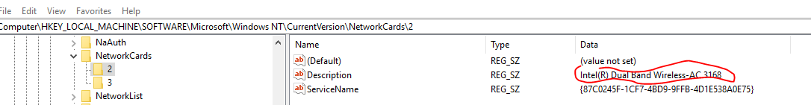
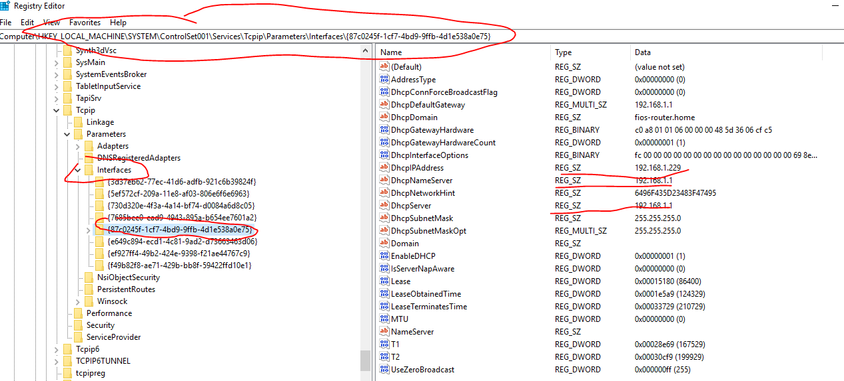
Demo 6: Network Card/Interfaces
GUID: Globally Unique Identifier
\GUID: Globally Unique Identifier
Multiple logical interface
210729-124329=86400 sec=1 day

Slide 48
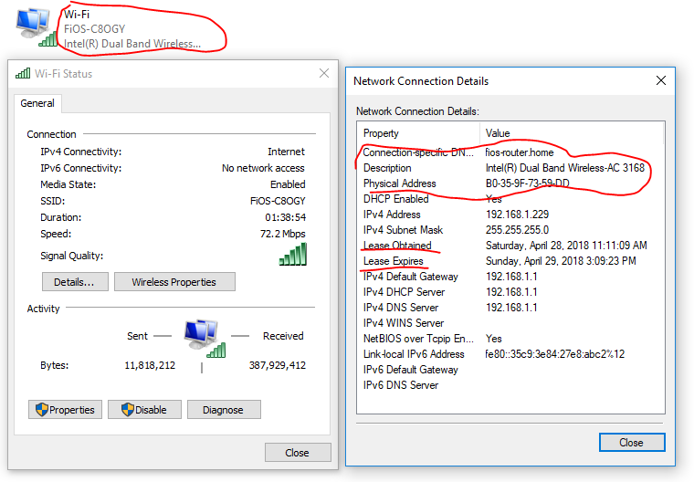

Slide 49
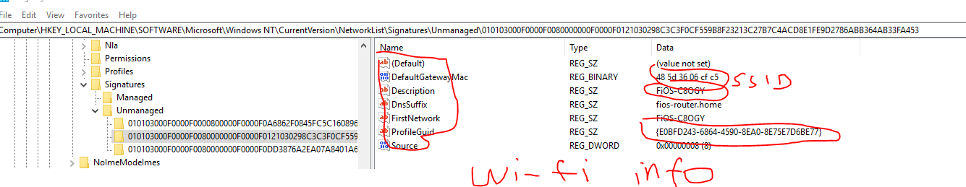
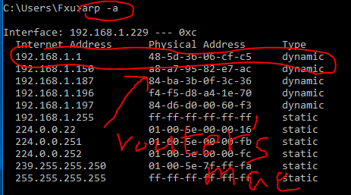
Demo 7: Wi-Fi Information: Getway Mac, last time connected
Match next slide

Slide 50
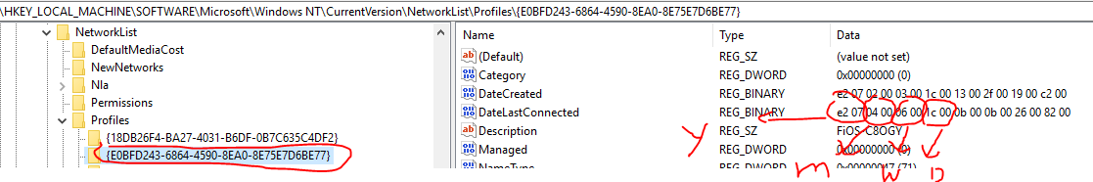
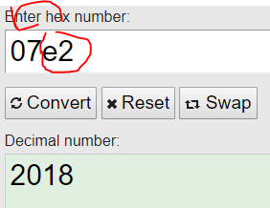
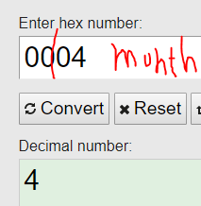
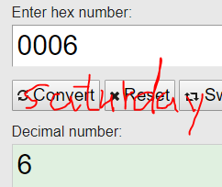
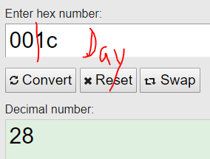

ProfileGuid

Slide 51
Demo 8: System Boot
Autostart locations within the Registry that are accessed when the system boots are favorites of malware authors
because they allow the malware to be launched with no user interaction whatsoever—not even logging in to the system. One location is the Windows Services
When the system starts
the value for the current ControlSet to be used is determined, and the settings for that ControlSet are used.
The services listed within that ControlSet are scanned, and services that are set to start automatically (Start value is 0×02) are launched.

Slide 52
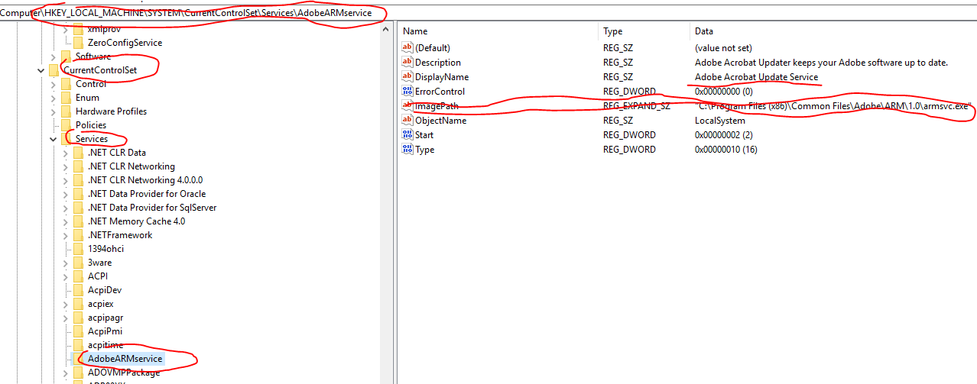

Slide 53
Demo 9: User Login
When a user logs in to a system, certain Registry keys are accessed and parsed so that listed applications can be run.
Keys
HKLM\Software\Microsoft\Windows\CurrentVersion\Runonce
HKLM\Software\Microsoft\Windows\CurrentVersion\Policies\Explorer\Run
HKLM\Software\Microsoft\Windows\CurrentVersion\Run
HKCU\Software\Microsoft\Windows NT\CurrentVersion\Windows\Run
HKCU\Software\Microsoft\Windows\CurrentVersion\Run
HKCU\Software\Microsoft\Windows\CurrentVersion\RunOnce

Slide 54
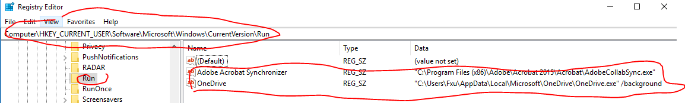
HKCU\Software\Microsoft\Windows\CurrentVersion\Run

Slide 55
Demo 10: NtfsDisableLastAccessUpdate
Windows systems maintain time stamps on files
"MAC time".
Use the NtfsDisableLastAccessUpdate Registry value to disable this functionality
increasing the performance of high-volume file servers,
http://support.microsoft.com/kb/894372
Lack of file last access time stamps may appear to be a significant obstacle during an examination.

Slide 56
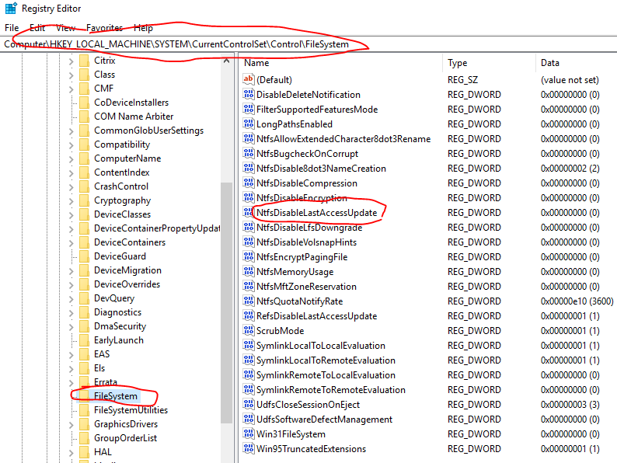

Slide 57
Demo 11: Which USB is attached to PC?
When a USB removable storage device is connected to a Windows system
footprints or artifacts are left in the Registry.
When the device is plugged in, the Plug and Play (PnP) Manager
receives the event and queries the device descriptor in the firmware for information about the device,
such as the manufacturer.
then uses this information to locate the appropriate driver for the device (based on the contents of .inf files) and, if necessary, loads that driver.
Once the device has been identified
a Registry key will be created
Disk&Ven_###&Prod_###&Rev_###

Slide 58

My USB Information

Slide 59

My USB Information in Registry

Slide 60

Find Last time the disk was connected to PC
How to decode the LastPresentDate?
Af c3 77 15 12 b3 d3 01
https://stackoverflow.com/questions/43818026/how-decode-windows-64bit-hex-value-little-endian-time

Slide 61

Tip: Decode Window 64 bits hex to date
In unix systems date/time is often (but not always) recorded as a 32-bit integer indicating seconds past since Epoch (00:00:00, Jan 1, 1970).
Windows 64-bit Little Endian format, it means "x100 nanoseconds past since 00:00:00.000,000,0 Jan 1, 1601".
Note Dcode maybe incorrect
Should be 4/29/2018, Sunday

Slide 62

Lab: regshot to take a snapshot of registry before and after insert a USB

Slide 63

Snap shoots

Slide 64

Two Snaps

Slide 65

Comparing Difference

Slide 66
reference
https://www.howtogeek.com/school/using-windows-admin-to
https://msdn.microsoft.com/en-us/library/windows/desktop/ms724881(v=vs.85).aspx ols-like-a-pro/lesson5/
https://en.wikipedia.org/wiki/Windows_Registry
https://www.makeuseof.com/tag/what-is-the-windows-registry-editor-and-how-do-i-use-it-makeuseof-explains/
http://what-when-how.com/windows-forensic-analysis/registry-analysis-windows-forensic-analysis-part-3/
http://what-when-how.com/windows-forensic-analysis/registry-analysis-windows-forensic-analysis-part-6/
https://technet.microsoft.com/en-us/library/cc750583.aspx

