Slide 1
Your Friend and Mine
The Windows Registry

Slide 2
What is the Registry?
Think of as a giant 411 switchboard
Simple idea of centralized one-stop shopping for all of Windows’ needs
Everything else is a GUI for it:
Windows Control Panel
File Associations
Startup Folder
Information about WHAT and WHERE things are but not specifics on HOW to run them

Slide 3
Why Edit the Registry?
Registry is the ULTIMATE authority
Editing it directly allows greater control over what windows does
Allows control over some features that don’t have a GUI
When things go bad…

Slide 4
Editing the Registry: The Choice is Simple
Regedit.exe
Designed for single user registries.
Cleaner interface
Available in all supported versions of Windows
Regedt32.exe
Designed primarily for networked registries
Available in Windows 2000, and NT
Merged with regedit.exe in Windows XP

Slide 5
Registry Basics
Keys and Subkeys(Folders)
Reg_Dword (Numbers)
Hexadecimal (decimal)
0x0000001 (1)
True =1 False =0
Reg_SZ (String)
Stores strings (paths to files, etc.)
Can be encrypted

Slide 6
Backup First!!
The registry stores everything that windows knows about the computer…let that sink in.
Backup first!
File =>Export or File =>Backup
“Scanreg /backup” and System Restore
MISTAKE=FORMAT!

Slide 7
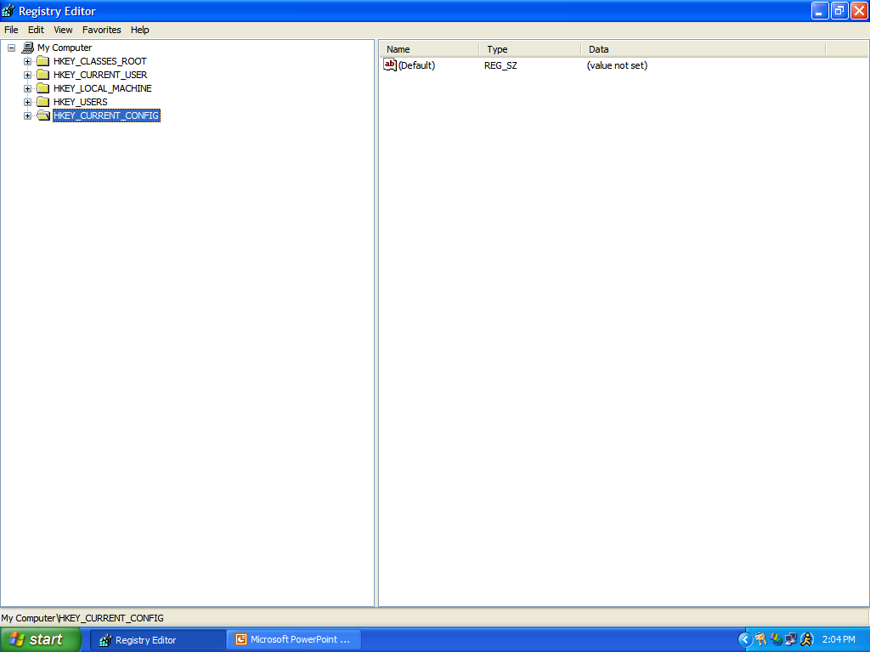

Slide 8
Organization of the Registry
Registry
(Hkey)
Local
Machine
Current
User
Users
Classes
Root
Current
Config

Slide 9
The forgotten one- HKey_Current_Config\
Stores temporary information about computer’s settings
Barely implemented
\Microsoft\Windows\CurrentVersion\InternetSettings (proxy enable)

Slide 10
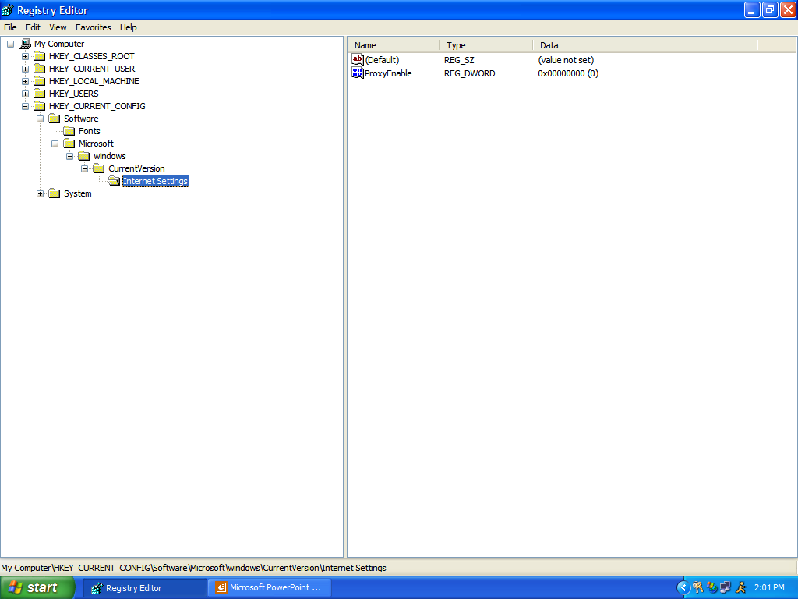

Slide 11
The User Database
Personalized Settings for Windows
Themes
Accessibility
Preferences
The Cycle- DB
Saved on Exit
Edit only Current_User
All Users
(2k/Me/XP)
Current User
HKey_Users

Slide 12
Important Stuff in HKCU
AppEvents= Themes (Event Sounds)
ControlPanel = duh!
Screen Saver
Desktop
Software=User Preferences
\Microsoft\Office\x.y\ (office prefs)
These keys are usually system safe to delete

Slide 13
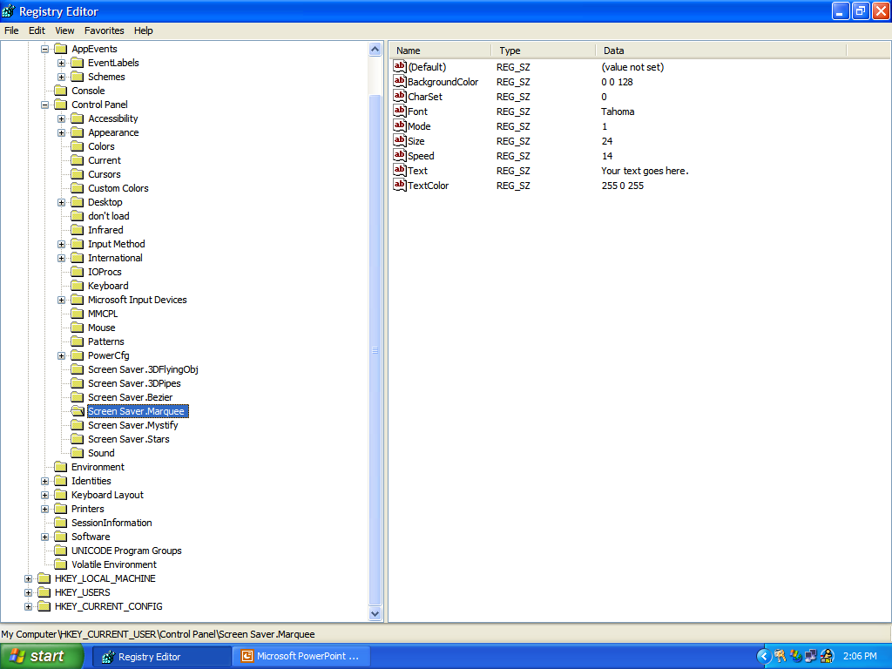

Slide 14
Important Stuff in HKCU
AppEvents= Themes (Event Sounds)
ControlPanel = duh!
Screen Saver
Desktop
Software=User Preferences
\Microsoft\Office\x.y\ (office prefs)
These keys are usually system safe to delete

Slide 15
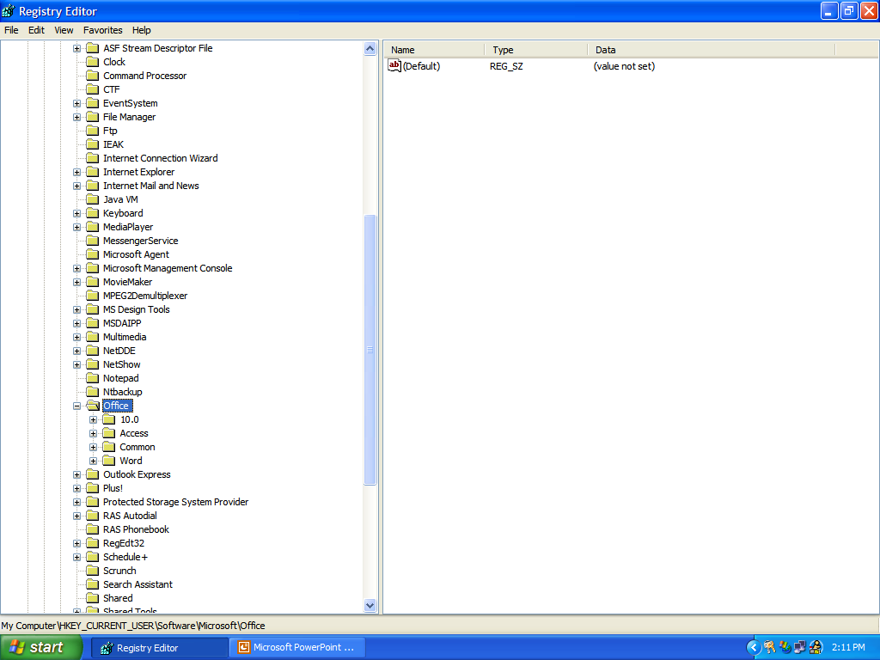

Slide 16
Hkey_Classes_Root: What should I do with that?
.mp3
(Default)
MMJB.mp3
Icon
Command
ContentType
OpenWithList
Icon
Command
Handles file extensions/ associations and links to methods
Choose what opens with what (remove old apps)
Who wins with multiple apps
.mp3 => MMJB.mp3 and mp3file
.EXE’s + Viruses

Slide 17
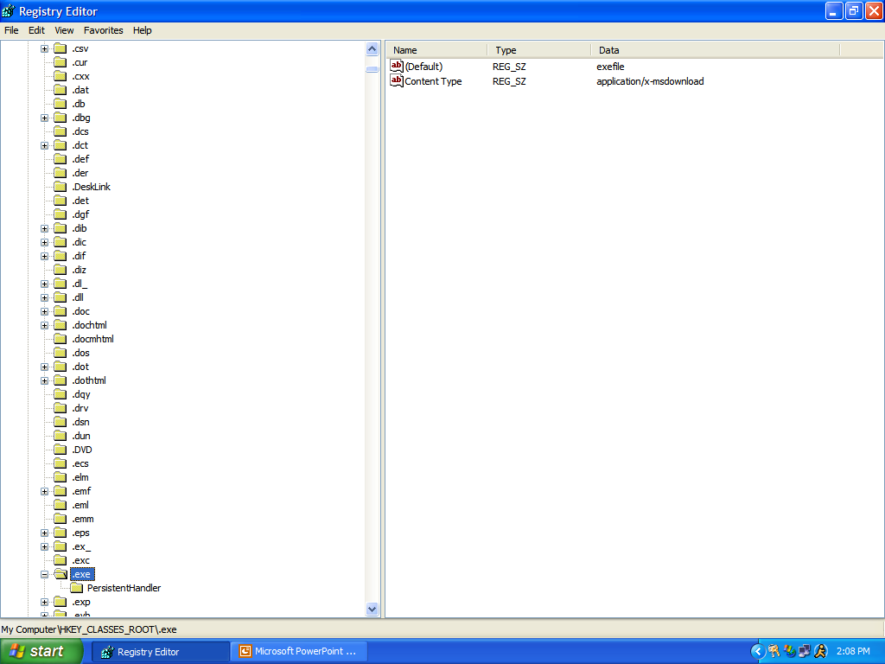

Slide 18
Hkey_Classes_Root: What should I do with that?
.mp3
(Default)
MMJB.mp3
Icon
Command
ContentType
OpenWithList
Icon
Command
Handles file extensions/ associations and links to methods
Choose what opens with what (remove old apps)
Who wins with multiple apps
.mp3 => MMJB.mp3 and mp3file
.EXE’s + Viruses

Slide 19
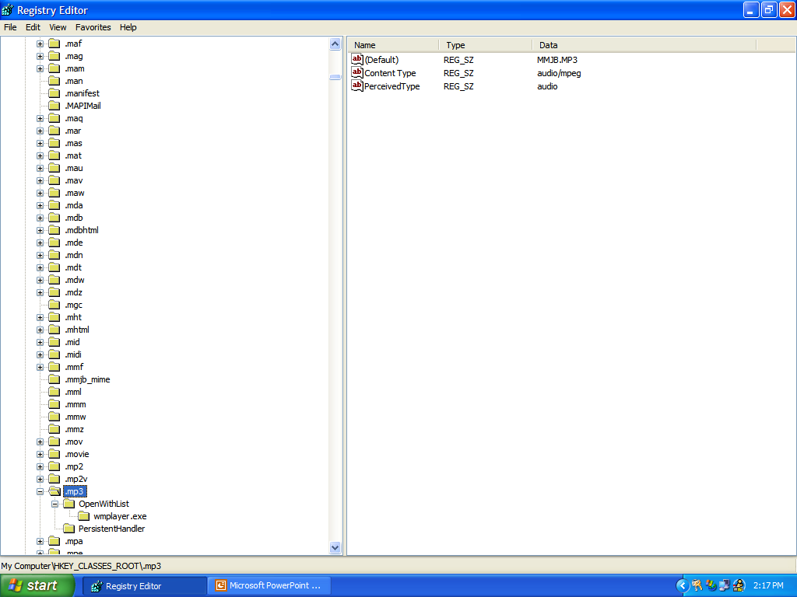

Slide 20
Hkey_Classes_Root: What should I do with that?
.mp3
(Default)
MMJB.mp3
Icon
Command
ContentType
OpenWithList
Icon
Command
Handles file extensions/ associations and links to methods
Choose what opens with what (remove old apps)
Who wins with multiple apps
.mp3 => MMJB.mp3 and mp3file
.EXE’s + Viruses

Slide 21
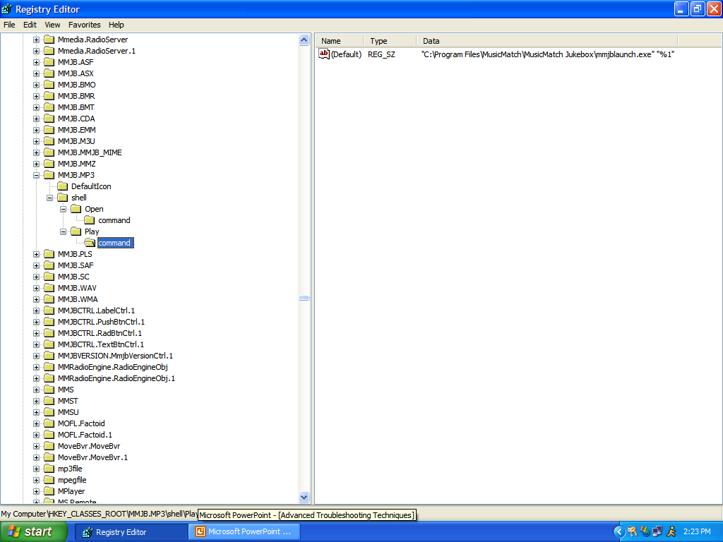

Slide 22
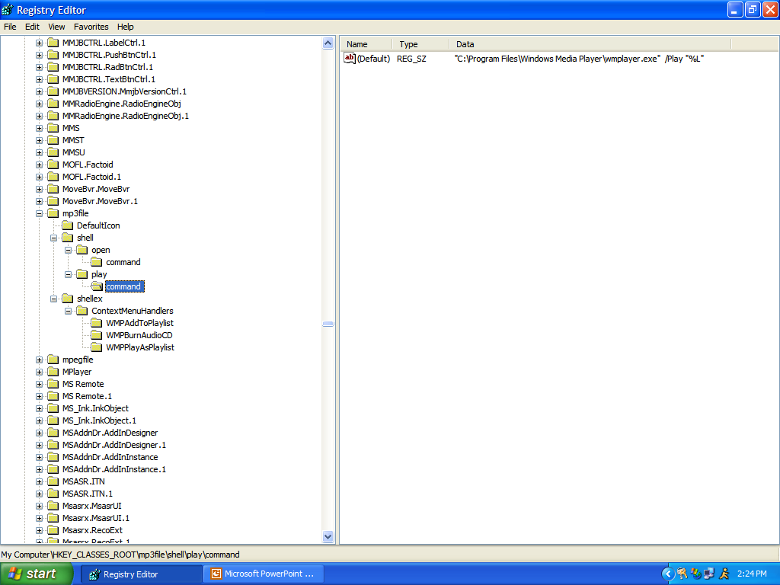

Slide 23
Hkey_Local_Machine
HKey_Local_Machine
Software
\Microsoft\Windows
Applications
System
Control Sets/HW Profiles
Hardware
Software- Application Settinsg
System- Control Sets
Control Sets = Windows HW Profiles
Otherwise leave it alone!

Slide 24
Hkey_Local_Machine
HKey_Local_Machine
Software
\Microsoft\Windows
Applications
System
Control Sets/HW Profiles
Hardware
Software- Application Settings
System- Control Sets
Control Sets = Windows HW Profiles
Otherwise leave it alone!

Slide 25
\CurrentControlSet
\Enum\ – same as Device Mgr
\Control\Class- Driver Database
HKLM\System\CurrentControlSet\Services
This is the source of a lot of errors
\Services\VxD
Those pesky VxD’s are stored here

Slide 26
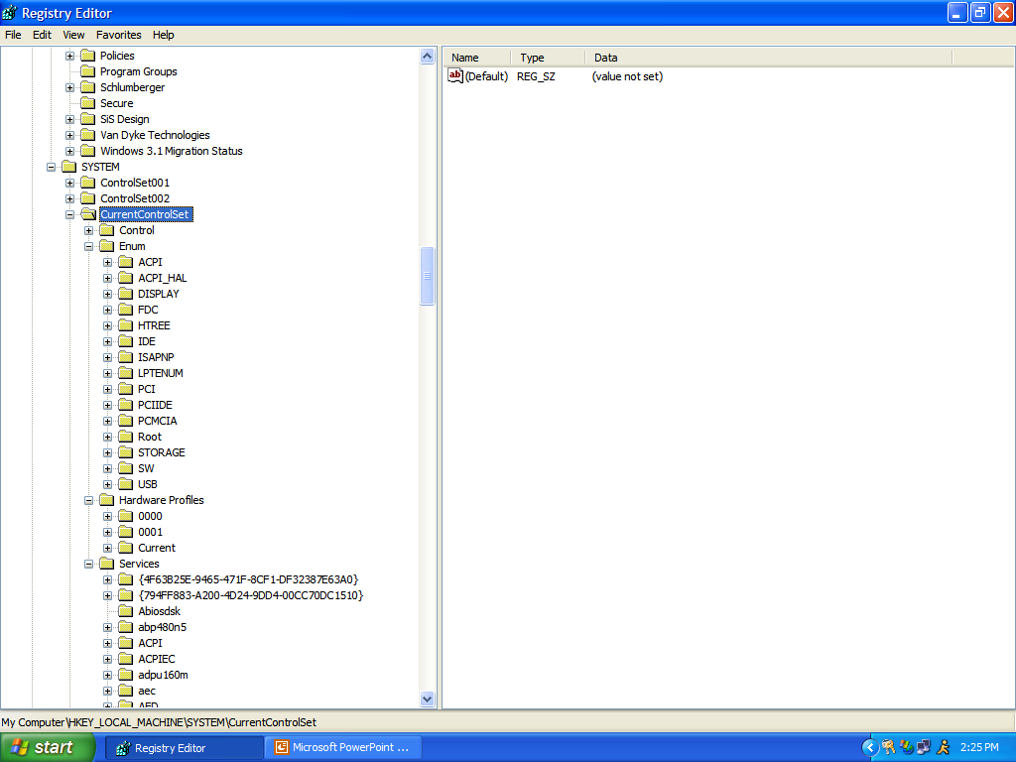

Slide 27
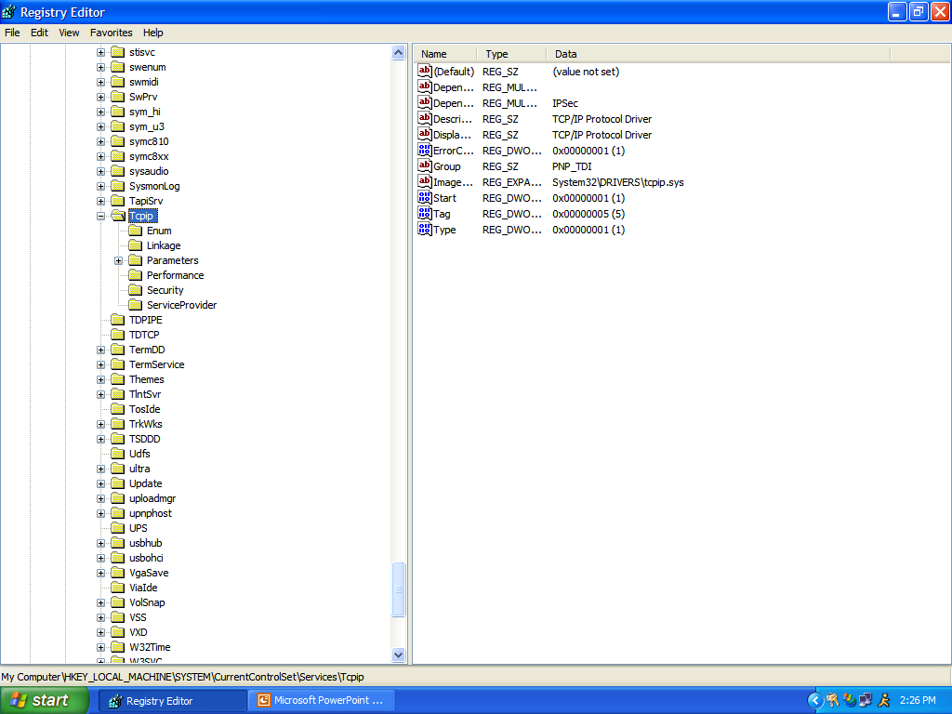

Slide 28
\Software\Microsoft\Windows\Current Version
/AppPath – points to registered apps
/Run/ vs /Run-/
/Setup/
Change install path
Finding CD keys (shhh!)

Slide 29
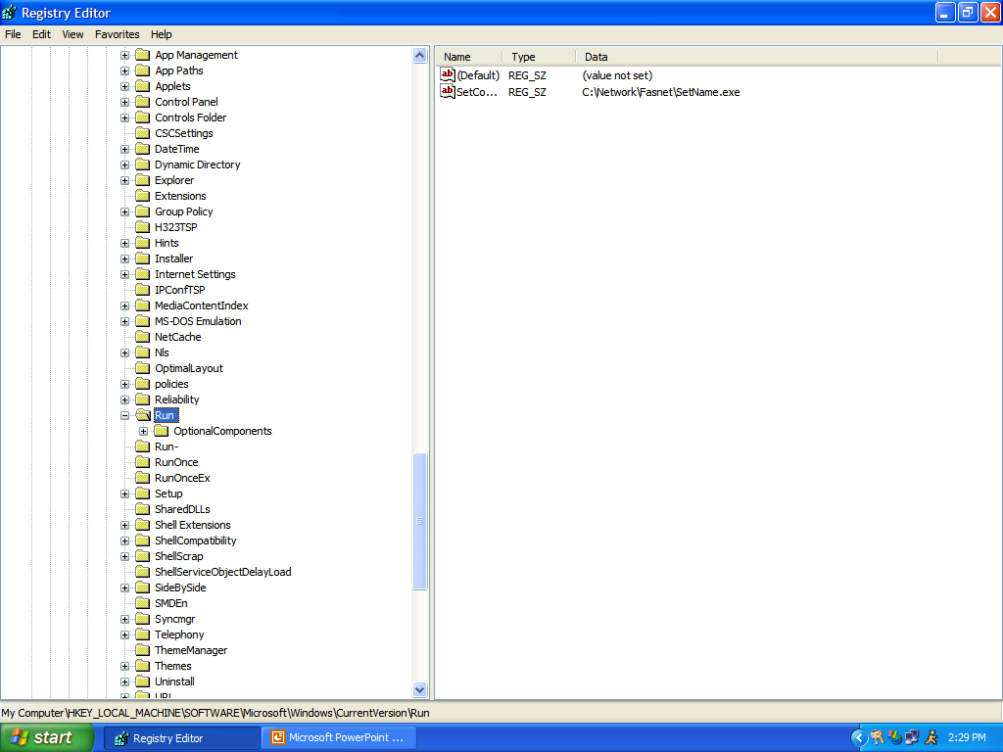

Slide 30
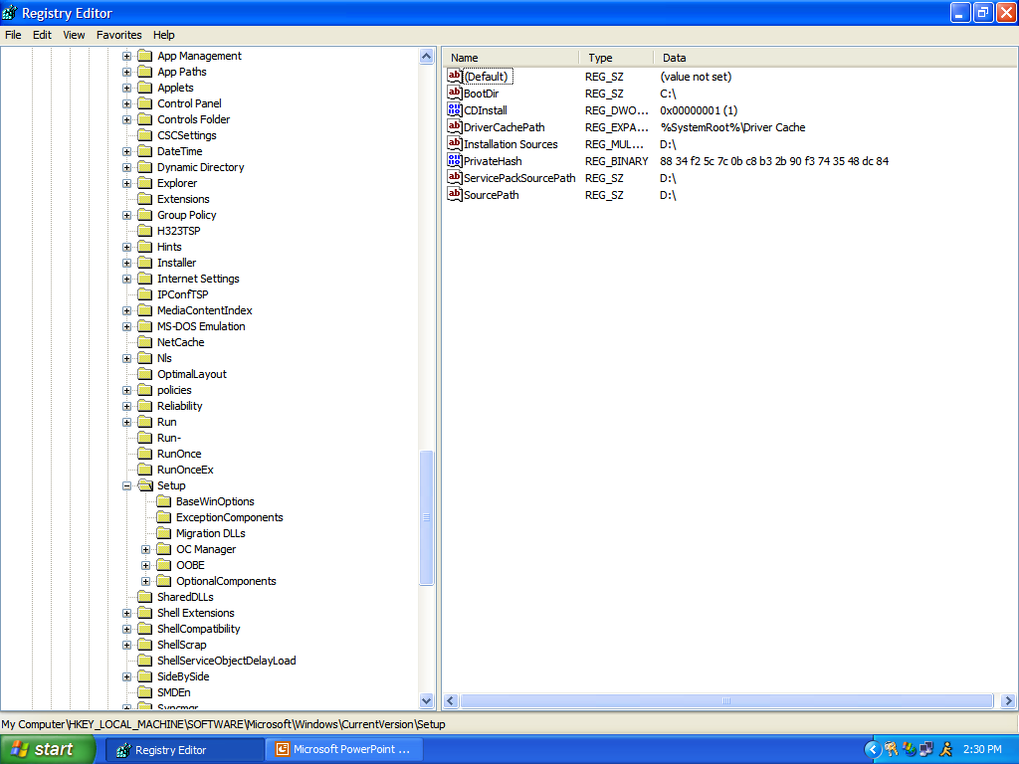

Slide 31
Registry Tricks
Backup first!
If you can’t find it – Search!
Copy to regedit.com if you’re infected by virus.
www.regedit.com for more info

