Slide 1
Guide to Computer Forensics and Investigations Sixth Edition Chapter 3
Data Acquisition

Slide 2
Overview
Data acquisition
Is the process of copy data
collecting digital evidence from electronic media.
Data acquisition type
Static and live (we focus on)
Static acquisition
Data is not accessed by other process
Live acquisition
File metadata, date, and time changes when read by acquisition tools

Slide 3
Objectives (1 of 2)
List digital evidence storage formats
Explain ways to determine the best acquisition method
Describe contingency planning for data acquisitions
Explain how to use acquisition tools

Slide 4
Objectives (2 of 2)
Explain how to validate data acquisitions
Describe RAID acquisition methods
Explain how to use remote network acquisition tools
List other forensic tools available for data acquisitions

Slide 5
Understanding Storage Formats for Digital Evidence

Slide 6
Understanding Storage Formats for Digital Evidence
Data collected by a forensics acquisition tool is stored as an image file
Three formats
Raw format
Proprietary formats
Advanced Forensics Format (AFF)
Open source
Gaining recognition

Slide 7
Raw Format
Makes it possible to write bit-stream data to files
Advantages
Fast data transfers
Ignores minor data read errors on source drive
Most computer forensics tools can read raw format
Disadvantages
Requires as much storage as original disk or data
Tools might not collect marginal (bad) sectors

Slide 8
Proprietary Formats
Most forensics tools have their own formats
Features offered
Option to compress or not compress image files
Can split an image into smaller segmented files
Can integrate metadata into the image file
Disadvantages
Inability to share an image between different tools
File size limitation for each segmented volume (the size of the target SATA)
The Expert Witness Compression format is unofficial standard
.E001

Slide 9
Advanced Forensics Format
Developed by Dr. Simson L. Garfinkel as an open-source acquisition format
Design goals
Provide compressed or uncompressed image files
No size restriction for disk-to-image files
Provide space in the image file or segmented files for metadata
Simple design with extensibility
Open source for multiple platforms and Oss
Internal consistency checks for self-authentication
File extensions include .afd for segmented image files and .afm for AFF metadata
AFF is open source

Slide 10
Determining the Best Acquisition Method

Slide 11
Determining the Best Acquisition Method (1 of 4)
Types of acquisitions
Static acquisitions and live acquisitions
Four methods of data collection
Creating a disk-to-image file
Creating a disk-to-disk
Creating a logical disk-to-disk or disk-to-data file
Creating a sparse data copy of a file or folder
Determining the best method depends on the circumstances of the investigation

Slide 12
Determining the Best Acquisition Method (2 of 4)
Creating a disk-to-image file
Most common method and offers most flexibility
Can make more than one copy
Copies are bit-for-bit replications of the original drive
Compatible with many commercial forensics tools
Creating a disk-to-disk
When disk-to-image copy is not possible, acquire old drives
Tools can adjust disk’s geometry configuration
You can move partitions around, resize them, defragment, and more
Tools: EnCase and X-Ways

Slide 13
Determining the Best Acquisition Method (3 of 4)
Logical acquisition or sparse acquisition
Can take several hours; use when your time is limited
Capture partial data
Logical acquisition
captures only specific files of interest to the case
PST or OST mail files,
Sparse acquisition
collects fragments of unallocated (deleted) data
RAID servers

Slide 14
Determining the Best Acquisition Method (4 of 4)
When making a copy, consider:
Size of the source disk
When working with large drives, an alternative is using lossless compression
Whether you can retain the disk
Time to perform the acquisition
Where the evidence is located

Slide 15
Contingency Planning for Image Acquisitions
Create a duplicate copy of your evidence image file
Make at least two images of digital evidence
Use different tools or techniques
Copy host protected area of a disk drive as well
Consider using a hardware acquisition tool that can access the drive at the BIOS level
Be prepared to deal with encrypted drives
Whole disk encryption feature in Windows called BitLocker makes static acquisitions more difficult
May require user to provide decryption key

Slide 16
Using Acquisition Tools

Slide 17
Using Acquisition Tools
Acquisition tools, particular for Windows
Advantages
Make acquiring evidence from a suspect drive more convenient
Especially when used with hot-swappable devices
Disadvantages
Must protect acquired data with a well-tested write-blocking hardware device
Tools can’t acquire data from a disk’s host protected area
Some countries haven’t accepted the use of write-blocking devices for data acquisitions
We need forensically sound boot utility
Read-only

Slide 18
Mini-WinFE Boot CDs and USB Drives
Mini-WinFE
Enables you to build a Windows forensic boot CD/DVD or USB drive so that connected drives are mounted as read-only
Before booting a suspect’s computer:
Connect your target drive, such as a USB drive
After Mini-WinFE is booted:
You can list all connected drives and alter your target USB drive to read-write mode so you can run an acquisition program

Slide 19
Acquiring Data with a Linux Boot CD (1 of 6)
Linux can access a drive that isn’t mounted
Windows OSs and newer Linux automatically mount and access a drive
Forensic Linux Live CDs don’t access media automatically
Which eliminates the need for a write-blocker
Using Linux Live CD Distributions
Forensic Linux Live CDs
Contain additionally utilities

Slide 20
Acquiring Data with a Linux Boot CD (2 of 6)
Using Linux Live CD Distributions (cont’d)
Forensic Linux Live CDs (cont’d)
Configured not to mount, or to mount as read-only, any connected storage media
Well-designed Linux Live CDs for computer forensics
Penguin Sleuth Kit
CAINE
Deft
Kali Linux
Knoppix
SANS Investigative Forensic Toolkit (SIFT)

Slide 21
Acquiring Data with a Linux Boot CD (3 of 6)
Preparing a target drive for acquisition in Linux
Current Linux distributions can create Microsoft FAT and NTFS partition tables
fdisk command lists, creates, deletes, and verifies partitions in Linux
mkfs.msdos command formats a FAT file system from Linux
If you have a functioning Linux computer, follow steps starting on page 105 to learn how to prepare a target drive for acquisition

Slide 22
Acquiring Data with a Linux Boot CD (4 of 6)
Acquiring data with dd in Linux
dd (“data dump”) command
Can read and write from media device and data file
Creates raw format file that most computer forensics analysis tools can read
Shortcomings of dd command
Requires more advanced skills than average user
Does not compress data
dd command combined with the split command
Segments output into separate volumes

Slide 23
Acquiring Data with a Linux Boot CD (5 of 6)
Acquiring data with dd in Linux (cont’d)
Follow the step starting on page 112 in the text to make an image of an NTFS disk on a FAT32 disk
Acquiring data with dcfldd in Linux
The dd command is intended as a data management tool
Not designed for forensics acquisitions
Extra feathers than DD
Hash
Segmentation
https://www.youtube.com/watch?v=5zSnCeaK-80

Slide 24
Acquiring Data with a Linux Boot CD (6 of 6)
Acquiring data with dcfldd in Linux (cont’d)
dcfldd additional functions
Specify hex patterns or text for clearing disk space
Log errors to an output file for analysis and review
Use several hashing options
Refer to a status display indicating the progress of the acquisition in bytes
Split data acquisitions into segmented volumes with numeric extensions
Verify acquired data with original disk or media data

Slide 25
Capturing an Image with AccessData FTK Imager Lite (1 of 8)
Included with AccessData Forensic Toolkit
Designed for viewing evidence disks and disk-to-image files
Makes disk-to-image copies of evidence drives
At logical partition and physical drive level
Can segment the image file
Evidence drive must have a hardware write-blocking device
Or run from a Live CD, such as Mini-WinFE

Slide 26
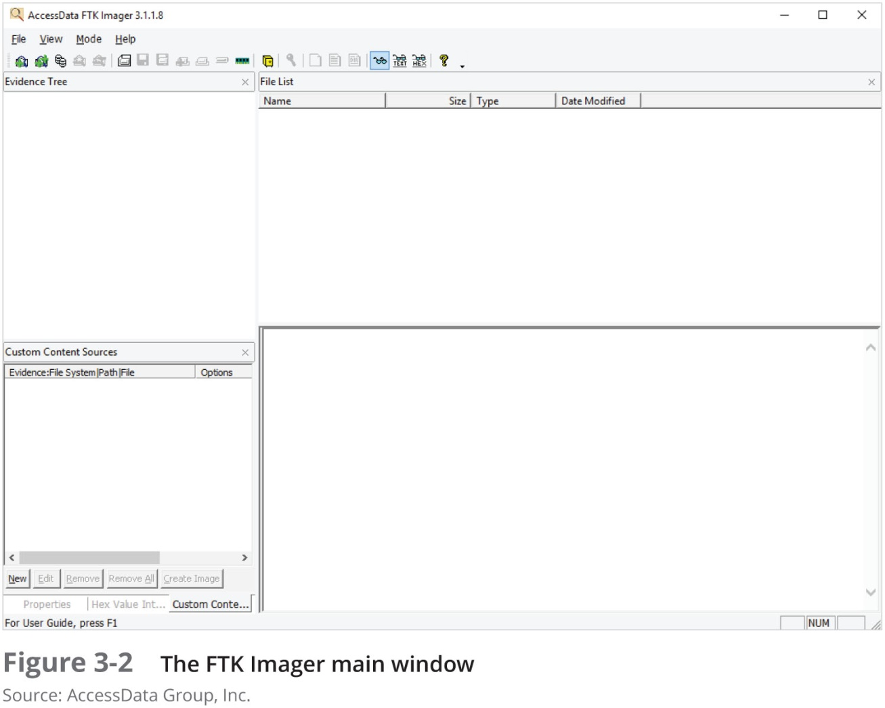
Capturing an Image with AccessData FTK Imager Lite (2 of 8)

Slide 27
Capturing an Image with AccessData FTK Imager Lite (3 of 8)
FTK Imager can’t acquire a drive’s host protected area
Use a write-blocking device and follow these steps
Boot to Windows
Connect evidence disk to a write-blocker
Connect target disk to write-blocker
Start FTK Imager Lite
Create Disk Image - use Physical Drive option
See Figures on the following slides for more steps

Slide 28
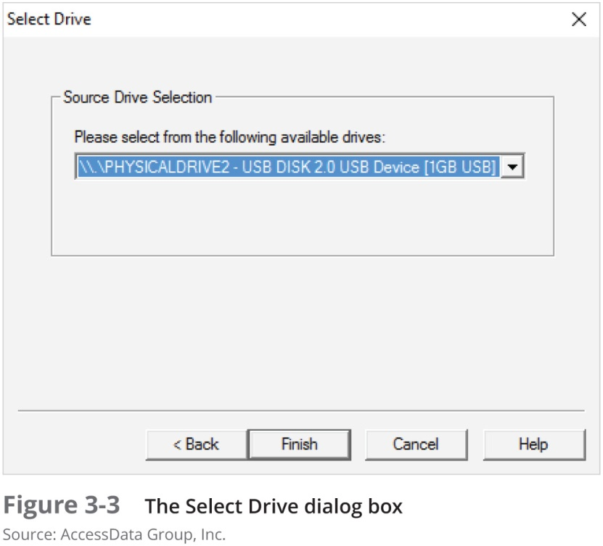
Capturing an Image with AccessData FTK Imager Lite (4 of 8)

Slide 29
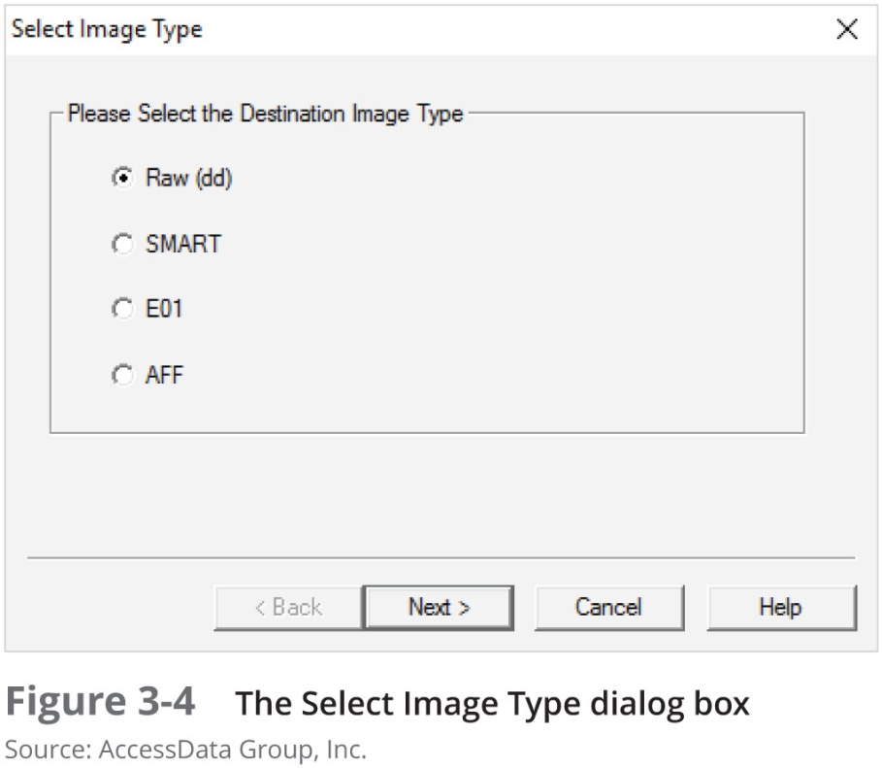
Capturing an Image with AccessData FTK Imager Lite (5 of 8)

Slide 30
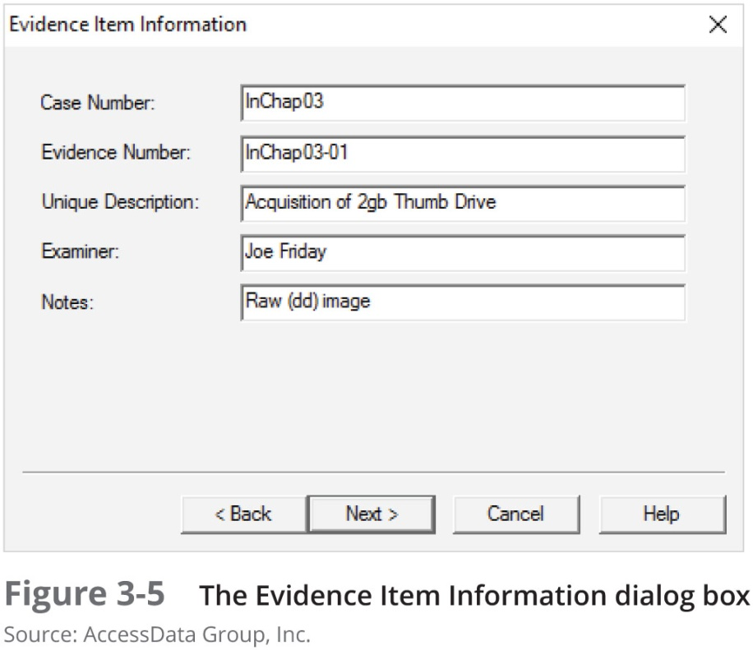
Capturing an Image with AccessData FTK Imager Lite (6 of 8)

Slide 31
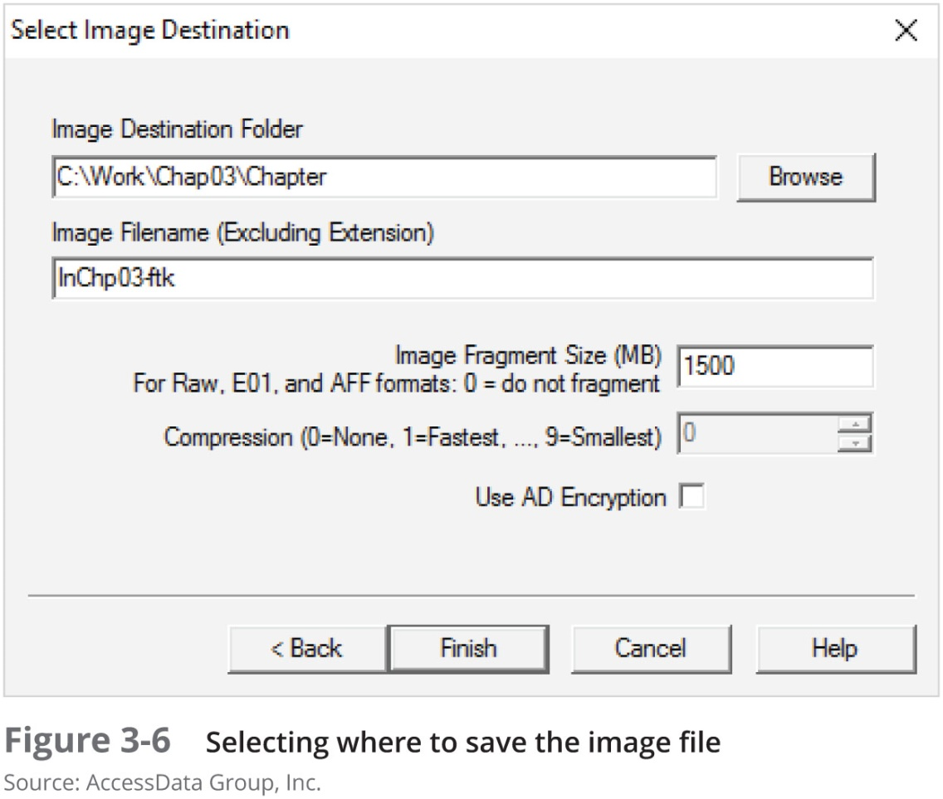
Capturing an Image with AccessData FTK Imager Lite (7 of 8)

Slide 32
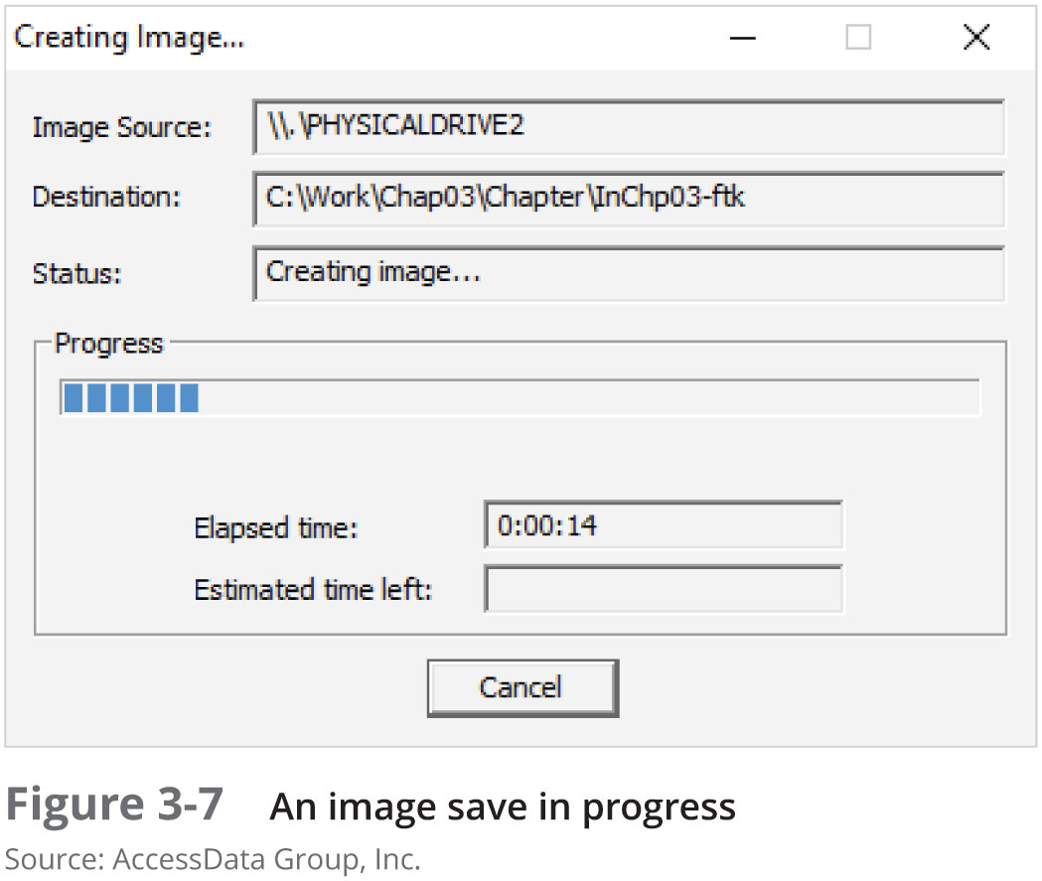
Capturing an Image with AccessData FTK Imager Lite (8 of 8)

Slide 33
Validating Data Acquisitions

Slide 34
Validating Data Acquisitions
Validating evidence may be the most critical aspect of computer forensics
Requires using a hashing algorithm utility
Validation techniques
CRC-32, MD5, and SHA-1 to SHA-512

Slide 35
Linux Validation Methods
Validating dd-acquired data
You can use md5sum or sha1sum utilities
md5sum or sha1sum utilities should be run on all suspect disks and volumes or segmented volumes
Command
md5sum /dev/sdb >md5_sdb.txt
cat image_sdb.* | md5sum >> md5_sdb_txt // for multiple segmented volumes
Page 122-123 see more commands
Validating dcfldd acquired data
Use the hash option to designate a hashing algorithm of md5, sha1, sha256, sha384, or sha512
hashlog option outputs hash results to a text file that can be stored with the image files
vf (verify file) option compares the image file to the original medium

Slide 36
Windows Validation Methods
Windows has no built-in hashing algorithm tools for computer forensics
Third-party utilities can be used
Commercial computer forensics programs also have built-in validation features
Each program has its own validation technique
Raw format image files don’t contain metadata
Separate manual validation is recommended for all raw acquisitions

Slide 37
Performing RAID Data Acquisitions
Acquisition of RAID drives can be challenging and frustrating because of how RAID systems are
Designed
Configured
Sized
Size is the biggest concern
Many RAID systems now have exabytes of data

Slide 38
Understanding RAID (1 of 7)
Redundant array of independent disks (RAID)
Computer configuration involving two or more disks
Originally developed as a data-redundancy measure
RAID 0
Provides rapid access and increased storage
Biggest disadvantage is lack of redundancy
RAID 1
Designed for data recovery
More expensive than RAID 0

Slide 39
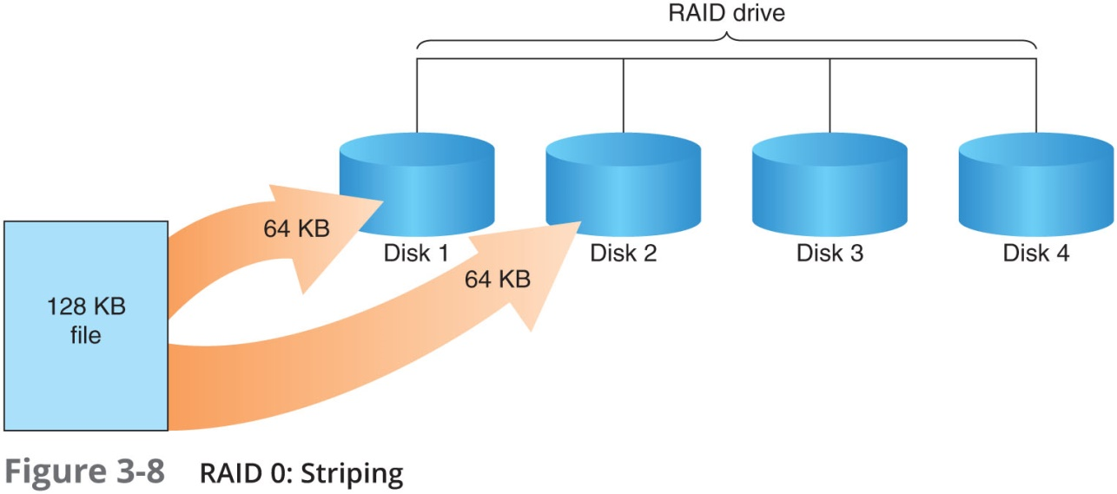
Understanding RAID (2 of 7)

Slide 40

Understanding RAID (2 of 6)

Slide 41
Understanding RAID (3 of 6)
RAID 2
Similar to RAID 1
Data is written to a disk on a bit level
Has better data integrity checking than RAID 0
Slower than RAID 0
RAID 3
Uses data stripping and dedicated parity
Requires at least three disks
RAID 4
Similar to RAID 3
Data is written in blocks

Slide 42
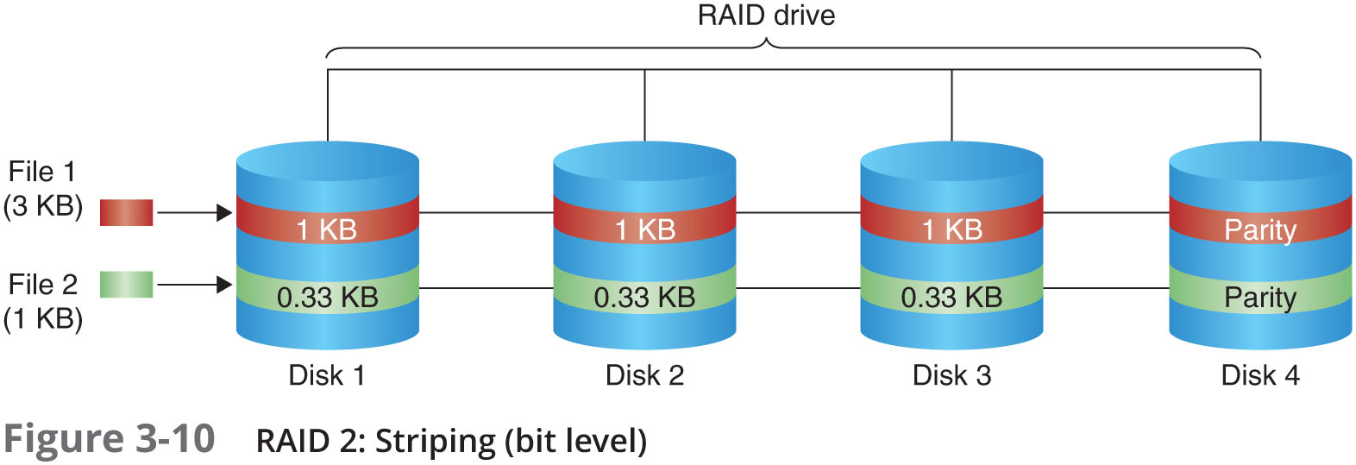
Understanding RAID (4 of 6)

Slide 43
Understanding RAID (5 of 6)
RAID 5
Similar to RAIDs 0 and 3
Places parity recovery data on each disk
RAID 6
Redundant parity on each disk
RAID 10 (1+0), or mirrored striping
Combination of RAID 1 and RAID 0
Provides fast access and redundancy
RAID 15 (1+5)
Combination of RAID 1 and RAID 5
More costly option

Slide 44
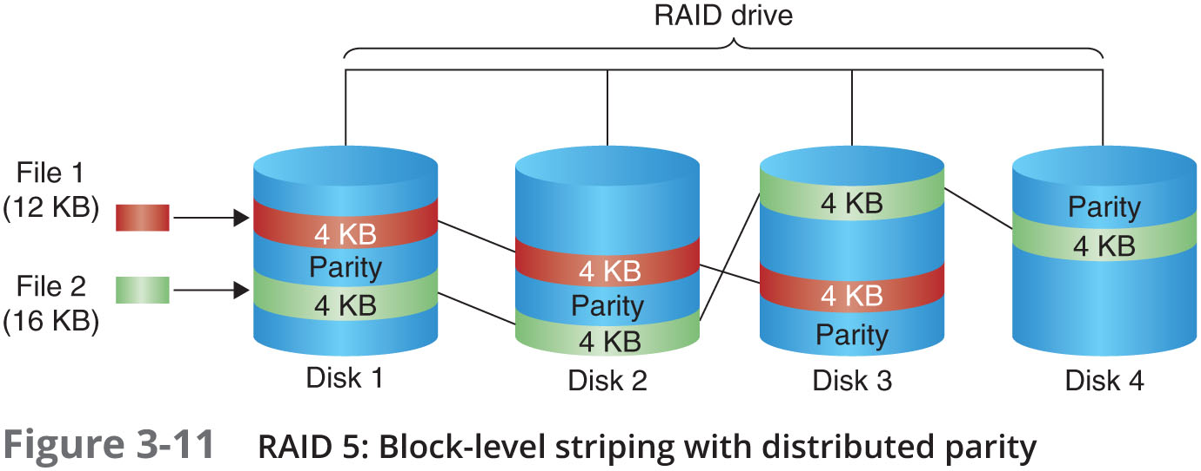
Understanding RAID (6 of 6)

Slide 45
Acquiring RAID Disks (1 of 2)
Address the following concerns:
How much data storage is needed?
What type of RAID is used?
Do you need to have all drives connected?
Do you have the right acquisition tool?
Can the tool read a forensically copied RAID image?
Can the tool read split data saves of each RAID disk?
Copying small RAID systems to one large disk is possible

Slide 46
Acquiring RAID Disks (2 of 2)
Vendors offering RAID acquisition functions
Guidance Software EnCase
X-Ways Forensics
AccessData FTK
Runtime Software
R-Tools Technologies
Occasionally, a RAID system is too large for a static acquisition
Retrieve only the data relevant to the investigation with the sparse or logical acquisition method

Slide 47
Using Remote Network Acquisition Tools
You can remotely connect to a suspect computer via a network connection and copy data from it
Remote acquisition tools vary in configurations and capabilities
Drawbacks
Antivirus, antispyware, and firewall tools can be configured to ignore remote access programs
Suspects could easily install their own security tools that trigger an alarm to notify them of remote access intrusions

Slide 48
Remote Acquisition with ProDiscover (1 of 3)
ProDiscover Incident Response functions:
Capture volatile system state information
Analyze current running processes
Locate unseen files and processes
Remotely view and listen to IP ports
Run hash comparisons
Create a hash inventory of all files remotely

Slide 49
Remote Acquisition with ProDiscover (2 of 3)
PDServer remote agent
ProDiscover utility for remote access
Needs to be loaded on the suspect
PDServer installation modes
Trusted CD
Preinstallation
Pushing out and running remotely
PDServer can run in a stealth mode
Can change process name to appear as OS function

Slide 50
Remote Acquisition with ProDiscover (3 of 3)
Remote connection security features
Password protection
Encryption
Secure communication protocol
Write-protected trusted binaries
Digital signatures

Slide 51
Remote Acquisition with EnCase Enterprise
Remote acquisition features
Search and collect internal and external network systems over a wide geographical area
Support multiple Oss and file systems
Triage to help determine system’s relevance to an investigation
Perform simultaneous searches of up to five systems at a time

Slide 52
Remote Acquisition with R-Tools R-Studio
R-Tools suite of software is designed for data recovery
Can remotely access networked computer systems
Creates raw format acquisitions
Supports various file systems

Slide 53
Remote Acquisition with WetStone US-LATT PRO
US-LATT PRO
Part of a suite of tools developed by WetStone
Can connect to a networked computer remotely and perform a live acquisition of all drives connected to it

Slide 54
Remote Acquisition with F-Response
F-Response
A vendor-neutral remote access utility
Designed to work with any digital forensics program
Sets up a security read-only connection
Allows forensics examiners to access it
Four different version of F-Response
Enterprise Edition, Consultant + Convert Edition, Consultant Edition, and TACTICAL Edition

Slide 55
Using Other Forensics-Acquisition Tools

Slide 56
Using Other Forensics-Acquisition Tools
Other commercial acquisition tools
PassMark Software ImageUSB
ASRData SMART
Runtime Software
ILookIX Investigator IXimager
SourceForge

Slide 57
PassMark Software ImageUSB
PassMark Software has an acquisition tool called ImageUSB for its OSForensics analysis product
To create a bootable flash drive, you need:
Windows XP or later
ImageUSB downloaded from the OSForensics Web site

Slide 58
ASR Data SMART
ASR Data SMART
A Linux forensics analysis tool that can make image files of a suspect drive
Can produce proprietary or raw format images
Capabilities:
Data reading of bad sectors
Can mount drives in write-protected mode
Can mount target drives in read/write mode
Compression schemes to speed up acquisition or reduce amount of storage needed

Slide 59
Runtime Software
Runtime Software offers shareware programs for data acquisition and recovery:
DiskExplorer for FAT and NTFS
Features:
Create a raw format image file
Segment the raw format or compressed image for archiving purposes
Access network computers’ drives

Slide 60
ILook Investigator IXimager
IXimager
Runs from a bootable floppy or CD
Designed to work only with ILookIX
Can acquire single drives and RAID drives
Supports:
IDE (PATA)
SCSI
USB
FireWire

Slide 61
SourceForge
SourceForge provides several applications for security, analysis, and investigations
For a list of current tools, see:
SourceForge-Tools
Windows version of dcfldd
SourceForge-dcfldd

Slide 62
Summary (1 of 3)
Forensics data acquisitions are stored in three different formats:
Raw, proprietary, and AFF
Data acquisition methods
Disk-to-image file
Disk-to-disk copy
Logical disk-to-disk or disk-to-data file
Sparse data copy

Slide 63
Summary (2 of 3)
Several tools available
Lossless compression is acceptable
Plan your digital evidence contingencies
Make a copy of each acquisition
Write-blocking devices or utilities must be used with GUI acquisition tools
Always validate acquisition
A Linux Live CD, such as SIFT, Kali Linux, or Deft, provides many useful tools for digital forensics acquisitions

Slide 64
Summary (3 of 3)
Preferred Linux acquisition tool is dcfldd (not dd)
Use a physical write-blocker device for acquisitions
To acquire RAID disks, determine the type of RAID
And then which acquisition tool to use
Remote network acquisition tools require installing a remote agent on the suspect computer

