Slide 1
Guide to Computer Forensics and Investigations Sixth Edition Chapter 7
Linux and Macintosh File Systems
Notes:
Guide to Computer Forensics and Investigations Sixth Edition
Chapter 7
Linux and Macintosh File Systems

Slide 2
Objectives
Describe Linux file structures
Describe Macintosh file structures
Use Linux forensics tools

Slide 3
Examining Linux File Structures (1 of 2)
UNIX distributions
Silicon Graphics, Inc. (SGI) IRIX, Santa Cruz Operation (SCO) UnixWare, Sun Solaris, IBM AIX, and HP-UX
Linux distributions
Ubuntu, CentOS, Mint, Fedora, and Gentoo
Linux is only the core of the OS
All UNIX-like OSs have a kernel
So do all Windows Oss
https://www.youtube.com/watch?v=jowCUo_UGts
https://www.quora.com/What-is-difference-between-UNIX-and-Linux
Must read

Slide 4
Examining Linux File Structures (2 of 2)
Remember that UNIX and Linux commands are case sensitive
Wrong capitalization can mean your commands are rejected as incorrect or interpreted as something different
Review some Linux commands by working through the activity on pages 310-312

Slide 5
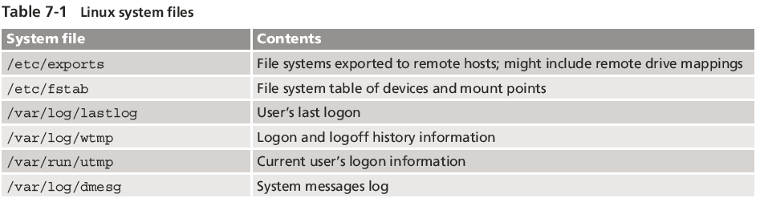
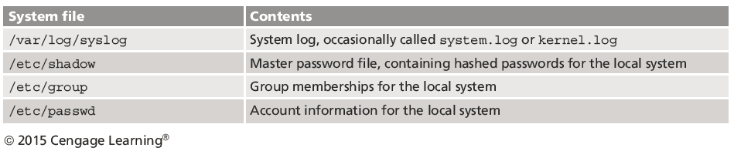
Examining Linux File Structures

Slide 6
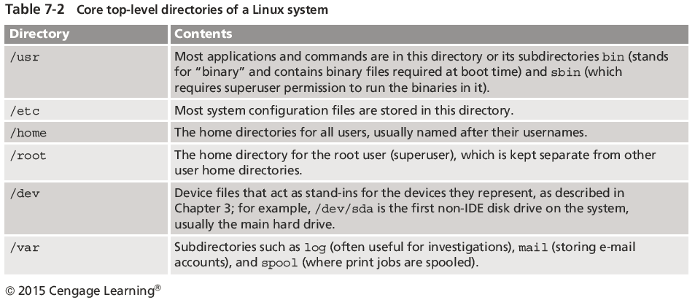
Examining Linux File Structures

Slide 7
File Structures in Ext4 (1 of 3)
The early file system standard was Second Extended File System (Ext2)
Third Extended File System (Ext3) replaced Ext2 in most Linux distributions
Fourth Extended File System (Ext4) added support for partitions larger than 16 TB
Improved management of large files and offered more flexibility
Adoption of Ext4 was slower in some Linux distributions
Now considered the standard file system for most distributions
The file systems supported by Linux are:
xfs, ramfs, nfs, vfat, cramfsm, ext3, ext4, ext2, ext1, ufs, autofs, devpts, ntfs.
all three FAT types, namely FAT12, FAT16 and FAT32.

Slide 8
File Structures in Ext4 (2 of 3)
Everything is a file
Files are objects with properties and methods
UNIX/Linux file system consists of four components
Boot block
Contains the bootstrap code
UNIX/Linux computer has only one boot block, located on the main hard disk

Slide 9
File Structures in Ext4 (3 of 3)
Superblock
Specifies disk geometry, available space, and keeps track of all inodes
Manages the file system
Inode blocks
First data after the superblock
Assigned to every file allocation unit
Data blocks
Where directories and files are stored on a disk drive
This location is linked directly to inodes

Slide 10
Inodes (1 of 5)
Contain file and directory metadata
Also link data stored in data blocks
An assigned inode contains the following:
Mode and type of file or directory
Number of links to a file or directory
UID and GID of the file’s or directory’s owner
Number of bytes in the file or directory
File’s or directory’s last access time and last modified time

Slide 11
Inodes (2 of 5)
An assigned inode contains the following (cont’d):
Inode’s last file status change time
Block address for the file data
Indirect, double-indirect, and triple-indirect block addresses for the file data
Current usage status of the inode
Number of actual blocks assigned to a file
File generation number of version number
Continuation inode’s link

Slide 12
Inodes (3 of 5)
First inode has 13 pointers
Pointers 1 to 10 are direct pointers to data storage blocks
Pointer 11 is an indirect pointer
Links to 128 pointer inodes and each pointer links directly to 128 blocks
Pointer 12 is a double-indirect pointer
Pointer 13 is a triple-indirect pointer

Slide 13
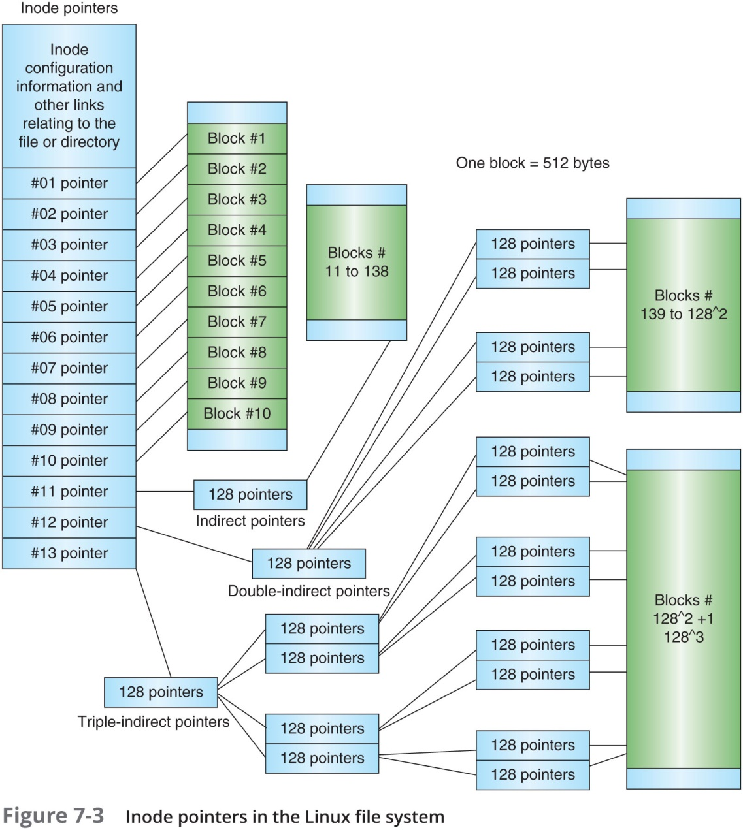
Inodes (4 of 5)

Slide 14
Inodes (5 of 5)
Bad block inode
Keeps track of disk’s bad sectors
To find bad blocks on a Linux computer, use the following commands
badblocks - must log in as root to use
mke2fs and e2fsck - include safeguards that prevent them from overwriting important information

Slide 15
Hard Links and Symbolic Links (1 of 6)
Hard link
A pointer that allows accessing the same file by different filenames
Must point to the same innode in the same physical drive
Use the ln command to create a hard link

Slide 16
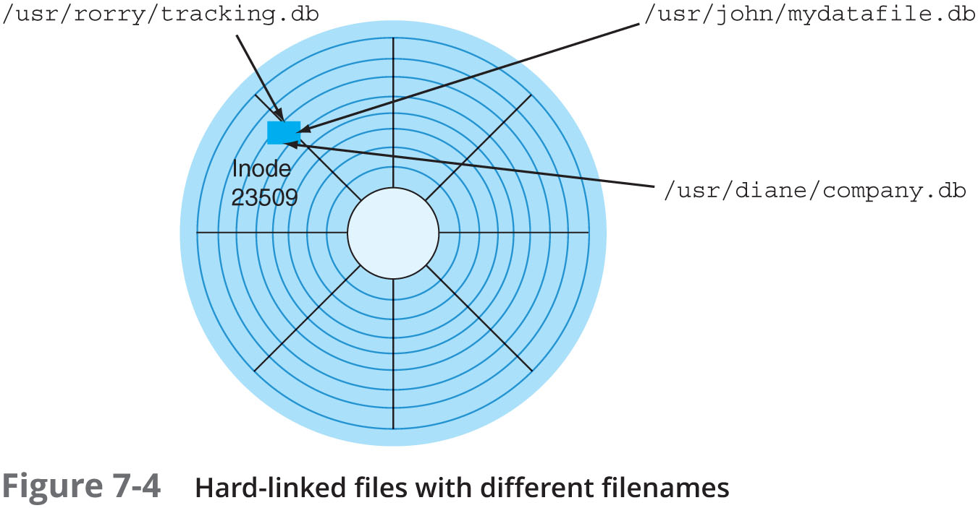
Hard Links and Symbolic Links (2 of 6)

Slide 17
Hard Links and Symbolic Links (3 of 6)
Link count
A field inside each inode that specifies the number of hard links
Increase by 1 if a new hard link is created , same innode
=0 , then file will be deleted
Can be recovered by forensic tools
Try command ls –al to see the link count
ls –i to show innode number
Directory has two links
Current directory
Parent directory

Slide 18
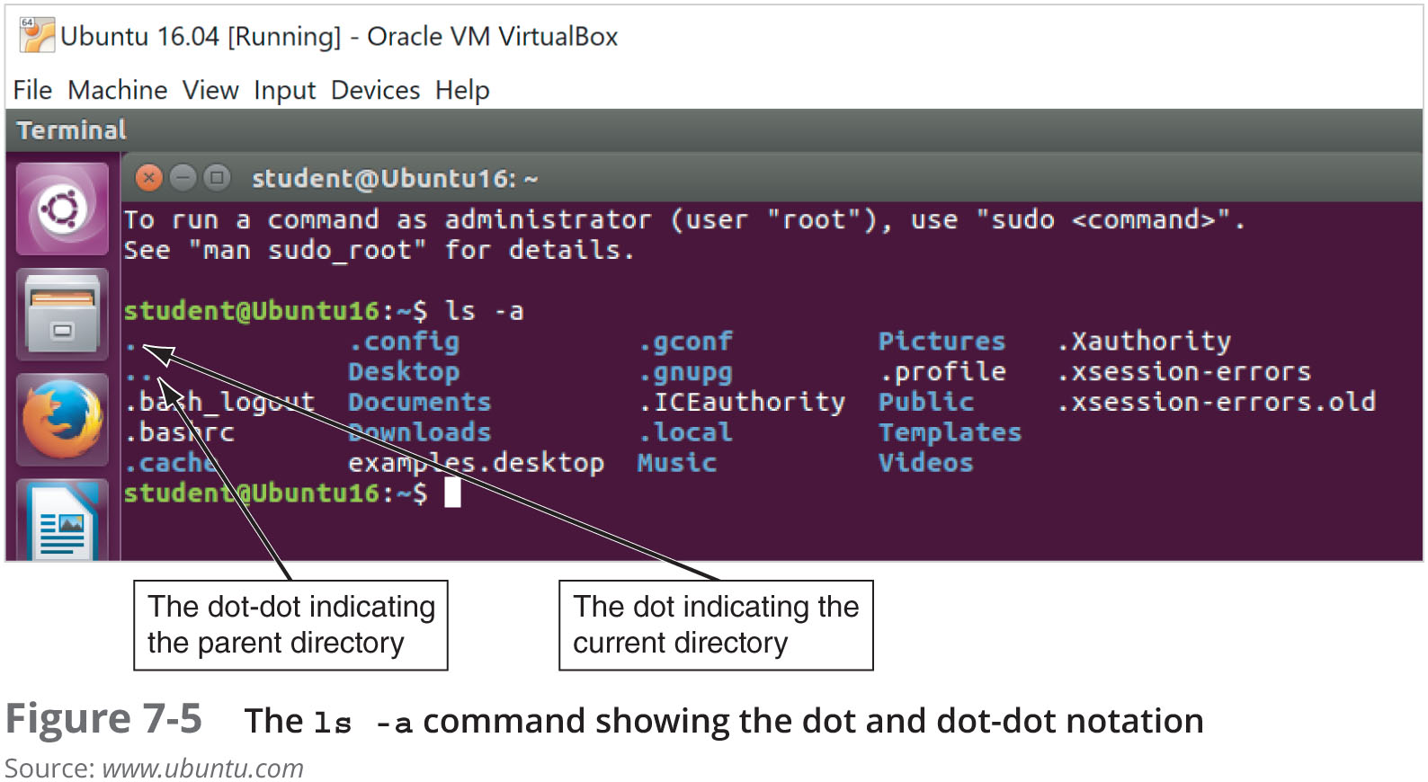
Hard Links and Symbolic Links (4 of 6)

Slide 19
Hard Links and Symbolic Links (5 of 6)
Symbolic links
Pointers to other files and aren’t included in the link count
Also known as “soft links” or “symlinks”
Can point to items on other drives or other parts of the network
Need absolute path
Have an inode of their own
Not the same as the inode of the item they are pointing to
Depend on the existence of the destination they are pointing to

Slide 20
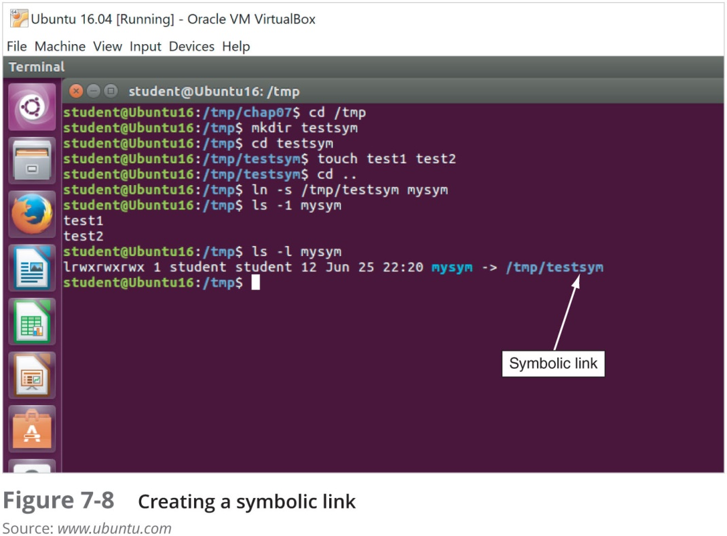
Hard Links and Symbolic Links (6 of 6)

Slide 21
Understanding Macintosh File Structures (1 of 2)
Mac OS X version 10.13
Code-named High Sierra
Current version
Offers better security, encryption, and performance speeds
With OS X, Macintosh moved to the Intel processor and become UNIX based

Slide 22
Understanding Macintosh File Structures (2 of 2)
Before OS X, Hierarchical File System (HFS)
Files stored in nested directories (folders)
Developed more than 30+ agos
Extended Format File System (HFS+)
Introduced with Mac OS 8.1
Supports smaller file sizes on larger volumes, resulting in more efficient disk use
Apple File System (APFS)
Introduced in macOS High Sierra
When data is written to a device, metadata is also copied to help with crash protection
One file system for all APPLE devices
Optimized for Apple devices

Slide 23
An Overview of Mac File Structures (1 of 7)
In Mac, a file consists of two parts:
Data fork and resource fork
Stores file metadata and application information
The data fork typically contains data the user creates, such as text or spreadsheets
Applications also read and write to the data fork
Resource block contains additional information
Such as menus and dialog boxes
E.g., a word process file store text in Data fork and image in resource fork
A volume is any storage medium used to store files
It can be all or part of the storage media for hard disks

Slide 24
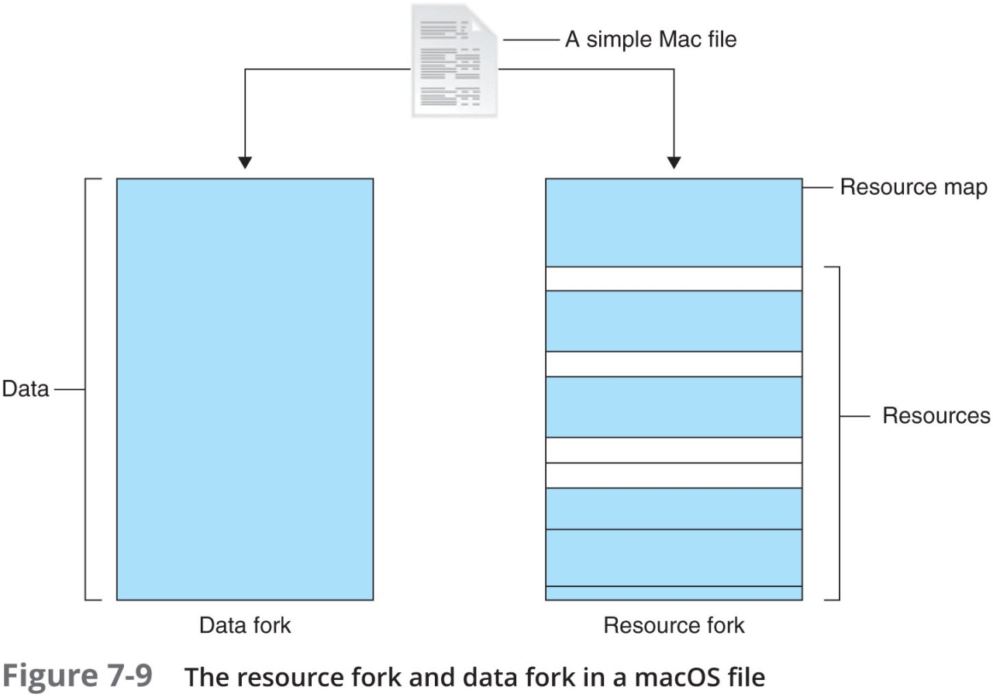
An Overview of Mac File Structures (2 of 7)

Slide 25
An Overview of Mac File Structures (3 of 7)
Volumes have allocation and logical blocks
Logical blocks cannot exceed 512 bytes
Allocation blocks are a set of consecutive logical blocks
Two end of file (EOF) descriptors
Logical EOF
Actual ending of the file
Physical EOF
The number of bytes allotted on the volume for a file

Slide 26
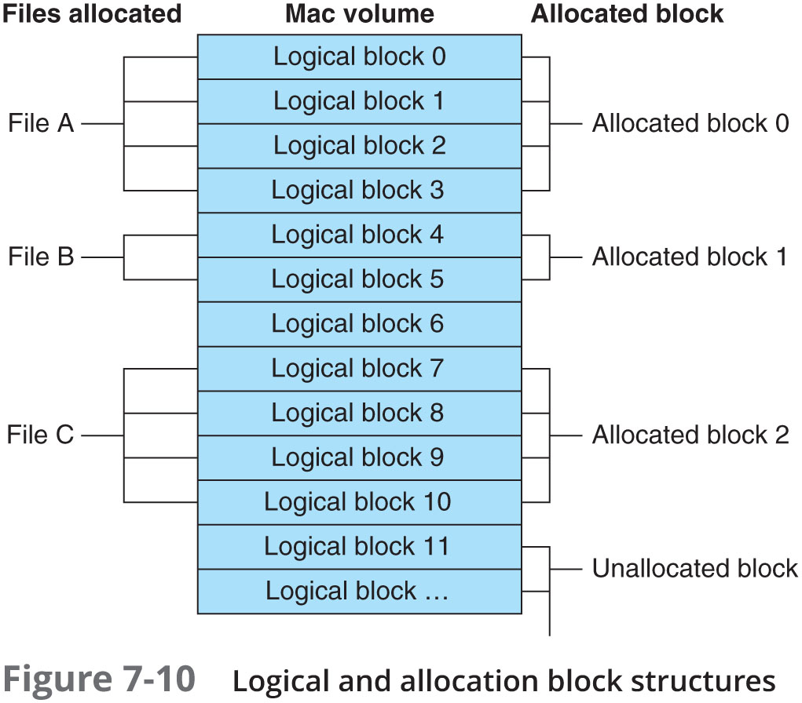
An Overview of Mac File Structures (4 of 7)

Slide 27
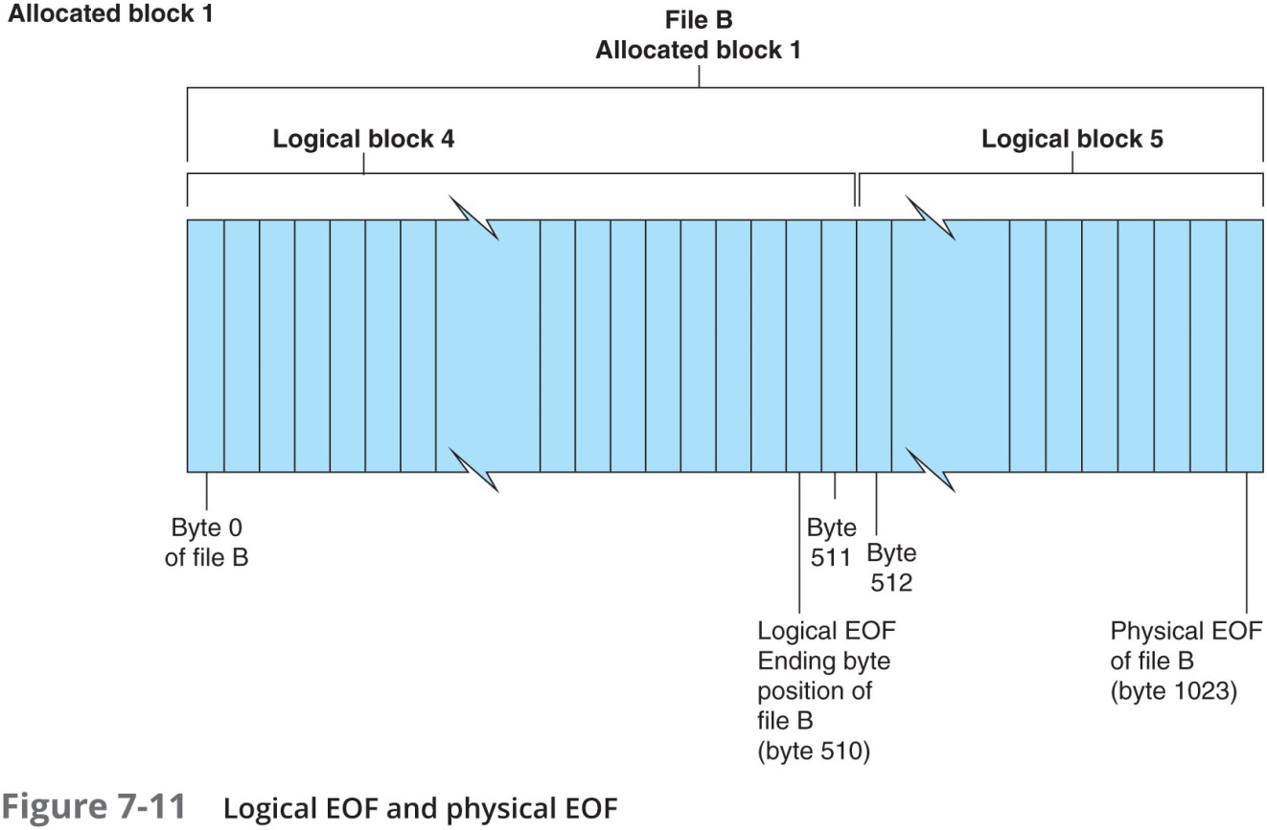
An Overview of Mac File Structures (5 of 7)

Slide 28
An Overview of Mac File Structures (6 of 7)
Clumps
Groups of contiguous allocation blocks
Reduce fragmentation
Older Macintosh OSs use
First two logical blocks, 0 and 1, as boot blocks
Master Directory Block (MDB) or Volume Information Block (VIB)
Stores all information about a volume
Volume Control Block (VCB)
Stores information from the MDB when OS mounts
Extents overflow file
Stores any file information not in the MDB or a VCB

Slide 29
An Overview of Mac File Structures (7 of 7)
Catalog
The listing of all files and directories on the volume
Maintains relationships between files and directories
B*-tree file system in earlier Mac version
Actual file data is stored on the leaf nodes
B*-tree also uses header, index, and map nodes

Slide 30
Forensics Procedures in Mac (1 of 6)
There are some differences between Linux and macOS file systems
Linux has the /home/username and /root directories
In macOS, the folders are /users/username and /private/var/root
The /home directory exists in the macOS but it is empty
macOS users have limited access to other user accounts’ files and the guest account is disabled

Slide 31
Forensics Procedures in Mac (2 of 6)
For forensics procedures in macOS:
You must know where file system components are located and how both files and file components are stored
Application settings are in three formats:
Plaintext, plist files, and the SQLite database
Plist files are preference files for installed applications on a system
FileVault is used to encrypt and decrypt a user’s /users directory

Slide 32
Forensics Procedures in Mac (3 of 6)
Keychains
Files used to manage passwords for applications, Web sites, and other system files
The Mac application Keychain Access enables you to restore passwords
Deleted files are in the Trashes folder
If a file is deleted at the command line, however, it doesn’t show up in the trash

Slide 33
Forensics Procedures in Mac (4 of 6)
Acquisition Methods in macOS
Make an image of the drive
Removing the drive from a Mac Mini case is difficult
Attempting to do so without Apple factory training could damage the computer
Also difficult for MacBook Air (need special screwdrivers)
Use a macOS-compatible forensic boot CD/DVD to make an image

Slide 34
Forensics Procedures in Mac (5 of 6)
Acquisition Methods in macOS (cont’d)
BlackBag Technologies sells acquisition products specifically designed for OS 9 and OS X
MacQuisition is a forensic boot CD that makes an image of a Mac drive
After making an acquisition, examine the image of the file system
The tool you use depends on the image file format

Slide 35
Forensics Procedures in Mac (6 of 6)
Acquisition Methods in macOS (cont’d)
Tools for working with a raw format image
BlackBag Technologies Macintosh Forensic Software
SubRosaSoft MacForensicsLab
Guidance Software EnCase
Recon Mac OS X Forensics with Palladin
X-Ways Forensics
AccessData FTK
First two tools can disable/enable Disk Arbitration
Being able to turn off the mount function in macOS
Allows you to connect a suspect drive to a Mac without a write-blocking device

Slide 36
Using Linux Forensics Tools
Most commercial computer forensics tools can analyze Linux Ext2, Ext3, Ext4, ReiserFS, and Reiser4 file systems
Freeware tools include Sleuth Kit and its Web browser interface, Autopsy Forensic Browser
Foremost
A freeware carving tool that can read many image file formats
Configuration file: foremost.conf
Tarball
A data file containing one or more files or whole directories and their contents

Slide 37
Installing Sleuth Kit and Autopsy (1 of 3)
Download the most current source code from www.sleuthkit.org
To run Sleuth Kit and Autopsy Browser, you need to have root privileges

Slide 38
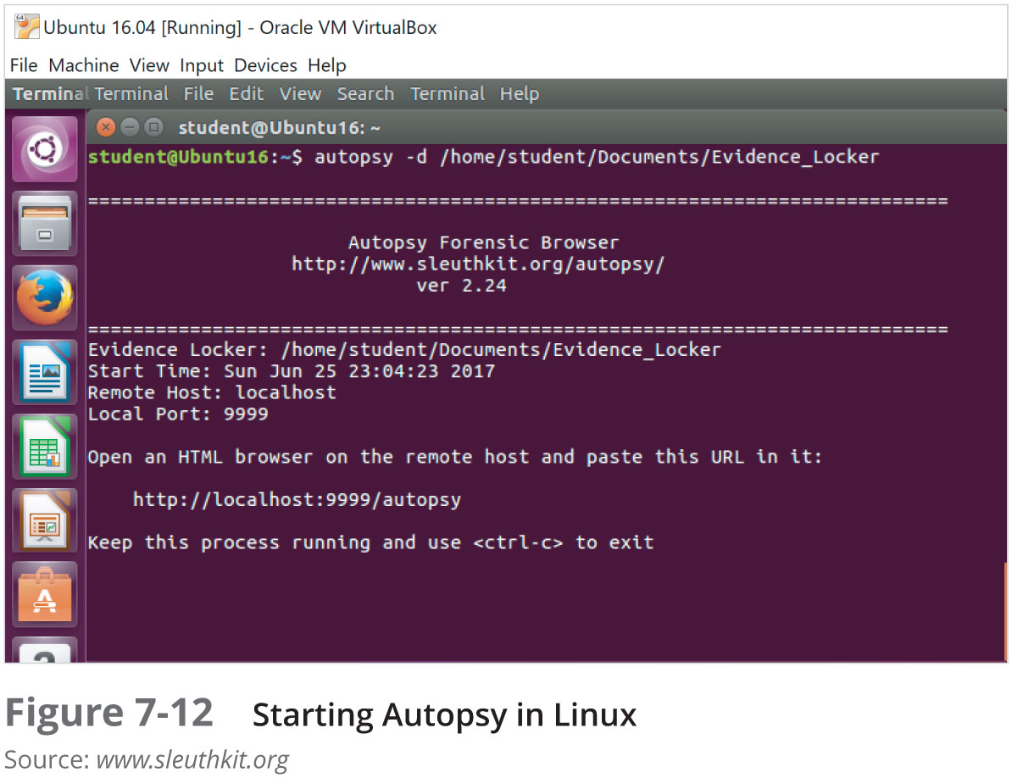
Installing Sleuth Kit and Autopsy (2 of 3)

Slide 39
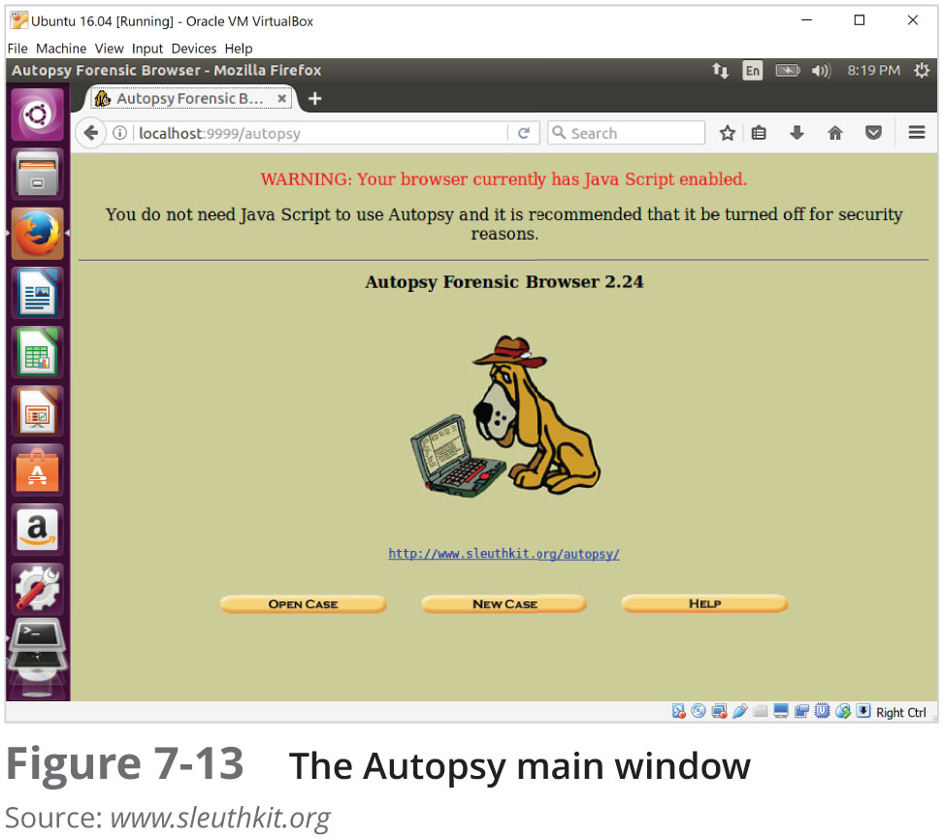
Installing Sleuth Kit and Autopsy (3 of 3)

Slide 40
Examining a Case with Sleuth Kit and Autopsy (1 of 3)
Follow instructions to use Sleuth Kit and Autopsy Browser to examine an older Linux file system
See Figures 7-14 and 7-15

Slide 41
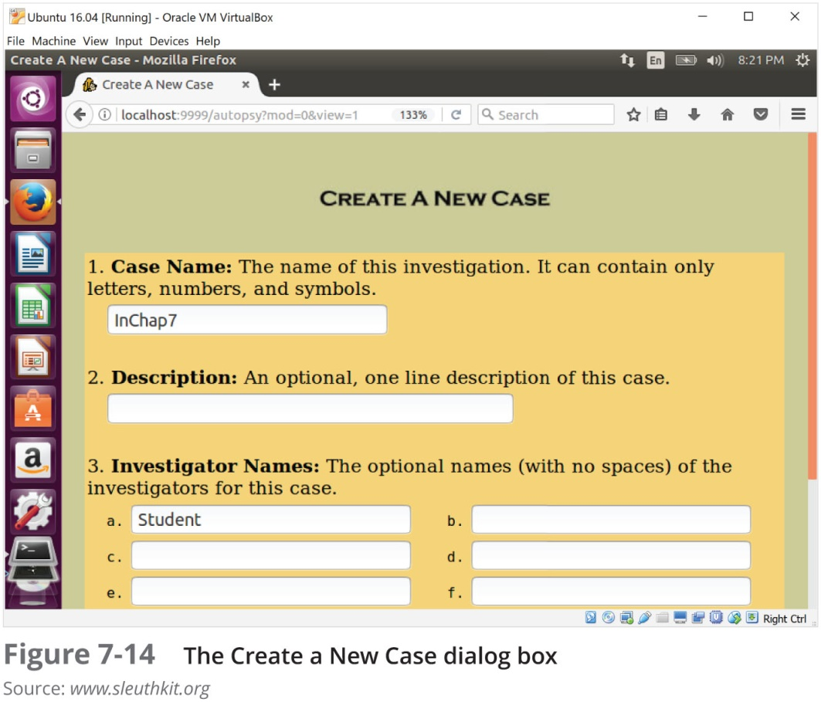
Examining a Case with Sleuth Kit and Autopsy (2 of 3)

Slide 42
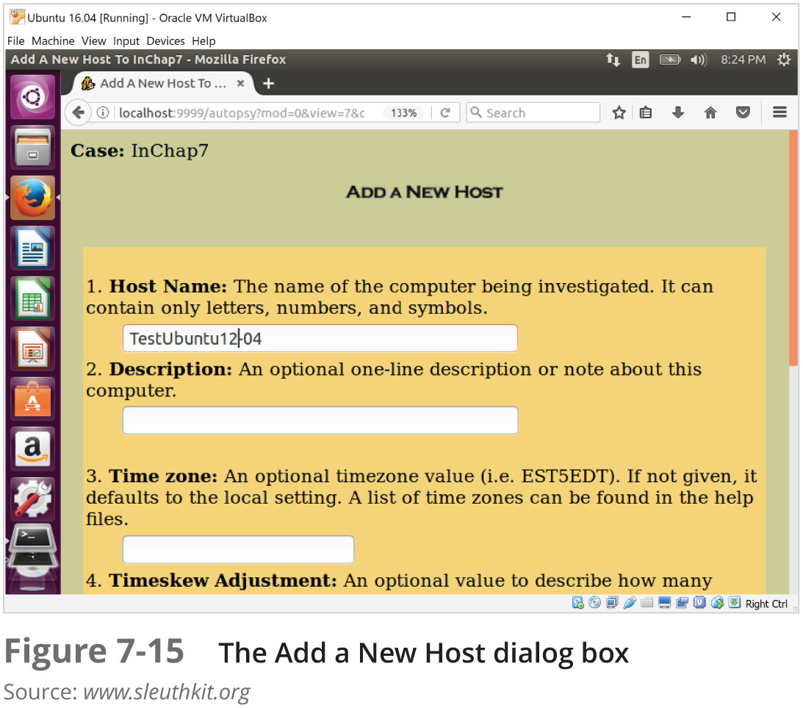
Examining a Case with Sleuth Kit and Autopsy (3 of 3)

Slide 43
Summary (1 of 3)
UNIX was created to be a multiuser, multithreaded, secure OS
The Linux kernel is usually packaged with other software components, such as a GUI and applications
Linux supports a wide range of file systems
UNIX and Linux have four components defining the file system: boot block, superblock, inode block, and data block

Slide 44
Summary (2 of 3)
In the Linux file system, a hard link is a pointer that allows accessing the same file by different filenames
Before macOS, the file systems HFS and HFS+ were used
In older version of macOS, a file consists of two parts: a data fork and a resource fork
A volume is any storage medium used to store files

Slide 45
Summary (3 of 3)
Plist files are preference files for installed applications on a macOS system
In macOS, unified logging has been added for recording log files and includes new utilities to help forensics examiners
The biggest challenge in acquiring images from macOS systems is often physical access to the drive
Linux forensic tools are often freeware

