Slide 1
Guide to Computer Forensics and Investigations Sixth Edition Chapter 9
Digital Forensics Analysis and Investigation
Notes:
Guide to Computer Forensics and Investigations Sixth Edition
Chapter 9
Digital Forensics Analysis and Investigation

Slide 2
Objectives
Determine what data to analyze in a digital forensics investigation
Explain tools used to validate data
Explain common data-hiding techniques

Slide 3
Determining What Data to Collect and Analyze (1 of 2)
Examining and analyzing digital evidence depend on the nature of the investigation
And the amount of data to process
Scope creep - when an investigation expands beyond the original description
Because of unexpected evidence found
Attorneys may ask investigators to examine other areas to recover more evidence
Increases the time and resources needed to extract, analyze, and present evidence

Slide 4
Determining What Data to Collect and Analyze (2 of 2)
Scope creep has become more common
Criminal investigations require more detailed examination of evidence just before trial
To help prosecutors fend off attacks from defense attorneys
New evidence often isn’t revealed to prosecution
It’s become more important for prosecution teams to ensure they have analyzed the evidence exhaustively before trial

Slide 5
Approaching Digital Forensics Cases (1 of 4)
Begin a case by creating an investigation plan that defines the:
Goal and scope of investigation
Materials needed
Tasks to perform
The approach you take depends largely on the type of case you’re investigating
Corporate, civil, or criminal

Slide 6
Approaching Digital Forensics Cases (2 of 4)
Follow these basic steps for all digital forensics investigations:
1. For target drives, use recently wiped media that have been reformatted and inspected for viruses
2. Inventory the hardware on the suspect’s computer, and note condition of seized computer
3. For static acquisitions, remove original drive and check the date and time values in system’s CMOS
4. Record how you acquired data from the suspect drive

Slide 7
Approaching Digital Forensics Cases (3 of 4)
Follow these basic steps for all digital forensics investigations (cont’d):
5. Process drive’s contents methodically and logically
6. List all folders and files on the image or drive
7. Examine contents of all data files in all folders
8. Recover file contents for all password-protected files
9. Identify function of every executable file that doesn’t match hash values
10. Maintain control of all evidence and findings

Slide 8
Approaching Digital Forensics Cases (4 of 4)
Refining and Modifying the Investigation Plan
Even if initial plan is sound, at times you may need to deviate from it and follow evidence
Knowing the types of data to look for helps you make the best use of your time
The key is to start with a plan but remain flexible in the face of new evidence

Slide 9
Using Autopsy to Analyze Data (1 of 6)
Autopsy can perform forensics analysis on the following file systems:
Microsoft FAT, NTFS, ExFAT, UFS1, and UFS2
ISO 9660 and YAFFS2
Mac HFS+ and HFSX
Linux Ext2fs, Ext3fs, and Ext4fs
Autopsy can analyze data from several sources
Including image files from other vendors

Slide 10
Using Autopsy to Analyze Data (2 of 6)
Autopsy can handle many formats, including:
Raw, Expert Witness, and virtual machine image files (.vdi and .vhd)
Has an indexed version of the NIST National Software Reference Library (NSRL) of MD5 hashes
Installing NSRL Hashes in Autopsy
Need to download the latest version

Slide 11
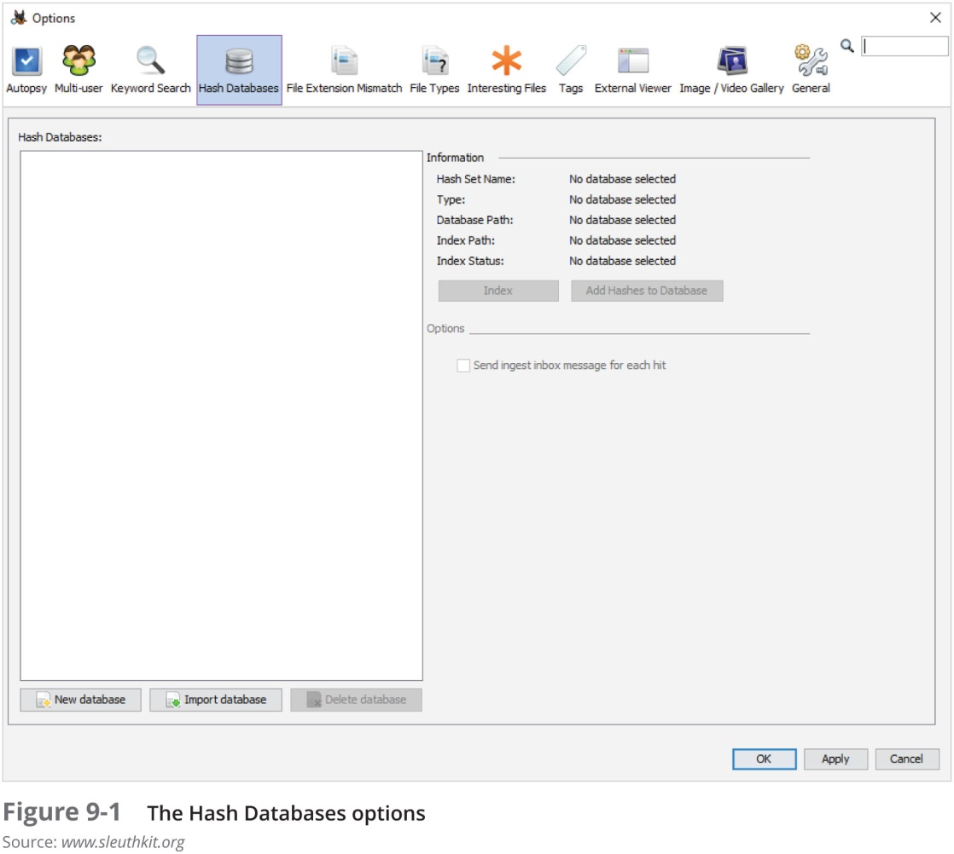
Using Autopsy to Analyze Data (3 of 6)

Slide 12
Using Autopsy to Analyze Data (4 of 6)
Collecting Hash Values in Autopsy
Create a hash database of known files of interest

Slide 13
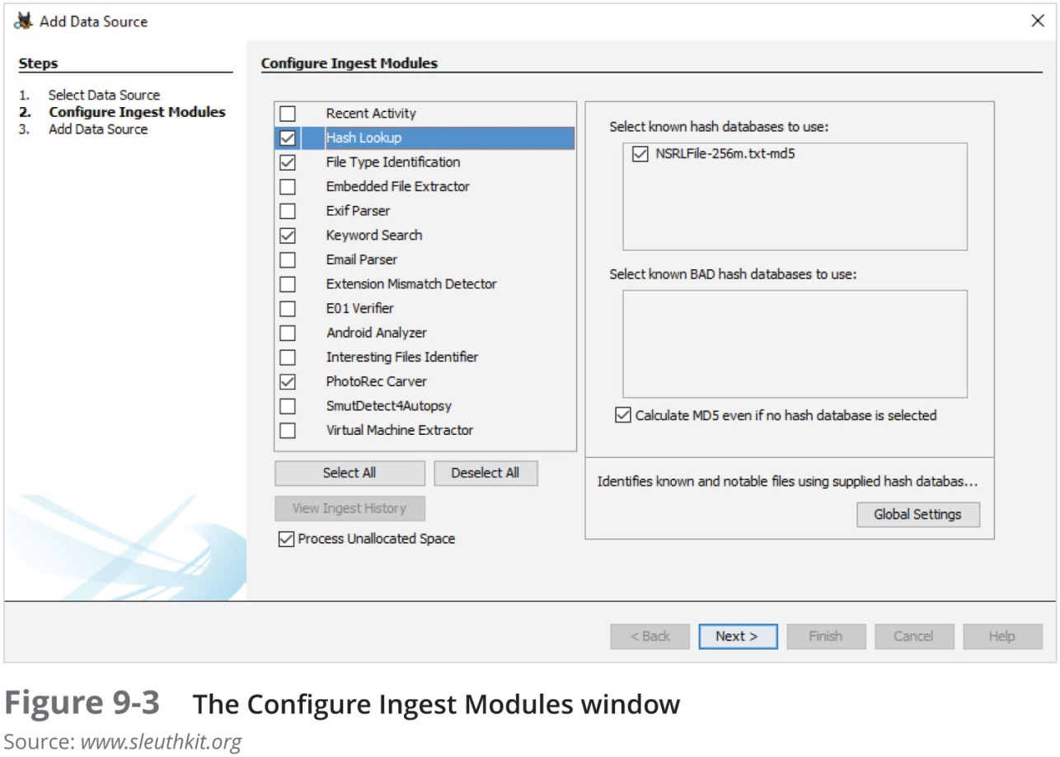
Using Autopsy to Analyze Data (5 of 6)

Slide 14
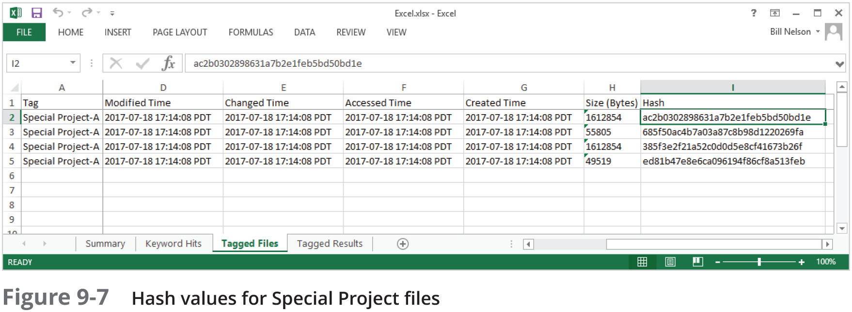
Using Autopsy to Analyze Data (6 of 6)

Slide 15
Validating Forensic Data
Ensuring the integrity of data collected is essential for presenting evidence in court
Most forensic tools offer hashing of image files
Using advanced hexadecimal editors ensures data integrity

Slide 16
Validating with Hexadecimal Editors (1 of 6)
Advanced hexadecimal editors offer features not available in digital forensics tools, such as:
Hashing specific files or sectors
With the hash value in hand
You can use a forensics tool to search for a suspicious file that might have had its name changed to look like an innocuous file
WinHex provides MD5 and SHA-1 hashing algorithms

Slide 17
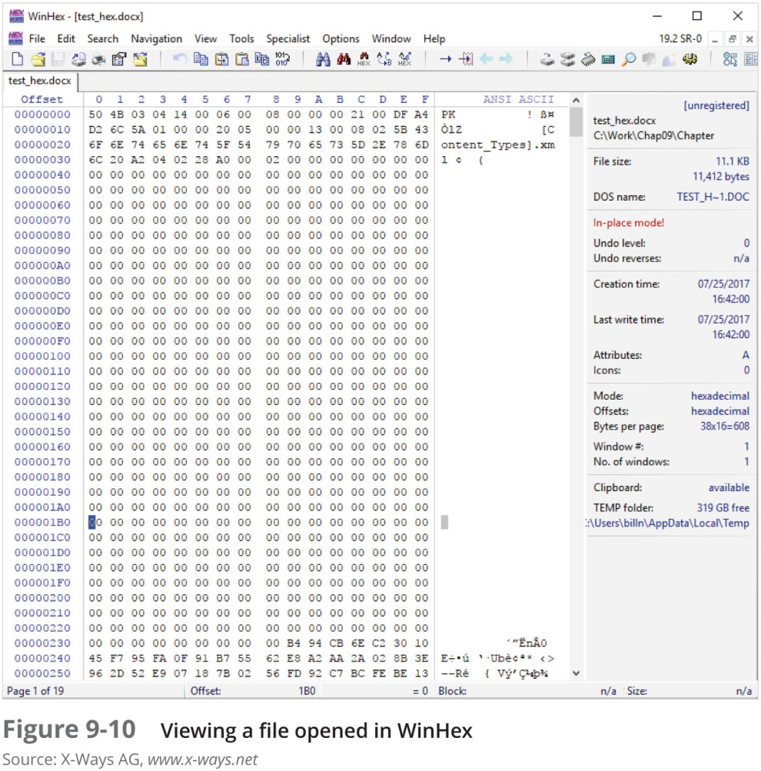
Validating with Hexadecimal Editors (2 of 6)

Slide 18
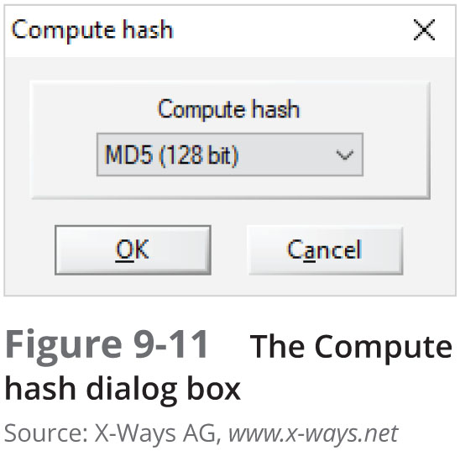
Validating with Hexadecimal Editors (3 of 6)

Slide 19
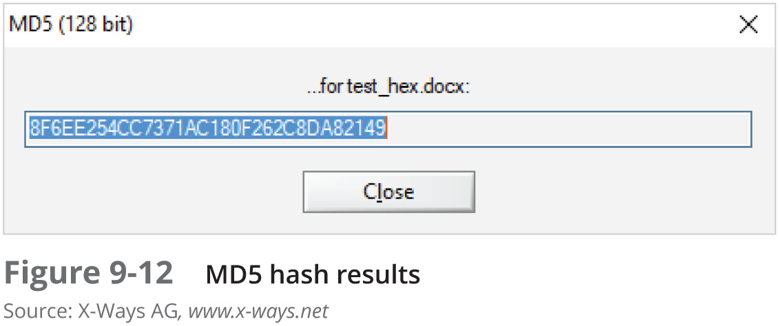
Validating with Hexadecimal Editors (4 of 6)

Slide 20
Validating with Hexadecimal Editors (5 of 6)
Advantage of recording hash values
You can determine whether data has changed
Block-wise hashing
A process that builds a data set of hashes of sectors from the original file
Then examines sectors on the suspect’s drive to see whether any other sectors match
If an identical hash value is found, you have confirmed that the file was stored on the suspect’s drive

Slide 21
Validating with Hexadecimal Editors (6 of 6)
Using Hash Values to Discriminate Data
AccessData has its own hashing database, Known File Filter (KFF)
KFF filters known program files from view and contains has values of known illegal files
It compares known file hash values with files on your evidence drive to see whether they contain suspicious data
Other digital forensics tools can import the NSRL database and run hash comparisons

Slide 22
Validating with Digital Forensics Tools (1 of 3)
In AccessData FTK Imager, when selecting the Expert Witness (.e01) or SMART (.s01) format:
Additional options for hashing all the data are available
Validation report lists MD5 and SHA-1 hash values
Follow steps starting on page 393 to see how to use WinHex to hash an image file and then compare it with the original hash value FTK Imager calculated

Slide 23
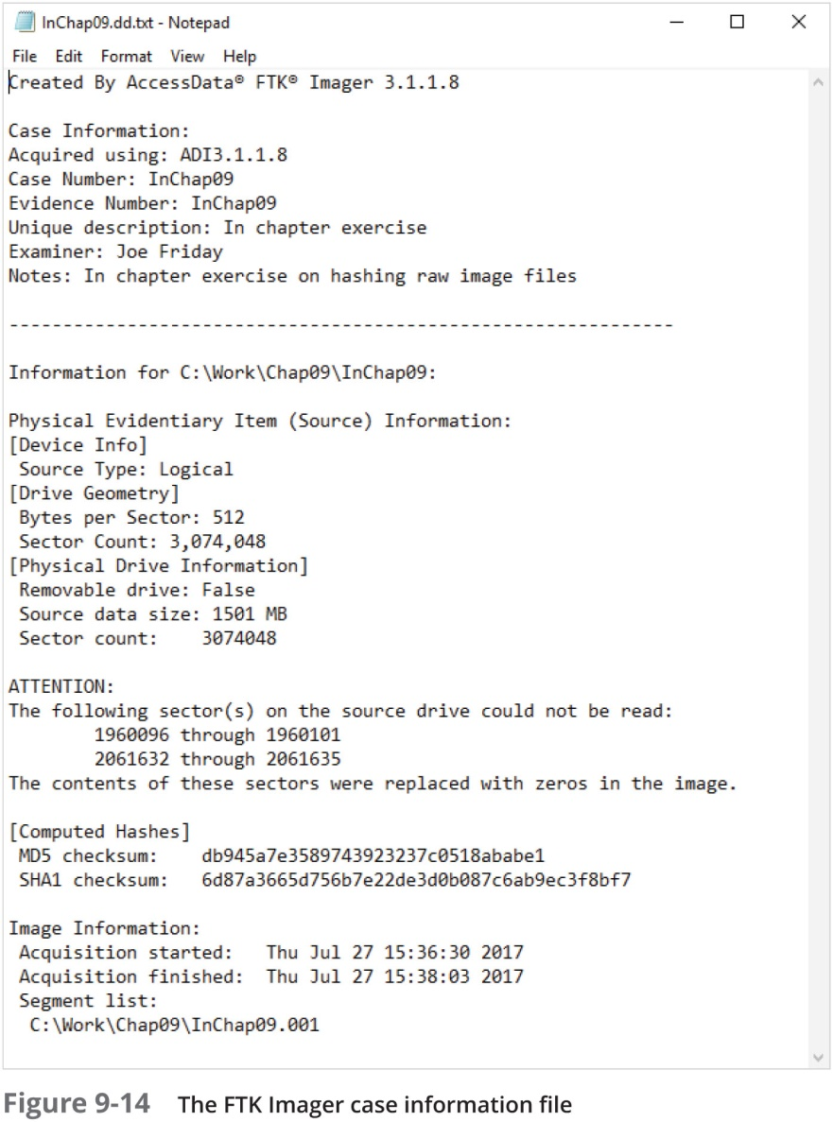
Validating with Digital Forensics Tools (2 of 3)

Slide 24
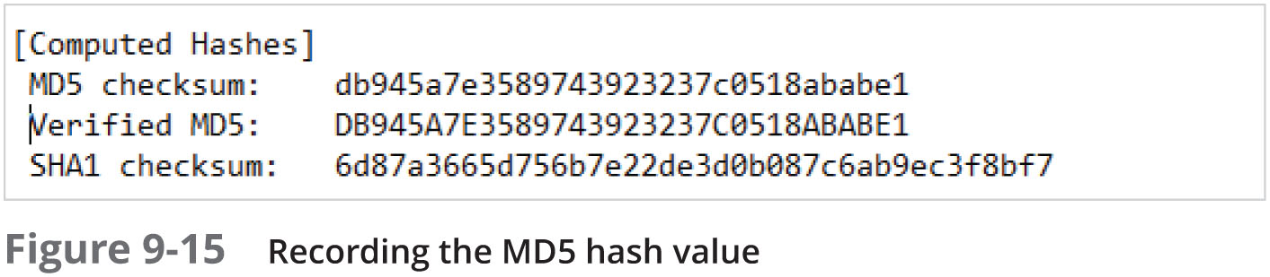
Validating with Digital Forensics Tools (3 of 3)

Slide 25
Addressing Data-Hiding Techniques
Data hiding - changing or manipulating a file to conceal information
Techniques:
Hiding entire partitions
Changing file extensions
Setting file attributes to hidden
Bit-shifting
Using encryption
Setting up password protection

Slide 26
Hiding Files by Using the OS
One of the first techniques to hide data:
Changing file extensions
Advanced digital forensics tools check file headers
Compare the file extension to verify that it’s correct
If there’s a discrepancy, the tool flags the file as a possible altered file
Another hiding technique
Selecting the Hidden attribute in a file’s Properties dialog box

Slide 27
Hiding Partitions (1 of 4)
By using the Windows diskpart remove letter command
You can unassign the partition’s letter, which hides it from view in File Explorer
To unhide, use the diskpart assign letter command
Other disk management tools:
IM-Magic, EaseUS Partition Master, and Linux Grand Unified Bootloader (GRUB)

Slide 28
Hiding Partitions (2 of 4)
To detect whether a partition has been hidden
Account for all disk space when examining an evidence drive
Analyze any disk areas containing space you can’t account for
Many digital forensics tools can detect and view a hidden partition

Slide 29
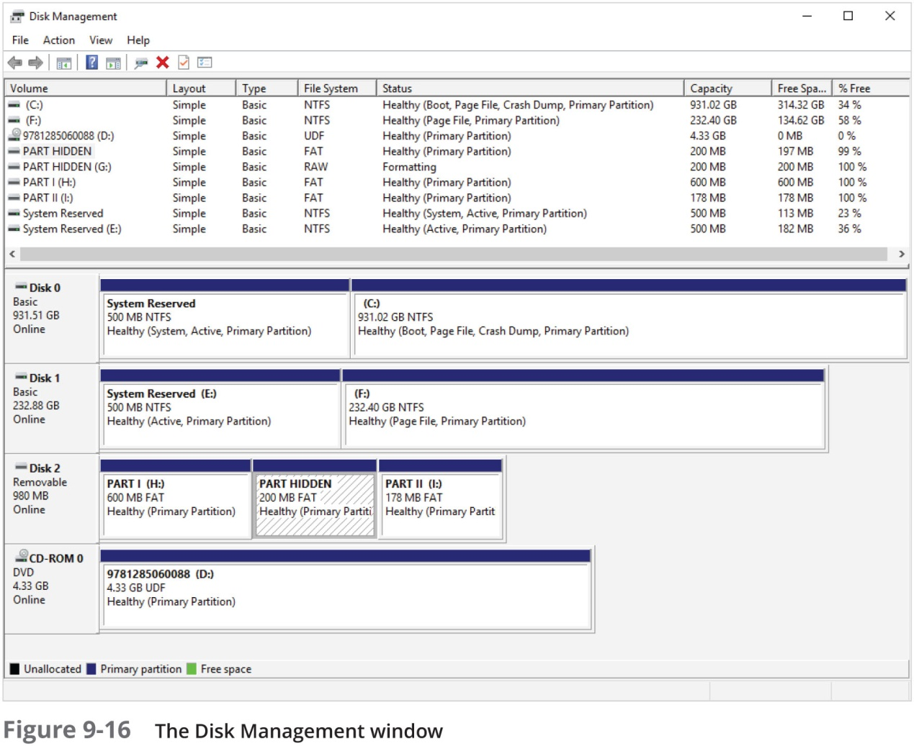
Hiding Partitions (3 of 4)

Slide 30
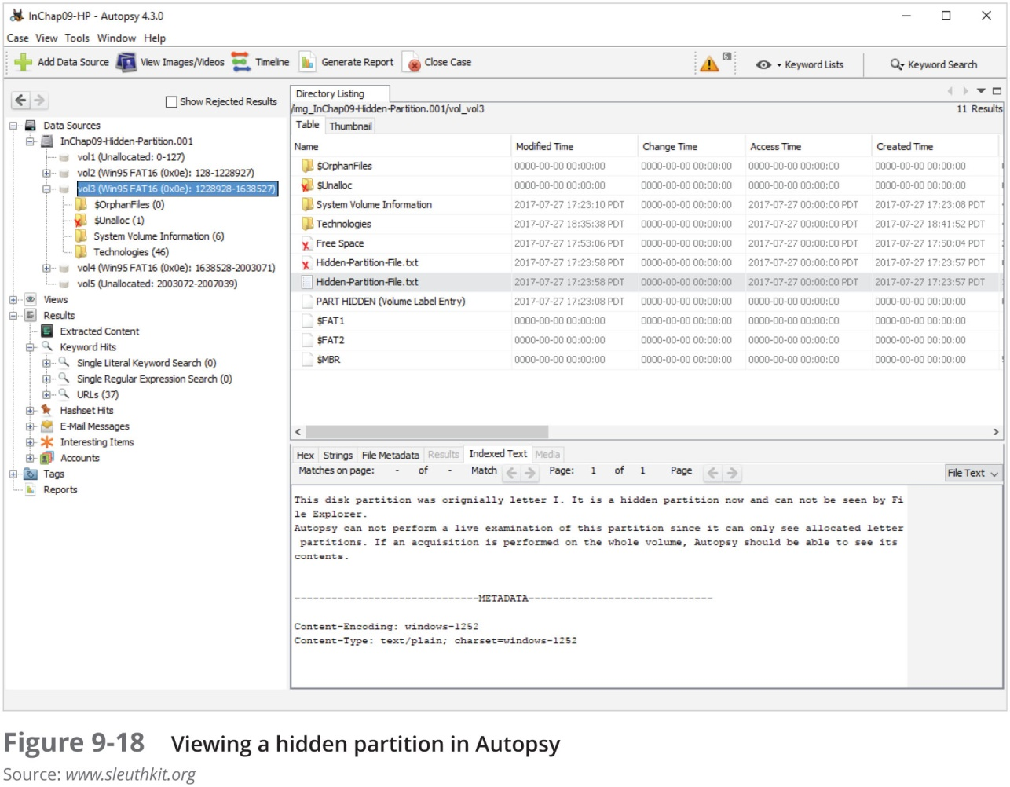
Hiding Partitions (4 of 4)

Slide 31
Marking Bad Clusters
A data-hiding technique used in FAT file systems is placing sensitive or incriminating data in free or slack space on disk partition clusters
Involves using old utilities such as Norton DiskEdit
Can mark good clusters as bad clusters in the FAT table so the OS considers them unusable
Only way they can be accessed from the OS is by changing them to good clusters with a disk editor
DiskEdit runs only in MS-DOS and can access only FAT-formatted disk media

Slide 32
Bit-Shifting (1 of 4)
Some users use a low-level encryption program that changes the order of binary data
Makes altered data unreadable to secure a file, users run an assembler program (also called a “macro”) to scramble bits
Run another program to restore the scrambled bits to their original order
Bit shifting changes data from readable code to data that looks like binary executable code
WinHex and Hex Workshop includes a feature for shifting bits

Slide 33
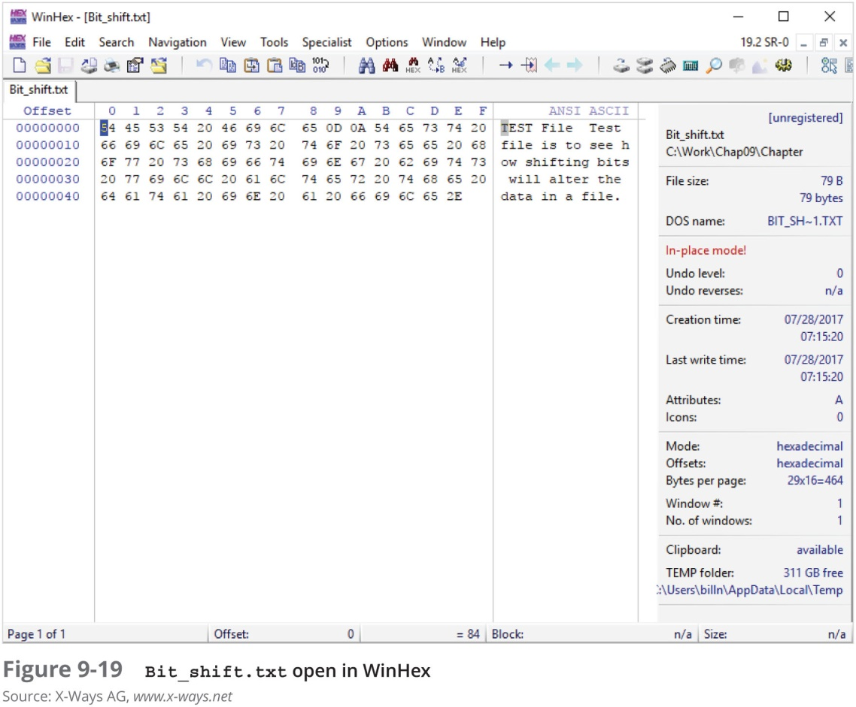
Bit-Shifting (2 of 4)

Slide 34
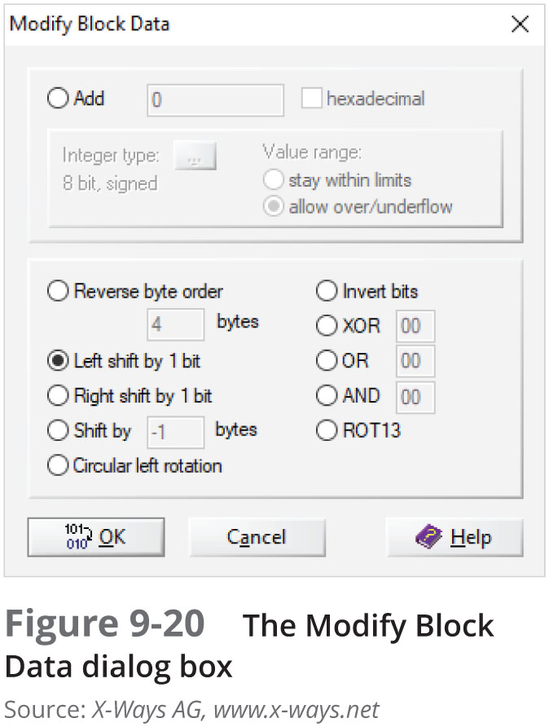
Bit-Shifting (3 of 4)

Slide 35
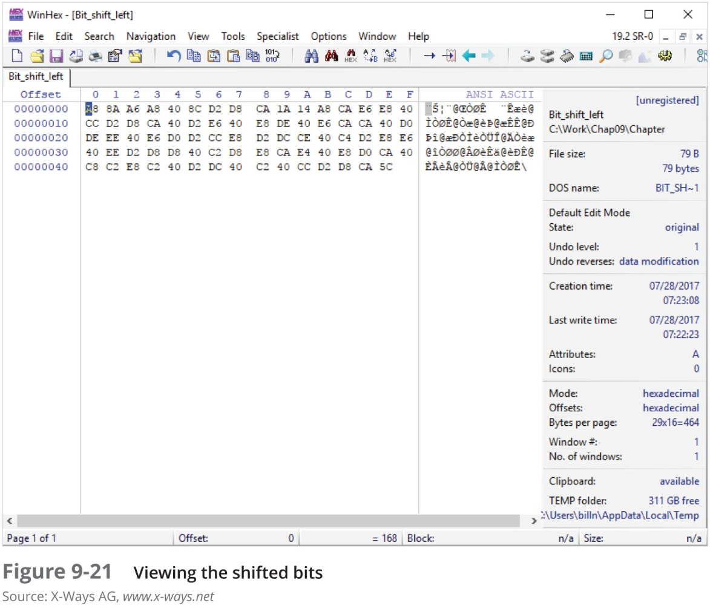
Bit-Shifting (4 of 4)

Slide 36
Understanding Steganalysis Methods (1 of 3)
Steganography - comes from the Greek word for “hidden writing”
Hiding messages in such a way that only the intended recipient knows the message is there
Steganalysis - term for detecting and analyzing steganography files
Digital watermarking - developed as a way to protect file ownership
Usually not visible when used for steganography

Slide 37
Understanding Steganalysis Methods (2 of 3)
A way to hide data is to use steganography tools
Many are freeware or shareware
Insert information into a variety of files
If you encrypt a plaintext file with PGP and insert the encrypted text into a steganography file
Cracking the encrypted message is extremely difficult

Slide 38
Understanding Steganalysis Methods (3 of 3)
Steganalysis methods
Stego-only attack
Known cover attack
Known message attack
Chosen stego attack
Chosen message attack

Slide 39
Examining Encrypted Files
To decode an encrypted file
Users supply a password or passphrase
Many encryption programs use a technology called “key escrow”
Designed to recover encrypted data if users forget their passphrases or if the user key is corrupted after a system failure
Key sizes of 128 bits to 4096 bits make breaking them nearly impossible with current technology

Slide 40
Recovering Passwords (1 of 4)
Password-cracking tools are available for handling password-protected data or systems
Some are integrated into digital forensics tools
Stand-alone tools:
Last Bit
AccessData PRTK
ophcrack
John the Ripper
Passware

Slide 41
Recovering Passwords (2 of 4)
Brute-force attacks
Use every possible letter, number, and character found on a keyboard
This method can require a lot of time and processing power
Dictionary attack
Uses common words found in the dictionary and tries them as passwords
Most use a variety of languages

Slide 42
Recovering Passwords (3 of 4)
With many programs, you can build profiles of a suspect to help determine his or her password
Many password-protected OSs and application store passwords in the form of MD5 or SHA hash values
A brute-force attack requires converting a dictionary password from plaintext to a hash value
Requires additional CPU cycle time

Slide 43
Recovering Passwords (4 of 4)
Rainbow table
A file containing the hash values for every possible password that can be generated from a computer’s keyboard
No conversion necessary, so it is faster than a brute-force or dictionary attack
Salting passwords
Alters hash values and makes cracking passwords more difficult

Slide 44
Summary (1 of 2)
Examining and analyzing digital evidence depend on the nature of the investigation and the amount of data to process
General procedures:
Wipe and prepare target drives, document all hardware components on the suspect’s computer, check date and time values in the suspect’s computer’s CMOS, acquire data and document steps, list all folders and files, attempt to open password-protected files, determine function of executable files, and document steps

Slide 45
Summary (2 of 2)
Advanced digital forensics tools have features such as indexing text data, making keyword searches faster
A critical aspect of digital forensics is validating digital evidence
Ensuring the integrity of data you collect is essential for presenting evidence in court
Data hiding involves changing or manipulating a file to conceal information
Three ways to recover passwords:
Dictionary attacks
Brute-force attacks
Rainbows tables

