Slide 1
Guide to Computer Forensics and Investigations Sixth Edition Chapter 10
Virtual Machine Forensics, Live Acquisitions, and Network Forensics
Notes:
Guide to Computer Forensics and Investigations Sixth Edition
Chapter 10
VIRTUAL Machine Forensics, Live Acquisitions, and Network Forensics

Slide 2
Objectives
Explain standard procedures for conducting forensic analysis of virtual machines
Describe the process of a live acquisition
Explain network intrusions and unauthorized access
Describe standard procedures in network forensics and network-monitoring tools

Slide 3
virtual machine (VM)
An emulation of a computer system.
Server and PC
Virtual machines are based on computer architectures and provide functionality of a physical computer.
Their implementations may involve specialized hardware, software, or a combination.

Slide 4
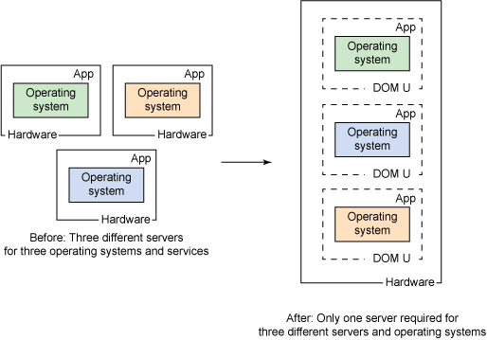

Slide 5
An Overview of Virtual Machine Forensics (1 of 2)
Virtual machines are common for both personal and business use
Investigators need to know how to analyze them and use them to analyze other suspect drives
The software that runs virtual machines is called a “hypervisor”
Two types of hypervisor:
Type 1 - hypervisors runs DIRECTLY on physical hardware
In full virtualization, the virtual machine simulates enough hardware to allow an unmodified "guest" OS (one designed for the same instruction set) to be run in isolation.
Type 2 - hypervisors run on a host operating system that provides virtualization services, such as I/O device support and memory management.
http://vapour-apps.com/what-is-hypervisor/

Slide 6
An Overview of Virtual Machine Forensics (2 of 2)
Type 1 hypervisors are typically loaded on servers or workstations with a lot of RAM and storage
Type 2 hypervisors are usually the ones you find loaded on a suspect machine
We will focus on the type 2

Slide 7
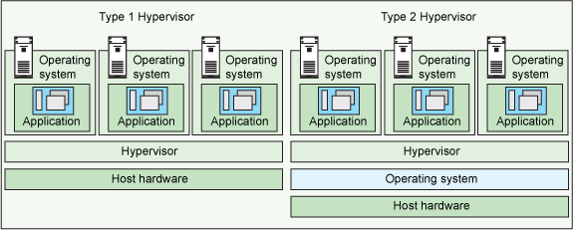
how type 1 and type 2 hypervisors differ
Image Source: www.ibm.com

Slide 8
Type 2 Hypervisors (1 of 4)
Before installing a type 2 hypervisor, enable virtualization in the BIOS before attempting to create a VM
Virtualization Technology (VT) - Intel’s CPU design for security and performance enhancements that enable the BIOS to support virtualization
Virtualization Machine Extensions (VMX) - instruction sets created for Intel processors to handle virtualization

Slide 9
Type 2 Hypervisors (2 of 4)
Most widely used type 2 hypervisors:
Parallels Desktop - created for Macintosh users who also use Windows applications
KVM (Kernel-based Virtual Machine) - for Linux OS
Microsoft Hyper-V - new hypervisor built into Windows 10
VMware Workstation and Player/fusion/ - can be installed on almost any device, including tablets
Can install Microsoft Hyper-V Server on it
Can create encrypted VMs
Can support up to 16 CPUs, 8 TB storage, and 20 VM
Oracle VM VirtualBox
VirtualBox shares many features with VMware vSphere and Microsoft Hyper-V

Slide 10
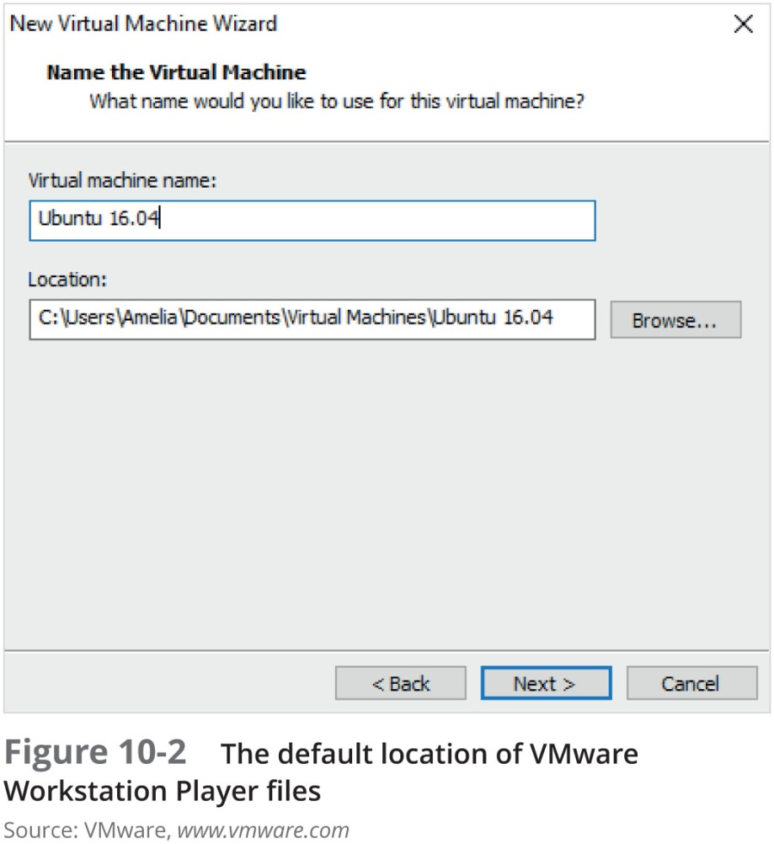
Type 2 Hypervisors (3 of 4)

Slide 11
Type 2 Hypervisors (4 of 4)
Most widely used type 2 hypervisors (cont’d):
VirtualBox - supports all Windows and Linux OSs as well as Macintosh and Solaris
Allows selecting types associated with other applications, such as VMware VMDK type or the Parallels HDD type
Type 2 hypervisors come with templates for different OSs

Slide 12
Conducting an Investigation with Type 2 Hypervisors (1 of 9)
Begin by acquiring a forensic image of the host computer as well as network logs
By linking the VM’s IP address to log files, you may determine what Web sites the VM accessed
To detect whether a VM is on a host computer:
Look in the Users or Documents folder (in Windows) or user directories (in Linux)
Check the host’s Registry for clues that VMs have been installed or uninstalled
Existence of a virtual network adapter

Slide 13
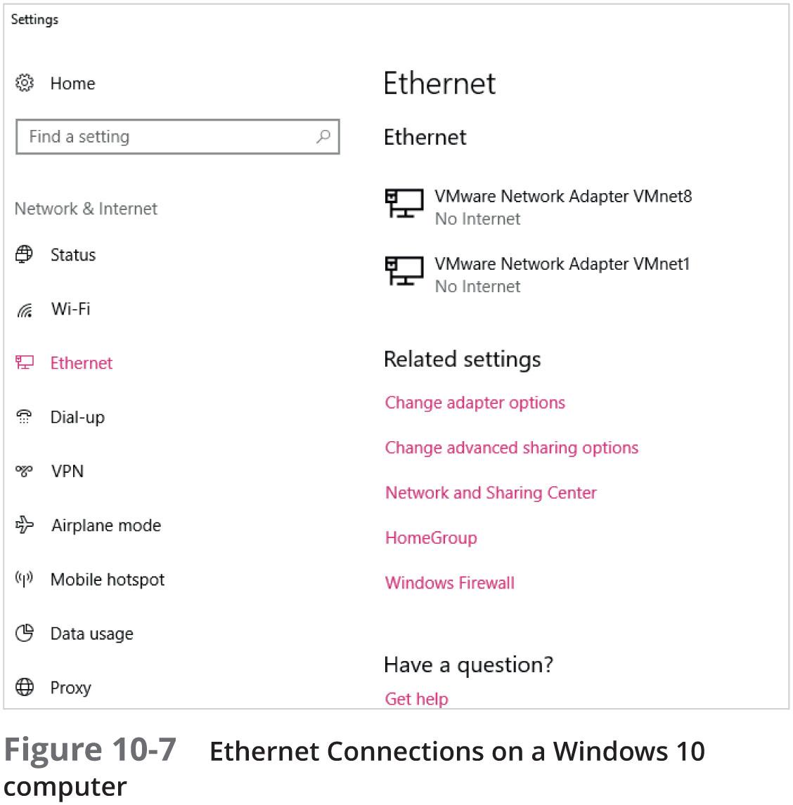
Conducting an Investigation with Type 2 Hypervisors (2 of 9)

Slide 14
Conducting an Investigation with Type 2 Hypervisors (3 of 9)
In addition to searching for network adapters, you need to determine whether USB drives have been attached to the host
They could have live VMs running on them
A VM can also be nested inside other VMs on the host machine or a USB drive
Some newer Windows systems log when USB drives are attached
Search the Windows Registry or the system log files

Slide 15
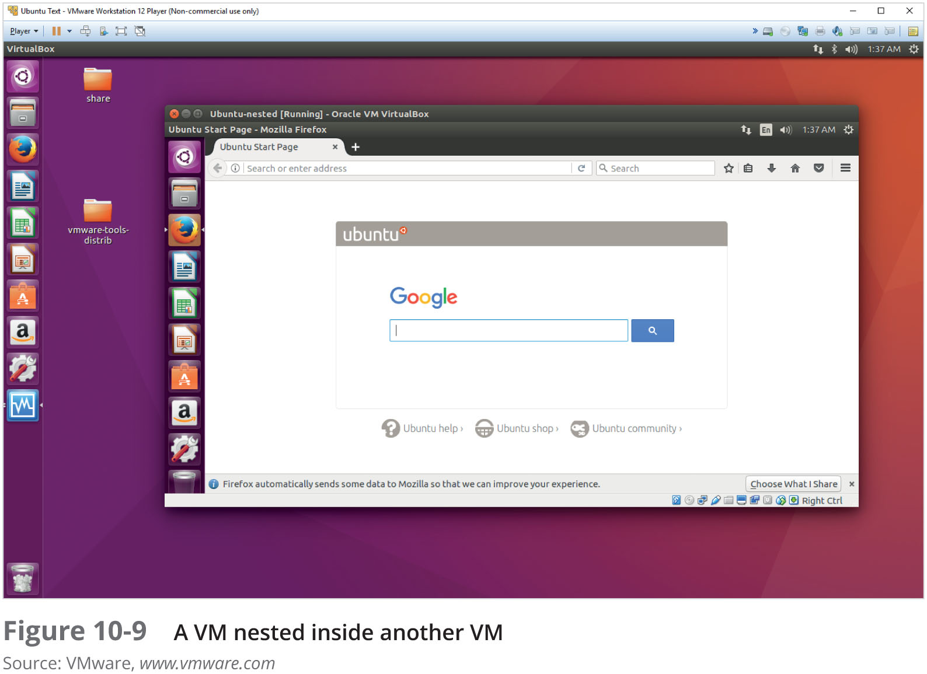
Conducting an Investigation with Type 2 Hypervisors (4 of 9)

Slide 16
Conducting an Investigation with Type 2 Hypervisors (5 of 9)
Follow a consistent procedure:
1. Image the host machine
2. Locate the virtualization software and VMs, using information learned about file extensions and network adapters
3. Export from the host machine all files associated with VMs
4. Record the hash values of associated files
5. Open a VM as an image file in forensics software and create a forensic image or mount the VM as a drive

Slide 17
Conducting an Investigation with Type 2 Hypervisors (6 of 9)
Live acquisitions of VMs are often necessary
They include all snapshots, which records the state of a VM at a particular moment (records only changes in state, not a complete backup)
When acquiring an image of a VM file, snapshots might not be included
In this case, you have only the original VM
Doing live acquisitions of VMs is important to make sure snapshots are incorporated

Slide 18
Conducting an Investigation with Type 2 Hypervisors (7 of 9)
Follow the steps in the activity on page 426 to see how to examine your own system for evidence of a VM
Follow the steps starting on page 427 to acquire an image of a VM
I will demonstrate the lab (with PPTs)

Slide 19
Conducting an Investigation with Type 2 Hypervisors (8 of 9)
Other VM Examination Methods
FTK Imager, Magnet AXIOM and OSForensics can mount VMs as an external drive
By mounting a VM as a drive, you can make it behave more like a physical computer
Allows you to use the same standard examination procedures for a static hard drive
Make a copy of a VM’s forensic image and open the copy while it’s running
Start it as a live VM so that forensics software can be used to search for clues

Slide 20
Conducting an Investigation with Type 2 Hypervisors (9 of 9)
Using VMs as Forensic Tools
Investigators can use VMs to run forensics tools stored on USB drives
Follow steps starting on page 430 to see how to set up a VM on a USB drive

Slide 21
Working with Type 1 Hypervisors (1 of 2)
This section is meant to help you understand the impact Type 1 hypervisors have on forensic investigations
Having a good working relationship with network administrators and lead technicians can be helpful
Type 1 hypervisors are installed directly on hardware
Can be installed on a VM for testing purposes
Capability is limited only by the amount of available RAM, storage, and throughput

Slide 22
Working with Type 1 Hypervisors (2 of 2)
Common type 1 hypervisors:
VMware vSphere
Microsoft Hyper-V 2016
XenProject XenServer
IBM PowerVM
Parallels Desktop for Mac
Follow steps starting on page 433 to install XenServer as a VM in VirtualBox

Slide 23
Performing Live Acquisitions (1 of 2)
Live acquisitions are especially useful when you’re dealing with active network intrusions or attacks
Live acquisitions done before taking a system offline are also becoming a necessity
Attacks might leave footprints only in running processes or RAM
Live acquisitions don’t follow typical forensics procedures
Order of volatility (OOV)
How long a piece of information lasts on a system

Slide 24
Performing Live Acquisitions (2 of 2)
Steps
Create or download a bootable forensic CD or USB drive
Make sure you keep a log of all your actions
A network drive is ideal as a place to send the information you collect
Copy the physical memory (RAM)
The next step varies, depending on the incident you’re investigating
Be sure to get a forensic digital hash value of all files you recover during the live acquisition

Slide 25
Performing a Live Acquisition in Windows
Several tools are available to capture the RAM.
Mandiant Memoryze
Belkasoft RamCapturer
Kali Linux (updated version of BackTrack)
GUI tools are easy to use
But they often require a lot of system resources
Might get false readings in Windows OSs
Command-line tools give you more control
Use a different PPT

Slide 26
Network Forensics Overview
Network forensics
Process of collecting and analyzing raw network data and tracking network traffic
To ascertain how an attack was carried out or how an event occurred on a network
Intruders leave a trail behind
Knowing your network’s typical traffic patterns is important in spotting variations in network traffic
Can also help you determine whether a network is truly under attack

Slide 27
The Need for Established Procedures
Network forensics examiners must establish standard procedures for how to acquire data after an attack or intrusion
Essential to ensure that all compromised systems have been found
Procedures must be based on an organization’s needs and complement network infrastructure
NIST created “Guide to Integrating Forensic Techniques into Incident Response” to address these needs

Slide 28
Securing a Network (1 of 2)
Layered network defense strategy
Sets up layers of protection to hide the most valuable data at the innermost part of the network
Defense in depth (DiD)
Similar approach developed by the NSA
Modes of protection
People
Technology
Operations

Slide 29
Securing a Network (2 of 2)
Testing networks is as important as testing servers
You need to be up to date on the latest methods intruders use to infiltrate networks
As well as methods internal employees use to sabotage networks
Small companies of fewer than 10 employees often don’t consider security precautions against internal threats necessary
Can be more susceptible to problems caused by employees revealing proprietary information

Slide 30
Developing Procedures for Network Forensics (1 of 2)
Network forensics can be a long, tedious process
Standard procedure that is often used:
Always use a standard installation image for systems on a network
Fix any vulnerability after an attack
Attempt to retrieve all volatile data
Acquire all compromised drives
Compare files on the forensic image to the original installation image

Slide 31
Developing Procedures for Network Forensics (2 of 2)
In digital forensics
You can work from the image to find most of the deleted or hidden files and partitions
In network forensics
You have to restore drives to understand attack

Slide 32
Reviewing Network Logs
Network logs record ingoing and outgoing traffic
Network servers
Routers
Firewalls
Tcpdump and Wireshark - tools for examining network traffic
Can generate top 10 lists
Can identify patterns

Slide 33
Using Network Tools
Variety of tools
Splunk
Spiceworks
Nagios
Cacti

Slide 34
Using Packet Analyzers (1 of 5)
Packet analyzers
Devices or software that monitor network traffic
Most work at layer 2 or 3 of the OSI model
Most tools follow the Pcap (packet capture) format
Some packets can be identified by examining the flags in their TCP headers
Tools
Tcpdump
Tethereal

Slide 35
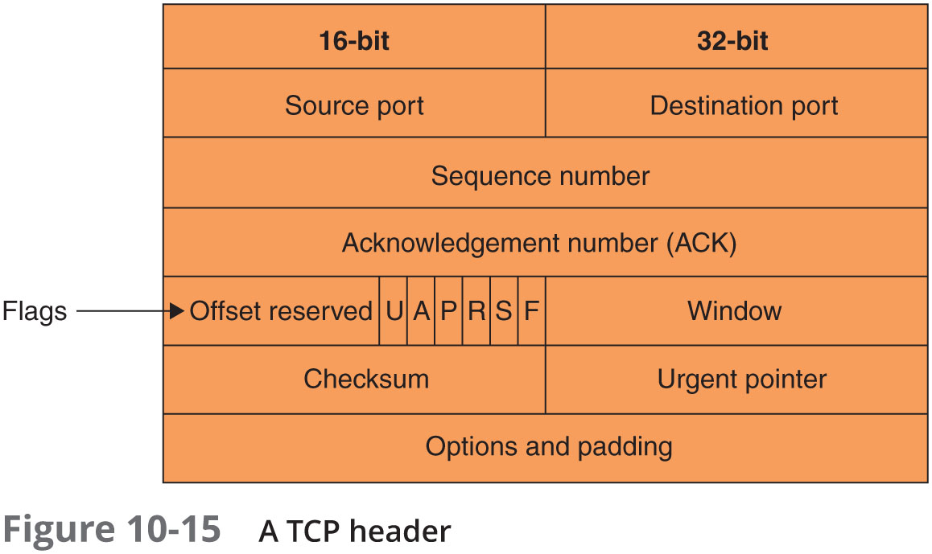
Using Packet Analyzers (2 of 5)

Slide 36
Using Packet Analyzers (3 of 5)
Tools (cont’d)
Tcpslice
Tcpreplay
Etherape
Netdude
Argus
Wireshark
Follow the steps starting on page 442 to see how the Wireshark tool works

Slide 37
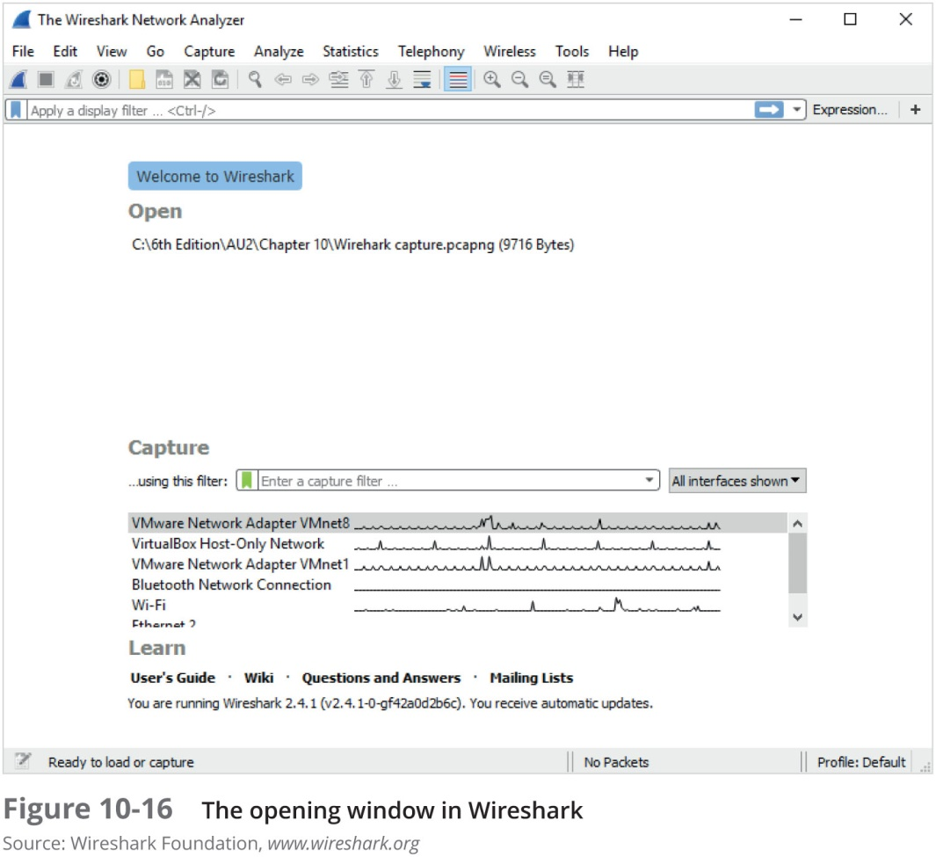
Using Packet Analyzers (4 of 5)

Slide 38
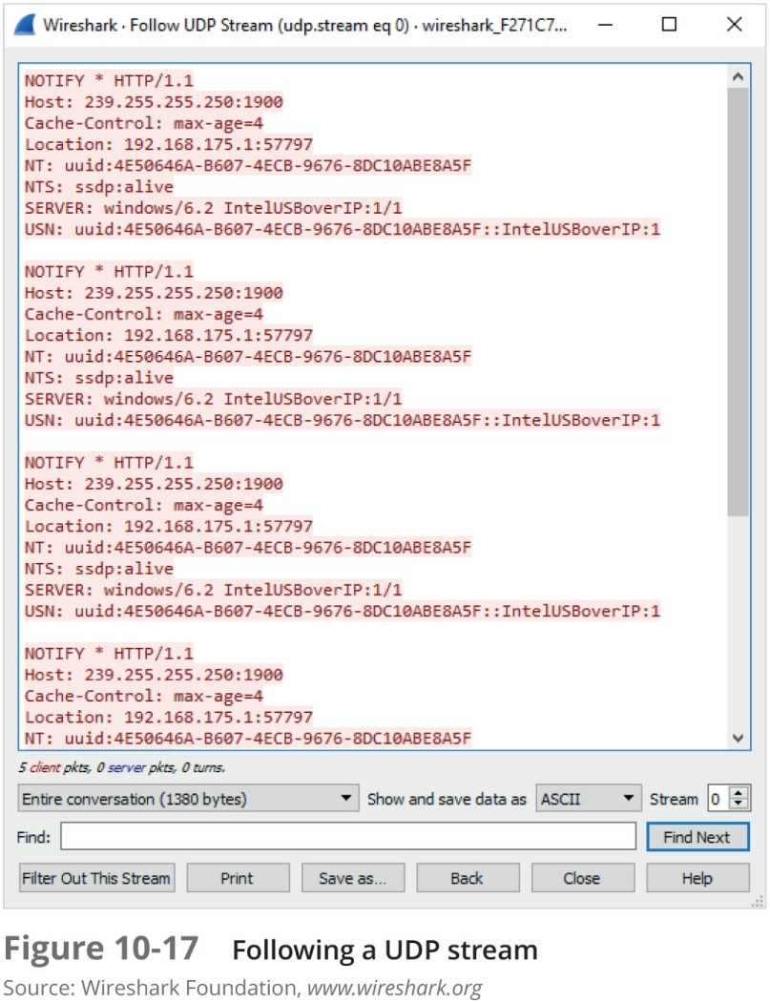
Using Packet Analyzers (5 of 5)

Slide 39
Investigating Virtual Networks
Virtual switch is a little different from a physical switch
There’s no spanning tree between virtual switches
Additional complications
Hypervisors can assign MAC addresses to virtual devices
Devices can have the same MAC address on different virtual networks
Cloud service providers host networks for several to hundreds of companies
Tools
Wireshark
Network Miner

Slide 40
Examining the Honeynet Project (1 of 2)
The Honeynet Project was developed to make information widely available in an attempt to thwart Internet and network attackers
Provides information about attacks methods and how to protect against them
Objectives are awareness, information, and tools
Distributed denial-of-service (DDoS) attacks
A major threat that may go through other organizations’ networks, not just yours
Hundreds or even thousands of machines (zombies) can be used

Slide 41
Examining the Honeynet Project (2 of 2)
Zero day attacks
Another major threat
Attackers look for holes in networks and OSs and exploit these weaknesses before patches are available
Honeypot
Normal looking computer that lures attackers to it
Honeywalls
Monitor what’s happening to honeypots on your network and record what attackers are doing

Slide 42
Summary (1 of 3)
Virtual machines are used extensively in organizations and are a common part of forensic investigations
There are two types of hypervisors for running virtual machines: Type 1 and Type 2
Virtualization Technology is Intel’s CPU design for security and performance enhancements that enable the BIOS to support virtualization
Forensic procedures for VMs start by creating an image of the host machine, and then exporting files associated with a VM

Slide 43
Summary (2 of 3)
Live acquisitions are necessary to retrieve volatile items, such as RAM and running processes
Network forensics is the process of collecting and analyzing raw network data and systematically tracking network traffic to ascertain how an attack took place
Steps must be taken to harden networks before a security breach happens
Being able to spot variations in network traffic can help you track intrusions

Slide 44
Summary (3 of 3)
Several tools are available for monitoring network traffic, such as packet analyzers and honeypots
The Honeynet Project is designed to help people learn the latest intrusion techniques that attackers are using

