Slide 1
Guide to Computer Forensics and Investigations Sixth Edition Chapter 12
Mobile Device Forensics and the Internet of Anything
Notes:
Guide to Computer Forensics and Investigations Sixth Edition
Chapter 12
Mobile Device Forensics

Slide 2
Objectives
Mobile Device Forensics Overview
Explain the basic concepts of mobile device forensics
Describe procedures for acquiring data from mobile devices
Summarize the challenges of forensic acquisitions of data stored on Internet of Anything devices

Slide 3

Mobile Device Forensics Overview
Cell Phone Forensics Short History
Originated in Europe and focused on the GSM SIM card. Roaming of Devices from Network and Spectrum Required - I.D. Info on SIM – Also SMS, Phonebooks, and Last Numbers Dialled on SIM
Terrorist use of phones as Improvised explosive device detonators Increased the demand for mobile forensics. Mobile device forensics is making a real impact in the war on terror.
Adoption Has Moved Quickly From Federal to Local Level and Now Enterprise, Prisons, Schools, etc.

Slide 4
Mobile Device Forensics Overview
Mobile Device Forensics Today
Now Used Widely Around the World
80% of All Criminal Investigations in Europe Involve Mobile Device Forensics
90% of All Criminal Investigations in UK
70% in US (estimate and growing)
Quickly Becoming The Necessary Part of Every Investigation!

Slide 5
Cell Phone Forensics is NOT Computer Forensics!
Mobile Device Forensics Overview
While The Intent Is Similar, The Method Is Different

Slide 6
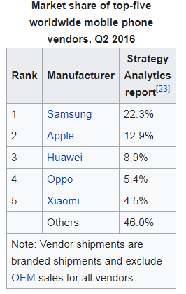
Mobile Device Forensics Overview
The Big Difference:
Computer Forensics: – Only a Few Major Operating System Standards: Windows, Mac, Linux. Standard practice is to image the Harddrive and Examine Data.
Cell Phone Forensics: – Multiple Operating Systems. Various Communication Standards. Each manufacturer has their own: iPhone, Samsung
Mobility Aspect: - Phones are Live Things Roaming Around. It’s not just about what’s on the device, but where has it been and what connections have been made?

Slide 7
Mobile Device Forensics Overview
Another Difference: Phones Are Always Updating – Proper Handling and Isolation Are Essential
A phone is always updating with the network, and remote destruction is possible.
Proper isolation of the device from the network and immediate analysis is best when possible.
Proper training in handling and processing phones is essential
in reducing the risk of loss or contamination.

Slide 8
Items stored on cell phones (1 of 3)
People store a wealth of information on cell phones
People don’t think about securing their phones
Items stored on cell phones:
Incoming, outgoing, and missed calls
Multimedia Message Service (MMS; text messages) and Short Message Service (SMS) messages
E-mail accounts
Instant-messaging (IM) logs
Web pages
Pictures, video, and music files

Slide 9
Items stored on cell phones(2 of 3)
Items stored on cell phones: (cont’d)
Calendars and address books
Social media account information
GPS data
Voice recordings and voicemail
Bank account logins
Access to your home
A search warrant is needed to examine mobile devices because they can contain so much information

Slide 10
Items stored on cell phones (3 of 3)
Investigating cell phones and mobile devices is a challenging tasks in digital forensics
No single standard exists for how and where phones store messages
New phones come out about every six months and they are rarely compatible with previous models

Slide 11
Mobile Phone Tech Overview (1 of 5)
Mobile phone technology has advanced rapidly
By the end of 2008, mobile phones had gone through three generations:
Analog
Digital personal communications service (PCS)
Third-generation (3G)
Fourth-generation (4G) was introduced in 2009
Several digital networks are used in the mobile phone industry
Fifth-generation (5G) cellular networks
Expected to be finalized in 2020, will incorporate emerging technologies

Slide 12
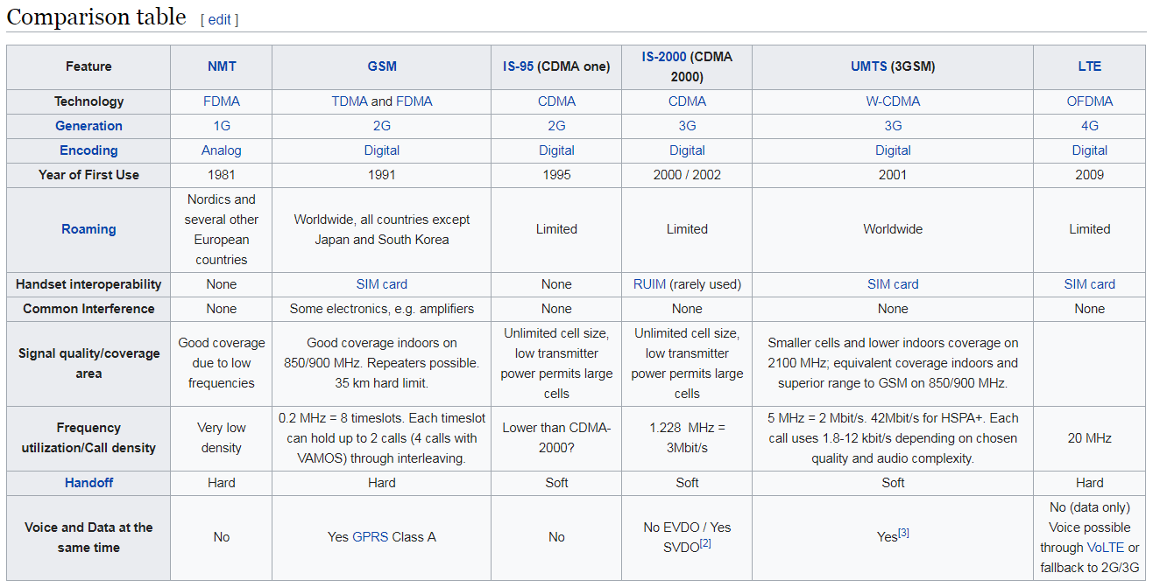
Mobile Phone Tech Overview (2 of 5)
Today’s Cellular Standards: GMS, CDMA, LTE
CDMA: https://www.youtube.com/watch?v=vdbc9P3U-Xo
https://en.wikipedia.org/wiki/Comparison_of_mobile_phone_standards

Slide 13
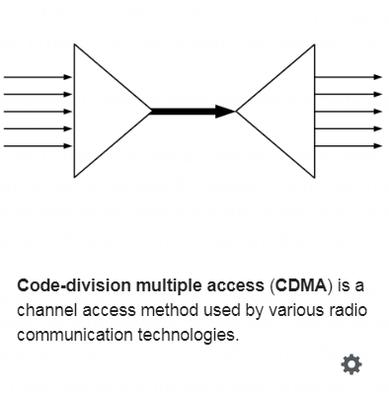
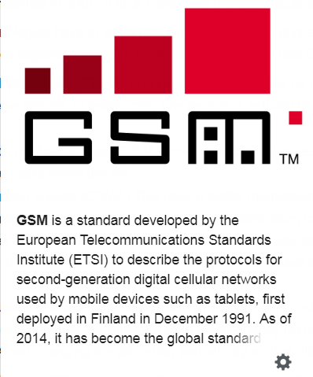
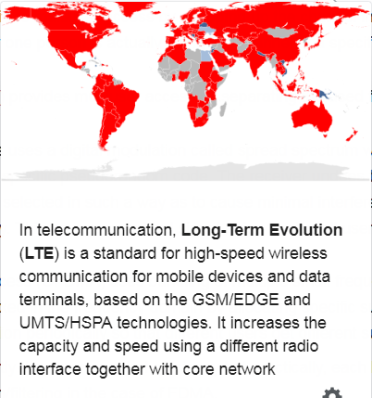
GMS, CDMA, LTE
for mobile communications – with over 90% market share, operating in over 193 countries and territories

Slide 14
Mobile Phone Tech Overview (3 of 5)
The 3G standard was developed by the International Telecommunications Union (ITU) under the United Nations
It is the upgrade for 2G and 2.5G GPRS networks, for faster internet speed.
This is based on a set of standards used for mobile devices and mobile telecommunications use services and networks that comply with the International Mobile Telecommunications-2000 (IMT-2000) specifications by the International Telecommunication Union.
3G finds application in wireless voice telephony, mobile Internet access, fixed wireless Internet access, video calls and mobile TV.

Slide 15
Mobile Phone Tech Overview (4 of 5)
4G networks can use the following technologies:
Orthogonal Frequency Division Multiplexing (OFDM)
Mobile WiMAX
Ultra Mobile Broadband (UMB)
Multiple Input Multiple Output (MIMO)
Long Term Evolution (LTE)
https://www.youtube.com/watch?v=vdbc9P3U-Xo

Slide 16
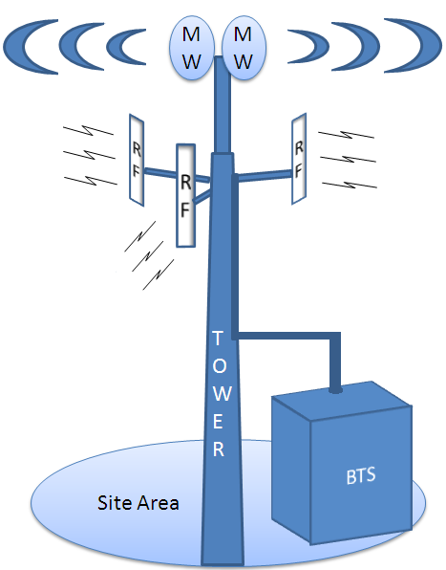
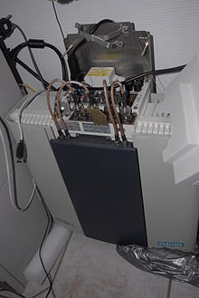
Mobile Phone Tech Overview (5 of 5)
Main components used for communication:
Base transceiver station (BTS)
contains the equipment for transmitting and receiving radio signals (transceivers), antennas, and equipment for encrypting and decrypting communications with the base station controller (BSC).
Cell ID is a generally unique number used to identify each (BTS)
The Cell ID method looks at the network as divided into cells, each cell being the radio coverage area of a single reference device.
BSC
provides, classically, the intelligence behind the BTSs. Typically a BSC has tens or even hundreds of BTSs under its control.
handles allocation of radio channels, receives measurements from the mobile phones, and controls handovers from BTS to BTS
The Base Station Identity Code (BSIC)
is a code used in GSM to uniquely identify a base station.

Slide 17
Cell Site Analysis

Slide 18

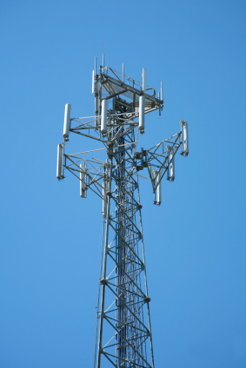

Cell Site Analysis
What Is It?
The Analysis of a Mobile Network’s Radio Signal Coverage Relative to Its Users

Slide 19
Cell Site Analysis
How Is It Useful?
Cell Site Analysis Shows the Real Coverage of the Network’s Signal – Used In Conjunction with
Network Call Data Records to Prove / Disprove
Users Location on the Network.
Gives Examiners the “Real Picture”
Of the Network Coverage.

Slide 20
Cell Site Analysis
Network Coverage
&
&
&
&
&
&
&
&
&
&
&
&
&
&
&
&
AT+T
BSIC: 1245
Cell ID#: 13565
&
&
&
&
&
&
&
&
&
T-Mobile
BSIC: 5498
Cell ID#: 20567
AT+T
BSIC: 9876
Cell ID#: 11987
&
&
AT+T
BSIC: 4949
Cell ID#: 20567
T-Mobile
BSIC: 768
Cell ID#: 6776
&
&
&
&
&
&
T-Mobile
BSIC: 4208
Cell ID#: 890275
&
User Information Including:
IMSI: International Mobile Subscriber Identity
IMEI: International Mobile Equipment Identity

Slide 21
Cell Site Analysis – What The Network Says…
Cell Site Analysis
What The Network Data Would Indicate as to Cell Coverage
&
&
&
&
&
&
&
&
&
&
&
&
&
&
&
&
AT+T
BSIC: 1245
Cell ID#: 13565
&
&
&
&
&
&
&
&
&
T-Mobile
BSIC: 5498
Cell ID#: 20567
AT+T
BSIC: 9876
Cell ID#: 11987
&
AT+T
BSIC: 4949
Cell ID#: 20567
T-Mobile
BSIC: 768
Cell ID#: 6776
The network could indicate that it is not possible for the caller to be at the location suspected based on the Network coverage data.
T-Mobile
BSIC: 4208
Cell ID#: 890275

Slide 22
But The Reality Can Be Far Different.
Cell Site Analysis
A Survey of the Network Shows Much Further Coverage.
&
&
&
&
&
&
&
&
&
&
&
&
&
&
&
&
AT+T
BSIC: 1245
Cell ID#: 13565
&
&
&
&
&
&
&
&
&
T-Mobile
BSIC: 5498
Cell ID#: 20567
AT+T
BSIC: 9876
Cell ID#: 11987
&
AT+T
BSIC: 4949
Cell ID#: 20567
T-Mobile
BSIC: 768
Cell ID#: 6776
Cell Site Analysis Shows That The Signal Extended To The Location in Question
T-Mobile
BSIC: 4208
Cell ID#: 890275

Slide 23
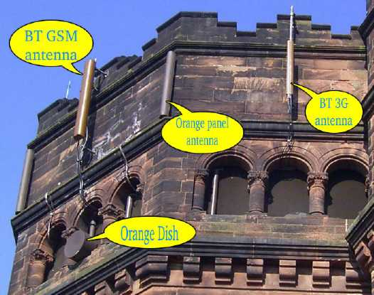
Cell Site Analysis
Cell Identities
Each Base Stations (BTS) on a tower, has its own radio coverage area.
The “Cell” or “Cell Identity” refers to the radio coverage in an area.

Slide 24
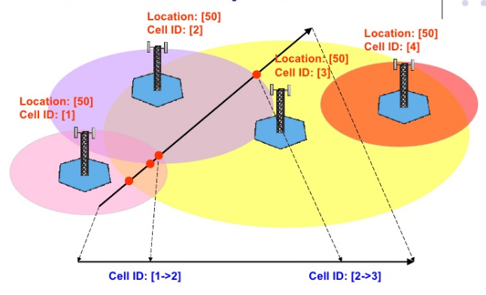

Slide 25
Cell Site Analysis
Surveying The Network As Soon As Possible Provides the Snapshot of Coverage For the Record
AT+T
BSIC: 1245
Cell ID#: 13565
BSIC: 9876
Cell ID#: 11987
BSIC: 4949
Cell ID#: 20567
T-Mobile
BSIC: 4208
Cell ID#: 890275
BSIC: 768
Cell ID#: 6776
BSIC: 5498
Cell ID#: 20567
Logging Network Location Data In Areas of Interest and Cross Referencing with Network Records Allows More Accurate Analysis of User Location on the Network. In Europe, LE is Constantly recording network coverage data to reference with networks when needed.

Slide 26
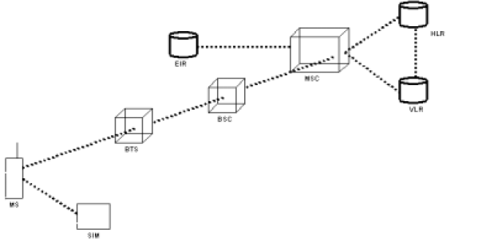
The GSM Network in Brief
Network Structure
b EIR – Equipment Identity Register - Holds Phone Identity. Can Be Used to Locate Stolen Devices
b MSC – Mobile Switching Center
b BSC – Base Station Control
b BTS – Base Transceiver Station
HLR
EIR
MSC
VLR
BSC
AT+T
BSIC: 9876
Cell ID#: 11987
BTS
b HLR - Home Location Register
b VLR – Visitor Location Register These Hold User Info Where Records Are Stored – Used Today for Traffic For Traffic Jam Reporting
MS
SIM

Slide 27
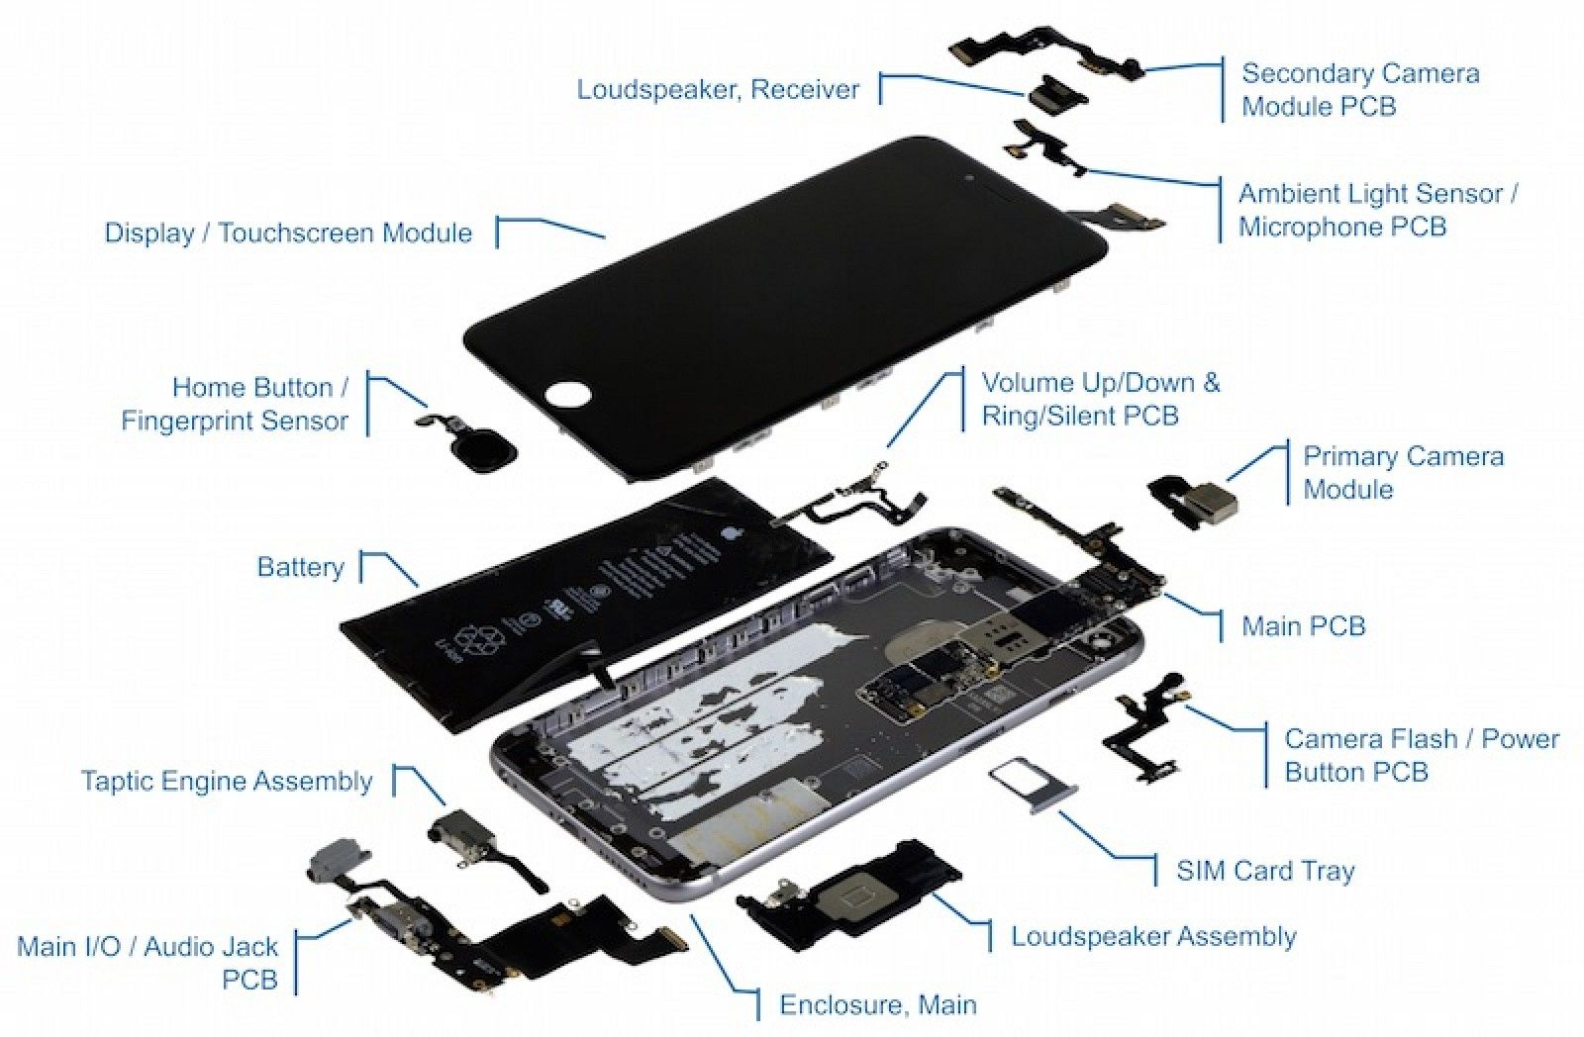
Inside Mobile Devices (1 of 5)

Slide 28
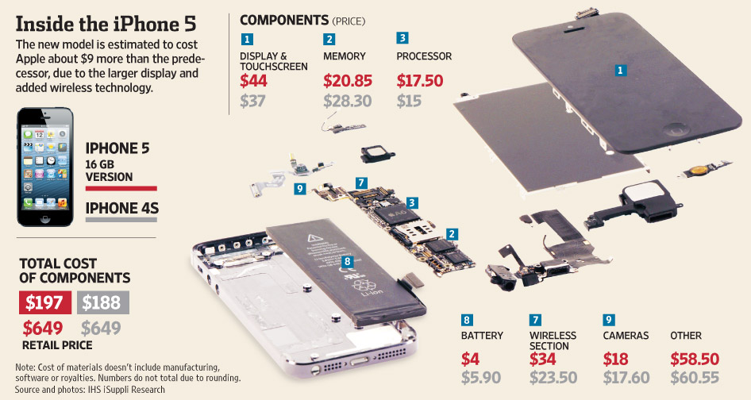

Slide 29
Inside Mobile Devices (2 of 5)
Phones store system data in electronically erasable programmable read-only memory (EEPROM)
Enables service providers to reprogram phones without having to physically access memory chips
OS is stored in ROM
Nonvolatile memory
Available even if the phone loses power

Slide 30
Inside Mobile Devices (3 of 5)
Personal digital assistants (PDAs) have been mostly replaced by iPods, iPads, and other mobile devices
Their use has shifted to more specific markets
Such as medical or industrial PDAs

Slide 31
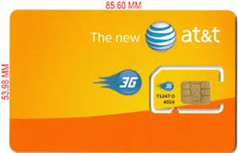
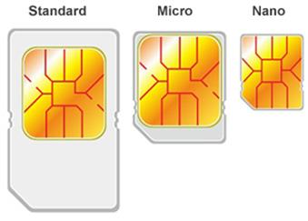
Inside Mobile Devices (4 of 5)
GSM refers to mobile phones as “mobile stations”
The SIM card and
The mobile equipment (ME)
Subscriber identity module (SIM) cards
Found most commonly in GSM devices
Consist of a microprocessor and internal memory
SIM cards come in three sizes

Slide 32
Inside Mobile Devices (5 of 5)
Subscriber identity module (SIM) cards (cont’d)
The SIM card is necessary for the ME to work and serves these additional purposes:
Identifies the subscriber to the network
Stores service-related information
Can be used to back up the device
Many phones now include SD cards for external storage

Slide 33
Understanding Acquisition Procedures for Mobile Devices (1 of 7)
The main concerns with mobile devices are
loss of power,
synchronization with cloud services, and
remote wiping
Prevent losing of power
You can retrieve RAM data is critical
Prevent synchronization
might occur automatically and overwrite data
Mobile device attached to a PC via a USB cable should be disconnected from the PC immediately

Slide 34
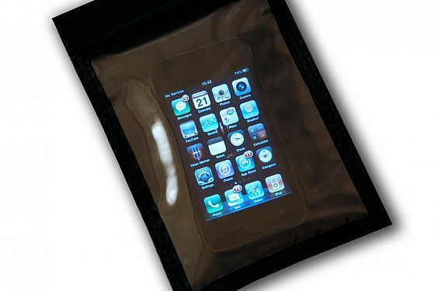
Understanding Acquisition Procedures for Mobile Devices (2 of 7)
Prevent remote wiping
Isolate the device from incoming signals with one of the following options:
Place the device in airplane mode
Use a Faraday bag
Turn the device off
http://www.itp.net/585942-faraday-bags-help-secure-seized-mobile-devices

Slide 35

Understanding Acquisition Procedures for Mobile Devices (3 of 7)
SANS DFIR Forensics recommends:
If device is on and unlocked - isolate it from the network, disable the screen lock, remove passcode
If device is on and locked - what you can do varies depending on the type of device
If device is off - attempt a physical static acquisition and turn the device on

Slide 36
Understanding Acquisition Procedures for Mobile Devices (4 of 7)
Check these areas in the forensics lab :
Internal memory
SIM card
Removable or external memory cards
Network provider
Checking network provider requires a search warrant or subpoena
A new complication has surfaced because backups might be stored in a cloud provided by the carrier or third party

Slide 37
Understanding Acquisition Procedures for Mobile Devices (5 of 7)
Due to the growing problem of mobile devices being stolen, service providers have started using remote wiping to remove a user’s personal information stored on a stolen device

Slide 38
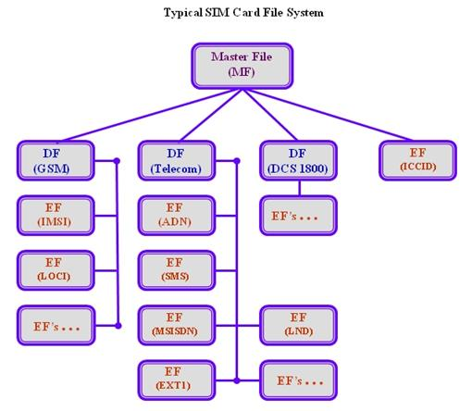
Understanding Acquisition Procedures for Mobile Devices (6 of 7)
The file system for a SIM card is a hierarchical structure
Integrated circuit card identifier (ICCID)
International mobile subscriber identity (IMSI)
Service provider name (SPN)
Mobile country code (MCC)
Mobile network code (MNC)
Mobile subscriber identification number (MSIN)
Mobile station international subscriber directory number (MSISDN)
Abbreviated dialing numbers (ADN)
Last dialed numbers (LDN)
Short message service (SMS)
Language preference (LP)
Card holder verification (CHV1 and CHV2)
Ciphering key (Kc)
Ciphering key sequence number
Emergency call code
Fixed dialing numbers (FDN)
Local area identity (LAI)
Own dialing number
Temporary mobile subscriber identity (TMSI)
Routing area identifier (RIA) network code
Service dialing numbers (SDNs)

Slide 39
Understanding Acquisition Procedures for Mobile Devices (7 of 7)
Information that can be retrieved falls into four categories:
Service-related data
such as identifiers for the SIM card and the subscriber
Call data
such as numbers dialed
Message information
Location information

Slide 40
Mobile Forensics Equipment (1 of 6)
Mobile forensics is an evolving science
Biggest challenge is dealing with constantly changing phone models
Procedures for working with mobile forensics software:
Identify the mobile device
Make sure you have installed the mobile device forensics software
Attach the phone to power and connect cables
Start the forensics software and download information

Slide 41
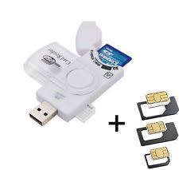
Mobile Forensics Equipment (2 of 6)
SIM card readers
A combination hardware/software device used to access the SIM card
You need to be in a forensics lab equipped with appropriate antistatic devices
General procedure is as follows:
Remove the device’s back panel
Remove the battery
Remove the SIM card from holder
Insert the SIM card into the card reader

Slide 42
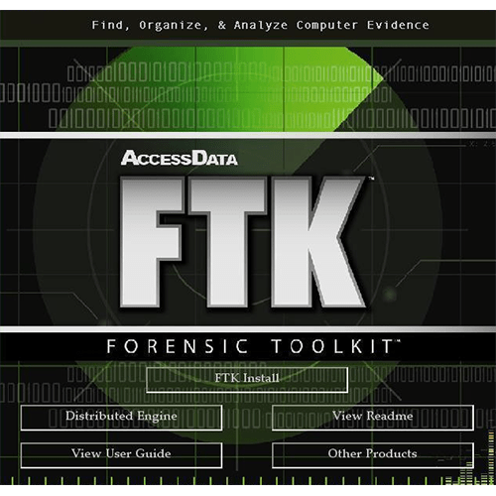

Mobile Forensics Equipment (3 of 6)
SIM card readers (cont’d)
A variety of SIM card readers are available
Some are forensically sound and some are not
Documenting messages that haven’t been read yet is critical
Use a tool that takes pictures of each screen
Mobile phone forensics tools and methods
AccessData FTK Imager
MacLockPick 3.0

Slide 43
Mobile Forensics Equipment (4 of 6)
NIST guidelines list six types of mobile forensics methods:
Manual extraction
Logical extraction
Physical extraction
Hex dumping and Joint Test Action Group (JTAG) extraction
Chip-off
Micro read

Slide 44
Data Capture Options
Screen Captures: The simplest way. Use a camera to take pictures of what’s on the screen. Reporting tools available. Sometimes this is the only way.
Logical Analysis: – Extracting the data on the device that you see and can access on the device. No deleted information with this method. Call logs, phone books, sms messages, pictures, email, browsing etc. The “active” information on the device can be extracted using a “Logical” extraction tool. This is the standard method today. Plenty of tools and easy to use.
Physical Analysis: – The practice of extracting data from the physical memory of the device, and removable memory. Like PC forensics, you are getting the raw binary / hex data. Requires decoding and understanding of language and techniques used by device manufacturers. Physical analysis is the way to recover deleted information, but it is difficult and sparsely supported.
Chip Level Analysis: - Analysis of the chips in the phone by removing them from the device and probing for data, or rebuilding another phone. Extremely technical. Broken SIMs analyzed this way.

Slide 45
Options For Cell Phone Forensics
Chip-Off Analysis
Chip-Off Analysis Just Starting to Get Attention.
Most Analysis is Logical Data or Screen Capture.
Physical Analysis and Alternative Methods for Extraction
Logical Analysis
Screen Capture and Manual Reporting
Sam Brothers Pyramid

Slide 46
The Unfortunate Reality of Kit…
There Is No One Size Fits All Solution
A Number of Mobile Device Forensic Tools on the Market
Each Have Their Strengths and Weaknesses. Plenty of Overlap of Support, but Success with Devices Varies.
This is due to the challenges in supporting the continuous introductions of new phones and changing technologies. It’s a tough job for the examiner to keep up – And equally difficult for the companies making the tools.
Examiners Never Know What They Are Going To Get! Often need more than one tool for the multiple different devices out there.
This is changing somewhat with a consolidation of mobile Operating Systems (Android, Apple, BlackBerry, Windows), but it still tools will do or dig deeper in some areas than others.

Slide 47


















Today’s Mobile Device Forensic Solutions

Slide 48
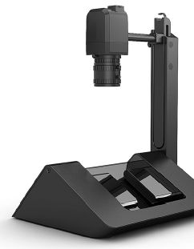
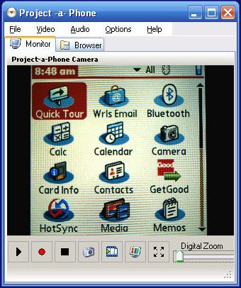
Screen Capture
Sometimes Taking A Picture is The Only Way To Get Data Off of a Phone

Slide 49
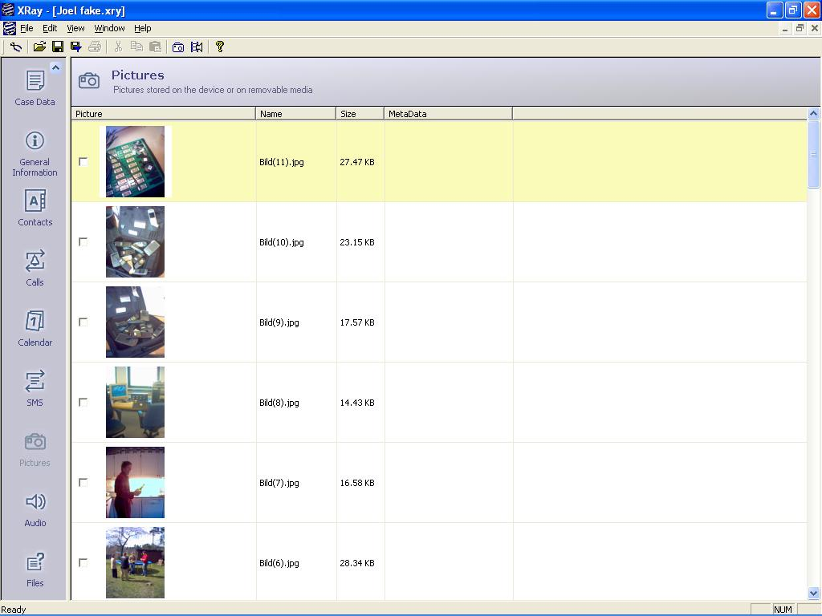
Logical Acquisition
“Logical” Acquisition Pulls the “Active” Data off the device… Basically, anything you can see or access using the keypad.

Slide 50
Physical Acquisition
Today’s Top Tools:
XRY Physical
And
UFED Physical
“Physical” Acquisition Accesses the Internal Memory and Pulls the Raw Data from the Memory. Formats and Storage Differ From Manufacturer to Manufacturer.

Slide 51
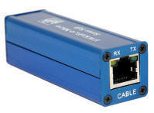
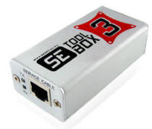
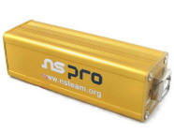
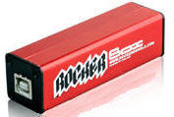
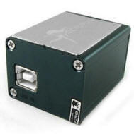
Physical Acquisition – Flasher Boxes
known as flashers or clips
used by mobile phone service providers and shops.
to recover user data from dead or faulty mobile phones that otherwise will not provide access to data stored on their internal memory.
used to update or replace software that is stored in the mobile phone's Read Only Memory (ROM).
for “Unlocking” Phones from the Network
Many have ability to dump raw data, and have been adopted by digital examiners for acquiring and validating data.

Slide 52
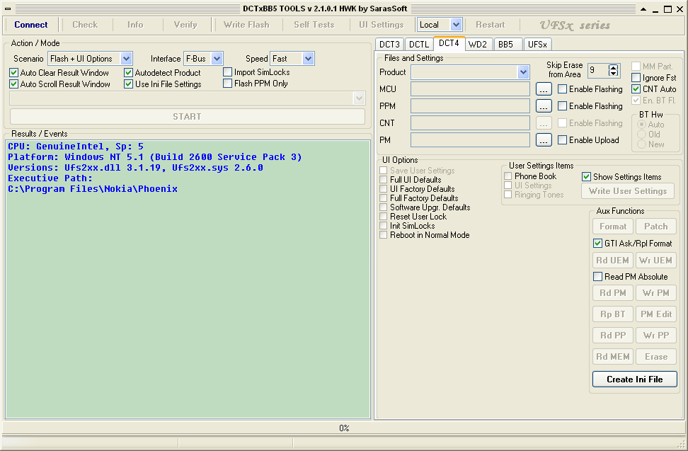
Physical Acquisition – Flasher Boxes
Interfaces Are Complicated – Not Made For Forensics. Require Proper Education
Risk of Destroying Phone!
Proceed With Extreme Caution!

Slide 53
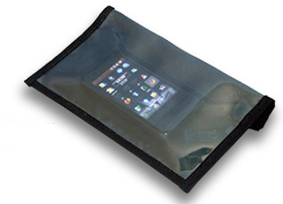
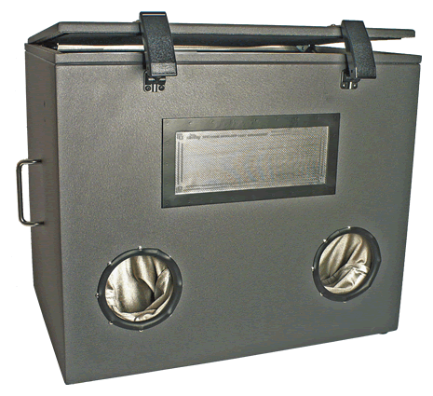
RF Protection – Required To Protect Device From The Network.
Faraday Box and Bag
RF Protection – Today Relying on Faraday Bags or Getting Devices in Airplane Mode Immediately and Keep Charged.

Slide 54
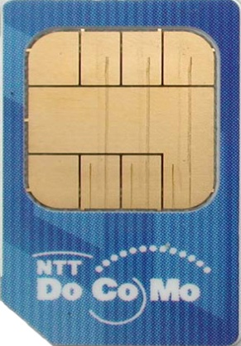
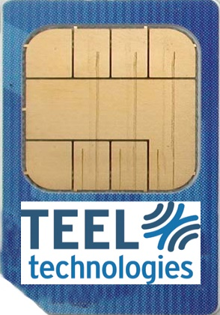
SIM ID Cloning
Cloning SIM Card – Reinsertion of Cloned SIM Card with No Network Connection Ability.
Tricks Phone Into Thinking Proper SIM is In. No Data Loss.
Best Option When Phone is Dead or no PIN is Set.

Slide 55
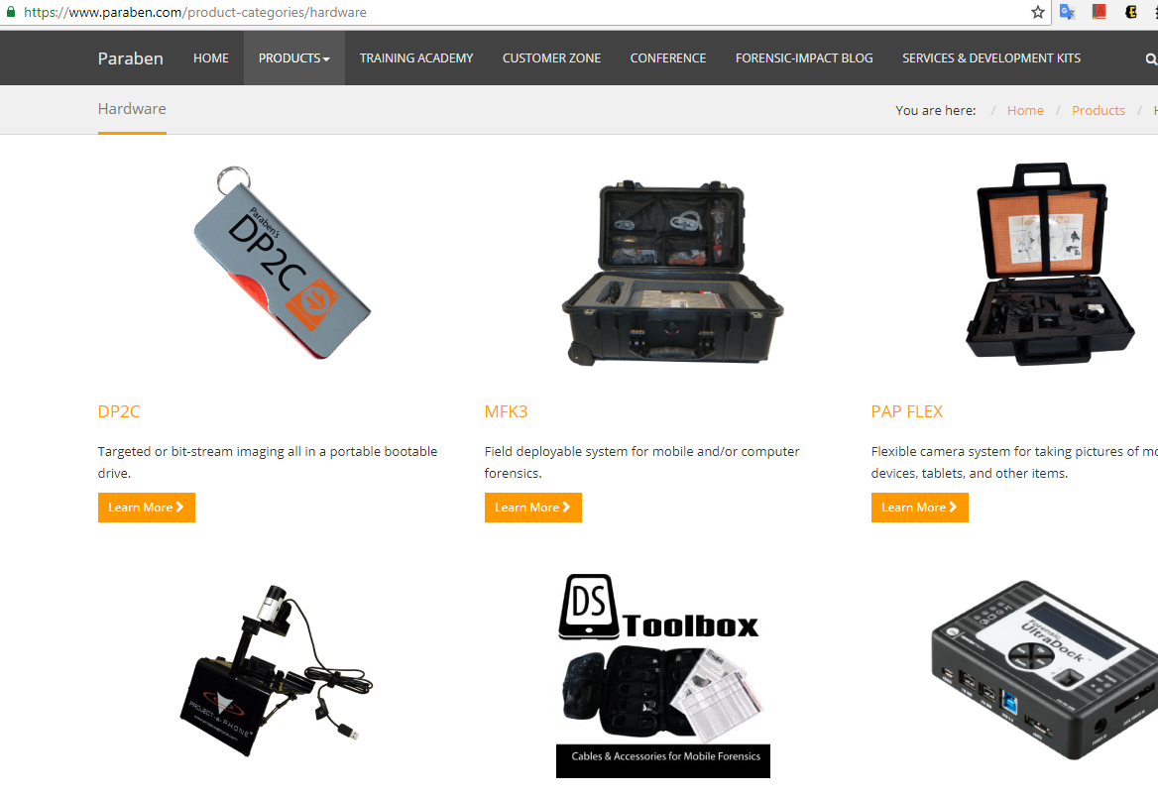
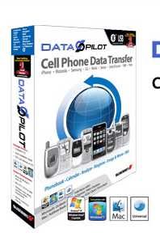

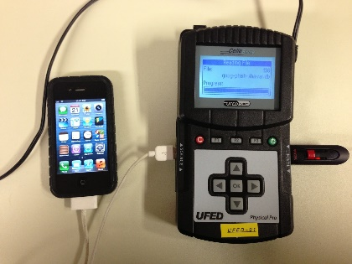
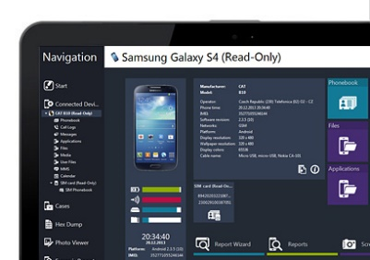
Mobile Forensics Equipment (5 of 6)
Paraben hardware/software offers several tools:
E3:DS – for mobile device investigations
DataPilot – has a collection of cables that can interface with phones from different manufacturers
BitPam - used to view data on many CDMA phones
Cellebrite UFED Forensic System - works with smartphones, PDAs, tablets, and GPS devices
MOBILedit Forensic - contains a built-in write-blocker

Slide 56
Mobile Forensics Equipment (6 of 6)
Software tools differ in the information they display and the level of detail
Some tools are designed for updating files, not retrieving data
In general, tools designed to edit information, although they are user friendly, usually aren’t forensically sound

Slide 57
Using Mobile Forensics Tools (1 of 4)
Cellebrite is often used by law enforcement
You can determine the device’s make and model, learn what has to be done before connecting a mobile device to the UFED device, and then retrieve the data
Three options for data extraction:
Logical
File system
Physical
You can also simply connect a mobile device to a computer to browse the file system and examine and retrieve files
Needs a USB write-blocker

Slide 58
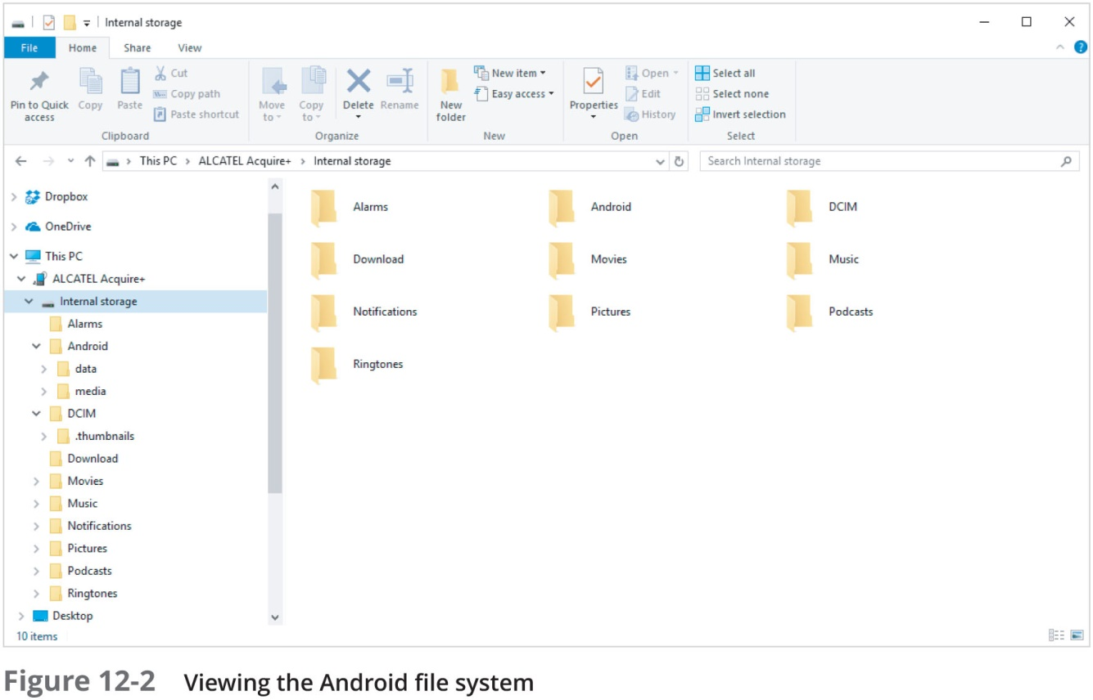
Using Mobile Forensics Tools (2 of 4)

Slide 59
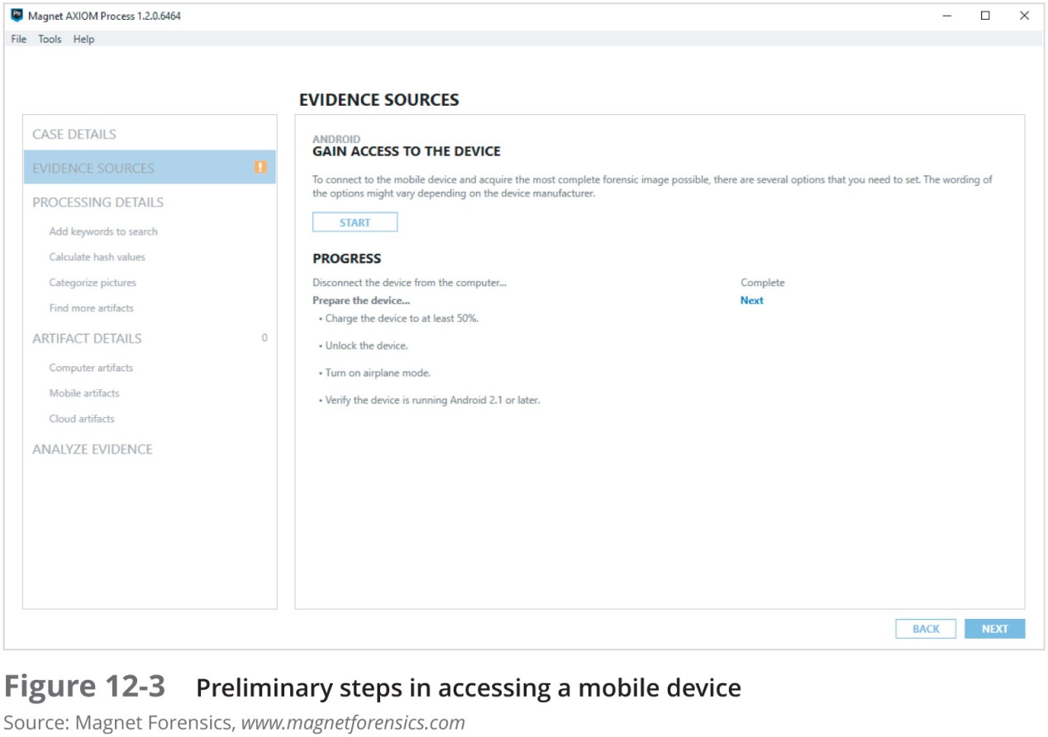
Using Mobile Forensics Tools (3 of 4)

Slide 60
Using Mobile Forensics Tools (4 of 4)
Many mobile forensics tools are available
Most aren’t free
Methods and techniques for acquiring evidence will change as market continues to expand and mature
Subscribe to user groups and professional organizations to stay abreast of what’s happening in the industry

Slide 61
Understanding Forensics in the Internet of Anything (1 of 3)
In 2010, VMware and BlackBerry were developing
Type 2 hypervisors for mobile devices
Useful for security and protecting personal information but will add another level of complexity to forensics investigations
Separate personal information from business-related data
Bring your own device (BYOD) practices make it even more difficult
Internet of Things (IoT)
The number of devices that connect to the Internet is higher than the amount of people
That number is expected to reach 50 billion in the next few decades

Slide 62
Understanding Forensics in the Internet of Anything (2 of 3)
Evolution from Internet of Thing (IoT) to Internet of Everything (IoE) to Internet of Anything (IoA)
IoE adds features that aren’t tangible but are widespread on the Internet
Google search engine and YouTube
IoA includes cars, homes, pets, livestock, and applications for making all these things work together
Eventually will include 5G smart devices
5G devices categories:
enhanced Mobile Broadband (eMBB)
Ultra-reliable and Low-latency Communications (uRLLC)
massive Machine Type Communications (mMTC)

Slide 63
Understanding Forensics in the Internet of Anything (3 of 3)
5G devices introduce new challenges for digital forensics:
People-to-device communications (P2D)
Device-to-device (D2D) communications
Device-to-cloud (D2C) communications
Wearable computers will pose many new challenges for investigators
Vehicle system forensics
Addresses the many parts that have sensors in cars

Slide 64
Summary (1 of 3)
People store a wealth of information on smartphones, including calls, text messages, picture and music files, address books, and more
Mobile devices have gone through four generations: analog, digital personal communications service (PCS), third-generation (3G), and fourth-generation (4G)
5G standards are being negotiated and developed by the IMT 2020 working group of the International Telecommunications Union
Mobile devices range from basic, inexpensive phones used primarily for phone calls to smartphones

Slide 65
Summary (2 of 3)
Data can be retrieved from several different places in phones
Use of personal digital assistants (PDAs) has declined due to the popularity of smartphones
As with computers, proper search and seizure procedures must be followed for mobile devices
To isolate a mobile device from incoming messages, you can put it in airplane mode, turn the device off, or place it in a special treated paint can or evidence bag
SIM cards store data in a hierarchical file structure
Mobile device forensics is becoming more important as these devices grow in popularity

Slide 66
Summary (3 of 3)
Many software tools are available for reading data stored in mobile devices
The Internet of Things (IoT) has resulted in yet another challenge for digital forensics investigators
Collecting information from wearable computers will pose many new challenges for investigators

