Slide 1
Guide to Computer Forensics and Investigations Sixth Edition Chapter 14
Report Writing for High-Tech Investigations
Notes:
Guide to Computer Forensics and Investigations Sixth Edition
Chapter 14
Report Writing for High-Tech Investigations

Slide 2
Objectives
Explain the importance of reports
Describe guidelines for writing reports
Explain how to use forensics tools to generate reports

Slide 3
Understanding the Importance of Reports (1 of 3)
Communicate the results of your investigation
Including expert opinion
Forensic reports can:
Provide justification for collecting more evidence
Be used at a probable cause hearing
Communicate expert opinion
U.S. district courts require expert witnesses to submit written reports
State courts are starting to also require them
“Probable cause hearing” may refer to a preliminary hearing that happens well after the filing of charges, at which the court hears testimony in order to determine whether it’s more likely than not that the defendant committed the alleged crimes. If the court finds “probable cause,” then the case may proceed to trial.

Slide 4
Understanding the Importance of Reports (2 of 3)
Rule 26, Federal Rules of Civil Procedure requires submission of the expert’s written report that includes:
Testimony is based on sufficient facts or data
Testimony is the product of reliable principles and methods
Witness has applied the principles and methods reliably to the facts of the case
Written report must specify fees paid for the expert’s services
And list all other civil or criminal cases in which the expert has testified

Slide 5
Understanding the Importance of Reports (3 of 3)
Keep a copy of any deposition notice or subpoena
Jurisdiction
Style of the case
Cause number
Date and location of the deposition
Name of the deponent
Deposition banks
Examples of expert witness’ previous testimonies

Slide 6
Limiting a Report to Specifics
All reports to clients should start with the job mission or goal, examples including
Find information on a specific subject
Recover certain important documents
Recover certain types of files with specific dates and times
Before you begin writing, identify your audience and the purpose of the report

Slide 7
Types of Reports (1 of 4)
Digital forensics examiners are required to create different types of reports
Examination plan: examiners -question-attorney
What questions to expect when testifying
Attorney uses the examination plan to guide you in your testimony
You can propose changes to clarify or define information
Helps your attorney learn the terms and functions used in computer forensics

Slide 8
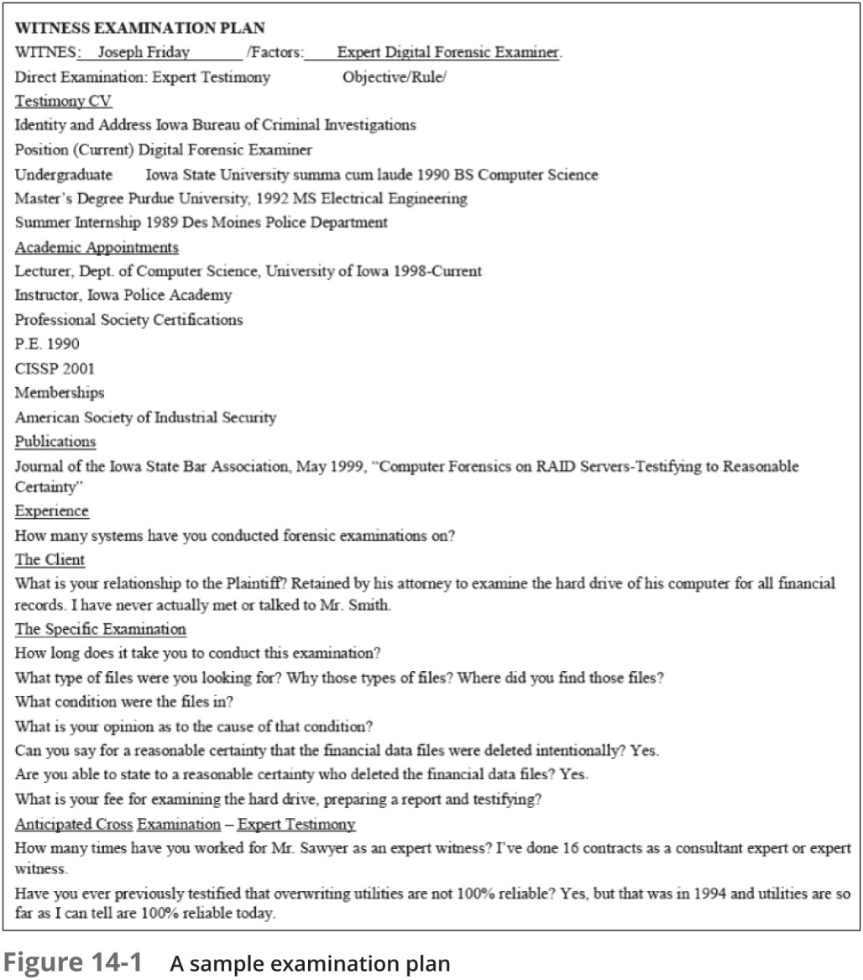
Types of Reports (2 of 4)

Slide 9
Types of Reports (3 of 4)
Verbal report
Less structured
Takes place in an attorney’s office
Attorneys cannot be forced to release verbal reports
Preliminary report
Addresses areas of investigation yet to be completed
Hypothetical tests that have not been concluded
Interrogatories: lawyer want to address to opposing parties
Document production: subpoenas
Depositions: who should be deposed

Slide 10
Types of Reports (4 of 4)
Written report
Affidavit or declaration
Sworn to under oath
Limit what you write and pay attention to details
Include thorough documentation and support of what you write

Slide 11
Guidelines for Writing Reports (1 of 2)
Hypothetical questions based on factual evidence
Guide and support your opinion
Can be abused and overly complex
State the facts needed to answer the question
Don’t include any unnecessary facts
Opinions/conclusion based on knowledge and experience
Based on Data

Slide 12
Guidelines for Writing Reports (2 of 2)
As an expert witness, you may testify to an opinion or conclusion, if four basic conditions are met:
Witness should qualify as a true expert in the field
Experts must know facts on which their opinions are based, or they must testify to a hypothetical question
Opinion, inferences, or conclusions depend on special knowledge, skills, or training
Witness must testify to a reasonable degree of certainty

Slide 13
What to Include in Written Preliminary Reports (1 of 2)
Anything you write down as part of your examination for a report
Subject to discovery from the opposing attorney
Discovery: the process of opposing attorneys seeking information from each other
Written preliminary reports are considered high-risk documents
Example of preliminary report: one created in software tools before all data analysis is complemented.
It’s better if there’s no preliminary written report to provide
Destroying the preliminary report could be considered destroying or concealing evidence (spoliation)

Slide 14
What to Include in Written Preliminary Reports (2 of 2)
Include the same information as in verbal reports
Restate the purpose of the assignment
Summarize what you have accomplished
What system have you have examed
Which tools have used
What you have seen
State evidence preservation or protection process used
Additional items to include in your report:
Summarize your billing to date and estimate costs to complete the effort
Identify the tentative conclusion (rather than the preliminary conclusion)
Identify areas for further investigation and get confirmation from the attorney on the scope of your examination

Slide 15
Report Structure (1 of 2)
Structure
Abstract (summary)
Table of contents
Body of report
Conclusion
References
Glossary
Acknowledgements
Appendixes

Slide 16
Report Structure (2 of 2)
An abstract condenses the report to concentrate on the essential information
The body consists of the introduction and discussion sections
The conclusion starts by referring to the report’s purpose, states the main points, draws conclusions, and possibly renders an opinion
References and appendixes list the supporting material to which your work refers

Slide 17
Writing Reports Clearly (1 of 3)
Consider
Communicative quality: easy to read?
Ideas and organization: information related and organized?
Grammar and vocabulary
Punctuation and spelling
Lay out ideas in logical order
Each sentence follow from the previous one
Build arguments piece by piece
Group related ideas and sentences into paragraphs
Group paragraphs into sections

Slide 18
Writing Reports Clearly (2 of 3)
Avoid jargon, slang, and colloquial terms
Define technical terms
Consider your audience
Considering writing style
Use a natural language style: use “I”
Avoid repetition, vague language, and generalizations:
“The problem” , you need to define what the problem
Use active rather than passive voice
Avoid presenting too many details and personal observations

Slide 19
Writing Reports Clearly (3 of 3)
Considering writing style (cont’d)
Project objectivity
Communicate calm, detached observations
Including signposts
Draw reader’s attention to a point
The step is to …
The results show that…
Assist readers in scanning the text quickly by highlighting the main points and logical development of information

Slide 20
Designing the Layout and Presentation of Reports (1 of 4)
Two numbering systems are typically used
Decimal numbering structure
Divides material into sections
Readers can scan heading
Readers see how parts relate to each other
Legal-sequential numbering
Used in pleadings
Roman numerals represent major aspects
Arabic numbers are supporting information

Slide 21
Designing the Layout and Presentation of Reports (2 of 4)
Providing supporting material
Use material such as figures, tables, data, and equations to help tell the story as it unfolds
Formatting consistently
How you format text is less important than being consistent in applying formatting
Explaining examination and data collection methods
Critical part of the report
Explain how you studied the problem, which should follow logically from the report’s purpose
Data source
How to collect data, tools, procedures, techniques

Slide 22
Designing the Layout and Presentation of Reports (3 of 4)
Including calculations
If you use any hashing algorithms, be sure to give the common name
Providing for uncertainty and error analysis
Protect your credibility
Explaining results and conclusions
Explain your findings, using subheadings to divide the discussion into logical parts
Save broader generalizations and summaries for the report’s conclusion

Slide 23
Designing the Layout and Presentation of Reports (4 of 4)
Providing references
Cite references by author’s last name and year of publication
Follow a standard format
Including appendixes
You can include appendixes containing material such as raw data, figures not used in the body of the report, and anticipated exhibits
Arrange them in the order referred to in the report

Slide 24
Example: Overview/Case Summary
Example:
On today's date, John Doe contacted my office in regards to imaging a stolen laptop computer running Windows® XP Professional that had been recovered. Doe is requesting a forensic examination to see what company documents may have been stolen by the suspect(s) and is requesting a full forensic examination and report for possible criminal charges & civil litigation.
This section will vary in length. You will include any relevant information regarding what led to you as the forensic examiner/analyst becoming involved with the digital evidence. You may be just receiving the forensic image and someone else conducted the forensic acquisition and this is a good place to document that as this will correlate with your chain of custody information that you immediately started once you came into contact with the digital evidence. Remember, this is an overview and a summary of how the case was initialized and where you as the examiner/analyst became involved.

Slide 25
Example: Forensic Acquisition & Exam Preparation
Example:
On today's date I began the forensic acquisition/imaging process of the stolen laptop. Prior to imaging the stolen laptop, I photographed the laptop, documenting any identifiers (e.g., make, model, serial #), unique markings, visible damage, etc. while maintaining chain of custody.
Using a sterile storage media (examination medium) that had been previously forensically wiped and verified by this examiner (MD5 hash value: ed6be165b631918f3cca01eccad378dd) using ABC tool version 1.0. The MD5 hash value for the examination medium yielded the same MD5 hash value as previous forensic wipes to sterilize this media.
At this point, I removed the hard drive from the stolen laptop and connected it to my hardware write-blocker, which is running the most recent firmware and has been verified by this examiner. After connecting the hardware write blocker to the suspect hard drive, I connected the hardware write blocker via USB 2.0 to my forensic examination machine to begin the forensic imaging process?
Etc, etc.

Slide 26
This section is very important, as you must detail your interaction with the digital evidence and the steps taken to preserve and forensically acquire the evidence.
Any additional steps that you take (e.g. forensically wiping storage/examination media, etc.) should be notated in this section of your report.
Remember, this section of your report is usually where you as the examiner/analyst came into contact with the digital evidence and thoroughly documenting what you have done is very important to the integrity of the digital evidence and your chain of custody.
Examiner's Tip: You should have a digital camera in your forensic toolkit. Take a picture of the evidence and document each step of the forensic acquisition and preparation process. Regardless, if you include the picture in your report or as an exhibit, this picture is a perfect field note for you as the examiner to reference when completing your report.
You will also need to include that you verified your forensic image and notate the hash values (e.g., MD5, SHA-1).
You will also need to briefly describe the process you used when making a working copy from the forensic image of the original evidence.

Slide 27
Findings and Report (Forensic Analysis)
Example:
After completing the forensic acquisition of the stolen laptop I began analyzing the forensic image of the stolen laptop with Forensic Tool
I used the following tools for forensic analysis, which are licensed to this examiner:
Guidance® Software's EnCase® 6.17
SANS Investigative Forensic Toolkit (SIFT) Version 2.0
Internet Evidence Finder v3.3
RegRipper by Harlan Carvey
Microsoft® Excel 2007
A review of the Internet history using Internet Evidence Finder, the following data was recovered from sector 117004, which shows a Facebook email between John Doe and Jane Doe. Further analysis shows that a John Doe logged into his Google Mail account. See screenshots below:

Slide 28
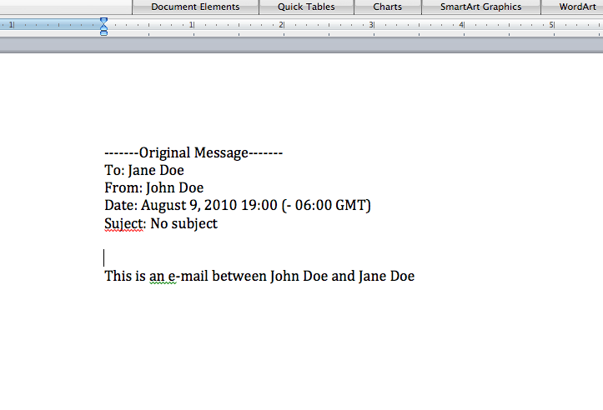
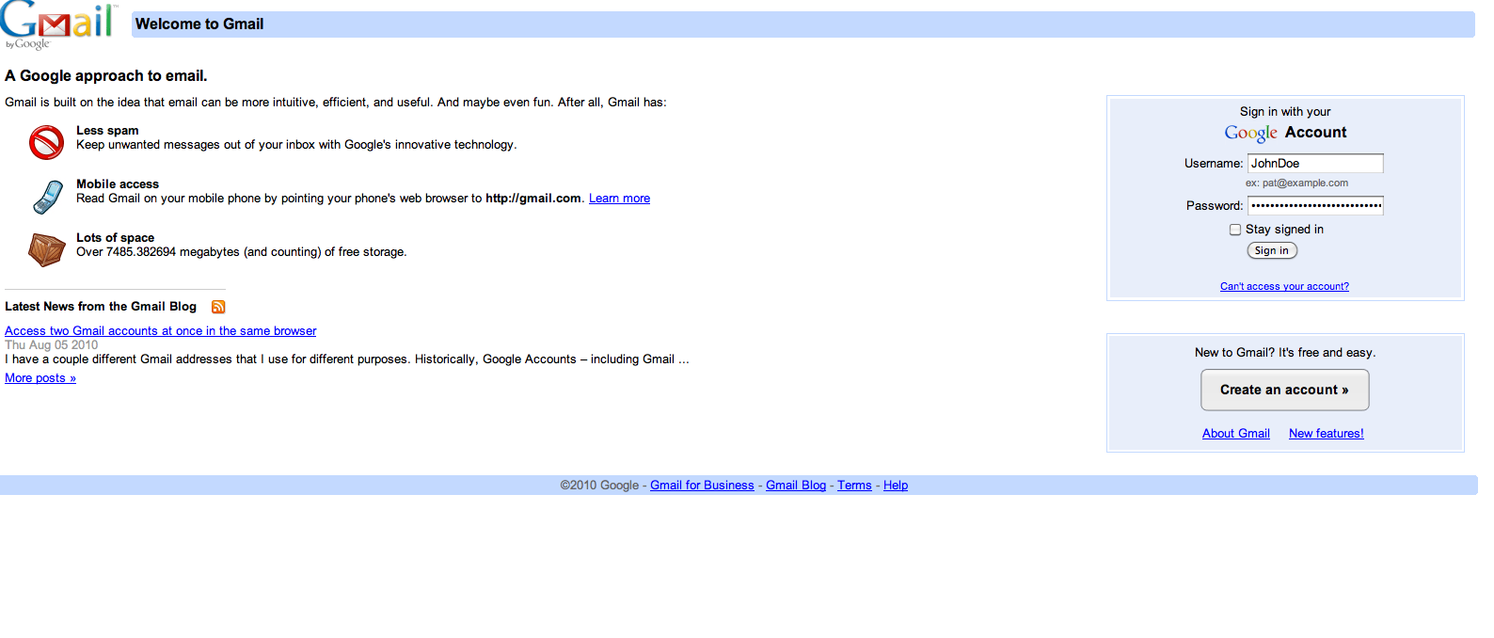

Slide 29
Example: Conclusion
In this section, you are basing your conclusion off the forensic evidence. Remember, the goal of the forensic examination is to report the facts, regardless if the evidence is inculpatory or exculpatory in nature.
A successful forensic examination is one that is very thorough and one in which you "leave no stone unturned".
In the scenario that I provided using a recovered stolen laptop, what else might you include besides e-mail and browser forensics in your analysis to put the suspect in possession and at the keyboard of the stolen laptop?
What about registry analysis to see what IP addresses the machine connected to in the SYSTEM hive: \CurrentControlSet\Services\{Adapter}\Parameters\Tcpip key?
Where else would you look and what would you look for?

Slide 30
Generating Report Findings with Forensics Software Tools
Forensics tools generate reports when performing analysis
It is still your responsibility to explain the significance of the evidence
Report formats
Plaintext
Word processor
Spreadsheet
HTML format

Slide 31
Using Autopsy to Generate Reports (1 of 4)
Follow Activity steps starting on page 575

Slide 32
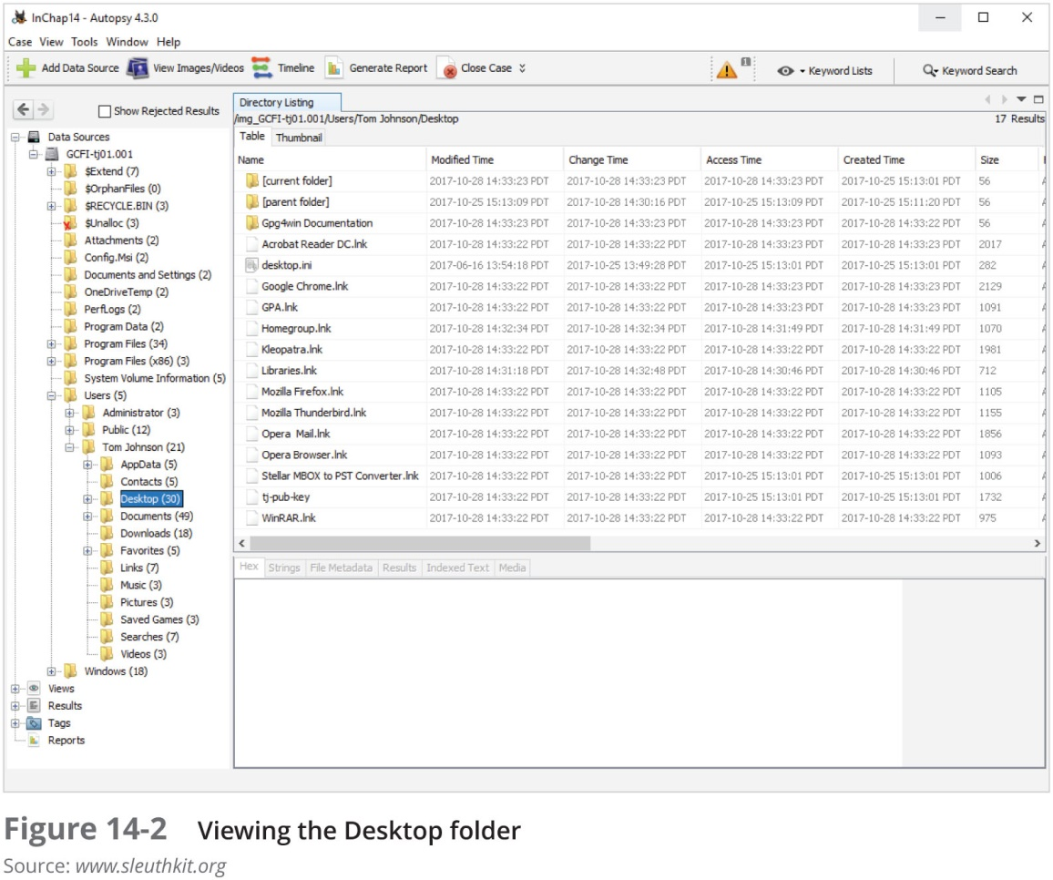
Using Autopsy to Generate Reports (2 of 4)

Slide 33
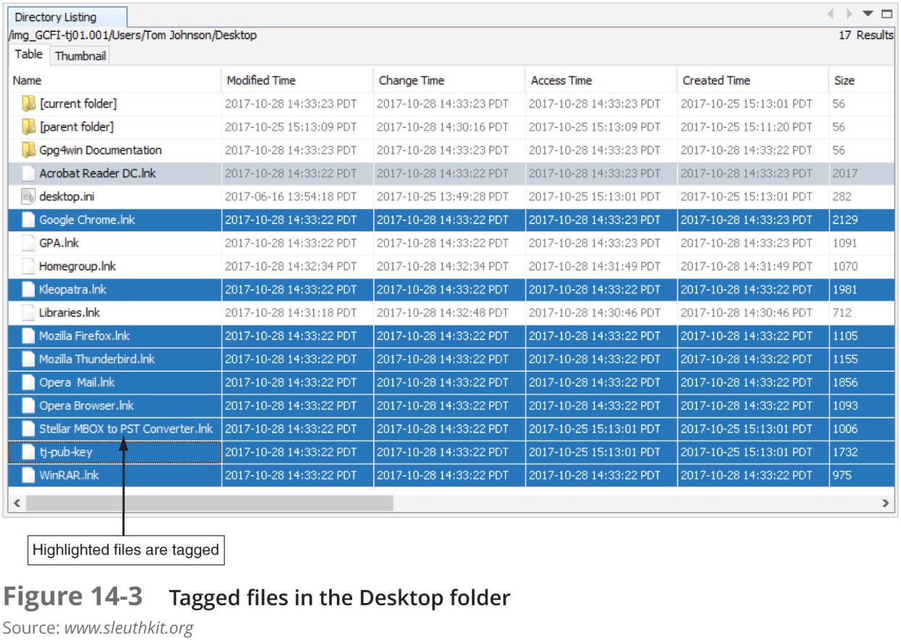
Using Autopsy to Generate Reports (3 of 4)

Slide 34
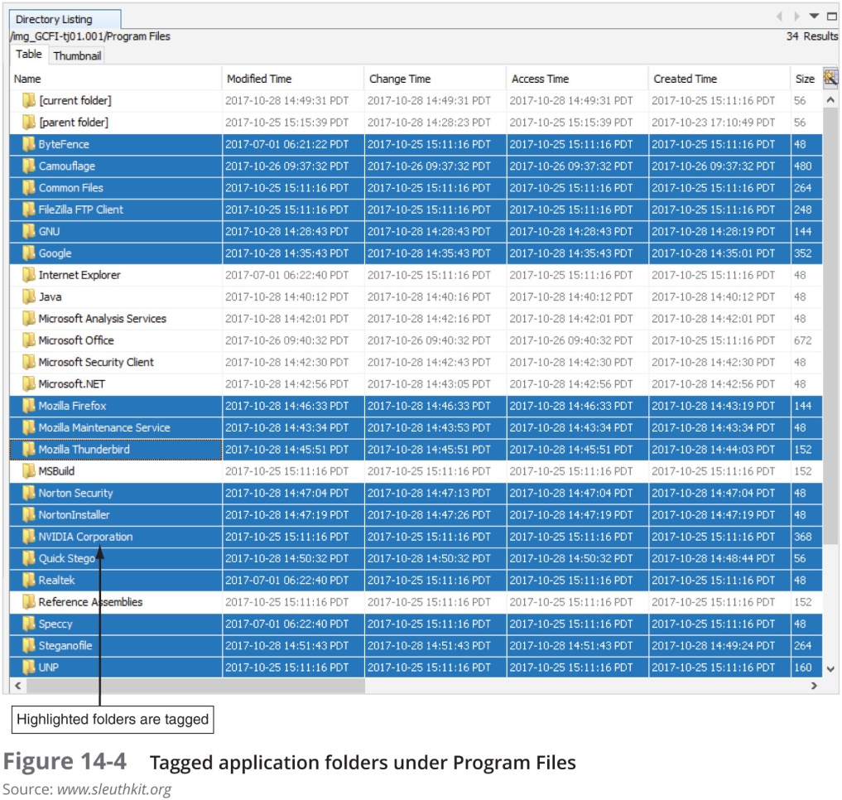
Using Autopsy to Generate Reports (4 of 4)

Slide 35
Summary (1 of 2)
All U.S. district courts and many state courts require expert witnesses to submit written reports
Rule 26 of the FRCP requires expert witnesses who anticipate testifying to submit written reports
Attorneys use deposition banks to research expert witnesses’ previous testimony
Reports should answer the questions you were retained to answer

Slide 36
Summary (2 of 2)
A well-defined report structure contributes to readers’ ability to understand the information you’re communicating
Clarity of writing is critical to a report’s success
Convey a tone of objectivity and be detached in your observations

Slide 37
Reference
https://digital-forensics.sans.org/blog/2010/08/25/intro-report-writing-digital-forensics/

