Slide 1
Windows Forensics Fat16 and Fat32

Slide 2
FAT File System Layout on disk

Slide 3
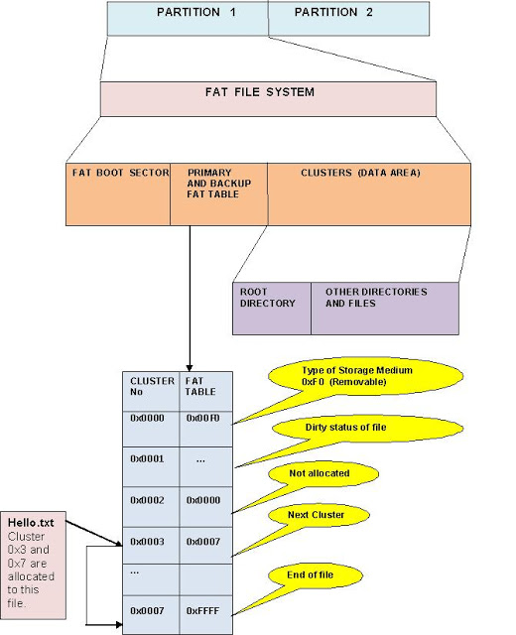
Boot section
Partition Parameters that describe the rest of the file system
It holds a special program (the bootstrap program)
bootstrap program: is used for loading the operating system into memory.
One sector
FAT
a method of keeping track of the contents of a hard drive
used by early Microsoft operating systems
was first introduced in 1977.
Root Directory
contains an entry for each file whose name appears at the root (the top level) of the file system.

Slide 4
FAT 16 Root Sector

Slide 5
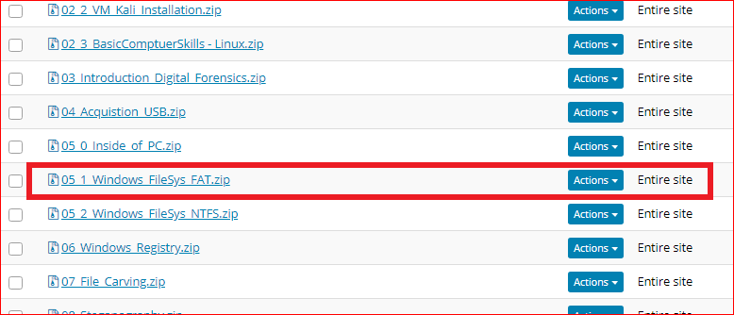
Download files from Sakai

Slide 6
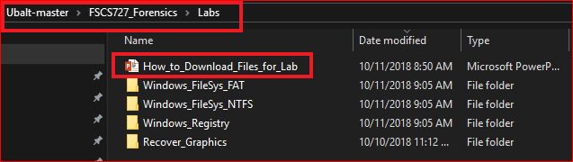
Following the PPTs to download required files for the lab

Slide 7
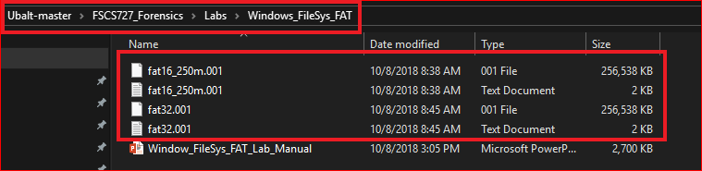
Verify all the files

Slide 8

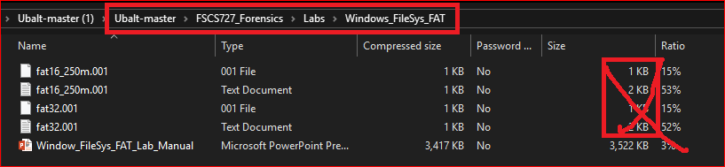
Warning: if you see this (Problem with Github large size files)
Follow next 3 slides to download four fat files again from Github

Slide 9
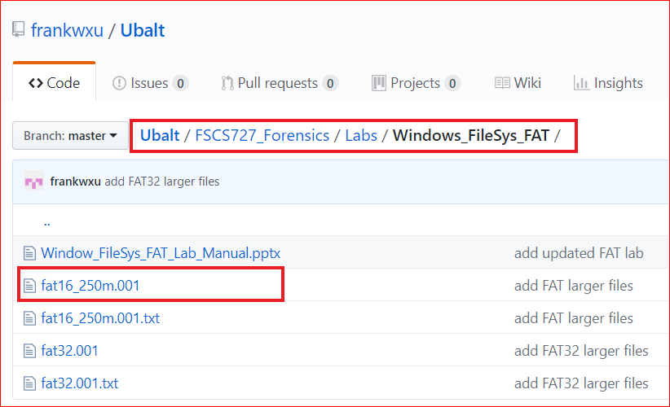
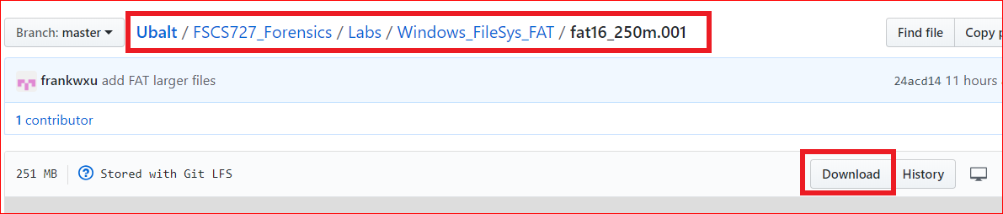

Slide 10
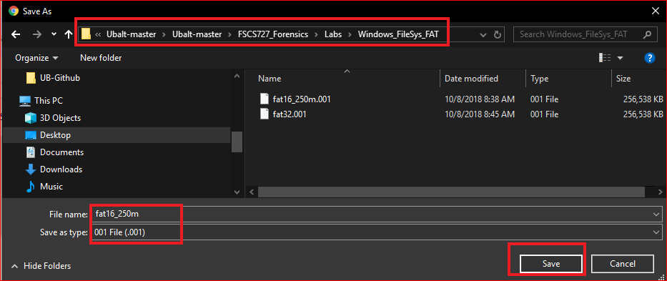

Slide 11

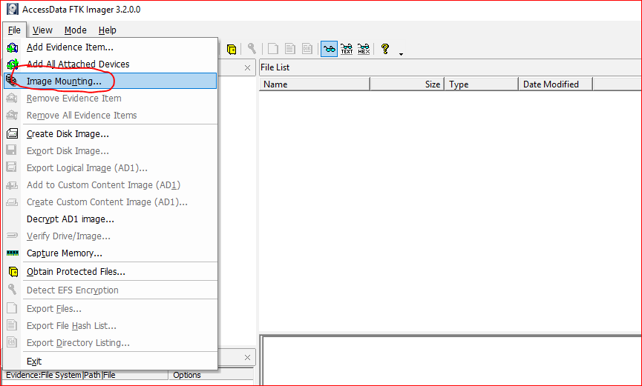

Slide 12
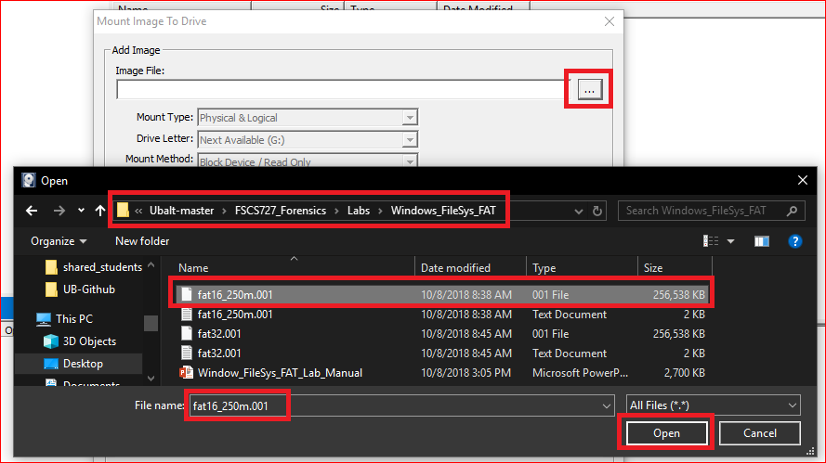

Slide 13
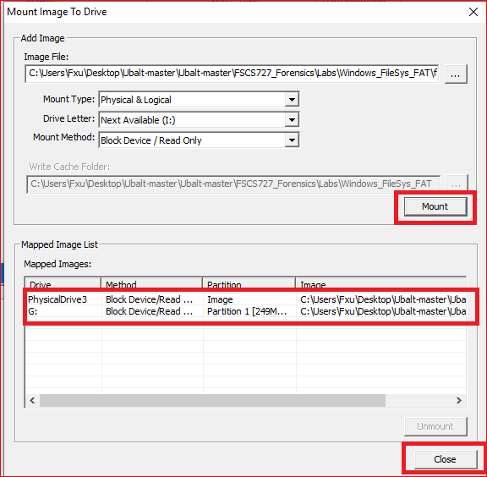
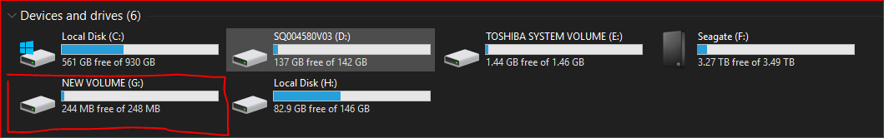

Slide 14
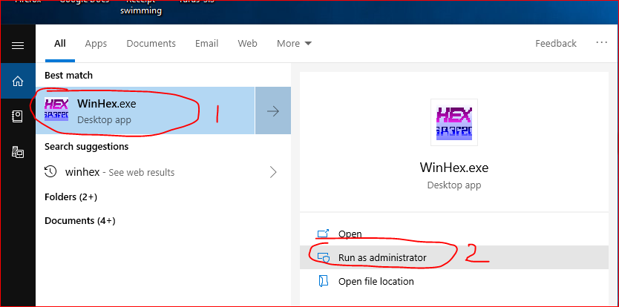
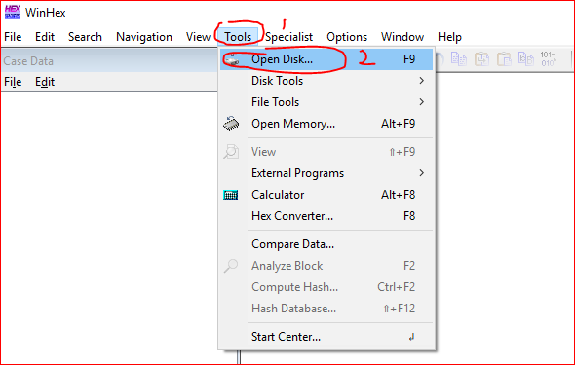

Slide 15
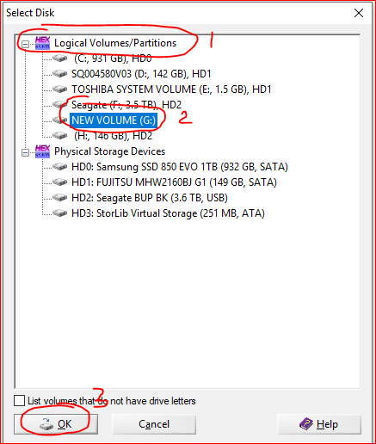

Slide 16
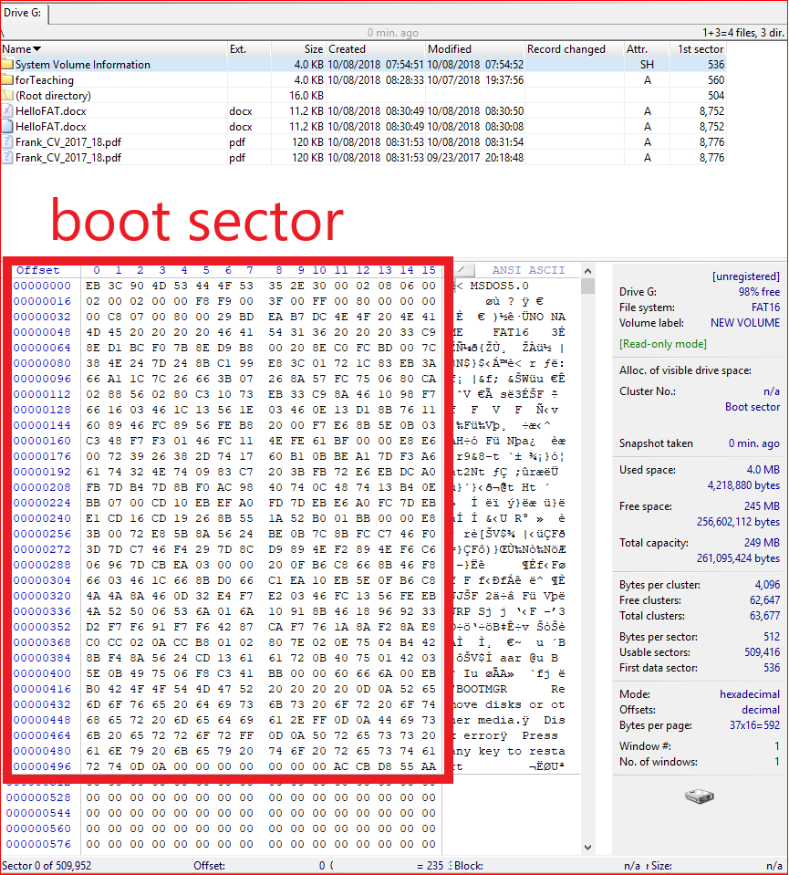

Slide 17
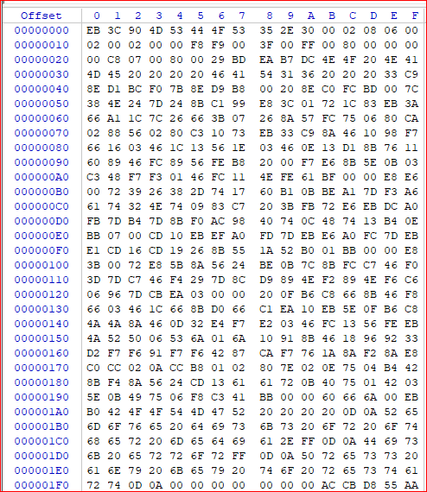

Slide 18
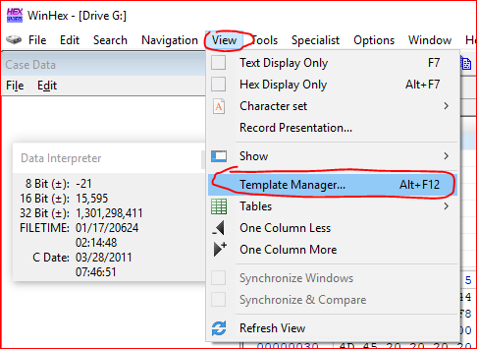
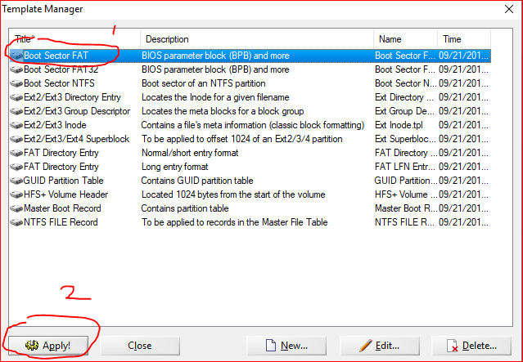

Slide 19
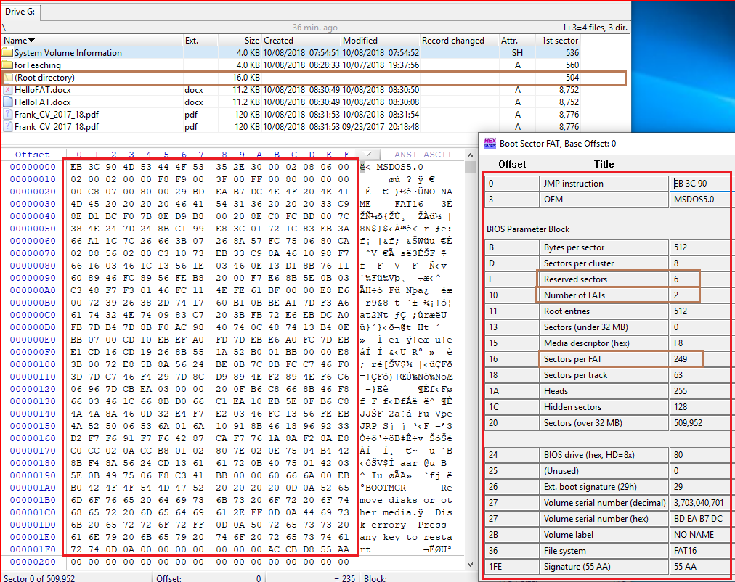
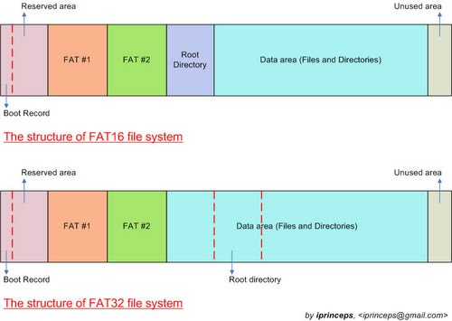
How to calculate the 1st sector of root directory?
1+6+249+249=505
We need minus 1 because of sector starts from 0

Slide 20
Root Directory

Slide 21
The Root Directory
The root directory contains an entry for each file whose name appears at the root (the top level) of the file system.
Each entry is 32 bytes (0x20) in size
a single block can contain 16 of them (=512/32).

Slide 22
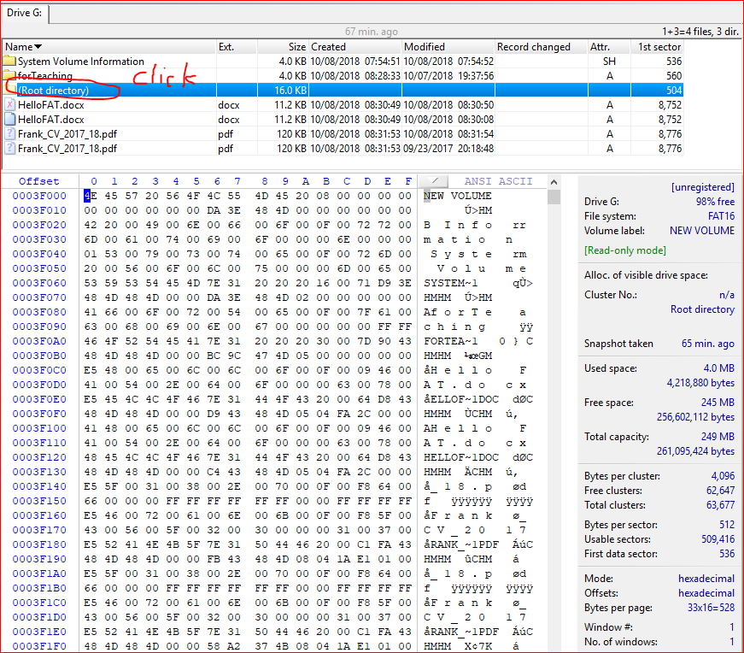

Slide 23
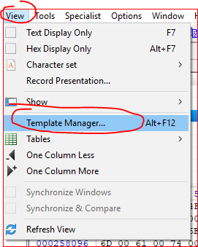
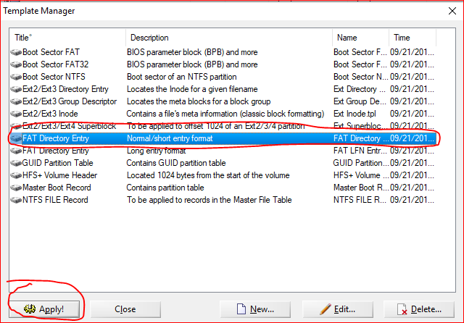

Slide 24
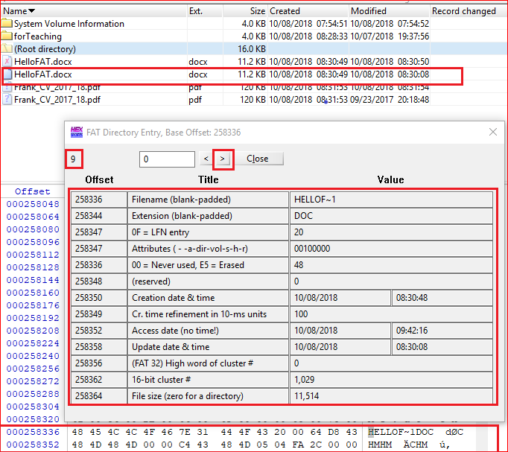
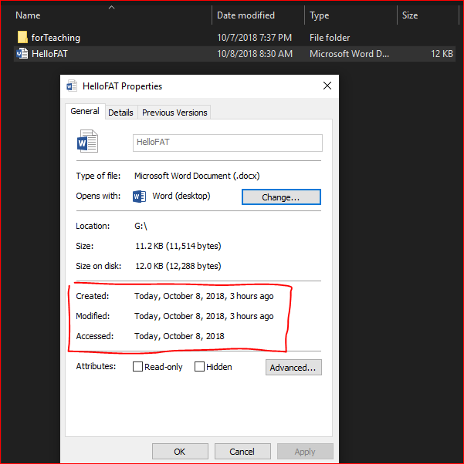

Slide 25
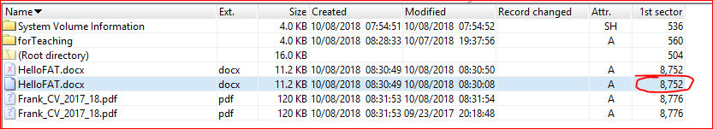
Why 8752

Slide 26
Boot sector (1) + Reserved sections (6) + FAT 1 (249) + FAT (249) + Root (32) + Cluster (1029 -2) *8
Size of root: 512 entry* 32 byte/ 512 byte /sector=32 sector

Slide 27
FAT 32

Slide 29
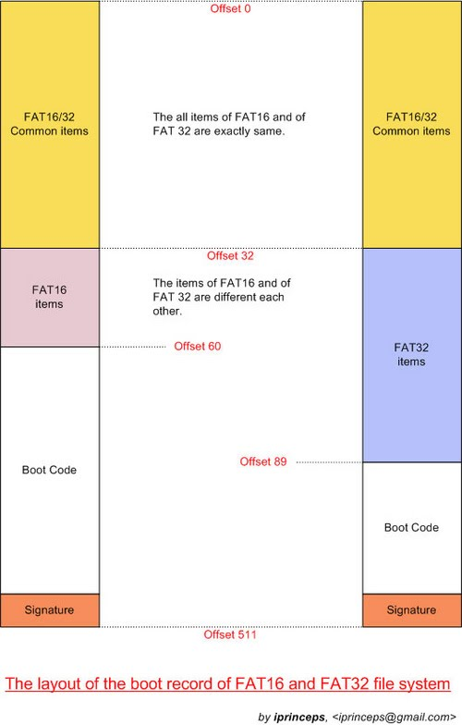

Slide 30
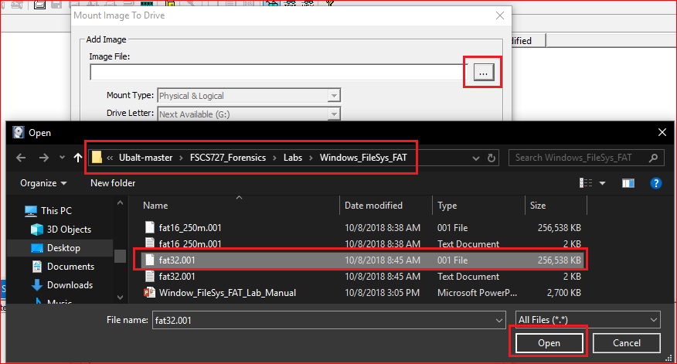

Slide 31
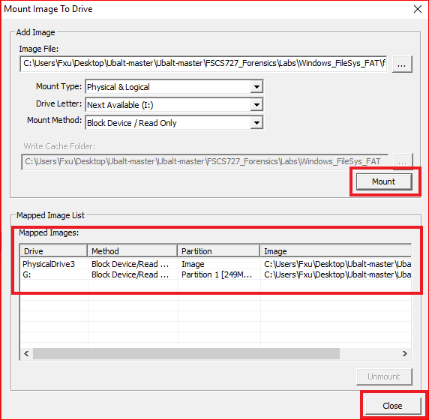
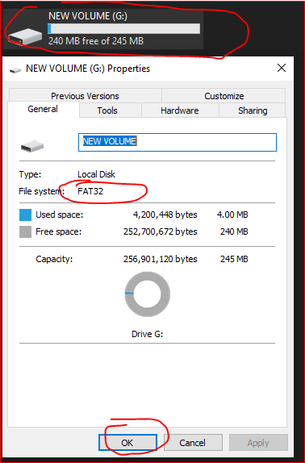

Slide 32
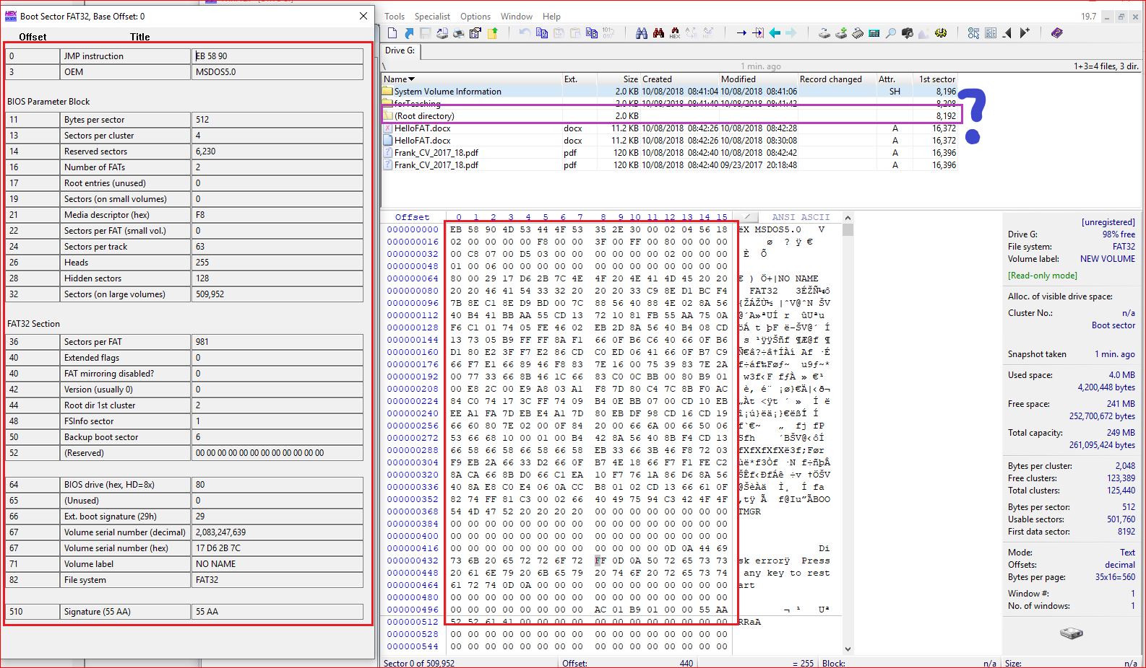
Boot sector (1) + Reserved sections (6230) + FAT 1 (981) + FAT2 (981)

Slide 33
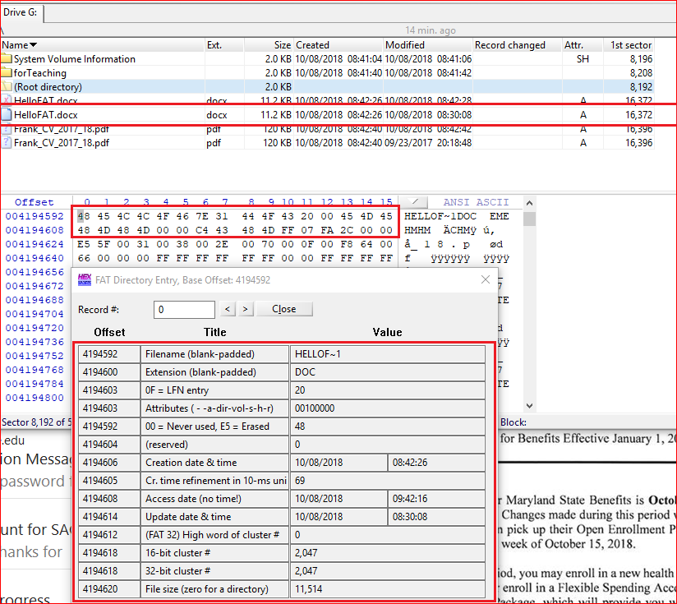

Slide 34
Reference
https://sites.google.com/site/iprinceps/Home/embedded-system-and-operating-systems/understanding-file-system
http://www.dewassoc.com/kbase/hard_drives/boot_sector.htm
http://www.tavi.co.uk/phobos/fat.html
https://www.compuphase.com/mbr_fat.htm
http://www.cse.scu.edu/~tschwarz/COEN252_09/Lectures/FatExample.html
http://havefunwhileulearn.blogspot.com/2010/05/dissecting-fat-16-file-system.html

