Slide 1
Email Forensics

Slide 2
Outlook PST files
Personal Storage Table files

Slide 3
Personal Storage Table or Personal Folders File
Is a file where Microsoft Outlook stores all of your Outlook items: Email, Calendar events, Contacts, Tasks and other.
After you setup your account in Microsoft Outlook it will automatically create a PST file and associate it with your created account.

Slide 4
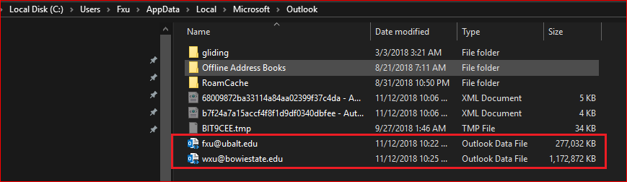
Where is a PST file located?

Slide 5
Extract Emails

Slide 6
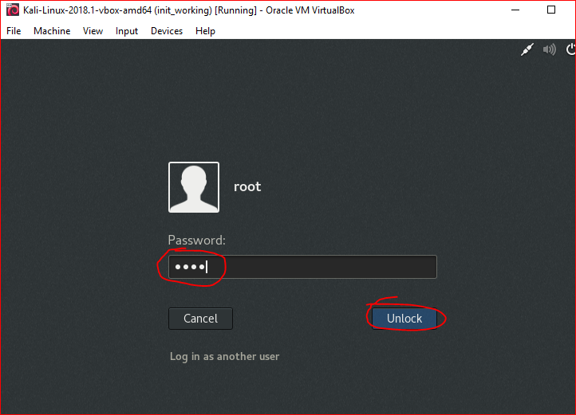

Slide 7
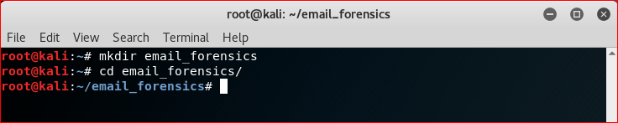

Slide 8
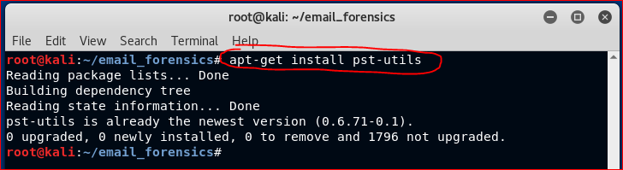

Slide 9

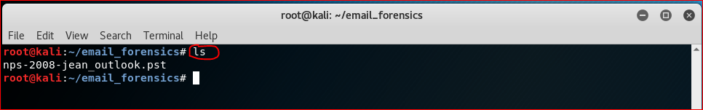

Slide 10
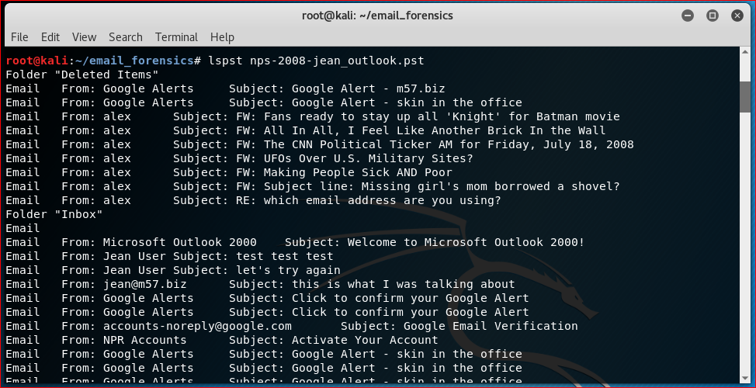

Slide 11
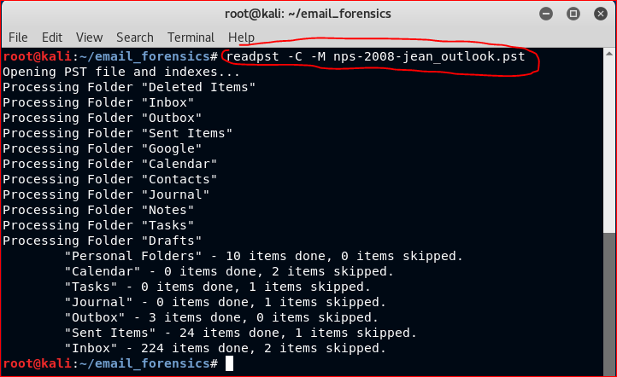
-C = standard character set
-M = output messages RFC 822 format (test messages) as separate files

Slide 12
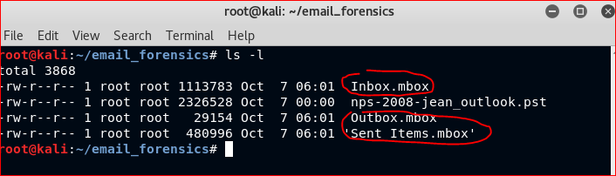

Slide 13
Extract Images

Slide 14
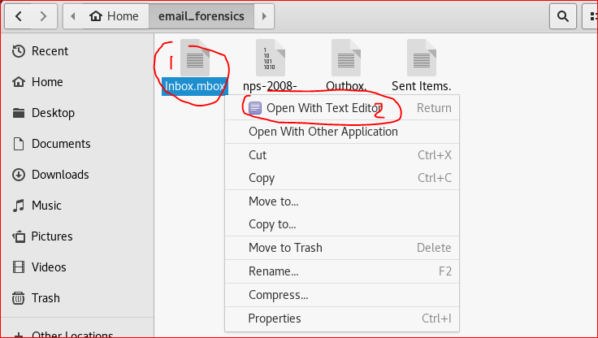
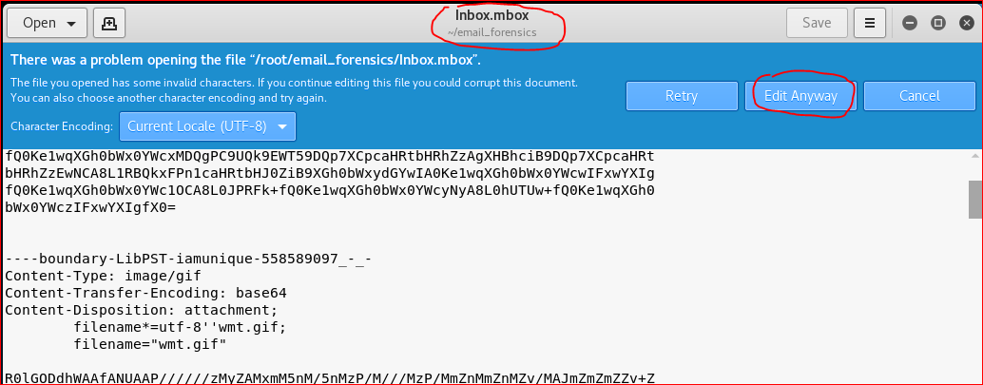

Slide 15
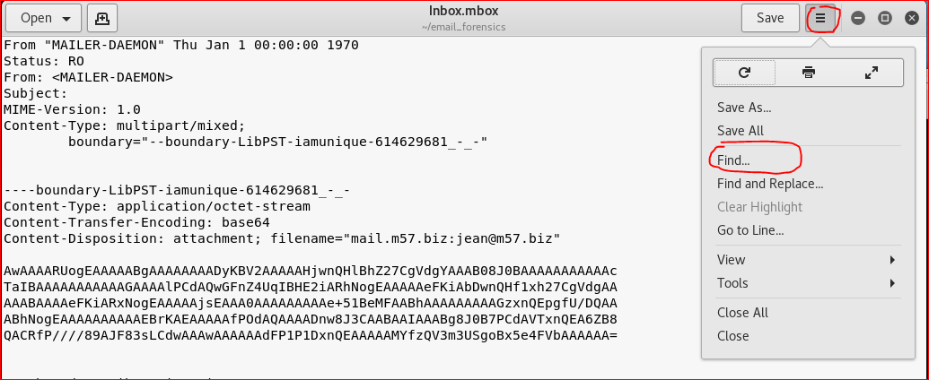

Slide 16
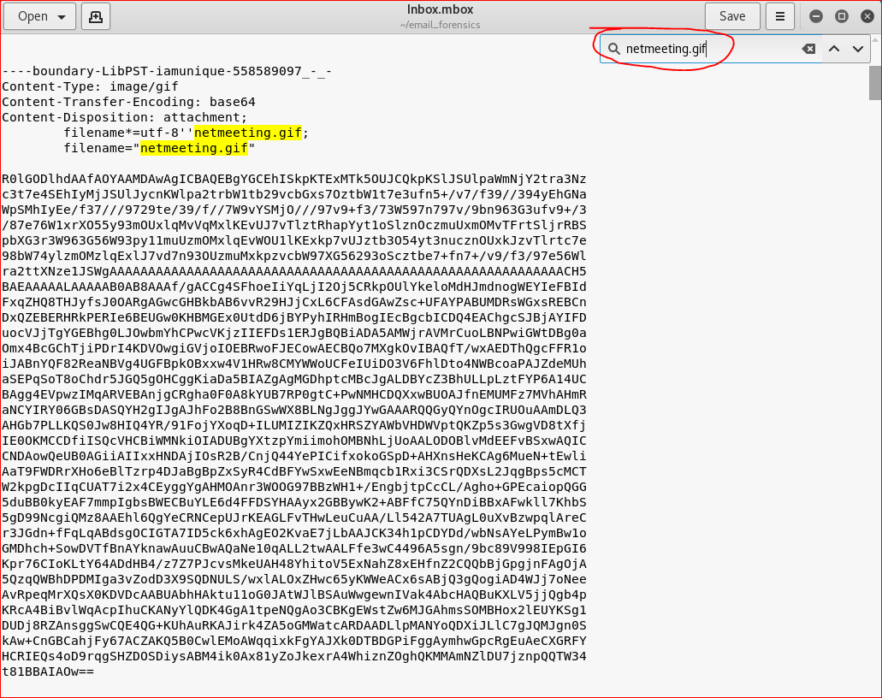
SMTP can’t transmit anything other than ASCII characters therefore attachments are encoded with Base64 encoding to translate non-ascii into ASCII for transmission.

Slide 17
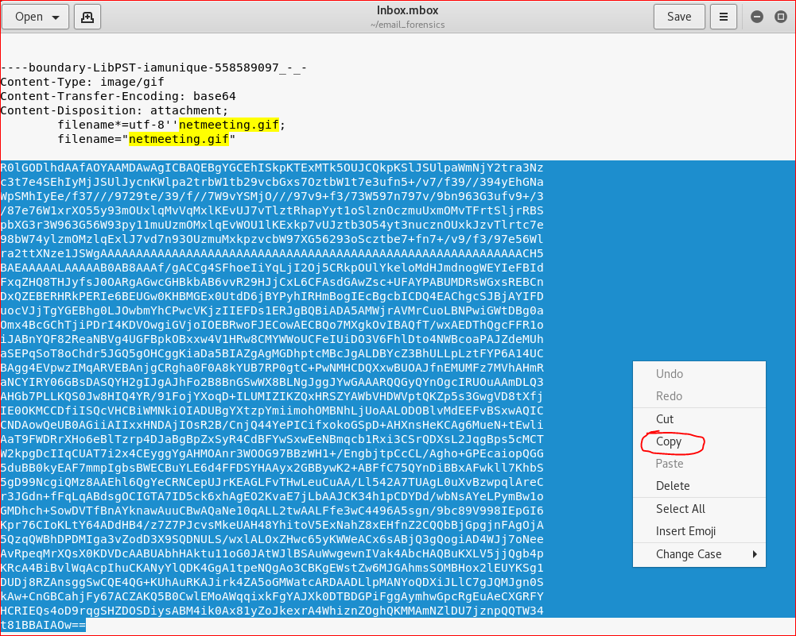

Slide 18
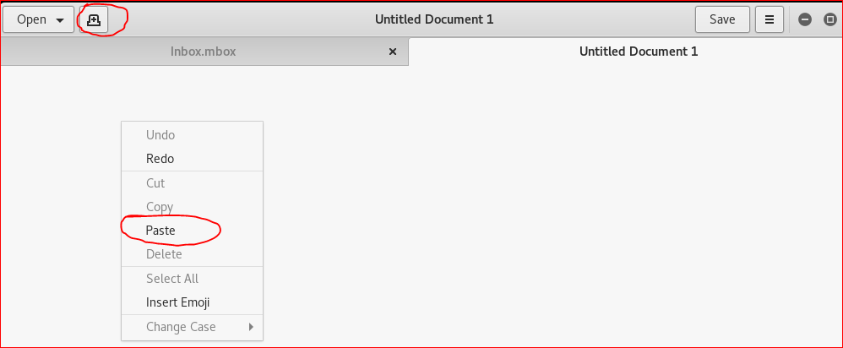

Slide 19
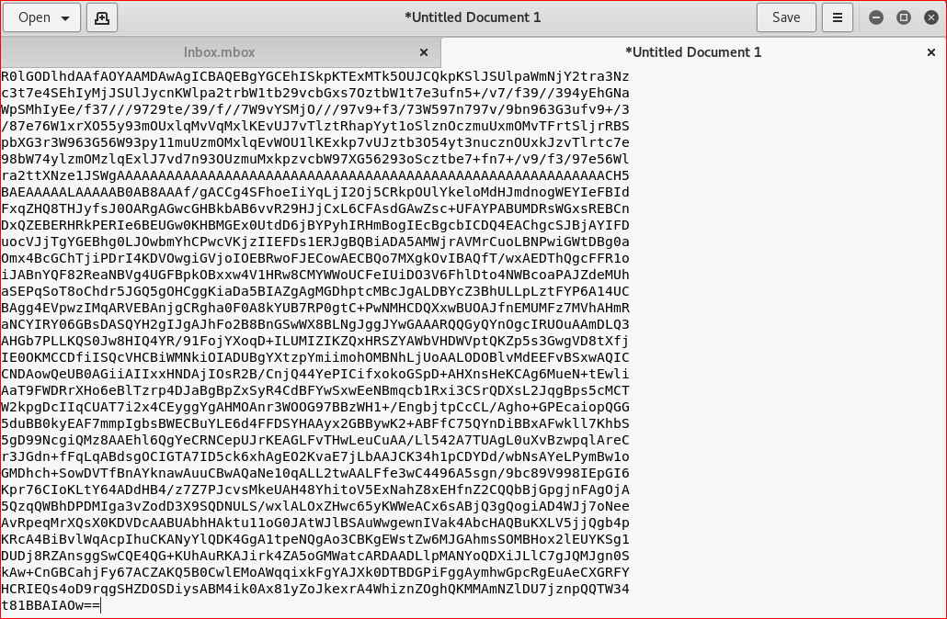

Slide 20
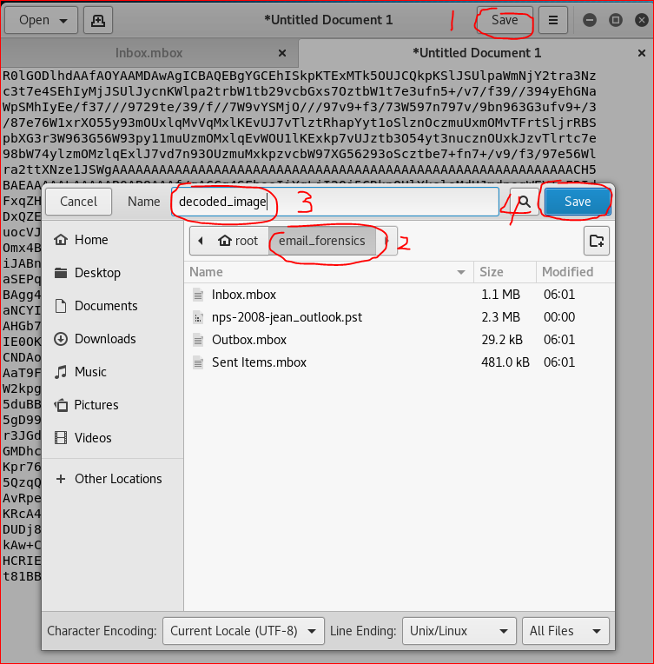

Slide 21
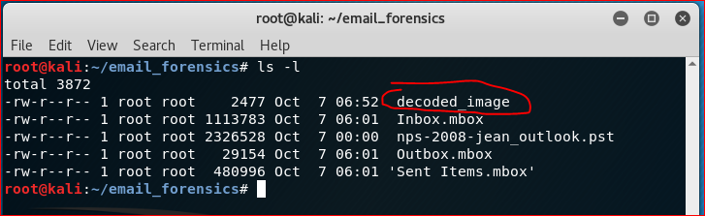

Slide 22
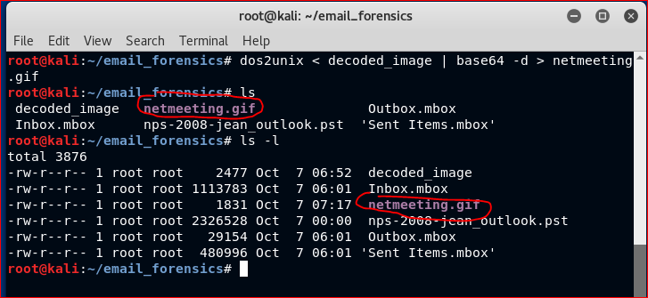

Slide 23
dos2unix
Sometimes, you will need to move files between windows and unix systems. Window files use the same format as Dos, where the end of line is signified by two characters, Carriage Return or CR or \r followed by Line Feed or LF or \n.
Unix files use only Line Feed (\n).
https://www.geeksforgeeks.org/dos2unix-unix2dos-commands/

Slide 24
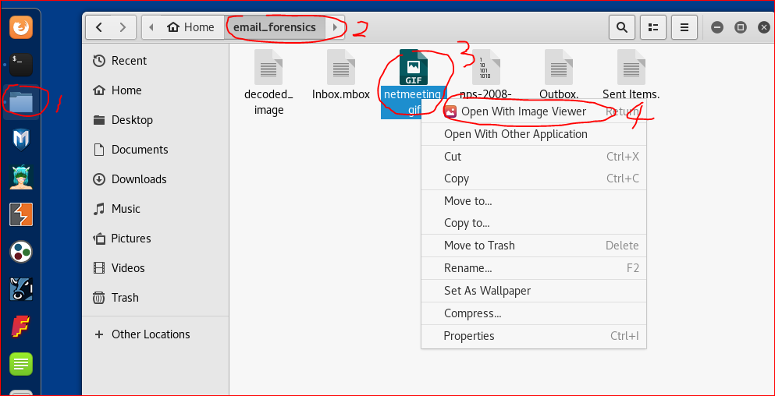

Slide 25
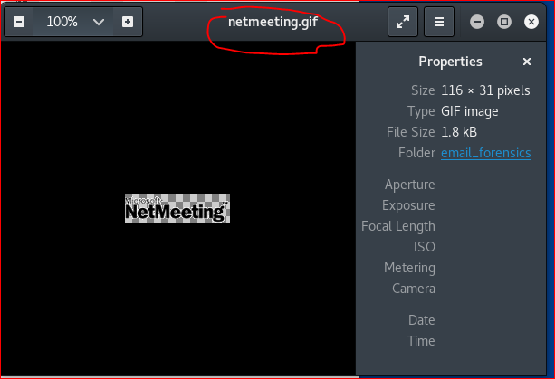

Slide 27
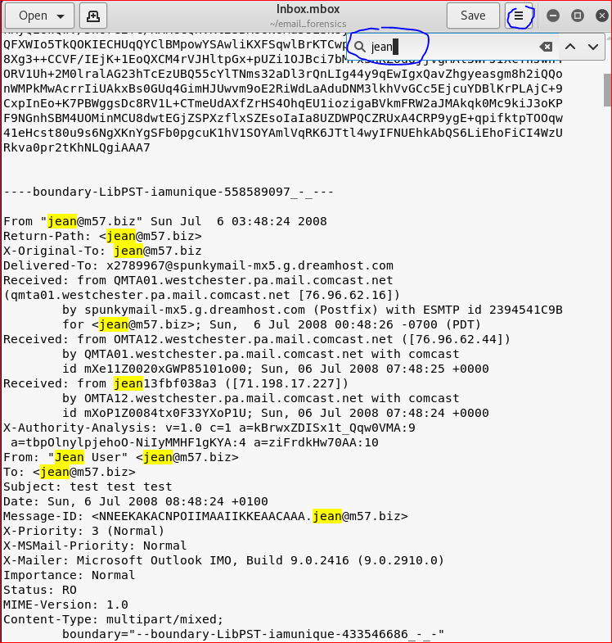

Slide 28
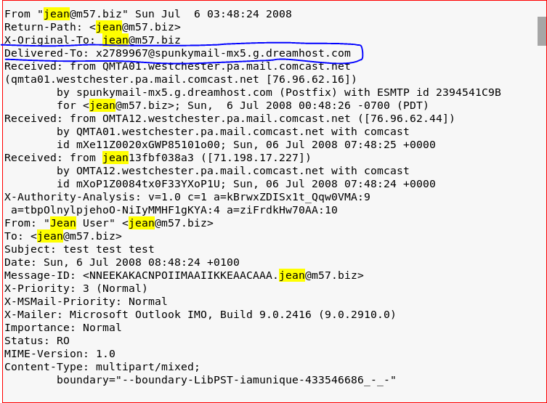
the incoming SMTP server of the message that it was delivered

Slide 29
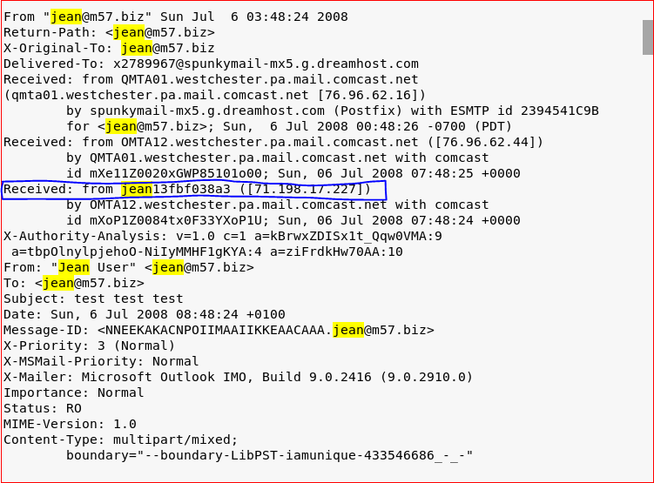
the originator of the message as well as the SMTP server

Slide 30
Your Work

Slide 31
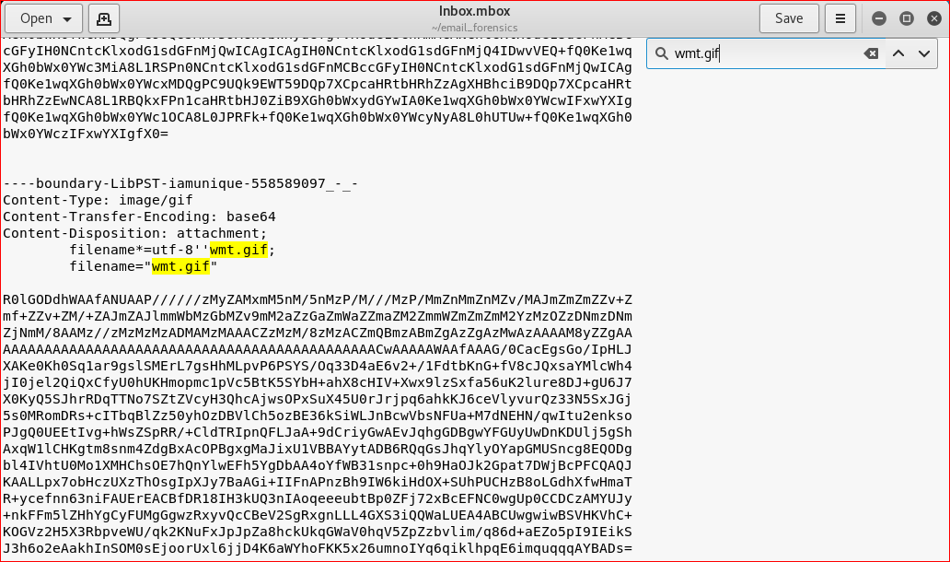

Slide 32
