Slide 1
Window 7 Memory Forensics-Chromehistory

Slide 2
Windows Volatile Memory (RAM)

Slide 3
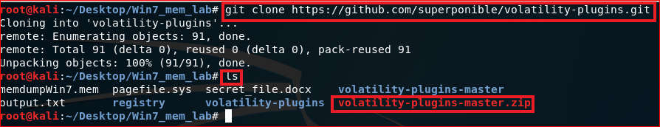
Download volatility plug-ins

Slide 4
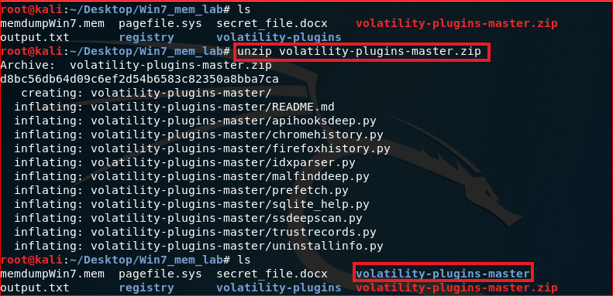
Unzip plug-ins

Slide 5
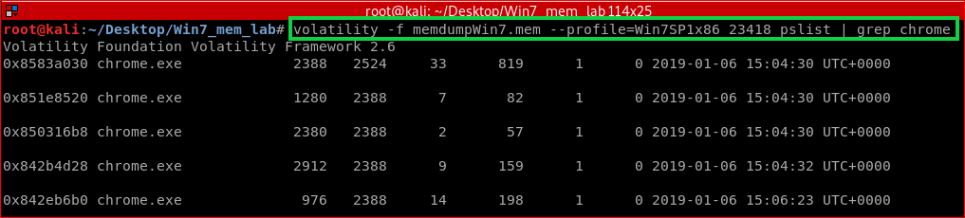

Slide 6
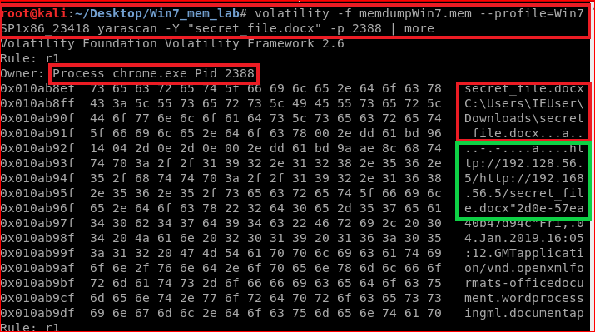

Slide 7
Reference
https://blog.superponible.com/2014/08/31/volatility-plugin-chrome-history/
https://github.com/superponible/volatility-plugins
https://github.com/cube0x8/chrome_ragamuffin
https://volatility-labs.blogspot.com/2012/09/howto-scan-for-internet-cachehistory.html

