Slide 1
Diffie–Hellman Key Exchange

Slide 2
Overview
Public-Key Cryptosystems Based on the Discrete Logarithm Problem

Slide 3
Diffie and Martin Hellman Key exchange protocol
Whitfield Diffie and Martin Hellman
Widely used, e.g. in Secure Shell, Transport Layer Security, and Internet Protocol Security

Slide 4
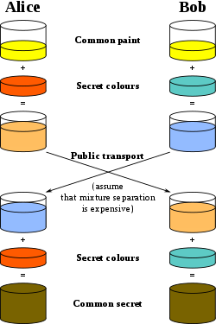
secret
https://en.wikipedia.org/wiki/Diffie%E2%80%93Hellman_key_exchange

Slide 5
Discrete Logarithm Problem
Easy
3 ¹⁰⁰ mod 7 = 4
Difficult to find n
Find n for 3 ^{n} ≡ 4 mode 7

Slide 6


Alice and Bob agree to use a modulus p = 23 and base g = 5
a = 4
A = 5⁴ mod 23 = 4
B = 5³ mod 23 = 10
b = 3
s = 10⁴ mod 23 = 18
S=18
s = 4³ mod 23 = 18
S=18
Proof of correctness:
Alice computes: Bª = (g^{b})ª mod p Bob computes: A^{b} = (gª)^{b} mod p
i.e., Alice and Bob compute the same key k_{AB} !
https://en.wikipedia.org/wiki/Diffie%E2%80%93Hellman_key_exchange

Slide 7
Lab

Slide 8
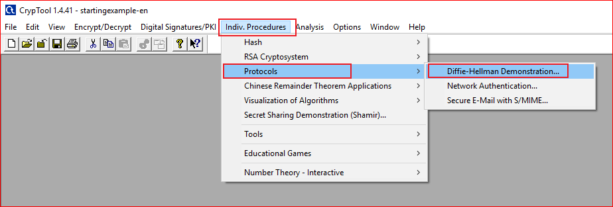

Slide 9
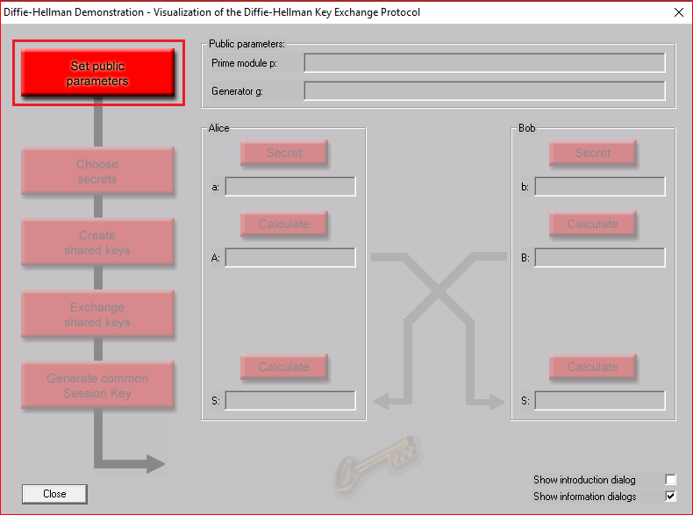
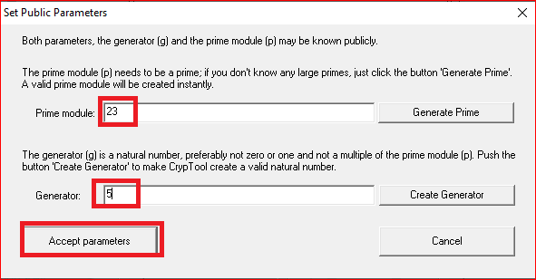

Slide 10
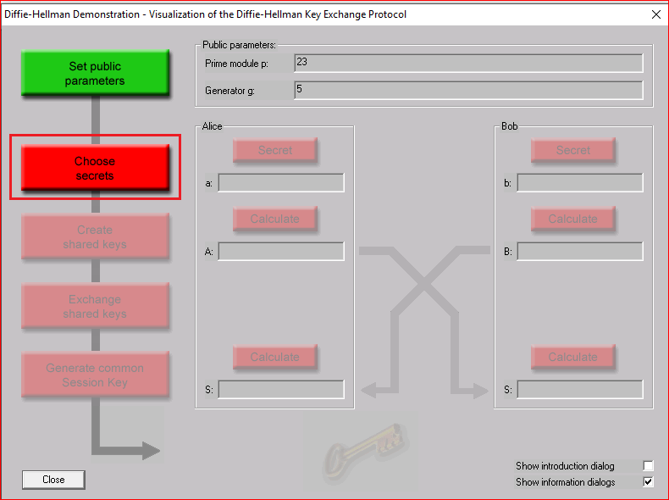
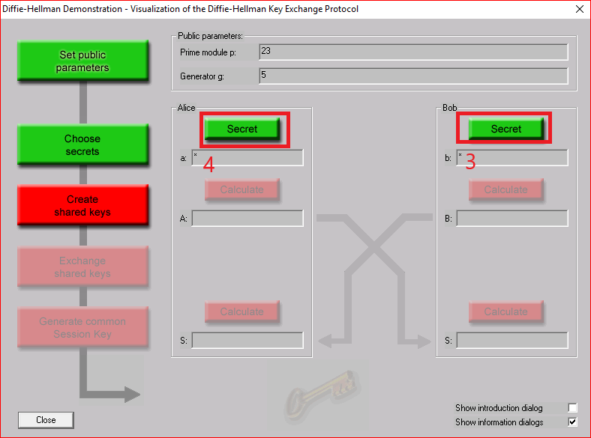

Slide 11
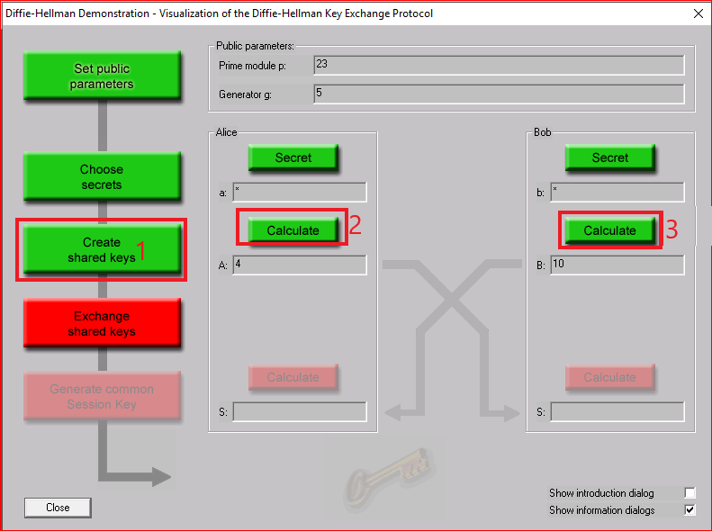
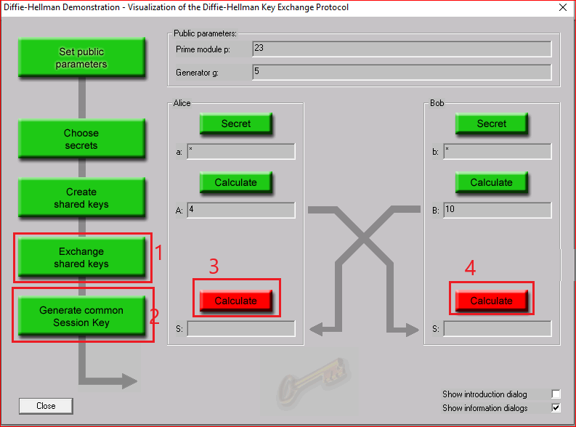

Slide 12
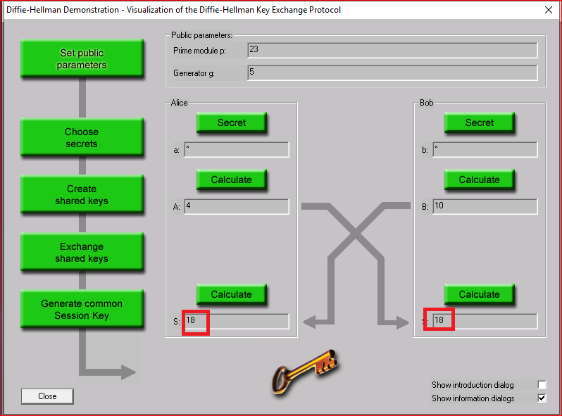

Slide 13
Question
Choose different secrets for Alice and Bob to generate session key.

