Slide 1
Brute force WPA/WPA2 Using PMKID

Slide 2
Router Setting

Slide 3
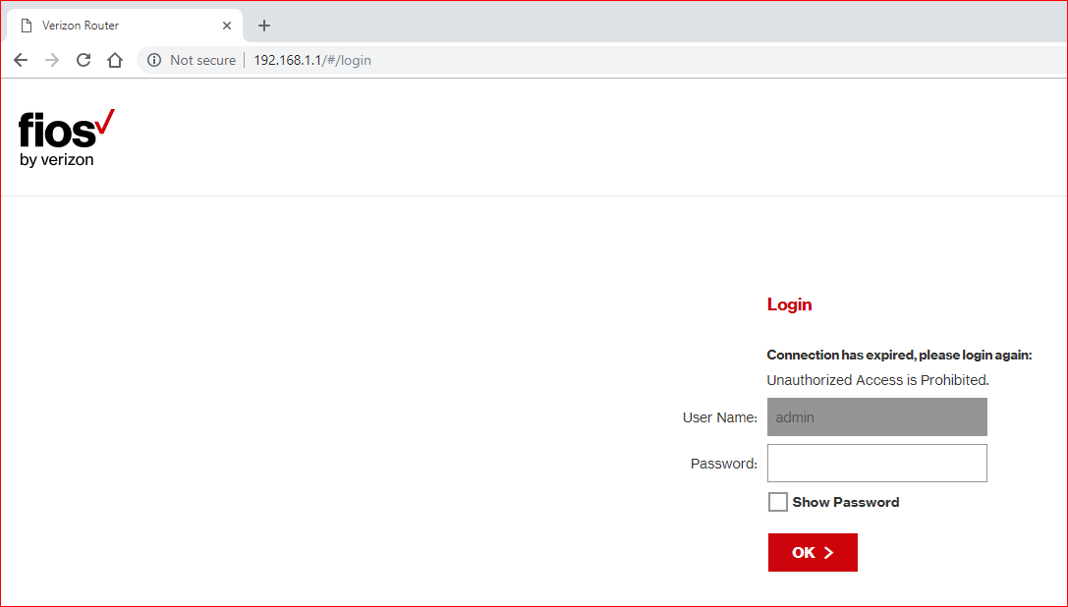

Slide 4
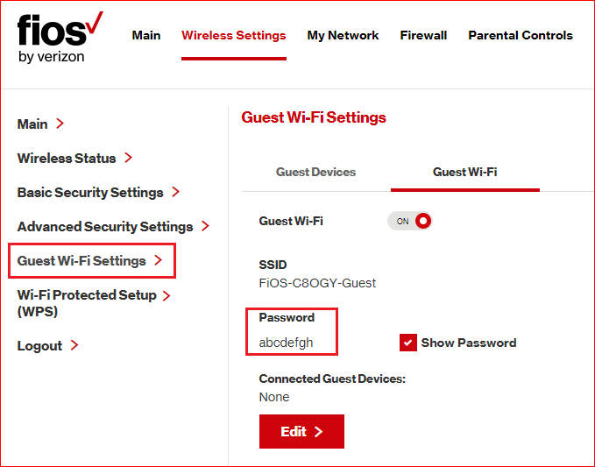

Slide 5
Install software

Slide 6
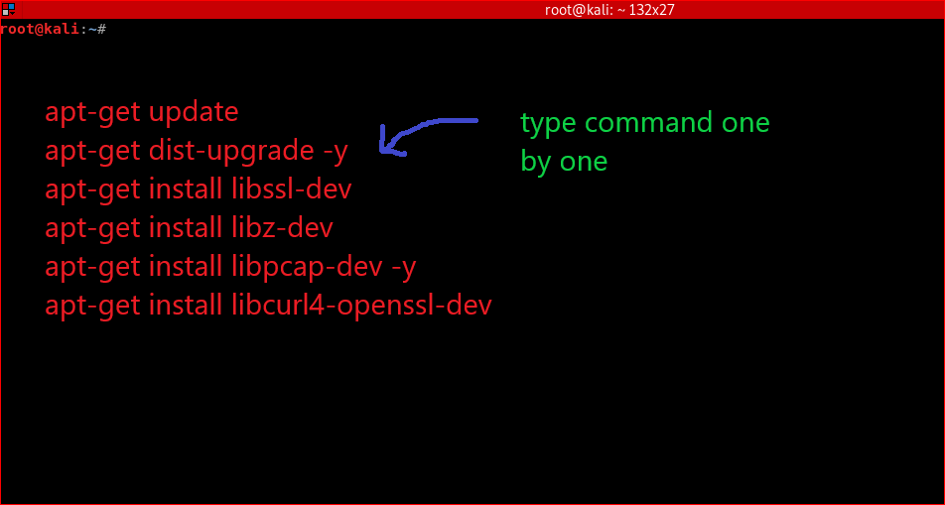
Notes:
apt-get update
apt-get dist-upgrade -y
apt-get install libssl-dev
apt-get install libz-dev
apt-get install libpcap-dev -y
apt-get install libcurl4-openssl-dev

Slide 7
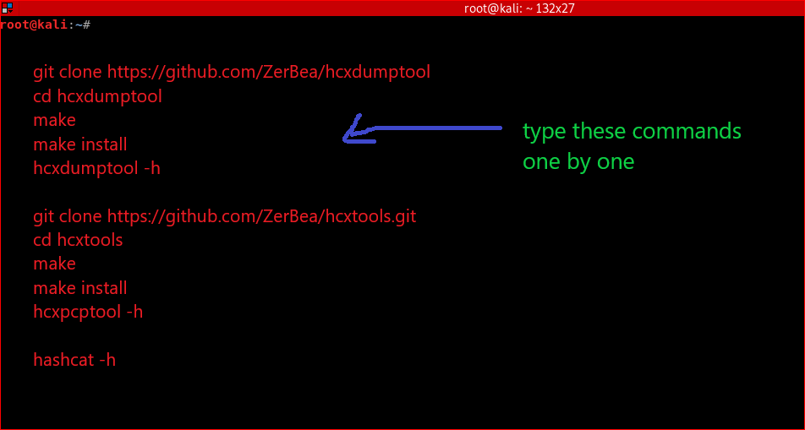
Notes:
git clone https://github.com/ZerBea/hcxdumptool
cd hcxdumptool
make
make install
hcxdumptool -h
git clone https://github.com/ZerBea/hcxtools.git
cd hcxtools
make
make install
hcxpcptool -h
hashcat -h

Slide 8
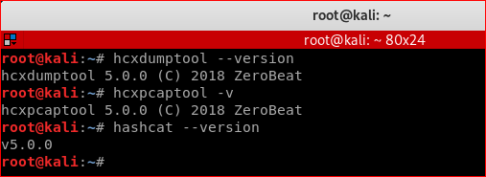
Verify software

Slide 9
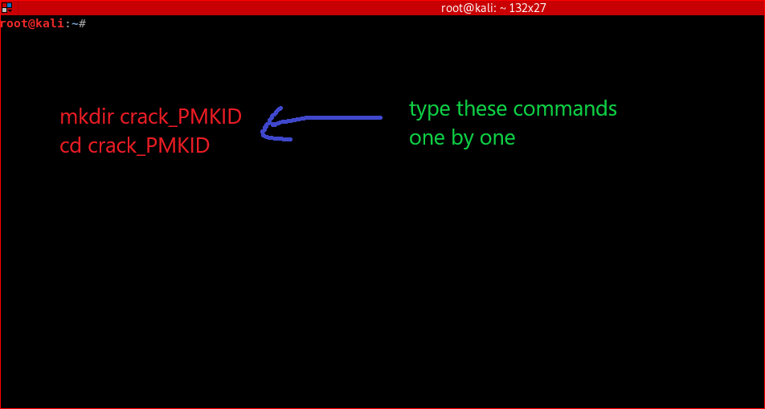
Create a working directory

Slide 10
Crack password using PMKID

Slide 11
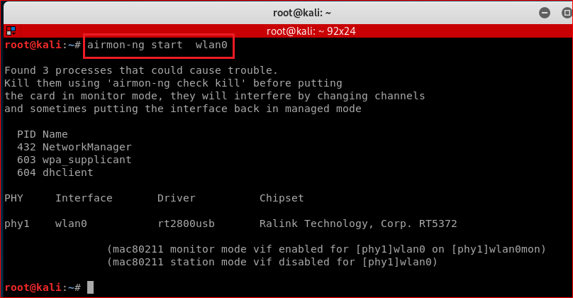

Slide 12
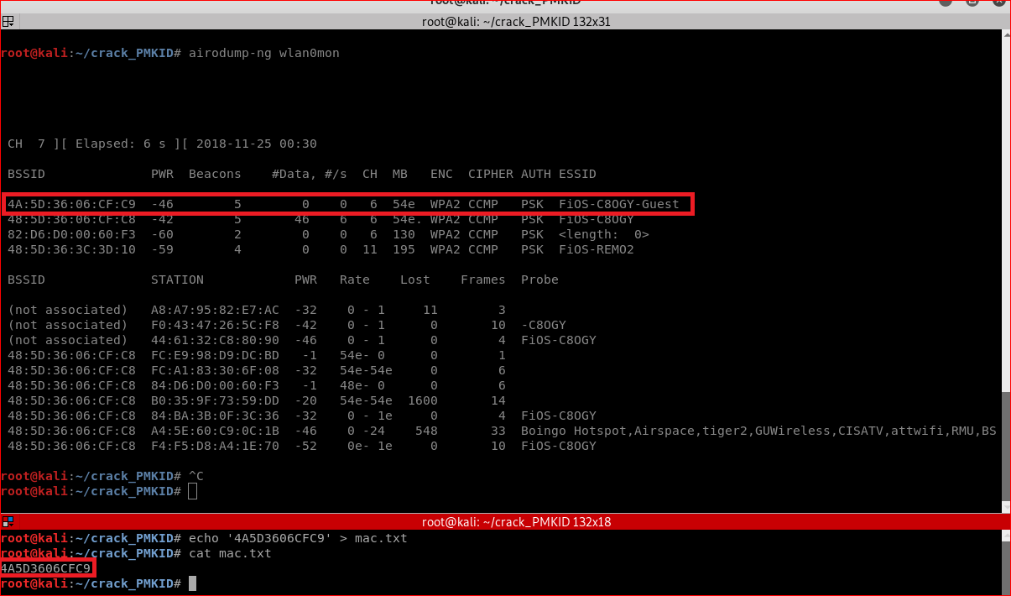

Slide 13
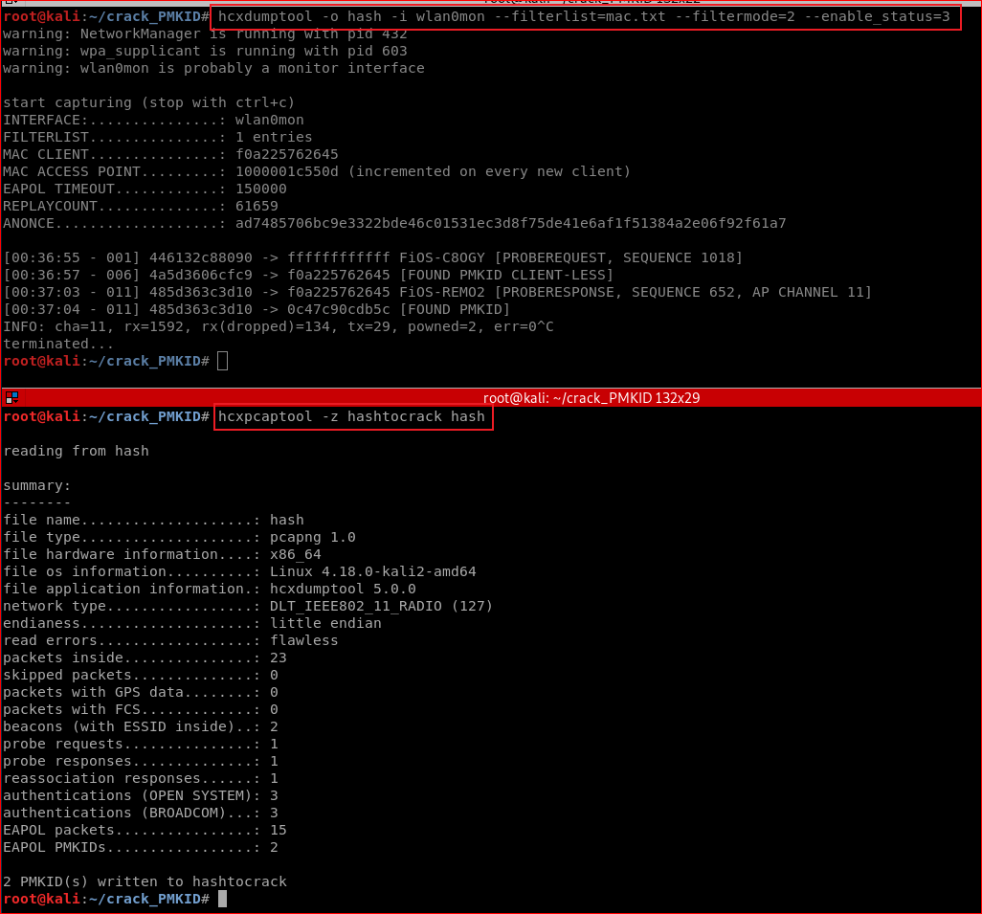

Slide 14
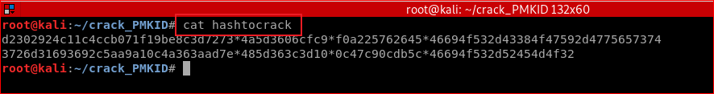

Slide 15
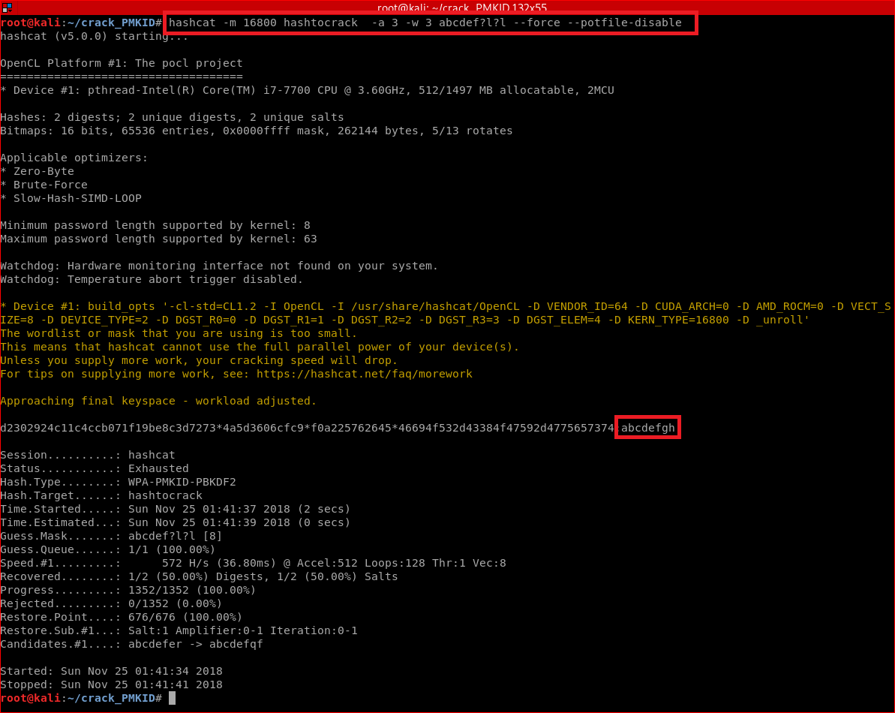

Slide 16
Parameters
-m 16800: hash mode
-a -3 : attack model: brute-force
-w 3: -workload-profile: high performance
potfile: the potfile stores which hashes were already cracked, and thus won't be cracked again.

Slide 17
Use dictionary

Slide 18
