Slide 1
The RSA Cryptosystem

Slide 2
What is the problem?
2 . t ≡ 1 mod 5
Big problem: Anyone knows the public key can find the private key!
Design goal: To design an algorithm such that we (good guy) can solve the equation (generate the private key) and other people (bad guy) are difficult to solve the equation.
Public key
Private key

Slide 3
Math Trick
2 . t ≡ 1 mod 5 f(m)
Don’t provide 5 directly.
Provide a number m and the function f(m) such that 5=f(m)
We (good guy) can compute the f(m) easily
Very difficult for bad guys get the results
Public key
Private key

Slide 4
Euler‘s Phi Function

Slide 5
A simple math problem
Given the set of the m integers {0, 1, 2, …, m -1}, how many numbers in the set are relatively prime to m ?
Euler‘s Phi Function: Φ(m) = ?

Slide 6
Option 1 (hard way)
The sets {0,1,2,3,4,5} (m=6)
gcd(0, 6) =6
gcd(1, 6) =1
gcd(2, 6) =2
gcd(3, 6) =3
gcd(4, 6) =2
gcd(5, 6) =1
1 and 5 relatively prime to m=6
Φ(6) = 2
Testing one gcd per number in the set is extremely slow for large m.

Slide 7
Another example
The sets {0,1,2,3,4,,,,35}, where m=36
gcd(1, 36) =1 gcd(19, 36) =1
gcd(5, 36) =1 gcd(23, 36) =1
gcd(7, 36) =1 gcd(25, 36) =1
gcd(11, 36) =1 gcd(29, 36) =1
gcd(13, 36) =1 gcd(31, 36) =1
gcd(17, 36) =1 gcd(35, 36) =1
Φ(36) = 12

Slide 8
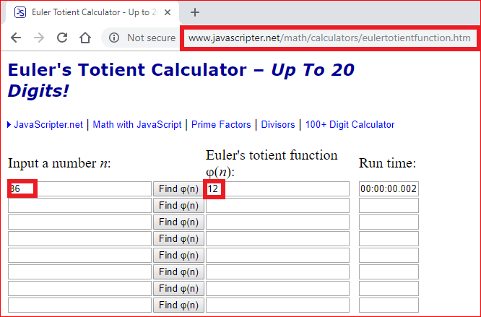

Slide 9
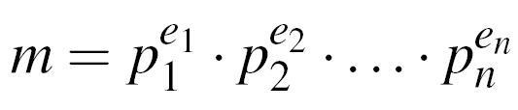
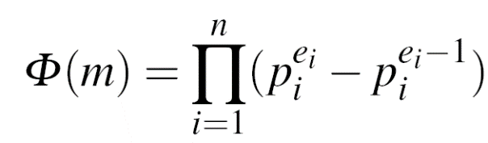
Option 2 (hard way)
Step 1: factorization
Step 2:

Slide 10
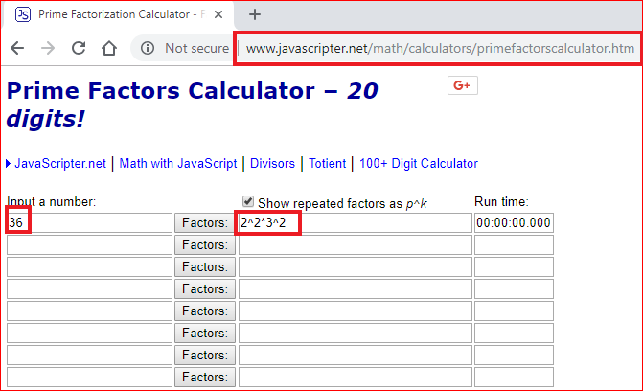
Step 1: factorization:
Factoring is complicated (and often infeasible) for large numbers

Slide 11
Step 2:
(2²-2¹)x(3²-3¹) =2x6=12
If m =p¹xq¹, then Φ(m) = (p-1) . (q-1)
6=2x3, Φ(6) = (2-1) . (3-1) =2

Slide 12
Why finding Φ(m) option 2 is hard?
Factorization is hard!
What if we know the factorization?
Finding Φ(m) is computationally easy if factorization of m is known

Slide 13
Euler‘s Theorem

Slide 14
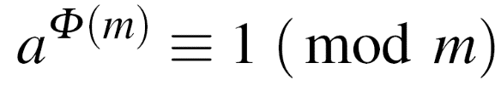
Euler‘s Theorem
Given two relatively prime integers a and m :
m=12, a=7
Calculate Euler‘s Phi Function
Verify Euler‘s Theorem
7 ^{Φ(12)} = 7 ⁴ =49x49= 1x1=1 ≡ 1 mod 12

Slide 15
RSA Algorithm

Slide 16
Steps
Choose two prime numbers p and q,
Compute the modulus in which the arithmetic will be done: n=pq,
Pick a public encryption key e ∈Z_{n}, gcd(e, Φ(n) ) = 1 (why)?
Compute the private decryption key as d such that ed=1 mod ϕ(n),
Encryption of message m: c= m ^{e} mod n,
Decryption of crypto message c: m=c ^{d} mod n.

Slide 17
Prove RSA correctness

Slide 18
Prove it
Choose two prime numbers p and q,
Compute the modulus in which the arithmetic will be done: n=pq,
Pick a public encryption key e ∈Z_{n},
Compute the private decryption key as d such that ed=1 mod ϕ(n),
Encryption of message m: c= m ^{e} mod n,
Decryption of crypto message c: m=c ^{d} mod n.
m=c ^{d} mod n
(c= m ^{e} mod n)
m=m ^{e} ^{d} mod n
( ed -1 = k ϕ(n) => ed = k ϕ(n) +1)
m=m ^{k ϕ(n) +1} mod n
m=mm ^{k ϕ(n)} mod n
m ^{ϕ(n)} = 1 mod n (Euler‘s Theorem)
m=m

Slide 19
Lab

Slide 20


Slide 21
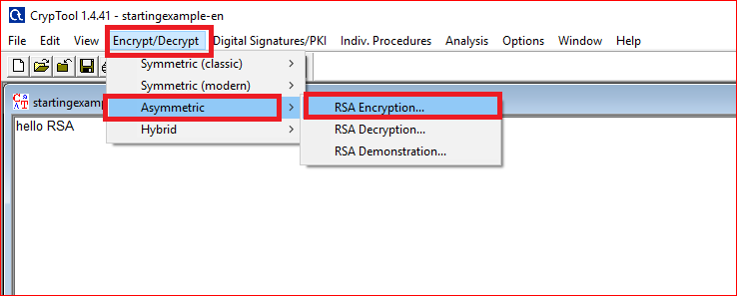

Slide 22
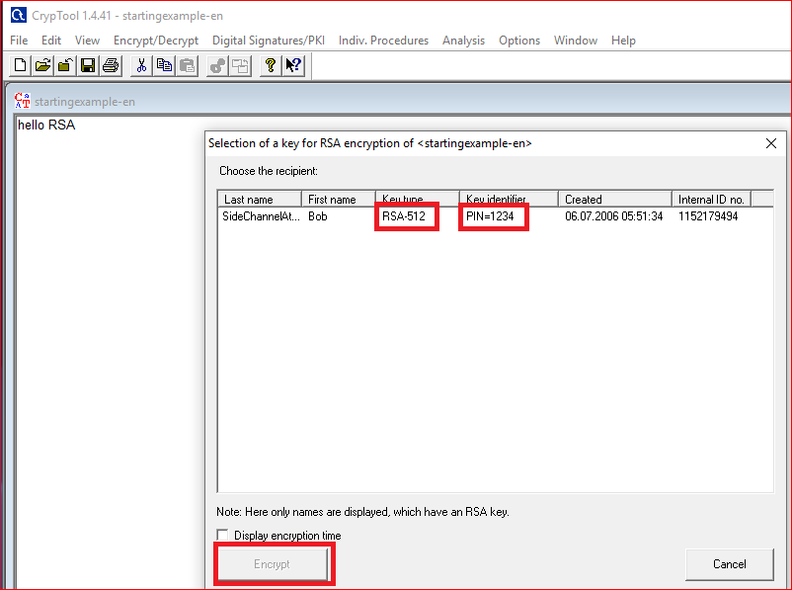

Slide 23
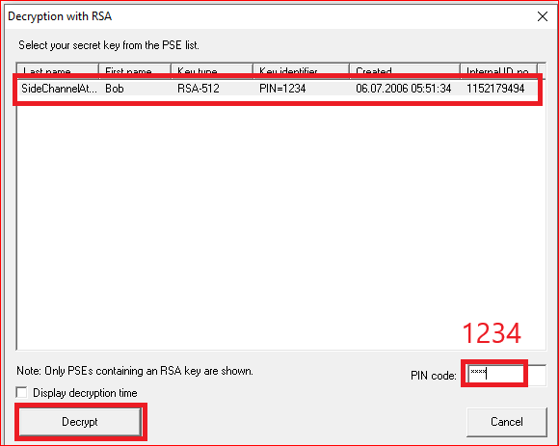
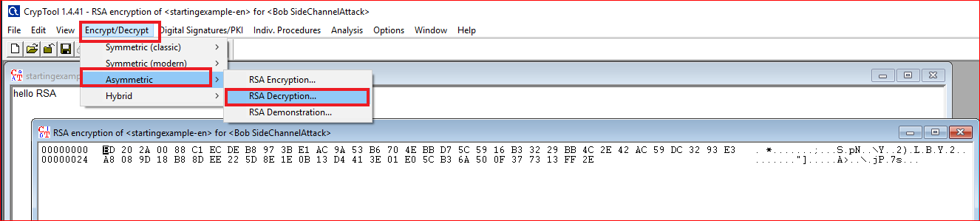
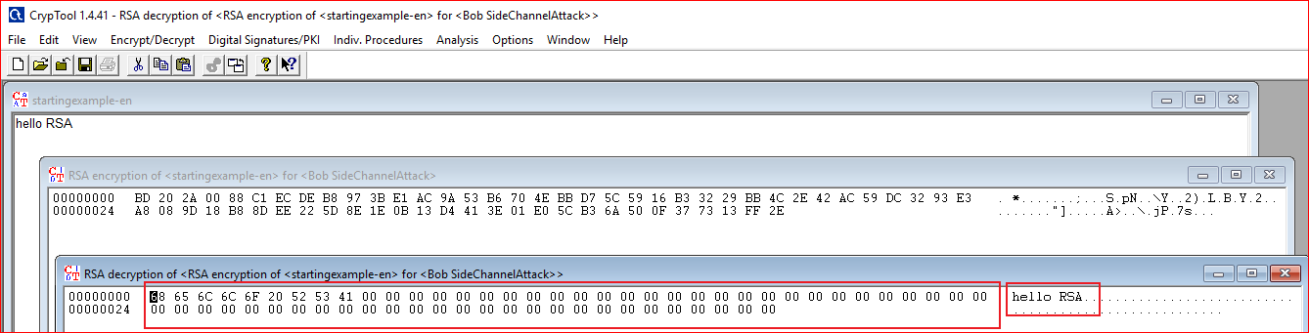

Slide 24
Question: Your need to answer
Design a message with length of 65. What is the size of encrypted message? Why?
Example
01234567890123456789012345678901234567890123456789012345678901234

Slide 25
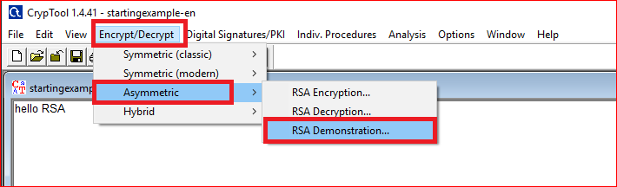
How RSA work?

Slide 26
Generate key

Slide 27
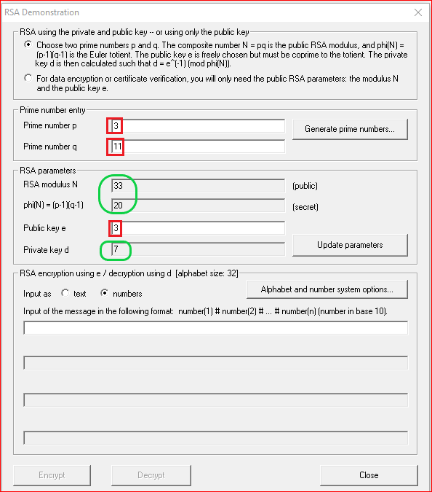
Question: Your need to do
Can we pick up 4 as the private key?
Why?

Slide 28
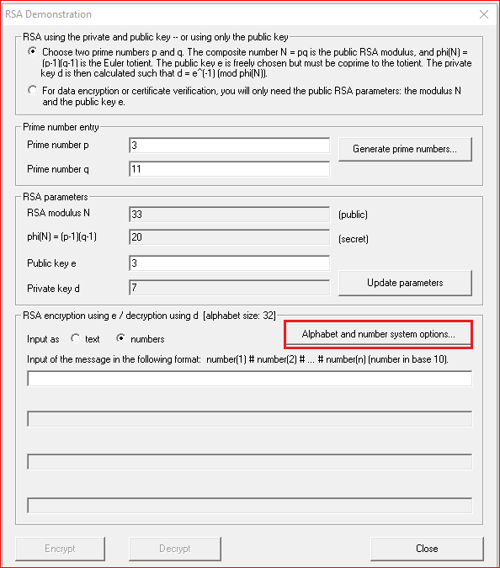
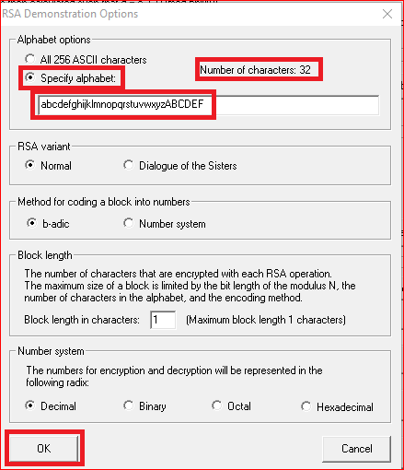
Question: why 32?

Slide 29
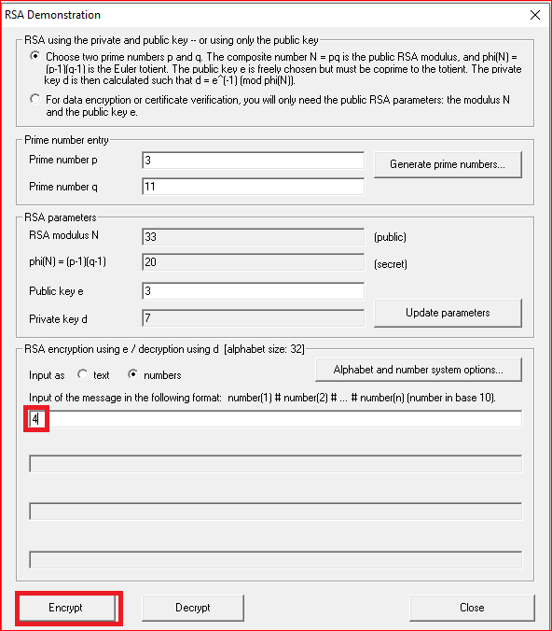


Slide 30
RSA Encryption

Slide 31
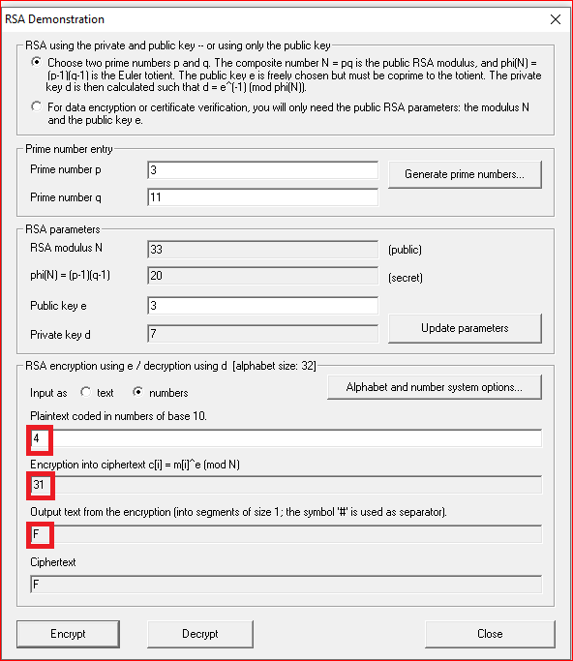


Slide 32
RSA Decryption

Slide 33
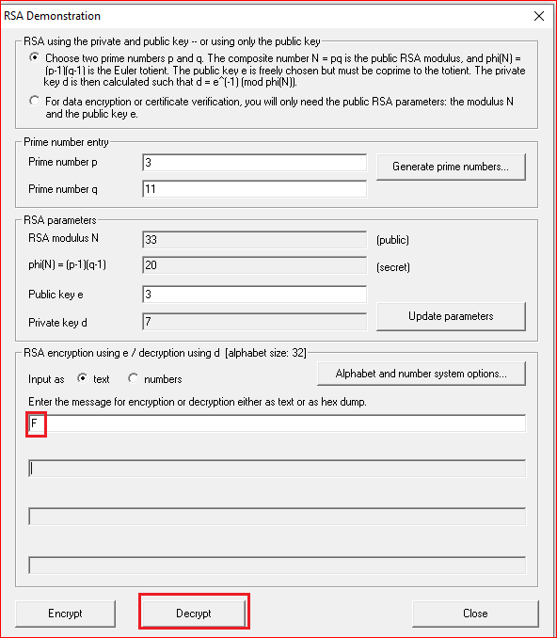


Slide 34
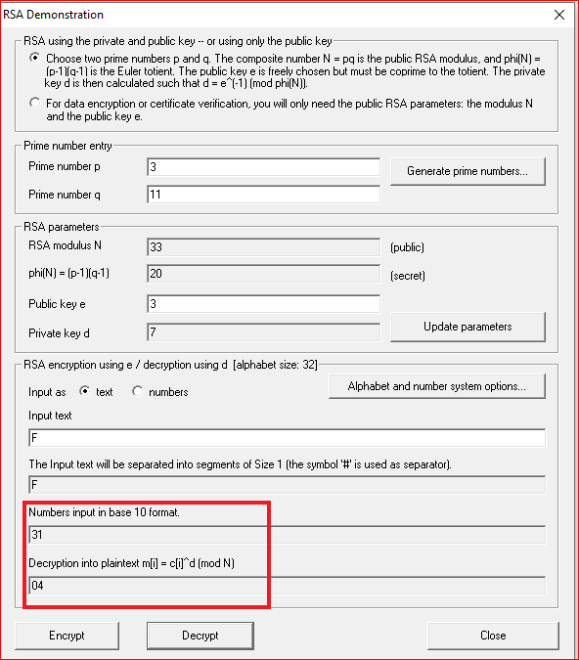

Slide 35
Your work
Pick up a different public key
Compute the private key
Encrypt the letter “F”
Manually
Using the tool
Encrypt and decrypt a message “hello rsa” and record your observation

