Slide 1
How to Create a Bootable Kali Linux USB Flash Drive Using Rufus

Slide 2
Goal
A bootable USB drive is the best way to install or try Linux.
But most Linux distributions—like Ubuntu—only offer an ISO disc image file for download.
You’ll need a third-party tool to turn that ISO file into a bootable USB drive.

Slide 3
What do you need?
Kali .iso file
Rufus software
UB: 4G+

Slide 4
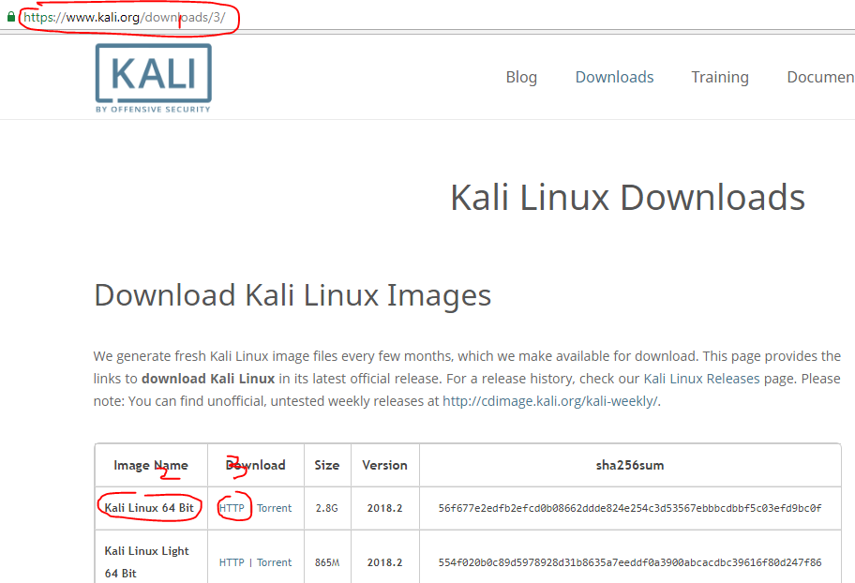
Downalod Kali

Slide 5
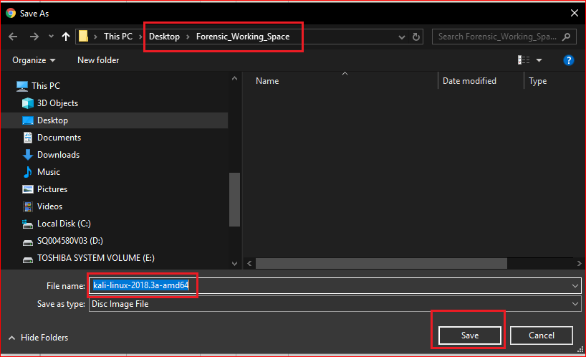

Slide 6
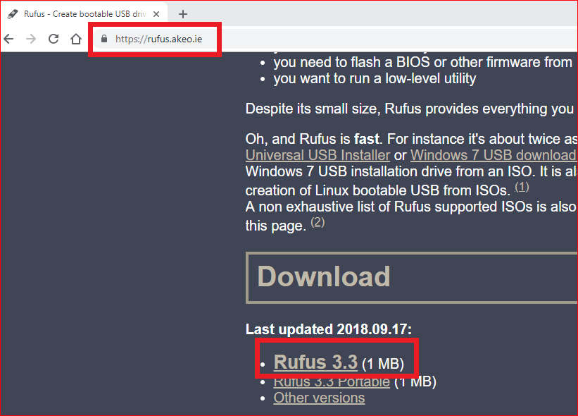
Download Rufus

Slide 7
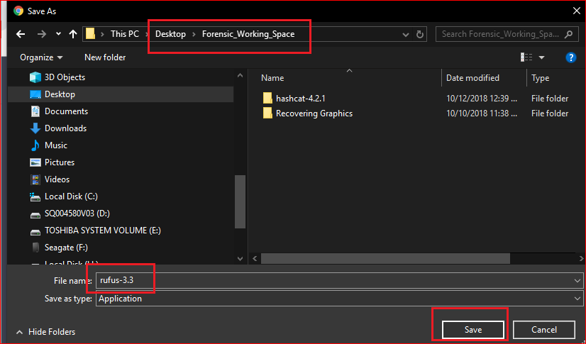
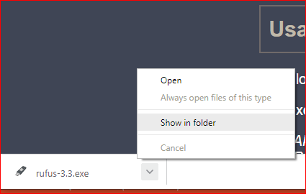

Slide 8
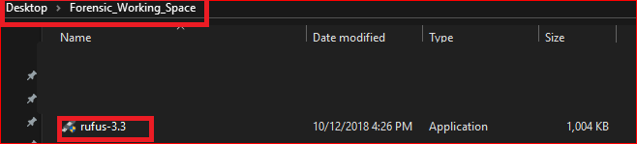

Slide 9
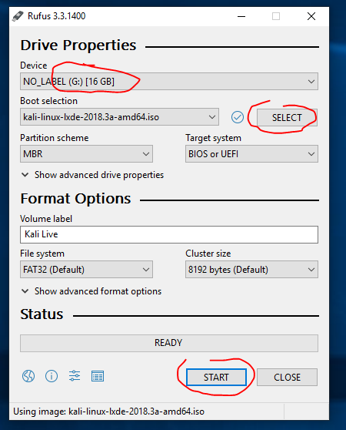
Activate the “Create a bootable disk using” checkbox

Slide 10
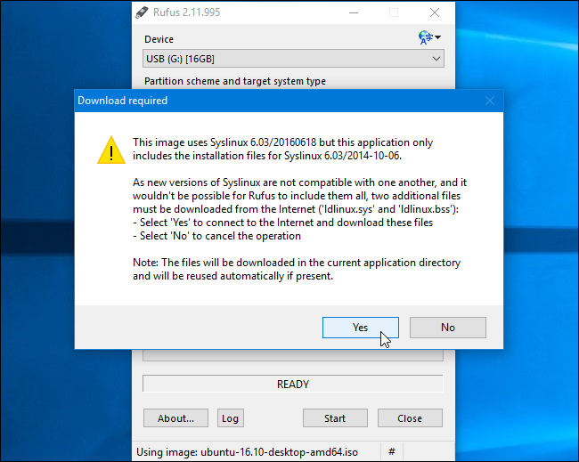

Slide 11
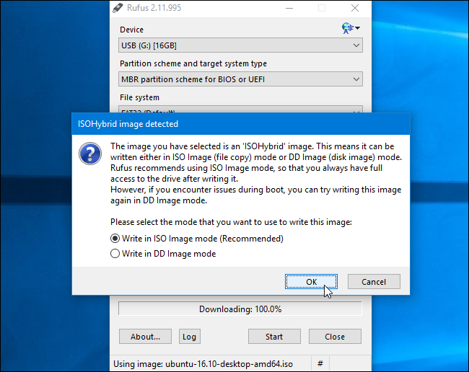

Slide 12
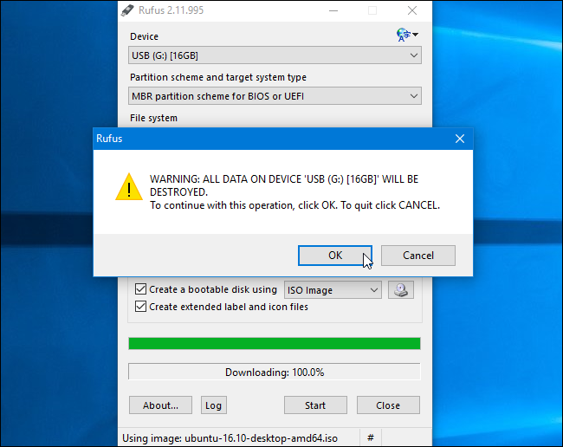

Slide 13
How to boot from USB Drive
To boot from a CD, DVD or USB device, make sure that the device has boot sequence priority over the hard drive.

Slide 14
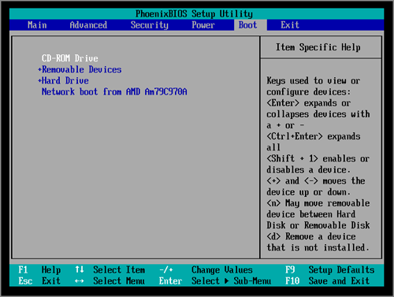

Slide 15
Reference
https://www.howtogeek.com/howto/14912/create-a-persistent-bootable-ubuntu-usb-flash-drive/

Slide 16
