Slide 1
The RSA Cryptosystem

Slide 2
Euler‘s Phi Function

Slide 3
A simple math problem
Given the set of the m integers {0, 1, 2, …, m -1}, how many numbers in the set are relatively prime to m ?
Euler‘s Phi Function: Φ(m) = ?

Slide 4
Option 1 (hard way)
The sets {0,1,2,3,4,5} (m=6)
gcd(0, 6) =6
gcd(1, 6) =1
gcd(2, 6) =2
gcd(3, 6) =3
gcd(4, 6) =2
gcd(5, 6) =1
1 and 5 relatively prime to m=6
Φ(6) = 2
Testing one gcd per number in the set is extremely slow for large m.

Slide 5
Another example
The sets {0,1,2,3,4,,,,35}, where m=36
gcd(1, 36) =1 gcd(19, 36) =1
gcd(5, 36) =1 gcd(23, 36) =1
gcd(7, 36) =1 gcd(25, 36) =1
gcd(11, 36) =1 gcd(29, 36) =1
gcd(13, 36) =1 gcd(31, 36) =1
gcd(17, 36) =1 gcd(35, 36) =1
Φ(36) = 12

Slide 6
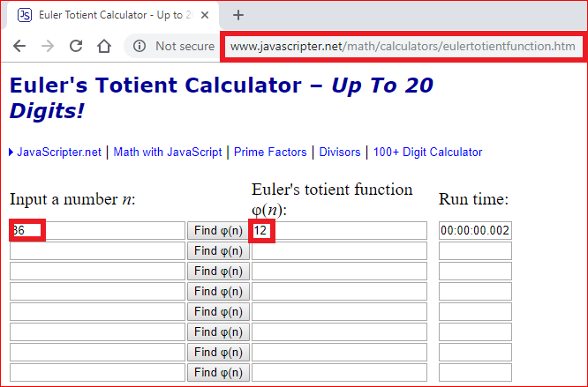

Slide 7
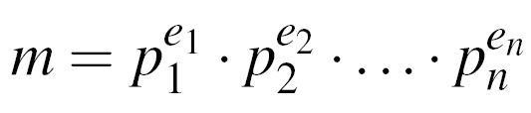
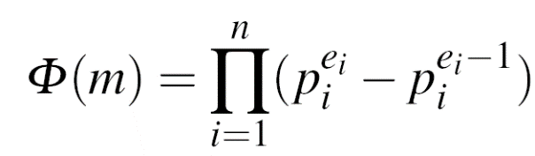
Option 2 (hard way)
Step 1: factorization
Step 2:

Slide 8
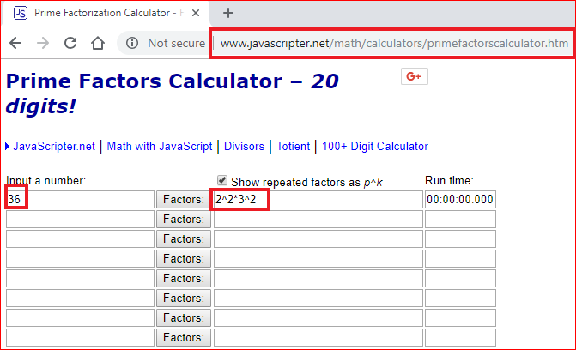
Step 1: factorization:
Factoring is complicated (and often infeasible) for large numbers

Slide 9
Step 2:
(2²-2¹)x(3²-3¹) =2x6=12
If m =p¹xq¹, then Φ(m) = (p-1) . (q-1)
6=2x3, Φ(6) = (2-1) . (3-1) =2
Finding Φ(m) is computationally easy if factorization of m is known

Slide 10
Euler‘s Theorem

Slide 11
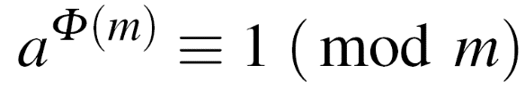
Euler‘s Theorem
Given two relatively prime integers a and m :
m=12, a=7
Calculate Euler‘s Phi Function
Verify Euler‘s Theorem
7 ^{Φ(12)} = 7 ⁴ =49x49= 1x1=1 ≡ 1 mod 12

Slide 12
RSA Algorithm

Slide 13
Steps
Choose two prime numbers p and q,
Compute the modulus in which the arithmetic will be done: n=pq,
Pick a public encryption key e ∈Z_{n}, gcd(e, Φ(n) ) = 1 (why)?
Compute the private decryption key as d such that ed=1 mod ϕ(n),
Encryption of message m: c= m ^{e} mod n,
Decryption of crypto message c: m=c ^{d} mod n.

Slide 14
Prove RSA correctness

Slide 15
Prove it
Choose two prime numbers p and q,
Compute the modulus in which the arithmetic will be done: n=pq,
Pick a public encryption key e ∈Z_{n},
Compute the private decryption key as d such that ed=1 mod ϕ(n),
Encryption of message m: c= m ^{e} mod n,
Decryption of crypto message c: m=c ^{d} mod n.
m=c ^{d} mod n
(c= m ^{e} mod n)
m=m ^{e} ^{d} mod n
( ed -1 = k ϕ(n) => ed = k ϕ(n) +1)
m=m ^{k ϕ(n) +1} mod n
m=mm ^{k ϕ(n)} mod n
m ^{ϕ(n)} = 1 mod n (Euler‘s Theorem)
m=m

Slide 16
Lab

Slide 17


Slide 18
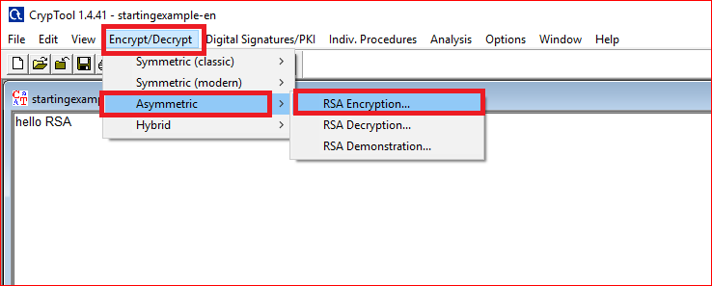

Slide 19
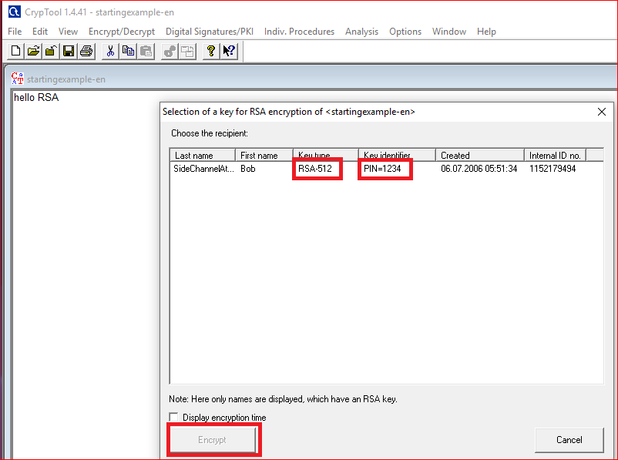

Slide 20
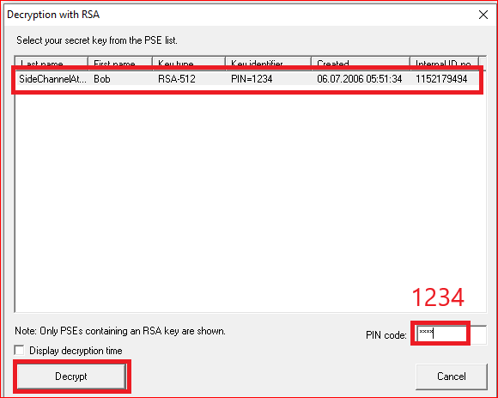
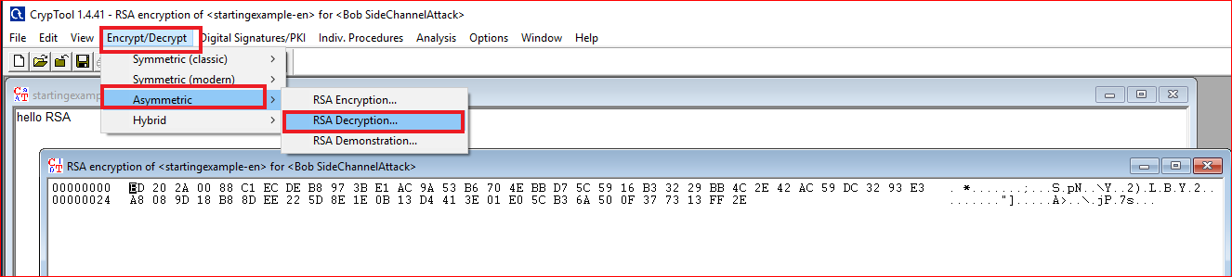
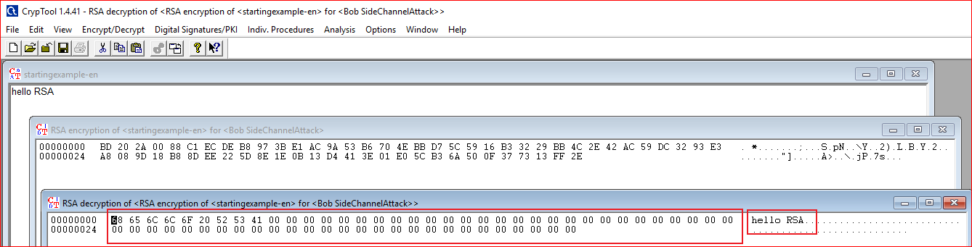

Slide 21
Question: Your need to answer
Design a message with length of 65. What is the size of encrypted message? Why?
Example
01234567890123456789012345678901234567890123456789012345678901234

Slide 22
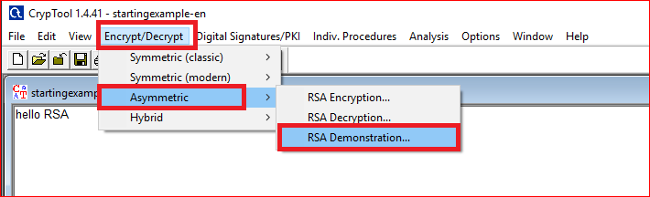
How RSA work?

Slide 23
Generate key

Slide 24
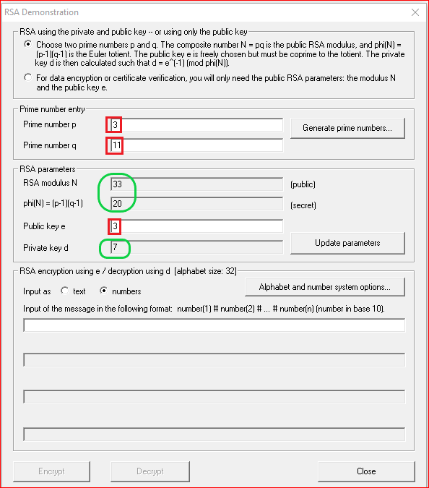
Question: Your need to do
Can we pick up 4 as the private key?
Why?

Slide 25
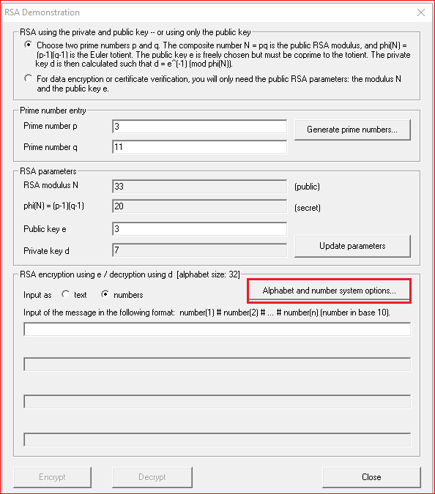
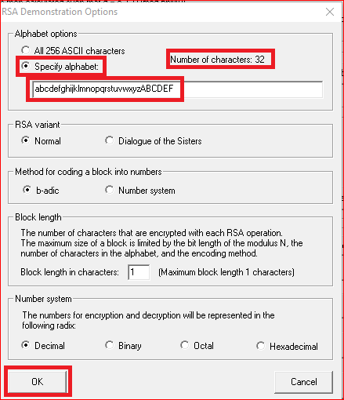
Question: why 32?

Slide 26
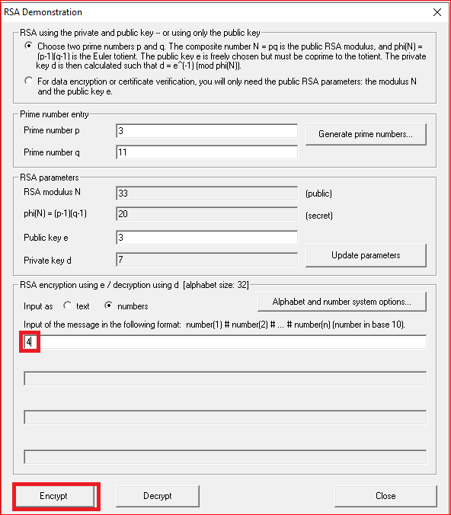


Slide 27
RSA Encryption

Slide 28
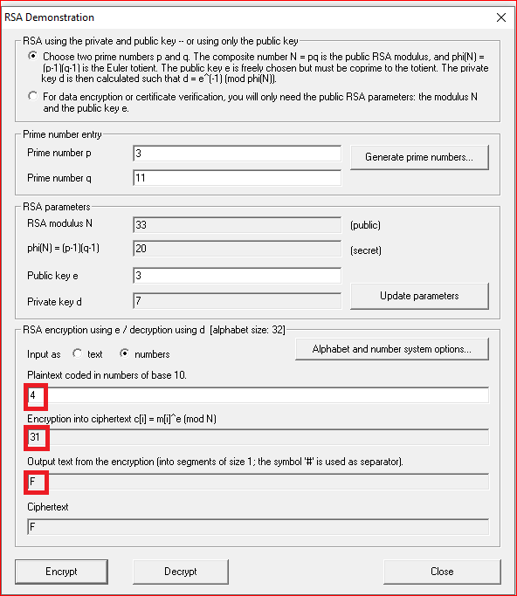


Slide 29
RSA Decryption

Slide 30
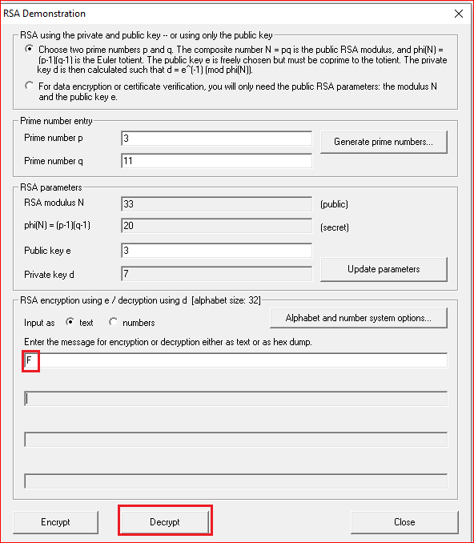


Slide 31
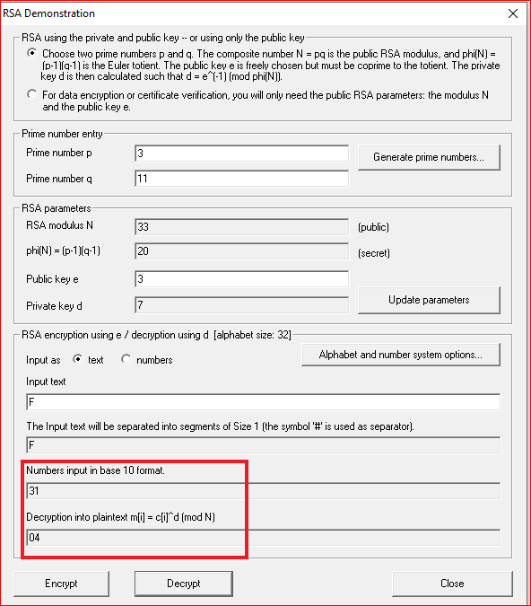

Slide 32
Your work
Pick up a different private key
Encrypt and decrypt a message “hello rsa” and record your observation

