Slide 1
XOR

Slide 2
Cryptology
Cryptography
Symmetric Ciphers
Asymmetric Ciphers
Cryptanalysis
Protocols
Block Ciphers
Stream Ciphers
Integer Factoring Problem
Discrete Logarithm problem
XOR

Slide 3

Symbol | Truth Table
2-input Ex-OR Gate | B | A | Q
 | 0 | 0 | 0
 | 0 | 1 | 1
 | 1 | 0 | 1
 | 1 | 1 | 0
Boolean Expression Q = A ⊕ B | A OR B but NOT BOTH gives Q
https://www.electronics-tutorials.ws/logic/logic_7.html

Slide 4
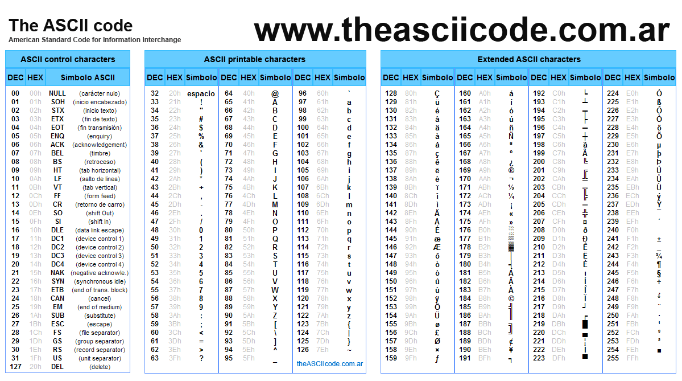

Slide 5
Byte by byte XOR

Slide 6
Idea for encryption
Convert each character to ASCII (Binary)
A= (41)h = (0100 0001)b
Xor with a key
(11)h=(0001 0001)b
A xor (11)h=?
(0100 0001)
xor (0001 0001)
------------------
(0101 0000)b=(50)h=80=P

Slide 7
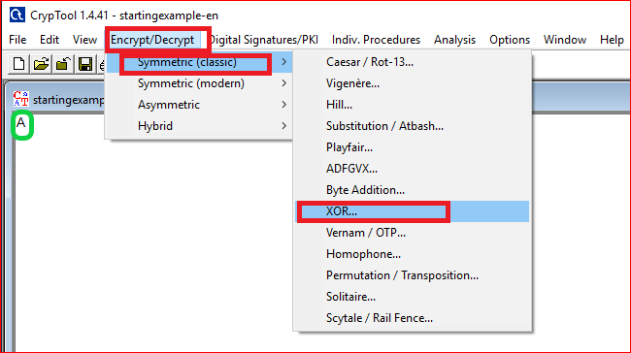
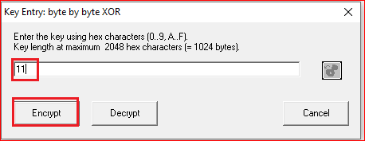
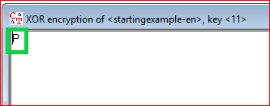

Slide 8
Idea for decryption
Convert the ciphertext to ASCII (Binary)
C= (50)h = (0101 0000)b
Xor with the same key
(11)h=(0001 0001)b
C xor (11)h=?
(0101 0000)
xor (0001 0001)
------------------
(0100 0001)b=(41)h=P

Slide 9
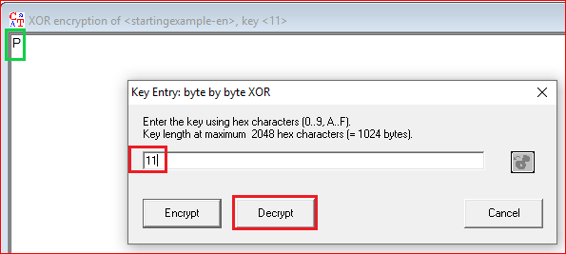
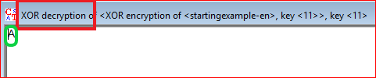

Slide 10
Question
Encrypt and decrypt “hello xor” using pencil and paper
Verify it using the tool

