Slide 1
The RSA Cryptosystem

Slide 2
What is the problem?
2 . t ≡ 1 mod 5
Big problem: Anyone knows the public key can find the private key!
Design goal: To design an algorithm such that we (good guy) can solve the equation (generate the private key) and other people (bad guy) are difficult to solve the equation.
Public key
Private key

Slide 3
Math Trick
2 . t ≡ 1 mod 5 f(m)
Don’t provide 5 directly.
Provide a number m and the function f(m) such that 5=f(m)
We (good guy) can compute the f(m) easily
Very difficult for bad guys get the results
How to find such a function?
One way function
Public key
Private key

Slide 4
Euler‘s Phi Function
One way function

Slide 5
A simple math problem
Given the set of the m integers {0, 1, 2, …, m -1}, how many numbers in the set are relatively prime to m ?
Euler‘s Phi Function: Φ(m) = ?

Slide 6
Option 1 (hard way)
The set {0,1,2,3,4,5} (m=6)
gcd(0, 6) =6
gcd(1, 6) =1
gcd(2, 6) =2
gcd(3, 6) =3
gcd(4, 6) =2
gcd(5, 6) =1
1 and 5 relatively prime to m=6
Φ(6) = 2
Testing one gcd per number in the set is extremely slow for large m.

Slide 7
Another example
The set {0,1,2,3,4,,,,35}, where m=36
gcd(1, 36) =1 gcd(19, 36) =1
gcd(5, 36) =1 gcd(23, 36) =1
gcd(7, 36) =1 gcd(25, 36) =1
gcd(11, 36) =1 gcd(29, 36) =1
gcd(13, 36) =1 gcd(31, 36) =1
gcd(17, 36) =1 gcd(35, 36) =1
Φ(36) = 12

Slide 8
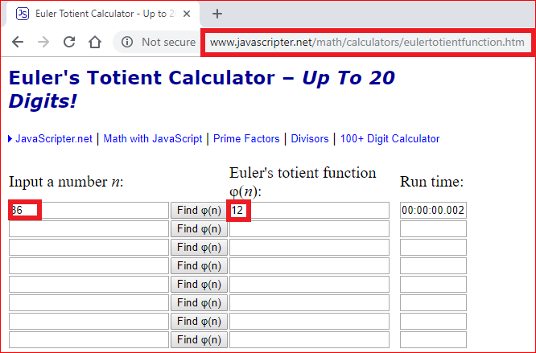

Slide 9
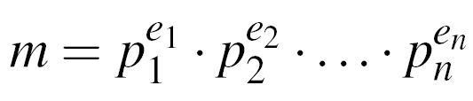
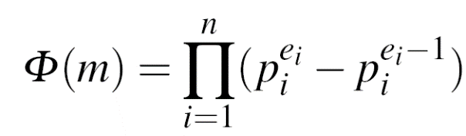
Option 2 (hard way)
Step 1: factorization
Step 2:

Slide 10
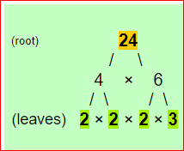
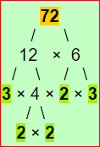

Step 1: factorization (1)
24=2³*3¹
Factoring is complicated (and often infeasible) for large numbers

Slide 11
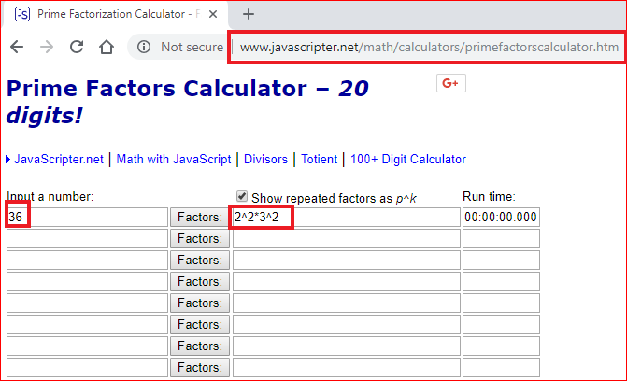
Step 1: factorization (2):
Factoring is complicated (and often infeasible) for large numbers

Slide 12
Step 2:
(2²-2¹)x(3²-3¹) =2x6=12
If m =p¹xq¹, then Φ(m) = (p-1) . (q-1)
6=2x3, Φ(6) = (2-1) . (3-1) =2

Slide 13
Why finding Φ(m) option 2 is hard?
Factorization is hard!
What if we know the factorization?
Finding Φ(m) is computationally easy if factorization of m is known
One way function
Integer factorizaiton is difficut, multiple two numbers is easy.

Slide 14
RSA Algorithm

Slide 15
RSA scheme
Choose two prime numbers p and q,
Compute the modulus in which the arithmetic will be done: n=pq,
Pick a public encryption key e ∈Z_{n}, gcd(e, Φ(n) ) = 1 (why)?
Compute the private decryption key as d such that ed=1 mod ϕ(n),
Encryption of message m: c= m ^{e} mod n,
Decryption of crypto message c: m=c ^{d} mod n.

Slide 16
Example: RSA with small numbers
ALICE
Message x = 4
y = x^{e} ≡ 4³ ≡ 31 mod 33
BOB
Choose p = 3 and q = 11
Compute n = p * q = 33
Φ(n) = (3-1) * (11-1) = 20
Choose e = 3
d ≡ e⁻¹ ≡7 mod 20
y^{d} = 31⁷ ≡ 4 = x mod 33
K_{pub} = (33,3)
y = 31
Notes:
e^Φ(n) = 1 mod n
e^-1=e^[Φ(n) -1]
3^19

Slide 17
Questions
Explain why it is very difficult for hackers to compute the private key based on the design of the RSA algorithm?
Explain why it is very easy for good people to derive the private key based on the design of the RSA algorithm?

Slide 18
Prove RSA correctness
(optional)

Slide 19
Partially Prove it
Choose two prime numbers p and q,
Compute the modulus in which the arithmetic will be done: n=pq,
Pick a public encryption key e ∈Z_{n},
Compute the private decryption key as d such that ed=1 mod ϕ(n),
Encryption of message m: c= m ^{e} mod n,
Decryption of crypto message c: m=c ^{d} mod n.
m=c ^{d} mod n
(c= m ^{e} mod n)
m=m ^{e} ^{d} mod n
( ed -1 = k ϕ(n) => ed = k ϕ(n) +1)
m=m ^{k ϕ(n) +1} mod n
m=mm ^{k ϕ(n)} mod n
m ^{ϕ(n)} = 1 mod n (Euler‘s Theorem)
m=m
https://crypto.stackexchange.com/questions/2884/rsa-proof-of-correctness

Slide 20
Euler‘s Theorem

Slide 21
Obersvation
a=7, m=12 | a=2, m=5 | a=3, m=5 | a=4, m=7
7 ¹ mod 12 = 7 | 2 ¹ mod 5 = 2 | 3 ¹ mod 5 = 3 | 4 ¹ mod 7 = 4
7 ² mod 12 = 1 | 2 ² mod 5 = 4 | 3 ² mod 5 = 4 | 4 ² mod 7 = 2
7 ³ mod 12 = 7 | 2 ³ mod 5 = 3 | 3 ³ mod 5 = 2 | 4 ³ mod 7 = 1
7 ⁴ mod 12 = 1 | 2 ⁴ mod 5 = 1 | 3 ⁴ mod 5 = 1 | 4 ⁴ mod 7 = 4
 |  |  | 4 ⁵ mod 7 = 2
 |  |  | 4 ⁶ mod 7 = 1
Φ(12) = 4 | Φ(5) = 4 | Φ(5) = 4 | Φ(7) = 6

Slide 22
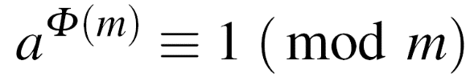
Euler‘s Theorem
Given two relatively prime integers a and m :
m=12, a=7
Calculate Euler‘s Phi Function
Verify Euler‘s Theorem
7 ^{Φ(12)} = 7 ⁴ =49x49= 1x1=1 ≡ 1 mod 12

Slide 23
Lab

Slide 24
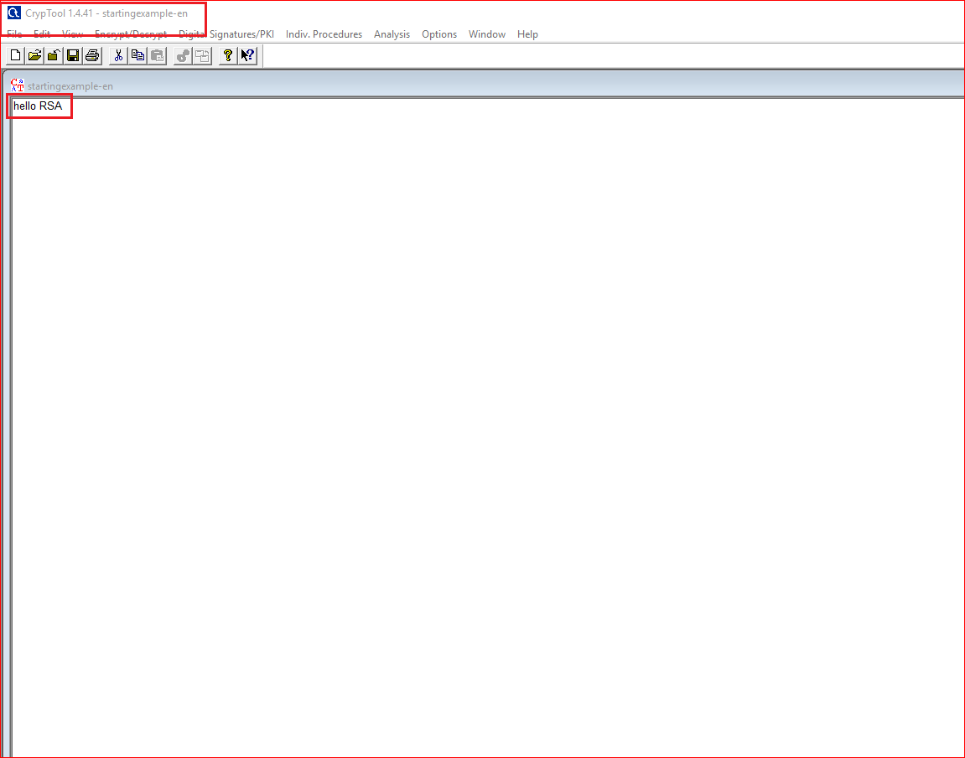

Slide 25
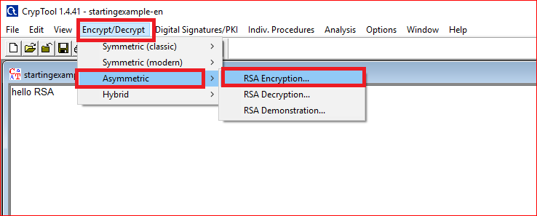

Slide 26
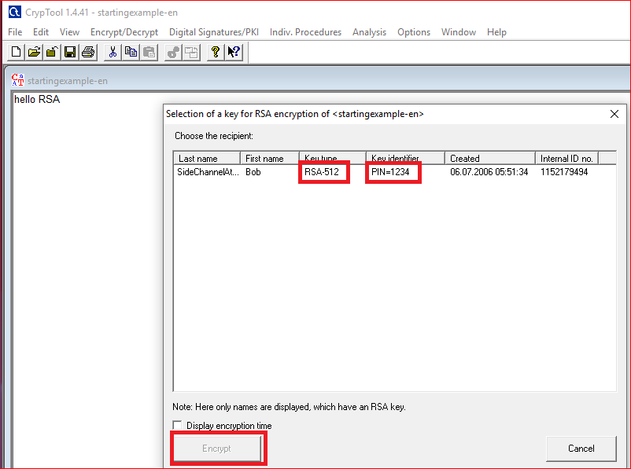

Slide 27
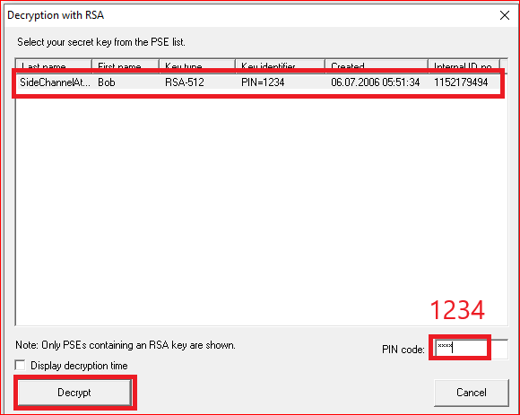
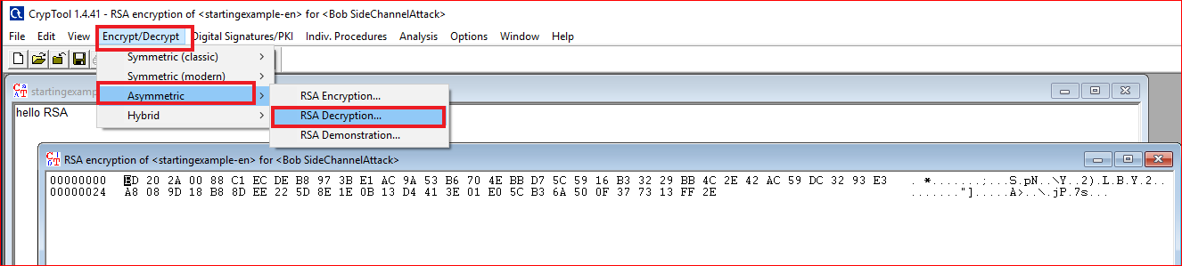
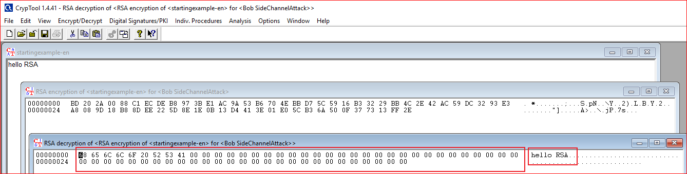

Slide 28
Question: Your need to answer
Design a message with length of 65. What is the size of encrypted message? Why?
Example
01234567890123456789012345678901234567890123456789012345678901234

Slide 29
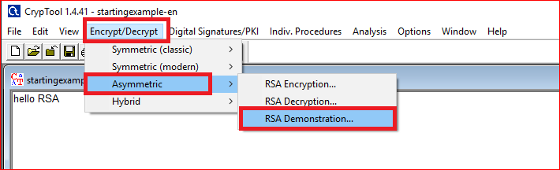
How RSA work?

Slide 30
Generate key

Slide 31
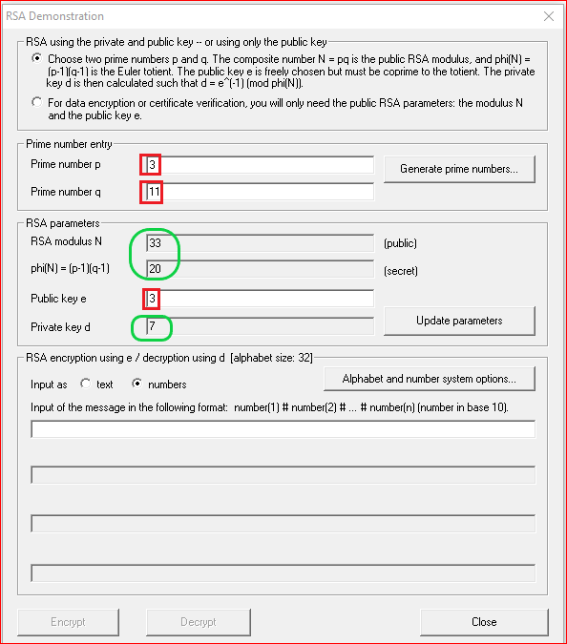
Question: Your need to do
Can we pick up 4 as the private key?
Why?

Slide 32
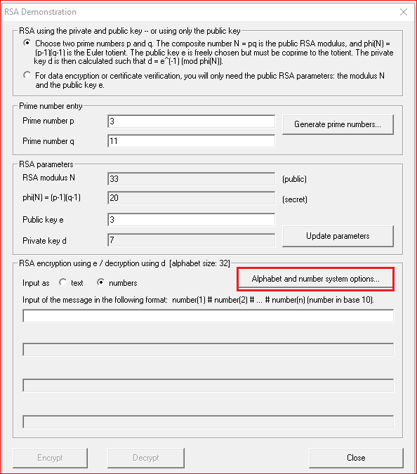
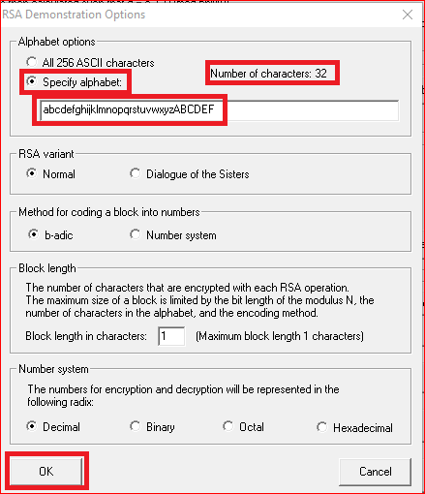
Question: why 32?

Slide 33
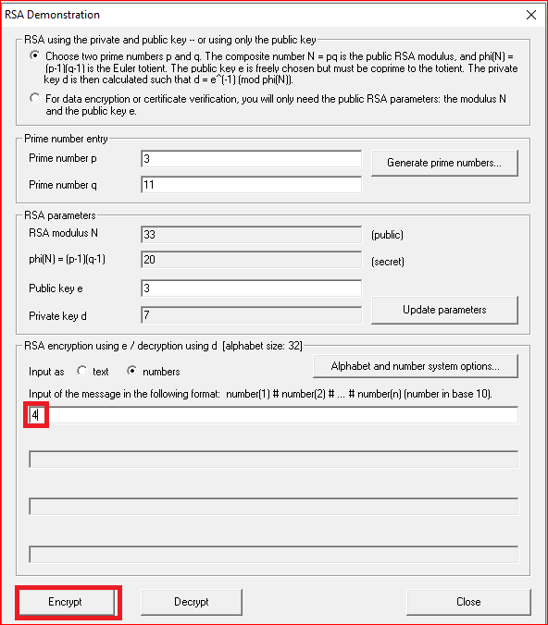


Slide 34
RSA Encryption

Slide 35
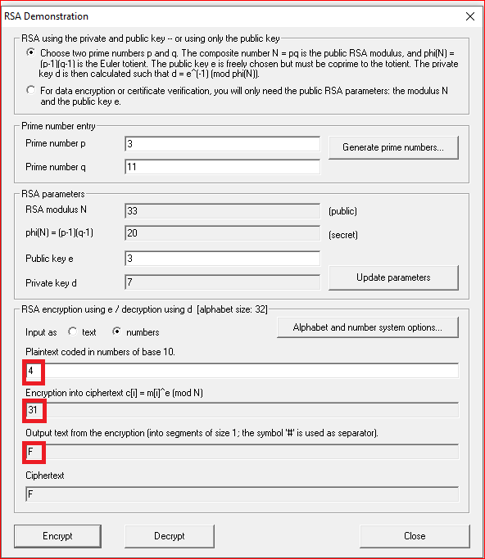


Slide 36
RSA Decryption

Slide 37
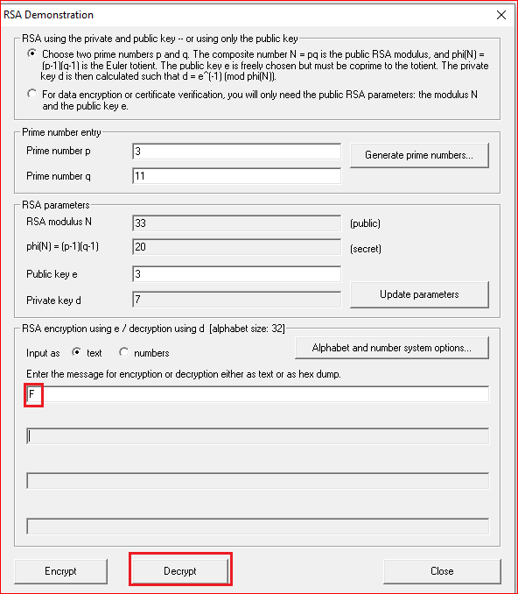


Slide 38
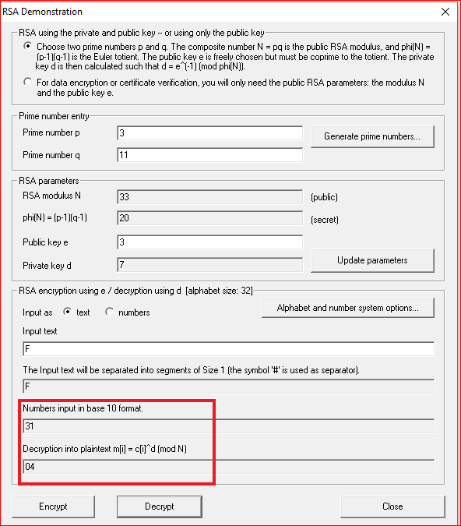

Slide 39
Your work
Pick up a different public key
Compute the private key
Encrypt the letter “F”
Manually
Using the tool
Encrypt and decrypt a message “hello rsa” using tool and record your observation

